Slide 1

Be Prepared
1 Thessalonians
Dr. Rick Griffith • Crossroads International Church Singapore
BibleStudyDownloads.org

Slide 2


Slide 3

Our Need
Notes:
At some point in perhaps the not-too-distant future millions of people will just quickly rise to meet the Lord Jesus Christ.

Slide 4
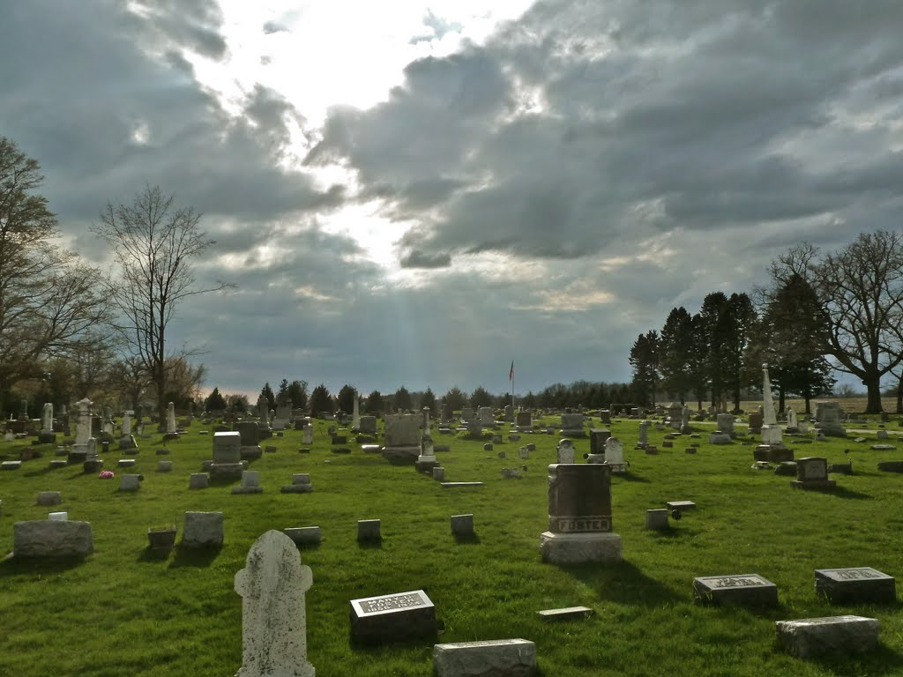
The Rapture
"And now, dear brothers and sisters, we want you to know what will happen to the believers who have died so you will not grieve like people who have no hope. ¹⁴For since we believe that Jesus died and was raised to life again, we also believe that when Jesus returns, God will bring back with him the believers who have died" (1 Thess. 4:13-14 NLT).
Notes:
Paul speaks clearly of this next event on God’s prophetic calendar in 1 Thess 4:13-18…

Slide 5
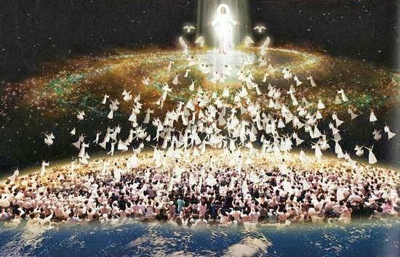
The Rapture
"For the Lord himself will come down from heaven with a commanding shout, with the voice of the archangel, and with the trumpet call of God. First, the Christians who have died will rise from their graves. ¹⁷Then, together with them, we who are still alive and remain on the earth will be caught up in the clouds to meet the Lord in the air. Then we will be with the Lord forever. ¹⁸So encourage each other with these words" (1 Thess. 4:16-18 NLT).

Slide 6

Our Need
Notes:
When I was a young man in the 1970s many speakers preached on these verses. In fact, I trusted Christ at one such gathering in 1972 when the speaker addressed the return of Christ.
Sadly, few talk of the return of Jesus today

Slide 7
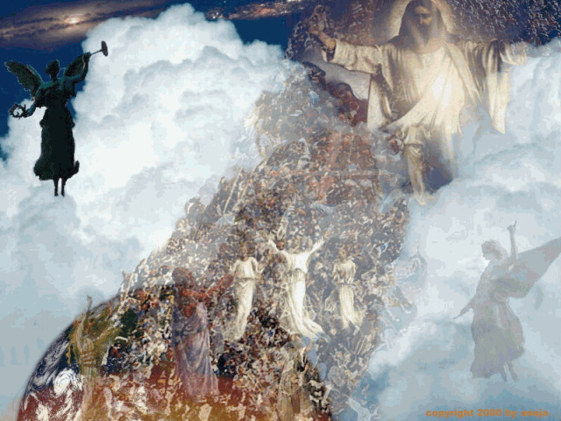
Christ’s Return
Notes:
However, since the NT notes Christ’s return more than 300 times, we should live in light of his coming.
We should teach it, talk of it, read it, study it, and share it since about every 14 verses in the NT mentions Christ coming back.

Slide 8
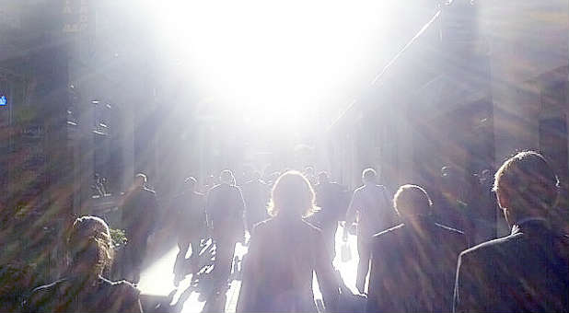
Are you ready for his return?
Notes:
More than that, we should live in light of his return. But how?

Slide 9

Eschatology
eschatos
+
ology
"last"
"study of"
= study of the last things (future)
Notes:
But first let's define three terms: eschatology, the Rapture, and the Revelation.

Slide 10
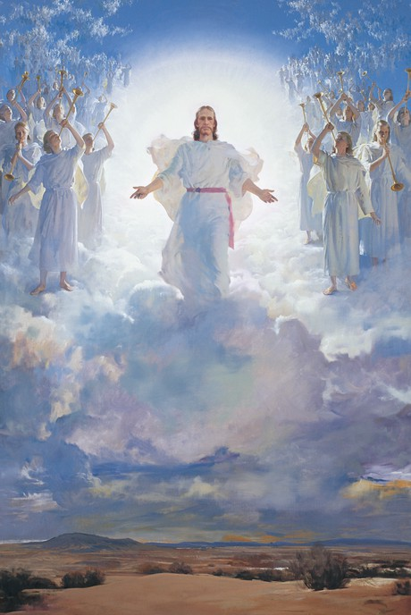
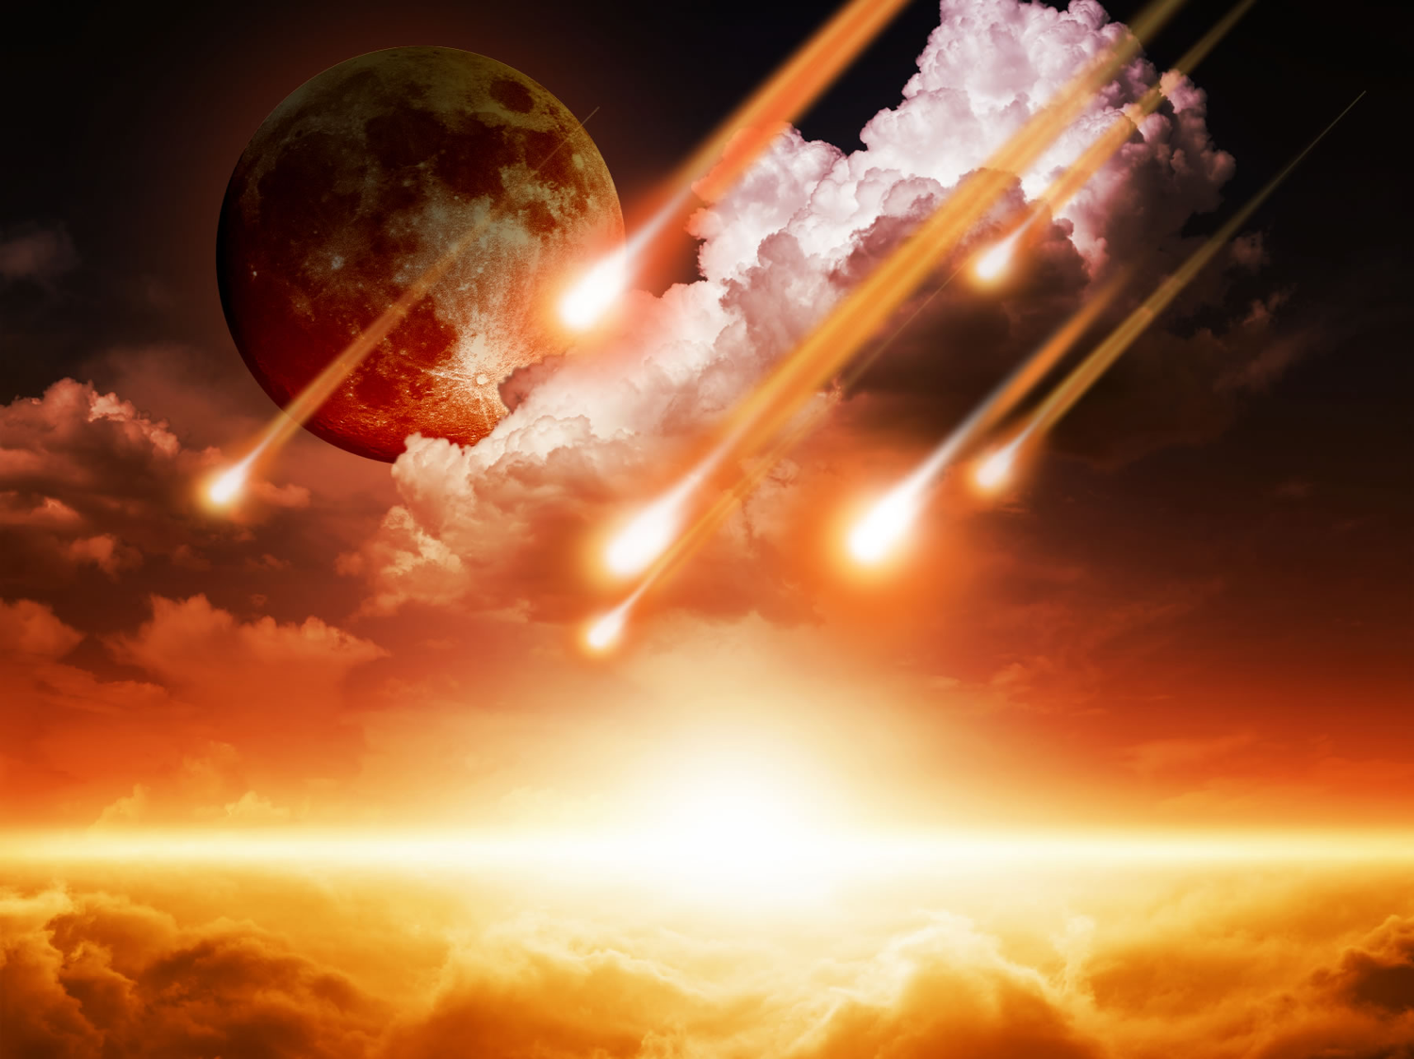
Two Stages of His Return
Literal
Christ
Future
"Coming"
Rapture
Revelation
Notes:
The Rapture (the coming of Christ for His own in the air to take the church from the earth prior to the Great Tribulation) differs from the Revelation (the coming of Christ with His own to judge unbelievers upon the earth after the Great Tribulation).
• Both events are literal returns. Never does the Scripture refer to these events as only allegorical returns for in both instances Christ actually will return to the earth.
• Both events find Christ as their central figure. Although humanity is involved in both, Christ Himself is at the forefront.
• Both events are still future. They are yet to be seen on God's prophetic calendar.
• Both events are sometimes referred to by the same word (e.g., "coming" refers to the Rapture in 1 Thessalonians 4:15 and the Revelation in Matthew 24:27).

Slide 11
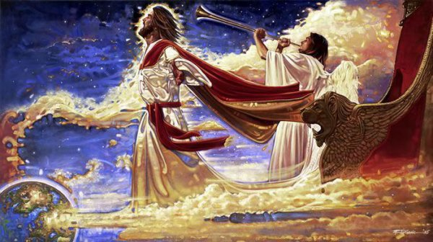
The Rapture

Slide 12

How can you be prepared for the Rapture?
Notes:
What specific ways can you be ready for Jesus when he come back?

Slide 13
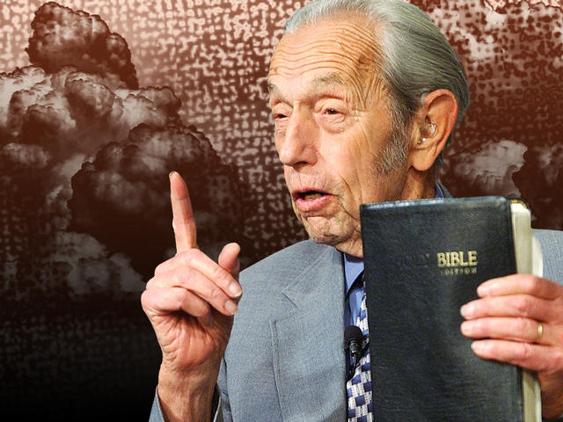
Harold Camping • 1994
21 May 2011
21 Oct 2011
Notes:
Some think we should prepare by knowing the exact date of his return. Yet all the date-setters like Harold Camping have only embarrassed the church and caused more doubt about his return.
Harold Camping was a Bible teacher who said he figured out the date of Christ’s coming in 1994.
When it didn’t happen he said it would be 21 May 2011.
After that date passed, his new date was 21 Oct 2011.
He eventually publicly apologized and later died.
Is that how to prepare for Christ’s coming? Not at all.

Slide 14
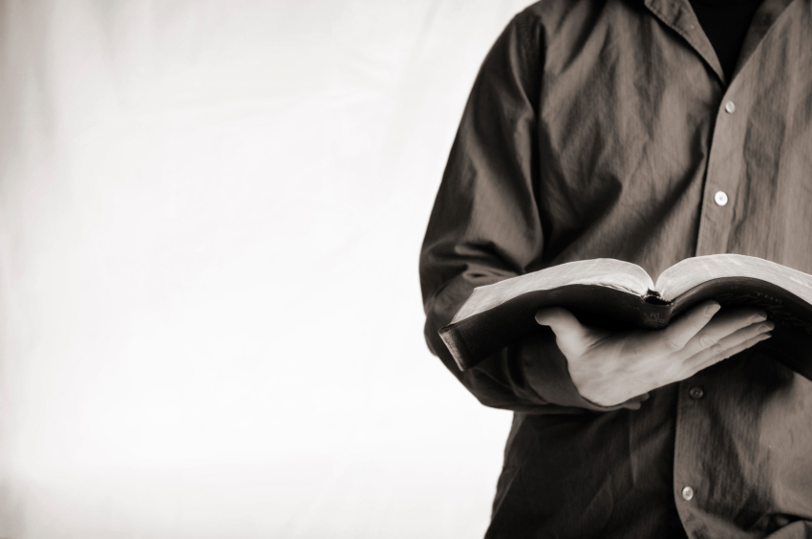
Let's Study Through Scripture
The Bible: Book by Book

Slide 15
Theme
23
203
Preparation for the Rapture
1 Thessalonians
Notes:
This means being ready for Christ’s return.

Slide 16
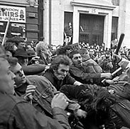
Throw him
in jail!
Down with
Paul!
What to do?...

Slide 17
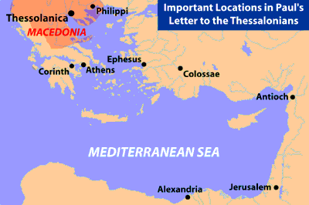
Some Geographical Perspective
139
Thessalonica

Slide 18
Book Chart
1 Thessalonians: Preparation for the Rapture
Innocence of Greed |  |  | Principles for Growth
Chapters 1–3 |  |  | Chapters 4–5
Personal |  |  | Practical
Silence Slanders |  |  | Strengthen Stand
Historical |  |  | Hortatory
Reflections |  |  | Exhortations
Looking Back |  |  | Looking Forward
Commendation 1:1-10 | Conduct 2:1-16 | Concern 2:17–3:13 | Love 4:1-12 | Eschatology 4:13–5:11 | Church Life 5:12-28
"You're great!" | "I'm innocent!" | "I care for you" | "Please God" | "Be comforted but watchful" | "Live holy"
Corinth
Early Summer AD 51 (on second missionary journey)
203

Slide 19
How can you be prepared for the Rapture?
2 ways…
Notes:
What specific ways can you be ready for Jesus when he come back?

Slide 20
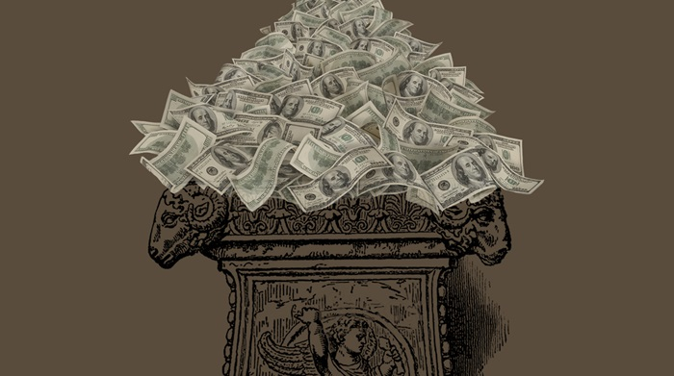
I. Serve Jesus without greed
(1 Thess 1–3).
Notes:
Live for Christ as if money is not a big concern.

Slide 21
Slides on
1 Thessalonians 1

Slide 22
Silas and Timothy (co-laborers in Thessalonica) wrote with Paul, who did not note his apostleship to show his concern (1:1).
“This letter is from Paul, Silas, and Timothy. We are writing to the church in Thessalonica, to you who belong to God the Father and the Lord Jesus Christ. May God give you grace and peace” (1:1 NLT).

Slide 23
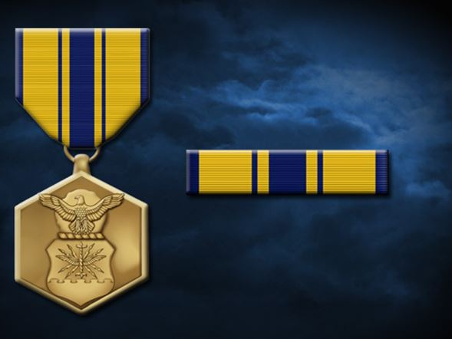
Paul commended their lifestyle of godly living…
in view of Christ’s return (1:2-10).
Notes:
The Air Force gives a commendation medal for a job well done.
Paul does that here…

Slide 24
Paul's Advice to Troubled Thessalonians: Focus on God!
215
Focus on God in the Thessalonian Epistles
Total Verses | "God" | "Jesus" | "Lord" | "Christ" | Total
1 Thess. (89) | 36 | 16 | 24 | 10 | 86
2 Thess. (47) | 18 | 13 | 22 | 10 | 63
Total (136) | 54 | 29 | 46 | 20 | 149
Number of Greek occurrences from Elwell & Yarbrough,
Encountering the New Testament, 332

Slide 25
Slides on
1 Thessalonians 2

Slide 26
Paul was not motivated by greed since he made tents and cared for them (2:1-16).
“Don’t you remember, dear brothers and sisters, how hard we worked among you? Night and day we toiled to earn a living so that we would not be a burden to any of you as we preached God’s Good News to you” (2:9 NLT).

Slide 27
205
I'm so proud of them! I must write to encourage them!

Slide 28
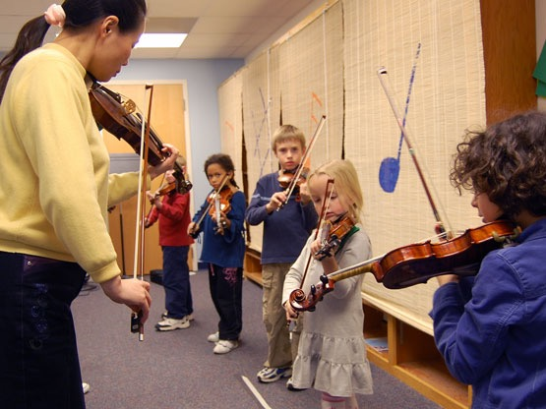

The Suzuki Method
Notes:
Have any of you attended a performance of schoolchildren trained in the Suzuki method of learning to play violin? I hear it is amazing! Imagine children as young as four, three and even two years old playing the violin—one of the most difficult musical instruments.
How do the instructors do it? Well, the first thing the kids learn is a proper stance. And the second thing they learn—even before they pick up the violin—is how to take a bow. One instructor notes, "If the children just play the violin and stop, people may forget to show their appreciation. But when the children bow, the audience invariably applauds. And applause is the best motivator we've found to make children feel good about performing and want to do it well."

Slide 29
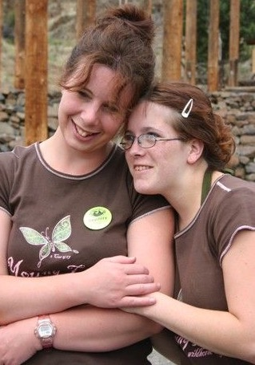
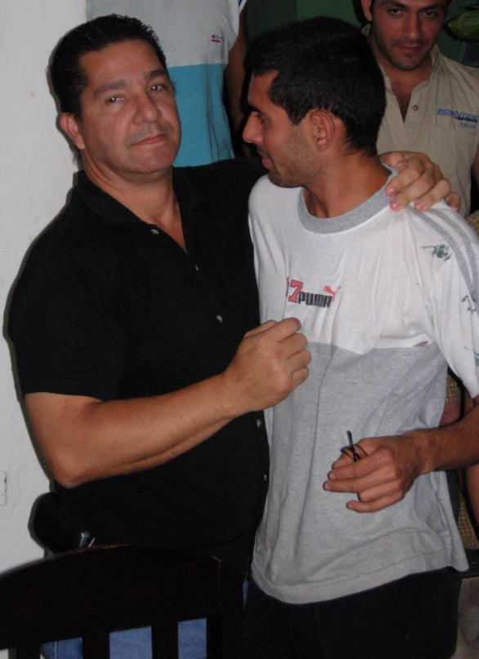
How can we strengthen others?

Slide 30
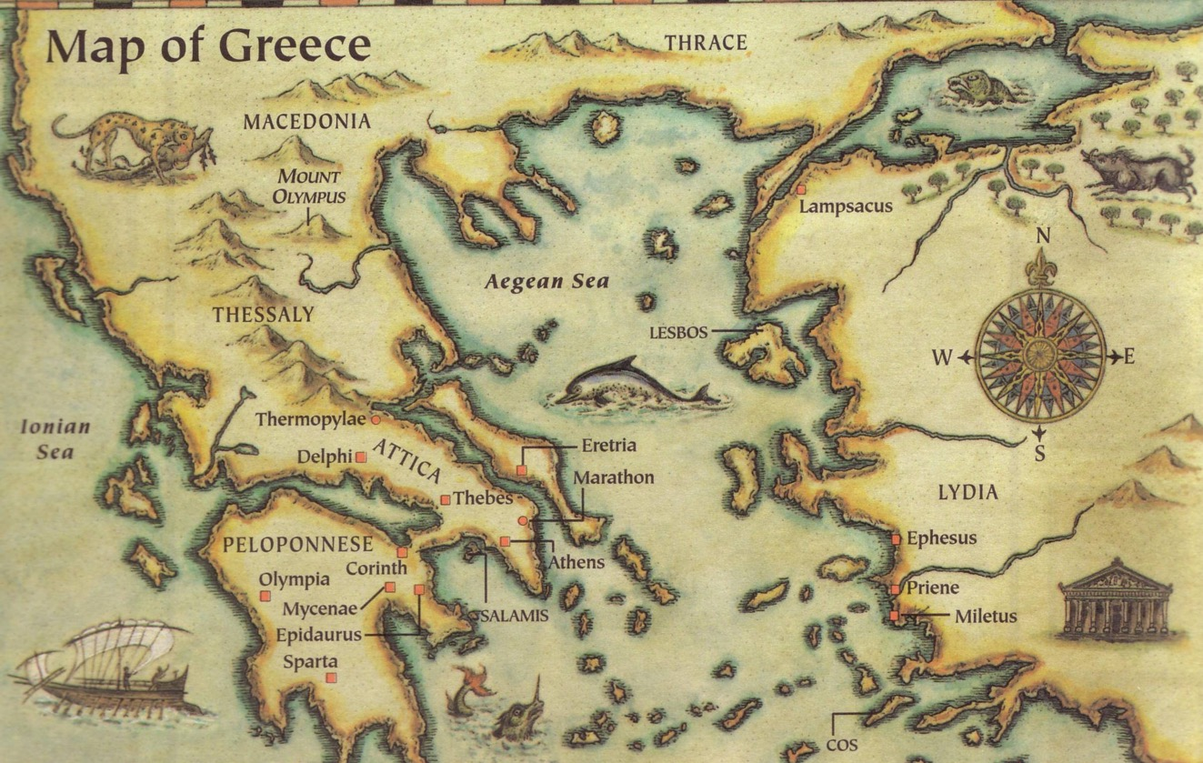
This epistle was written in AD 51
Thessalonica
Berea
Athens
Corinth
Three ways we can encourage others...
Written in Corinth after hearing Tim's report

Slide 31
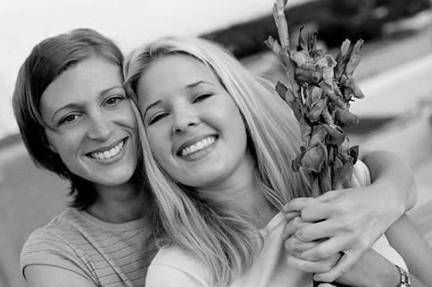
Go in person (2:17-20).
How can we strengthen others?
Black

Slide 32
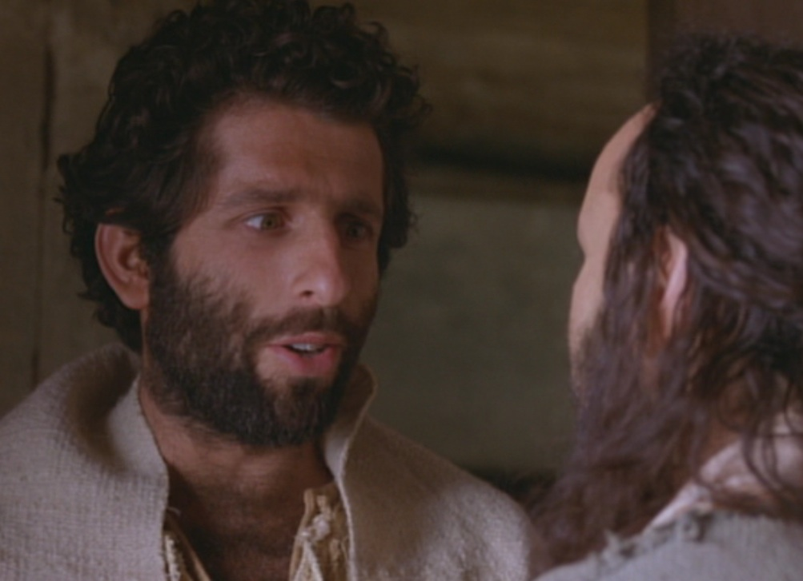
Paul Tried to Go in Person
But, brothers, when we were torn away from you for a short time (in person, not in thought), out of our intense longing we made every effort to see you. ¹⁸For we wanted to come to you—certainly I, Paul, did, again and again—but Satan stopped us" (1 Thess 2:17-18 NIV)

Slide 33
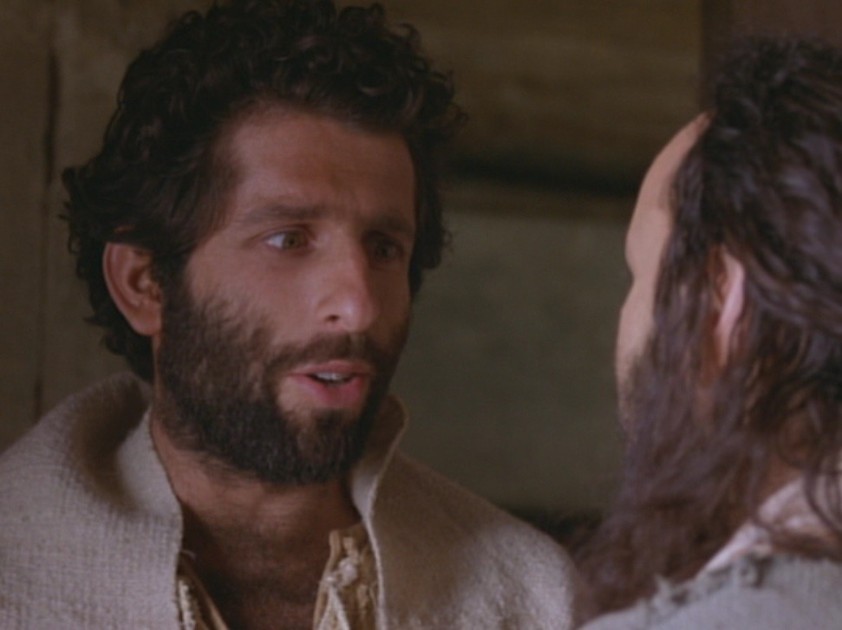
Paul's greatest blessing = People!
"For what is our hope, our joy, or the crown in which we will glory in the presence of our Lord Jesus when he comes? Is it not you? ²⁰Indeed, you are our glory and joy"
(1 Thess 2:19-20 NIV)
Notes:
Paul was a people person who saw these new believers as
his hope (his future, like a parent lives to see his kids grow into maturity),
his joy (what greater satisfaction is there than seeing people become all God wants them to be?), and his crown (the symbol of God's blessing on his life).

Slide 34

The best way to show people how valuable they are is in person

Slide 35
Go in person (2:17-20).
How can we strengthen others?
Black

Slide 36
Slides on
1 Thessalonians 3

Slide 37

Bring others into their lives (3:1-9).
How can we strengthen others?

Slide 38
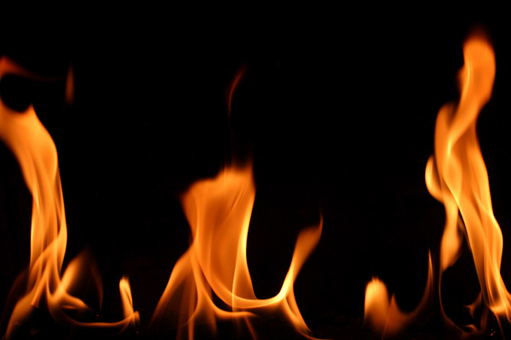
Paul sent Timothy to strengthen the church (3:1-5)
So when we could stand it no longer, we thought it best to be left by ourselves in Athens. ²We sent Timothy, who is our brother and God's fellow worker in spreading the gospel of Christ, to strengthen and encourage you in your faith, ³so that no one would be unsettled by these trials. You know quite well that we were destined for them.

Slide 39
Paul sent Timothy to strengthen the church (3:1-5)
⁴In fact, when we were with you, we kept telling you that we would be persecuted. And it turned out that way, as you well know. ⁵For this reason, when I could stand it no longer, I sent to find out about your faith. I was afraid that in some way the tempter might have tempted you and our efforts might have been useless.
Notes:
Paul could have just written a letter, which he was obviously doing in this epistle, but he always carefully chose the men who carried the letter.
Not "just anybody" could accomplish a mission such as this one to encourage these suffering Christians—but Timothy fit the bill.
Timothy was with Paul when they planted the church.
Timothy was also a sensitive man who could genuinely feel for these persecuted believers.

Slide 40

Paul was encouraged (3:6-9)
⁶But Timothy has just now come to us from you and has brought good news about your faith and love. He has told us that you always have pleasant memories of us and that you long to see us, just as we also long to see you. ⁷Therefore, brothers, in all our distress and persecution we were encouraged about you because of your faith. ⁸For now we really live, since you are standing firm in the Lord. ⁹How can we thank God enough for you in return for all the joy we have in the presence of our God because of you?

Slide 41

Send others when you can't go

Slide 42
Bring others into their lives (3:1-9).
How can we strengthen others?
Minister with others as peers (3:1-2a).
Minister as a partner with God (3:2b).
Minister as an encourager during other's trials (3:2c-4).
Minister face-to-face in person (3:5).
Send others when you can't go in person (3:6-9).

Slide 43
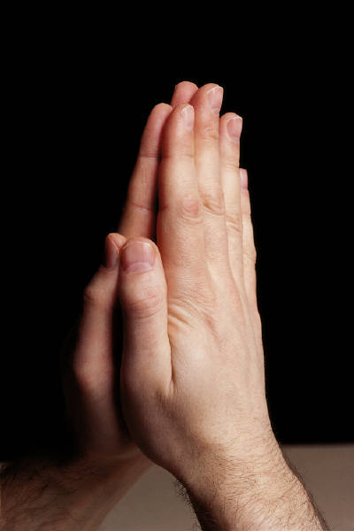
Pray for them (3:10-13).
How can we strengthen others?
¹⁰ Night and day we pray most earnestly that we may see you again and supply what is lacking in your faith.
¹¹ Now may our God and Father himself and our Lord Jesus clear the way for us to come to you.

Slide 44
Pray for them (3:10-13).
How can we strengthen others?
¹² May the Lord make your love increase and overflow for each other and for everyone else, just as ours does for you.
¹³ May he strengthen your hearts so that you will be blameless and holy in the presence of our God and Father when our Lord Jesus comes with all his holy ones.

Slide 45
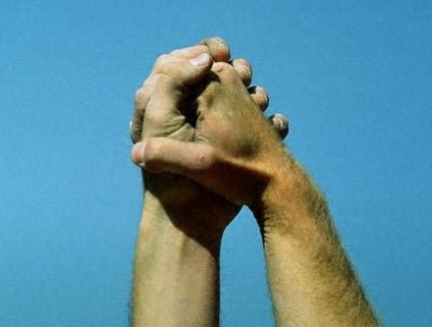
Main Idea of 1 Thess 2:17–3:13
Strengthen others to show you care for them
How?
• Visits: Go in person (2:17-20)
• Co-laborers: Bring others (3:1-9)
• Prayer: Pray for them (3:10-13)
Notes:
Application: Who do you know that needs encouragement today?
Which of these three ways can you infuse strength into that person?

Slide 46

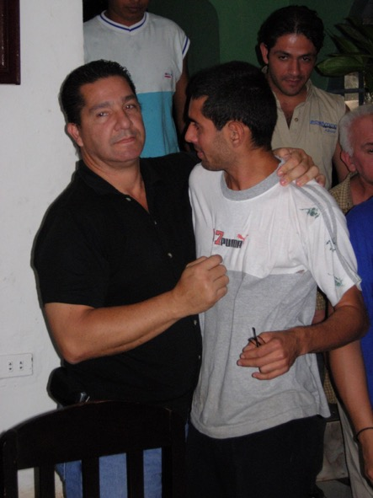
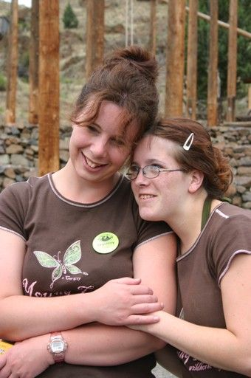
Encouragement

Slide 47
Live on what you need and invest the rest for eternity.
“Lay up for yourselves treasures in heaven
—not on earth”
(Matthew 6:20)

Slide 48
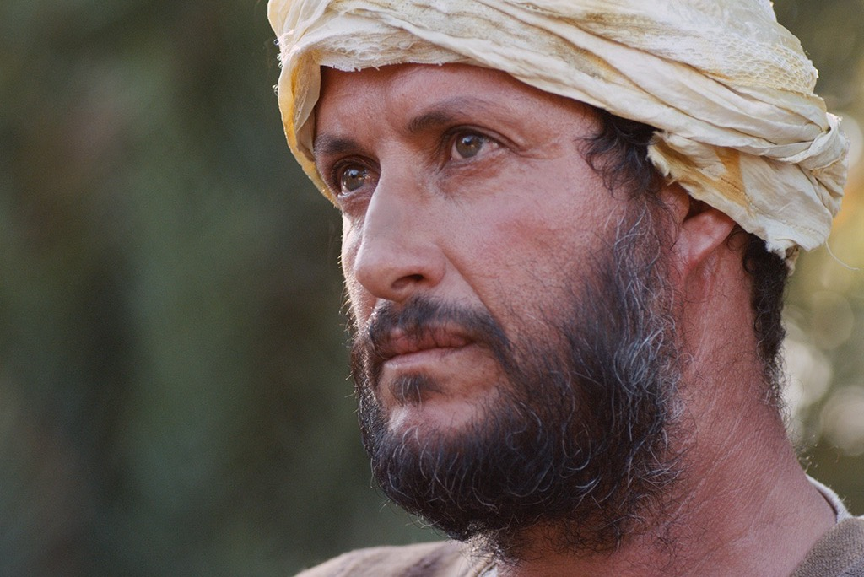

Free
Bible
images
A RICH YOUNG MAN QUESTIONS JESUS
Matthew 19:16-30; Mark 10:17-31; Luke 18:18-30

Slide 49
How can you be prepared for the Rapture?
2 ways…
Notes:
What specific ways can you be ready for Jesus when he come back?

Slide 50
I. Serve Jesus without greed
(1 Thess 1–3).
Notes:
Live for Christ as if money is not a big concern.

Slide 51

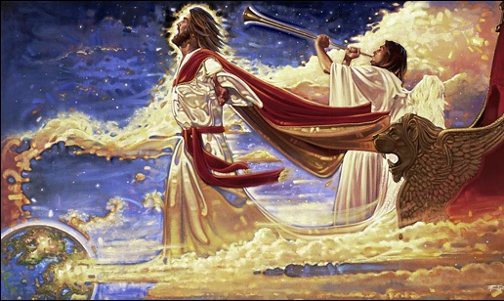
II. Care about both people and theology (1 Thess 4–5).
+
Notes:
Doctrine and relationships should occupy much of our time.
In particular, we need a theology of Christ’s second coming.

Slide 52
Slides on
1 Thessalonians 4
Notes:
Next Paul prepared for the Rapture by strengthening the church's doctrine and relationships (1 Thess 4–5).

Slide 53

What's Most Important?
Mark 12:29-31 -- Jesus replied, “The most important commandment is this: 'Listen, O Israel! The Lord our God is the one and only Lord. ³⁰ And you must love the Lord your God with all your heart, all your soul, all your mind, and all your strength.'
³¹ The second is equally important:
'Love your neighbor as yourself.' No other commandment is greater than these.”
Notes:
One of the teachers of religious law was standing there listening to the debate. He realized that Jesus had answered well, so he asked, “Of all the commandments, which is the most important?” Jesus answered…
53

Slide 54
Our Vision
Love the Nations
Love the Church
Love God

Slide 55

Preparing for
205
the Rapture
Although Paul appeared to be writing about and addressing 5 different issues in his letter, there is one topic which he repeatedly mentions: the Rapture.
--> Exhortations on the Rapture of believers to meet the Lord as end markers ending each chapter:
1:10 – "…and to wait for his Son from heaven…"
2:19 – "…in the presence of our Lord Jesus when he comes…"
3:13 – "…when our Lord Jesus comes with all his holy ones."
4:16-18 – "…we who are still alive and are left will be caught up with them in the clouds to meet the Lord in the air…"
5:23 – "…at the coming of our Lord Jesus Christ."

Slide 56
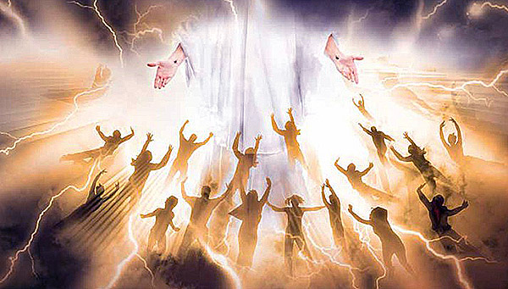
The Rapture will be both a comfort and a warning
1 Thessalonians 4:13–5:11

Slide 57
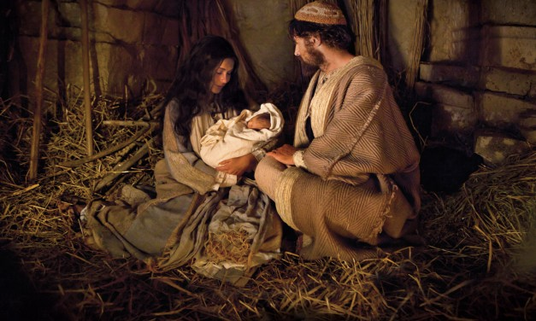
Christ's First Coming
Notes:
At Christmas we focus on the first coming of our Savior in Bethlehem. Christ’s first coming was both a comfort and warning.

Slide 58
Are you ready for his return?
Notes:
But our focus today is "Are You Ready For the Lord's Return?"

Slide 59
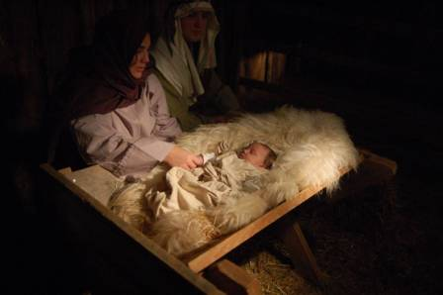
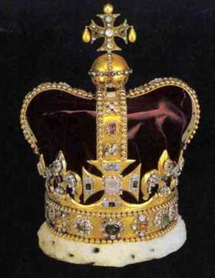
Christ's Two Comings
420
FIRST COMING | (CHURCH AGE) | SECOND COMING
Laid in a manger |  | Lands on a mountain
Came as a lamb |  | Comes as the Lord
Lowly and poor |  | Lavish and powerful
Died for His enemies |  | Death to His enemies
Tempted by Satan |  | Traps Satan in bottomless pit
Lived in a world of unrighteousness |  | Leads the world in righteousness
Died for sins and rose again |  | Directs and reigns
Ruth & Larry Moody; cited by Terry Hall, Bible Panorama, 117
Notes:
Today as we experience the new year I believe the Scripture has some words of encouragement for us in regard to Christ's second coming to earth at the Rapture.

Slide 60
"Pre-Trib" Rapture
209
361
Second Coming
Rapture
Tribulation
Millennium
Church Age
Eternal Kingdom
7 years
1000 years
Judgment

Slide 61
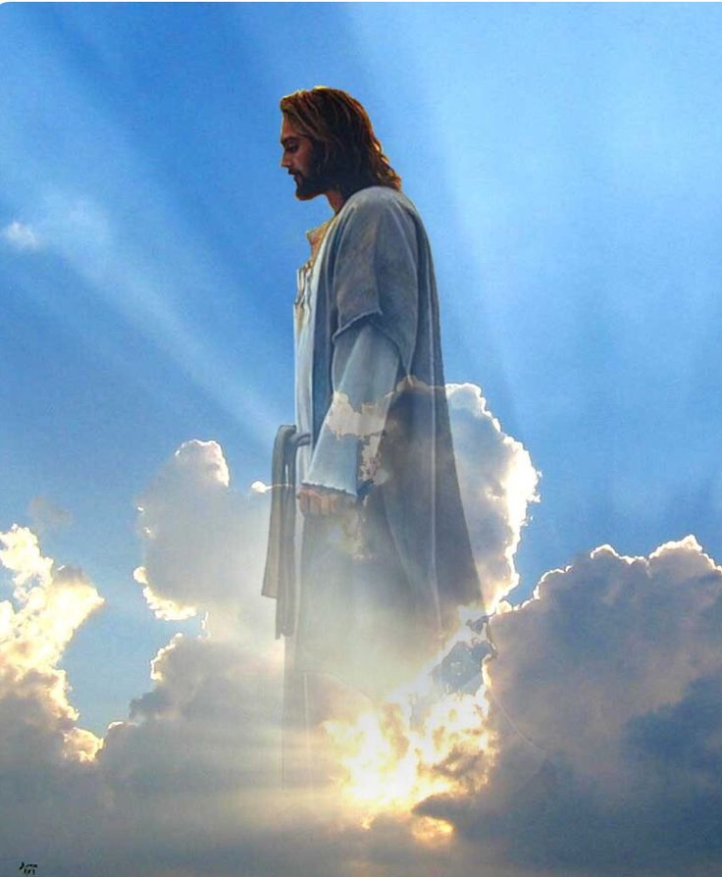
The Rapture
Notes:
Today we will focus on the first stage: The Rapture.

Slide 62
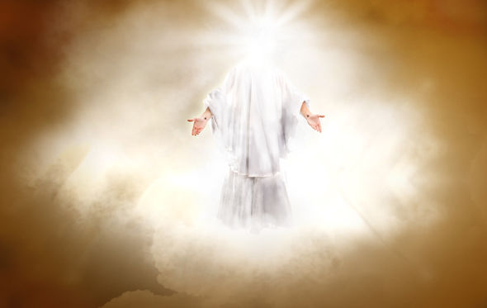
Why should we look forward to the Rapture with expectancy?
1 Thessalonians 4:13-18
3 Reasons
Notes:
Paul gave them three reasons to have hope in the Lord’s return. So today we’ll see these three reasons to look forward to the Lord’s return at the Rapture.

Slide 63

1. The Rapture helps us grieve with hope
(1 Thess 4:13-14).
Notes:
Knowing the destiny of Christians at death helps us to control our grief.

Slide 64
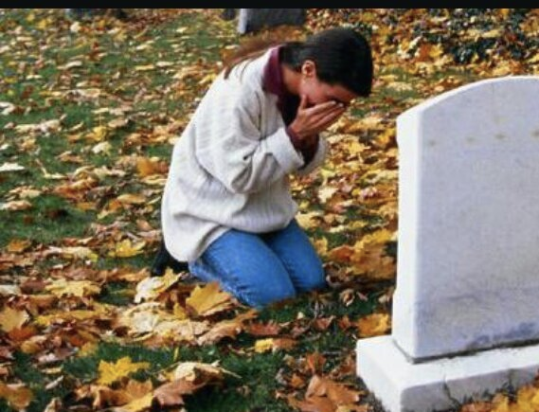
"And now, dear brothers and sisters, we want you to know what will happen to the believers who have died..."
(4:13a NLT).

Slide 65
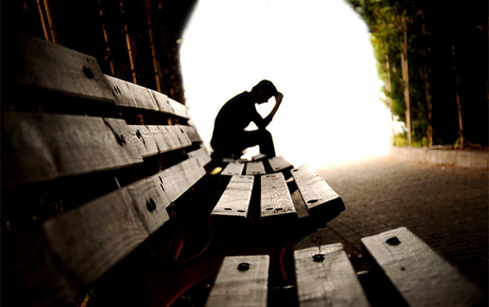
Know about the future destiny of believers who die (4:13a).
Notes:
Many people think that eschatology is unimportant.
This is seen in what some say about the time of the Rapture: I'm not pretrib, midtrib, or posttrib. I am pantrib, because it will all pan out in the end!

Slide 66
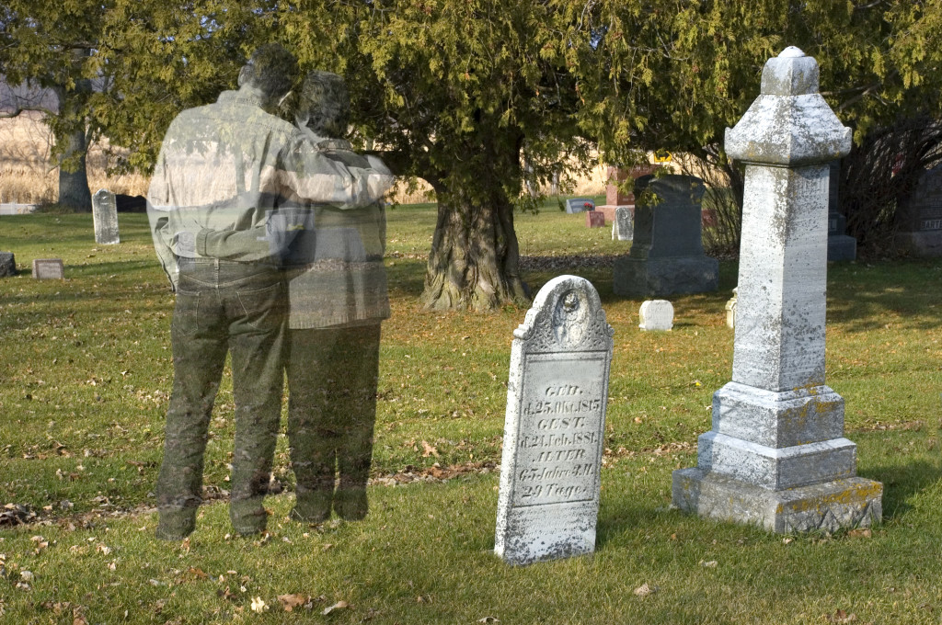
Grief is hard
Notes:
Text

Slide 67
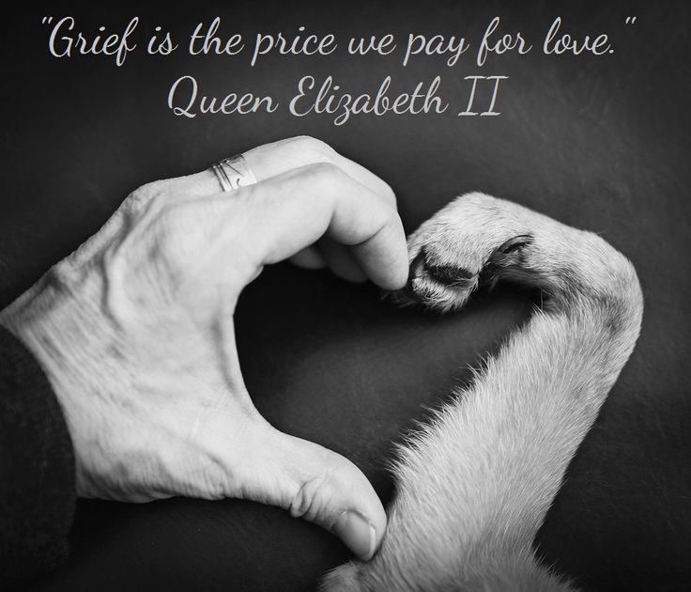
"Grief is the price we pay for love."
Queen Elizabeth II
Notes:
Why is it so important that we know about future things such as the destiny of believers? Paul saw eschatology as vital because it affects our hope. It's important because…

Slide 68

Being informed about believers who have died will prevent us from hopeless grief (4:13b).

Slide 69
"And now, dear brothers and sisters, we want you to know what will happen to the believers who have died so you will not grieve like people who have no hope"
(4:13 NLT).

Slide 70
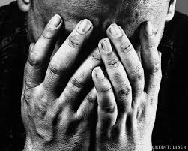
Should Christians grieve when a fellow believer dies?

Slide 71
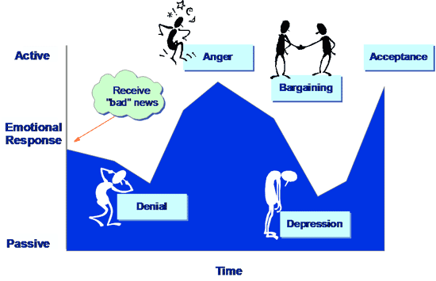
Five Stages of Grief
Active
Anger
Acceptance
Receive the "bad" news
Bargaining
Emotional Response
Denial
Depression
Passive
Time

Slide 72
"And now, dear brothers and sisters, we want you to know what will happen to the believers who have died so you will not grieve like people who have no hope"
(4:13 NLT).
Notes:
Notice what Paul is really saying in this verse.
He is not saying that Christians will not grieve.
He is only addressing the issue of how they should grieve. They should grieve in such a way that shows hope—like when Jesus grieved over Lazarus.

Slide 73

The Rapture
Notes:
Why did Paul say these things though? What problem was he addressing in the church?
Paul had already taught the believers about the Rapture when he was with them personally. He told them that when Christ comes all who have trusted Him will be removed from the earth.
Apparently the Thessalonians were confused regarding the destiny of believers who have died before the Rapture.
—Perhaps some thought these would miss the Rapture and have to wait until the Great White Throne Judgment.
—Perhaps some wondered whether they would be saved at all.

Slide 74
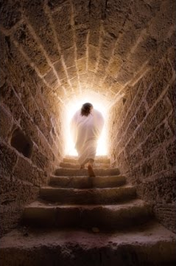
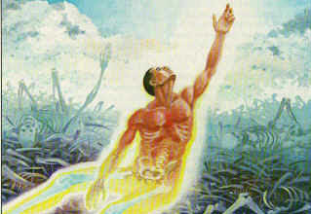
Christ's resurrection guarantees the believer's resurrection (4:14).

Slide 75
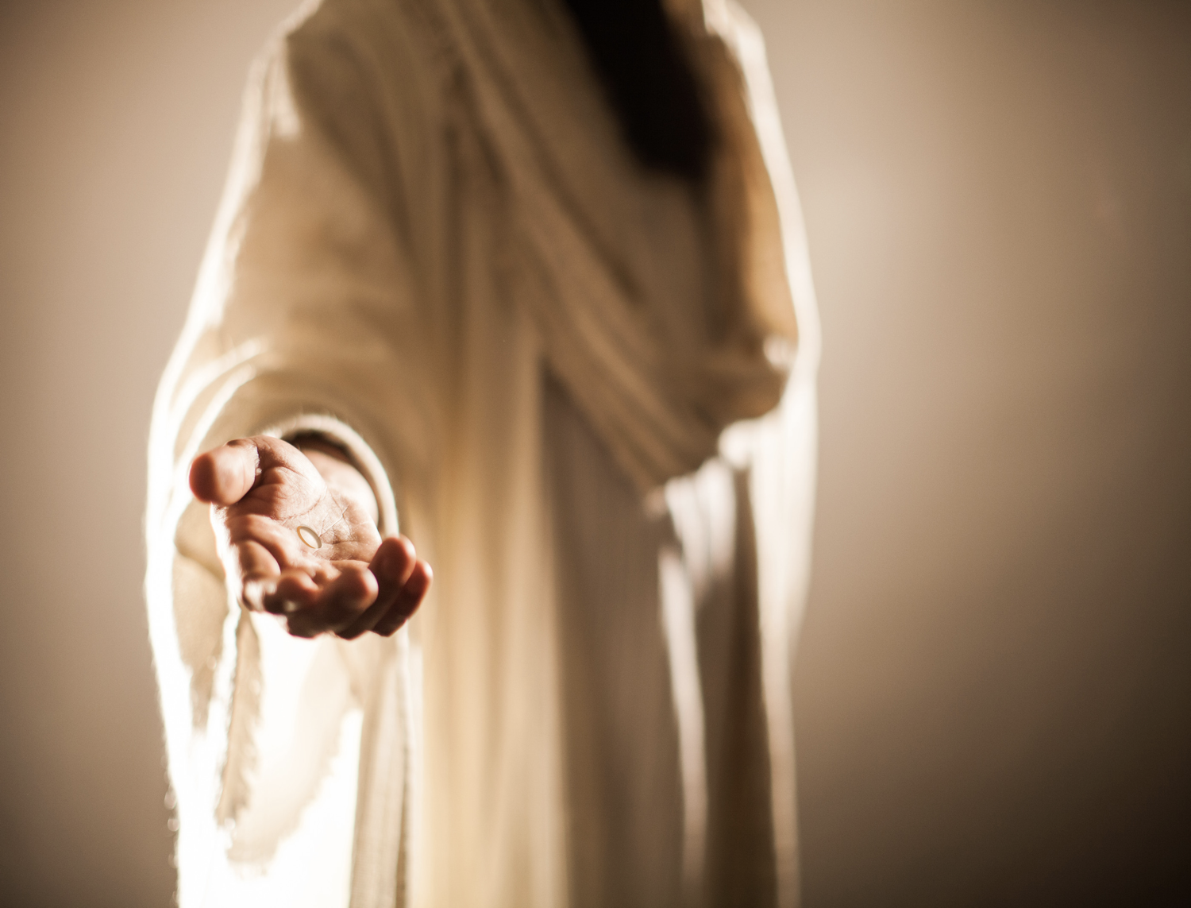
"For since we believe that Jesus died and was raised to life again, we also believe that when Jesus returns, God will bring back with him the believers who have died" (4:14 NLT).
Notes:
The "if" here (in the NASB & KJV) is better translated "since" (as in the NIV & NLT) because of the Greek construction.
1) Therefore, it really means "since we believe that Christ died…"
2) Paul had no doubt regarding the validity of the resurrection.

Slide 76
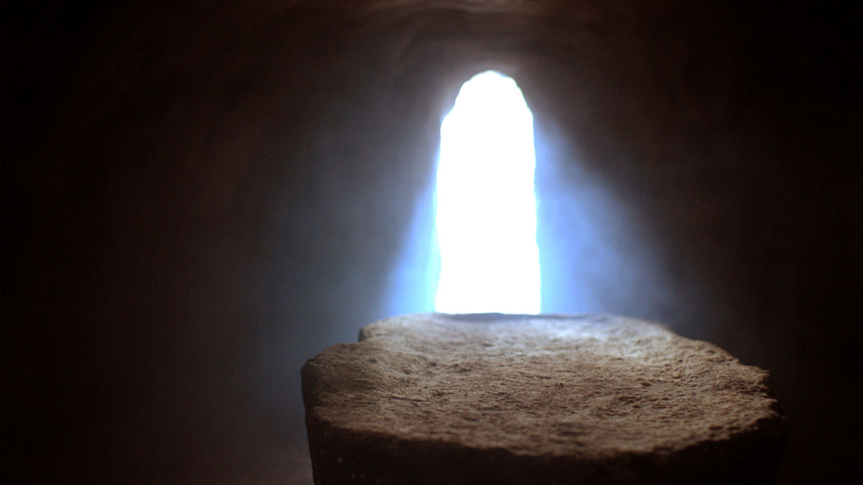
The Implictions
Notes:
This historical basis provides assurance that the bodies of all Christians also will be raised (4:14b).
Paul declared that both Christ's resurrection and our resurrection stand or fall together.
This is taught in 1 Corinthians 15:12-20.

Slide 77
1. The Rapture helps us grieve with hope
(1 Thess 4:13-14).
Notes:
So Paul has told us that when we undergo affliction to the point of death we shouldn't grieve hopelessly because all believers will be resurrected. But how will this come about when Christ comes to receive His church? Who will be the first to be bodily with the Lord—those who have died or those of us who are living? This leads us into the second reason to expect his return…

Slide 78
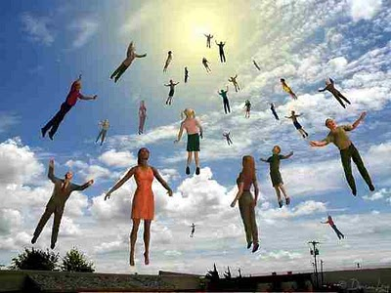
2. Christians who have died will meet Christ in the air before those living (4:15-17).
Notes:
We who are alive when the Rapture comes will be taken up only after the dead in Christ.
Now the living moving faster than the dead—but then the dead will move faster than the living!

Slide 79
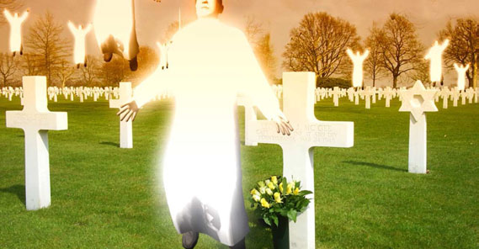
"We tell you this directly from the Lord: We who are still living when the Lord returns will not meet him ahead of those who have died"
(1 Thess 4:15 NLT).
Notes:
1. Notice how the verse expresses that this great truth wasn't something that Paul made up. It was Christ's own promise.
Perhaps this was an unrecorded statement of Christ (cf. Acts 20:35).
Maybe Paul received this word by direct revelation.
In either case, there was no need to worry since the dead will have a prominent place in the Rapture because they will rise even before the living.
2. Notice that Paul included himself among the living group and evidently expected to be living when Christ returned.
Here we see more evidence for a pre-tribulation Rapture.
According to Paul, the next event on God's timetable was the return of Christ since it could happen at any moment.

Slide 80
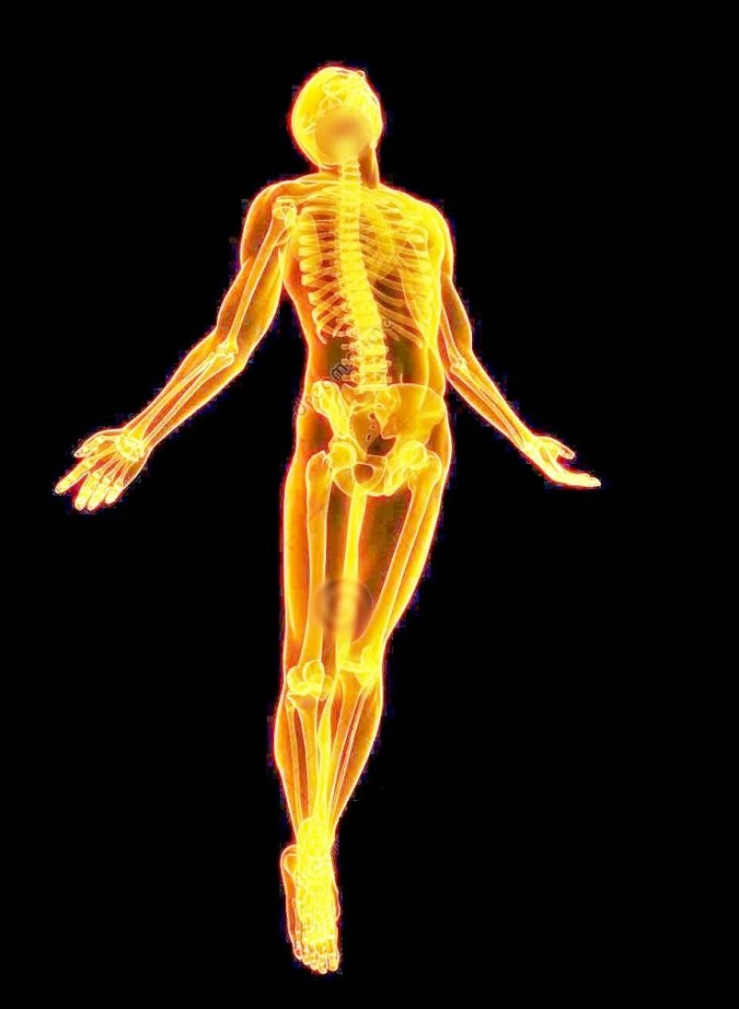
Some future day
4 amazing events will happen without a moment's notice (4:16-17)
Notes:
These four events will happen in the following order, each event beginning with the letter "R" (cf. Ryrie)…

Slide 81
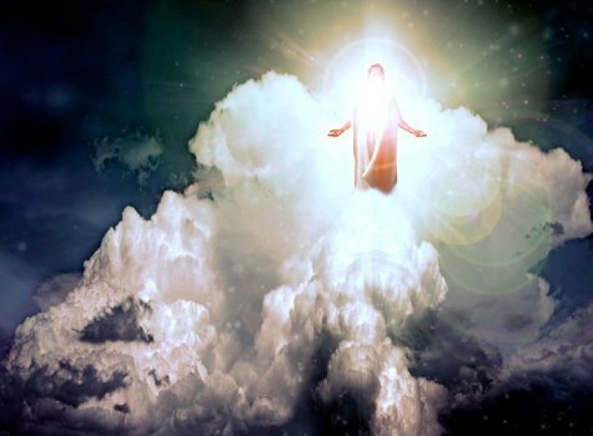
Return
"For the Lord himself will come down from heaven with a commanding shout, with the voice of the archangel, and with the trumpet call of God"
(1 Thess 4:16a NLT).
Notes:
Where is Christ right now? In heaven seated at the right side of the Father.
Christ Himself (not an angel) will return for the church.
His return will be accompanied by three things:

Slide 82
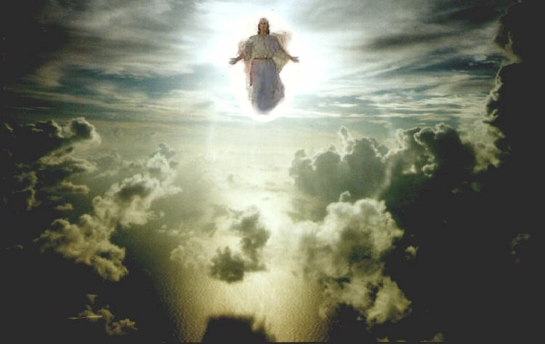
Christ's Commanding Shout
Notes:
Is this from Christ or an angel or Michael the archangel? The text isn't clear, but I like to think that it's from Christ.
The word for "loud command" or "shout" is "used of the cry of the charioteer to his horses or the hunter to his hounds; it is the shout of the ship's master to the rowers, or of the commander to his soldiers" (Morris).
What is the command? "Rise!" "Come forth!" "It's time!" ????
The word carries with it a ring of authority and urgency.

Slide 83
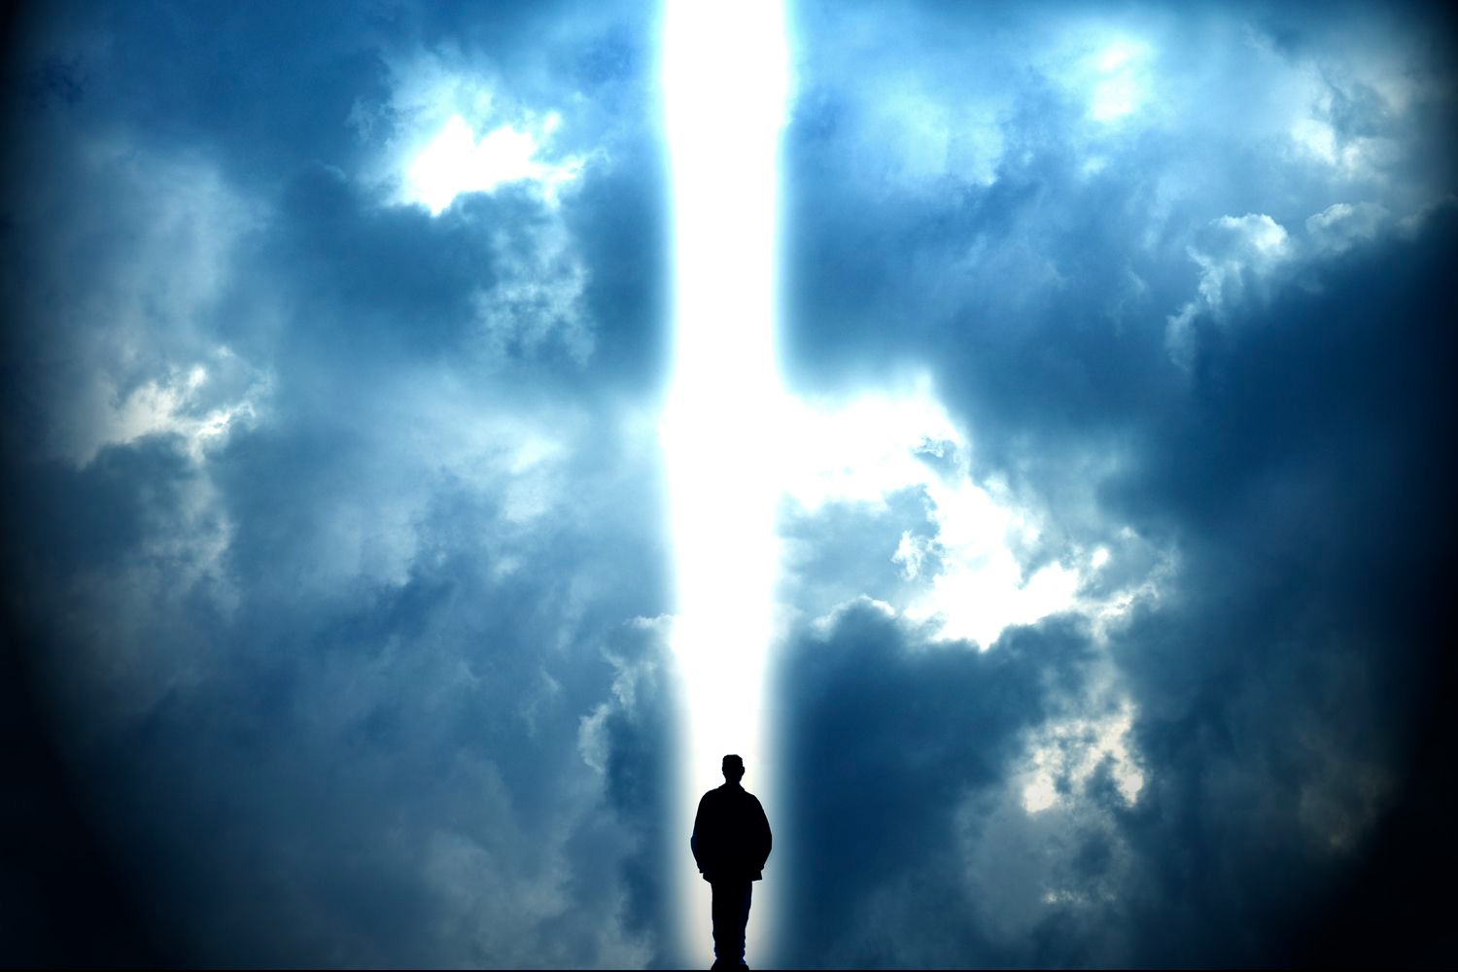
Voice of the Archangel
Notes:
The Jews listed seven chief angels, but which one is the archangel?
The identity of this angel is somewhat unclear since Michael is the only angel in Scripture specifically referred to as an archangel, but here the word appears without a definite article.
"Voice" also lacks the word "the" in the Greek.
However, a definite article is not necessary to be definite so this is probably Michael.

Slide 84
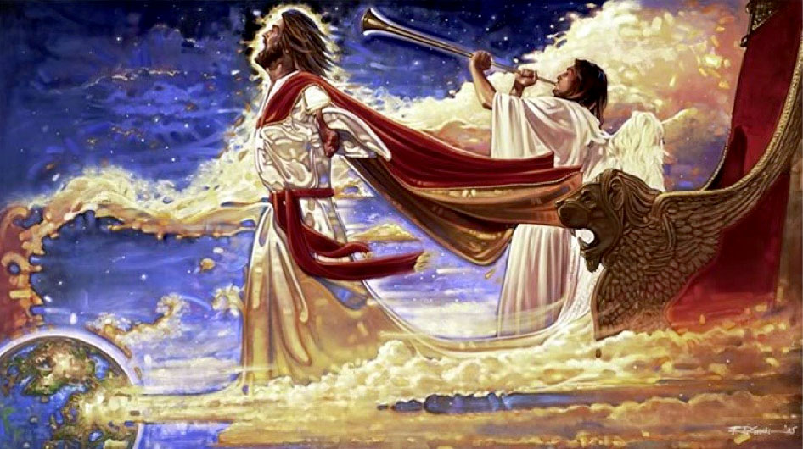
The Trumpet Call of God
Notes:
Trumpets are associated with God's activity in the Bible:
-Ex 19:16 has a trumpet at Mt. Sinai
-Isa 27:13 uses the trumpet to signal the return to the land from Assyria
-Joel 2:1 mentions the trumpet sounding in judgment
-Matt 24:31 has a trumpet sound when Christ returns after the Tribulation
Through the use of the trumpet God calls attention to this event as a majestic, dramatic, spectacular one worthy of Christ who is King of kings and Lord of lords.

Slide 85

Resurrection
"First, the Christians who have died will rise from their graves"
(1 Thess 4:16b NLT).
Notes:
Christians who have died during the church age will rise first.
The designation "in Christ" refers only to those who have died since Christ's death and resurrection in the Church Age.
So those who have died as Christians will be rejoined with their spirits which have already been with Christ.

Slide 86

“The dead in Christ will rise first”
(1 Thess. 4:16b)
Notes:
But what happens to the bodies of these who have died? Are they changed? (RAPTURE transformation of the body= farmer's wife in elevator).
For sure! Read 1 Corinthians 15:50-55.
Exactly how these bodies are reassembled and resurrected is not stated.

Slide 87

Rapture
"Then, together with them, we who are still alive and remain on the earth will be caught up in the clouds to meet the Lord in the air"
(1 Thess 4:17a NLT).
"caught up"—not "disappear"

Slide 88


THE RAPTURE
From rapturo, "to catch up" (Latin)
Notes:
Text

Slide 89


Slide 90

Enoch
Notes:
Text

Slide 91

Rapture Chaos
Notes:
Text

Slide 92

The Translation

Slide 93

Reunion
"Then we will be with the Lord forever"
(1 Thess 4:17b NLT).

Slide 94

3. Christ’s return helps us encourage one another (4:18).
Notes:
The word for "comfort" (or "encourage") here literally means to "come alongside to help (Read Charles Swindoll, Contagious Christianity, 46-47).
We're also guaranteed escape from the coming wrath of the Tribulation, which is something to be encouraged about! (A post-tribulation rapture would be no comfort to anyone!)

Slide 95
Why should we look forward to the Rapture with expectancy?
Notes:
So are you looking to Christ’s return at the Rapture?
What reasons can we give to anticipate Jesus coming back?

Slide 96

Main Idea of
1 Thessalonians 4:13-18
The Rapture gives hope and encouragement that he will come for you.
Notes:
Restatement

Slide 97

We will join him in the clouds

Slide 98
Slides on
1 Thessalonians 5
Notes:
Christ’s return also includes a warning not to be caught unaware (5:1-11).

Slide 99
205
Looks like I must clarify some of their queries in the letter also.

Slide 100

After the Rapture…
comes the Tribulation…
Notes:
Christ’s return also includes a warning not to be caught unaware (5:1-11).

Slide 101

"Now concerning how and when all this will happen, dear brothers and sisters, we don’t really need to write you. ²For you know quite well that the day of the Lord’s return will come unexpectedly, like a thief in the night.”

Slide 102

"³When people are saying, ‘Everything is peaceful and secure,’ then disaster will fall on them as suddenly as a pregnant woman’s labor pains begin. And there will be no escape"
(1 Thess 5:1-3 NLT).

Slide 103

"But you aren’t in the dark about these things, dear brothers and sisters, and you won’t be surprised when the day of the Lord comes like a thief. ⁵For you are all children of the light and of the day; we don’t belong to darkness and night. ⁶So be on your guard, not asleep like the others. Stay alert and be clearheaded"
(1 Thess 5:4-6 NLT).

Slide 104
Five Purposes in Writing
Paul's Purpose
203
in Writing
Encoura-gement to grow
Defence against opponents
Exhortation to Persevere
Instruc-tions for godly living
Clarifica-tion to queries
Commen-dation
1:1-10
Conduct 2:1-16
Concern 2:17-
3:13
Love
4:1-12
Eschatology 4:13-5:11
Church Life 5:12-28
Notes:
We prepare for Christ’s return by obeying Paul’s instructions for godly living (5:12-28).

Slide 105
Healthy church life is where each person fulfills his roles (5:12-28).
205
I must include some instructions in the letter on how to lead a healthy church life.
Notes:
Healthy church life is where each person fulfills his roles (5:12-28).

Slide 106

Don’t be lazy (5:14).
“Brothers and sisters, we urge you to warn those who are lazy. Encourage those who are timid. Take tender care of those who are weak. Be patient with everyone.”
1 Thessalonians 5:14 NLT
Notes:
Don’t be lazy (5:14).

Slide 107


Be joyful (5:16).
Notes:
Be joyful (5:16).

Slide 108


      Pray without ceasing (5:17).

Slide 109

Never Stop Praying (5:18).

Slide 110


Always give thanks (5:18).

Slide 111

Be honest that while the Spirit is present, you may have quenched him.

Slide 112

DO NOT QUENCH THE SPIRIT (1 THESS 5:19)
DO NOT QUENCH THE SPIRIT
Notes:
“Do not put out the Spirit’s fire” (NIV) is more literal.

Slide 113

Benediction

Slide 114
May God himself, the God of peace, sanctify you through and through. May your whole spirit, soul and body be kept blameless at the coming of our Lord Jesus Christ. The one who calls you is faithful, and he will do it.
1 Thessalonians 5:23-24

Slide 115
So…how about you?
Are you growing in your relational and Bible skills?
+
Notes:
Every one of us is changing all the time! So…
How do you relate to others better now than last year?
How do you obey God’s Word better than last year?

Slide 116


Church

Slide 117
How can you be prepared for the Rapture?
2 ways…
Notes:
What specific ways can you be ready for Jesus when he come back?

Slide 118

Main Idea
Be prepared for Christ’s return with your money, friends and Bible.
1 Thessalonians

Slide 119
I. Serve Jesus without greed
(1 Thess 1–3).
Notes:
Live for Christ as if money is not a big concern.

Slide 120
II. Care about both people and theology (1 Thess 4–5).
+
Notes:
Doctrine and relationships should occupy much of our time.
In particular, we need a theology of Christ’s second coming.

Slide 121

He will definitely return

Slide 122

We will all give an account

Slide 123

The faithful will reign with Christ
Notes:
Text

Slide 124

"I've got time..."
Notes:
Restatement

Slide 125

Behold,
I COME QUICKLY
Rev 3:11
Notes:
Text

Slide 126

1 Thessalonians 5:2
"like a thief in the night"

Slide 127

How to live?
Charles R. Swindoll, Contagious Christiantiy, 47
Notes:
Text

Slide 128
Black

Slide 129


NT Preaching • BibleStudyDownloads.org
Get this presentation and script for free!

