Slide 1
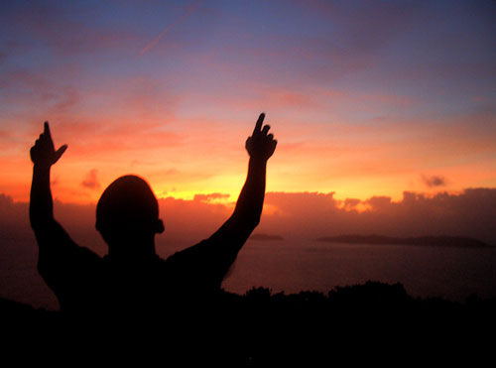
Be Expectant
Ezekiel
Dr. Rick Griffith • Crossroads International Church Singapore
CICFamily.com • BibleStudyDownloads.org

Slide 2
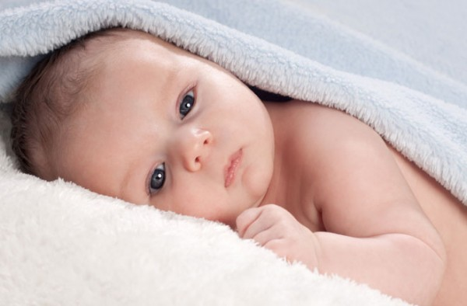
Expectant?
Notes:
Are you expectant? I don’t mean pregnant! But when a baby is born, we can’t help but look ahead.
Yet sometimes it seems that our best days are past.

Slide 3
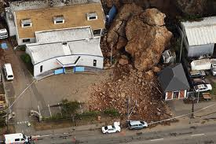
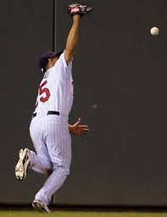
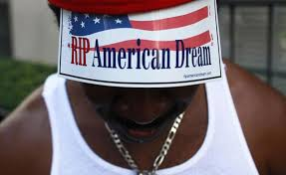

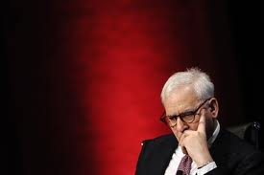
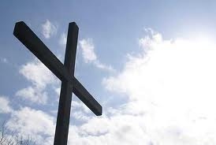
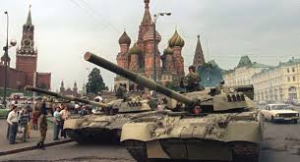
When have you seen the glory go?
Glory
Notes:
Do you feel that God’s glory has departed from your life? Do you find yourself thinking about the “good ol’ days”?
• We are in a current difficulty.
• We make errors that we used to not make.
• Our relationships have seen better days.
• We suffer for our faith.
• Depression sets in.

Slide 4
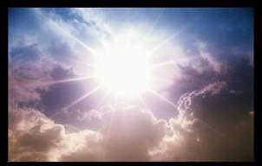
Key Word for Ezekiel
500
Glory
Notes:
What can you do to restore that sense of blessing that you used to have—those times when the presence of the Lord was real? This isn't simply a feeling, for that time may have been one of the most difficult periods of your life. Yet you knew that God was showing himself to you in new ways, there was a sense of expectancy at what he would do next. How can that return?
So today we will look at Ezekiel where the keyword is GLORY! We will address this question…

Slide 5
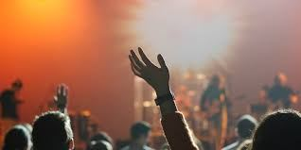
How can you be expectant of God’s glory once again in your life?
Notes:
Our hope is in God, so when God himself removes his glory and presence in our lives, we need to know what to do!
We often can tell that something is wrong. However, knowing what to do about it escapes us.

Slide 6

Sin
JUDGMENT
IDOLATRY
WRATH
D A N I E L
E Z E K I E L
PUNISHMENT
SIN
DISOBEDIENCE
Notes:
Ezekiel was an exile wondering about the future of his country.

Slide 7
The Babylonian Threat
Babylonian Expansion
Mediterranean
Sea
Syria
Babylon
Israel
Judah
586 BC
Persian
Gulf
Egypt
Notes:
The Babylonians had conquered the world north of Judah—and then in 586 BC they destroyed Jerusalem, which is addressed in Jeremiah and Lamentations.

Slide 8

Babylonian Deportations of Judah
142
492
Summary of the Exiles
Sequence and Size | Date | King of Judah | Key Captives
1: Minor | 605 BC | Jehoiakim | Daniel, 3 friends and other nobility and royalty (Dan 1:3)
2: Moderate | 598 BC | Jehoiakim | 3023 people (Jer 52:28)
3: Major | 597 BC | Jehoiachin | 10,000 (Jehoiachin, Ezekiel, Mordecai) (2 Kings 24:12b, Ezek. 1:2, Esther 2:6)
4: Minor | 587 BC | Zedekiah | 832 people (Jer 52:29)
5: Major (Temple Ruin) | 586 BC | Zedekiah | ca. 10,400 people (2 Kings 25:11)
6: Minor | 582 BC | - | 745 people (Jer. 52:30)
Before the Exile (pre 605 BC)
During the Exile (605-538 BC)
After the Exile (post 538 BC)
Notes:
The Babylonians had six deportations of Israelites. In 605 BC, Daniel was taken with a small group of nobility. Eight years later, Ezekiel was taken away from Jerusalem along with 10,000 others in 597 BC.
___________
BE-26-Ezekiel-8
OS-26-Ezekiel1-39-slide 78

Slide 9
Josiah's Sons & Prophets
560
232
342
Daniel
605
Ezekiel
City Fell
Jehoahaz
Josiah
Jehoiakim
Jehoiachin
Zedekiah
609
597
586
(3 mos.)
(11 yrs.)
(3 mos.)
(11 yrs.)
Jeremiah
627
Brief Puppet Kings
Notes:
Ezekiel lived in Babylon during the last days of his country when God's glory was fading—so much so that he was forcibly deported with ten thousand others, including the king! This was due to trust in idols instead of God.
He was age 25 at his deportation since he was 30 years old 5 years later (Ezek 1:1-2).
______
Jeremiah was the only prophet to live through the 586 BC fall of Jerusalem.
• That 586 dates was key as God called Jeremiah to show God’s compassion in Jerusalem even in Judah’s darkest hours.
• For much of Jeremiah's life, Daniel and Ezekiel also served in their various capacities.
• Daniel was playing a vital role in the palace shaping public policy by advising the king.
• Ezekiel was an exile with the exiles. As the people in Babylon waited to see what will happen to their homeland, they needed to be expectant of what God will do once again with the temple and their land.
Jeremiah was also playing his key role back in Jerusalem by living among the people as well as giving messages to Judah’s kings. So what about the kings of Judah?
• Josiah was the last good king, who died in 609. • After him the reigns of his descendants alternated between 3 months• to 11 years • to 3 months • to 11 years once again! • But God spoke to these godless kings through three major prophets. Jeremiah was the only one to preach in Jerusalem until the city fell in 586, • while Daniel was taken to Babylon in 605 • and Ezekiel in 597.
———————
Common English Slides-161
OS-12-2Kings-220
OS-14-2Chron-283
OS-23-Jeremiah-82

Slide 10
How can you be expectant of God’s glory once again in your life?
3 STEPS
Notes:
Through the entire book of Ezekiel, we will see three steps to expect God’s glory to return in your life.
What is the first step to expect God’s glory to return in your life? To see a solution, we must first confess there is a problem, so…

Slide 11
STEPS TO GOD'S GLORY
1—Admit that God’s glory left (Ezek 1–24).
ADMIT
Notes:
The sense of God's presence will not remain when we insist on sin.

Slide 12
Slides on
Ezekiel 1
Notes:
God judged Judah’s sin by his glory leaving Solomon’s temple (Ezek 1–24).

Slide 13
Chart of Ezekiel
500
Sovereign Departing and Return of Glory
Glory Departs 1–24 |  | Nations Judged (No Glory) 25–32 |  |  | Glory Returns 33–48
Exile |  | Sovereignty Vindicated |  |  | Restoration
Judgment of Judah |  | Judgment of Nations |  |  | Blessing of Israel
Judah's Fall |  | Judah's Foes |  |  | Judah's Future
Before the Siege |  | During the Siege |  |  | After the Siege
Call in glory 1–3 | Pre-exile Hopeless-ness 4–24 | Ammon, Moab, Edom, Philistia 25 | Tyre and Sidon 26–28 | Egypt 29–32 | New Life 33–39 | New Order 40–48
Babylon (592-570 BC)
Notes:
God reveals his glory with Judah to prepare Ezekiel as a prophet to deliver his messages of judgment and blessings (Ezek 1–3).

Slide 14
"Now the earth was formless and empty, darkness was over the surface of the deep…"
"…and the Spirit of God was hovering over the waters."
Genesis 1:2 NIV
Notes:
The Spirit presided over creation (Gen 1:2).
But what is God’s glory? The idea is one of God’s weight or God’s presence. Remember where his presence is first mentioned in the second verse of the Bible?

Slide 15

The Tabernacle
7
God sets up a place for Him to dwell as King
MOSES
Exodus
Sinai
M - C - C
Kadesh Barnea
40
The Tabernacle in the Wilderness
Handbook pg. 26-29
2
16
Notes:
God’s glory or presence then appeared at the tabernacle made for him to dwell as king.

Slide 16
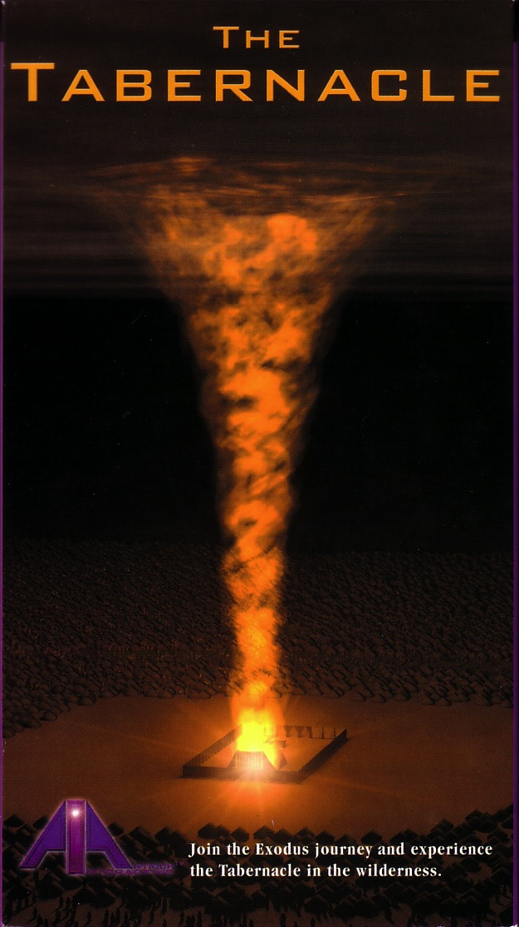

God's presence filled his new palace!
Then the cloud covered the tent of meeting, and the glory of the LORD filled the tabernacle.
Exodus 40:34 ESV
Notes:
The tabernacle was more than a place where people would go to meet with God—it was God's palace where he dwelt!

Slide 17
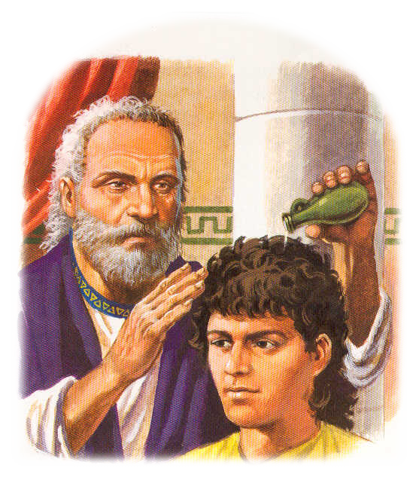
The Spirit also came upon judges, prophets, and kings in the Old Testament
Notes:
God's presence through his Spirit was not an indwelling in the OT. The Spirit was more of an "on-dwelling" for power for ministry, as when Samuel anointed David.

Slide 18

God's Presence Indwelt Solomon's Temple
Notes:
Later, once Solomon built the temple, God's Spirit filled it in such an amazing way that the priests at first could not do their work with the cloud filling the entire place before moving only into the Holy of Holies.

Slide 19
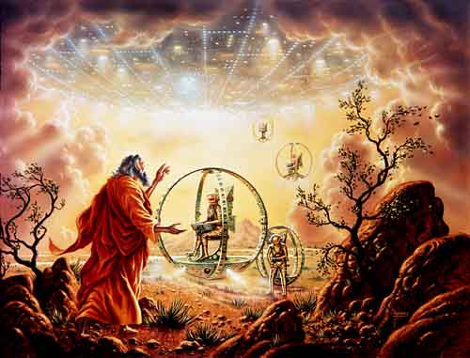
Ezekiel 1
Notes:
Now in Ezekiel 1, we see God’s presence in his glory appearing to Ezekiel.
Before Jerusalem’s fall, Ezekiel sees a vision of God’s glory to show his sovereignty and holiness as the basis for the book (Ezek 1).

Slide 20
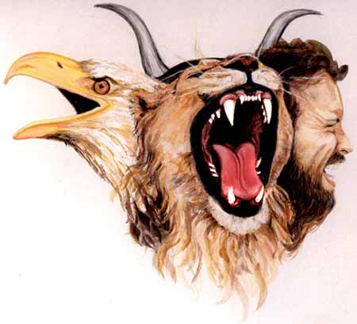
Creatures with Four Faces
(Ezek. 1:10 NLT)
367
"Each had a human face in the front, the face of a lion on the right side, the face of an ox on the left side, and the face of an eagle at the back."
Notes:
God’s glory is depicted in these amazing heavenly beings with four faces!
___________
"I believe that these special creatures symbolize God's creation and are related to God's covenant with Noah (Gen. 9:8–17). The faces of the living creatures parallel God's statement in Genesis 9:10—His covenant is with Noah (the face of the man), the fowl (the face of the eagle), the cattle (the face of the calf), and the beasts of the earth (the face of the lion)" (Wiersbe on Revelation 4:7).

Slide 21
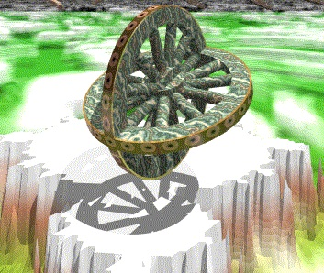
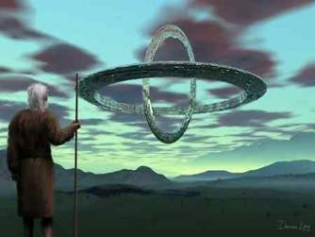
Ezekiel 1:15-16
"As I looked at these beings, I saw four wheels touching the ground beside them, one wheel belonging to each. ¹⁶The wheels sparkled as if made of beryl. All four wheels looked alike and were made the same; each wheel had a second wheel turning crosswise within it" (NLT).
Notes:
Each creature was next to an amazing wheel configuration with horizontal wheels within vertical wheels.

Slide 22
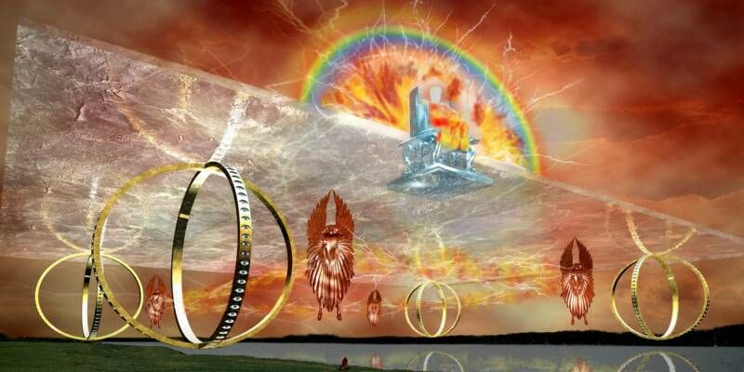
Ezekiel 1
Notes:
So before Jerusalem’s fall, Ezekiel sees a vision of God’s glory to show his sovereignty and holiness as the basis for the book (Ezek 1).
_____
Picture from http://ldsscriptureteachings.org/2012/05/02/ezekiels-vision-ezekiel-1-3/

Slide 23
Slides on
Ezekiel 2
Notes:
God calls Ezekiel as a prophet to judge Israel and the Spirit empowers him as Israel's watchman despite his trials (Ezek 2–3).

Slide 24
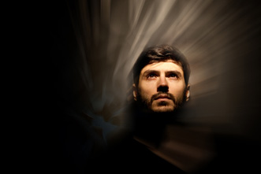
Ezekiel 2:3-4
"'Son of man,' he said, 'I am sending you to the nation of Israel, a rebellious nation that has rebelled against me. They and their ancestors have been rebelling against me to this very day. ⁴They are a stubborn and hard-hearted people. But I am sending you to say to them, "This is what the Sovereign LORD says!'" (NLT).
Notes:
God tells Ezekiel to fearlessly deliver his message despite Israel’s rebellion so they would know that he is a true prophet (2:1-7).
Ezekiel eats a scroll to receive God's word of judgment on the nation (2:8–3:3).

Slide 25
Slides on
Ezekiel 4
Notes:
God’s pre-exile judgment shows him justified for his glory departing the temple as Jerusalem is hopeless (Ezek 4–24).

Slide 26
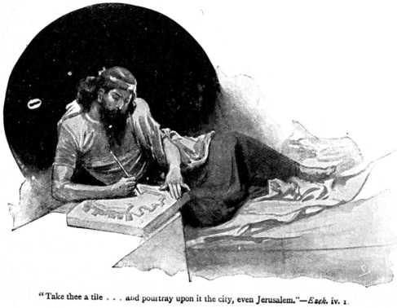
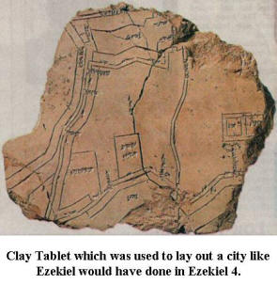
The Siege Signified (Ezek. 4)
"And now, son of man, take a large clay brick and set it down in front of you. Then draw a map of the city of Jerusalem on it" (Ezek. 4:1).
Notes:
He symbolizes Jerusalem under attack by using a clay tablet (4:1-3).
He symbolizes Israel's 390 years of sin and Judah's 40 years of sin by lying on his sides fourteen months (4:4-8).
He symbolizes eating unclean food cooked with cow dung to show Jerusalem's future scarcity of food and water (4:9-17).

Slide 27
Slides on
Ezekiel 5
Notes:
He symbolizes Jerusalem's division and destruction despite God's warnings by dividing and burning his hair (Ezek 5).

Slide 28
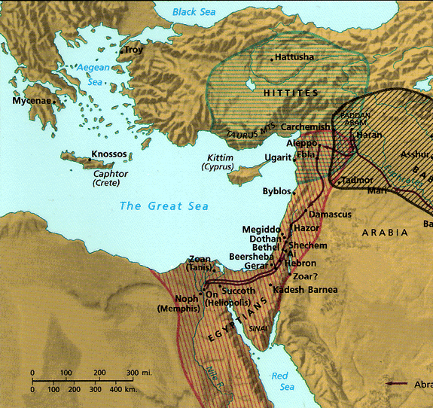
Israel's Strategic Location
26
Thought Question:
How has God placed you in a strategic place for His purposes?
"Thus says the LORD God: This is Jerusalem; I have set her in the center of the nations, with countries round about her"
Ezekiel 5:5
Notes:
God claims to have given Israel every opportunity to serve him—even the best piece of real estate in the known world.

Slide 29
Slides on
Ezekiel 8
Notes:
Sadly, four visions show God as just to judge Judah due to its disobedience and
culminate in the exit of God's glory (Ezek 8–11).

Slide 30

Solomon's Temple
502
Ezekiel 8:3-4
Notes:
“He reached out what seemed to be a hand and took me by the hair. Then the Spirit lifted me up into the sky and transported me to Jerusalem in a vision from God. I was taken to the north gate of the inner courtyard of the Temple, where there is a large idol that has made the Lord very jealous. 4 Suddenly, the glory of the God of Israel was there, just as I had seen it before in the valley” (Ezek 8:3-4 NLT).

Slide 31
Slides on
Ezekiel 9
Notes:
The execution of the godless in Jerusalem while sparing the righteous shows that God will end open rebellion (Ezek 9).

Slide 32
Solomon's Temple
502
Ezekiel 9:3
Notes:
“Then the glory of the God of Israel rose up from between the cherubim, where it had rested, and moved to the entrance of the Temple” (Ezek 9:3a NLT).

Slide 33
Slides on
Ezekiel 10
Notes:
God's glory departing the temple depicts how God cannot dwell among a wicked and idolatrous people (Ezek 10).

Slide 34
Solomon's Temple
502
Ezekiel 10:3-4
Notes:
“The cherubim were standing at the south end of the Temple when the man went in, and the cloud of glory filled the inner courtyard. 4 Then the glory of the Lord rose up from above the cherubim and went over to the door of the Temple. The Temple was filled with this cloud of glory, and the courtyard glowed brightly with the glory of the Lord” (Ezek 10:3-4 NLT).

Slide 35
Solomon's Temple
502
Ezekiel 10:18-19
Notes:
“Then the glory of the Lord moved out from the door of the Temple and hovered above the cherubim. 19 And as I watched, the cherubim flew with their wheels to the east gate of the Lord’s Temple. And the glory of the God of Israel hovered above them” (Ezek 10:18-19 NLT).

Slide 36
Slides on
Ezekiel 11
Notes:
Jerusalem will be judged for its wicked rulers and the captives restored after the removal of God's glory (Ezek 11).

Slide 37

The Glory Leaving
502
656
Ezekiel 11:23
Notes:
“Then the glory of the Lord went up from the city and stopped above the mountain to the east” (Ezek 11:23 NLT).

Slide 38
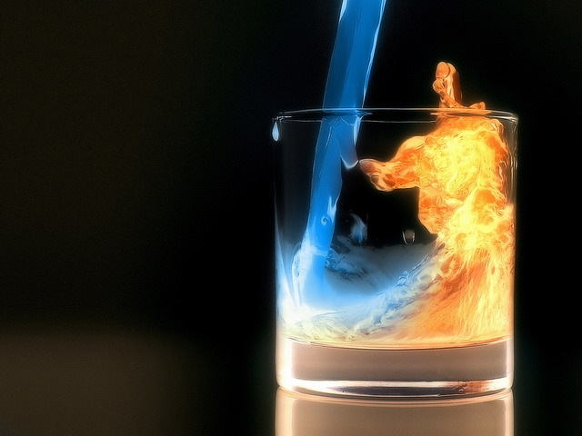
Be honest that while the Spirit is present, you may have quenched him.

Slide 39
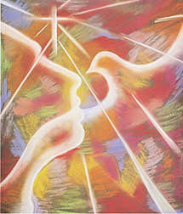
Indwelling of the Holy Spirit
xvi
II. C.
Romans 8:9
"You, however, are controlled not by the sinful nature but by the Spirit, if the Spirit of God lives in you. And if anyone does not have the Spirit of Christ, he does not belong to Christ."
Notes:
39
Paul taught that the Holy Spirit indwells every believer (Rom 8:9; Eph 1:13-14).

Slide 40
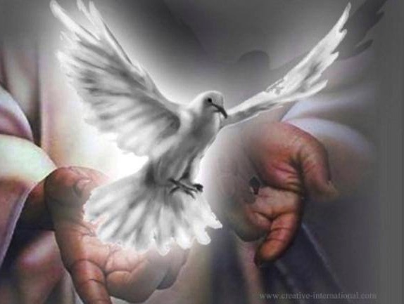
John 14:15-17
xvi
II. D.
¹⁵"If you love me, you will obey what I command. ¹⁶And I will ask the Father, and he will give you another Counselor to be with you forever — ¹⁷the Spirit of truth. The world cannot accept him, because it neither sees him nor knows him. But you know him, for he lives with you and will be in you."
Notes:
40
Jesus promised that the Holy Spirit would never leave us when we truly know him (John 14:15-17).
This indwelling is PERMANENT (forever) and for ALL believers!
________
BE-26-Ezekiel-40
OS-26-Ezek1-39-slide 152
NS-04-John12-21-slide 100

Slide 41
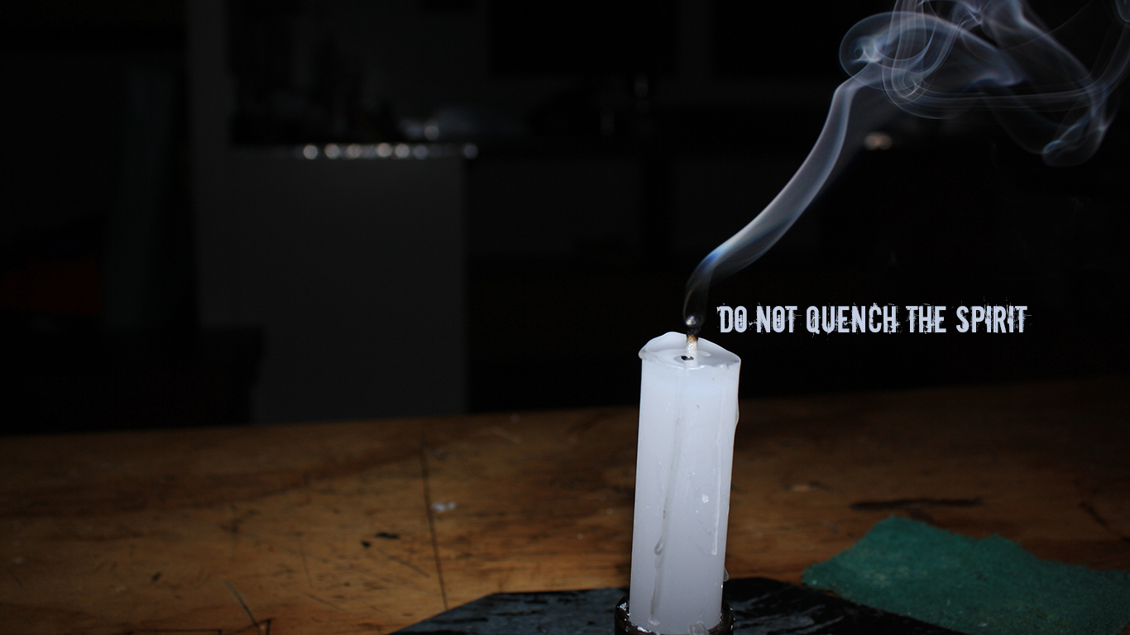
DO NOT QUENCH THE SPIRIT (1 THESS 5:19)
DO NOT QUENCH THE SPIRIT
Notes:
However, we can certainly quench the Spirit through sin (1 Thess 5:19).
“Do not put out the Spirit’s fire” (NIV) is more literal.
Is God trying to ignite a fire in you but you keep throwing cold water on him?
Do you want God’s glory in your life but also want to hold onto your sin?
It doesn’t work that way!

Slide 42
How can you be expectant of God’s glory once again in your life?
Notes:
What can you do to restore that sense of blessing that you used to have—those times when the presence of the Lord was real? This isn't simply a feeling, for that time may have been one of the most difficult periods of your life. Yet you knew that God was showing himself to you in new ways, there was a sense of expectancy at what he would do next. How can that return?

Slide 43
STEPS TO GOD'S GLORY
1—Admit that God’s glory left (Ezek 1–24).
ADMIT
Notes:
The sense of God's presence will not remain when we insist on sin.
Now what is the second step to expect God’s glory to return in your life?

Slide 44
STEPS TO GOD'S GLORY
2—Allow God to handle all rivals to his glory (Ezek 25–32).
ADMIT
ALLOW
Notes:
Know that the Shekinah presence of the LORD will purge all forms of darkness.

Slide 45
Slides on
Ezekiel 25
Notes:
God promised to destroy Israel’s enemies (Ezek 25–32).

Slide 46
Chart of Ezekiel
500
Sovereign Departing and Return of Glory
Glory Departs 1–24 |  | Nations Judged (No Glory) 25–32 |  |  | Glory Returns 33–48
Exile |  | Sovereignty Vindicated |  |  | Restoration
Judgment of Judah |  | Judgment of Nations |  |  | Blessing of Israel
Judah's Fall |  | Judah's Foes |  |  | Judah's Future
Before the Siege |  | During the Siege |  |  | After the Siege
Call in glory 1–3 | Pre-exile Hopeless-ness 4–24 | Ammon, Moab, Edom, Philistia 25 | Tyre and Sidon 26–28 | Egypt 29–32 | New Life 33–39 | New Order 40–48
Babylon (592-570 BC)
Notes:
Know that the Shekinah presence of the LORD will purge all forms of darkness (Ezek 25–32).

Slide 47
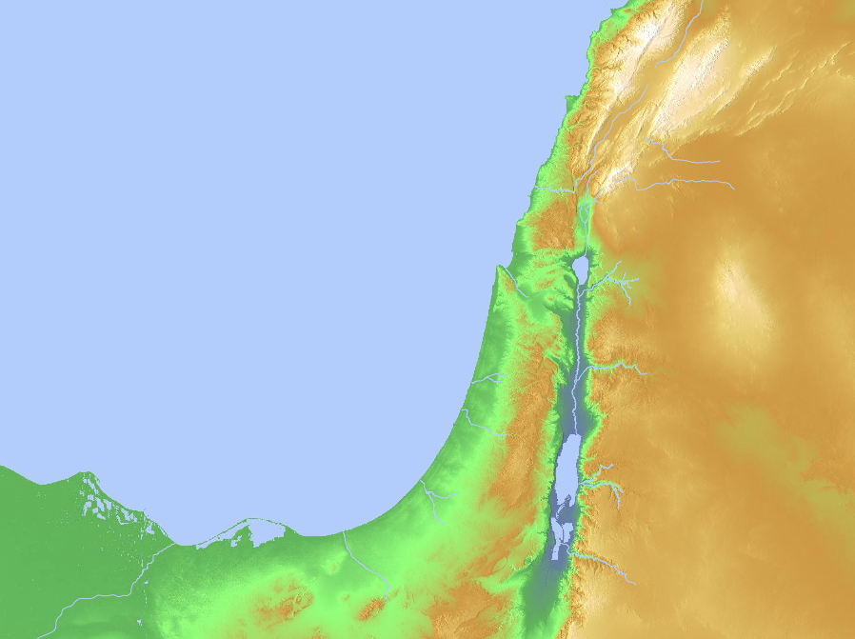
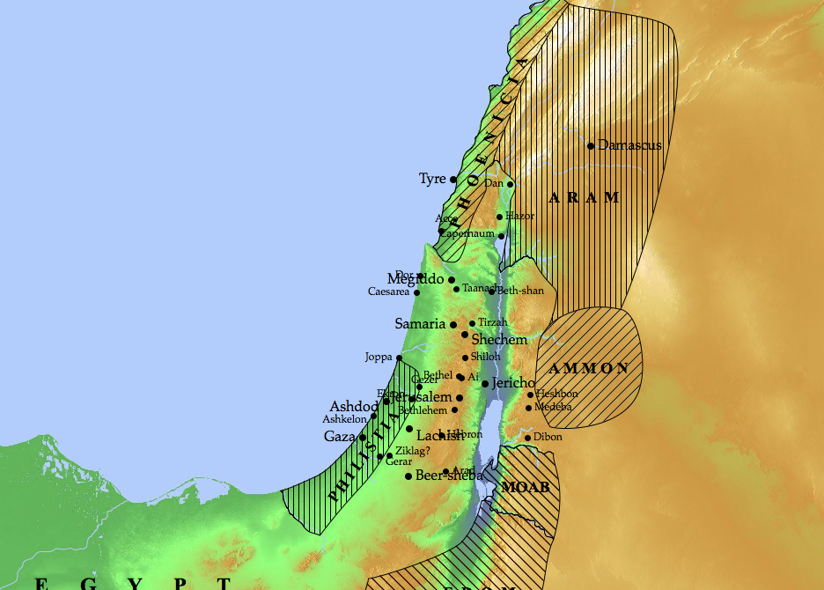
Nations to Be Judged (Ezek. 25–32)
Sidon
Tyre
Ammon
Philistia
Moab
Egypt
Edom
Notes:
God will judge Ammon for rejoicing at the temple’s destruction to show his sovereignty (25:1-7).
God will judge Moab for thinking that Israel was like all of the other nations to show God's sovereignty (25:8-11).
God will judge Edom for avenging Judah to show God's sovereignty (25:12-14).
God will judge Philistia for avenging Judah to show God's sovereignty (25:15-17).
God will judge Tyre so it will never be rebuilt due to its pride in its beauty, power, trade, and leaders to show God's sovereignty (26:1–28:19).
God will judge Sidon for maliciousness against Judah to show his sovereignty by gaining glory in the judgment (28:20-26).
God will judge Egypt by Nebuchadnezzar who will take exiles to Babylon to show God's sovereignty (Ezek 29–32; fulfilled in 571 BC).

Slide 48
Slides on
Ezekiel 28

Slide 49
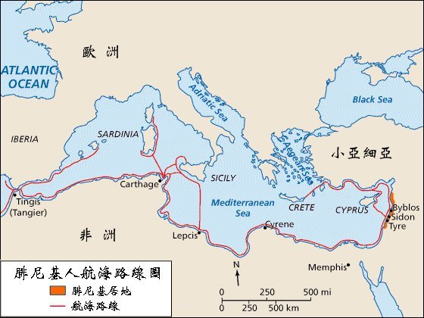
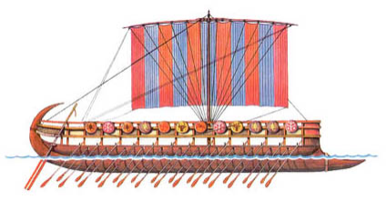
Phoenician Colonies
119
EUROPE
(Tarshish)
ASIA MINOR
AFRICA
Phoenician Shipping Routes
Land of Phoenicia
Trade Routes
Notes:
The Phoenicians were the master shipbuilders and sailors of antiquity. Their ability to conquer the seas gave them an empire of colonies spanning the Mediterranean. This brought untold wealth to them, despite being on the geographical edge of the "Great Sea," or the Mediterranean.

Slide 50
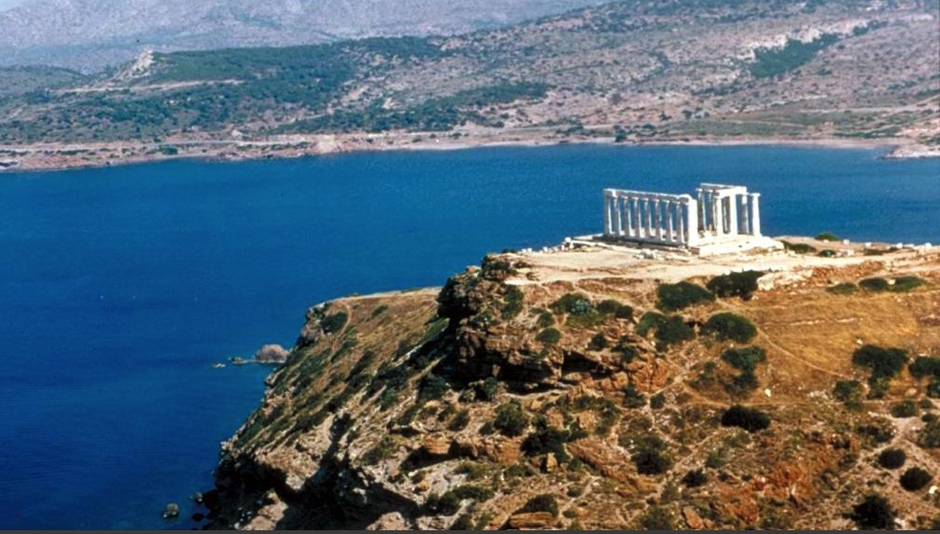
Poseidon's Temple
Son of man, give the prince of Tyre
this message from the Sovereign LORD:
"In your great pride you claim, 'I am a god!
I sit on a divine throne in the heart of the sea.'
But you are only a man and not a god,
though you boast that you are a god."
Tyre's king regarded himself as the god of the sea (Ezek. 28:2 NLT)
Notes:
Phoenicia's key city of Tyre was not humble about its influence and wealth. Its boasting about being the god of the sea led later to enshrine this in the temple of the Greek god of the sea, Poseidon.

Slide 51
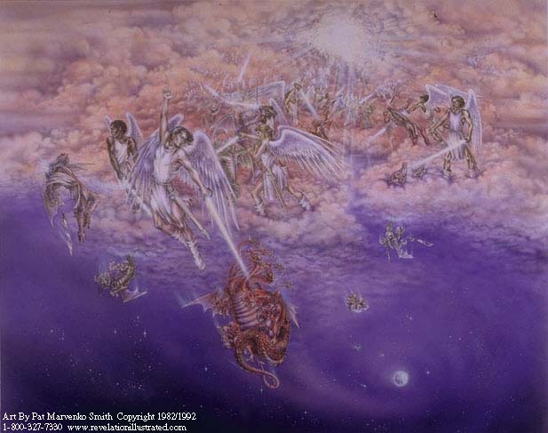
Satan cast down (cf. Rev. 12:7-13)
² "Son of man, give the prince of Tyre this message from the Sovereign LORD:
"In your great pride you claim, 'I am a god!
I sit on a divine throne in the heart of the sea.'
But you are only a man and not a god,
though you boast that you are a god" (Ezek. 28:2).
Notes:
Like the king of Tyre, Satan also boasted of divine rights. The true God threw both Satan and Tyre's prince down.

Slide 52
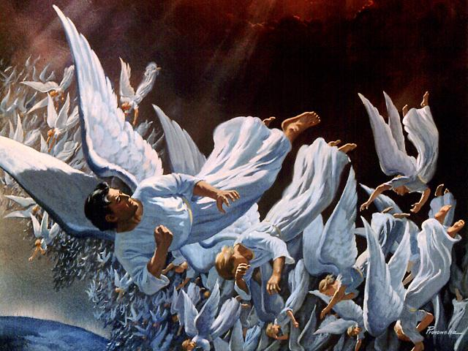
Fall of Lucifer, the Shining Star (cf. Rev. 12:7-9)
3 You regard yourself as wiser than Daniel
and think no secret is hidden from you.
4 With your wisdom and understanding you have amassed great wealth—
gold and silver for your treasuries.
5 Yes, your wisdom has made you very rich,
and your riches have made you very proud" (Ezek. 28:3-5)
Notes:
Daniel's name had already become proverbial, despite him being contemporary to Ezekiel.
Sadly, wealth and beauty and power often bring pride—first true of Satan and now true on earth.

Slide 53
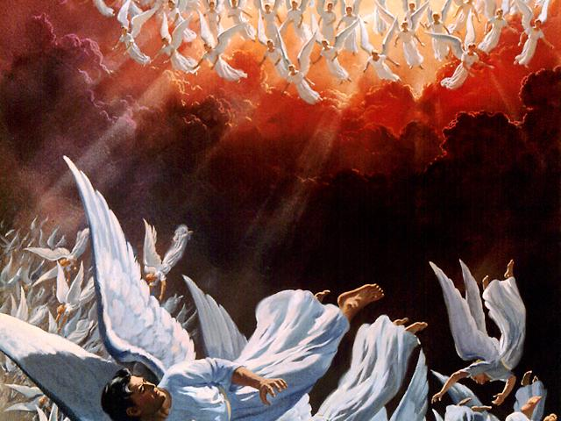
The angels pursue
"You were the model of perfection, full of wisdom and exquisite in beauty. ¹³ You were in Eden, the garden of God… ¹⁵You were blameless in all you did from the day you were created until the day evil was found in you.
¹⁶Your rich commerce led you to violence,
and you sinned.
So I banished you in disgrace
from the mountain of God.
I expelled you, O mighty guardian,
from your place among the stones of fire.
¹⁷Your heart was filled with pride
because of all your beauty.
Your wisdom was corrupted
by your love of splendor.
So I threw you to the ground and
exposed you to the curious gaze of kings"
(Ezek. 28:12-17)
Notes:
The pride of the king of Tyre reflected that of Lucifer himself.

Slide 54

God’s glory will not shine with competitors in your life.
Notes:
One wonders why Israel ever trusted any of these nations that were doomed themselves.
But the same question can be asked of us: Why do we trust anything or anyone other than Almighty God? Why trust something weaker that does not have our best interest in mind?
Who will be king in your life?

Slide 55
How can you be expectant of God’s glory once again in your life?
Notes:
What can you do to restore that sense of blessing that you used to have—those times when the presence of the Lord was real? This isn't simply a feeling, for that time may have been one of the most difficult periods of your life. Yet you knew that God was showing himself to you in new ways, there was a sense of expectancy at what he would do next. How can that return?

Slide 56
STEPS TO GOD'S GLORY
1—Admit that God’s glory left (Ezek 1–24).
ADMIT
Notes:
The sense of God's presence will not remain when we insist on sin.

Slide 57
STEPS TO GOD'S GLORY
2—Allow God to handle all rivals to his glory (Ezek 25–32).
ADMIT
ALLOW
Notes:
Know that the Shekinah presence of the LORD will purge all forms of darkness.

Slide 58
STEPS TO GOD'S GLORY
3—Anticipate God’s glory to return (Ezek 33–48).
ADMIT
ALLOW
ANTICIPATE
Notes:
Live as if the future really does include God’s blessing once again.

Slide 59
Chart of Ezekiel
500
Sovereign Departing and Return of Glory
Glory Departs 1–24 |  | Nations Judged (No Glory) 25–32 |  |  | Glory Returns 33–48
Exile |  | Sovereignty Vindicated |  |  | Restoration
Judgment of Judah |  | Judgment of Nations |  |  | Blessing of Israel
Judah's Fall |  | Judah's Foes |  |  | Judah's Future
Before the Siege |  | During the Siege |  |  | After the Siege
Call in glory 1–3 | Pre-exile Hopeless-ness 4–24 | Ammon, Moab, Edom, Philistia 25 | Tyre and Sidon 26–28 | Egypt 29–32 | New Life 33–39 | New Order 40–48
Babylon (592-570 BC)
Notes:
Live as if the future really does include God’s blessing once again (Ezek 33–48).

Slide 60
Slides on
Ezekiel 33

Slide 61
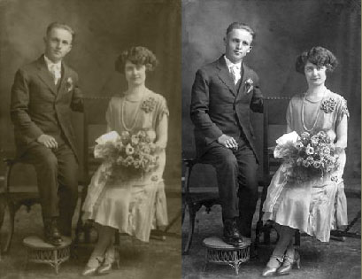
Restoration
Q: Why must there be restoration?
A: God promised to restore to Israel:
-Land
-New heart (a heart of flesh)
-Ability to keep His word

Slide 62
Slides on
Ezekiel 36

Slide 63
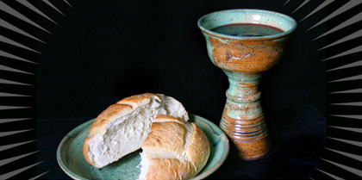
The Glory of the
New Covenant

Slide 64
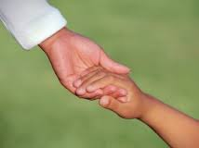
The New Covenant in Ezekiel 36
Restoration to the land (36:24, 28, 33)
Cleansing from sin (36:25)
A responsive heart (36:26)
Indwelling of the Spirit (36:27)
Motivation and ability for obedience (36:27)

Slide 65
Slides on
Ezekiel 37
Notes:
Judah’s "deadness" will be restored to fulfill the Land Covenant (Deut. 30:1-10), begun in AD 1948 in the State of Israel (37:1-14).

Slide 66
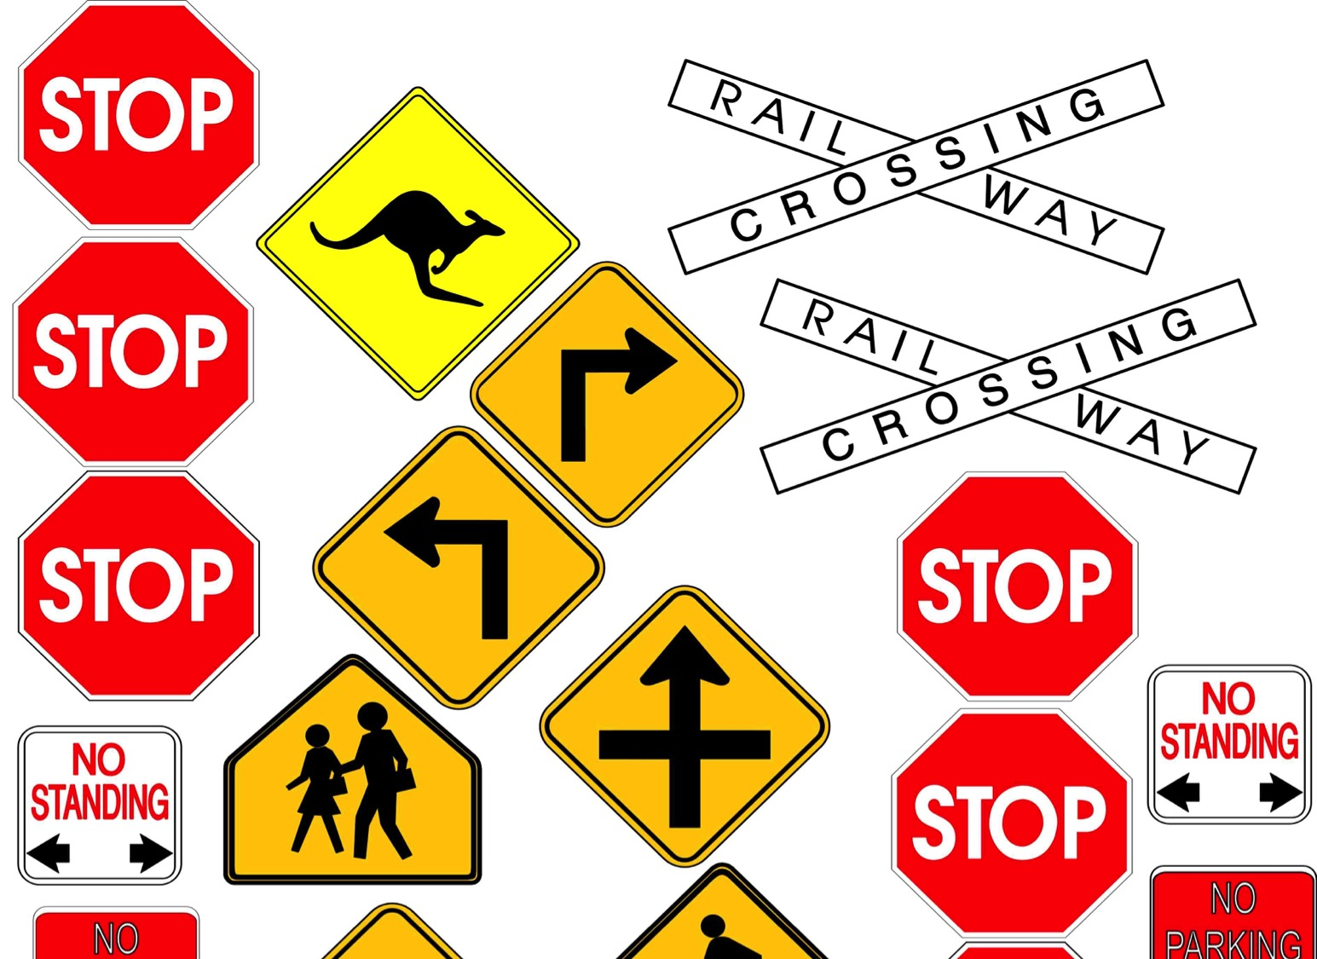
When are the signs of Christ's return?
They come in the Tribulation
Notes:
People sometimes ask me if there are any fulfilled prophecies that need to precede the Rapture. Not really. We don’t need to see any signs as the Rapture will take us by surprise. The signs relate to the Tribulation to follow. But think about this idea…

Slide 67
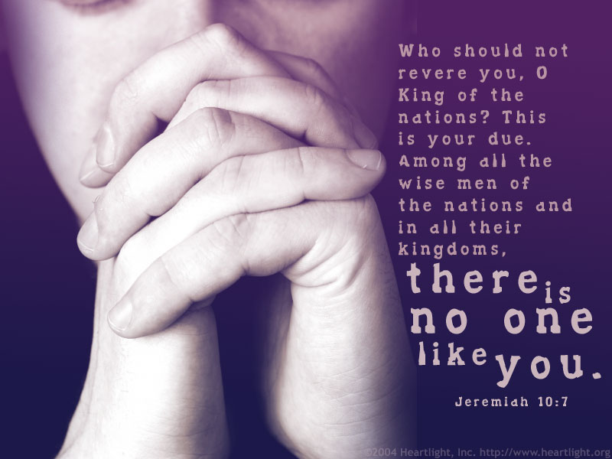
But can God restore Israel as a nation?
508

Slide 68
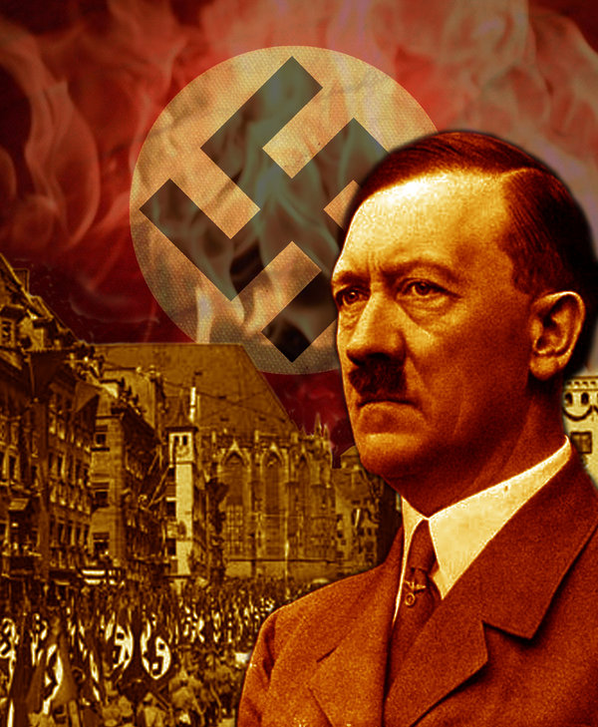
Hitler motivated the Jews to go to their homeland!
Notes:
The very opposite happened to what Hitler tried to do. He sought to kill the Jews and pushed them out of his land.

Slide 69
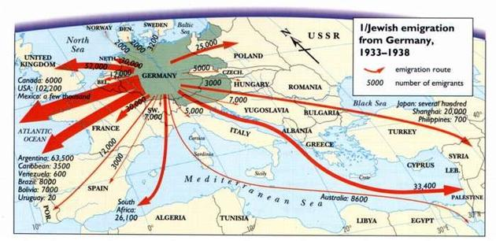
Hitler motivated the Jews to go to their homeland!
Jewish emigration from Germany
1933-1938
Route
Number
Notes:
Hitler sought to eradicate the Jews, but God sought to eradicate Hitler. He committed suicide in 1945 and three years later the Jews established their homeland in Israel! God told Abraham, "I will bless those who bless you and curse those who curse you" (Gen 12:3). Hitler's attempt to curse the Jews led to him being cursed.

Slide 70

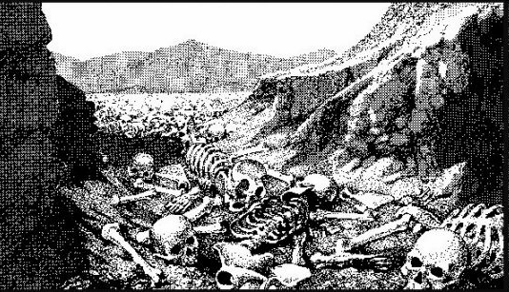
The Dry Bones of Ezekiel 37
508
What do they mean?
When is the fulfillment?
Notes:
Ezekiel 37 has one of the most amazing depictions in Scripture with bones coming to life.

Slide 71
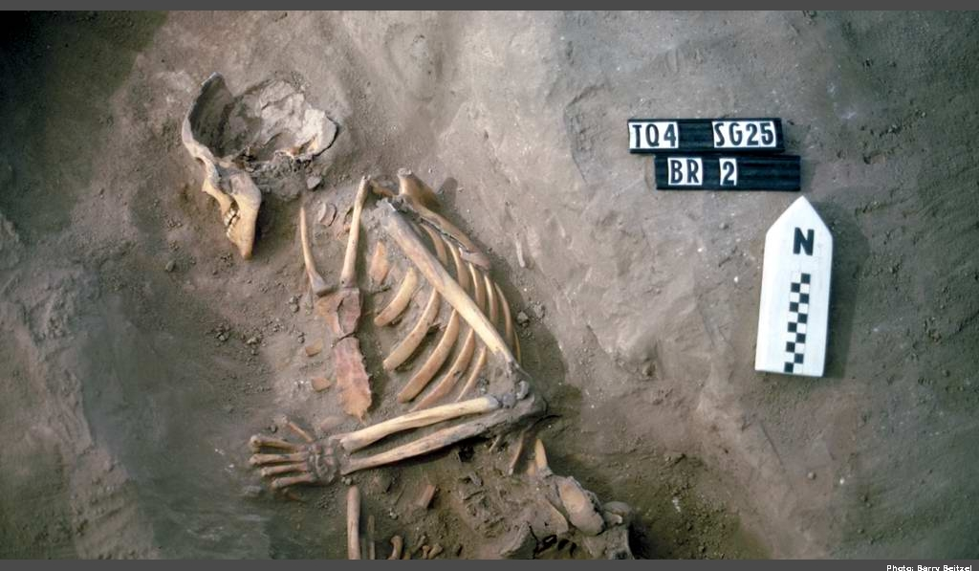
The Valley of Dry Bones (Ezek. 37)
Notes:
Imagine a skeleton standing up on its own, growing flesh, and then coming alive.

Slide 72
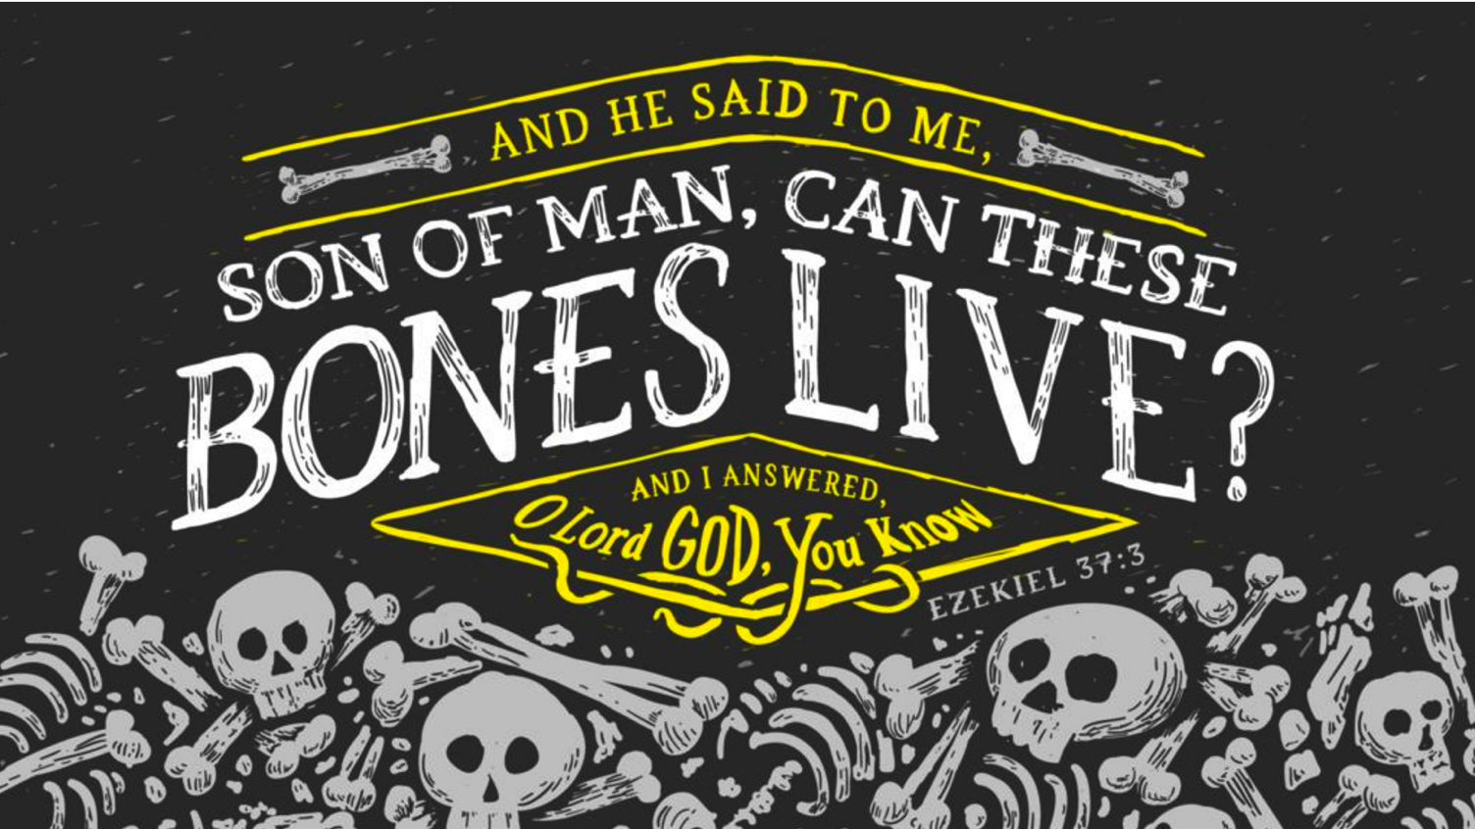
Son of man, can these bones live?
* Don't try that on the final exam
Notes:
The angel asked Ezekiel this question—and his doubt is shown by convincing the angel to answer his own question.

Slide 73
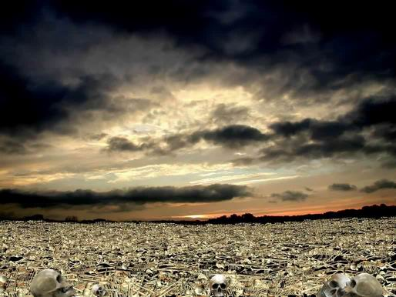
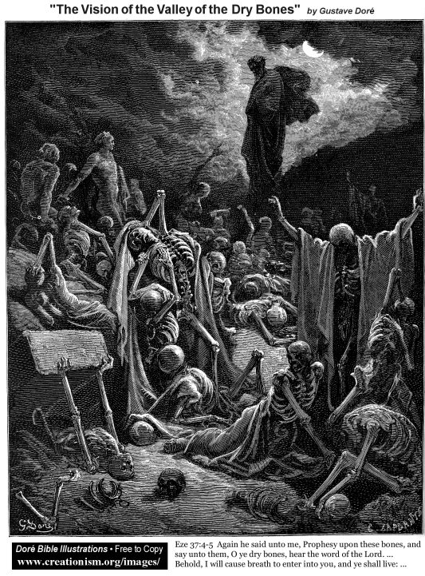
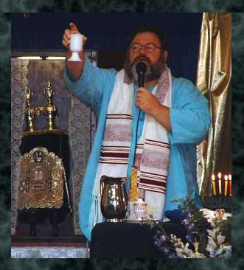
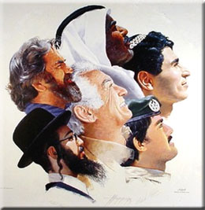
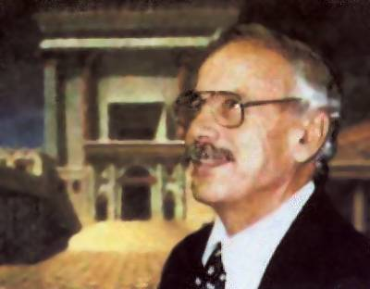
The Valley of Dry Bones (Ezek. 37)
Stage 1:
Return in Unbelief
Stage 2:
Trust in Messiah
Notes:
God predicted a two-stage return to the land—first in unbelief…
• but then later they will believe in a single day (Zech 3:9; 9:16).

Slide 74

A Hebrew Play on Words
"Prophesy to the
breath" (37:5, 9)
"Prophesy to the
Spirit" (37:14)
=
Hebrew insert
"breath, wind, Spirit"
Gen. 2:7
Greek insert
"breath, wind, Spirit"
John 3:5, 8; 2 Thess. 2:8
=
Notes:
Amazingly, the same three meanings of the Hebrew ruah are replicated in the Greek pneuma.
This probably is not true of any other Hebrew and Greek words.
So the angel told Ezekiel twice to prophesy to the ruah, but it is correct to translate it as "Spirit" the second time.
The point, of course, is that the Spirit gives life and breath to individuals—and will do so to Israel also in the last days.

Slide 75

Exiles & Returns
508
Exile
to
Babylon
by
King
Nebuchad-nezzar
(586 BC)
Exile
to
Nations
by
Roman
General
Titus
(AD 70)
Return
to
Israel
by
King
Cyrus
(516 BC)
Return
to
Israel
by
Zionists
(AD 1948)
Ezekiel's Time (597 BC)
But how do we know Ezekiel 37 relates to this second exile and return?
Notes:
After Ezekiel's time, the Jews would experience TWO EXILES and TWO RETURNS in the future.
How do we know he prophesied the SECOND RETURN?
Slide 244 notes these elements from Ezek 36–37:
Re-gathering of Israel back into their own land
Reuniting of two nations into one
Ruling of Israel under one king
Rescuing of Israel from her sins
Recommitment of Israel to obey Yahweh's laws
Reestablishing covenant of peace with Israel
Residing of Yahweh in Israel's midst
Recognition of Yahweh's holiness by all

Slide 76
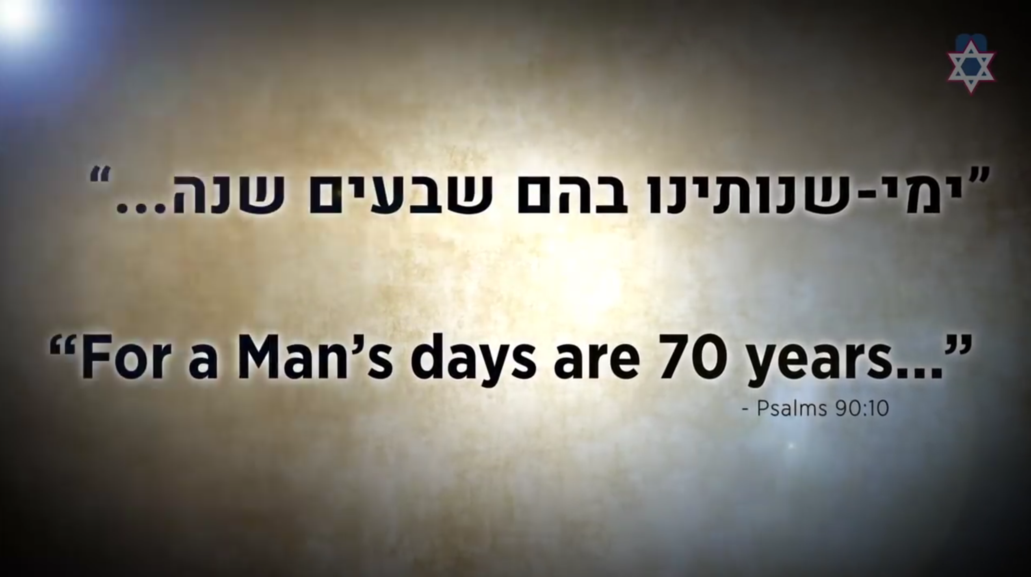
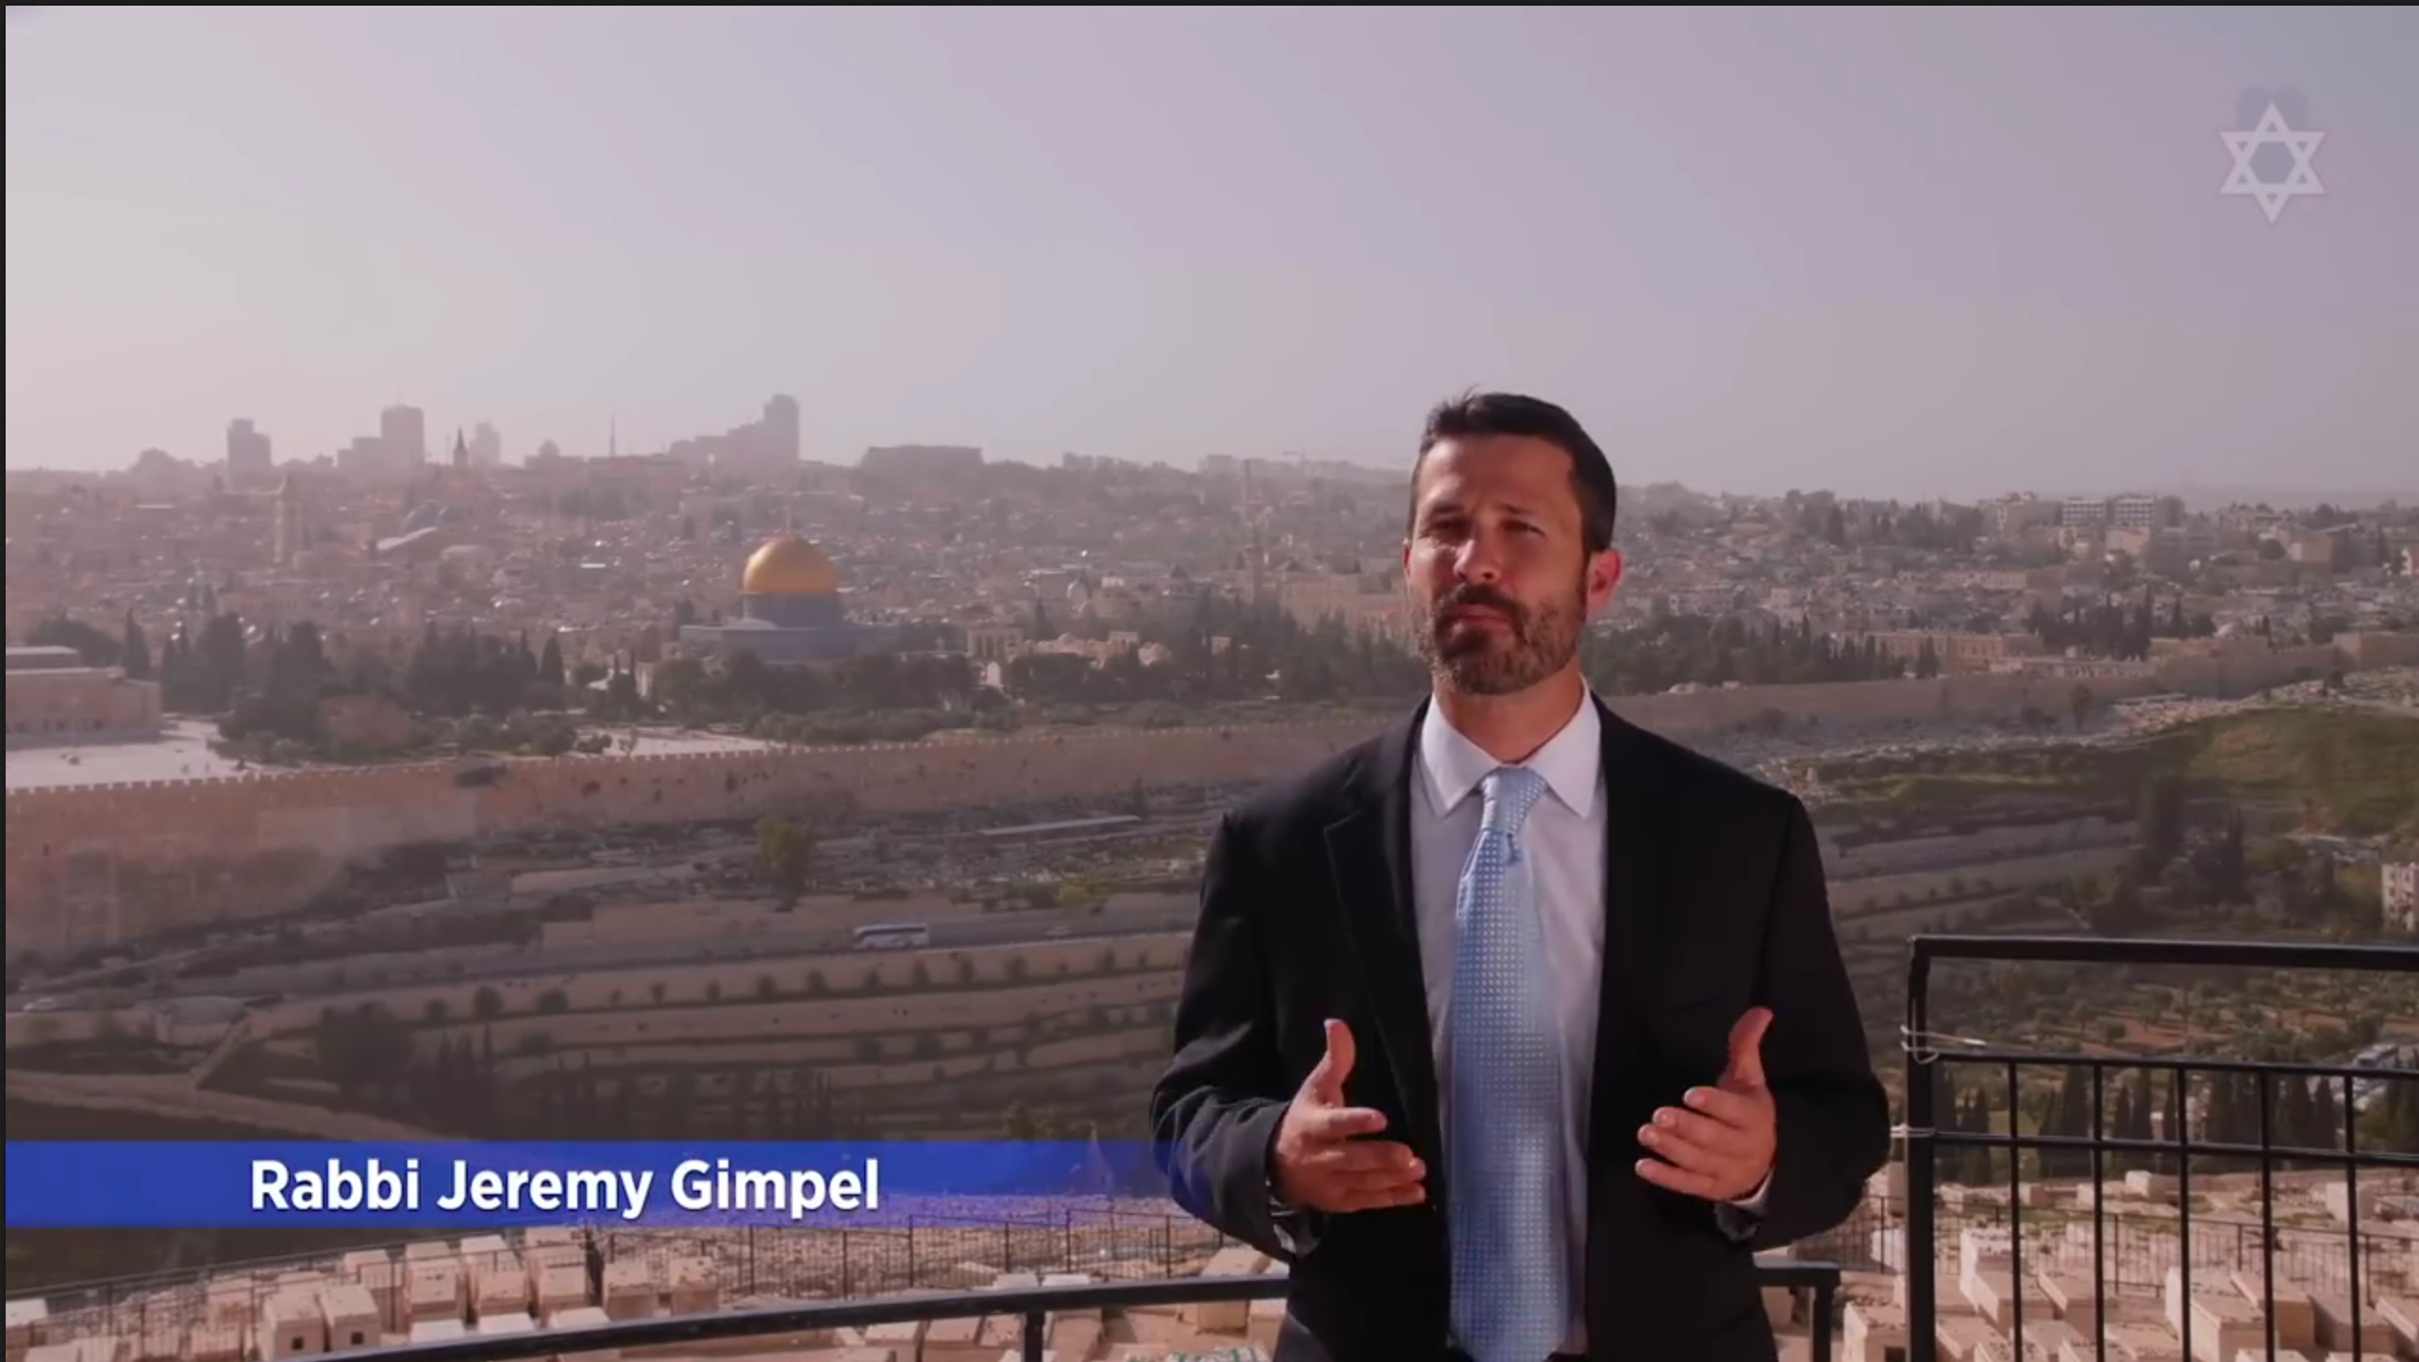
In 2018 Israel celebrated 70 years of return!
Notes:
26-Ezekiel-Israel's 70th - Do You See The Miracle.mp4 at
http://biblestudydownloads.org/files/eng/os/26-Ezekiel-Israel's%2070th%20-%20Do%20You%20See%20The%20Miracle.mp4

Slide 77

Theodore Herzl
First Zionist Congress
1897
Notes:
That 1948 return actually began with the First Zionist Congress by Theodore Herzl in 1897.

Slide 78


To return to the land of Israel, Jews had to become a nation once again (1948)

Slide 79

Israel regained ancient borders in stages (1946-2000)
http://tema1tema.blogspot.com/2011/05/stop-israeli-war-crimes-yells-woman-at.html

Slide 80

Jewish Population by Major Regions (1948-2012)
14
Oceania
7 million outside Israel
Latin America
12
North America
10
10 million outside Israel
South Africa
11 million outside Israel
8
North Africa
Millions
Other Asia
6
FSU Asia
God is bringing His people back!
4
FSU Europe
East Europe
2
West Europe
0
Israel
1948
1970
2012
––Jews for Jesus
Notes:
David Brickner, "Israel's Salvation" (Jews for Jesus Publication, 8 July 2013) at http://www.jewsforjesus.org/images/population-israel-800w.jpg accessed 17 July 2013

Slide 81
Slides on
Ezekiel 38

Slide 82

Opposition to Israel will only increase
Notes:
33-Micah-Netanyahu UN Speech Slams Antisemitism Sep 22 2016.mp4 at http://biblestudydownloads.org/files/eng/os/33-Micah-Netanyahu%20UN%20Speech%20Slams%20Antisemitism%20Sep%2022%202016.mp4

Slide 83

Who is Gog?
Many suggestions have been made.
Land areas of Meshech and Tubal – cover areas in Turkey, Russia and Iran
Is Gog and Magog in Ezek 38–39 the same as the Gog and Magog in Rev 20:8?
Ezekiel 38–39

Slide 84
A Dispensational Timeline
473
Great
White
Throne
(Rev. 20:11-14)
Rapture
(1 Thess. 4:13-18)
2nd Advent
(Zech. 14:3-5)
Church Age
Tribulation
(Zech. 14:1-2)
Millennium
(Zech. 14:6-21)
Gog & Magog
(Armageddon)
(Ezek. 38–39)
Gog and Magog
Revisited
(Rev. 20:7-10)
Notes:
84

Slide 85
Reasons Ezekiel's Gog & Magog is different from
John's Gog & Magog in Revelation 20:7-10
512a
Revelation 20:8
Gog & Magog = nations
Revelation 20:8
Gog & Magog v. Messiah
Revelation 20:10
Satan cast into lake of fire
Revelation 20:7-10
Events fit after millennium in 20:1-6
Ezekiel 38:2
Gog = Prince
Magog = Land
Ezekiel 38:16
Gog against Israel
Ezekiel 39:17-20
Great feast of corpses
Ezekiel 38:39
Events fit before restored
millennial temple (ch. 40)

Slide 86
Slides on
Ezekiel 39

Slide 87

When Will Gog's Invasion Occur?
511b-512
Differing Views:
Passage entirely symbolic
Before Tribulation
Middle of Tribulation
End of Tribulation
Between end of Tribulation & Millennium
After Millennium
Combination of 4th and 6th views

Slide 88
Slides on
Ezekiel 40

Slide 89

Ezekiel 40–48
Rick Griffith, Singapore Bible College
BibleStudyDownloads.org

Slide 90

Israel's Restored Community
New Temple (40–43)
New Worship (44–46)
New Territories (47–48)

Slide 91

The Five Sections
517
1. Outer Court - 40:17-19
2. Inner Court - 40:44-47
3. The Temple or Sanctuary - 41:1-26
4. Wall around the outside of the temple - 40:5 (42:15-20; 45:2)
5. Fifty cubits of open space - 45:2
www.pauljab.net/temple/ TemplePictures.html

Slide 92
Slides on
Ezekiel 43

Slide 93

God's Glory Will Return!

Slide 94

The Glory Returns
502
656
Ezekiel

Slide 95

The Eastern Gate (Ezek. 43:1-4 NLT)
"After this, the man brought me back around to the east gateway. ²Suddenly, the glory of the God of Israel appeared from the east. The sound of his coming was like the roar of rushing waters, and the whole landscape shone with his glory. ³This vision was just like the others I had seen, first by the Kebar River and then when he came to destroy Jerusalem. I fell face down on the ground. ⁴And the glory of the LORD came into the Temple through the east gateway."

Slide 96
Slides on
Ezekiel 44

Slide 97

Entering the East Gate (44:1-3)
519
Prince David entering the outer east gate from the porch on the outer court side
Wayne ODonnell • "Ezekiel 40–48: Tour of Ezekiel's Temple" • http://bible.ag/en/enezekieltranscript.htm
Notes:
"See Picture #26. Prince David entering the outer east gate from the porch on the outer court side. The gate is sealed up on the outside because the shekinah glory entered the temple compound through that gate. The light on the steps is shining from the shekinah glory in the temple through the east inner gate behind him.
Ezekiel 44:1-3, "Then he brought me back the way of the gate of the outward sanctuary which looketh toward the east; and it was shut. Then said the LORD unto me; This gate shall be shut, it shall not be opened, and no man shall enter in by it; because the LORD, the God of Israel, hath entered in by it, therefore it shall be shut." The outside of the outer east gate will be sealed after the shekinah glory enters through it. This gate does not yet exist. People confuse it with the sealed eastern gate in Jerusalem today, and say it will be unsealed for Messiah to enter by. That is the opposite of what scripture teaches here, that a future gate will be sealed after the Messiah enters through it, with the shekinah glory.
"It is for the prince; the prince, he shall sit in it to eat bread before the LORD; he shall enter by the way of the porch of that gate, and shall go out by the way of the same." The prince gets to use this sealed gate to sit and eat in. He will have a nice view of the inner east gate and the temple from here, and be out of the sun. He has to enter and leave the gate through the porch because the outside doorway is sealed.
The prince is Prince David. He will be a king to Israel, but a prince to Yeshua, the King of Kings. Jeremiah 30:9, "They shall serve the LORD their God, and David their king, whom I will raise up unto them," along with all the other people whose bodies are resurrected before the kingdom is established.
Serving under David, in either the federal or tribal governments, will be the resurrected and glorified twelve apostles, including Paul in place of Judas. "And Jesus said unto them, Verily I say unto you, That ye which have followed me, in the regeneration when the Son of man shall sit in the throne of his glory, ye also shall sit upon twelve thrones, judging the twelve tribes of Israel," Mt19:28."
Wayne ODonnell, "Ezekiel 40–48: Tour of Ezekiel's Temple"
http://bible.ag/en/mr4web.html#EZanchor-anchor
Recorded December 30, 2007
Accessed 30 Aug 2016

Slide 98
Slides on
Ezekiel 46

Slide 99

Solomon's & Ezekiel's Temples Contrasted
518
Notes:
99

Slide 100

View from Above
517
6. Outer Court Northern Gateway - 40:20-23
7. Outer Court Eastern Gateway - 40:6-16
8. Outer Court Southern Gateway - 40:24-27
9. Inner Court Northern Gateway - 40:35-37
10. Inner Court Eastern Gateway - 40:32-34
11. Inner Court Southern Gateway - 40:28-31
www.pauljab.net/temple/ TemplePictures.html
Notes:
100

Slide 101

Ezekiel's temple won't fit on the present Temple Mount!
521
656
www.pauljab.net/temple/ TemplePictures.html

Slide 102




Which temple for Ezekiel?
520
Solomon
Zerubbabel/Herod
Three
Literal
Views
Conditional
Millennial
Church

Slide 103



Problems Either Way!
525
Premillennial:
Sacrifices for Sin
(Ezek. 40:39) in Light of Christ's Death
Amillennial:
Abandon Normal Hermeneutic for Gates, Doors, Walls, Sacrifices
Notes:
We should not stop the normal way we read words in Ezekiel just because we feel uncomfortable with the idea of future sacrifices. Spiritualizing these chapters leads to even greater problems in determining what is meant by these parts of the temple and sacrifices when the Bible does not tell us what else they mean other than the plain use of words and phrases.

Slide 104
Why Millennial Sacrifices?
527
Pre-Cross:
Looked toward Christ's Death
Post-Cross:
Look back on Christ's Death
Theocratic: like confession of sin (1 John 1:9)
Memorial: like Lord's Supper that looks back
Paul offered a temple sacrifice in AD 57 (Acts 21:26) without seeing a "digression problem"

Slide 105
Slides on
Ezekiel 47

Slide 106

The River from Ezekiel's Temple
(47:1-12)

Slide 107

The River & the Land (47:1)
519
The river that starts on the south side of the temple entrance
Wayne ODonnell • "Ezekiel 40–48: Tour of Ezekiel's Temple" • http://bible.ag/en/enezekieltranscript.htm
Notes:
"Ezekiel 47-48. The River and the Land
See Picture #32. The river that starts on the south side of the temple entrance.
Ezekiel 47:1, "Afterward he brought me again unto the door of the house," the temple, "and, behold, waters issued out from under the threshold of the house eastward: for the forefront of the house stood toward the east, and the waters came down from under from the right side of the house, at the south side of the altar." Picture #32 shows a trickle of water flowing from south side of the threshold of the temple. "The right side of the house" is the south side, since the temple faces east."
Wayne ODonnell, "Ezekiel 40–48: Tour of Ezekiel's Temple"
http://bible.ag/en/mr4web.html#EZanchor-anchor
Recorded December 30, 2007
Accessed 30 Aug 2016

Slide 108

The River from Ezekiel's Temple (47:1-12)
"Measuring as he went, he took me along the stream for 1,750 feet and then led me across. The water was up to my ankles"
(Ezek. 47:3 NLT).

Slide 109

The River from Ezekiel's Temple (47:1-12)
"He measured off another 1,750 feet and led me across again. This time the water was up to my knees"
(Ezek. 47:4a NLT).

Slide 110

The River from Ezekiel's Temple (47:1-12)
"After another 1,750 feet, it was up to my waist"
(Ezek. 47:4b NLT).

Slide 111

The River from Ezekiel's Temple (47:1-12)
"Then he measured another 1,750 feet, and the river was too deep to walk across. It was deep enough to swim in, but too deep to walk through"
(Ezek. 47:5 NLT).

Slide 112
Slides on
Ezekiel 48

Slide 113

Borders of the Land Promised to Abraham
531e
Syria
Lebanon
Israel
Jordan
Genesis 15:18
"On that day the LORD made a covenant with Abram, saying, 'To your offspring I give this land, from the river of Egypt to the great river, the river Euphrates'" (ESV)
India
Egypt
Notes:
God’s promised land stretched northeard from the small wadi of Egypt south in the Sinai to the large Euphrates River in the far north—a HUGE piece of real estate! When today’s boundaries are placed over this land we can see the struggle modern Israel has to claim land from Egypt, Lebanon, Syria and possibly even Jordan on the other side of the Jordan River.

Slide 114

Land Portions (48:1-7)
531e
Portions of land for the tribes of Israel going straight across from east to west. I have not tried to present accurate boundaries, but rather to show the general arrangement of the tribal portions. For example, the Golan Heights will probably be within the borders of Israel, though the picture doesn't show it that way.
Wayne ODonnell • "Ezekiel 40–48: Tour of Ezekiel's Temple" • http://bible.ag/en/enezekieltranscript.htm
Notes:
"See Picture #35. Portions of land for the tribes of Israel going straight across from east to west. I have not tried to present accurate boundaries, but rather to show the general arrangement of the tribal portions. For example, the Golan Heights will probably be within the borders of Israel, though the picture doesn't show it that way.
Northern Boundaries. Ezekiel 48:1, "Now these are the names of the tribes. From the north end to the coast of the way of Hethlon, as one goeth to Hamath, Hazarenan, the border of Damascus northward, to the coast of Hamath." Hamath is present day Hama in Syria. The northern border of Israel during the Messianic Kingdom will extend to about the present northern border of Lebanon. Present day Lebanon will be part of millennial Israel.
Seven Northern Tribes. Ezekiel 48:2-7, "These are his sides east and west; a portion for Dan. And by the border of Dan, from the east side unto the west side, a portion for Asher. And by the border of Asher, from the east side even unto the west side, a portion for Naphtali. And by ... Naphtali, ... a portion for Manasseh. And by ... Manasseh, ... a portion for Ephraim. And by ... Ephraim, ... a portion for Reuben. And by ... Reuben, ... a portion for Judah." Each tribe's portion will extend completely across from the western boundaries, like the Jordan River, to the Mediterranean Sea.
Today most Jewish people don't know which tribe they are descended from, the exception being some descendants of priests and Levites who have family names like Cohen, the Hebrew word for priest, or Levi. But now we have genetic tests, and anyway the Lord knows the genealogy of everyone. Jewish tradition says that when Elijah returns before the Messianic Kingdom is set up, he will provide Jewish people with their tribal identities.
So although physical things like genealogies have no relevance in the church age or for spiritual salvation; in the future, genealogies will be important again, at least in determining how physically close to the shekinah glory a person will be able to live.
Some Gentiles, possibly proselytes, will dwell among the tribes in the land, "in what tribe the stranger sojourneth, there shall ye give him his inheritance," Ez47:23. And some Gentiles in their natural bodies during the kingdom will become servants to Israelites so they can live in the land. "Strangers shall stand and feed your flocks, and the sons of the alien shall be your plowmen and your vinedressers ... For your shame, ye shall have double [blessing, joy, inheritance, etc.]," Is60:1-61:7."
Wayne ODonnell, "Ezekiel 40–48: Tour of Ezekiel's Temple"
http://bible.ag/en/mr4web.html#EZanchor-anchor
Recorded December 30, 2007
Accessed 30 Aug 2016

Slide 115


Tribal Redistribution
Dan
531e
146
147
Asher
After Conquest
(Josh. 13)
Millennial Israel
(Ezek.
47–48)
Naphtali
Manasseh
Ephraim
Reuben
Judah
Leaders & Temple
Benjamin
Simeon
Issachar
Millennial Jerusalem in Ezekiel 47 retains its central location but is south (not north) of Judah
Zebulun
Gad

Slide 116

Things are not falling apart—they are falling together.
Notes:
God has restored Israel and is preparing nations to attack Israel to fulfill Ezek 38–39.
Serve the Lord Jesus like he really is coming back to reward you.

Slide 117

Ezekiel 38 shows a Turkey-Iran-Russia Alliance Against Israel
TEXT

Slide 118

Ezekiel 38 shows a Turkey-Iran-Russia Alliance Against Israel
TEXT

Slide 119

Trilateral Summit on 7 Sept 2018
TEXT
Notes:
Watchman Report: Why Russia, Iran, and Turkey have to make their move against Israel very soon.
Why Russia, Iran, and Turkey have to make their move against Israel very soon!
https://ai-tube.com/videoai/Th_XDmQA2Cp
Accessed 23 Sep 2018
Pastor J.D. talks about why Russia, Iran, and Turkey have to make their move against Israel very soon.
http://www.calvarychapelkaneohe.com/
All the signs of the last days are converging at the same time. Bible Prophecy is happening right before our eyes and like birth pains, the predicted events are happening more frequently and more intently. Never, in the history throughout the world have so many forces, including economic, scientific, techno-logic, ecologic, cultural, geopolitical, moral, spiritual and religion, converged together to bring this world that's already teetering over the edge into the abyss, to a point of no return. Jesus said when you see all these signs happening, know that I am near, even at the door.
For more in-depth studies, commentary, and analysis of Bible Prophecy and End Times events visit our web site www.prophecyupdate.com and sign-up for our free newsletter…

Slide 120

Third Temple Plans are in Place Now
TEXT

Slide 121

The Priesthood is Being Prepared
TEXT

Slide 122

A Red Heifer was born 28 August 2018
Jewish Group Says End Times Biblical Prophecy Fulfilled, Flawless "Red Heifer" Could Signal the Third Temple
“In Jewish theology, the red heifer is essential to the rebuilding of the third Holy Temple in Jerusalem and will be needed to be sacrificed to complete the ritual of purification for the Temple.”
Notes:
The Temple Institute has announced the birth of a flawless all-red heifer that could pave the way for the fulfillment of a major End Times biblical prophecy.
The reddish-colored female calf was reportedly born in Israel on August 28 and is being raised in accordance with the Jewish laws of the Torah, according to the Temple Institute.
In Jewish theology, the red heifer is essential to the rebuilding of the third Holy Temple in Jerusalem and will be needed to be sacrificed to complete the ritual of purification for the Temple.
Related
Sounding the Shofar, a Call to Repentance
A Sign of the End Times? Another Blood Moon Appears July 27
'The Trump Prophecy' Hitting Theaters: How God Told This Firefighter His Plan for America
'Super Blue Blood Moon' Over Jerusalem: Does It Have Prophetic Significance?
Jews believe this event is part of the process that would mark the coming of the Messiah and the final judgment.
But the significance of the red heifer also relates to Christians who believe the completion of the third Temple is a symbol heralding the second coming of Jesus Christ.
READ: Sounding the Shofar, a Call to Repentance
It is claimed there have only been nine true red heifers, and the 10th will herald the construction of the third Temple. Several red heifers have been born in the past, but have been disqualified for not meeting the Biblical requirements.
Israel News reports this year's newborn red heifer was certified by a board of rabbis one week after its birth.
"If there has been no red heifer for the past 2,000 years, perhaps it is because the time was not right; Israel was far from being ready," Rabbi Chaim Richman, the international director of the Temple Institute, wrote on their website. For one thing, the modern state of Israel wasn't reestablished until 1948. This year marked the 70th anniversary of that historic event.
Rabbi Richman continued, "But now what could it mean for the times we live in, to have the means for purification so close at hand? With the words of Maimonides in mind, we cannot help but wonder and pray: If there are now red heifers, is ours the era that will need them?"
To meet requirements, the heifer must be born from a natural birth and be entirely red with no more than two non-red hairs on its body. It must also never have been used for any labor or have been impregnated.
The Bible refers to the red heifer in Numbers 19 which begins, "And the Lord spoke to Moses and Aaron, saying: This is the ordinance of the Torah which the Lord has decreed, saying, Speak to the children of Israel and have them bring you a red heifer without defect, in which there is no blemish, and upon which never came a yoke..."
The rabbis emphasized that the heifer could, at any time, acquire a blemish rendering it unsuitable. They will be inspecting the calf periodically to verify its condition.
Jewish tradition requires the heifer to be three-to-four years old when it is used for the purification and rebuilding the Temple, so that could also affect a possible End Times timeline.
Meanwhile, there's a verse about that heifer and purification in the New Testament of the Bible, and it's all about salvation.
"The blood of goats and bulls and the ashes of a heifer sprinkled on those who are ceremonially unclean sanctify them so that they are outwardly clean. How much more, then, will the blood of Christ, who through the eternal Spirit offered himself unblemished to God, cleanse our consciences from acts that lead to death, so that we may serve the living God!" - ‭‭Hebrews‬ ‭9:13-14‬ ‭NIV
09-16-2018 by Kayla Root
CBN News
https://www1.cbn.com/cbnnews/world/2018/september/jewish-group-says-end-times-biblical-prophecy-fulfilled-first-flawless-red-heifer-could-signal-the-third-temple
Accessed 23 Sep 2018

Slide 123
How can you be expectant of God’s glory once again in your life?
Notes:
What can you do to restore that sense of blessing that you used to have—those times when the presence of the Lord was real? This isn't simply a feeling, for that time may have been one of the most difficult periods of your life. Yet you knew that God was showing himself to you in new ways, there was a sense of expectancy at what he would do next. How can that return?

Slide 124
STEPS TO GOD'S GLORY
1—Admit that God’s glory left (Ezek 1–24).
ADMIT
Notes:
The sense of God's presence will not remain when we insist on sin.

Slide 125
STEPS TO GOD'S GLORY
2—Allow God to handle all rivals to his glory (Ezek 25–32).
ADMIT
ALLOW
Notes:
Know that the Shekinah presence of the LORD will purge all forms of darkness.

Slide 126
STEPS TO GOD'S GLORY
3—Anticipate God’s glory to return (Ezek 33–48).
ADMIT
ALLOW
ANTICIPATE
Notes:
Live as if the future really does include God’s blessing once again.

Slide 127
Expect God to discipline and restore you for his glory.
ADMIT
ALLOW
ANTICIPATE
MAIN IDEA OF EZEKIEL
Notes:
Live as if the future really does include God’s blessing once again.
Act like God will transform your present discipline into his future glory.

Slide 128

Applications
How do you reveal the glory of God in your life?
How has God disciplined you for your sin but restored you by His grace?
Do you see his hand in world events today?
Will you return to him so he can return to you?
Notes:
Are you expectant?

Slide 129
Black

Slide 130


OT Preaching link at BibleStudyDownloads.org
Get this presentation and script for free!

