Slide 1

Be Renewed
Deuteronomy
Dr. Rick Griffith, Crossroads International Church Singapore
BibleStudyDownloads.org

Slide 2

The Second Law of Thermodynamics
Notes:
Everything runs down. Things get old. That's The Second Law of Thermodynamics.

Slide 3
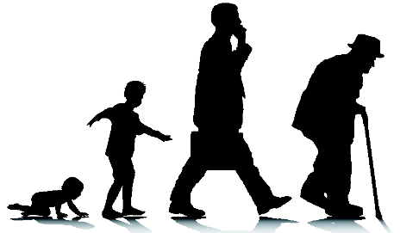
The Second Law of Thermodynamics
Notes:
Also, people get run down daily. That’s why we need air, water, food, rest, etc. Without a plan, you will look worse year by year. Do you agree?

Slide 4

How are you doing spiritually right now?
Notes:
Are you feeling tired? Worn out?

Slide 5

Sinking
Notes:
Maybe you’re sinking?
Do you think the future will be easier or harder for you as a believer?
I am an optimist, but I think the days ahead will be even more difficult, so we better be prepared.

Slide 6

What are the keys to spiritual renewal?
Notes:
We all need a continual spiritual renewal plan in our lives. But…

Slide 7

How can you be spiritually renewed?
Notes:
What is God’s plan for continual restoration in our walk with Christ?

Slide 8
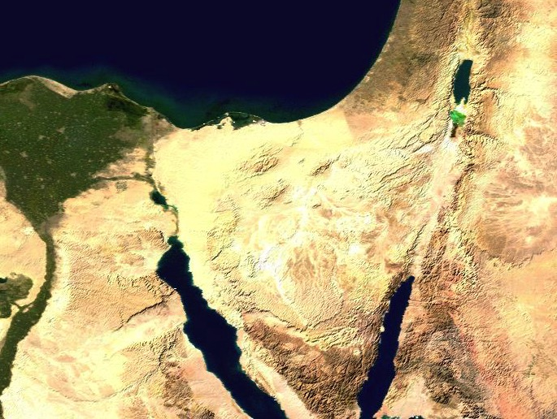
Wilderness Wanderings
Moab
Egypt
Kadesh- barnea
Mt. Sinai
Notes:
Today we pick up the story when God disciplined Israel for 40 years in the wilderness and the people were ready now to enter Canaan—or were they? They were at Moab after all 2 million of their parents had died off. You see this in Deuteronomy 1:1-4.

Slide 9

Moses at Moab
Moab
"These are the words that Moses spoke to all the people of Israel while they were in the wilderness east of the Jordan River. They were camped in the Jordan Valley near Suph, between Paran on one side and Tophel, Laban, Hazeroth, and Di-zahab on the other"
(Deut 1:1 NLT).
Kadesh- barnea
Mt. Hor
Mt. Sinai
Notes:
In Deuteronomy Moses, the covenant mediator, speaks to Israel's new generation opposite the Jordan (1:1).

Slide 10
The Normal Trip
"Normally it takes only eleven days to travel from Mount Sinai to Kadesh-barnea, going by way of Mount Seir. ³But forty years after the Israelites left Egypt, on the first day of the eleventh month, Moses addressed the people of Israel, telling them everything the LORD had commanded him to say"
(Deut 1:2-3 NLT).
Kadesh- barnea
Mt. Sinai
Notes:
The time of the Book of Deuteronomy is after the Transjordan conquests in the final month (cf. 34:8) of the 40-year wilderness wanderings that should have taken eleven days—a clear expression of the cost of disobeying God (1:2-3).

Slide 11
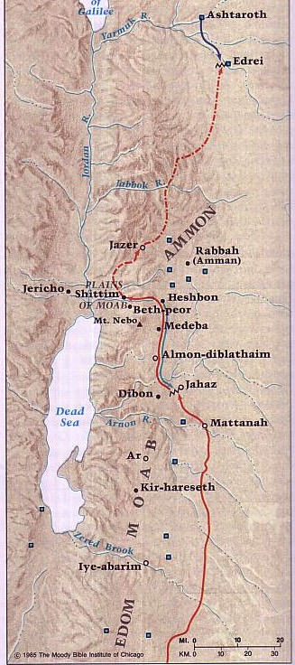
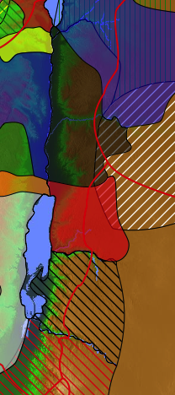
Transjordan Events
140
Edrei
Kingdom of Og
Ammon
Victory over Sihon and Og (Num. 21:21-35)
Kingdom of Sihon
Heshbon
"This took place after he had defeated King Sihon of the Amorites, who had ruled in Heshbon, and King Og of Bashan, who had ruled in Ashtaroth and Edrei" (Deut 1:4 NLT).
Moab
Edom
Beitzel, Moody Atlas, 1st ed., 94
Notes:
Israel has already cleared the east side of the Jordan (1:4).

Slide 12

Crossing to Jericho
DEAD SEA
JORDAN RIVER
MODERN JERICHO
JOSHUA
Jericho/Ai
ANCIENT JERICHO
From Jericho...
Looking East Across the Jordan River
Handbook pg. 26-29
42
Notes:
They are poised to cross over into Jericho.

Slide 13
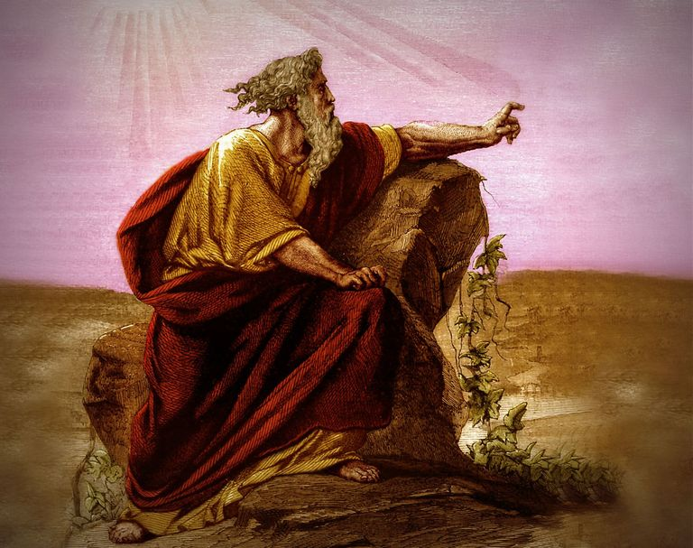
Deuteronomy
Renewal of the Mosaic Covenant
Renewal of the Mosaic Covenant
Notes:
So Moses commits to prepare them. What would he say?

Slide 14
Key Word
147
39
Renewal
Deuteronomy
Notes:
He sees the need for renewal of the people, which is our key word for the book.

Slide 15
Deuteronomy
147
Renewal of the Mosaic Covenant
FOCUS | Intro & 1st Sermon (Past Faithfulness) 1:1–4:43 | 2nd Sermon (Present Love Laws) 4:44–26:19 | 3rd & 4th Sermons (Future Hope) 27:1–34:12 | FOCUS
DIVISIONS | Preamble (1:1-4) God’s Acts for Israel (1:5–4:43) | 10 Commandments (4:44–11:32) Ceremonial Laws (12:1–16:17) Civil & Social Laws (16:18–26:19) | 3rd Blessings & Curses (27–28) 4th Land Covenant (29–30) | Leadership Transition (31–34)
TOPICS | What God Has Done Historical | What God Expects Legal | What God Will Do Prophetic | TOPICS
PLACE | Plains of Moab
TIME | About 1 Month
Adapted from Bruce Wilkinson & Kenneth Boa, Talk Thru the Bible, Vol. 1 (Nashville: Nelson, 1983)

Slide 16
How can you be spiritually renewed?
Notes:
What is God’s plan for continual restoration in our walk with Christ?

Slide 17

I. Thank God for his faithfulness in your past.
1:1–
4:43
Notes:
Recognize what the LORD already did for you.

Slide 18
Deuteronomy
147
Renewal of the Mosaic Covenant
FOCUS | Intro & 1st Sermon (Past Faithfulness) 1:1–4:43 | 2nd Sermon (Present Love Laws) 4:44–26:19 | 3rd & 4th Sermons (Future Hope) 27:1–34:12 | FOCUS
DIVISIONS | Preamble (1:1-4) God’s Acts for Israel (1:5–4:43) | 10 Commandments (4:44–11:32) Ceremonial Laws (12:1–16:17) Civil & Social Laws (16:18–26:19) | 3rd Blessings & Curses (27–28) 4th Land Covenant (29–30) | Leadership Transition (31–34)
TOPICS | What God Has Done Historical | What God Expects Legal | What God Will Do Prophetic | TOPICS
PLACE | Plains of Moab
TIME | About 1 Month
Adapted from Bruce Wilkinson & Kenneth Boa, Talk Thru the Bible, Vol. 1 (Nashville: Nelson, 1983)

Slide 19
Wilderness Wanderings
Moab
Egypt
Kadesh- barnea
Mt. Sinai

Slide 20

Don’t forget what Christ did in your life.
Notes:
What has he done?
Where would you be now without Jesus?
When you remember Jesus, you won’t follow idols.

Slide 21
I. Thank God for his faithfulness in your past.
1:1–
4:43
Notes:
Recognize what the LORD already did for you.

Slide 22
II. Love God now in your present.
1:1–
4:43
4:44–
26:19
Notes:
Reaffirm your commitment to him today.

Slide 23
Deuteronomy
147
Renewal of the Mosaic Covenant
FOCUS | Intro & 1st Sermon (Past Faithfulness) 1:1–4:43 | 2nd Sermon (Present Love Laws) 4:44–26:19 | 3rd & 4th Sermons (Future Hope) 27:1–34:12 | FOCUS
DIVISIONS | Preamble (1:1-4) God’s Acts for Israel (1:5–4:43) | 10 Commandments (4:44–11:32) Ceremonial Laws (12:1–16:17) Civil & Social Laws (16:18–26:19) | 3rd Blessings & Curses (27–28) 4th Land Covenant (29–30) | Leadership Transition (31–34)
TOPICS | What God Has Done Historical | What God Expects Legal | What God Will Do Prophetic | TOPICS
PLACE | Plains of Moab
TIME | About 1 Month
Adapted from Bruce Wilkinson & Kenneth Boa, Talk Thru the Bible, Vol. 1 (Nashville: Nelson, 1983)

Slide 24
Slides on
Deuteronomy 4
Notes:
The Ten Commandments are repeated for the new generation as their general covenant obligation as their defection at Beth Peor showed they needed a review of God's stipulations (4:44–5:33).

Slide 25
Sermon # 2: Stipulations
(4:44–26:19)
Introduction to Decalogue (4:44–5:33)
Notes:
An introduction to the Ten Commandments reminds the new generation that they need to hear them afresh due to their idolatry and intermarriage at Beth Peor about five months before (4:44-49; cf. Num. 25:1-3).

Slide 26
Slides on
Deuteronomy 5

Slide 27

The Big Ten
Exodus 20 & Deut 5
Notes:
The Ten Commandments spoken by God to their parents at Mount Sinai are repeated as the general covenant obligation for the new generation of Israel (Ch. 5).

Slide 28

The Ten Commandments
What are they?

Slide 29

The Two-Fold Structure
"Jesus replied, '"You must love the LORD your God with all your heart, all your soul, and all your mind.' ³⁸This is the first and greatest command-ment'"
(Matt 22:37-38).
Commands 1-4
Notes:
"But when the Pharisees heard that he had silenced the Sadducees with his reply, they met together to question him again. 35 One of them, an expert in religious law, tried to trap him with this question: 36 'Teacher, which is the most important commandment in the law of Moses?'
37 Jesus replied, “‘You must love the Lord your God with all your heart, all your soul, and all your mind.’ 38 This is the first and greatest commandment. 39 A second is equally important: ‘Love your neighbor as yourself.’ 40 The entire law and all the demands of the prophets are based on these two commandments.”
Matt. 22:34-40 NLT

Slide 30

Exodus 20:2-3 NLT
Command 1
"I am the LORD your God, who rescued you from the land of Egypt, the place of your slavery. ³You must not have any other god but me."
Notes:
Holy Bible: New Living Translation (Carol Stream, IL: Tyndale House Publishers, 2013), Ex 20:2–3.

Slide 31
Exodus 20:4-5a NLT
Command 2
"You must not make for yourself an idol of any kind or an image of anything in the heavens or on the earth or in the sea. ⁵You must not bow down to them or worship them, for I, the LORD your God, am a jealous God who will not tolerate your affection for any other gods."
Notes:
Holy Bible: New Living Translation (Carol Stream, IL: Tyndale House Publishers, 2013), Ex 20:2–3.

Slide 32
Exodus 20:5a-6 NLT
Command 2
"I lay the sins of the parents upon their children; the entire family is affected—even children in the third and fourth generations of those who reject me.
⁶But I lavish unfailing love for a thousand generations on those who love me and obey my commands."
Notes:
Holy Bible: New Living Translation (Carol Stream, IL: Tyndale House Publishers, 2013), Ex 20:2–3.

Slide 33
Exodus 20:7 NLT
Command 3
"You must not misuse the name of the LORD your God. The LORD will not let you go unpunished if you misuse his name."
Notes:
Holy Bible: New Living Translation (Carol Stream, IL: Tyndale House Publishers, 2013), Ex 20:2–3.

Slide 34
Exodus 20:8-10a NLT
Command 4
"Remember to observe the Sabbath day by keeping it holy. ⁹You have six days each week for your ordinary work, ¹⁰but the seventh day is a Sabbath day of rest dedicated to the LORD your God. On that day no one in your household may do any work."
Notes:
Holy Bible: New Living Translation (Carol Stream, IL: Tyndale House Publishers, 2013), Ex 20:2–3.

Slide 35
Exodus 20:10a NLT
Command 4
"This includes you, your sons and daughters, your male and female servants, your livestock, and any foreigners living among you."
Notes:
Holy Bible: New Living Translation (Carol Stream, IL: Tyndale House Publishers, 2013), Ex 20:2–3.

Slide 36
Exodus 20:11 NLT
Command 4
"For in six days the LORD made the heavens, the earth, the sea, and everything in them;
but on the seventh day he rested.
That is why the LORD blessed the Sabbath day and set it apart as holy."
Notes:
Holy Bible: New Living Translation (Carol Stream, IL: Tyndale House Publishers, 2013), Ex 20:2–3.

Slide 37
The Two-Fold Structure
"Jesus replied, '"You must love the LORD your God with all your heart, all your soul, and all your mind.' ³⁸This is the first and greatest command-ment'"
(Matt 22:37-38).
Commands 5-10
Commands 1-4
"A second is equally important: 'Love your neighbor as yourself.'
⁴⁰The entire law and all the demands of the prophets are based on these two commandments"
(Matt 22:39-40).
Notes:
"But when the Pharisees heard that he had silenced the Sadducees with his reply, they met together to question him again. 35 One of them, an expert in religious law, tried to trap him with this question: 36 'Teacher, which is the most important commandment in the law of Moses?'
37 Jesus replied, “‘You must love the Lord your God with all your heart, all your soul, and all your mind.’ 38 This is the first and greatest commandment. 39 A second is equally important: ‘Love your neighbor as yourself.’ 40 The entire law and all the demands of the prophets are based on these two commandments.”
Matt. 22:34-40 NLT

Slide 38
Exodus 20:12 NLT
Command 5
"Honor your father and mother. Then you will live a long, full life in the land the LORD your God is giving you."
Notes:
Holy Bible: New Living Translation (Carol Stream, IL: Tyndale House Publishers, 2013), Ex 20:2–3.

Slide 39
Exodus 20:13 NLT
Command 6
"You must not murder."
Notes:
Holy Bible: New Living Translation (Carol Stream, IL: Tyndale House Publishers, 2013), Ex 20:2–3.

Slide 40
Exodus 20:14 NLT
Command 7
"You must not commit adultery."
Notes:
Holy Bible: New Living Translation (Carol Stream, IL: Tyndale House Publishers, 2013), Ex 20:2–3.

Slide 41
Exodus 20:15 NLT
Command 8
"You must not steal."
Notes:
Holy Bible: New Living Translation (Carol Stream, IL: Tyndale House Publishers, 2013), Ex 20:2–3.

Slide 42
Exodus 20:16 NLT
Command 9
"You must not testify falsely against your neighbor."
Notes:
Holy Bible: New Living Translation (Carol Stream, IL: Tyndale House Publishers, 2013), Ex 20:2–3.

Slide 43
Exodus 20:17 NLT
Command 10
"You must not covet your neighbor’s house. You must not covet your neighbor’s wife, male or female servant, ox or donkey, or anything else that belongs to your neighbor."
Notes:
Holy Bible: New Living Translation (Carol Stream, IL: Tyndale House Publishers, 2013), Ex 20:2–3.

Slide 44
The Ten Commandments
How do they
APPLY TODAY?

Slide 45
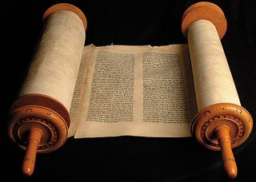
The Christian's Relationship to the Law
112

Slide 46


"Old" Replaced by "New"
NTS 266hh
Wayne Grudem, Systematic Theology, 521
"What then is the 'old covenant' in contrast with the 'new covenant' in Christ? It is not the whole of the Old Testament, because the covenants with Abraham and David are never called 'old' in the New Testament. Rather, only the covenant under Moses, the covenant made at Mount Sinai (Ex. 19-24) is called the 'old covenant' (2 Cor. 3:14; cf. Heb. 8:6, 13), to be replaced by the "new covenant" in Christ (Luke 22:20; 1 Cor. 11:25; 2 Cor. 3:6; Heb. 8:8, 13; 9:15; 12:24)."
Notes:
What covenant does Jesus mediate that is far better than the old (8:6)?

Slide 47
TRADITIONAL VIEW ON LAW
Ex. 25-31
104
7
A Godly Education In Three Parts:
MORAL: The Ten Commandments; a basis for our current legal system.
CIVIL: How the people are to live with each other in the new social structure.
CEREMONIAL: How to worship God in the new social structure.
BUT ARE THE BIG 10 MORAL LAW?
MOSES
Exodus
Sinai
M - C - C
40
Handbook pg. 26-29
13

Slide 48

Moral law means God's rules that apply to…
Every time period
Every culture
Every place
Every people

Slide 49
The Ten Commandments
113a
#
Old Testament Commands
New Testament Repetitions
1
And God spoke all these words: "I am the LORD your God, who brought you out of Egypt, out of the land of slavery. You shall have no other gods before me" (Exod. 20:1-3).
"Men, why are you doing this? We too are only men, human like you. We are bringing you good news, telling you to turn from these worthless things to the living God…" (Acts 14:15; noted 50+ times).
2
"You shall not make for yourself an idol… of anything in heaven above or on the earth beneath or in the waters below… for I… am a jealous God, punishing the children for the sin of the fathers … but showing love to a thousand generations of those who love me…" (Exod. 20:4-6).
"Dear children, keep yourselves from idols" (1 John 5:21; cf. 1 Thess. 1:9; Rev. 2:14, 20; 9:20; mentioned in the NT 12 times = 12x).
* This chart is adapted and expanded from one by Lewis Sperry Chafer, Systematic Theology, 4:209-10
3
"You shall not misuse the name of the LORD your God, for the LORD will not hold anyone guiltless who misuses his name" (Exod. 20:7).
"Above all…do not swear–not by heaven or by earth or by anything else. Let your 'Yes' be yes, and your 'No,' no, or you will be condemned" (James 5:12; 4x).

Slide 50
The Ten Commandments
113a
#
Old Testament Commands
New Testament Repetitions
4
"Remember the Sabbath day by keeping it holy. Six days you shall labor and do all your work, but the seventh day is a Sabbath to the LORD your God. On it you shall not do any work… nor your son or daughter, nor your manservant or maidservant, nor your animals, nor the alien within your gates. For in six days the LORD made the heavens and the earth… but he rested on the seventh day…" (Exod. 20:8-11).
No NT text requires this of Christians.
However, one passage clearly prohibits the practice as required for believers: "Therefore do not let anyone judge you by what you eat or drink, or with regard to a religious festival, a New Moon celebration or a Sabbath day. These are a shadow of the things that were to come; the reality, however, is found in Christ"
(Col. 2:16-17; 0x).
5
"Honor your father and your mother, so that you may live long in the land the LORD your God is giving you" (Exod. 20:12).
"Children, obey your parents in the Lord, for this is right. 'Honor your father and mother'–which is the first commandment with a promise–that it may go well with you and that you may enjoy long life on the earth" (Eph. 6:1-3; Matt. 15:4-6; 19:19; Mark 7:10; 10:19; 6x).
6
"You shall not murder" (Exod. 20:13).
"Anyone who hates his brother is a murderer, and you know that no murderer has eternal life in him" (1 John 3:15; cf. Matt. 19:18; Mark 10:19; Luke 18:20; Rom. 13:9; James 2:11; 6x).

Slide 51
The Ten Commandments
113a
#
Old Testament Commands
New Testament Repetitions
7
"You shall not commit adultery" (Exod. 20:14).
"Marriage should be honored by all, and the marriage bed kept pure, for God will judge the adulterer and all the sexually immoral" (Heb. 13:4; cf. Mark 10:19; 12x).
8
"You shall not steal" (Exod. 20:15).
"He who has been stealing must steal no longer, but must work, doing something useful with his own hands…" (Eph. 4:28; cf. Matt. 27:64; Mark 10:19; Luke 18:20; Rom. 13:9; Titus 2:10; 6x).
9
"You shall not give false testimony against your neighbor" (Exod. 20:16).
"Do not lie to each other, since you have taken off your old self with its practices" (Col. 3:9; cf. Eph. 4:25; 4x).
10
"You shall not covet your neighbor's house… wife, or his manservant or maidservant, his ox or donkey, or anything that belongs to your neighbor" (Exod. 20:17).
"'Watch out! Be on your guard against all kinds of greed; a man's life does not consist in the abundance of his possessions'" (Luke 12:15; Rom. 7:7; 13:9; Eph. 5:3; James 4:2; 2 Pet. 2:3, 14; 9x).

Slide 52
Does the Law of Moses Apply to Me? (5 Views)
113c
Spectrum on Degree of Applicability:
Theonomic Greg Bahnsen | Reformed Willem VanGemeren | Weightier Issues Walter Kaiser | Modified Lutheran Douglas Moo | Dispensational Wayne G. Strickland
Law as applicable
in every sense
Law as not applicable
in every sense
This chart summarizes Stanley N. Gundry, ed. Five Views on Law and Gospel (Grand Rapids: Zondervan, 1996), where each author presents his view and responds to the other four views. Generally speaking, views 1-2 are similar as both are Reformed (stressing continuity between the NT and OT) and these stand against views 3-5 which alike stress discontinuity. In my opinion, the dispensational view has the most to commend it as law in the NT is never broken into component parts and this view clearly distinguishes Israel from the church. Further, it is inconsistent to change the Sabbath (Saturday) to Sunday but not apply the OT penalties for Sabbath-breaking today (i.e., death by stoning; cf. Exod. 31:14-15; 35:2). The following chart is adapted from Lee Hwee Chin, "The Applicability of the Law Today," unpublished research paper for the course "Old Testament Survey," Singapore: Singapore Bible College, 2001), 1.
Notes:
There’re actually at least five major approaches to how Christians relate to the Old Testament

Slide 53
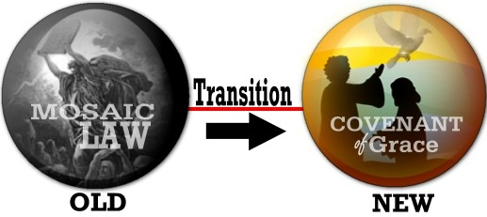
Two Covenants
Transition
OLD
NEW
Notes:
The same applies to God’s relationship to us now, as contrasted with his relationship to OT Israel

Slide 54
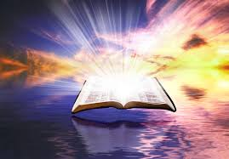
Old vs. New Covenants
Notes:
But the nature of these relationships is quite different. Our new covenant with him is much better than the agreement that Israel had with God. But how is it different?

Slide 55
Contrasting the Covenants (2 Cor. 3–4)
NTS 166c
Old Covenant | New Covenant
initiated by Moses (3:8) | initiated by Christ (3:4)
of the letter (3:6a) | of the Spirit (3:6a, 18b)
kills (3:6b, 7a) | gives life (3:6b)
engraved on stone (3:3b, 7a) | engraved on hearts (3:3b; Jer. 31:33)
glorious (3:7a) | more glorious (3:8, 10)
glory faded (3:7b, 11a, 13b) | glory ever-increases (3:11b, 18)
condemns men (3:9a) | brings righteousness (3:9b)
deception (3:13) | boldness (3:12)
veiled face of Moses (3:13b) | unveiled faces (3:13a, 18a)
veiled minds (3:14a) | unveiled minds (3:14b; 4:3-6)
veiled hearts (3:15) | unveiled hearts (3:16)
dullness (3:14a) | freedom (3:17)
Moses reflected God's glory | all believers reflect Son's glory (3:17)
non-transforming (3:7) | transforming (3:18)
lack of zeal (3:13) | confidence, steadfastness (3:4-5; 4:1)
deception (3:13) | sincerity (4:2)

Slide 56
Slides on
Deuteronomy 6
Notes:
Israel is promised blessings of land, long life, and material prosperity as incentive to obey the covenant (6:1-3).

Slide 57
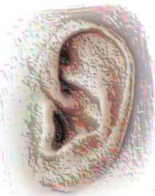
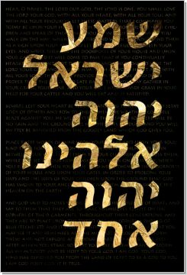
The Jewish Shema
"Hear, O Israel:
The LORD our God,
the LORD is one"
(Deut. 6:4)
Notes:
The importance to love the LORD (the Shema) is the basis for obeying all stipulations in the covenant (6:4-9).

Slide 58
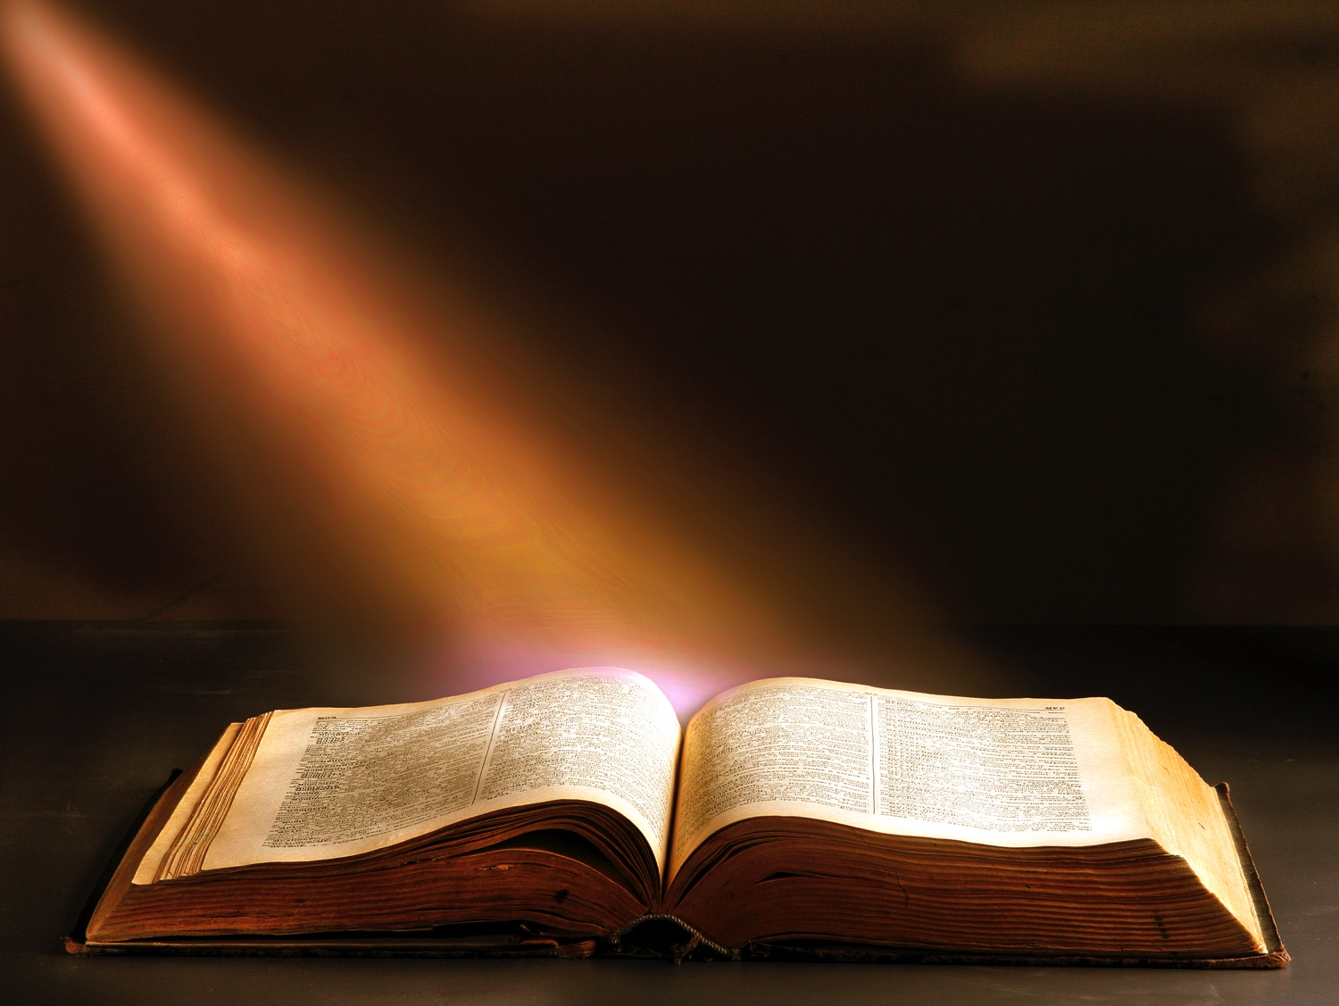
Hear & Obey
Deuteronomy 6:4-12 (ESV)

Slide 59
⁴"Hear, O Israel: The LORD our God, the LORD is one. ⁵You shall love the LORD your God with all your heart and with all your soul and with all your might. ⁶And these words that I command you today shall be on your heart.

Slide 60
⁷You shall teach them diligently to your children, and shall talk of them when you sit in your house, and when you walk by the way, and when you lie down, and when you rise. ⁸You shall bind them as a sign on your hand, and they shall be as frontlets between your eyes.

Slide 61
⁹You shall write them on the doorposts of your house and on your gates. ¹⁰And when the LORD your God brings you into the land that he swore to your fathers, to Abraham, to Isaac, and to Jacob, to give you—with great and good cities that you did not build,
Notes:
Thanking God for a land not deserved so as not to acquire a sense of independence shows love for the LORD (6:10-19).

Slide 62
¹¹and houses full of all good things that you did not fill, and cisterns that you did not dig, and vineyards and olive trees that you did not plant—and when you eat and are full, ¹²then take care lest you forget the LORD, who brought you out of the land of Egypt, out of the house of slavery."

Slide 63
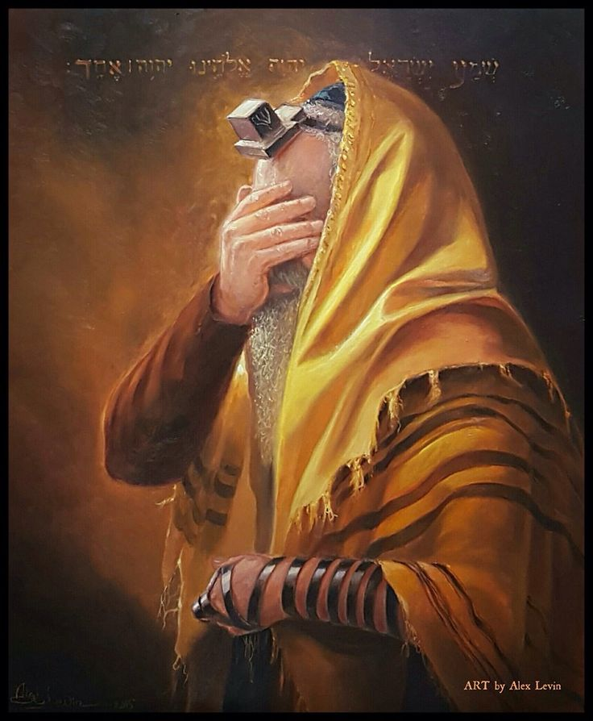
Taking Scripture Literally
Notes:
Jews of later days took this so literally that they actually tied verses to their foreheads and arms.

Slide 64

Taking Scripture Literally
Notes:
They even have a mazzuzah on the sides of their doors with Scripture verses underneath.

Slide 65
Slides on
Deuteronomy 7
Notes:
Totally conquering Canaan so that no rival may exist to God's Lordship shows love for the LORD (Ch. 7).

Slide 66
Deuteronomy 7:1-4
"When the LORD your God brings you into the land you are entering to possess and drives out before you many nations – the Hittites, Girgashites, Amorites, Canaanites, Perizzites, Hivites, and Jebusites, seven nations larger and stronger than you – and when the LORD your God has delivered them over to you and you have defeated them, then
you must destroy them totally."

Slide 67
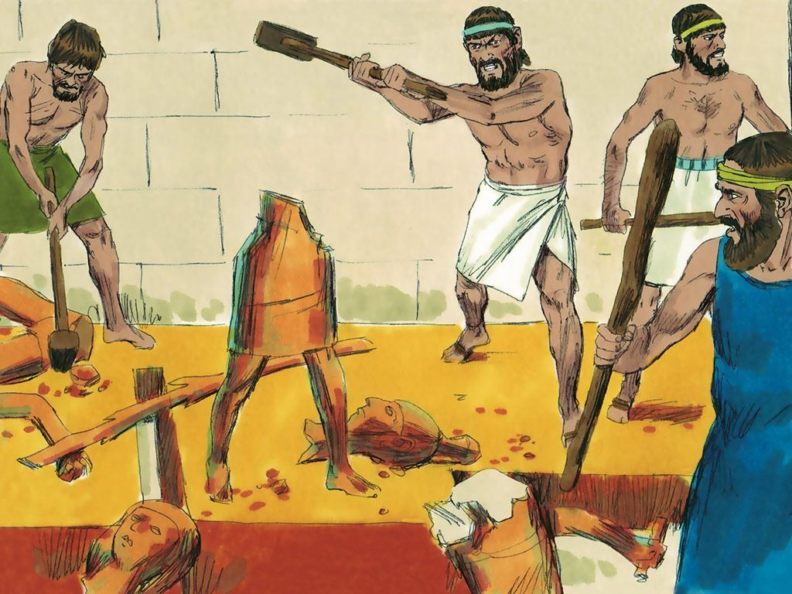
Destroying Pagan Images

Slide 68
Deuteronomy 7:1-4
"Make no treaty with them, and show them no mercy. Do not intermarry with them. Do not give your daughters to their sons or take their daughters for your sons, for they will turn your sons away from following me to serve other gods, and the LORD's anger will burn against you and
will quickly destroy you."

Slide 69
Slides on
Deuteronomy 8

Slide 70
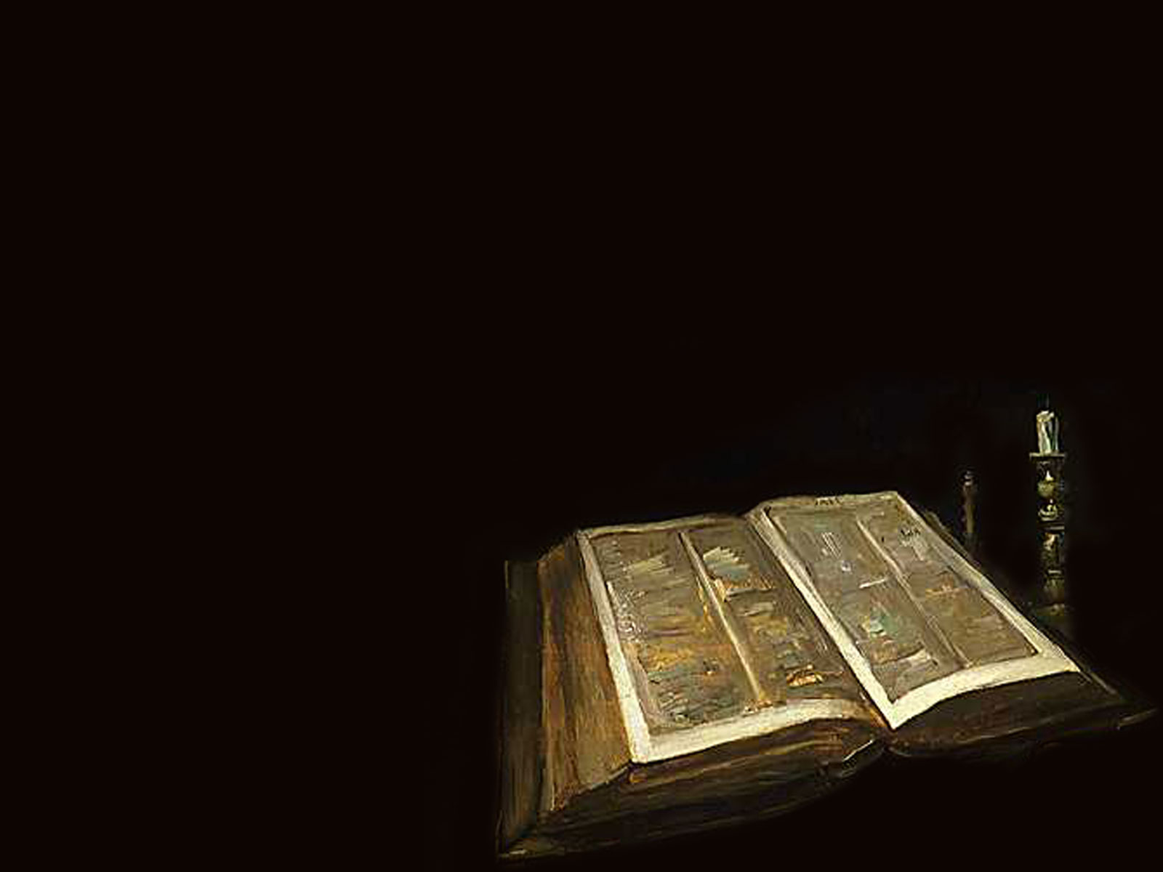
Remember the LORD Your God
Deut. 8:1-5 (ESV)
Notes:
Remembering God's provision in the wilderness so that the land's abundance will not promote a spirit of self-sufficiency shows love for the LORD (Ch. 8).

Slide 71
"The whole commandment that I command you today you shall be careful to do, that you may live and multiply, and go in and possess the land that the LORD swore to give to your fathers (8:1).

Slide 72
"And you shall remember the whole way that the LORD your God has led you these forty years in the wilderness, that he might humble you, testing you to know what was in your heart, whether you would keep his commandments or not" (8:2).

Slide 73
"And he humbled you and let you hunger and fed you with manna, which you did not know, nor did your fathers know, that he might make you know that man does not live by bread alone, but man lives by every word that comes from the mouth of the LORD" (8:3).

Slide 74
"Your clothing did not wear out on you and your foot did not swell these forty years.
⁵ Know then in your heart that, as a man disciplines his son, the LORD your God disciplines you" (8:4-5).

Slide 75
Slides on
Deuteronomy 12

Slide 76
Sermon # 2: Stipulations
(4:44–26:19)
Introduction to Decalogue (4:44–5:33)
  The Shema (6–11)
Religious & Ceremonial Laws (12:1–16:17)

Slide 77
Slides on
Deuteronomy 13

Slide 78

Categories of the Mosaic Law
Criminal
Civil
Family
Religious
Charitable

Slide 79
Slides on
Deuteronomy 16

Slide 80
Sermon # 2: Stipulations
(4:44–26:19)
Introduction to Decalogue (4:44–5:33)
  The Shema (6–11)
Religious & Ceremonial Laws (12:1–16:17)
Civil and Social Laws (16:18–26:19)

Slide 81
What does it have to do with me?
LOVE
& OBEY
Notes:
Jesus said that if we love him, then we’ll obey him.
Conversely, if we don’t love someone, we rebel against him.
Do you love Jesus?
How would you know if you love Jesus?
We typically spend time with those we love. So do you spend time with Jesus?
We share like values with people we love. Are your values becoming more like what Jesus values?
(What is the third and final way you can be spiritually renewed?)

Slide 82
Our Vision
Love the Nations
Love the Church
Love God

Slide 83
How can you be spiritually renewed?
Notes:
What is God’s plan for continual restoration in our walk with Christ?

Slide 84
I. Thank God for his faithfulness in your past.
1:1–
4:43
Notes:
Recognize what the LORD already did for you.

Slide 85
II. Love God now in your present.
1:1–
4:43
4:44–
26:19
Notes:
Reaffirm your commitment to him today.

Slide 86
III. Serve God with hope in your future.
1:1–
4:43
4:44–
26:19
27:1–
34:12
Notes:
Live as if he will fulfill his promises to you.

Slide 87
Deuteronomy
147
Renewal of the Mosaic Covenant
FOCUS | Intro & 1st Sermon (Past Faithfulness) 1:1–4:43 | 2nd Sermon (Present Love Laws) 4:44–26:19 | 3rd & 4th Sermons (Future Hope) 27:1–34:12 | FOCUS
DIVISIONS | Preamble (1:1-4) God’s Acts for Israel (1:5–4:43) | 10 Commandments (4:44–11:32) Ceremonial Laws (12:1–16:17) Civil & Social Laws (16:18–26:19) | 3rd Blessings & Curses (27–28) 4th Land Covenant (29–30) | Leadership Transition (31–34)
TOPICS | What God Has Done Historical | What God Expects Legal | What God Will Do Prophetic | TOPICS
PLACE | Plains of Moab
TIME | About 1 Month
Adapted from Bruce Wilkinson & Kenneth Boa, Talk Thru the Bible, Vol. 1 (Nashville: Nelson, 1983)

Slide 88
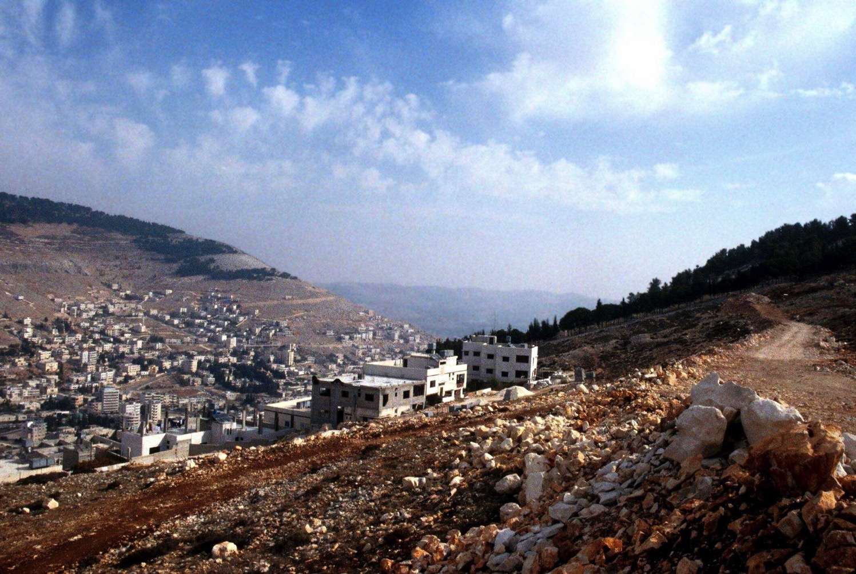
Mount Gerizim Looking East (Deut. 27:9-13)
Shechem
Mount Ebal (cursing)
Mount Gerizim (blessing)
Notes:
“Then Moses and the Levitical priests addressed all Israel as follows: ‘O Israel, be quiet and listen! Today you have become the people of the Lord your God. ¹⁰ So you must obey the Lord your God by keeping all these commands and decrees that I am giving you today.’ ¹¹ That same day Moses also gave this charge to the people: ¹² ‘When you cross the Jordan River, the tribes of Simeon, Levi, Judah, Issachar, Joseph, and Benjamin must stand on Mount Gerizim to proclaim a blessing over the people. ¹³ And the tribes of Reuben, Gad, Asher, Zebulun, Dan, and Naphtali must stand on Mount Ebal to proclaim a curse’” (Deut. 27:11-13).

Slide 89
Blessings & Curses
154
220
Deut. 28
Your towns and your fields
will be blessed (3)
Your towns and your fields
will be cursed (16)
Your children and your crops
will be blessed (4)
Your children and your crops
will be cursed (17)
Your fruit baskets and bread-boards will be blessed (5)
Your fruit baskets and bread-boards will be cursed (18)
Wherever you go and whatever you do, you will be blessed (6)
Wherever you go and whatever you do, you will be cursed (19)
Your enemies will attack you from one direction, but they will scatter from you in seven! (7)
You will attack your enemies from one direction, but you will scatter from them in seven! (25)
You will lend to many nations, but you will never need to borrow from them (12)
They will lend to money to you, but you will not lend to them
(44)
Notes:
The parallels between the individual blessings and cursings are just too obvious!

Slide 90
Prophetic Curses
154
220
Why?
Exile
Deut. 28
Notes:
Later in the OT we see justification for God's judgment on Israel. The leaders and the people sinned through ungodliness and idolatry, and true to the curses of Deut. 28, God gave the people the consequences of their obedience by exiling them to Babylon.

Slide 91

The Elements Expanded
The Abrahamic Covenant
("The Call")
Genesis 12:1-3
ABRAHAM
LAND
SEED
BLESSING
The CALL
L - S - B
12:1
12:2
12:3
"L-S-B"
Handbook pg. 19-24
16
3
Notes:
Now study this plan of organization…the down-to-earth meaning of those three promises…the L-S-B on ABRAHAM's folder…
//// First…PROMISE #1: GENESIS 12:1...A LAND — real estate, a geographic inheritance that most Jewish people respect politically to this present day.
//// PROMISE #2: GENESIS 12:2...A SEED — a long line of descendants...especially interesting because at the time the Promise is given, ABRAHAM and SARAH are approaching old age and yet they have never had children.
//// The final PROMISE, Number 3: GENESIS 12:3...A BLESSING promised to Abraham personally and to his descendants. Furthermore, God promises that, through His blessing to ABRAHAM, all the families of the earth will be blessed…NOT JUST ABRAHAM'S descendants! Notice that wording! It's important to an understanding of GRACE!

Slide 92
Deuteronomy 30:1-4
44
7
EXILE & RETURN PROMISED
¹ When all these blessings and curses I have set before you come upon you and you take them to heart wherever the Lord your God disperses you among the nations, ²and when you and your children return to the Lord your God and obey him with all your heart and with all your soul according to everything I command you today, ³then the Lord your God will restore your fortunes and have compassion on you and gather you again from all the nations where he scattered you. ⁴Even if you have been banished to the most distant land under the heavens, from there the Lord your God will gather you and bring you back (NIV).
27
Notes:
Chapter 30 says that Israel will be dispersed but then Israel will return to the LORD, so he will restore them from the nations and bring them back to the Land.

Slide 93
7
Deuteronomy 30
THE LAND (PALESTINIAN) PROMISES
⁵ He will bring you to the land that belonged to your fathers, and you will take possession of it. He will make you more prosperous and numerous than your fathers.
MOSES
Exodus
⁶ The Lord your God will circumcise your hearts and the hearts of your descendants so that you may love him with all your heart and with all your soul, and live (NIV).
Sinai
M - C - C
Kadesh Barnea
40
40
5 Sermons
Handbook pg. 26-29
29
2
Notes:
Verses 5 and 6 are the very heart of that Land Covenant from Deuteronomy 30:
5 "He will bring you to
//// the land that belonged to your fathers, and you will take possession of it. He will make you more prosperous and numerous than your fathers.
//// 6 The Lord your God will circumcise your hearts and the hearts of your descendants so that you may love him with all your heart and with all your soul and live."

Slide 94

Future Hope
Notes:
What are you looking forward to in the future?
My friends are beginning to retire, so their lives are full of expectation about retirement, time with grandkids, not working anymore, taking life easy. I know very few people over 70 who are spiritually vibrant!
The Bible speaks much about our future inheritance in ruling with Christ. Do you?

Slide 95
How can you be spiritually renewed?
Notes:
Back to our original question: How can you be spiritually renewed? Can we answer this simply in one sentence? I think we can…

Slide 96
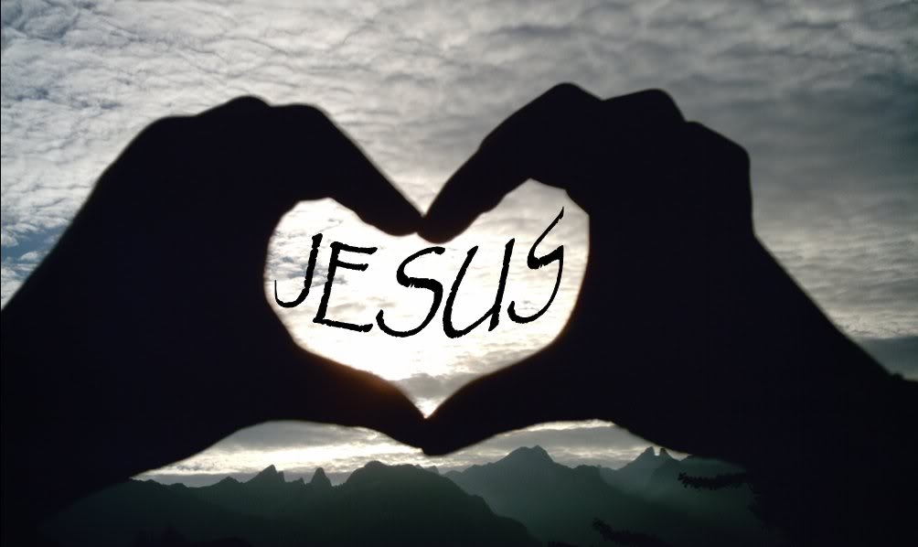
Main Idea
Show Jesus you love him
by serving him with thanks.
Notes:
Focus your past, present and future on love for Christ and obedience (restated).
Renewal is active in three tenses…

Slide 97
I. Thank God for his faithfulness in your past.
1:1–
4:43
Notes:
Recognize what the LORD already did for you.

Slide 98
II. Love God now in your present.
1:1–
4:43
4:44–
26:19
Notes:
Reaffirm your commitment to him today.

Slide 99
III. Serve God with hope in your future.
1:1–
4:43
4:44–
26:19
27:1–
34:12
Notes:
Live as if he will fulfill his promises to you.

Slide 100
Key Verse
147
"Hear, O Israel: The LORD our God, the LORD is one. Love the LORD your God with all your heart and with all your soul and with all your strength" (Deut. 6:4-5)
Deuteronomy
Notes:
The most important thing is love for Christ in the key verse of the book—love with all your heart, soul and strength.

Slide 101

Spiritual Renewal
Past
Future
Present
Notes:
Which tense do you most need to look: past, present or future?
How can you better thank God for his faithfulness in your past?
How can you better love God now in your present?
How can you better serve God with hope in your future?

Slide 102
Black

Slide 103


OT Sermons link at BibleStudyDownloads.org
Get this presentation and script for free!

