Slide 1

Be Holy
Leviticus
Dr. Rick Griffith, Crossroads International Church Singapore
CICFamily.com • BibleStudyDownloads.org

Slide 2

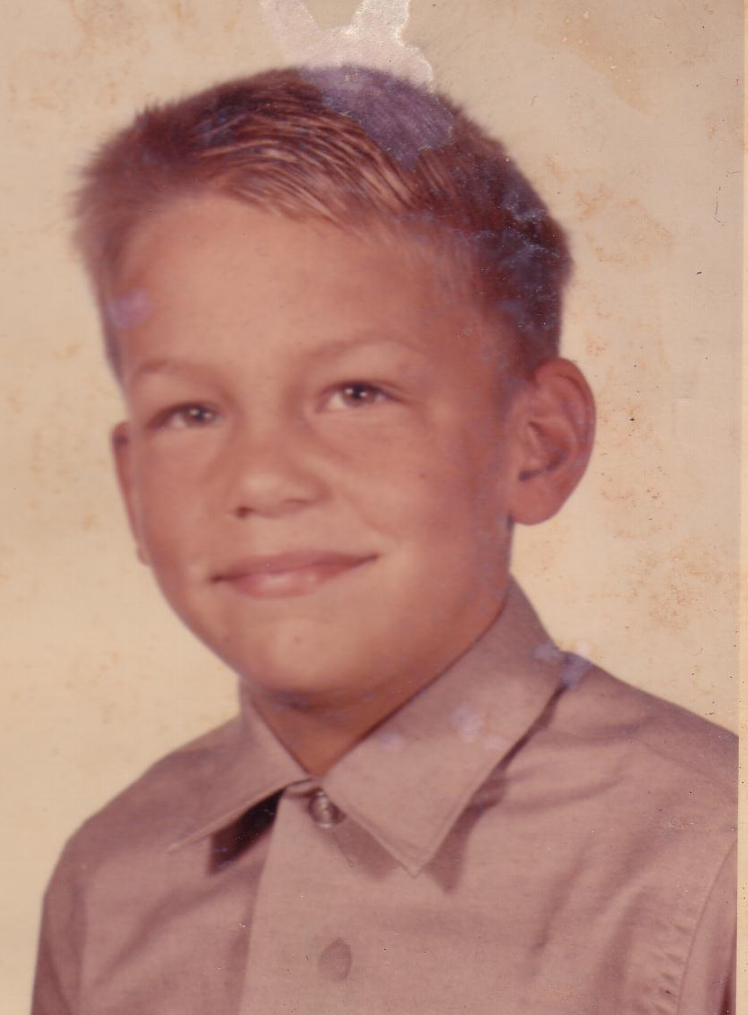
Holiness
Notes:
Over 50 years ago when I was seven years old I went to my first camp. It was at the YMCA: Young Men's Christian Association. Of course, I wasn't from a Christian family, and I had never read the Bible before, but I recall a sense of awe in the outdoor amphitheater looking up within the circle of redwoods.

Slide 3
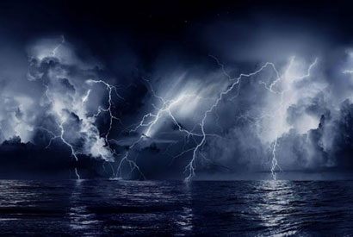
HOLY, HOLY,
HOLY
Isaiah 6:1-7
Notes:
Then we sang the first hymn I ever remember, called "Holy, Holy, Holy."

Slide 4
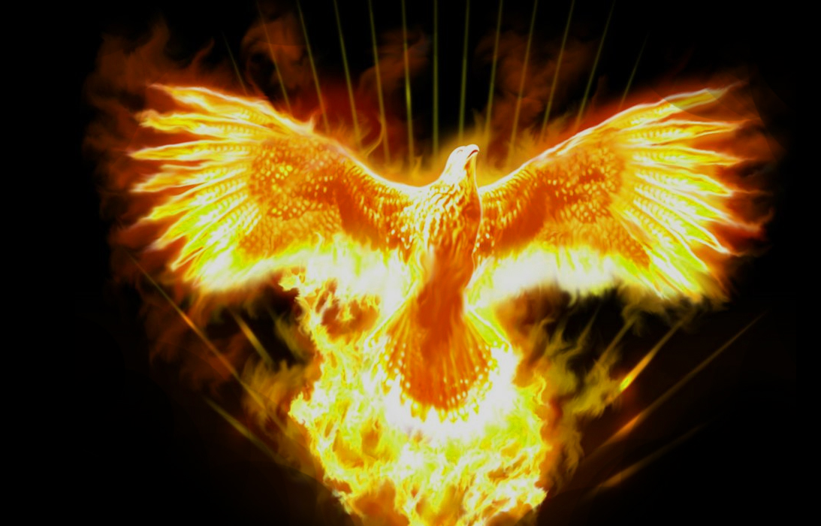
What does it mean to be holy?
Notes:
The word "holy" was curious to me, so I went forward after chapel and asked a camp counselor, "What does it mean to be holy?"

Slide 5

Holiness
Notes:
If someone asked you such a question, what would you say?

Slide 6

100% PURE
Notes:
The counselor looked down at this scrawy 7-year-old and said, "Well, I guess it means 100% pure. God is like that. He is 100% pure."

Slide 7
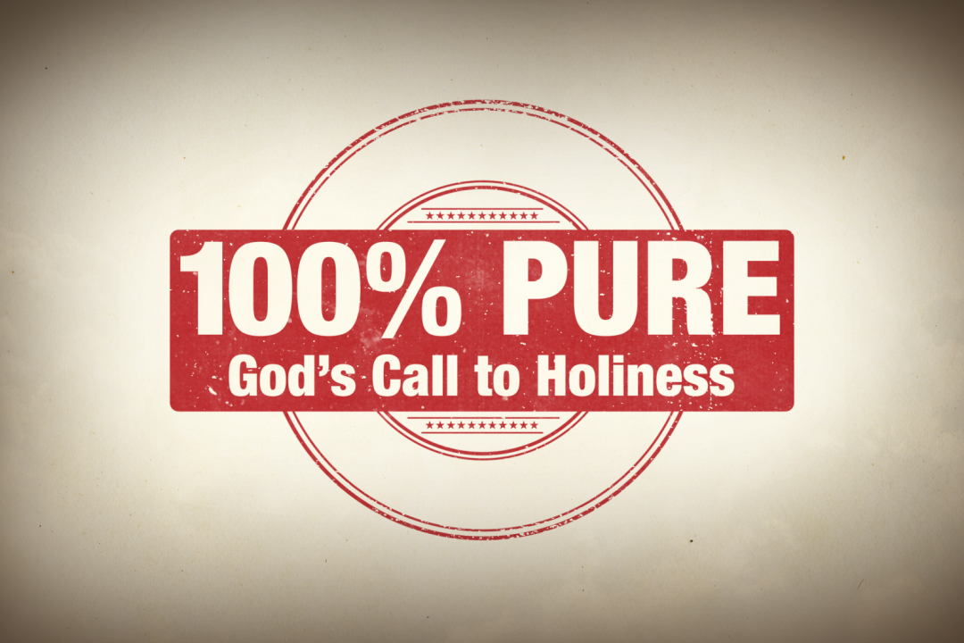
Holiness
100% PURE
God's Call to Holiness
Notes:
Seven years later I came into a relationship with that God and found that not only is God 100% pure, he requires that of me at well.

Slide 8
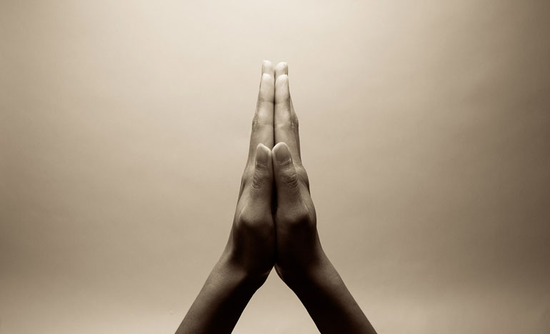
The Holy Spirit
Notes:
In fact, God gave us his Holy Spirit.
He is also a gracious Spirit, but his title is Holy Spirit.
He is also a loving Spirit, but his title is Holy Spirit.
He is also an indwelling Spirit, but his title is Holy Spirit.

Slide 9
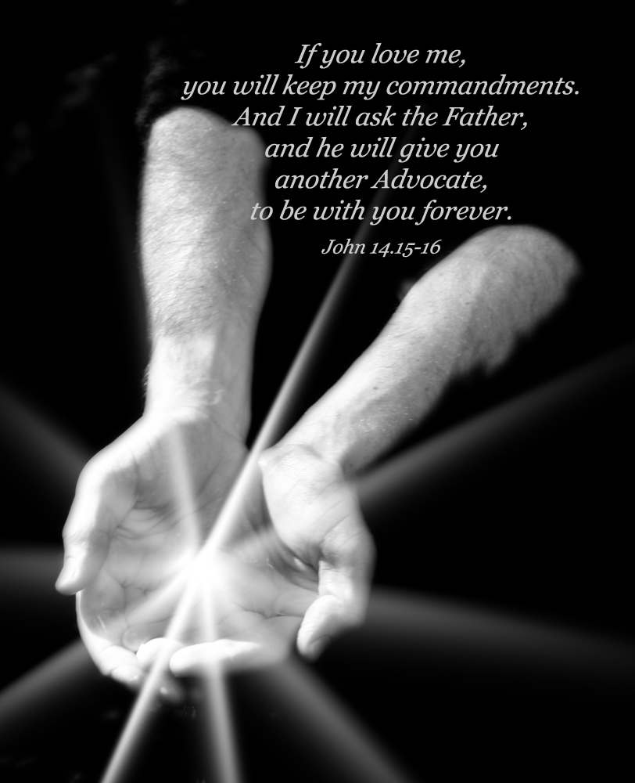
The Spirit Advocate
"If you love me, you will keep my commandments. And I will ask the Father, and he will give you another Advocate, to be with you forever."
John 14:15-16
Notes:
Jesus promised that the Holy Spirit would be with us forever.

Slide 10
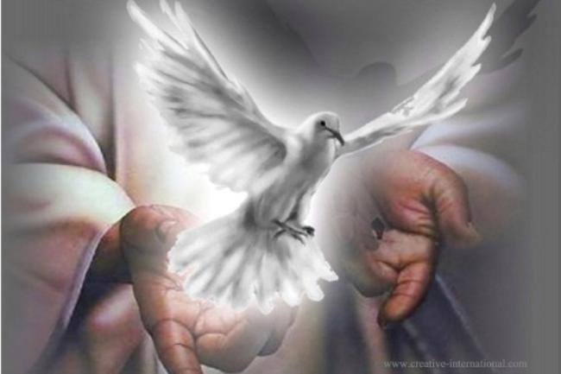
The Paraclete (John 14:16)
Advocate = Counselor = Comforter
Greek = “one who comes alongside”
Greek options for “another”:
Heteros = “another of a different kind”
Allos = “another of the same kind”
The Spirit will come alongside us in the same way as Jesus Himself!
Notes:
Jesus called the Spirit our advocate or counselor or comforter…

Slide 11
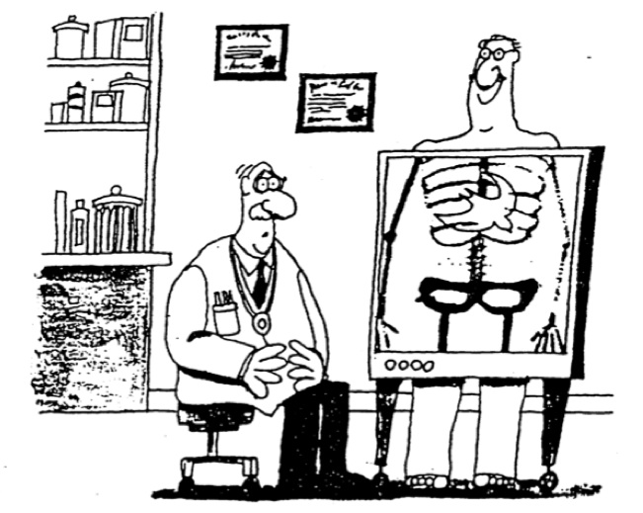
The Spirit indwelling is God’s new work!
Notes:
Amazingly, the Bible says that the Holy Spirit actually dwells in our bodies!

Slide 12
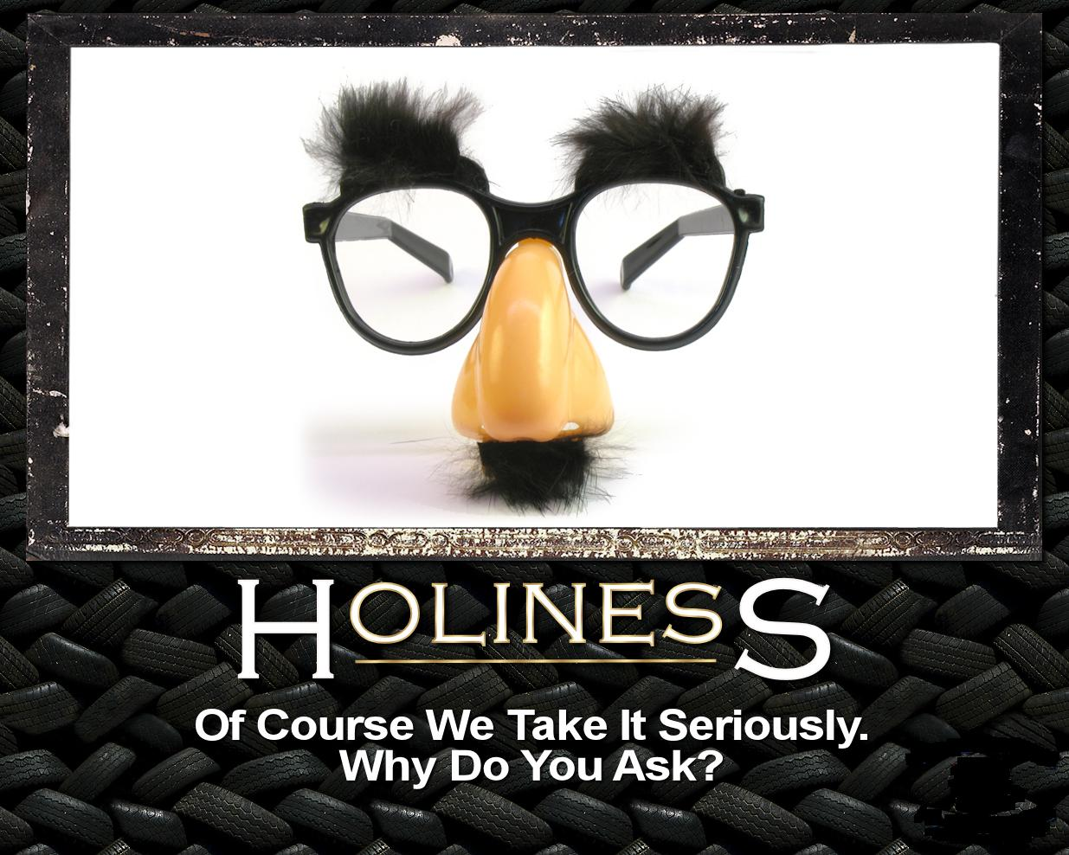
Holiness
Holiness
Of Course We Take It Seriously.
Why Do You Ask?
Notes:
Yet the reality for most of us is that we don’t really sense God with us. Too often we live as if he isn’t first on our thoughts. We can go for days without listening to him or talking to him (prayer and Bible reading).

Slide 13
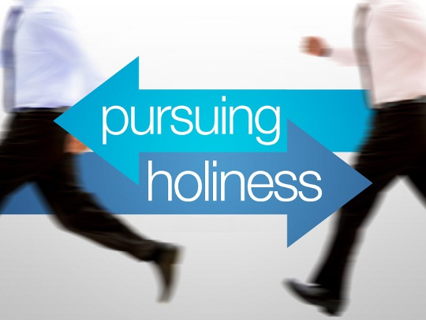
holiness
pursuing
Notes:
Some of us are even “two-timers” since we attend church only on Christmas and Easter. That means we only hear about his birth and death/resurrection.

Slide 14
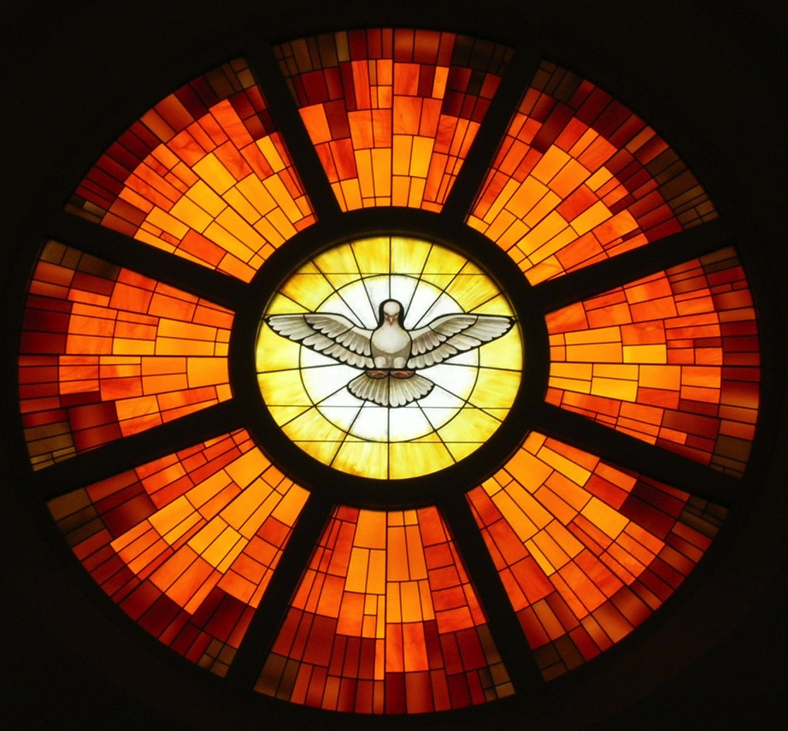
The Fruit of the Spirit
xliii
Joy
Self-Control
Peace
Gentleness
Love
Patience
Faithfulness
Kindness
Goodness
Galatians 5:22-23
Notes:
We know that God is with us, but sometimes we don’t see his fruit. Too often we’re Christian in name but atheist in practice. Since we don't live in dependence on the Holy Spirit, we lack the fruit of the Spirit…

Slide 15

Holiness
Notes:
We know that we’ll never be completely holy in this life, but we need to be holy enough for God to want to fellowship with us. So here is our practical question…

Slide 16

How can we continue to enjoy God’s presence after coming to know him?
Notes:
We experience the indwelling of the Holy God now, and he promises to stay with us, but how can we keep a sense of his fellowship?

Slide 17
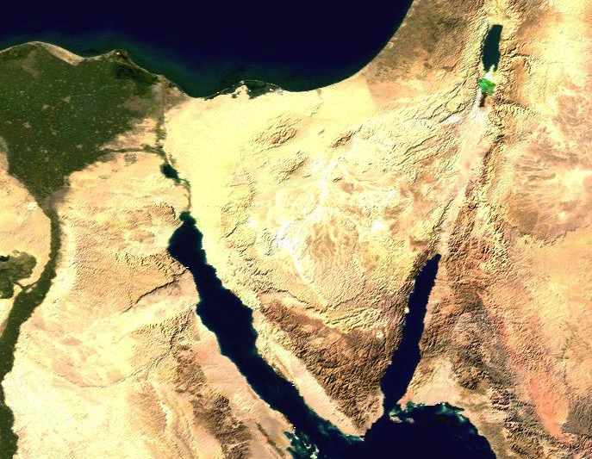
Route of the Exodus
107
111a
123
Canaan
Goshen
Marah
Desert of Sin
Elim
Midian
Mt. Sinai
Notes:
#14 in original file

Slide 18
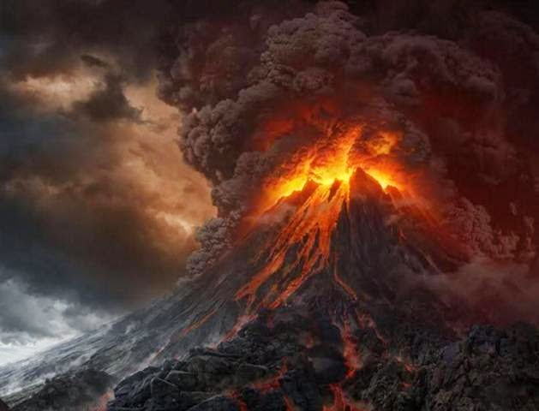
Mount Sinai
Notes:
Israel invited God’s presence at Mt. Sinai and God was pleased to dwell with them (Exodus 40:34).
Despite God’s awesome holiness at Sinai, they had come into a relationship with God though the Passover lamb at the Exodus 1–18.

Slide 19
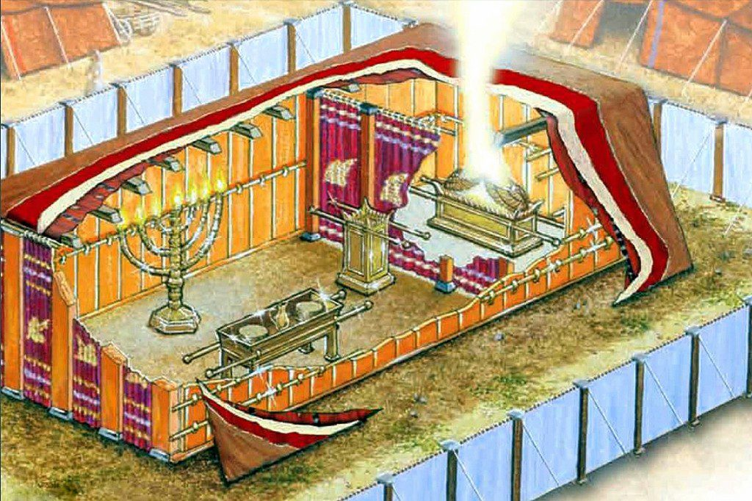
Background
Notes:
They had agreed to follow God’s laws and saw him inhabit the tabernacle just completed.

Slide 20
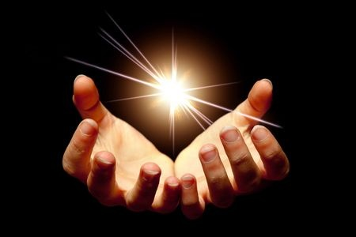
Main Idea
God saved you to enjoy his presence
Exodus

Slide 21
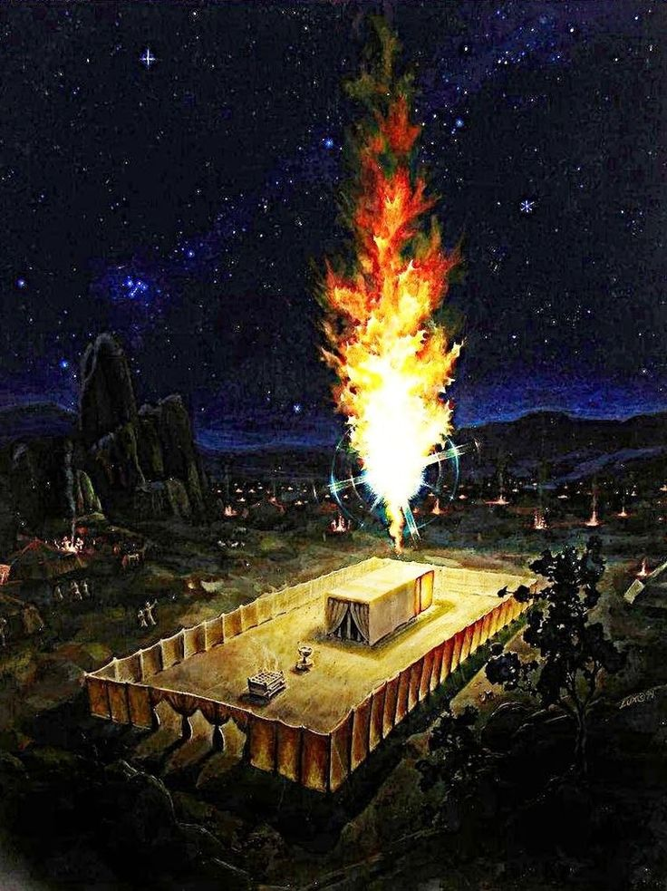
Background
Notes:
Now they stand there at the tabernacle wondering how long this will last. How could they experience God’s blessing, guidance and reality continually?

Slide 22
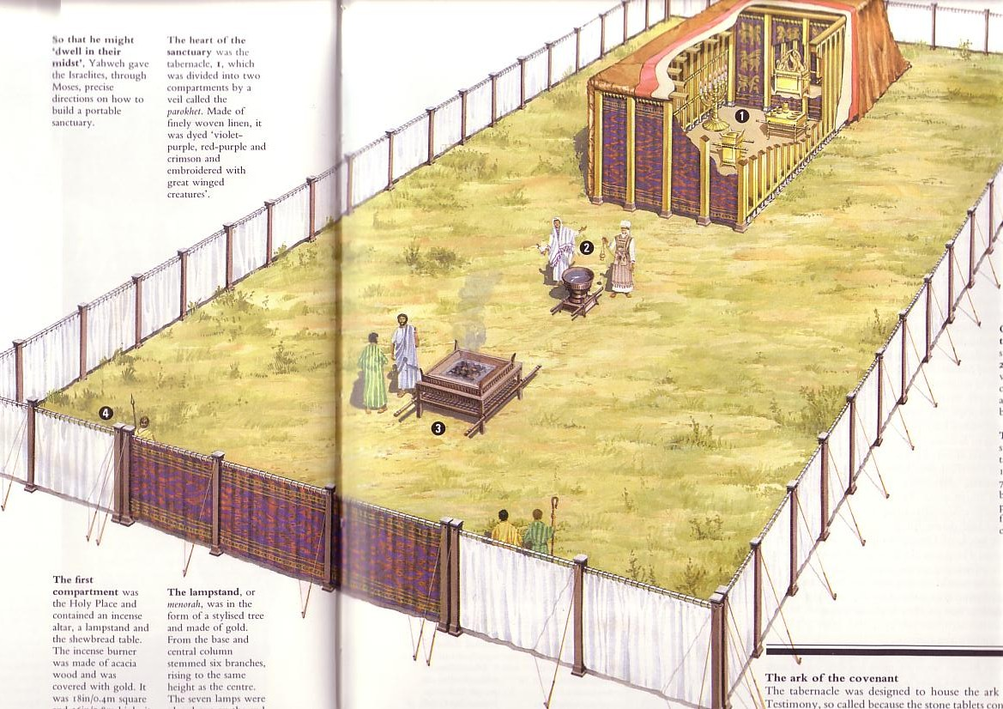
Circumstances When Leviticus Was Written
123
Israel has a new tabernacle built in the book of Exodus.
But they don't know how to use it.
So Moses wrote Leviticus to explain the worship and walk of the new nation.

Slide 23
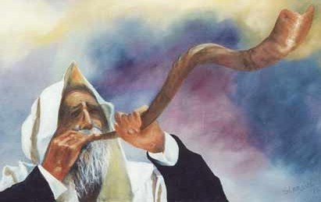
Leviticus
Sanctification
through sacrifice & separation

Slide 24
Key Word
122
39
Sanctification
= "set apart"
Leviticus

Slide 25
How can we continue to enjoy God’s presence after coming to know him?
Notes:
As Christians, we know that Jesus will never leave us or forsake us (Heb 13:5). But how can we experience his presence in our daily experience?

Slide 26
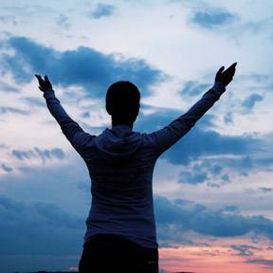
I. Confess that God is all you need.
Leviticus 1–10
Notes:
Admit that you are nothing without the LORD.

Slide 27

Which is the Most Accurate?
121a
Salvation by…
Faith + Works
Faith Alone
Faith + Works
OT
Works
Faith Alone
Faith Alone
Faith + Works
NT
Faith
• Which verses in the Bible support your answer?
cf. OTS 119e
Notes:
Did God change the means of salvation from the OT to the NT?
We are NOT talking about whether people should do good works—we all agree on that. But are works needed for salvation?
Paul answers this question in Romans 4 with the example of Abraham who was saved by faith alone—see Gen 15:6.
________
BE-03-Lev-27
OB-37-Sacrifices-72_eng_ob_1667_v5—slide 17
OB-39-Salvation-2
OS-03-Leviticus-13
OP-03-Lev-27
OP-Lev_6v24-7v10 Why All That Blood Sin & Guilt Offerings-49_eng_op_v4.0—slide 34
OS-04-Num-27
NP-Acts_15v1-35_Dont_Be_Law_Abiding_(Rick_Griffith)-61_eng_pr_v4—slide 5
NS-05-Acts15-16-slide 26
NS-Rom3-4-slide 77
NS-09-Galatians-48
NS-20-James-30
NS-23-1Jn-58
SA-03-Biblical Terms-6
SA-15-Inheritance-26

Slide 28
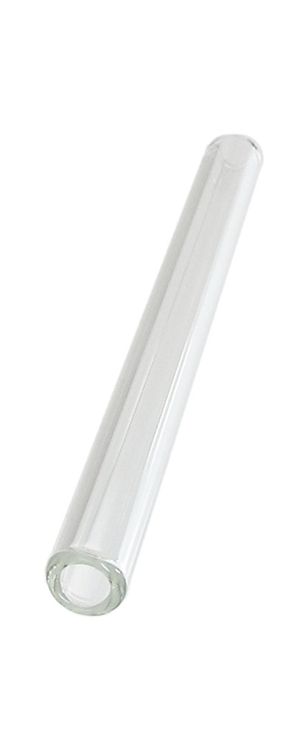
OT Forgiveness of Sin
121b
Pipe = Relationship with God (never changing)
Sin
Clog = Fellowship with God (hindered by sin)
Sacrifices = Confession of Sin (sin forgiven to restore fellowship but relationship was never threatened)
Notes:
Do we still have a relationship with God when we sin? Yes!
Sin does not hinder our relationship with God but our fellowship with Him.
OT sacrifices did not establish a relationship with God but rather they restored their fellowship with God
________
OS-03-Leviticus-14
OS-04-Num-29
OP-02-Lev-28
NS-23-1Jn-58
SA-03-Biblical Terms-9
SA-15-Inheritance-27

Slide 29
Slides on
Leviticus 1

Slide 30
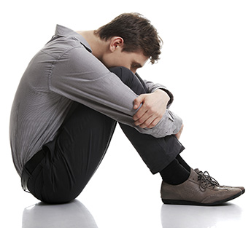
What attitude do you have about your weaknesses and sins?
Do you admit that you need forgiveness for sin?

Slide 31
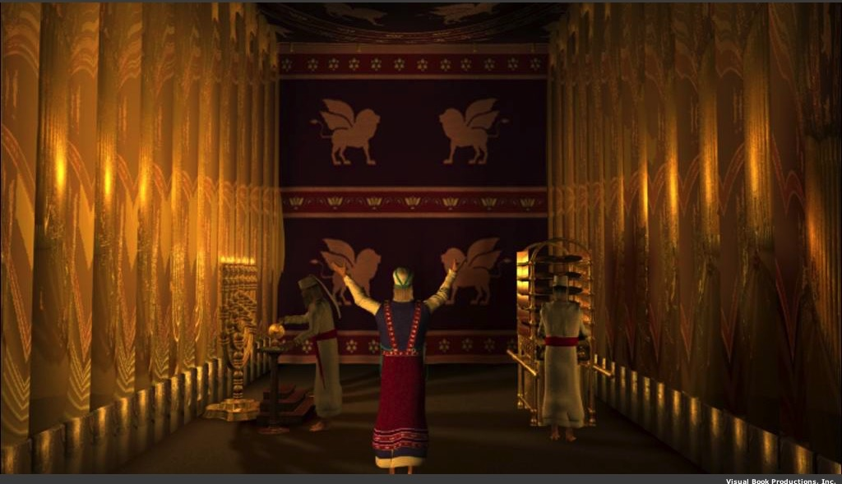
Why did God prescribe offerings for Israel's weaknesses and sins?

Slide 32
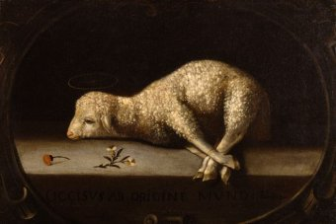
God forgave Israelites through the blood of offerings
(Lev 4:1–5:13; 6:24-30).
Notes:
Jews restored their fellowship with the Lord through sin and guilt sacrifices.

Slide 33
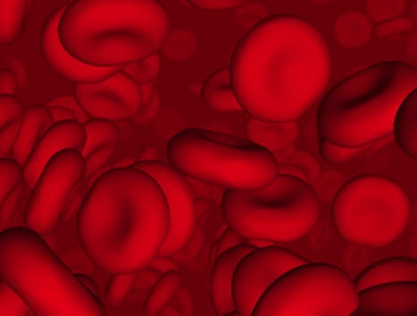
Why did God institute the sacrificial system?
Did the blood actually forgive sin?

Slide 34
Did blood sacrifices save Israelites under the Law?
BLOOD

Slide 35
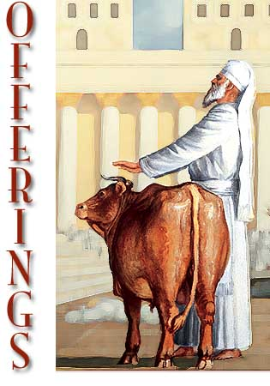
Sacrifices forgave sin
"Through this process, the priest will purify the people, making them right with the LORD, and
they will be forgiven"
(4:20 NLT; cf. 4:26, 31, 35).

Slide 36
Slides on
Leviticus 2

Slide 37
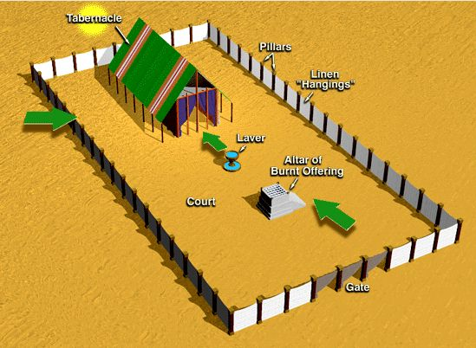
The Tabernacle & Courtyard
Tabernacle
Pillars
Linen "Hangings"
Laver
Altar of Burnt Offering
Court
Gate
Notes:
#35 in original file

Slide 38
Offering Rituals in Lev. 1–5
128
The worshipper presents his offering
He lays his hand(s) upon the victim, and possibly confesses his sin.
3. The worshipper slaughters the offering.
R. T. Beckwith, New Bible Dictionary, 1962

Slide 39
Offering Rituals in Lev. 1–5
128
4. The priest collects the blood in a basin and dashes it against the NE and SW corners of the altar in such a way that all four sides are spattered. The remainder of the blood is then poured out at the base of the altar.
R. T. Beckwith, New Bible Dictionary, 1962

Slide 40
Offering Rituals in Lev. 1–5
128
5. A portion of the sacrifice is burned.
6. Any remaining portions of the sacrifice were eaten in a sacrificial meal, either by the priests and worshippers (fellowship-offering), or by the priests and their families, or by the priests alone.
R. T. Beckwith, New Bible Dictionary, 1962

Slide 41
Slides on
Leviticus 3

Slide 42
Old Testament Sacrifices
128
NAME
OT TEXTS
ELEMENTS
PURPOSE
BURNT OFFERING
Lev 1
6:8-13
8:18-21
16:24
Perfect bull, ram or male bird (dove or young pigeon for poor); wholly consumed
Voluntary act of worship; atone for unintentional sin in general; expression of surrender to God
GRAIN OFFERING
Lev 2
6:14-23
Grain, flour, olive oil, incense, bread, with salt & burnt or fellowship offering
Voluntary act of worship; recognition of God's goodness and provisions; devotion to God
The Bible Visual Resource Book, 29

Slide 43

Romans 12:1
154e
"Offer your body as a
living sacrifice…"

Slide 44


ROMANS 12:2
BE TRANSFORMED
BY THE RENEWING OF YOUR MIND

Slide 45
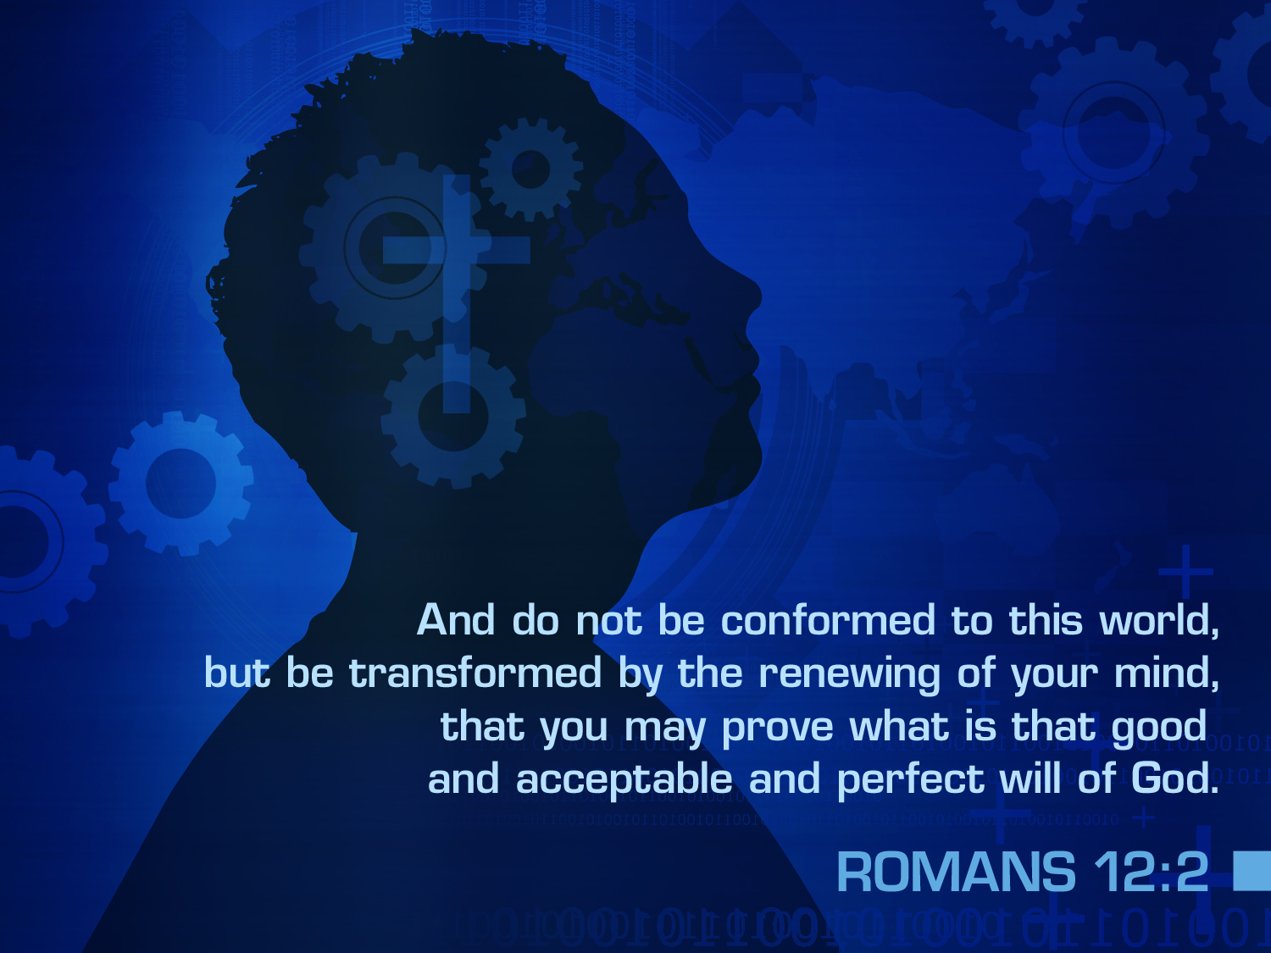

ROMANS 12:2
And do not be conformed to this world,
but be transformed by the renewing of your mind,
that you may prove what is that good
and acceptable and perfect will of God.

Slide 46
Old Testament Sacrifices
128
NAME
OT TEXTS
ELEMENTS
PURPOSE
FELLOWSHIP OFFERING
Lev 3
7:11-34
Perfect goat or sheep; variety of breads
Voluntary; thanksgiving with group meal
SIN
OFFERING
Lev 4:1–5:13 6:24-30
8:14-17
16:3-22
Perfect bull, goat, or lamb; dove/pigeon (poor); 1/10 ephah fine flour for very poor
Mandatory; atoned for unintentional sin; confession, forgiveness & cleansing
GUILT OFFERING
Lev 5:14–6:7
7:1-6
Perfect ram or lamb
Mandatory to atone for unintentional sin; pay 20% fine
The Bible Visual Resource Book, 29

Slide 47
Slides on
Leviticus 4

Slide 48
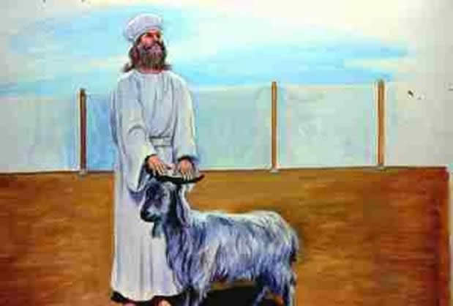
The blood of the sin offering forgave unintentional sin (4:1–5:13; 6:24-30).

Slide 49
Slides on
Leviticus 5

Slide 50
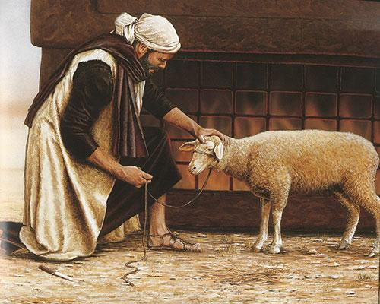
The blood and restitution of the guilt offering forgave unintentional sin
(5:14–6:7; 7:1-10).
+20%

Slide 51
Slides on
Leviticus 6

Slide 52
Offerings in Leviticus 1–7
128
Whole burnt offering
Grain offering
Fellowship offering
Sin offering
Guilt offering
Consecration
Voluntary
Cleansing
Obligatory

Slide 53
Slides on
Leviticus 7

Slide 54
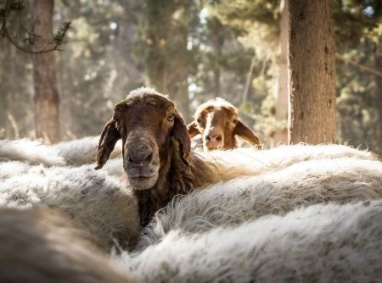
Do animals save?

Slide 55
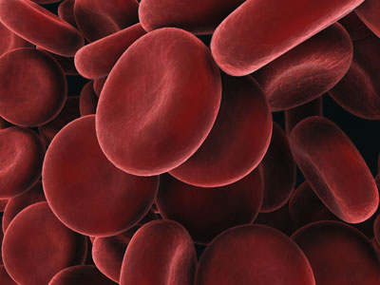
God forgives us though the blood of Christ
So why did God send Jesus?
Notes:
We restore our fellowship with God with Jesus' blood that saves us.

Slide 56
NT Forgiveness of Sin
121b
"If we confess our sins,
He is faithful and righteous to forgive us our sins and to cleanse us from all unrighteousness"
(1 John 1:9 NAU)
Pipe = Relationship with God (never changing)
Sin
Clog = Fellowship with God (hindered by sin)
Christ's Sacrifice = The Basis for Confession of Sin (sin is forgiven to restore fellowship but relationship has never been never threatened)
Notes:
Our relationship with God can be compared to a pipe.
Occasionally the pipe gets a clog—like sin—that hinders our fellowship with God.
Do we still have a relationship with God when we sin? Yes!
Sin does not hinder our relationship with God but our fellowship with Him.
_________
OB-38-Salvation-11
OS-03-Leviticus-56, 72, 130
OS-04-Numbers-30
NS-23-1Jn-59
SA-03-Biblical Terms-9
SA-15-Inheritance-28

Slide 57
Blood & Forgiveness
"In fact, the law requires that nearly everything be cleansed with blood, and without the shedding of blood there is no forgiveness."
Hebrews 9:22 (NIV)

Slide 58
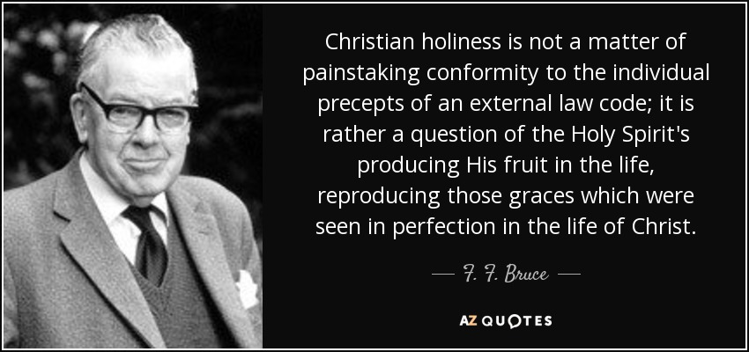
Holiness
Christian holiness is not a matter of painstaking conformity to the individual precepts of an external law code; it is rather a question of the Holy Spirit's producing His fruit in the life, reproducing those graces which were seen in perfection in the life of Christ.
——F. F. Bruce——

Slide 59
Slides on
Leviticus 8

Slide 60
Leviticus 8-10 Chart
124
Offerings 1–7
Priests 8–10
Directions 6:8–7:38
Worship 1–3
Restoration 4–6:7
  Contaminated 10
  Commenced 8–9
Sacrifices
Worship

Slide 61
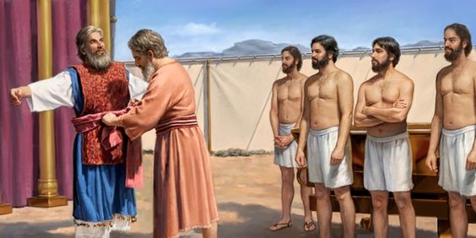
The Priesthood Begins
125
"Next Moses presented Aaron's sons. He clothed them in their tunics, tied their sashes around them, and put their special head coverings on them, just as the Lord had commanded him" (Leviticus 8:13 NLT).

Slide 62
Slides on
Leviticus 9

Slide 63
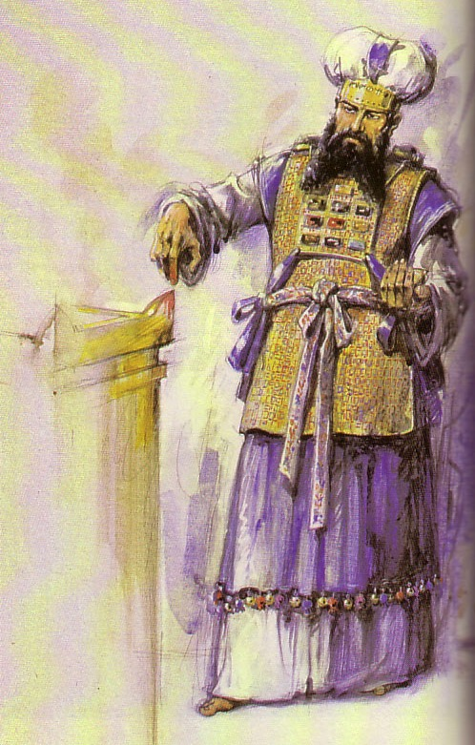
Ordination of Aaron and His Sons as Priests
Leviticus 8–10

Slide 64
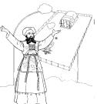
Contrasting Levites and Priests
132
Abraham
Isaac
Jacob
12 Sons: Reuben–Simeon–Levi–Judah– etc.
All other lines Aaron
Levites Priests
see p. 171a see p. 202

Slide 65
Contrasting Levites and Priests
132
Levites
Priests
Descendants of…
Levi
Aaron (also a descendant of Levi)
Population
Many (the larger group)
Few (a subset of the Levites, Josh. 21:4)
Role
Assisted priests and supervised religious activities permitted outside of the sanctuary: teaching, singing, leading worship, officials, administration, judges & gatekeepers
Mediators between God and Israel
Sacrificial Role
Didn't offer sacrifices though they did offer incense (Deut. 33:10b)
Offered sacrifices (Deut. 33:10b)
Location of Homes
Extensive–in 35 cities throughout the tribes in the central, northern, and eastern parts of Israel (Josh. 21:5-7)
Limited to 13 cities in Judah, Simeon, & Benjamin that were near the temple (Josh. 21:4, 9-13)

Slide 66
Slides on
Leviticus 10

Slide 67
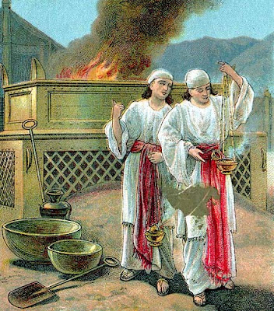
Nadab & Abihu
125
Leviticus 10

Slide 68
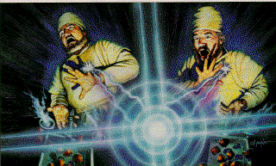
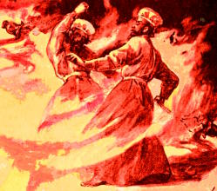
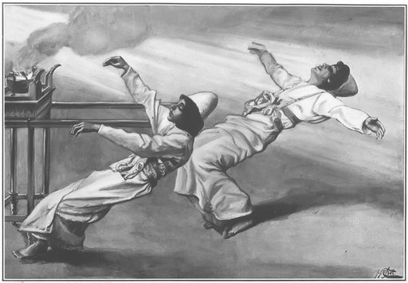
Nadab & Abihu
125
Leviticus 10

Slide 69
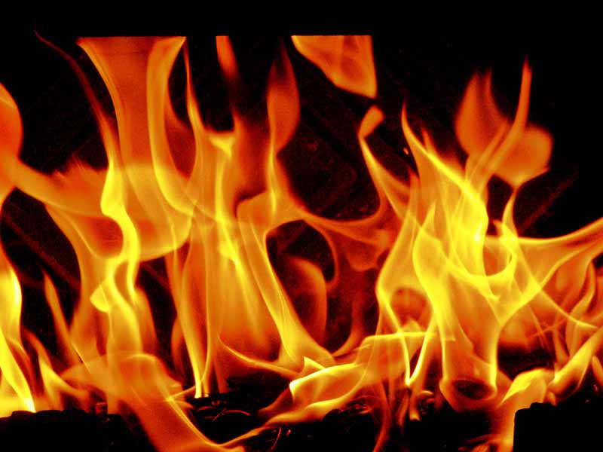
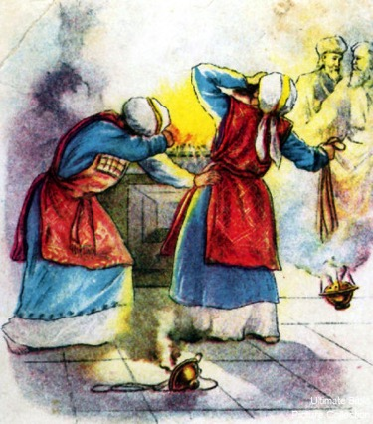
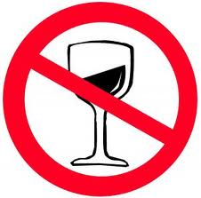
Nadab & Abihu
125
Then the LORD said to Aaron, "You and your descendants must never drink wine or any other alcoholic drink before going into the Tabernacle.
If you do, you will die. This is a permanent law for you, and it must be observed from generation to generation."
Leviticus 10:8-9

Slide 70
Levi's Family Tree
125
202
Levi's Family Tree
LEVI
Gershon
Kohath
Merari
Levites
Amram
Priests
High Priest
Miriam
Aaron
Moses
Offered
Unauthorised Fire;
Killed by God
Nadab
Abihu
Eleazar
Ithamar
Adapted from Manna Bible Maps
Manna

Slide 71
I. Confess that God is all you need.
Leviticus 1–10
Notes:
Admit that you are nothing without the LORD.

Slide 72
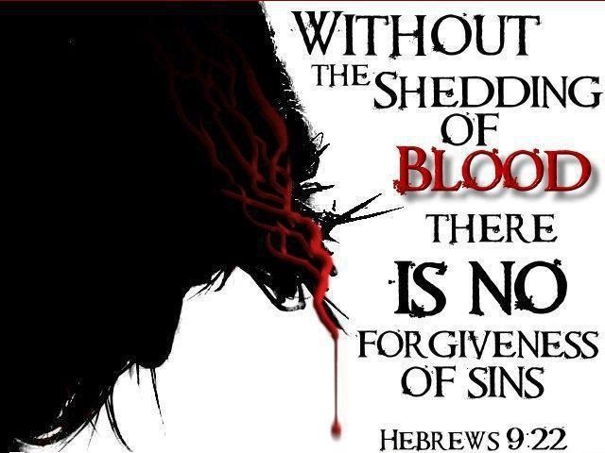
Without the shedding of
BLOOD there is no forgiveness of sins
Hebrews 9:22

Slide 73
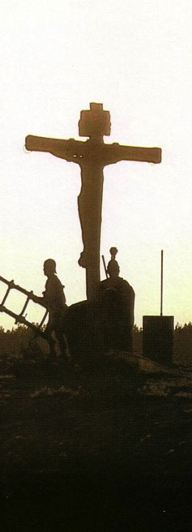
Salvation in All Ages:
The Centrality of the Cross
B.C.
Looked forward to the
Cross of Christ
A.D.
Look
back at the
Cross of Christ
Notes:
It helped me see the centrality of the cross—how people before Jesus believed by looking toward the cross while those of us after Jesus look back at the cross. In other words…
The grounds of salvation has always been the death of Christ—for believers before and after the cross.
____________________
Common English-78
BE-03-Leviticus-73
OB-37-Sacrifices-19
OB-38-Salvation-4
OS-03-Leviticus-193
NS-09-Galatians-16, 50
NS-20-James-32
SA-03-Biblical Terminology-10
SA-15-Inheritance-26

Slide 74
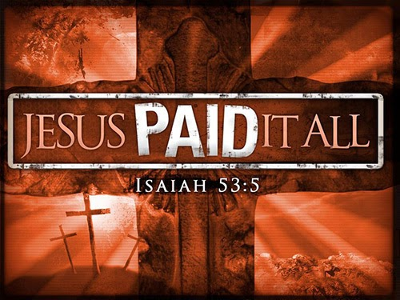
Focus of Leviticus 1–10
JESUS PAID IT ALL
Jesus is our sin offering and our High Priest.

Slide 75
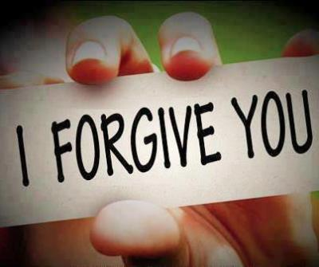
How can Christ's blood forgive our sins?

Slide 76
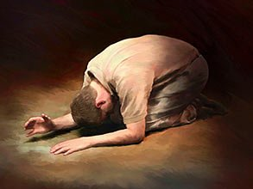
Christ's blood forgives in two ways:
Trusting in Christ's blood puts unbelievers in a relationship with God
—Confess Jesus as Saviour—
Confessing our sins restores the
believers in their fellowship with God
—Confess Jesus as Lord—

Slide 77
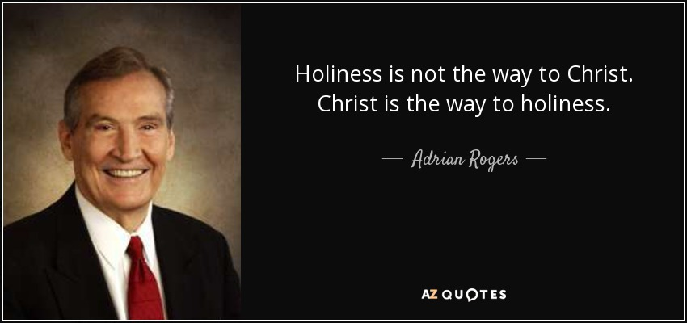
Holiness
Holiness is not the way to Christ. Christ is the way to holiness.
——Adrian Rogers——

Slide 78
Slides on
Leviticus 11

Slide 79
How can we continue to enjoy God’s presence after coming to know him?

Slide 80
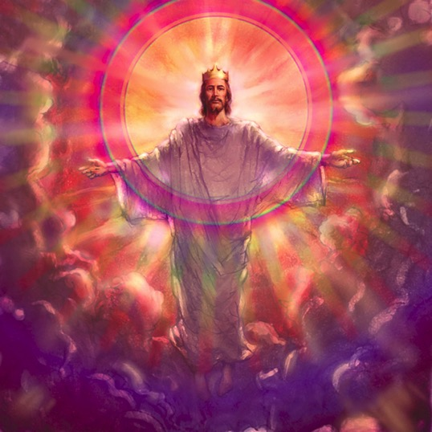
Argument
123
Two ways Israel could be holy (11:45):
Sacrifices (1-10)
Separation from the paganism of her neighbors (11-27)

Slide 81
I. Confess that God is all you need (Lev 1–10).

Slide 82
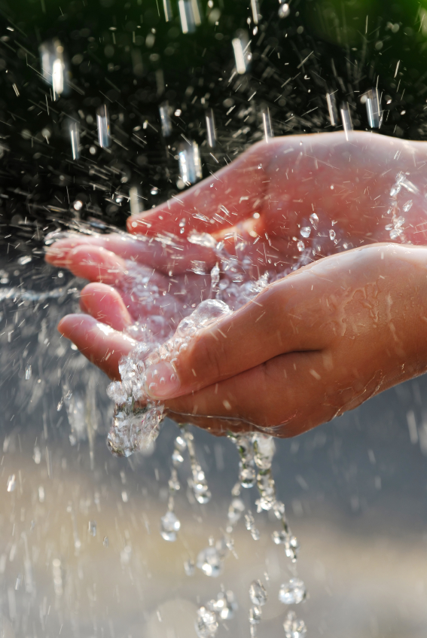
II. Practice godly habits
(Lev 11–27).

Slide 83

Leviticus
122
Sanctification through sacrifice and separation
Purpose: that the LORD might be able to remain with the nation
Place: Mount Sinai
Time: One Month
Chapters 1–10
Chapters 11–27
Sacrifice
Separation
Worshipping a Holy God
Walking with a Holy God
Securing Fellowship with God
Continuing Fellowship with God
Approaching God
Appeasing God
Perfect Sacrifices
(1–7)
Perfect Priests
(8–10)
Laws of Sanctification for…
(11–27)
Uncleanness
(11–15)
Unintentional Sin (16)
Tabernacle
(17)
Crimes
(18–20)
Priests
(21–22)
Worship
(23–24)
Canaan
(25–26)
Vows
(27)

Slide 84
Leviticus 11-16 Chart
124
Offerings 1–7
Priests 8–10
Purity 11–16
Directions 6:8–7:38
Worship 1–3
Restoration 4–6:7
  Atonement 16
  Contaminated 10
  Commenced 8–9
  Body 12–15
  Food 11
Sacrifices
Separation
Worship
Walk

Slide 85

Clean and Unclean (Lev. 11)
Clean = life, health, holiness
Unclean = death, illness, profane
Separation and special status

Slide 86

What foods?
125
Camel, rabbit, bacon, ham, snake, and the eagle, vulture, raven, certain kites and owls, the gull, any kind of hawk, the stork, any kind of heron, and the bat.
Leviticus 11

Slide 87

"Get up, Peter! Kill and eat!"
Peter Prep
  Eat "unclean" food (Acts 10:8-16)
    The sheet "contained all kinds of four-footed animals, as well as reptiles of the earth and birds of the air" (Acts 10:12)

Slide 88
Clean & Unclean (Lev. 11)
125
Clean = life, health, holiness
Unclean = death, illness, profane
Separation and special status

Slide 89


Lamb

Slide 90
Why No Pork? (And Other Law Questions)
131
Issue | Law Command | Reasons
Why not eat pork, bacon, or ham? | "And the pig, though it has a split hoof completely divided, does not chew the cud; it is unclean for you" (Lev. 11:7-8). | Prohibited foods: (1) carried disease (2) are… uneconomical to raise (3) are favored for pagan sacrifice Food laws… kept Israel away from some allergies [but] the main source of Israel's meat–lamb–is the least allergic of all major meats (Fee & Stuart, 145).

Slide 91
Slides on
Leviticus 12

Slide 92
Why No Pork? (And Other Law Questions)
131
Issue | Law Command | Reasons
Why require circum-cision (Lev 12:13)? | "You are to undergo circumcision, and it will be the sign of the covenant between me and you" (Gen. 17:11). | Jewish women have far less cervical cancer than those married to uncircumcised men. Uncircumcised men can deposit cancer-producing bacteria in the uterus. The eighth day of life has the highest levels of vitamin K and prothrombin for clotting blood.

Slide 93

Circumcision, Vitamin K & Prothrombin
Available Prothrombin
Prothrombin (% of Normal)
Prothrombin Concentration
Days
Notes:
Circumcision is not bad in itself. God commanded it in the OT on the eighth day of a Jewish boy's life, which had the highest blood-clotting Prothrombin of any day in a male's life.
However, the problem was with God's people, who made circumcision a requirement for salvation that had to be imposed on the Gentiles as well as the Jews.

Slide 94

"So Christ has truly set us free. Now make sure that you stay free, and don't get tied up again in slavery to the law" (Gal. 5:1 NLT).
"Listen! I, Paul, tell you this: If you are counting on circumcision to make you right with God, then Christ will be of no benefit to you. ³I'll say it again. If you are trying to find favor with God by being circumcised, you must obey every regulation in the whole law of Moses. ⁴For if you are trying to make yourselves right with God by keeping the law, you have been cut off from Christ! You have fallen away from God's grace" (5:2-4 NLT).

Slide 95
Slides on
Leviticus 13

Slide 96

Is God compassionate?
"Those who suffer from a serious skin disease must tear their clothing and leave their hair uncombed. They must cover their mouth and call out, 'Unclean! Unclean!' ⁴⁶As long as the serious disease lasts, they will be ceremonially unclean. They must live in isolation in their place outside the camp"
(Lev 13:45-46 NLT).

Slide 97

How could a leper be lifted out of his plight?

Slide 98
Why No Pork? (And Other Law Questions)
131
Issue | Law Command | Reasons
"Lepers feel bad about their disease, so why isolate them?" | "The priest is to examine the sore on his skin… If the spot on his skin is white… the priest is to put the infected person in isolation for seven days… He must live alone… outside the camp" (Lev. 13:3-4, 46). | Between the 6th-14th centuries leprosy killed hundreds of millions of Europeans. Some suggested unsuccessful, wild ideas. After the physicians had nearly given up, the Church suggested the scriptural quarantine of lepers, which finally stopped the dreadful plague

Slide 99
Slides on
Leviticus 14

Slide 100
Why No Pork? (And Other Law Questions)
131
Issue | Law Command | Reasons
What's wrong with mixing meat and milk? | "Do not cook a young goat in its mother's milk" (Deut. 14:21; Exod 23:19; 34:26). | Avoid Canaanite fertility practices (2) Calcium cannot be assimilated easily on a milk and meat diet, which weakens teeth and slows the healing of broken bones

Slide 101
Slides on
Leviticus 16

Slide 102

Day of Atonement (Lev. 16:29-34)
Courtyard
Holy Place
Holy of Holies

Slide 103

"Then he must take the two male goats and present them to the Lord at the entrance of the Tabernacle. ⁸He is to cast sacred lots to determine which goat will be reserved as an offering to the Lord and which will carry the sins of the people to the wilderness of Azazel" (Leviticus 16:7-8 NLT).

Slide 104

"Aaron will then present as a sin offering the goat chosen by lot for the LORD"
(Leviticus 16:9 NLT).

Slide 105

"Then Aaron must slaughter the first goat as a sin offering for the people and carry its blood behind the inner curtain.
There he will sprinkle the goat's blood over the atonement cover and in front of it, just as he did with the bull's blood"
(Leviticus 16:15 NLT).

Slide 106

"As the goat goes into the wilderness, it will carry all the people's sins upon itself into a desolate land" (Leviticus 16:22).

Slide 107

"So Christ has now become the High Priest over all the good things that have come. He has entered that greater, more perfect Tabernacle in heaven, which was not made by human hands and is not part of this created world"
(Hebrews 9:11 NLT).

Slide 108
Slides on
Leviticus 17

Slide 109

Blood?
127a
What's the Significance of
"In fact, the law requires that nearly everything be cleansed with blood, and without the shedding of blood there is no forgiveness" (Heb. 9:22 NIV)

Slide 110

"The life is in the blood"
127a
"For the life of a creature is in the blood, and I have given it to you to make atonement for yourselves on the altar; it is the blood that makes atonement for one's life" (Lev. 17:11)

Slide 111

Once with His Own Blood for All!
"He did not enter by means of the blood of goats and calves; but he entered the Most Holy Place once for all by his own blood, having obtained eternal redemption."
Hebrews 9:12 (NIV)

Slide 112
No More Atonement Needed
"Nor did he enter heaven to offer himself again and again, the way the high priest enters the Most Holy Place every year with blood that is not his own."
Hebrews 9:25 (NIV)

Slide 113
Sin Done Away With (Not Just Covered)
"Then Christ would have had to suffer many times since the creation of the world. But now he has appeared once for all at the end of the ages to do away with sin by the sacrifice of himself."
Hebrews 9:26 (NIV)

Slide 114
A Seat in the Holy of Holies?
"But when this priest had offered for all time one sacrifice for sins, he sat down at the right hand of God."
Hebrews 10:12 (NIV)

Slide 115
Slides on
Leviticus 18

Slide 116

Homosexuality
“Do not practice homosexuality, having sex with another man as with a woman. It is a detestable sin."
——Leviticus 18:22 NLT——

Slide 117
Slides on
Leviticus 19

Slide 118

"So Christ has truly set us free. Now make sure that you stay free, and don't get tied up again in slavery to the law" (Gal. 5:1 NLT).
No Prisons or Jails in the Law of Moses
Notes:
Slavery Instead of Jails in Mosaic Legal System!
Have you ever noticed that there were no prisons in the law of Moses? People were stoned, beaten, fined but NEVER sent to prison or confined in any way including shackles or stocks etc. This brand new study sheds a positive light on the role slavery had in rehabilitating criminals and providing welfare for the poor. Confinement was something completely foreign in the Jewish Legal system.
See the full article at http://www.bible.ca/sin-no-jails-prisons-in-judaism-old-testament-law-of-moses-slavery-welfare-jewish-comparison.htm

Slide 119

Leviticus 19:28
"Do not cut your bodies for the dead, and do not mark your skin with tattoos. I am the LORD."

Slide 120
Slides on
Leviticus 21

Slide 121

Leviticus 21 Requirements:
179
What Did it Take to Be a Priest?
Ritually clean (1-4)
No shaven heads, beards, or bodies (5)
Marriage to a divorcee prohibited (7)
Marriage to a former harlot prohibited (7, 14)
Not physically disabled (17-21)

Slide 122
Slides on
Leviticus 22

Slide 123

Uniqueness:
179
How did Israel's Priests Differ from Pagan Priesthoods?
Genealogically determined
Appointed by God
Salary paid by worshippers
No tribal allotment
High standards
Served two weeks annually

Slide 124
Slides on
Leviticus 23

Slide 125




Bible Feasts
134
Holy Day Celebrations in the Old Testament

Slide 126
Feasts Historically Looked Backward to Israel's Past
134
1 Nisan
2 Iyar
3 Sivan
4 Tammuz
5 Av
6 Elul
7 Tishri
8 Cheshvan
9 Kislev
10 Tevet
11 Shevat
12 Adar
Passover
Unleavened Bread
Firstfruits
Pentecost
Tabernacles/Booths
Day of Atonement
Trumpets
3 Pilgrimage Feasts

Slide 127
Feasts Also Prophetically Look Forward to Israel's Future
134
1 Nisan
2 Iyar
3 Sivan
4 Tammuz
5 Av
6 Elul
7 Tishri
8 Cheshvan
9 Kislev
10 Tevet
11 Shevat
12 Adar
Passover
Redemption
Unleavened Bread
Separation
Firstfruits
Resurrection
Pentecost
Spirit
Kingdom
Tabernacles/Booths
Repentance
Day of Atonement
Rapture
Trumpets
3 Pilgrimage Feasts

Slide 128
Leviticus 23 Feasts
134
1 Nisan
2 Iyar
3 Sivan
4 Tammuz
5 Av
6 Ellul
7 Tishri
8 Cheshvan
9 Kislev
10 Tevet
11 Shevat
12 Adar
(Passover)
Redemption
(Unleavened Bread)
Separation
(Firstfruits)
Resurrection
WINTER
SUMMER
(Pentecost)
Spirit
Kingdom
(Tabernacles/Booths)
Repentance
(Day of Atonement)
Rapture
(Trumpets)
3 Pilgrimage Feasts

Slide 129
Slides on
Leviticus 26

Slide 130
Prophetic Curses
220
Why?
Exile
Lev 26 &
Deut 28
Notes:
Jeremiah's prophecy and Lamentations record his eyewitness account of Babylon's siege and destruction of Jerusalem for the nation's sin, the Holy Spirit moved him to record an historical compilation which provides the context and justification for God's judgment upon these two nations. The leaders and the people sinned through ungodliness and idolatry, and true to the curses of Deut. 28, God gave the people the consequences of their obedience.

Slide 131
Slides on
Leviticus 27

Slide 132

Our habits must reflect God’s holiness

Slide 133
Interpreting and
Preaching Legal Literature
113
1. Interpretation: Study the intent behind the legal command, asking, "Why was this command given in Israel?"
2. Principlizing: State the law's intent in a general principle showing God's character.
3. Application: Show how this principle relates to a modern parallel situation.

Slide 134

A Suggested Strategy for Expounding the OT Law
113
Principlizing: Universal truth
Interpretation:
Intent behind
the command
Application:
Parallel Modern
Situation

Slide 135
Application
122
We as believers need to continually separate (sanctify) ourselves by confessing our sin and walking in holiness before God in order to experience His presence with us.
Notes:
One worship leader at another church recently got drunk.
The movies we see Saturday night should reinforce what we learn Sunday morning.

Slide 136
How can we continue to enjoy God’s presence after coming to know him?

Slide 137

Main Idea
Be holy as God is holy.
Leviticus

Slide 138
I. Confess that God is all you need (Lev 1–10).

Slide 139
II. Practice godly habits
(Lev 11–27).

Slide 140

Holiness
How little people know who think that holiness is dull... When one meets the real thing, it's irresistible!
——C. S. Lewis——

Slide 141

What practice in your life must you confess and purge?
Follow peace with all men, and holiness, without which no man shall see the Lord.
Hebrews 12:14 KJV

Slide 142
Black

Slide 143


OT Preaching link at BibleStudyDownloads.org
Get this presentation and script for free!

