Slide 1
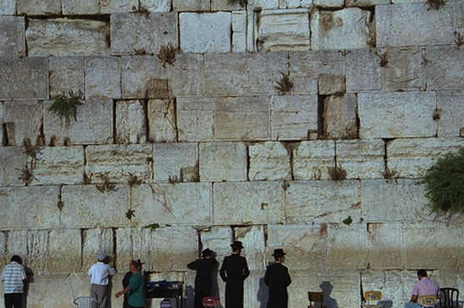
Biblical
Bedrock
PART 2
Designed by Dr. John Fryman, Texas, USA
Taught by Dr. Rick Griffith, Jordan Evangelical Theological Seminary
All files in many languages for free download at BibleStudyDownloads.org

Slide 2


THE BIBLE... BASICALLY
©2006 TBBMI

Slide 3

GOD'S SPECIAL ARRANGEMENT WITH MOSES
I
II
III
IV
V
VI
VII
VIII
IX
X
FROM THE OLD TESTAMENT
BOOK OF EXODUS:
STUDY HELP #15
"THE MOSAIC COVENANT"
WHAT ABOUT
THIS ARRANGEMENT?
9.65.05B.
©2006 TBBMI
01
Notes:
We'll be using Study Help #15 for this
//// Look at The MOSAIC COVENANT or MOSAIC LAW in the book of Exodus.
//// What about this arrangement? We must consider it in order to have the complete picture.

Slide 4
I
II
III
IV
V
VI
VII
VIII
IX
X
MOSES
EXODUS
SINAI
M - C - C
"M-C-C"
M - C - C
KADESH BARNEA
40
Moral
Civil
Ceremonial
5 SERMONS
02
1
Notes:
In the MOSES Bible File, remember the item M-C-C?
//// M-C-C: standing for MORAL...CIVIL...CEREMONIAL parts of the new Law. Many scholars and teachers have organized the Mosaic Law into those main parts…as God dictated to Moses—twice, by the way – atop Mt. Sinai.

Slide 5
REMEMBER THE CONTEXT!
I
II
III
IV
V
VI
VII
VIII
IX
X
• EGYPTIAN BONDAGE: 400 YEARS
• POOR CULTURAL & CIVIC DEVELOPMENT
• RELATING TO GOD: A MYSTERY?
SO…
• THE MOSAIC LAW BECOMES A MAJOR STEP IN DEVELOPMENT OF THE ISRAELITES' RELATIONSHIP TO GOD…AND AMONG THEMSELVES!
03
4
©2006 TBBMI
9.65.05B.
Notes:
Remember also the context for these Laws.
//// The Israelites had been in Egyptian bondage for four long centuries...hard labor...
//// poor or very little cultural and civic development...probably deeply lacking in experience in relating to each other in a civilized society...having no time for development of higher levels of interpersonal relationships..
//// And certainly, little direction on how to maintain a growing relationship with their Creator God. ..the God of Abraham, Isaac, and Jacob. It had become a mystery…perhaps only a distant memory.
//// So…the Mosaic Law then becomes a major step in the development of the Israelites as they mature in their relationship to God while learning to behave among themselves as the Chosen People.
SO YOU SEE…THERE IS ALWAYS A CONTEXTUAL REASON FOR EVERY BIBLICAL EVENT OR INSTRUCTION.

Slide 6
I
II
III
IV
V
VI
VII
VIII
IX
X
The Distinction:
The Mosaic Covenant
had a BEGINNING
and it had an
END!
04
1
Notes:
But there is one most important distinction between the Abrahamic and the Mosaic arrangements. And here it is…
//// ….the MOSAIC COVENANT had a beginning --- as did the Abrahamic, of course --- but THE MOSAIC also had an END. As of this moment, the Abrahamic Contract is still running while the Mosaic ended at Calvary…as we will shortly see!

Slide 7
MOSAIC
"THE MOSAIC COVENANT"
I
II
III
IV
V
VI
VII
VIII
IX
X
"M"
EXODUS CHAPTER 20:
THE DECALOGUE
"The Ten Commandments"
MORAL
The First Table –
Duties to God (Verses 1-12)
The Lord your God
No other gods before Him
No idols or likenesses of Him
No worship of other gods
Sanctity of the Lord's name
Keeping the Sabbath Day holy
Working six days
Resting on the Sabbath...
05
12
Notes:
Here's a quick tour of the parts of the Mosaic Covenant from
//// the 20th Chapter of Exodus, sometimes called the Decalogue…
//// containing the familiar TEN COMMANDMENTS...
//// Beginning with M...for the MORAL parts of the Mosaic Covenant...THE LAW...or, in Hebrew, the Torah.
The MORAL part of the law is traditionally divided into two TABLES...
//// …the first table being the Israelites' duties to God...Exodus 20, verses 1-12:
//// Briefly, Moses is given directions for proper respect to "the Lord your God.”(Intro)
//// that there should be no other gods before him... (TC1)
//// no idols or likenesses of him (TC2)
//// no worship of other gods...
//// attention to the sanctity of the Lord's name... (TC3)
//// keeping the Sabbath Day holy... (TC4)
//// working only six days...
//// and resting on the Sabbath. This is the FIRST TABLE...man's duties to God alone

Slide 8
"THE MOSAIC COVENANT"
I
II
III
IV
V
VI
VII
VIII
IX
X
"M"
EXODUS CHAPTER 20:
THE DECALOGUE
"The Ten Commandments"
MORAL
The First Table –
Duties to God (Verses 1-12)
The Second Table –
Duties to Men (verses 13-17)
Parents to be honored
The forbidden acts:
Murder
Adultery
Stealing
Lying
Coveting Persons & Things...
06
7
Notes:
Then verses 13-17 – The Second Table -- are directed to duties to Man.
//// Such as honoring our parents...
//// and the several forbidden acts...
//// murder...
//// adultery...
//// stealing...
//// lying...
//// and coveting the persons and things belonging to others

Slide 9
"THE MOSAIC COVENANT"
I
II
III
IV
V
VI
VII
VIII
IX
X
EXODUS CHAPTER 20:
THE DECALOGUE
"M"
"The Ten Commandments"
The First Table –
Duties to God (Verses 1-12)
The Second Table –
Duties to Men (verses 13-17)
"C"
CHAPTERS 21–24:
THE SOCIAL ORDINANCES
CIVIL
Personal rights
Property rights
Requirements for personal integrity...
07
4
Notes:
Now the FIRST "C" of the M-C-C idea...the CIVIL part of the Mosaic Law...these are the so-called Social ordinances….
//// CHAPTERS 21 THROUGH 24....in other words....how to get along with one another...out in the desert, later in their settlements...because the wilderness wanderings are lying just ahead in Israel's dramatic future. Here we find the Lord's fundamental directions regarding
//// personal rights...
//// property rights...and
//// basic ideas for personal integrity. The Social Ordinances.

Slide 10
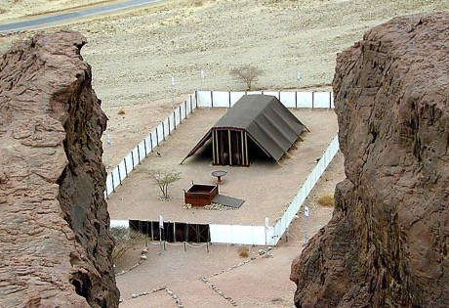
"THE MOSAIC COVENANT"
I
II
III
IV
V
VI
VII
VIII
IX
X
EXODUS CHAPTER 20:
THE DECALOGUE
"M"
"The Ten Commandments"
Its Ark, Table and Candlestick
The First Table –
Duties to God (Verses 1-12)
Special Ordinances
Its General Construction
The Bronze Altar and the Court
The Second Table –
Duties to Men (verses 13-17)
A System of Worship
Its Priesthood
Consecration of the Priesthood
"C"
Guidelines for Living
CHAPTER 21-24:
THE SOCIAL ORDINANCES
The Altar of Incense and the Worshippers
The Workmen and the Sabbath...
"C"
CHAPTERS 25–31:
THE TABERNACLE ORDINANCES
CEREMONIAL
08
11
Notes:
And the FINAL "C" of M-C-C...this one representing the CEREMONIAL part of the Law.
//// Chapters 25-31: called the Tabernacle Ordinances…that ancient worship center shown here in a modern model out in today's Israeli desert…built according to the Old Testament directions. And again we must remember that these new regulations were being provided for a people just coming out of four centuries of debilitating slavery and a culturally stunted growth.
//// These SPECIAL ORDINANCES were given to turn the people directly to the worship of their God while providing them
//// with A SYSTEM OF WORSHIP in the new Tabernacle, along with the new
//// GUIDELINES FOR LIVING among themselves, alone, and in the conditions of the desert wilderness.
//// Which included…the Tabernacle's Ark, Table, and Candlestick
//// Directions for its General Construction,
//// The Bronze Altar and the Court,
//// Its Priesthood for its ritual services,
//// Consecration of the Priesthood,
//// The Altar of Incense and the Worshippers, and
//// The Workmen in relation to the Sabbath.

Slide 11
I
II
III
IV
V
VI
VII
VIII
IX
X
"THE MOSAIC COVENANT" SUMMED UP:
"M"
CHAPTER 20:
THE DECALOGUE
"C"
CHAPTERS 21–24:
THE SOCIAL ORDINANCES
"C"
CHAPTERS 25–31:
THE TABERNACLE ORDINANCES
09
3
Notes:
So...the Mosaic Covenant, summed up…in its three distinct parts…
//// THE DECALOGUE…M…the MORAL PART…
//// THE SOCIAL ORDINANCES…C…the CIVIL PART…and
//// THE TABERNACLE ORDINANCES…another C…the CEREMONIAL PART…all given to Moses by the Lord…and then to the people...in all of their complexities and far-reaching implications -- even into our own day.

Slide 12
Implications of the Mosaic Covenant
1. A temporary arrangement.
2. A conditional agreement.
3. It had served its purpose at the conclusion of Jesus Christ's ministry. It ended there.
4. After the Holy Spirit was introduced into the earth, the Law became a part of the life and heart of each believer!
9.65.05B.
4
©2006 TBBMI
10
Notes:
So…what were some of those implications of the Mosaic Covenant?
At least…these four…
//// the Mosaic Covenant was a TEMPORARY arrangement. It had a beginning and it had an end.
//// It was a CONDITIONAL agreement. You do THIS, God will do THAT. And then…some 1500 years later…in Jerusalem…on Calvary…
//// ….it had served its purpose at the conclusion of Jesus Christ's ministry. It ended there. Finally…
//// After the Holy Spirit was introduced into the earth – following the Lord's Ascension -- the Mosaic Law became an internalized part of the life and heart of each believer. Jeremiah had foretold that enormous change in man's heart when He announced the New Covenant.
Jesus himself attested to his place in the history of the Law…

Slide 13
MATTHEW 5:17
Jesus said:
"Do not think that I have come to abolish the Law or the Prophets; I have not come to abolish them but to fulfill them."
I have not come to abolish them but to fulfill them."
11
1
Notes:
In Matthew 5:17, he said..."Do not think that I have come to abolish the Law or the Prophets.
//// I HAVE NOT COME TO ABOLISH THEM BUT TO FULFILL THEM." Remember in the JESUS FILE, where we mentioned the implications of the Cross? This statement is at the core of that enormous event…a profound shift in man's relationship to his Creator through the new Gospel ministry of the Messiah.

Slide 14

The Call to Abraham Gen. 12:1-3
ABRAHAMIC COVENANT
The Covenant Gen. 15:9-18
The Amplified Subcovenants
CONTINUE STUDY HELP #14
The Very "Backbone" of Biblical Revelation
12
©2006 TBBMI
9.65.05B.
Notes:
Now…using Study Help #14…let's return to dig a little deeper into that backbone of Biblical revelation…THE ABRAHAMIC COVENANT. We'll develop the so-called amplified sub-covenants of God's UNCONDITIONAL COVENANTAL PROGRAM with man …

Slide 15
The Call to Abraham Gen. 12:1-3
ABRAHAMIC COVENANT
The Covenant Gen. 15:9-18
ETERNAL
LITERAL
UNCONDITIONAL
Gen. 13:15
Gen. 13:14-16
Gen. 15:9-18
LAND
SEED
BLESSING
Gen. 12:1
Gen. 12:2
Gen. 12:3
The Very "Backbone" of Biblical Revelation
13
1
©2006 TBBMI
9.65.05B.
Notes:
…the LAND, SEED AND BLESSING aspects of the Abrahamic arrangements….and their qualities as:
//// ETERNAL, LITERAL, and UNCONDITIONAL.

Slide 16
The Call to Abraham Gen. 12:1-3
ABRAHAMIC COVENANT
The Covenant Gen. 15:9-18
THE LAND
COVENANT
ETERNAL
LITERAL
UNCONDITIONAL
Gen. 13:15
Gen. 13:14-16
Gen. 15:9-18
LAND
SEED
BLESSING
Gen. 12:1
Gen. 12:2
Gen. 12:3
The Amplified Subcovenants
Land
Deut. 30:1-10
The Very "Backbone" of Biblical Revelation
14
©2006 TBBMI
9.65.05B.
Notes:
Beginning with the Land Covenant...sometimes called by its earlier name, the Palestinian...
//// This is the first amplification of the Abrahamic Covenant…the land portion.

Slide 17
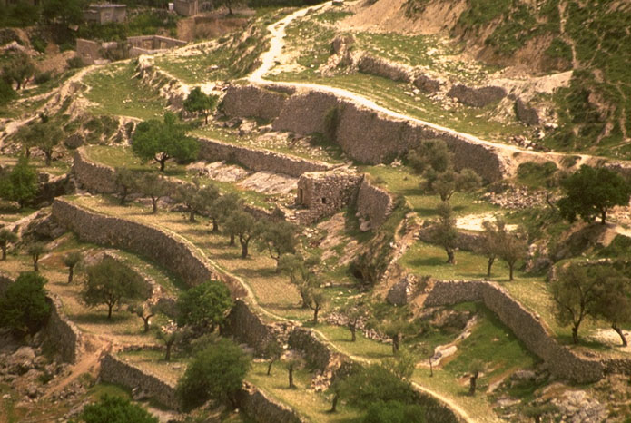
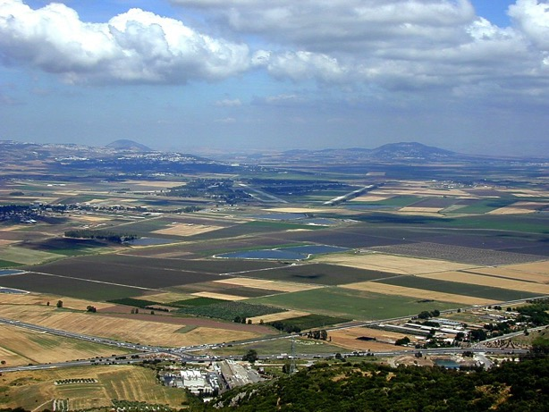
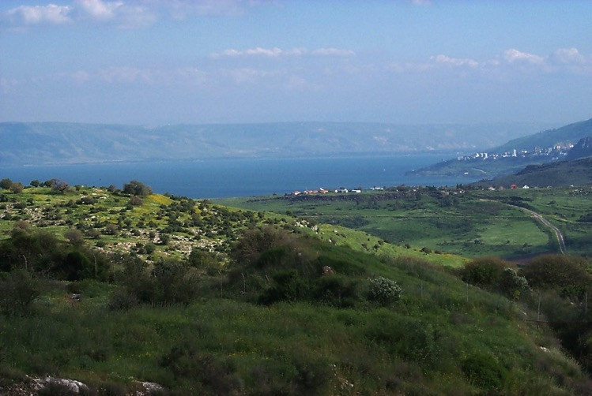
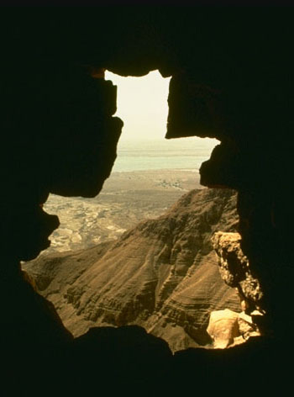
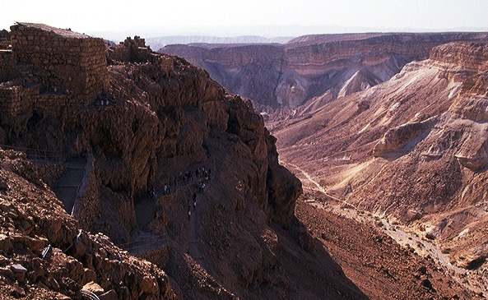
THE LAND OF ABRAHAM'S INHERITANCE
15
Notes:
First…take a look at the Land of Abraham's inheritance…remember that this was…and is…real acreage…real land…real lakes…farm fields…orchards…deserts and canyons. A place of great beauty and enormous wealth potential…

Slide 18
Deuteronomy 30
THE LAND PROMISES
⁵ He will bring you to the land that belonged to your fathers, and you will take possession of it. He will make you more prosperous and numerous than your fathers.
⁶ The Lord your God will circumcise your hearts and the hearts of your descendants so that you may love him with all your heart and with all your soul, and live. (NIV)
16
2
Notes:
THE LAND PROMISE is recounted by Moses in Scripture at Deuteronomy 30, verses 1-10. In the heart of those ten verses lie these two:
//// 5 He will bring you to the land that belonged to your fathers, and you will take possession of it. He will make you more prosperous and numerous than your fathers.
//// 6 The Lord your God will circumcise your hearts and the hearts of your descendants so that you may love him with all your heart and with all your soul, and live.

Slide 19
A LAND OF BEAUTY AND PROSPERITY
17
Notes:
The words of that promise, made here to Moses, reflect God's earlier promises to Abraham, stating clearly that, in some distant day, both Israel AND Judah will return to their land to live in peace with their neighbors…a land of enormous beauty and material prosperity.

Slide 20
The Call to Abraham Gen. 12:1-3
The Covenant Gen. 15:9-18
ABRAHAMIC COVENANT
THE DAVIDIC
COVENANT
ETERNAL
LITERAL
UNCONDITIONAL
Gen. 13:15
Gen. 13:14-16
Gen. 15:9-18
LAND
SEED
BLESSING
Gen. 12:1
Gen. 12:2
Gen. 12:3
The Amplified Subcovenants
Land
Davidic
Deut. 30:1-10
2 Sam. 7:4-16
The Very "Backbone" of Biblical Revelation
18
©2006 TBBMI
9.65.05B.
Notes:
Now...the Davidic Covenant...
//// ….an amplification of the SEED portion of the Abrahamic...
2 Samuel 7, verses 4-16.

Slide 21

THE DAVIDIC COVENANT
ITS THREE GUARANTEES
2 Samuel 7
¹⁶ Your house and your kingdom will endure forever before me; your throne will be established forever.
forever
forever
19
6
©2006 TBBMI
9.65.05B.
Notes:
Again...at the heart of that scripture…
//// is the great Davidic Covenant and its three guarantees…
/// It has this statement: 2 Samuel 7:16…to David through his household prophet Nathan…God says, "Your house and your kingdom will endure forever before me; your throne will be established forever.".
To clarify:...
//// Your HOUSE.. or your lineage or family line...and your
//// KINGDOM...meaning actual real estate over which to govern...
//// and your THRONE...meaning a governmental administration...will be established…
//// …forever. Not just until the end of modern history, but forever...into eternity. So this verse then becomes a key idea in understanding Biblical eschatology or a study of The End Times.

Slide 22
So, then, ask yourself the question:
Who is qualified to sit on that Davidic throne?
20
©2006 TBBMI
9.65.05B.
Notes:
So, then, the question must be asked…AFTER King David's day…1000 B.C….who is qualified to sit on that Davidic throne?

Slide 23
STUDY HELP #16
THE DAVIDIC DYNASTY
The Royal Genealogy of Jesus Christ
21
1
©2004 TBBMI
8.0.05B.

Slide 24
THE LINE OF DAVID: The Royal Genealogy of Jesus Christ*
*VASTLY ABBREVIATED
22
1
Notes:
What about the genealogy of the Lord Jesus Christ, out of that line of David, according to Scripture? What do the scriptures have to say about all that? We are given a long and complex genealogy...
/// so this one will be vastly abbreviated.

Slide 25
THE LINE OF DAVID: The Royal Genealogy of Jesus Christ*
ADAM EVE
Scripture Location:
Genesis 3:20
*VASTLY ABBREVIATED
23
Notes:
We begin with Adam and Eve, first recounted in Genesis 3:20...

Slide 26
THE LINE OF DAVID: The Royal Genealogy of Jesus Christ*
ADAM EVE
Scripture Location:
Genesis 4:1-2; 4:8
CAIN ABEL
*VASTLY ABBREVIATED
24
1
Notes:
From their union came the brothers Cain and Abel.
//// And we know that Cain slew Abel because of Cain's jealousy of the gifts Abel made in sacrifice to the Lord. As a replacement for that murdered brother who was more favored by God, another son was born to Adam and Eve...

Slide 27
THE LINE OF DAVID: The Royal Genealogy of Jesus Christ*
ADAM EVE
Scripture Location:
Genesis 4:25
CAIN ABEL SETH
*VASTLY ABBREVIATED
25
Notes:
He was Seth, the beginning of a godly line of men. AND RIGHT HERE is where the royal genealogy of Jesus Christ gets underway.

Slide 28
THE LINE OF DAVID: The Royal Genealogy of Jesus Christ*
ADAM EVE
Scripture Location:
Genesis 5:29
CAIN ABEL SETH
NOAH
*VASTLY ABBREVIATED
26
Notes:
From Seth...followed Noah. By the way...dotted lines represent an abbreviation of all the biblical names that actually occur during the long lines of descent. Scripture tells us the names of each one.

Slide 29
THE LINE OF DAVID: The Royal Genealogy of Jesus Christ*
ADAM EVE
Scripture Location:
Genesis 11:26
CAIN ABEL SETH
NOAH
ABRAHAM
*VASTLY ABBREVIATED
27
Notes:
Eventually through this line...we arrive at Abraham.

Slide 30
THE LINE OF DAVID: The Royal Genealogy of Jesus Christ*
ADAM EVE
Scripture Location:
Matthew 1:2-6
CAIN ABEL SETH
NOAH
ABRAHAM (Sarah)
*VASTLY ABBREVIATED
DAVID
28
Notes:
And from Abraham, a thousand years later, appears David..

Slide 31
THE LINE OF DAVID: The Royal Genealogy of Jesus Christ*
ADAM EVE
Scripture Location:
2 Samuel 12:24
CAIN ABEL SETH
NOAH
ABRAHAM
*VASTLY ABBREVIATED
DAVID BATHSHEBA
29
Notes:
And...among other of David's several wives...appears Bathsheba.

Slide 32
THE LINE OF DAVID: The Royal Genealogy of Jesus Christ*
ADAM EVE
Scripture Location:
2 Samuel 5:14
CAIN ABEL SETH
NOAH
ABRAHAM
*VASTLY ABBREVIATED
DAVID BATHSHEBA
NATHAN SOLOMON
30
Notes:
Among the children of David and Bathsheba are these two sons: Nathan and Solomon. And here the line splits. Note that. It's a crucial place.

Slide 33
THE LINE OF DAVID: The Royal Genealogy of Jesus Christ*
ADAM EVE
Scripture Location:
Luke 3:23 Plus Others
CAIN ABEL SETH
NOAH
ABRAHAM
*VASTLY ABBREVIATED
DAVID BATHSHEBA
NATHAN SOLOMON
LUKE 3:23 (see other references)
MARY
31
Notes:
From the line of son Nathan, eventually appears Mary, the mother of Jesus.

Slide 34
THE LINE OF DAVID: The Royal Genealogy of Jesus Christ*
LUKE 3:23 (see other references)
Luke 3:23: "Now Jesus himself was about 30 years old when He began His ministry. He was the son, so it was thought, of Joseph." (NIV)
"Luke was tracing the line of Mary. Many interpreters [among varied positions…] argue that Luke was giving the genealogy of Mary, showing that she also was in the line of David and that therefore Jesus was qualified as the Messiah, not only through Joseph (since he was the oldest legal heir) but also through Mary."
Louis Barbieri, The Bible Knowledge Commentary, eds. John Walvoord & Roy Zuck (Victor Books, 1983), 212.
32
1
Notes:
Luke wrote about this in his Gospel. In his third chapter, verse 23: "Now Jesus himself was about 30 years old when He began His ministry. He was the son, SO IT WAS THOUGHT, of Joseph."
//// This further explanation from two eminent Bible scholars: "Luke was tracing the line of Mary. Many interpreters [among varied other positions…] argue that Luke was giving the genealogy of Mary, showing that she also was in the line of David and that therefore Jesus was qualified as the Messiah, not only through Joseph (since he was the oldest legal heir) but also through Mary."

Slide 35
THE LINE OF DAVID: The Royal Genealogy of Jesus Christ*
ADAM EVE
Scripture Location:
Matthew 1:16
CAIN ABEL SETH
NOAH
ABRAHAM
*VASTLY ABBREVIATED
DAVID BATHSHEBA
NATHAN SOLOMON
MARY JOSEPH
33
Notes:
And from Solomon's side...the line of descent leads directly to Joseph, Jesus' FOSTER-father. And then the climactic event of the ages...from Joseph and Mary, through the intervention of the Holy Spirit in Mary's womb…

Slide 36
THE LINE OF DAVID: The Royal Genealogy of Jesus Christ*
ADAM EVE
Scripture Location:
Matthew 1:16
CAIN ABEL SETH
NOAH
ABRAHAM
*VASTLY ABBREVIATED
DAVID BATHSHEBA
NATHAN SOLOMON
MARY JOSEPH
JESUS CHRIST
34
Notes:
…the Lord Jesus Christ enters the earth. And, you might say, "well…we all know that. What is the importance of such an emphasis on it?" Answer: earthly kingship presents two requirements...

Slide 37
THE LINE OF DAVID: The Royal Genealogy of Jesus Christ*
ADAM EVE
CAIN ABEL SETH
NOAH
ABRAHAM
DAVID BATHSHEBA
NATHAN SOLOMON
BLOOD SUCCESSION
LEGAL SUCCESSION
The FAMILY Right
Luke 3:23-38
The LEGAL Right
Matt 1:1-17
MARY JOSEPH
JESUS CHRIST
35
3
Notes:
FIRST…a family qualification by right of a bloodline succession.
//// SECOND…there must also be a legal qualification by right of traditional succession.
//// The family right and blood line through Mary – the mother of Jesus – as it is laid out in Luke's gospel, third chapter, verses 23-38,
//// While the legal line of Jesus' father – Joseph -- appears in detail in Matthew's Gospel, chapter 1, verses 1-17.
Much has been written all about this...far more than can be described here. So you are encouraged to dig into these ideas. They are rich with meaning, significance and credibility toward establishing the Lord's place in the great Plan of the Ages.

Slide 38
THE LINE OF DAVID: The Royal Genealogy of Jesus Christ*
ADAM EVE
CAIN ABEL SETH
NOAH
ABRAHAM
DAVID BATHSHEBA
NATHAN SOLOMON
The FAMILY Right
Luke 3:23-38
The LEGAL Right
Matt 1:1-17
BLOOD
RIGHT
MARY JOSEPH
JESUS CHRIST
36
Notes:
So...to sum up...
Mary, Jesus' birth mother, supplies his bloodline directly back to the throne of David...and beyond.

Slide 39
THE LINE OF DAVID: The Royal Genealogy of Jesus Christ*
ADAM EVE
CAIN ABEL SETH
NOAH
ABRAHAM
DAVID BATHSHEBA
NATHAN SOLOMON
The FAMILY Right
Luke 3:23-38
The LEGAL Right
Matt 1:1-17
BLOOD
RIGHT
LEGAL
RIGHT
MARY JOSEPH
JESUS CHRIST
37
Notes:
...and Joseph…as the foster-father and a descendant of King Solomon… has the right of legal succession to bestow upon his foster son, Jesus. A remarkable evidence of the credibility and reliability of the Scriptural record.

Slide 40
Criswell, W. A.
Danker, Frederick
Ellis, E. Earle
Fitzmeyer, Joseph
Godet, F. A.
Hendricksen, William
Hoehner, Harold
Ironside, F. A.
Marshall, I. Howard
McGee, J. Vernon
Morgan, G. Campbell
MacArthur, John
Scofield, C. I.
Swindoll, Charles
Unger, Merrill
Walvoord, John
Zuck, Roy
Some of the many authors who have written on Jesus's genealogy:
38
©2006 TBBMI
9.65.05B.
Notes:
Here is a list of only a few of the dozens of authors who have written extensively on the genealogy of Jesus Christ as it is presented in the Gospels of Matthew and Luke. There are many, many more than these!

Slide 41

HAVE YOU EVER CONSIDERED THE INCREDIBLE PROBABILITIES OF THE BIRTH AND LIFE OF JESUS CHRIST?
JUST AN ACCIDENT OF BIRTH?
STUDY HELP #17
39
2
©2006 TBBMI
9.65.05B.
Notes:
With Study Help #17 in hand…place yourself here in a rocky field outside Bethlehem where a shepherd tends his flock –– as it has been for thousands of years on this same land…just outside that ancient little town where Jesus was born. From here you could have seen and heard the angelic announcement of his miraculous birth! Which leads to another question…
//// Have you ever considered the astonishing statistical probabilities of the birth and life of Jesus Christ?
//// Was it just an accident of birth?

Slide 42
HAVE YOU EVER CONSIDERED THE INCREDIBLE PROBABILITIES OF THE BIRTH AND LIFE OF JESUS CHRIST?
*
JUST AN ACCIDENT OF BIRTH?
IN THE OLD TESTAMENT: MORE THAN 300 REFERENCES TO A COMING MESSIAH WERE FULFILLED UPON THE BIRTH, LIFE AND CRUCIFIXION OF JESUS CHRIST. WITH THAT SAID…
STUDY HELP #17
*Source: Josh McDowell, Evidence That Demands A Verdict, 1972, page 175; Peter Stoner, Science Speaks, Moody Press, 1963.
40
Notes:
In the Old Testament…more than 300 references to a coming Messiah were fulfilled upon the birth, life and crucifixion of Jesus Christ. So then, with that said, according to established scientific techniques of probability and statistics.

Slide 43
THAT SAID…
WHAT ARE THE CHANCES OF ONLY 8 PREDICTIONS BEING FULFILLED IN THE LIFE OF ANY ONE INDIVIDUAL BETWEEN THEN AND NOW?
_{ANSWER: ONE CHANCE IN}
_{100 QUADRILLION (10} ¹⁷₎
_{1:100,000,000,000,000,000}
*Source: Josh McDowell, Evidence That Demands A Verdict, 1972, page 175; Peter Stoner, Science Speaks, Moody Press, 1963.
41
2
Notes:
What, then, are the chances of only EIGHT predictions being fulfilled in the life of any one individual between then and now?
//// The answer: one chance in 100 quadrillion…or…10 to the 17th!
//// and here is what that number looks like typed out!
If you think that is incredible…here comes another one.

Slide 44
TAKE IT A STEP FURTHER…
WITH JUST 48 (OF THE 300) PREDICTIONS BEING FULFILLED IN THE LIFE OF ANY ONE INDIVIDUAL BETWEEN THEN AND NOW:
_{ANSWER: one chance in 10}¹⁵⁷
1:10,000,000,000,000,000,000,000,000,000,000,000,000,000, 000,000,000,000,000,000,000,000,000,000,000,000,000,000, 000,000,000,000,000,000,000,000,000,000,000,000,000,000, 000,000,000,000,000,000,000,000,000,000,000,000
*Source: Josh McDowell, Evidence That Demands A Verdict, 1972, page 175; Peter Stoner, Science Speaks, Moody Press, 1963.
42
3
Notes:
Another measure of scientific probability…
//// Then…with just 48 of the 300 predictions being fulfilled in the life of any one individual between then and now:
//// The answer: one chance in 10 to the 157th!
//// Typed out…here you are!
Before your very eyes…statistical probabilities produced by a world-renowned scientist…according to established scientific procedures of statistics and probability.

Slide 45
THE LINE OF DAVID: The Royal Genealogy of Jesus Christ*
BACK TO STUDY HELP #16
MARY
JOSEPH
Luke 3:23-38
Matt. 1:1-17
• THE BLOOD LINE
• Backward to Adam
through Mary,
the Lineal Descent
• A Personal Genealogy,
through Mary
• A Seed of the House of David
(2 Sam. 7:12-13; Rom. 1:3)
• THE ROYAL,
LEGAL LINE
• Forward from Abraham
Son of David,
through Joseph
• The Legal Line
• A Revelation to the Jew
The Royal Birth of Jesus Christ
43
16
Notes:
Now…with all this said, let's summarize the ROYAL GENEALOGY OF JESUS CHRIST…along with Study Help 16…
//// ….Mary…produced the bloodline for the Messiah.
//// ….This Lucan genealogy traces the Lord's bloodline
backward to Adam.
//// ….through Mary.
//// ….it's the lineal descent.
//// ….It's a personal genealogy…
//// ….through Mary.
//// ….A seed of the House of David…
//// ….All of it recounted in 2 Samuel and Romans.
Meanwhile…from Joseph's side…
//// ….This is the Royal
//// ….Legal line.
//// ….Moving forward from Abraham…
//// ….As a son of David…
//// ….through Joseph…
//// ….the Legal Line…
//// ….As a revelation to the Jew…
//// ….both lines of descent then producing….THE ROYAL BIRTH …INTO THE EARTH…OF THE LORD JESUS CHRIST.

Slide 46

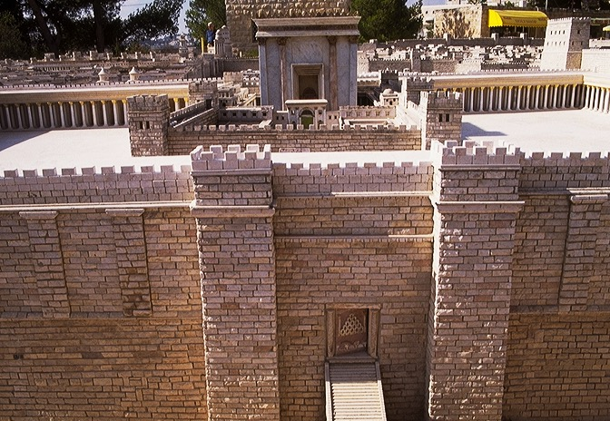
MODEL OF ANCIENT JERUSALEM AT TIME OF JESUS
EASTERN ENTRANCE TO HERODIAN TEMPLE OF JESUS' TIME
44
Notes:
Taken together, we can see that when Jesus entered
the City of Jerusalem on Palm Sunday he was approaching…the eastern entrance to the great Herodian Temple with the apparent purpose –– so the people thought –– of actually claiming the Throne of David as his own.

Slide 47

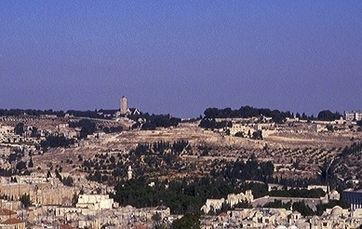
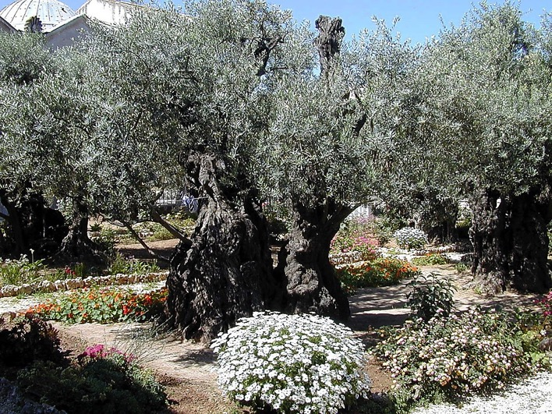
THE "SECOND TEMPLE" BY HEROD THE GREAT
THE MOUNT OF OLIVES
ANCIENT OLIVES IN GETHSEMANE'S GARDEN
45
2
Notes:
It all happened here… in the massive armed precincts of Herod's great Temple on the same site as Solomon's earlier Temple and before that, the mountaintop where Abraham was instructed to sacrifice Isaac 2000 years earlier…
….and on the Mount of Olives…in the outskirts of the ancient city of Jerusalem…
…and the Lord's agony in the Gethsemane garden.

Slide 48
THE NEW
COVENANT
The Call to Abraham Gen. 12:1-3
The Covenant Gen. 15:9-18
ABRAHAMIC COVENANT
ETERNAL
LITERAL
UNCONDITIONAL
Gen. 13:15
Gen. 13:14-16
Gen. 15:9-18
LAND
SEED
BLESSING
Gen. 12:1
Gen. 12:2
Gen. 12:3
The Amplified Subcovenants
Land
Davidic
New
Deut. 30:1-10
2 Sam. 7:4-16
Jer. 31:31-34
The Very "Backbone" of Biblical Revelation
46
1
©2006 TBBMI
9.65.05B.
Notes:
The appearance of the Lord in Israel 2000 years ago leads directly to the last of the amplified subcontracts of the Abrahamic Covenant. This last one is...the NEW COVENANT...
//// ….a further expansion on the message and implications of that BLESSING part of the Abrahamic. We find it in Jeremiah 31:31-34.

Slide 49
Jeremiah 31
THE NEW COVENANT
ROYALTY
(1000 B.C.)
Jeremiah's circumstances were severe…
S - D - S
••• SPLIT •••
North South
Israel
Judah
10 2
THE PROPHETS
19-J 20-R
200 350
"Judah in Crisis"
Assyria Babylon
47
2
Notes:
We'll become more familiar with Jeremiah further on. But for now…Jeremiah is the Bible's central figure in delivering the New Covenant announcement…a new arrangement just over the prophet's historical horizon from his Old Testament time!
//// Think about the prophet's severe circumstances at the time he was writing…They are right there in the ROYALTY FILE FOLDER. Jeremiah appeared in the time of THE PROPHETS.
The United Kingdom had split apart. Jerusalem was soon to be destroyed by the approaching Babylonians. In spite of those terrible times, Jeremiah pronounced a message of incomparable brilliance and optimism…a piece of "good news" that would echo through the coming centuries...awaiting only the appearance of Messiah to fulfill his vision.
//// …Yes…Jeremiah's circumstances were severe…JUDAH WAS IN CRISIS!

Slide 50
Jeremiah 31
THE NEW COVENANT
³¹ "The time is coming," declares the Lord, "when I will make a new covenant with the house of Israel [the Northern Kingdom] and with the house of Judah [the Southern Kingdom].
(NIV)
48
4
Notes:
Here are those amazing words from Jeremiah 31... This is THE NEW COVENANT announcement! Pay close attention to every word!
//// Calling out verse 31 specifically..."The time is coming," declares the Lord, "when I will make a NEW COVENANT with the house of Israel"…the Northern Kingdom… "and with the house of Judah"…the Southern Kingdom.
//// A new covenant…
//// with Israel…the Northern Kingdom, now dispersed…
//// and with Judah…the Southern Kingdom…a nation to go into captivity but with a promised return to the Land of Abraham's inheritance.

Slide 51
Jeremiah 31
THE NEW COVENANT
³² It will not be like the covenant I made with their forefathers when I took them by the hand to lead them out of Egypt,
because they broke my covenant though I was a husband to them," declares the Lord.
(NIV)
49
Notes:
"It will not be like the covenant I made with their forefathers when I took them by the hand to lead them out of Egypt, because they broke my covenant though I was a husband to them, " declares the Lord."

Slide 52
Jeremiah 31
THE NEW COVENANT
³³ "This is the covenant I will make with the house of Israel after that time," declares the Lord.
"I will put my law in their minds and write it on their hearts. I will be their God, and they will be my people."
(NIV)
50
1
Notes:
This is the covenant I will make with the house of Israel after that time, declares the Lord.
//// [THIS PHRASE IS TYPED OUT ON SCREEN FOR EMPHASIS.] "I will put my law in their minds and write it on their hearts. I will be their God and they will be my people." Notice that this newly announced Covenant will be with BOTH HOUSES OF THE DIVIDED KINGDOM...BOTH JUDAH AND ISRAEL.
[John Walvoord, Roy Zuck, eds, The Bible Knowledge Commentary – Old Testament Edition; Victor Books, 1985; page 1171

Slide 53
The New Testament Announcement
Luke 22:19-20
¹⁹ And he took bread, gave thanks and broke it, and gave it to them, saying, "This is my body given for you; do this in remembrance of me."
²⁰ In the same way, after the supper he took the cup, saying,
"This cup is the new covenant in my blood, which is poured out for you.
(NIV)
51
4
Notes:
Now move over to the New Testament...for the announcement at that time…
//// …The 22nd chapter of Luke...verses 19-20. At that final supper with his friends…Jesus
//// ..."took bread, gave thanks and broke it, and gave it to them, saying, "This is my body given for you; do this in remembrance of me."
//// 20In the same way, after the supper he took the cup, saying, "This is the …
//// …new covenant in my blood, which is poured out for you."

Slide 54
The New Testament Announcement
Matthew 26:26-28
²⁶ While they were eating, Jesus took bread, gave thanks and broke it, and gave it to his disciples, saying, "Take and eat; this is my body."
²⁷ Then he took the cup, gave thanks and offered it to them, saying, "Drink from it, all of you.
²⁸ This is my blood of the covenant, which is poured out for many for the forgiveness of sins.
52
4
Notes:
And then again...in the 26th chapter of Matthew...verses 26-28:
//// 26While they were eating, Jesus took bread, gave thanks and broke it, and gave it to his disciples, saying, "Take and eat; this is my body."
//// 27Then he took the cup, gave thanks and offered it to them, saying, "Drink from it, all of you.
//// 28This is my blood of the covenant, which is poured out for many for the forgiveness of sins.
//// Again…the Lord said clearly…MY BLOOD OF THE COVENANT!

Slide 55

Sunset from Kursi
WHAT IS
HAPPENING HERE?
ANSWER: A PROFOUND CHANGE IN THE RELATIONSHIP BETWEEN THE CREATOR AND HIS CREATED!
WHAT IS HAPPENING HERE?
53
1
©2006 TBBMI
9.65.05B.
Notes:
WHAT IS HAPPENING HERE? Jeremiah was announcing…and Jesus is establishing…
//// …the arrival of a profound change in the relationship between the Creator and His Created! Meaning…in a very practical sense.

Slide 56
The "HAVE-TO" mentality of the
Old Testament had given way……
54
©2006 TBBMI
9.65.05B.
Notes:
The ancient HAVE-TO mentality of the Old Testament and THE LAW had given way…

Slide 57
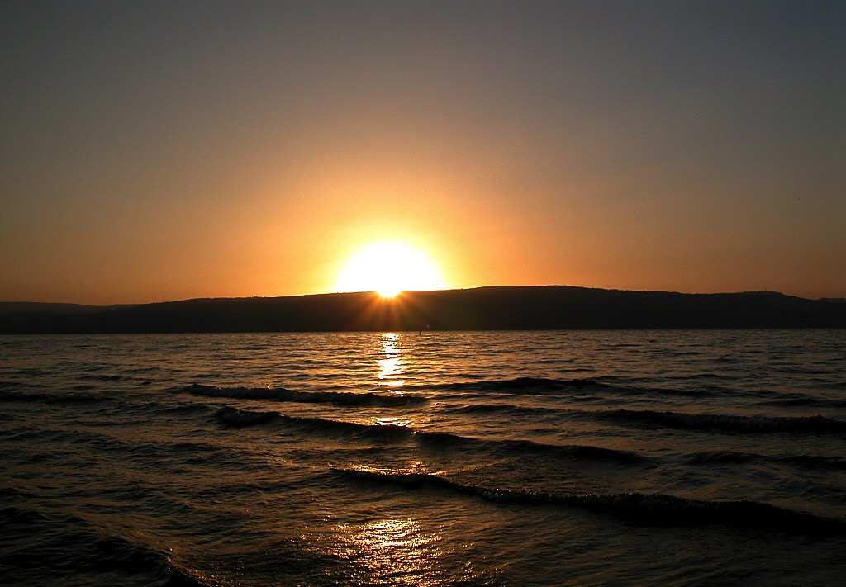
Sunset over Sea of Galilee
The "HAVE-TO" mentality of the Old Testament had given way……
…to the "WANT-TO" mentality of the New Testament.
How? Because of the internalized urgings of the Holy Spirit — to be available to every believer in the Messiah's Gospel!
55
1
©2006 TBBMI
9.65.05B.
Notes:
The ancient HAVE-TO mentality of the Old Testament and THE LAW had given way. …to the WANT-TO mentality of the New Testament and the Gospel! A profound change, indeed. From the "HAVE-TO" OF LEGALISM – "Do this, do that" according to the strict Mosaic Regulations -- TO THE "WANT-TO" OF THE GENTLE INDWELLING HOLY SPIRIT!
//// How? Because of the internalized urgings of the Holy Spirit… ….to be available to every believer and living in every believer's heart...to be available with the coming of the Messiah and His inauguration of the New Covenant. An approach to God no longer based on human performance on the outside…as in the time of The Law. But now…INSIDE THE HEART OF EVERY BELIEVER!…the time of THE NEW COVENANT!

Slide 58
Sunset over Sea of Galilee
LAW
HAD GIVEN WAY TO
GRACE
56
©2006 TBBMI
9.65.05B.
Notes:
Summed up:
LAW HAD GIVEN WAY TO GRACE!
A time of enormous spiritual change had arrived. That change was destined to cause schism and friction – indeed, an explosion – in the Jewish community to which the Lord would be appearing…as the New Testament records tell us! It's effect on world history would be profound!

Slide 59

NOW WE CAN UNDERSTAND THE IMPORTANCE OF THE BIBLICAL STORY LINE TOWARD GRASPING…
CREATION
ABRAHAM
JOSEPH
MOSES
JOSHUA
ANARCHY
ROYALTY
THE GRAND PANORAMA OF REDEMPTION!
CAPTIVITY
SILENCE
JESUS
57
Notes:
Now we can understand the importance of the Biblical story line toward grasping THE GRAND PANORAMA OF REDEMPTION! Here also we can see in hindsight the foundation of the Church coming into view.

Slide 60
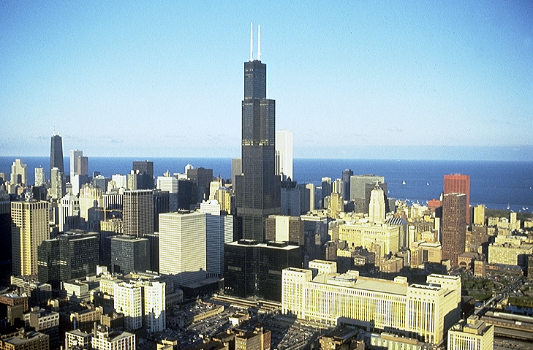


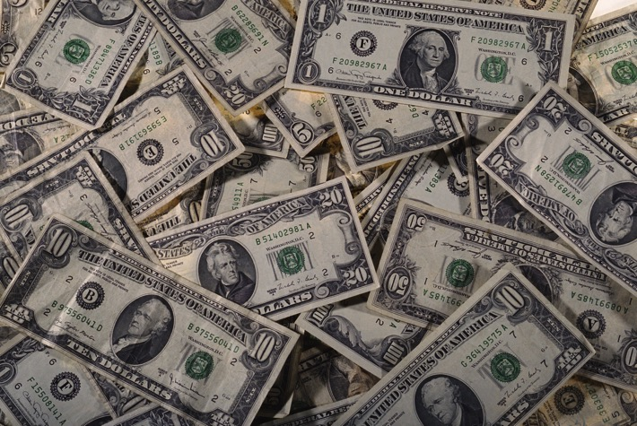


QUESTION:
IN A HIGH TECH WORLD, WHAT ABOUT JESUS' BLOOD SACRIFICE?
58
Notes:
Now...one final question...in our world of high technology, satellites and computers, the Internet…for many the concept of a blood sacrifice or the meaning or necessity of Jesus' blood sacrifice is downright disturbing. What about that? To clear up this issue…let's turn again to God's Word.

Slide 61
On the Meaning of the "BLOOD"...
Hebrews 9:15-22
¹⁵For this reason Christ is the mediator of a new covenant, that those who are called may receive the promised eternal inheritance — now that he has died as a ransom to set them free from the sins committed under the first covenant.
59
2
Notes:
Hebrews 9 tells us...
For this reason, Christ is the mediator of
//// a new covenant, that those who are called may receive
//// the promised eternal inheritance — now that he has died as a ransom to set them free from the sins committed under the first covenant.

Slide 62
¹⁶In the case of a will, it is necessary to prove the death of the one who made it,
On the Meaning of the "BLOOD"...
Hebrews 9:15-22
¹⁷because a will is in force only when somebody has died; it never takes effect while the one who made it is living.
60
1
Notes:
In the case of a will, it is necessary to prove the death of the one who made it,
//// because a will is in force only when somebody has died; it never takes effect while the one who made it is living.

Slide 63
On the Meaning of the "BLOOD"...
Hebrews 9:15-22
¹⁸This is why even the first covenant was not put into effect without blood.
61
Notes:
This is why even the first covenant was not put into effect without blood.

Slide 64
¹⁹When Moses had proclaimed every commandment of the law to all the people, he took the blood of calves, together with water, scarlet wool and branches of hyssop, and sprinkled the scroll and all the people.
On the Meaning of the "BLOOD"...
Hebrews 9:15-22
62
Notes:
When Moses had proclaimed every commandment of the law to all the people, he took the blood of calves, together with water, scarlet wool and branches of hyssop, and sprinkled the scroll and all the people.

Slide 65
On the Meaning of the "BLOOD"...
Hebrews 9:15-22
²⁰ He said, "This is the blood of the covenant, which God has commanded you to keep."
²⁰ He said, "This is the blood of the covenant, which God has commanded you to keep."
63
1
Notes:
He said, "This is the blood of the covenant, which God has commanded you to keep."

Slide 66
On the Meaning of the "BLOOD"...
Hebrews 9:15-22
²¹In the same way, he sprinkled with the blood both the tabernacle and everything used in its ceremonies.
64
Notes:
In the same way, he sprinkled with the blood both the tabernacle and everything used in its ceremonies.

Slide 67
On the Meaning of the "BLOOD"...
Hebrews 9:15-22
²²In fact, the law requires that nearly everything be cleansed with blood, and without the shedding of blood there is no forgiveness.
65
Notes:
In fact, the law requires that nearly everything be cleansed with blood.

Slide 68
On the Meaning of the "BLOOD"...
Hebrews 9:15-22
²²In fact, the law requires that nearly everything be cleansed with blood, and without the shedding of blood there is no forgiveness.
shedding of blood
66
1
Notes:
and without the shedding of blood there is no forgiveness.
So...finally...we come to understand that without
//// the shedding of blood...which represents the Creator's most precious gift to Man outside of His own son...the gift of life itself which resides in human blood.

Slide 69
On the Meaning of the "BLOOD"...
Hebrews 9:15-22
Without that sacrifice, there is no forgiveness. Our Lord provided that ultimate sacrifice when he went to Calvary and became victorious over death itself IN OUR BEHALF!
67
Notes:
Without that sacrifice there is no forgiveness. Our Lord provided that ultimate sacrifice when he went to Calvary and became victorious over death itself…IN OUR BEHALF!

Slide 70
STUDY HELP #14 & #32
The Call to Abraham Gen. 12:1-3
The Covenant Gen. 15:9-18
ABRAHAMIC COVENANT
ETERNAL
LITERAL
UNCONDITIONAL
Gen. 13:15
Gen. 13:14-16
Gen. 15:9-18
LAND
SEED
BLESSING
Gen. 12:1
Gen. 12:2
Gen. 12:3
The Amplified Subcovenants
Land
Davidic
New
Deut. 30:1-10
2 Sam. 7:4-16
Jer. 31:31-34
The Very "Backbone" of Biblical Revelation
68
5
©2006 TBBMI
9.65.05B.
Notes:
So..with Study Helps 14 and 32 in hand…the Abrahamic Covenant can be seen now in its full grandeur...
//// …a Call to Abraham in Genesis 12…followed by…
//// …the making or "cutting" of the Covenant itself... in Genesis 15...
//// proclaiming its LAND, SEED AND BLESSING aspects....
//// …and seen to be ETERNAL IN ITS DURATION...LITERAL IN ITS MEANING...AND UNCONDITIONAL IN ITS APPLICATION...with each of the three parts amplified through later centuries
//// …in the form of the Land Covenant of Deuteronomy given through Moses...the Davidic Covenant of Second Samuel...and finalized in the New Covenant in the writings of Jeremiah.
//// THIS IS THE FULL IMPACT OF THE ABRAHAMIC COVENANT…THE VERY BACKBONE OF BIBLICAL REVELATION.

Slide 71



REMEMBER THAT THREADED LOOM!
A FABRIC OF THE BIBLE'S CHRONOLOGY
STUDY HELP #08
69
© 2006 TBBMI
9.65.05B.
Notes:
One final time let's set up and thread that loom of biblical chronology as shown in Study Help #8…

Slide 72
REMEMBER THAT THREADED LOOM!
A FABRIC OF THE BIBLE'S CHRONOLOGY
70
© 2006 TBBMI
9.65.05B.
Notes:
…15 threads on the loom... each vertical thread representing an event in the chronology and…

Slide 73
A FABRIC OF THE BIBLE'S CHRONOLOGY
7
EARTHLY REIGN OF CHRIST
4P
3S
MARRIAGE SUPPER OF
THE LAMB
NEW HEAVEN, NEW EARTH
GREAT WHITE THRONE
JUDGMENT
J
THE SECOND COMING
C
A
J
M
J
A
R
C
S
71
© 2006 TBBMI
9.65.05B.
Notes:
…according to many...the progressive events of earth's history reach far out into the future until the end of time itself...

Slide 74
A FABRIC OF THE BIBLE'S CHRONOLOGY
7
THE CHURCH
EARTHLY REIGN OF CHRIST
4P
3S
MARRIAGE SUPPER OF
THE LAMB
NEW HEAVEN, NEW EARTH
GREAT WHITE THRONE
JUDGMENT
J
THE SECOND COMING
C
A
J
M
J
A
R
C
S
ABRAHAMIC COVENANT
LAND COVENANT
DAVIDIC COVENANT
NEW COVENANT
72
6
© 2006 TBBMI
9.65.05B.
Notes:
...and then on our loom are horizontal bands...those wide, strong bands representing:
//// THE ABRAHAMIC COVENANT...
//// THE LAND COVENANT…
//// THE DAVIDIC COVENANT...
//// AND THE NEW COVENANT.
//// And here between the time of the JESUS thread and the final five threads on the loom is our time frame of the Church…this is us…at work right now moving forward our part of the Kingdom of God
//// And after that time…there will be the final five threads to deal with…

Slide 75
A FABRIC OF THE BIBLE'S CHRONOLOGY
7
EARTHLY REIGN OF CHRIST
4P
3S
MARRIAGE SUPPER OF
THE LAMB
NEW HEAVEN, NEW EARTH
GREAT WHITE THRONE
JUDGMENT
MARRIAGE SUPPER OF THE LAMB
J
THE SECOND COMING
C
A
J
M
J
A
R
C
S
SECOND COMING JESUS CHRIST
ABRAHAMIC COVENANT
EARTHLY REIGN OF CHRIST
LAND COVENANT
GREAT WHITE THRONE JUDGMENT
DAVIDIC COVENANT
THE NEW HEAVEN & THE NEW EARTH
NEW COVENANT
73
4
© 2006 TBBMI
9.65.05B.
Notes:
Five great landmarks of The Revelation…THE MARRIAGE SUPPER OF THE LAMB.
//// ….THE SECOND COMING OF CHRIST…
//// …THE EARTHLY REIGN OF CHRIST…
//// …THE GREAT WHITE THRONE JUDGMENT…
//// … and THE NEW HEAVEN AND THE NEW EARTH.

Slide 76
A FABRIC OF THE BIBLE'S CHRONOLOGY
7
EARTHLY REIGN OF CHRIST
4P
3S
MARRIAGE SUPPER OF
THE LAMB
NEW HEAVEN, NEW EARTH
GREAT WHITE THRONE
JUDGMENT
J
THE SECOND COMING
C
A
J
M
J
A
R
C
S
ABRAHAMIC COVENANT
LAND COVENANT
DAVIDIC COVENANT
NEW COVENANT
74
© 2006 TBBMI
9.65.05B.
Notes:
And at the end of all time…the unconditional ABRAHAMIC COVENANT and its three sub-contracts or covenants with men are – in effect – sewn together. We are given very little information about the world and its existence after that time. Hints, of course. But the message there: concentrate on what the Lord wants us to do right now; don't spend a lot of time on the hereafter! There is enough work to do in the here and the now.

Slide 77
HERE, THEN, IS A QUESTION:
In this sophisticated Twenty-First Century, should we honor that 4,000-year-old legal, documented agreement between God and his friend, Abraham? (Gen. 12 & 15)
(Remember: it is found in every accurate Bible translation, version or edition throughout the world!)
YES…ABSOLUTELY…because…
God repeated it to Abraham's son, ISAAC, in Genesis 26.
It was restated to JACOB in Genesis 35.
Again to JOSEPH in Genesis 48.
To MOSES, Exodus 6…and to JOSHUA in Joshua 1.
Finally…most important…
the Messiah arrived in fulfillment of it!
75
8
©2006 TBBMI
9.65.05B.
Notes:
Here, then, is a question:
//// In this sophisticated twenty-first century, should we honor that 4,000 year old legal, documented agreement between God and his friend, Abraham?
//// (Remember: it is found in every accurate Bible translation version or edition throughout the world.)
//// Yes…absolutely…because…
//// God repeated it to Abraham's son, Isaac in Genesis 26.
//// It was restated to Jacob in Genesis 35.
//// Again to Joseph in Genesis 48.
//// To Moses in Exodus 6…and to Joshua in Joshua 1.
//// Finally…most important…the Messiah arrived in fulfillment of it.

Slide 78
So…with all this said:
Because these unconditional, literal Promises are right there in your Bible…we must deal with them... somehow!
76
1
Notes:
With all this said…
//// …Because these UNCONDITIONAL, LITERAL Promises are right there in your Bible…we MUST deal with them…somehow!

Slide 79
"Unless our faith is established on , it is no more than , and ."
Miles Stanford
Principles of Spiritual Growth
facts
facts
conjecture
conjecture
superstition
superstition
presumption
presumption
77
4
Notes:
As Miles Stanford said earlier…"Unless our faith is established on
//// …facts, it is no more than…
//// …conjecture….
//// …superstition and…
//// …presumption."
He had it absolutely right! All of our work and study in THE BIBLE…BASICALLY is aimed squarely toward establishing many of the irrefutable basic facts of our faith just as they appear in the pages of its BASIC DOCUMENT.

Slide 80
Here are some choices:
1. Ignore them as irrelevant.
2. Forget about them because they are OLD Testament.
3. Intelligently explore their meaning and implications in terms of the future of this planet.
78
3
Notes:
So once again we have some choices that must be made.
//// …First…We can ignore these ancient promises as IRRELEVANT. Or…
//// …Second…We can forget about them because, after all, they are in the OLD TESTAMENT! Or…
//// …Third…We can intelligently explore their meaning and implications in terms of the future of this planet.

Slide 81
Here are your choices:
1. Ignore them as irrelevant.
2. Forget about them because they are OLD Testament.
3. Intelligently explore their meaning and implications in terms of the future of this planet.
But if you choose #3, then…you must
4. Decide what they mean for your future and your relationship to Jesus Christ.
79
1
Notes:
But if you choose Number Three, then…you must deal with…
//// …Number Four…Decide what they mean for YOUR future and YOUR relationship to Jesus Christ.

Slide 82
The Crucial, Personal Question:
Is God's Word true or not?
No matter what your answer, a new question logically follows.
80
2
Notes:
HERE THEN IS THE CRUCIAL, PERSONAL QUESTION…
//// …Is God's Word true or not?
//// …And no matter what your answer, a new question logically follows…and it is most the crucial of any possible question.

Slide 83
What do we do with this Jesus?
81
Notes:
WHAT DO WE DO WITH THIS JESUS?

Slide 84
"I am trying here to prevent anyone saying the really foolish thing that people often say about Him:
'I'm
ready to accept Jesus as a great moral teacher, but I
don't accept His claim to be God.'
That is the one thing we must not say.
A man who was merely a man and said the sort of things Jesus said would not be a great moral teacher.
He would either be a lunatic—on a level with the man who says he is a poached egg—or else he would be the Devil of Hell.
You must make your choice.
Either this man was, and is, the Son of God; or else a madman or something worse."
C.S. Lewis, Mere Christianity, 40-41
82
7
Notes:
Hear this from that stupendous enormous Christian intellect of C.S. Lewis where he wrote…
//// …"I am trying here to prevent anyone saying the really foolish thing that people often say about Him – Jesus -- : they say
//// …"I'm ready to accept Jesus as a great moral teacher, but I don't accept His claim to be God.'
//// …That is the one thing we must not say.
//// …A man who was merely a man and said the sort of things Jesus said would not be a great moral teacher.
//// …He would either be a lunatic—on a level with the man who says he is a poached egg—or else he would be the Devil of Hell.
//// …You must make your choice.
//// …Either this man was, and is, the Son of God; or else a madman or something worse."

Slide 85
So once again,
the question:
What do YOU do with this Jesus?
83
Notes:
So…once again…comes the question: WHAT DO YOU DO WITH THIS JESUS? It is the single most crucial decision to be made in the life of any one human being.

Slide 86

By now in The Bible…Basically, you have in your thinking…
•An Idea Called "The Bible File"
•The Mental Key to Open "The Bible File"…C 7 S J
•A Mental Map locating The Major Biblical Events
•The Bible's "STORY" Core: "The Quick Chronology"
•Abrahamic Foundations of Scripture leading directly
to The Ministry of The Lord Jesus Christ
84
1
Notes:
All right…take a deep breath! We've made a lot of progress…by now you have in mind
//// ….THE BIBLE FILE idea…
//// ….the key to open your file…
//// ….ability to make your own map of the Middle East…
//// ….you have THE QUICK CHRONOLOGY storyline, the very core of Scripture…and now
////…the Abrahamic Foundations of Scripture that lead us directly from the Old Testament into the New Testament ministry of the Lord Jesus Christ.
//// Now – more than ever before –– we're in a position to bring together the varied parts of the Bible, itself…the actual book…how it is structured and organized, based on THE BIBLE FILE ideas of chronology and the Abrahamic Foundations of Scripture.
//// Now we can explore how the book itself is arranged…logically and progressively.

Slide 87

A Ministry Presentation of The Bible…Basically Inc. Fort Worth, Texas
85
© 2006 TBBMI
9.65.05B.

Slide 88


The Bible…Basically link at BibleStudyDownloads.org
Get this presentation for free!
Notes:
The Bible…Basically (bb)

Slide 89
81
9.65.05B.
©2006 TBBMI
86

