Slide 1
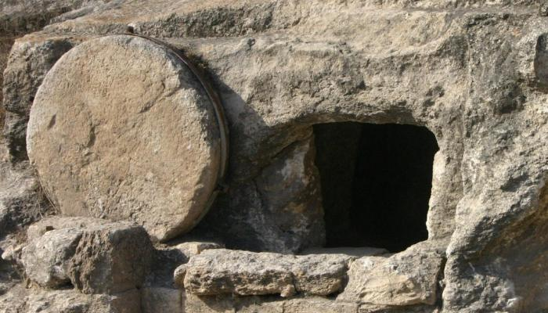
谁搬了石头?
专题讯息
Dr. Rick Griffith • 博士 • 新加坡神学院 • BibleStudyDownloads.org
Crossroads International Church Singapore • CICFamily.com

Slide 2
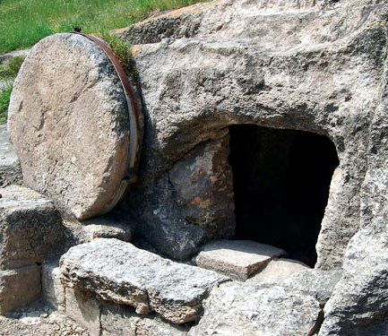
Matthew 28 Eyewitness Account

Slide 3
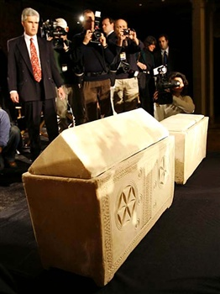
"耶稣的 骨头"
詹姆斯·卡梅隆 2007年2月26 日 REUTERS/Mike Segar
Notes:
BBC和其他新闻社一再报道着耶路撒冷的考古学家发现了拿撒勒耶稣的骨头。 这是真的
In February 2007 members of the media gathered at a news conference in New York to photograph two ossuaries (a chests with human skeletal remains) said to have been found in a 2000-year-old tomb in Talpiot Jerusalem in 1980 that may have held the bones of Jesus and Mary Magdalene. Filmmaker James Cameron unveiled the artifacts in New York to promote a documentary film which claims scientists may have found the lost tomb of Jesus Christ and that Jesus and Mary Magdalene may have had a son named Judah.
26 Feb 2007 REUTERS/Mike Segar

Slide 4
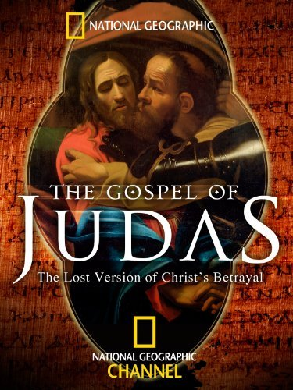
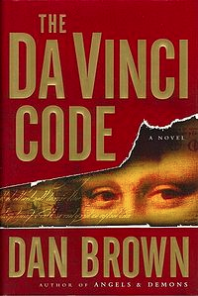
The month of March…
Notes:
—to support Dan Brown’s claim in The Da Vinci Code—Jesus and Mary Magdalene may have had a son named Judah. Time and again BBC and other news agencies report that archaeologists in Jerusalem have discovered the bones of Jesus of Nazareth. Is this true?

Slide 5
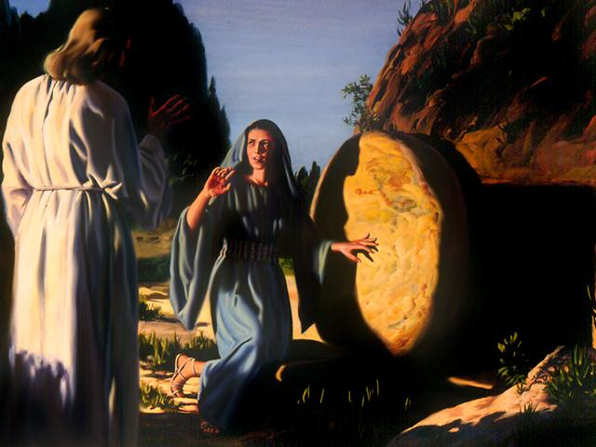
对你来说，有什么分别呢？
Notes:
这不是一个闲置的问题，因为自从基督教信徒的第一天 他们已经宣称耶稣基督复活了。 事实上，耶稣基督复活和基督教站立或摔倒在一起.

Slide 6
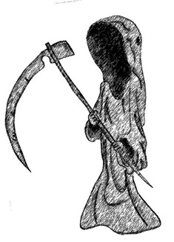
有什么分别?
已去世
佛
穆罕默德
马克思
仍活着

Slide 7
World Religions
Notes:
No other religion makes a claim of an empty tomb for its founder.

Slide 8
有什么分别?
5 并 且 显 给 矶 法 看 ， 然 後 显 给 十 二 使 徒 看 ；
6 後 来 一 时 显 给 五 百 多 弟 兄 看 ， 其 中 一 大 半 到 如 今 还 在 ， 却 也 有 已 经 睡 了 的 。
7 以 後 显 给 雅 各 看 ， 再 显 给 众 使 徒 看
已去世
耶稣
仍活着
佛
穆罕默德
马克思

Slide 9
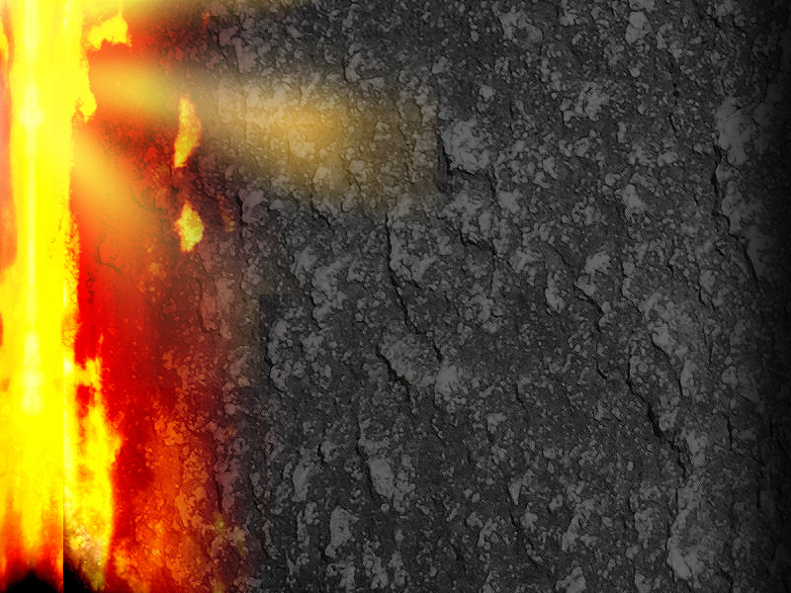
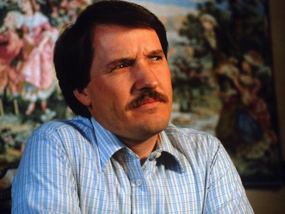
若我们怀疑耶稣从死里复活，我们就会失去盼望 (12-19节
• 若不信从死里复活(12-13节)
• 我 们 所 传 的/你们所信的 便 是 枉 然 (14节)
• 我 们 是 为 神 妄 作 见 证 的(15-16节)
• 仍 在 罪 里(17节)
• 没有天堂(18节)
• 比 众 人 更 可 怜(19节)

Slide 10
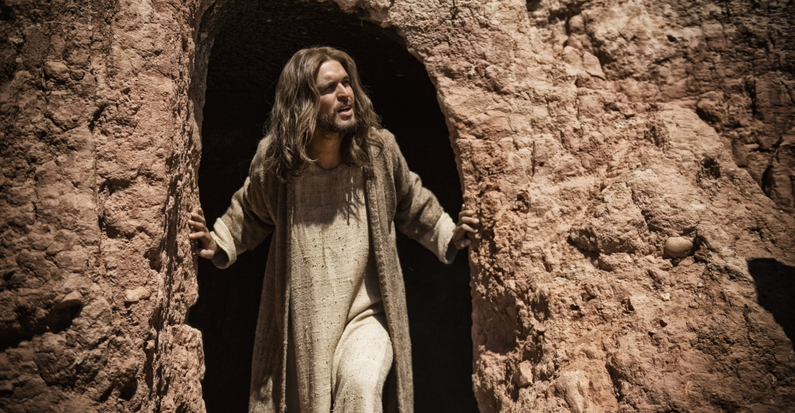
"I am the resurrection and the life." —Jesus
Notes:
A dead Jesus invalidates all that he taught. He claimed to be “the resurrection and the life.”
In other words, the resurrection is an issue of utmost importance!

Slide 11
六个事实
JUST THE FACTS
Notes:
So let’s evaluate what we know are the facts.

Slide 12
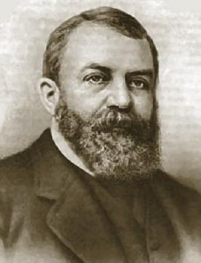
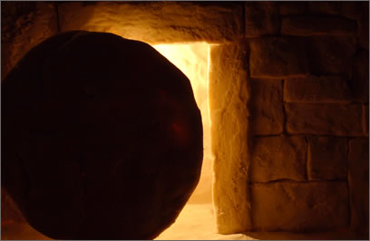
Thinking people consider important matters
Notes:
You are all thinking people, skilled in looking at facts in science, law, and business. I trust that you can look at evidence and weigh it for what it is like many have in the generations preceding you. I was trained this way in business school myself, being forced to make decisions based on balance sheets, cost analyses, and the like.

Slide 13
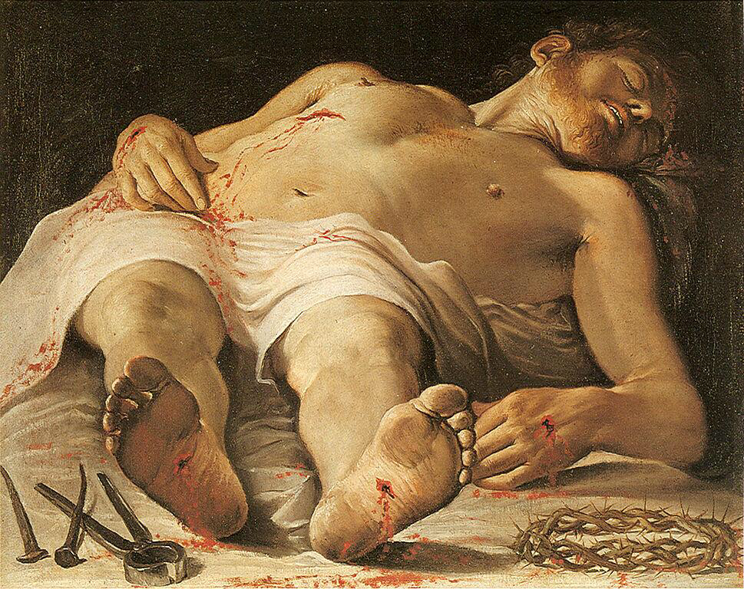
事实 1: Jesus was dead.
Notes:
The facts show at least six precautions taken to assure that Christ would not rise again:
Fact 1: Christ was dead. If anyone knew how to kill, it was the Romans.

Slide 14
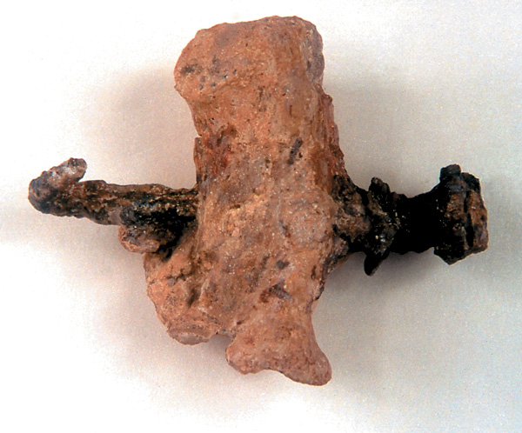
Bone & Nail
Notes:
One remnant of a crucified man shows the ankle wholly pierced with a massive nail.

Slide 15
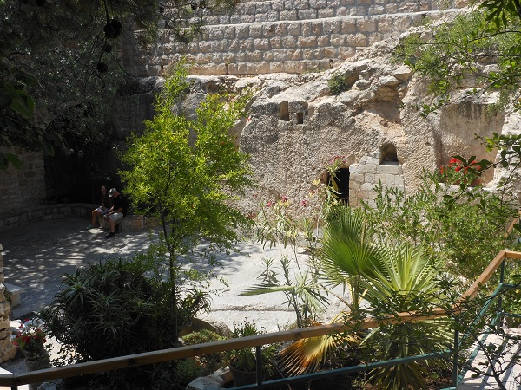
事实 2: Solid rock tomb
Notes:
Fact 2: He was buried in a solid rock tomb according to the common practice of the time—

Slide 16
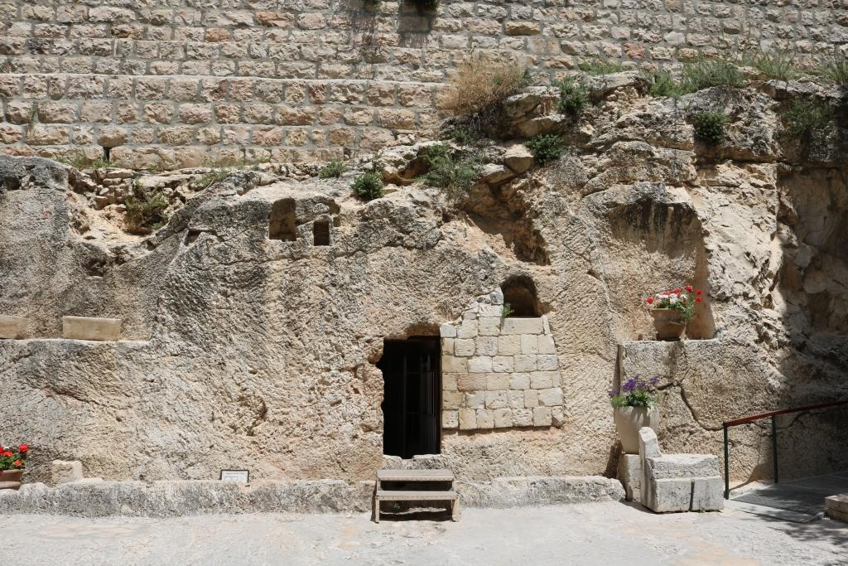
Hewn from Rock
Notes:
—a cave carved out of a wall of rock with no entry except a meter and a half door.

Slide 17
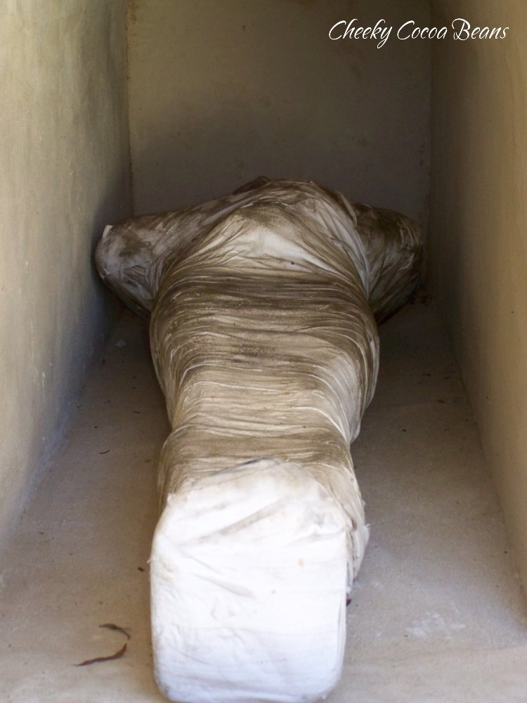
事实 3: Wrapped in 45 kg (100 lbs.)
Notes:
Fact 3: The body was wrapped with a 45 kg (100-pound) encasement of grave clothes. These linen strips and gummy spices hardened into a cocoon case much like a mummy.

Slide 18
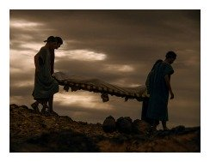
Jewish Burial Custom
Notes:
The friends of Jesus would have had a hard time carrying such a heavy load.

Slide 19
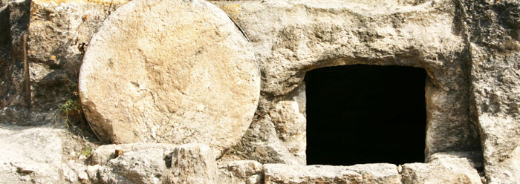
事实 4: 2-ton stone
Notes:
Fact 4: Engineers have calculated that a stone of nearly 2 tons would have been required to cover the 1.5-meter opening.

Slide 20
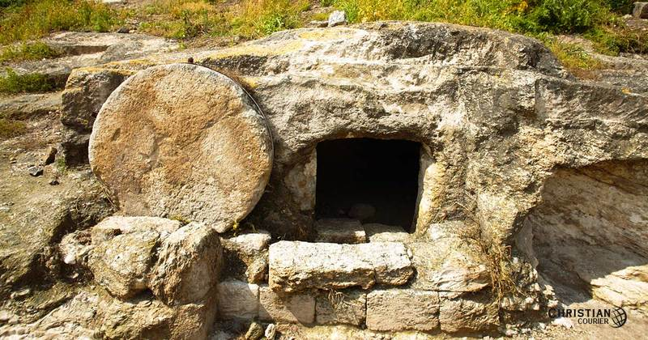
The stone was rolled uphill!
Notes:
The Bible says that after two days of burial this was rolled uphill away from the entire tomb area!

Slide 21
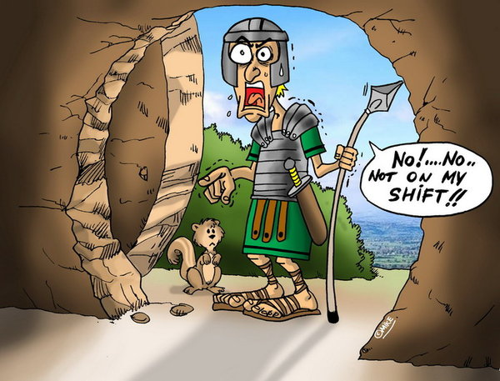
事实 5: Roman guard
Notes:
Fact 5: A Roman guard was placed at the tomb to protect the body from being stolen.

Slide 22
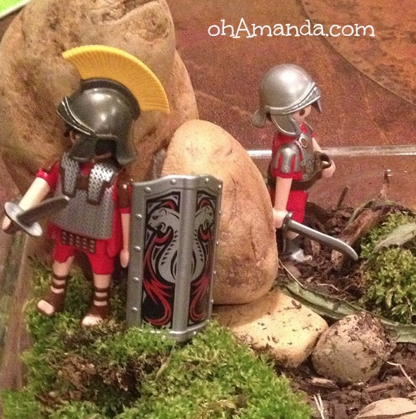
事实 5: Roman guard
Notes:
Some imagine few men in miniskirts “guarding the tomb.”

Slide 23
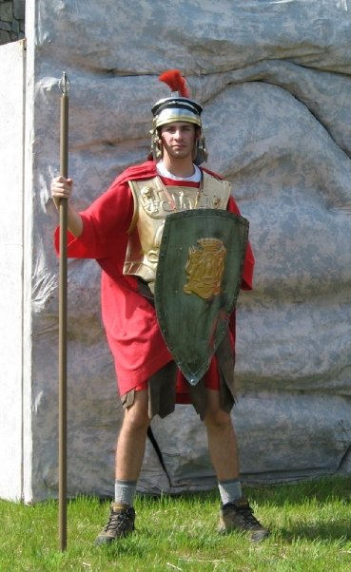
The Facts
Notes:
Hardly!

Slide 24
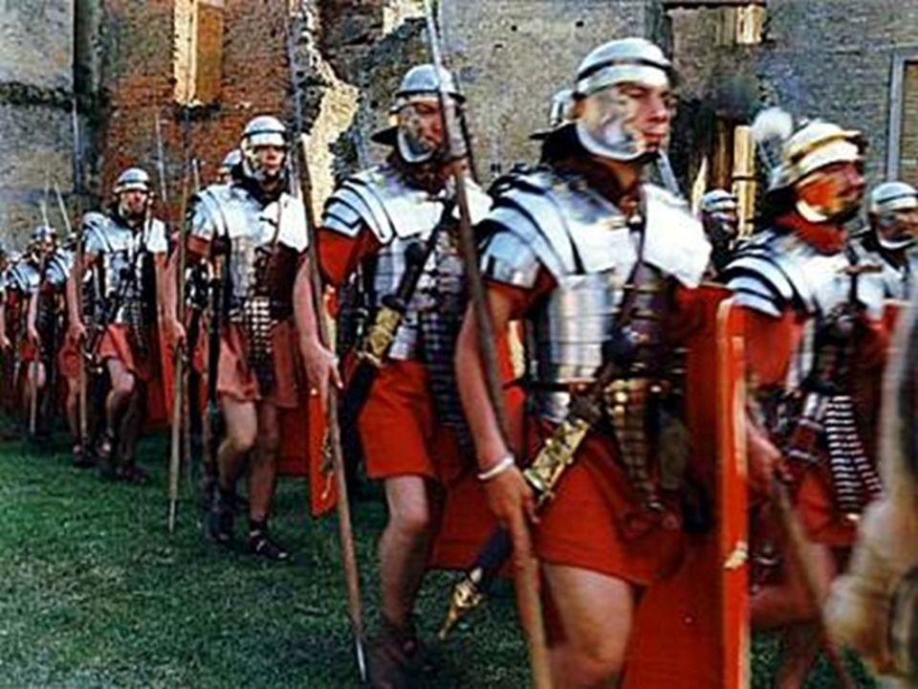
事实 5: Roman guard
Notes:
A Roman guard was a 4 to 16-man force capable of withstanding an advancing army of enemy troops. These guys were tough dudes!

Slide 25
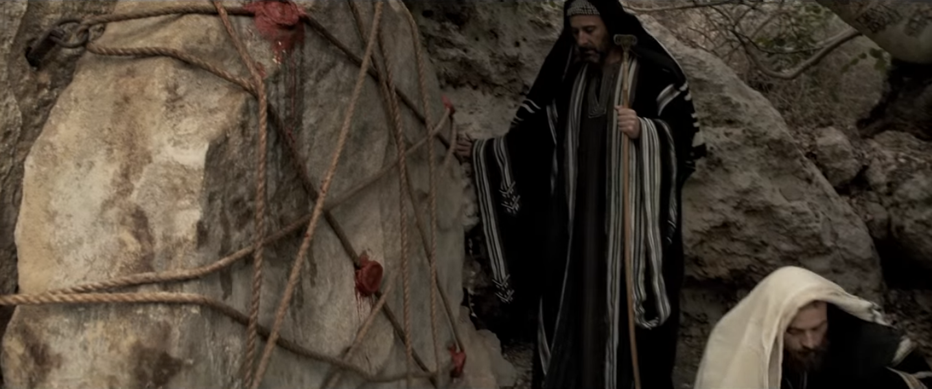
事实 6: Seal with signet
Notes:
Fact 6: The seal. After the guard inspected the body and rolled the stone into place, they stretched a cord across it, fastening it with sealing clay at either end.

Slide 26
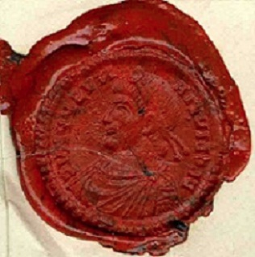
事实 6: Seal with signet
Notes:
On the clay in the middle was stamped the seal of the governor. Breaking his signet would incur the wrath of Roman law.

Slide 27
Our Calendar
A.D. Anno Domini "in the year of our Lord
Notes:
But something happened two days later that changed the course of history.
Today’s date testifies to it, for the date—2017, “in the year of our Lord”—bears witness to the events of that day.

Slide 28
Happy Sunday
Notes:
In fact, you even have each Sunday off work due to belief in the resurrection, which eventually made Sunday a rest day.

Slide 29
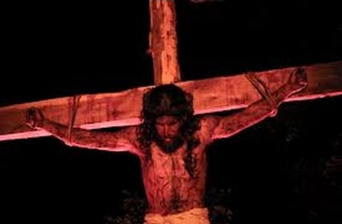
所以发生了什么事？
谁搬走基督的坟墓 前的巨大的石头?

Slide 30
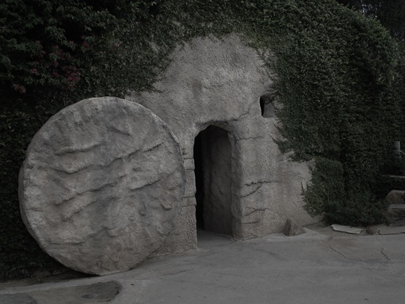
The "Wrong Tomb" Theory
Notes:
Some have claimed that what happened was not a resurrection, but the so-called eyewitnesses went to the wrong tomb.

Slide 31
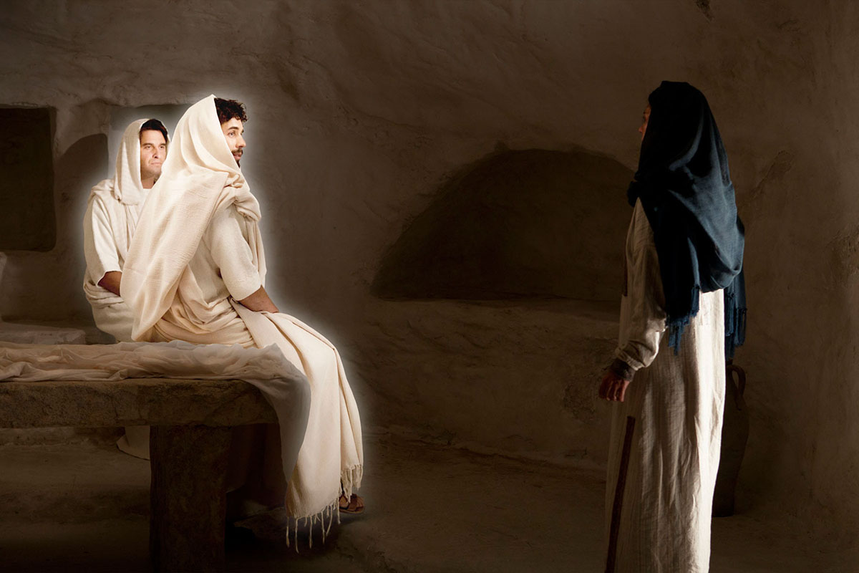
But did the women find angels at the wrong tomb?
Notes:
Sounds plausible, especially for people mourning over the death of a loved one. I’m not sure how that will make angels appear at that wrong tomb, though!

Slide 32
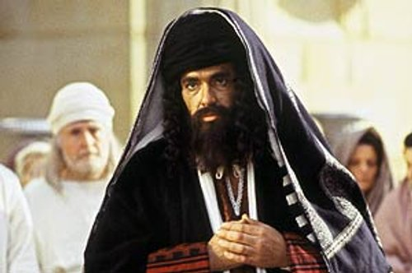
Jewish leaders had no misty eyes.
Notes:
But the Jewish authorities didn’t have misty eyes! When it was proclaimed that Jesus arose, all these unbelieving authorities had to do was to bring people to the right tomb and display the body of Jesus!

Slide 33
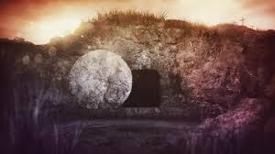
谁搬走基督的坟墓 前的巨大的石头?
Notes:
No, somebody moved stone. You’re thinking, educated people. Let’s think through this together: Who moved the massive stone over Christ’s tomb (subject)?
___________
Faith, Philosophy, and Science
and the refutation of absurdities
Jesus, Resurrection, Tomb
Was Jesus’ Body Stolen from the Tomb?
Date: March 25, 2017Author: Scientific Christian 6 Comments
https://faithfulphilosophy.wordpress.com/2017/03/25/was-jesus-body-stolen-from-the-tomb/
Accesssed 15 April 2017
Jesus Christ was crucified by the Romans, under the reign of the Pontius Pilate, the fifth prefect of Judea. Shortly thereafter, Joseph of Arimathea acquired permission from Pilate that he would be able to take down the dead body of Jesus from the cross, and bury it. And so Joseph did. Several days later, the tomb of Jesus was discovered to be empty by a group of Jesus’ women followers, including well-known women in the New Testament such as Mary Magdalene, a women whom Jesus cast out seven demons from. Indeed, nowadays, a substantial majority of historians accept the historicity of the empty tomb. Indeed, after conducting an analysis on the recent trends of New Testament scholarship in Resurrection research, the eminent scholar Gary Habermas notes the following;
…while far from being unanimously held by critical scholars, it may surprise some that those who embrace the empty tomb as a historical 事实 still comprise a fairly strong majority.
This is not surprising, of course. There is overwhelming historical evidence for the empty tomb. So, we shall now go in and refute a rather popular hypothesis, the hypothesis that the body of Jesus was stolen from the its burial tomb, or purposefully removed from its burial place by some person. This claim is put forth in order to explain away the historicity of the empty tomb without invoking the historical Resurrection of Jesus.
Indeed, what can we say about this claim? Aside from there being zero explicit historical evidence to support such a notion, there is strong evidence from history to show that this would not have possibly happened, and that comes from an artifact known as the Nazareth Inscription. It likely dates to either the reign of Julius Caesar, or perhaps Augustus — at about 30 BC – [14] AD. This is what it says:
EDICT OF CAESAR
It is my decision [concerning] graves and tombs—whoever has made them for the religious observances of parents, or children, or household members—that these remain undisturbed forever. But if anyone legally charges that another person has destroyed, or has in any manner extracted those who have been buried, or has moved with wicked intent those who have been buried to other places, committing a crime against them, or has moved sepulcher-sealing stones, against such a person I order that a judicial tribunal be created, just as [is done] concerning the gods in human religious observances, even more so will it be obligatory to treat with honor those who have been entombed. You are absolutely not to allow anyone to move [those who have been entombed]. But if [someone does], I wish that [violator] to suffer capital punishment under the title of tomb-breaker.
According to the Nazareth Inscription, not only did 1) destroying the body in a tomb 2) removing a body from a tomb or 3) moving a body from a tomb to another location become illegal, but if someone is charged with doing such a thing, they would face capital punishment, i.e. execution. Indeed, this means that in the time of the death of Jesus, it was illegal to steal the body of Jesus and doing so would result in a sentencing of death. This highly removes the probability that anyone would even think of intentionally ceasing Jesus’ dead body from its tomb, especially the disciples themselves. The last thing a disciple of Jesus would do after being devastated by Jesus’ crucifixion, is steal His body and risk death.
Secondly, we must also consider that there is also no motivation for any person to actually steal the body in the first place, and so historically speaking, there is absolutely no warrant for suggesting this hypothesis in the first place. Thirdly, no scholar actually thinks that the body of Jesus was stolen from the tomb, and fourthly, the Gospel of Matthew entails that there existed a guard at the tomb of Jesus in the morning after the burial specifically so it would not be stolen (Matthew 27:62). So it seems to me that the historical evidence is quite overall weighty to establish that indeed, the body of Jesus was not stolen from the tomb. Therefore, Christians can be very happy and comfortable in taking up the position that the empty tomb is not due to some tomb-breaker or grave-bandit, but rather due to the physical Resurrection of Jesus Christ, our Lord and Savior. Amen.

Slide 34
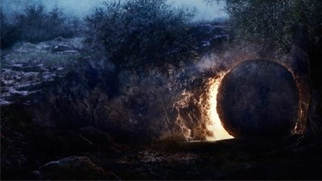
强盗没有动摇石头
Notes:
Random thieves certainly did not fake a resurrection.
Why am I so convinced that grave robbers didn't take the body?
One author notes, "Aside from there being zero explicit historical evidence to support such a notion, there is strong evidence from history to show that this would not have possibly happened, and that comes from an artifact known as the Nazareth Inscription. It likely dates to either the reign of Julius Caesar, or perhaps Augustus — at about 30 BC – [14] AD. This is what it says:"
_____________
Faith, Philosophy, and Science
and the refutation of absurdities
Jesus, Resurrection, Tomb
Was Jesus’ Body Stolen from the Tomb?
Date: March 25, 2017Author: Scientific Christian 6 Comments
https://faithfulphilosophy.wordpress.com/2017/03/25/was-jesus-body-stolen-from-the-tomb/
Accesssed 15 April 2017

Slide 35
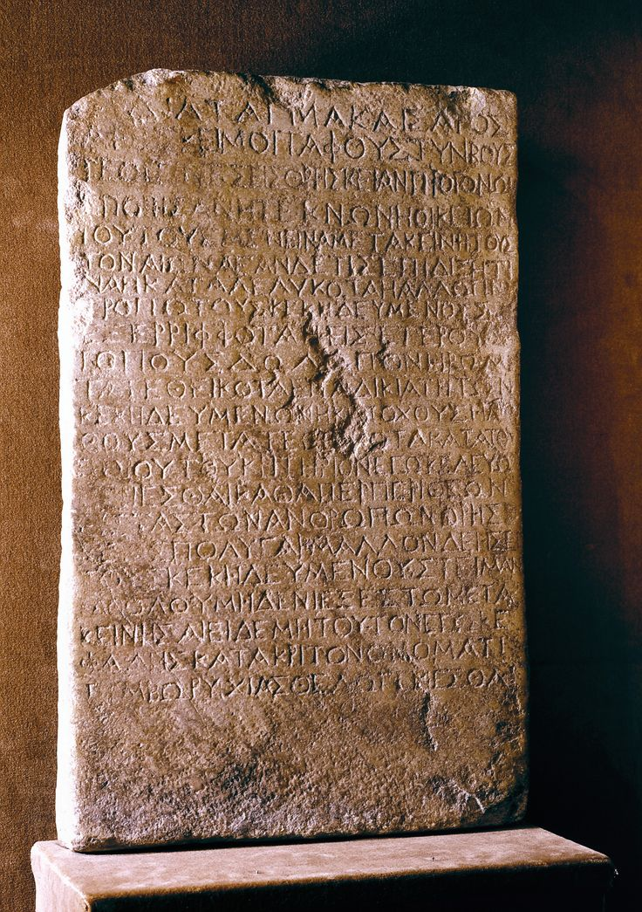
Edict of Caesar
It is my decision [concerning] graves and tombs—whoever has made them for the religious observances of parents, or children, or household members—that these remain undisturbed forever.
Notes:
__________
Faith, Philosophy, and Science
and the refutation of absurdities
Jesus, Resurrection, Tomb
Was Jesus’ Body Stolen from the Tomb?
Date: March 25, 2017Author: Scientific Christian 6 Comments
https://faithfulphilosophy.wordpress.com/2017/03/25/was-jesus-body-stolen-from-the-tomb/
Accesssed 15 April 2017
EDICT OF CAESAR
It is my decision [concerning] graves and tombs—whoever has made them for the religious observances of parents, or children, or household members—that these remain undisturbed forever. But if anyone legally charges that another person has destroyed, or has in any manner extracted those who have been buried, or has moved with wicked intent those who have been buried to other places, committing a crime against them, or has moved sepulcher-sealing stones, against such a person I order that a judicial tribunal be created, just as [is done] concerning the gods in human religious observances, even more so will it be obligatory to treat with honor those who have been entombed. You are absolutely not to allow anyone to move [those who have been entombed]. But if [someone does], I wish that [violator] to suffer capital punishment under the title of tomb-breaker.
According to the Nazareth Inscription, not only did 1) destroying the body in a tomb 2) removing a body from a tomb or 3) moving a body from a tomb to another location become illegal, but if someone is charged with doing such a thing, they would face capital punishment, i.e. execution. Indeed, this means that in the time of the death of Jesus, it was illegal to steal the body of Jesus and doing so would result in a sentencing of death. This highly removes the probability that anyone would even think of intentionally ceasing Jesus’ dead body from its tomb, especially the disciples themselves. The last thing a disciple of Jesus would do after being devastated by Jesus’ crucifixion, is steal His body and risk death.
Secondly, we must also consider that there is also no motivation for any person to actually steal the body in the first place, and so historically speaking, there is absolutely no warrant for suggesting this hypothesis in the first place. Thirdly, no scholar actually thinks that the body of Jesus was stolen from the tomb, and fourthly, the Gospel of Matthew entails that there existed a guard at the tomb of Jesus in the morning after the burial specifically so it would not be stolen (Matthew 27:62). So it seems to me that the historical evidence is quite overall weighty to establish that indeed, the body of Jesus was not stolen from the tomb. Therefore, Christians can be very happy and comfortable in taking up the position that the empty tomb is not due to some tomb-breaker or grave-bandit, but rather due to the physical Resurrection of Jesus Christ, our Lord and Savior. Amen.

Slide 36
Edict of Caesar
But if anyone legally charges that another person has destroyed, or has in any manner extracted those who have been buried, or has moved with wicked intent those who have been buried to other places, committing a crime against them, or has moved sepulcher-sealing stones, against such a person I order that a judicial tribunal be created,
Notes:
__________
Faith, Philosophy, and Science
and the refutation of absurdities
Jesus, Resurrection, Tomb
Was Jesus’ Body Stolen from the Tomb?
Date: March 25, 2017Author: Scientific Christian 6 Comments
https://faithfulphilosophy.wordpress.com/2017/03/25/was-jesus-body-stolen-from-the-tomb/
Accesssed 15 April 2017
EDICT OF CAESAR
It is my decision [concerning] graves and tombs—whoever has made them for the religious observances of parents, or children, or household members—that these remain undisturbed forever. But if anyone legally charges that another person has destroyed, or has in any manner extracted those who have been buried, or has moved with wicked intent those who have been buried to other places, committing a crime against them, or has moved sepulcher-sealing stones, against such a person I order that a judicial tribunal be created, just as [is done] concerning the gods in human religious observances, even more so will it be obligatory to treat with honor those who have been entombed. You are absolutely not to allow anyone to move [those who have been entombed]. But if [someone does], I wish that [violator] to suffer capital punishment under the title of tomb-breaker.
According to the Nazareth Inscription, not only did 1) destroying the body in a tomb 2) removing a body from a tomb or 3) moving a body from a tomb to another location become illegal, but if someone is charged with doing such a thing, they would face capital punishment, i.e. execution. Indeed, this means that in the time of the death of Jesus, it was illegal to steal the body of Jesus and doing so would result in a sentencing of death. This highly removes the probability that anyone would even think of intentionally ceasing Jesus’ dead body from its tomb, especially the disciples themselves. The last thing a disciple of Jesus would do after being devastated by Jesus’ crucifixion, is steal His body and risk death.
Secondly, we must also consider that there is also no motivation for any person to actually steal the body in the first place, and so historically speaking, there is absolutely no warrant for suggesting this hypothesis in the first place. Thirdly, no scholar actually thinks that the body of Jesus was stolen from the tomb, and fourthly, the Gospel of Matthew entails that there existed a guard at the tomb of Jesus in the morning after the burial specifically so it would not be stolen (Matthew 27:62). So it seems to me that the historical evidence is quite overall weighty to establish that indeed, the body of Jesus was not stolen from the tomb. Therefore, Christians can be very happy and comfortable in taking up the position that the empty tomb is not due to some tomb-breaker or grave-bandit, but rather due to the physical Resurrection of Jesus Christ, our Lord and Savior. Amen.

Slide 37
Edict of Caesar
just as [is done] concerning the gods in human religious observances, even more so will it be obligatory to treat with honor those who have been entombed. You are absolutely not to allow anyone to move [those who have been entombed]. But if [someone does], I wish that [violator] to suffer capital punishment under the title of tomb-breaker.
Notes:
__________
Faith, Philosophy, and Science
and the refutation of absurdities
Jesus, Resurrection, Tomb
Was Jesus’ Body Stolen from the Tomb?
Date: March 25, 2017Author: Scientific Christian 6 Comments
https://faithfulphilosophy.wordpress.com/2017/03/25/was-jesus-body-stolen-from-the-tomb/
Accesssed 15 April 2017
EDICT OF CAESAR
It is my decision [concerning] graves and tombs—whoever has made them for the religious observances of parents, or children, or household members—that these remain undisturbed forever. But if anyone legally charges that another person has destroyed, or has in any manner extracted those who have been buried, or has moved with wicked intent those who have been buried to other places, committing a crime against them, or has moved sepulcher-sealing stones, against such a person I order that a judicial tribunal be created, just as [is done] concerning the gods in human religious observances, even more so will it be obligatory to treat with honor those who have been entombed. You are absolutely not to allow anyone to move [those who have been entombed]. But if [someone does], I wish that [violator] to suffer capital punishment under the title of tomb-breaker.
According to the Nazareth Inscription, not only did 1) destroying the body in a tomb 2) removing a body from a tomb or 3) moving a body from a tomb to another location become illegal, but if someone is charged with doing such a thing, they would face capital punishment, i.e. execution. Indeed, this means that in the time of the death of Jesus, it was illegal to steal the body of Jesus and doing so would result in a sentencing of death. This highly removes the probability that anyone would even think of intentionally ceasing Jesus’ dead body from its tomb, especially the disciples themselves. The last thing a disciple of Jesus would do after being devastated by Jesus’ crucifixion, is steal His body and risk death.
Secondly, we must also consider that there is also no motivation for any person to actually steal the body in the first place, and so historically speaking, there is absolutely no warrant for suggesting this hypothesis in the first place. Thirdly, no scholar actually thinks that the body of Jesus was stolen from the tomb, and fourthly, the Gospel of Matthew entails that there existed a guard at the tomb of Jesus in the morning after the burial specifically so it would not be stolen (Matthew 27:62). So it seems to me that the historical evidence is quite overall weighty to establish that indeed, the body of Jesus was not stolen from the tomb. Therefore, Christians can be very happy and comfortable in taking up the position that the empty tomb is not due to some tomb-breaker or grave-bandit, but rather due to the physical Resurrection of Jesus Christ, our Lord and Savior. Amen.

Slide 38
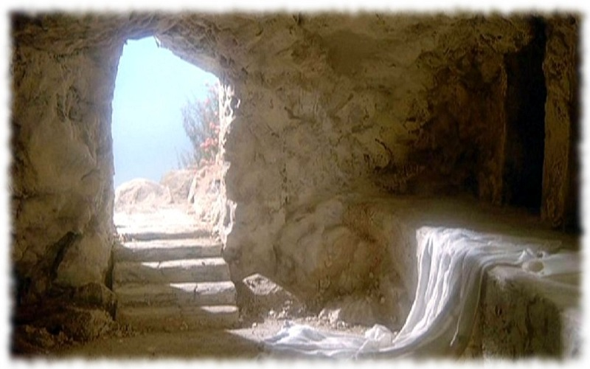
Possible for grave robbers?
Notes:
Besides, there was no incentive or wealth buried with Jesus—

Slide 39
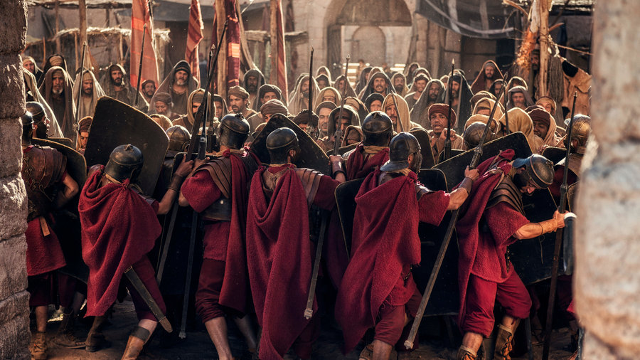
Romans had the army of the day
Notes:
—plus they would have to risk their lives against the Roman contingent.

Slide 40
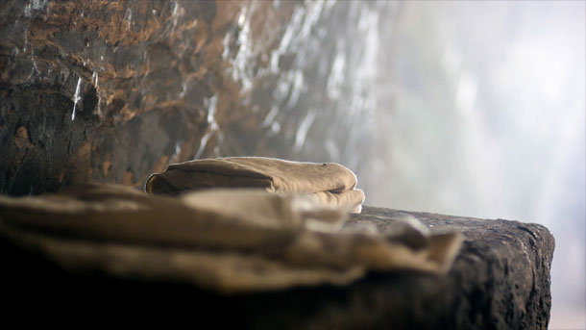
Neat robbers?
Notes:
And John says that the headpiece on Jesus was folded by itself. Why would robbers leave any of the grave clothes?

Slide 41
基督门徒没有移动石头
Notes:
The followers of Jesus certainly did not fake a resurrection.

Slide 42
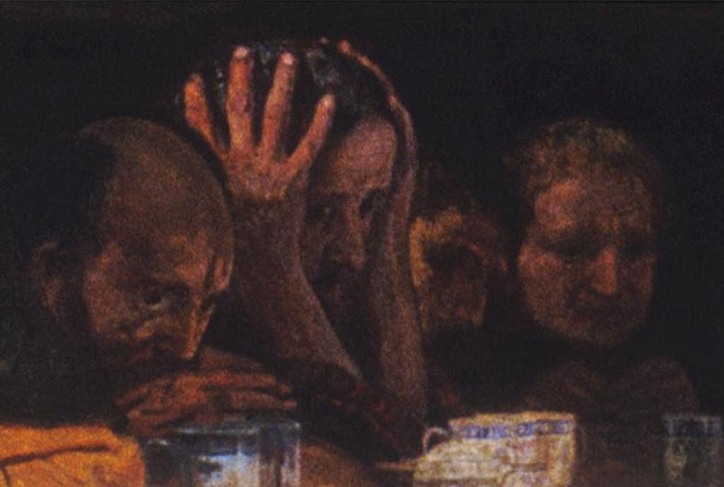
Despondency at its worst
Notes:
Why not? They were least expecting a resurrection! Nearly every disciple fled when Jesus was crucified and then locked themselves up like scared chickens in a hen house.
But within a few days they changed from fearful men to fearless men boldly proclaiming the resurrection—and ten of the eleven disciples died a martyr’s death for their faith. Would you give your life for a lie? That’s not courage but insanity!

Slide 43
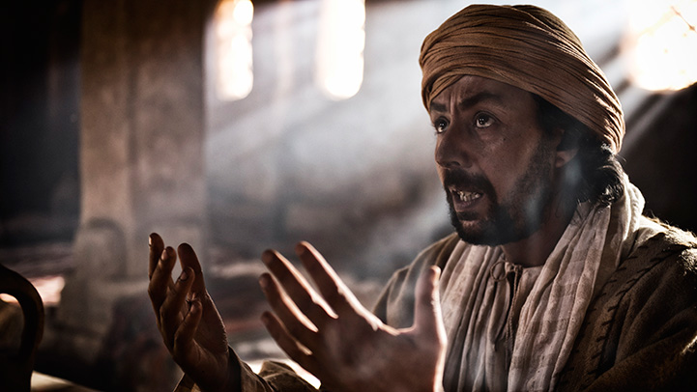
Despondency at its worst
Notes:
Jesus’ followers were mostly fishermen by trade. Can we really believe that such men could fight through a Roman guard and move a 2-ton stone? You’ve heard of the Jewish 6-day war? This would have been the Jewish 6-second war!

Slide 44
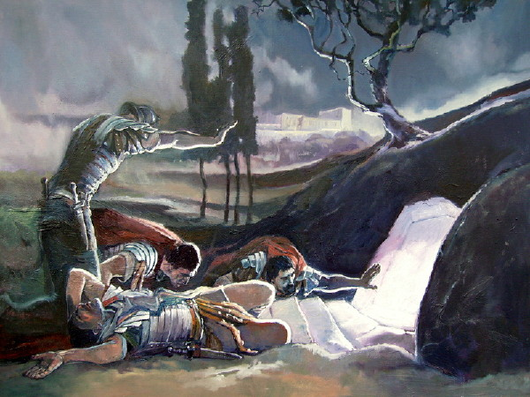
The guards were the only eyewitnesses
Notes:
Even still, the rumor that the leaders spread was that the Roman soldiers saw the disciples steal the body while they were asleep. Tell me, friends, have you ever seen anybody steal anything when you were asleep?
Do you know the penalty for Roman soldiers who fell asleep on duty? Especially at night? Automatic execution by having his clothes set on fire! These soldiers would be banging each other on the head to keep awake! Not one of these guards would have been asleep—let alone the whole bunch of them!

Slide 45
犹太人没有移动石头
Notes:
The religious authorities in Jerusalem certainly didn’t want to fake a resurrection.

Slide 46
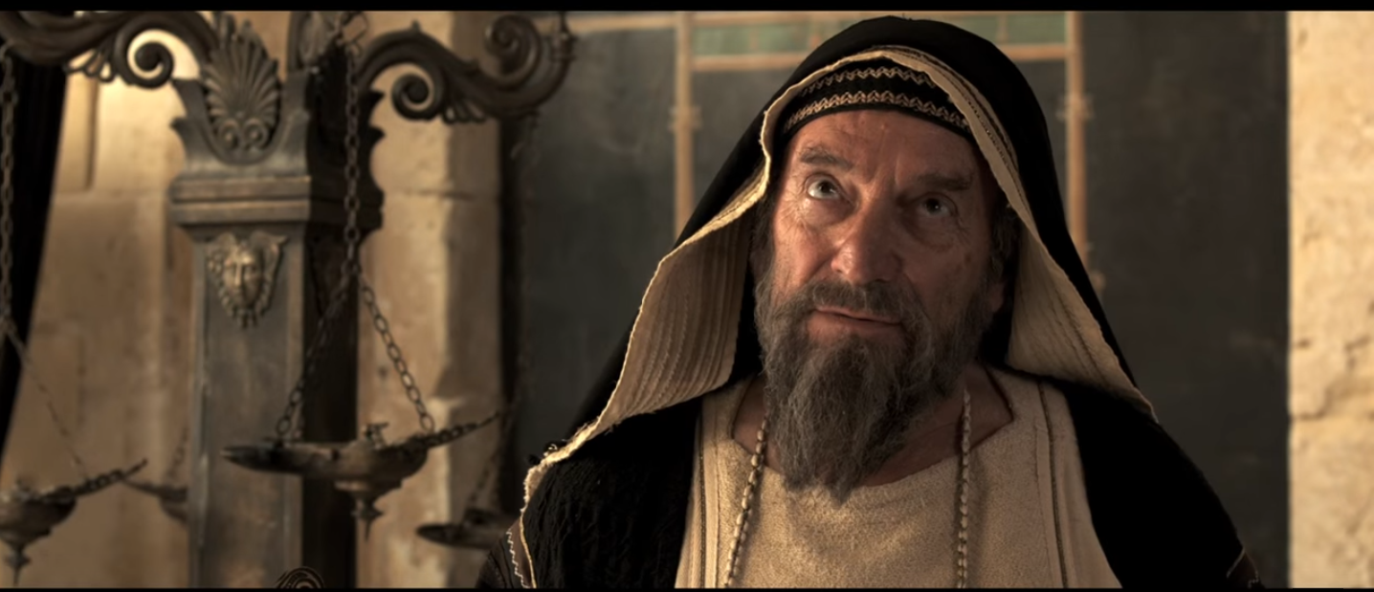
Jewish leaders were the only ones to remember that Jesus predicted a resurrection!
Notes:
They were the ones to try to prevent the stone from being moved!

Slide 47
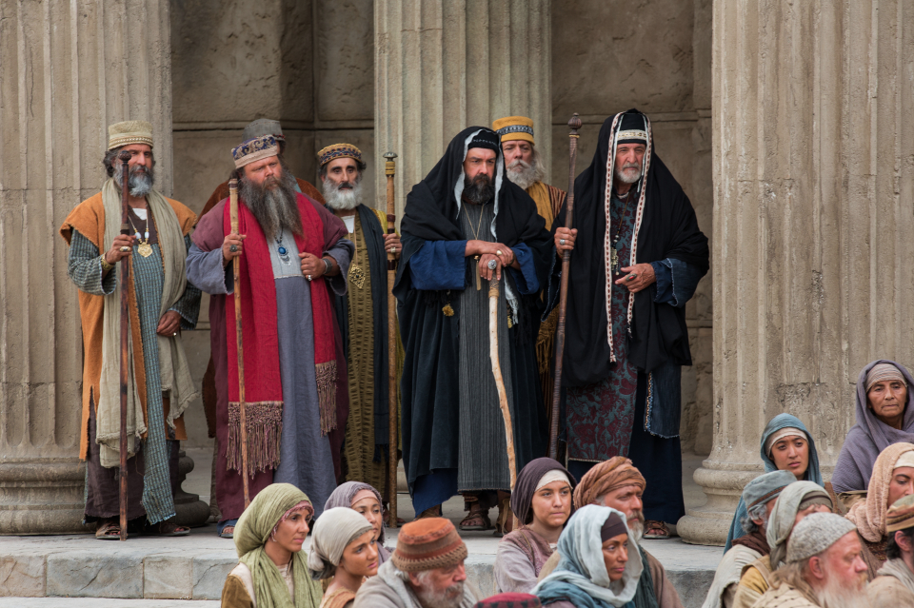
Jewish leaders had the most to lose
Notes:
The Jewish leaders were the ones who requested the Roman guard.

Slide 48
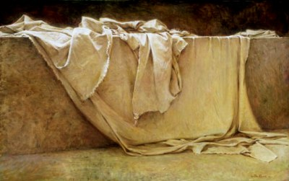
If the Jews took the body not anticipating that others would see this as a resurrection, all they had to do was to publicly show the body!.
Notes:
They felt that a fake resurrection would lead to even more followers of Jesus. No one out of envy aids his opponent!

Slide 49
罗马人没有动摇石头
Notes:
Guards funded by the occupying power had no interest in suicide by not doing their job.

Slide 50
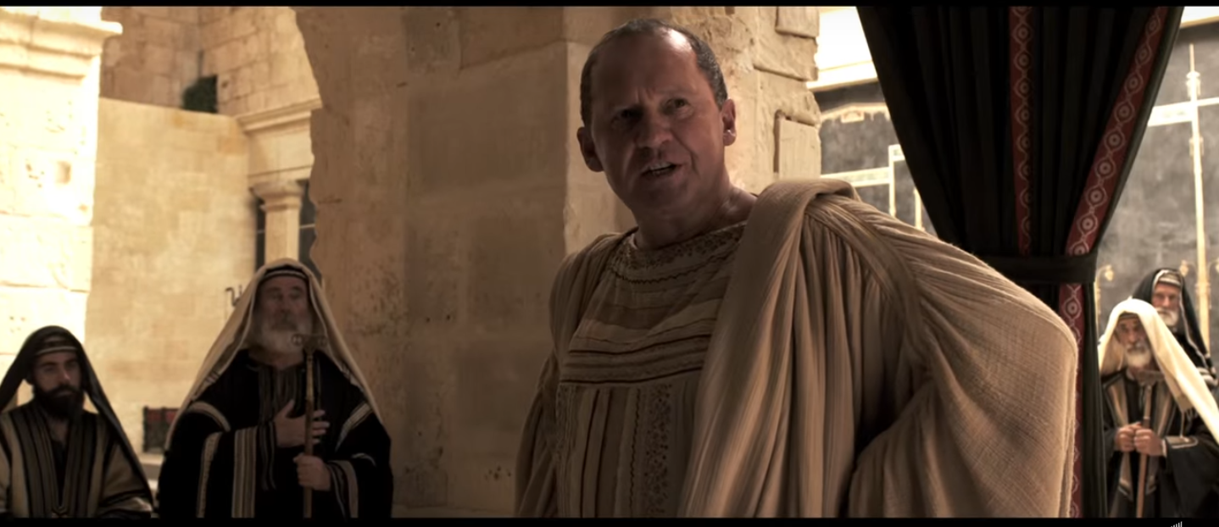
Pilate and the Romans ordered that the tomb be sealed.
Notes:
The Roman soldiers were the ones commanded by Pilate to guard the tomb!
Do you know the penalty for a Roman soldier who let the seal get broken? Execution again! You can be sure they guarded it for fear of death itself.
As hard as they tried to protect it, though, the Bible says that an earthquake occurred, the seal was broken and then the guards became the scared chickens. In fact, they were the first witnesses to the resurrection! They told the religious leaders about it and even made some money off by taking a bribe. The Jewish authorities also protected their lives.

Slide 51
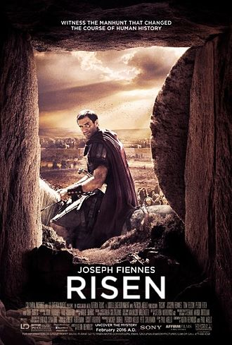
"Risen" (2016)
Notes:
The 2016 movie “Risen” accurately depicts the plight of the Romans who needed to find the body to prevent the resurrection story from being spread.
https://en.wikipedia.org/wiki/Risen_(2016_film)
Accessed 16 April 2017
Plot
After crushing a Zealot revolt led by Barabbas, Clavius, a Roman Tribune, is sent by Pontius Pilate to expedite a crucifixion already in progress. Three days later he is appointed to investigate the rumors of a risen Jewish Messiah. Pilate orders him to locate the missing body of Yeshua, one of the crucified men. In doing so, Pilate seeks to quell an imminent uprising in Jerusalem before the Emperor arrives.^{[4]} Failing to secure Yeshua's body, Clavius attempts to locate and question his disciples for clues to his disappearance.
During a raid through a Jewish enclave, Clavius unexpectedly discovers a seemingly resurrected Yeshua with his apostles in a solitary abode. Clavius calls off the search; he disperses his troops without revealing to them his personal encounter with the risen Yeshua. Having abandoned Roman polytheism and the god Mars, Clavius later joins Yeshua and his followers on a journey to determine the validity of his mortal rejuvenation.
Pilate deduces that Clavius has apparently betrayed him, and dispatches a contingent of Roman troops to pursue him and Yeshua. Clavius assists the disciples in evading the Roman search party; he consequently witnesses the healing of a leper, and then the ascension of Yeshua into Heaven. Later, communicating his travels to a stranger in a remote dwelling, Clavius acknowledges the vivifying wisdom which he observed through Yeshua, feeling he will never be the same.

Slide 52
"Risen" Trailer (2016)
Notes:
In the recent movie "Risen" the Roman commander is taked to find the body of Jesus. Good luck!
https://en.wikipedia.org/wiki/Risen_(2016_film)
Accessed 16 April 2017
Plot
After crushing a Zealot revolt led by Barabbas, Clavius, a Roman Tribune, is sent by Pontius Pilate to expedite a crucifixion already in progress. Three days later he is appointed to investigate the rumors of a risen Jewish Messiah. Pilate orders him to locate the missing body of Yeshua, one of the crucified men. In doing so, Pilate seeks to quell an imminent uprising in Jerusalem before the Emperor arrives.^{[4]} Failing to secure Yeshua's body, Clavius attempts to locate and question his disciples for clues to his disappearance.
During a raid through a Jewish enclave, Clavius unexpectedly discovers a seemingly resurrected Yeshua with his apostles in a solitary abode. Clavius calls off the search; he disperses his troops without revealing to them his personal encounter with the risen Yeshua. Having abandoned Roman polytheism and the god Mars, Clavius later joins Yeshua and his followers on a journey to determine the validity of his mortal rejuvenation.
Pilate deduces that Clavius has apparently betrayed him, and dispatches a contingent of Roman troops to pursue him and Yeshua. Clavius assists the disciples in evading the Roman search party; he consequently witnesses the healing of a leper, and then the ascension of Yeshua into Heaven. Later, communicating his travels to a stranger in a remote dwelling, Clavius acknowledges the vivifying wisdom which he observed through Yeshua, feeling he will never be the same.

Slide 53
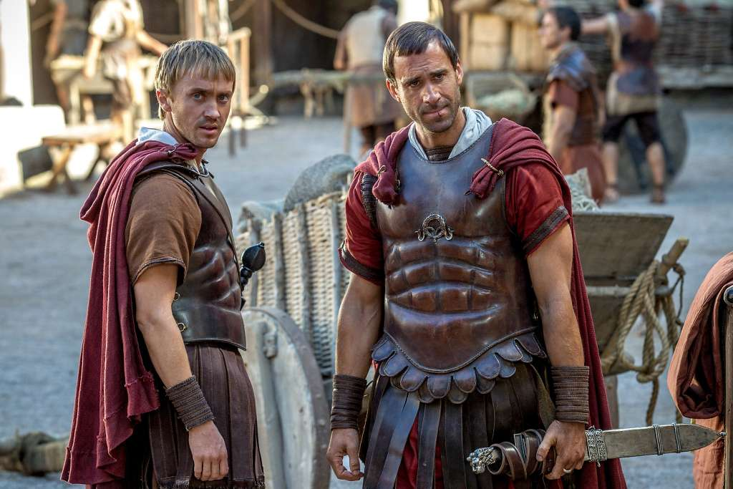
"Risen" (2016)
Notes:
‘Risen’: an earthy view of miraculous events
By Mick LaSalle
Published 6:00 pm, Thursday, February 18, 2016
Accessed 15 April 2017
Drama. Starring Joseph Fiennes and Cliff Curtis. Directed by Kevin Reynolds. (PG-13. 107 minutes.)
Photo: Handout, McClatchy-Tribune News Service
Joseph Fiennes (right) as tribune Clavius and Tom Felton.
The abundance of biblical epics over the decades has left behind a minefield of movie cliches. The result is that, with the slightest misstep, the most pious and well-intentioned film can explode into unintended farce. The only hope is to devise a brand-new strategy, and that’s what we find in “Risen,” a movie that’s different, not only in its point of view but also in its presentation of biblical events.
The movie’s whole approach is secular. To be sure, the movie is ultimately a critique of secularism, but it’s a shrewd critique, one that begins by persuading us to root for the Romans against a mob of Jewish insurgents. After all, the Jews look like a bunch of scruffy, humorless religious fanatics, while the Romans are efficient, well groomed and ironic. They seem like people who can actually run an empire, and probably should.
At the head of the small Roman force is the military tribune, Clavius, played by a sturdy-looking Joseph Fiennes. Clavius is an ambitious guy, just putting in his time in some miserable outpost of the empire. His boss is Pontius Pilate, who has no idea that he has just stepped into history by crucifying Yeshua, a Nazarene religious zealot. Clavius arrives at the scene of the crucifixion in its final minutes, and the sight is squalid and horrible — but also, in the most dispiriting possible way, routine.
That would seem to be the end of a very minor chapter in Clavius’ life, but the Jewish high priest Caiaphas shows up, insisting that the Romans guard the tomb. Caiaphas is worried that Yeshua’s associates might steal the body and proclaim his resurrection, and so Clavius gets the job of sealing the tomb and appointing guards to stand watch.
You pretty much know what happens from there, but how it’s all perceived, by the characters and by the audience, makes “Risen” a different kind of experience. In every biblical epic of the 1950s, the Romans were effete and had English accents, while the Jews were more or less like the audience. But here, the Romans are like us — modern people, with recognizable worldviews and life plans, living amid a poverty-ridden, backward and superstitious culture. At least a third of the movie is like a detective story, with Clavius and an assistant questioning witnesses, trying to locate a dead body.
Here and there are little hints that maybe it’s not so great being a Roman. In a reflective moment, Pilate asks Clavius what the younger man hopes to achieve through worldly success. His reply tells us that all Clavius really wants is to work like a dog in the hope of a little peace at the end of his life. A bit later, Pilate points to a corpse and tells Clavius, “In a few years, that’s us.” The secular life is attractive and recognizable, but a dead end.
Every biblical epic treats Jesus’ disciples as either gentle simpletons or wooden idols, but in “Risen” they are just normal men, from various ages and backgrounds, trying to process the miraculous. Bartholomew (Stephen Hagan) is like a proto-hippie, freaking out at the delight of it all, while Peter is a middle-aged no-nonsense fisherman just trying to keep up with events. And Jesus (Cliff Curtis), instead of speaking like an oracle (like, say, Jeffrey Hunter in “King of Kings”), is calm, benevolent and baffling.
The difference between “Risen” and other biblical films perhaps can best be described in this way: Here, whenever the miraculous happens, it happens on an otherwise unremarkable day. And so people react as they would — they are transformed, and yet they’re not. They’re astonished, and yet normal reality surrounds them, so that it’s hard to believe their own eyes. At one point, Clavius is sitting with Jesus, expressing his religious doubts, even after all that he has seen. And yet this doesn’t seem at all strange. We understand.
Director Kevin Reynolds, who also co-wrote the script, doesn’t strive to lift audiences up into the sky. He keeps one foot on the ground and lets you experience it as the people must have 2,000 years ago. Whatever your religious affiliation, you will come away thinking that if all this did actually happen, it probably happened something like this.
Mick LaSalle is The San Francisco Chronicle’s movie critic. E-mail: mlasalle@sfchronicle.com Twitter: @MickLaSalle

Slide 54
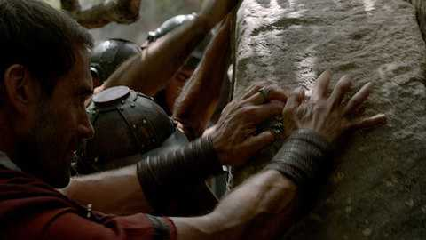
"Risen" (2016)
Clavius helps roll the stone over the entrance to Jesus' tomb and then secures it with a seal and guards.
Notes:
No grave robber, disciple, Jewish leader, or Roman soldier would have stolen the body. And if an unbeliever ever found a body, the enemies of Christianity would have paraded it through Jerusalem to kill this new faith in the womb. And who would have become a believer in Jesus by seeing a dead body—or even die for a hoax? No, it stands to reason that…
________
http://www.catbryant.com/movie-review-risen/
Accessed 15 April 2017

Slide 55
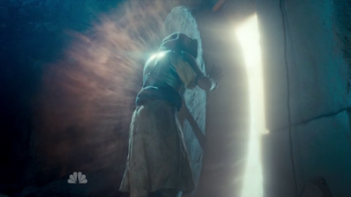
耶稣基督移动了石头！
Notes:
Our Lord is the only reasonable option for the empty tomb—so he rose from the dead!

Slide 56
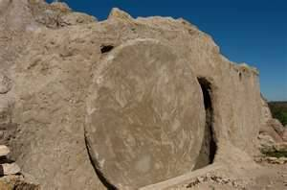
A huge stone was no match for Jesus.
Notes:
And why not? Several times before his death he predicted that he would die and rise again.
But you say, “Maybe he did it, but he didn’t actually die.” Suppose Jesus wasn’t really dead.
No, he was up all night in six trials that included being beaten beyond recognition…
Was so weak he couldn’t even carry his own cross…
Was crucified with seven inch nails driven through his hands and feet…
Received a spear thrust into his heart…
Was put into a 100-pound cocoon of grave cloths…
Laid in a dark, cold, wet tomb with a nearly 2-ton doorway…
But, instead of all of these things killing him, it healed him?
He split out of the clothes…
He pushed the stone uphill away from the tomb…
He conquered the entire group of guards…
He appeared to his disciples and never even got any pity from them?
Sorry, I don’t have enough faith to believe that! That’s even more miraculous than a resurrection!

Slide 57
主旨
由于没有人会有或可能移动石头， 必须发生超自然的复活。
Notes:
We have exhausted all reasonable options. Jesus rose!

Slide 58
花园墓

Slide 59
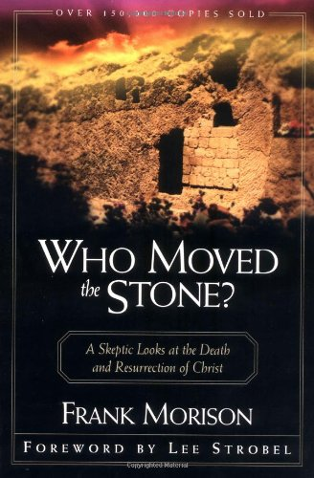
Who Moved the Stone?
Notes:
In the 1920s, the skeptic Frank Morison set out on a quest to disprove the resurrection. His research ended in proving what he tried to destroy, so instead he wrote the classic book, Who Moved the Stone?

Slide 60
He is not here – for he is risen
“他不在，因为他已经复活了。”
基督的复活有什么重要?

Slide 61
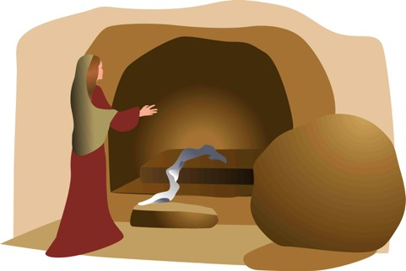
全备的福音
“我 如 今 把 先 前 所 传 给 你 们 的 福 音 告 诉 你 们 知 道。。”
埋葬
复活
死亡
“基督为了我们的罪死…”
“第三天，他从死里复活…”
“他被埋葬…”
林前15:3-4

Slide 62
The Garden Tomb
Notes:
It is based in history as you can visit the tomb today to see it for yourself.

Slide 63
The real issue isn't an issue.
Notes:
It’s not an issue as much as it is a Person—the Person of Jesus Christ of Nazareth.

Slide 64
Resurrection life!
"…stand firm…give yourself fully to the work of the Lord, because you know that your labor in the Lord is not in vain" (1 Cor 15:58 NIV)
Notes:
Jesus came alive and never died since. That means that he is as alive today as you or me. It also means that as God himself he can change your life as a living Saviour.

Slide 65
The real issue isn't an issue.
Notes:
As he reached out his hand to give his followers bread, so he is reaching out to give you himself as the True Bread from heaven right now. Will you accept him?

Slide 66
Black

Slide 67
主题讲道 • BibleStudyDownloads.org
免费获得该讲解!
圣经学习下载
Notes:
The explanation for free
TP Topical Preaching link address

