Slide 1
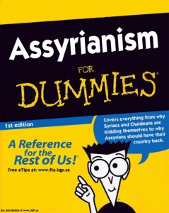
Book of 那鸿
小先知书
那鸿书
亚述论
给
傻瓜的书
Dr. Rick Griffith • 博士 • 新加坡神学院 • www.biblestudydownloads.org

Slide 2
关键字
621
343
尼尼微
那鸿书

Slide 3
主题
308
尼尼微的毁灭
那鸿书

Slide 4
关键节
621
"耶和华不轻易发怒，可是大有能力；
他绝不以有罪的为无罪。"
(那鸿 1:3a).
那鸿书

Slide 5
那鸿书 国度宣言
343
神对尼尼微城的审判显示出
他掌管地上万民 (1:3)。

Slide 6
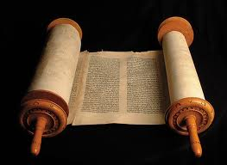
那鸿书 信息声明
621
346
那鸿书语言对尼尼微的毁灭，因为他们密谋反对上帝，并残忍对待别人，以毁灭来安慰犹大，上帝会保护犹大，因着他的公义而毁灭尼尼微。

Slide 7
圣约
347d
尼尼微城早在一百年前因约拿所发的预言而加入以色列与神的约里面，但是他们后来却回去犯罪而成为神的敌人 (1:7-8; 3:5-7)。
那鸿书

Slide 8
救赎
347d
当亚述人无可救药地
回去犯罪的路上时 (1:8, 14; 2:7),
复兴将会临到犹大 (1:15; 2:2)。
那鸿书

Slide 9
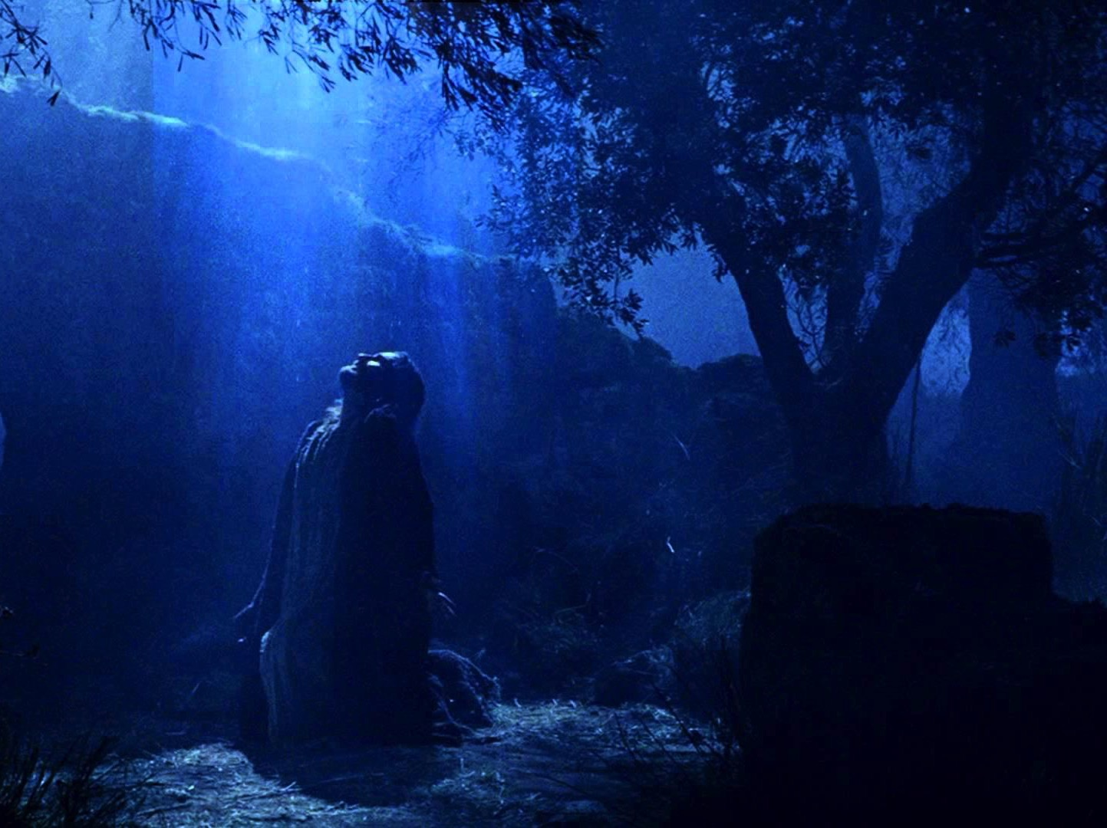
弥赛亚
347d
这本书没有任何关于弥赛亚的预言
但是却透过表述神的
愤怒和恩典来预表耶稣 (1:2-8)。
那鸿书

Slide 10
图表
621
尼尼微的毁灭
预定 |  |  |  | 叙述 |  | 公义
那鸿 1 |  |  |  | 那鸿 2 |  | 那鸿 3
预定的毁灭 |  |  |  | 描述毁灭 |  | 应得的毁灭
报复的判决 |  |  |  | 报复的异象 |  | 报复的刑法
上帝将要作的 |  |  |  | 上帝将如何作 |  | 上帝为什么要如此作
上帝的震怒 |  |  |  | 上帝的作为 |  | 上帝的指责
上帝给犹大的预言 |  |  |  | 上帝给犹大的能力 |  | 上帝给犹大的公义
题目 1:1 | 上帝的属性 1:2-8 | 反抗上帝 1:9-11 | 毁灭是犹大的释放 1:12-15 | 斗争与犹大的辉煌 2:1-2 | 毁灭与掠夺 2:3-13 | 残暴行为的审判 3:1-7 | 在醉酒中被毁灭 3:3-11 | 被火烧 3:12-19
犹大与亚述王国的首都尼尼微
主前 660

Slide 11
Barry Huddleston, The Acrostic Summarized Bible 圣经总意离合诗集 (Grand Rapids: Baker, 1992)
那鸿书
1 God’s character and judgment
2 Overthrow of Nineveh imminent
3 Details of Nineveh’s judgment

Slide 12
作个有耐心的人
那鸿书
Dr. Rick Griffith, Crossroads International Church Singapore
BibleStudyDownloads.org

Slide 13
我们通常会对 神的忍耐 有什么误解?
那鸿书
Notes:
We’ll answer this question: what mistake do we too often make about God’s patience?

Slide 14
约拿书与那鸿书的对比
约拿书 | 那鸿 书
第一本书(4 章) | 续著 (3章)
主前 760 年 | 主前660 年
从罪中悔改 | 回到罪恶中
尼尼微被释放 | 尼尼微被毁灭
以色列被指责 | 以色列被保护
悔改的机会 | 没有悔改的机会
叙述式 | 宣告式
626
626

Slide 15
100 年后…
亚述
提革拉毗尼色
亚述强盛时期
约拿 760
那鸿 660
以色列沦陷 722
尼尼微被毁 612
1100
900
850
800
750
700
650
600
尼尼微重蹈旧辙

Slide 16
Barry Huddleston, The Acrostic Summarized Bible 圣经总意离合诗集 (Grand Rapids: Baker, 1992)
I. 神会摧毁尼尼微但是拯救犹大 (1–3章)。
1 God’s character and judgment
2 Overthrow of Nineveh imminent
3 Details of Nineveh’s judgment
那鸿书
Notes:
The capital of Assyria would have capital punishment for its capital crimes, yet the southern kingdom of Israel could gain comfort from this as the LORD would preserve them.

Slide 17
II. 神会审判恶人并且 在将来拯救义人。
要有耐性
那鸿书
Notes:
The LORD is watching over your future, including his promise to punish all who reject him.

Slide 18
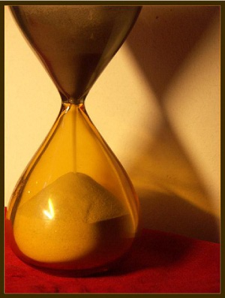
主旨
不要误将神的忍耐看作是神的无能。
—黄石玟牧师
那鸿书

Slide 19
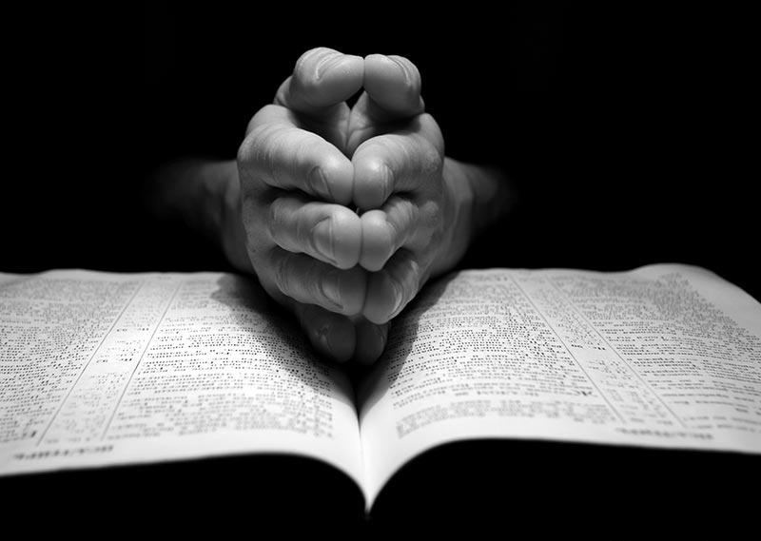
你在等什么?
三个神对你祷告的回应:
好。
现在还不是时候。
我有更好的给你。
那鸿书

Slide 20
Black

Slide 21
大纲
1. 书名
2. 著作日期
3. 作者
4. 对象
大纲
那鸿
5. 历史背景
6.难题
7. 文学架构
8. 神学

Slide 22
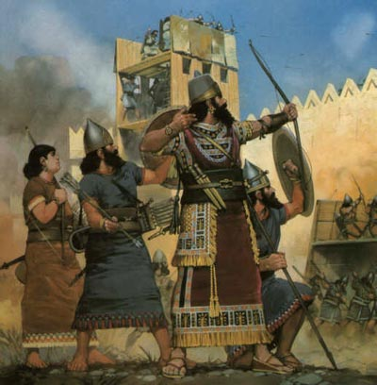
书名
那鸿的意思是安慰或安慰者
这意表他的信息是安慰犹大被压迫与受苦的人民
621
日期
最迟:主前612 (在尼尼微被巴比伦毁灭时)
最早:主前663 (鸿 3:8 提到挪亚们, 即底比斯-埃及国的首都,位于北埃及)

Slide 23
尼尼微城
602
利河伯
新加坡的面积
尼尼微大城市
亚述
迦 拉
创世记 10:11-12
0
20
公里
Notes:
There’s a problem here regarding the three-day’s journey (cf. OTS, 602). Nineveh’s inner wall was less than eight miles, so the diameter of the city was only two miles—hardly a three-day journey. One day’s journey in the open was usually 15-20 miles (Hannah, BKC, 1:1463).
But this isn’t really a problem in either of two ways:
“The great city of Nineveh” (1:2; 3:2; cf. 4:11) almost surely included three other towns in the vicinity as well. Four cities (Nineveh, Rehoboth Ir, Calah, and Resen) are mentioned in Genesis 10:11-12 as “the great city” and they still exist today with different names (Kouyunjik, Khorsbad, Nimroud, and Karamles). This can be observed on the following map by Austin Henry Layard, Nineveh and Its Remains, 2:40.
If we superimpose a map of Singapore over it, we can see that walking through Nineveh would be like walking in Singapore from the far north in Yishun to Harbourfront in the south. That could take 3 days easily!
23

Slide 24
作个有耐心的人
那鸿
Dr. Rick Griffith, Crossroads International Church Singapore
BibleStudyDownloads.org

Slide 25
续集

Slide 26
Major Messages, Minor Prophets
God’s Old Message for Our New Day
Notes:
In recent weeks, we have covered five of the 12 Minor Prophets.

Slide 27
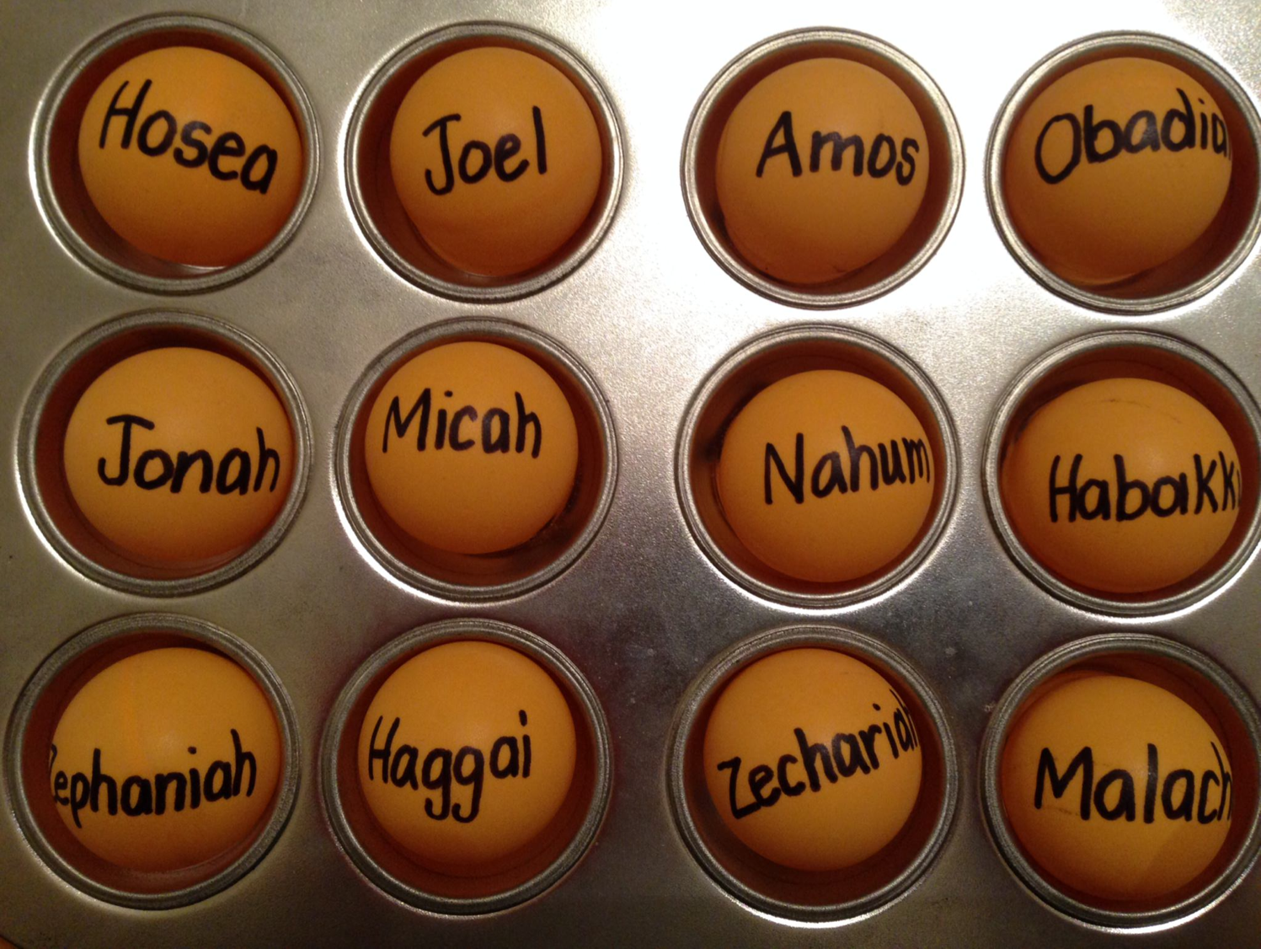
Be...
Loyal
Just
Humble
Caring
Generous
Notes:
So far we have seen 5 “Be” titles:
• Humble—Obadiah taught us not to be proud like the Edomites. Instead, be humble.
• Caring—Jonah warned that God cared for Nineveh, so we also should be caring.
• Just—Amos said that God was just, so we should be just.
• Loyal—Hosea was a great example of God’s loyalty to Israel, so we should be loyal to him.
• Generous—Micah defended the poor as God does, so we also should be generous.

Slide 28
约拿 God's Reluctant Prophet
Notes:
Jonah at first was the reluctant prophet

Slide 29
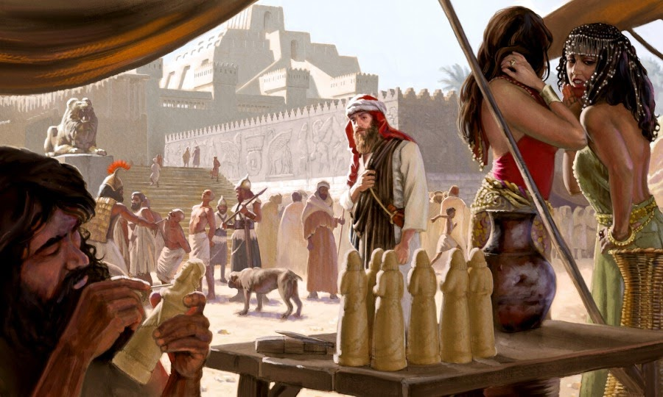
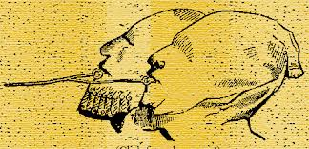
约拿 Wicked Nineveh
Notes:
You can't blame him, in that Nineveh was the epitome of idolaty, immorality, injustice, and torture!

Slide 30
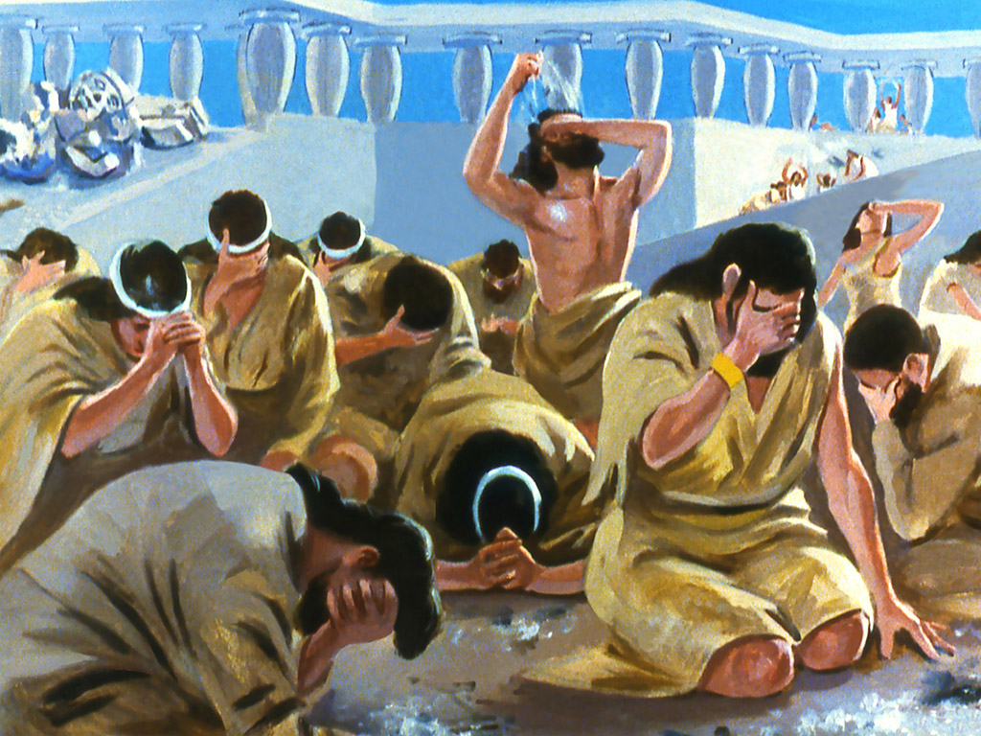
约拿 Amazing Repentance of Nineveh
Notes:
When we studied Jonah we saw at the end that Nineveh repented, God relented…

Slide 31
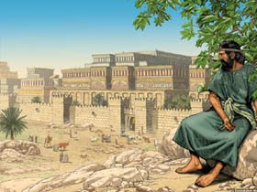
约拿 Waiting for Judgment
So what happened afterwards?
Notes:
…and Jonah resented! So whatever happened to Jonah and Nineveh?
We left Jonah pouting—but what ever happened to him? Well, we just don’t know! The Bible doesn’t say.

Slide 32
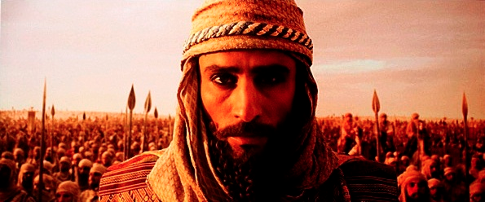
A Prophetic Word for a Day of Military Might
Notes:
But what happened to Nineveh? The Bible does tell us where the city was at spiritually 100 years later—

Slide 33
h
Jonah
那鸿
760
663
660
612
United Kingdom
1050-930
Divided Kingdom
930-722
Solitary Kingdom
722-586
Post- Exile
536-425
1100
1050
1000
950
900
850
800
7 5 0
7 0 0
650
600
550
500
450
Exile 586-536
Notes:
OS-34-Nahum-33

Slide 34
约拿与那鸿的对比
约拿 | 那鸿
第一本书(4 章) | 续著 (3章)
主前 760 年 | 主前660 年
从罪中悔改 | 回到罪恶中
尼尼微被释放 | 尼尼微被毁灭
以色列被指责 | 以色列被保护
悔改的机会 | 没有悔改的机会
叙述式 | 宣告式
626
626

Slide 35
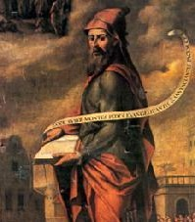
约拿与那鸿的对比
626
约拿 | 那鸿
尼尼微顺服 | 尼尼微不顺服
免洪水毁灭 | 受洪水毁灭
回转与悔改 | 不回转也不悔改
约拿的怒气不合乎理 | 重顾约拿的怒气
上帝的怜悯 | 上帝的审判

Slide 36
那鸿的日子
560
660 650 640 630 620 610 600 590 580 570 560 550 540 530 520
亚述提里兰尼
西撒勒辊
亚述乌巴
力二世
亚述诸王
亚述巴尼拔王
663 BC
尼尼微被毁灭
挪亚们被毁灭
612
609 605 539
当代强国
亚述时代
新巴比伦时代
波斯
那鸿
犹大
约雅敬
西底家
犹大诸王
犹大被掳至巴比伦(586)
回归
玛拿西
约西亚
亚们
约哈斯
约雅斤
哈巴谷

Slide 37
OT Prophets & Kings
342
旧约的列王与先知
931
俄巴底亚
722
约拿
阿摩司
何西阿
以赛亚
弥迦
那鸿
哈巴谷
586

Slide 38
The Assyrian Threat
Assyrian Expansion
Nineveh
Mediterranean
Sea
Syria
Israel
Judah
Persian
Gulf
Egypt
Notes:
Nineveh repented 100 years earlier under Jonah, but then went back to its sin.
Assyrians invaded Israel 60 years earlier and scattered the people.
Then they destroyed 46 towns of Judah—all but Jerusalem!
OS-34-Nahum-38

Slide 39
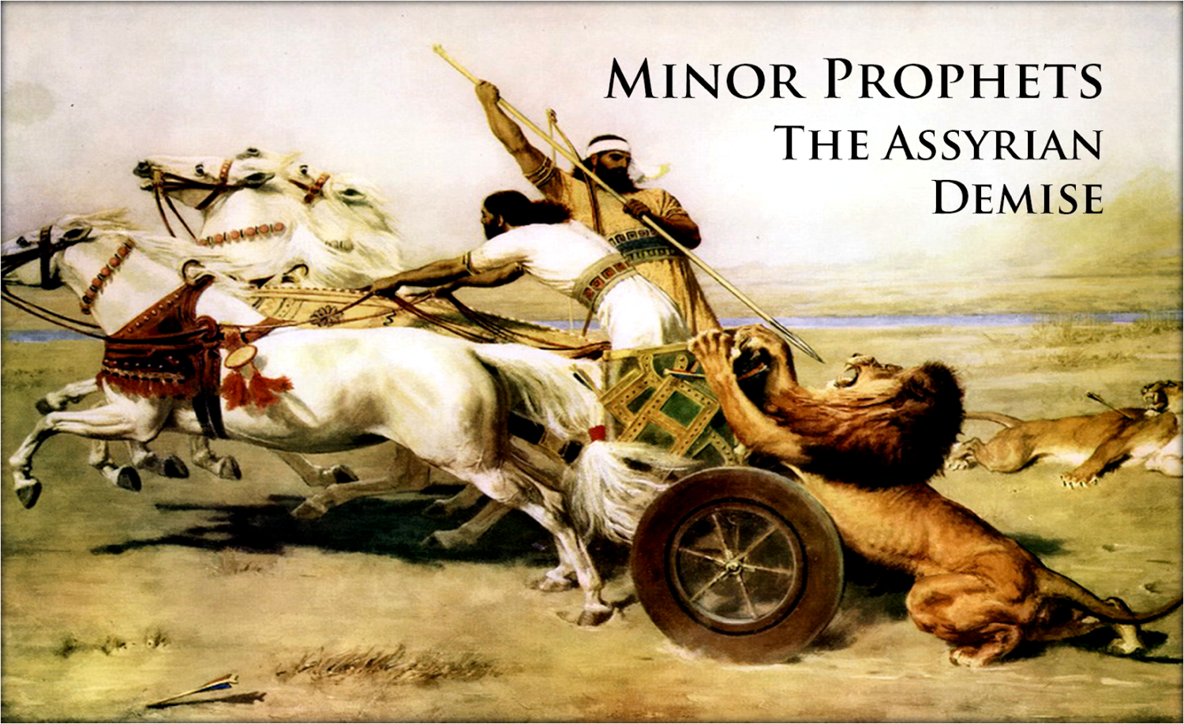
What would God do with short-lived repentance?
Notes:
Would God do anything about this? What happens when repentance is short-lived?

Slide 40
The Incredible Patience of God
Notes:
Today we will study the incredible patience of God, which is the title of a book by Charles Stanley.

Slide 41
我们通常会对 神的忍耐 有什么误解?
那鸿书
Notes:
We’ll answer this question: what mistake do we too often make about God’s patience?

Slide 42
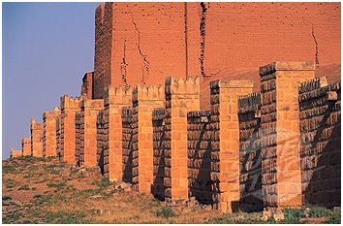
约拿书的续集
Notes:
Our text is the sequel to Jonah called 那鸿. It tells us Nineveh’s fate.

Slide 43
100 年后…
亚述
提革拉毗尼色
亚述强盛时期
约拿 760
那鸿 660
以色列沦陷 722
尼尼微被毁 612
1100
900
850
800
750
700
650
600
尼尼微重蹈旧辙

Slide 44
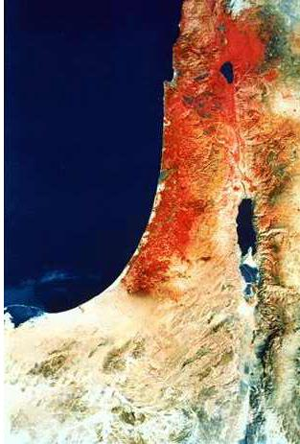
今日的以色列 (国家航空和宇宙航行局 )

Slide 45
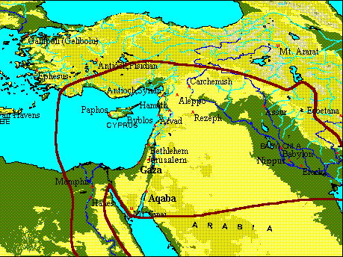
迦基米施之役 (主前609年)
亚述人
巴比伦人
米吉多 : 约西亚死亡
巴比伦王国
埃及人

Slide 46
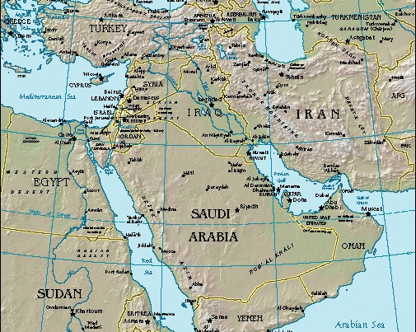
那鸿
尼尼微
今天的主题:
I. 尼尼微的将来
II. 我们的将来
Notes:
Today we will see what would happen to Nineveh, then what will happen in our future too.
And what is that fate? 那鸿 tells us that…

Slide 47
Barry Huddleston, The Acrostic Summarized Bible 圣经总意离合诗集 (Grand Rapids: Baker, 1992)
那鸿书
1 God’s character and judgment
2 Overthrow of Nineveh imminent
3 Details of Nineveh’s judgment

Slide 48
图表
621
尼尼微的毁灭
预定 |  |  |  | 叙述 |  | 公义
那鸿 1 |  |  |  | 那鸿 2 |  | 那鸿 3
预定的毁灭 |  |  |  | 描述毁灭 |  | 应得的毁灭
报复的判决 |  |  |  | 报复的异象 |  | 报复的刑法
上帝将要作的 |  |  |  | 上帝将如何作 |  | 上帝为什么要如此作
上帝的震怒 |  |  |  | 上帝的作为 |  | 上帝的指责
上帝给犹大的预言 |  |  |  | 上帝给犹大的能力 |  | 上帝给犹大的公义
题目 1:1 | 上帝的属性 1:2-8 | 反抗上帝 1:9-11 | 毁灭是犹大的释放 1:12-15 | 斗争与犹大的辉煌 2:1-2 | 毁灭与掠夺 2:3-13 | 残暴行为的审判 3:1-7 | 在醉酒中被毁灭 3:3-11 | 被火烧 3:12-19
犹大与亚述王国的首都尼尼微
主前 660

Slide 49
Slides on 那鸿 1

Slide 50
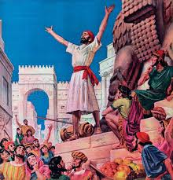
那鸿 1:1 (CNV)
623
"以下是对尼尼微的宣判，就是伊勒歌斯人那鸿的异象录。"

Slide 51
作者
622
只知作者是伊勒歌斯人(1:1)，而对作者其他一切却一无所知
没有其他证据表明作者是他人
伊勒歌斯的正确地点有四个主要的看法:
它是一个现代的乡村，离底格里斯河左岸不远，离尼尼微古城北部只有两天的路程
在加利利的一个小村，
在迦百农，其意思是那鸿村
位于犹大的南部的地区

Slide 52
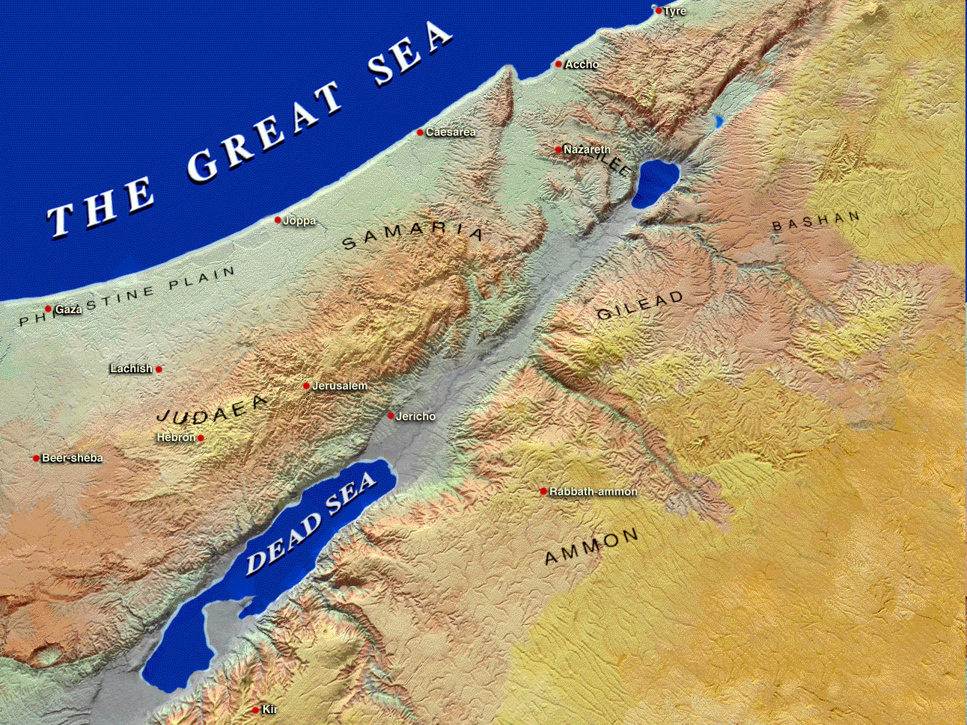
Potential Hometown Locations of 那鸿
Capernaum
= "City of 那鸿)
Israel
Elkosh
Jerusalem
Judah

Slide 53
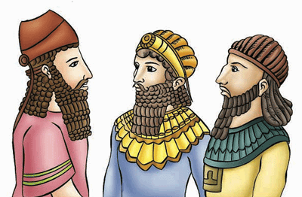
对象
622
信息关乎尼尼微,但是这信息是否达到这国度,却没有这方面的记录. 但上帝怎样审判这个压迫他们的国家却是犹大需要知道的
历史背景
同时代的先知:耶利米,哈巴谷与西番雅
离以色列被亚述毁灭大约一百年 (主前722)
如今,上帝特意用回他”发怒的杖”
虽然曾经在约拿先知时代悔改,但是尼尼微却是要为他在战争时所行的残暴与贪婪面对审判.
这管辖了西亚三百年的强国却要因为巴比伦与玛代的联军而灭亡.

Slide 54
神是公正的: 那鸿1:2-3
623
"耶和华是嫉恶和施行报复的 神；
耶和华施行报复，并且满怀烈怒；
耶和华向他的对头施行报复，
向他的仇敌怀怒。
³耶和华不轻易发怒，可是大有能力；
他绝不以有罪的为无罪。
耶和华乘着狂风暴雨而来，
云彩是他脚下的尘土。" (CNV).
Notes:
God is just—so Nineveh won’t go unpunished (1:2-3).

Slide 55
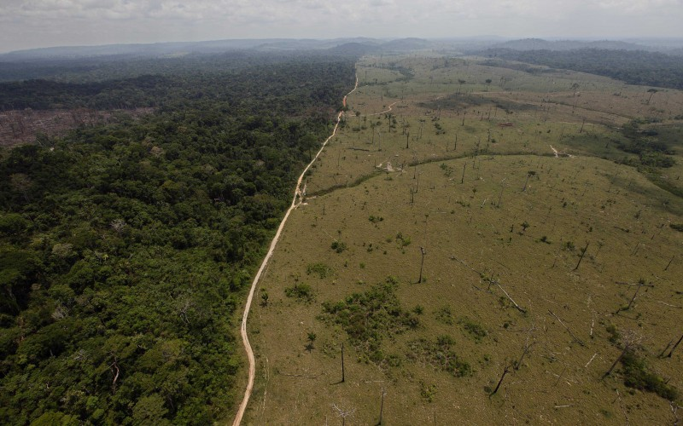
God is All Powerful: 那鸿1:4
623
"他一斥责海，海就干了；
他使一切江河枯干。
巴珊和迦密的树林枯槁，
黎巴嫩的花卉凋残。" (CNV).
Notes:
God is all-powerful—so he can handle Nineveh (1:4-6).

Slide 56
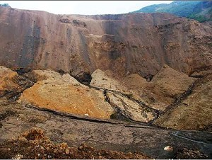
God is All Powerful: 那鸿1:5-6
623
"大山在他面前震动，
小山也都融化；
大地在他面前废去，
世界和所有住在世上的，也都这样。
在他盛怒之下，谁能站得住呢？
他的烈怒谁能受得了呢？
他的忿怒像火一般喷出来，
盘石在他面前都崩裂了。" (CNV).
Notes:
God is all-powerful—so he can handle Nineveh (1:4-6).

Slide 57
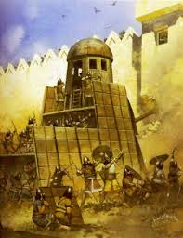
God is Good: 那鸿1:7
623
"耶和华是良善的；
在患难的时候，他作人的避难所；
信靠他的人，他都认识。" (CNV).
Notes:
God is good—so he will be loyal to Judah (1:7-8).

Slide 58
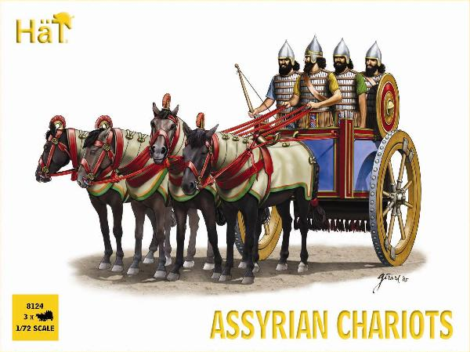
Assyrian Chariots

Slide 59
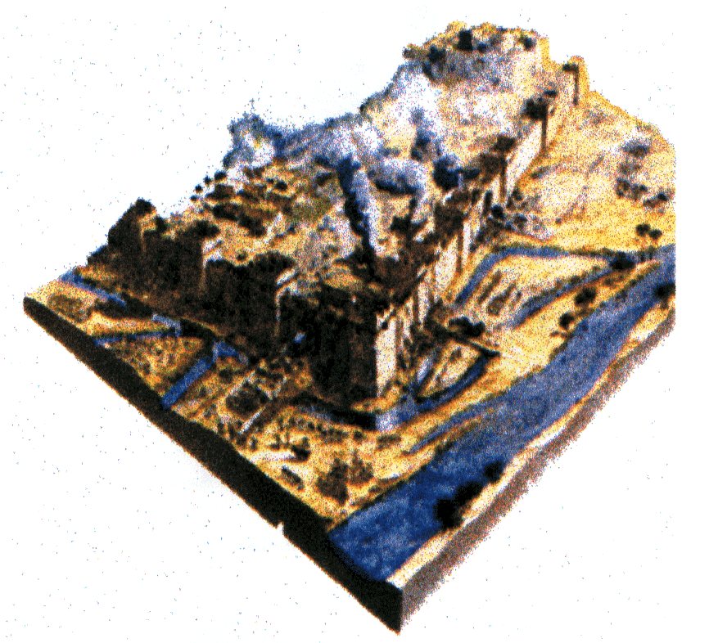
God is Good: 那鸿1:8
623
"但他必用泛滥的洪水，
尽行毁灭尼尼微之地，
把他的仇敌赶入黑暗之中。" (CNV).

Slide 60
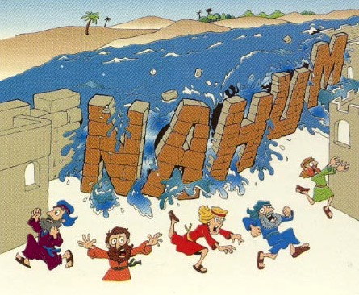
“洪水"
那鸿
那鸿 1:8
Walk Through The Bible ©1989

Slide 61
“尼尼微人哪， 你们对耶和华还有甚么企图？ 他必尽行毁灭；患难必不再次来临。 ¹⁰ 他们像缠结着的荆棘， 像喝醉了的酒徒， 又像枯干的禾秸，全都被吞灭了。” (那鸿 1:9-10 CNV).
Notes:
Nineveh will plot against God the last time (1:9-11).

Slide 62
亚述的毁灭应允了那鸿的预言
625
那鸿的预言 | 历史的证据
"有一人从你那里出来，图谋邪恶，设恶计攻击耶和华。…” (1:11-12) | 亚述王撒缦以色在主前701向犹大与耶路撒冷作出傲慢的恐吓 (cf. 2 Kings 18–19).
"现在我必从你颈项上折断他的轭，扭开他的绳索。” (1:13) | 当尼尼微被毁灭，亚述奴役犹大的日期也满了 (王下18:14; 2代下. 33:11)
Hobart E. Freeman, An Introduction to the Old Testament Prophets (Chicago: Moody Press, 1977).

Slide 63
那鸿's Prophecies Happened
625
那鸿的预言 | 历史的证据
12. 尼尼微必被灭绝净尽. (1:9,14) | 12. Many cities of the ancient Near East were rebuilt after being destroyed (e.g., Samaria, Jerusalem, Babylon) but not Nineveh.
Elliott E. Johnson, “那鸿,” in The Bible Knowledge Commentary (Colorado Springs: SP Pub., 1985), 1:1495.
Notes:
1:9 "Whatever they plot against the LORD
he will bring to an end;
trouble will not come a second time" (NIV)
1:14 "And this is what the LORD says concerning the Assyrians in Nineveh:
“You will have no more children to carry on your name.
I will destroy all the idols in the temples of your gods.
I am preparing a grave for you
because you are despicable!” (NLT)

Slide 64
那鸿's Prophecies Happened
625
那鸿的预言 | 历史的证据
11. Nineveh’s images and idols would be destroyed (1:14). | 11. The statue of the goddess Ishtar lay headless in the debris of Nineveh’s ruins (“The British Museum Excavations on the Temple of Ishtar at Nineveh, 1930-1,” Annals of Archaeology and Anthropology 19, pp. 55-56).
Elliott E. Johnson, “那鸿,” in The Bible Knowledge Commentary (Colorado Springs: SP Pub., 1985), 1:1495.
Notes:
1:14 "And this is what the LORD says concerning the Assyrians in Nineveh:
“You will have no more children to carry on your name.
I will destroy all the idols in the temples of your gods.
I am preparing a grave for you
because you are despicable!” (NLT)

Slide 65
“看哪！那传报佳音、宣告和平之人的脚， 已经站在山上，说： 犹大啊！守你的节期， 还你的愿吧！ 因为那奸恶的人永不会再从你中间经过； 他已被彻底除灭了。” (那鸿 1:15 CNV).
Notes:
Nineveh's destruction will bring peace to Judah (1:12-15).

Slide 66
那鸿书的神学
上帝是个有主权的王
那鸿描述上帝控制天地与万国，拥有主宰宇宙的主权。上帝照着自己的意思，能审判人，也能藉着人为审判的工具。强如亚述王国，那鸿时代最有势力的国家，也不能抵挡主的审判。主必除灭尼尼微所有的雕刻与铸造的偶像(1:14),展示他对亚述神明的主权。

Slide 67
那鸿书里的神学
上帝为万军的统师
在那鸿而言， 主是独一无二，至高无上，万军的统师。 那鸿书一开始，把万军之耶和华形容为斥责海，震动山的忿怒与施报的勇士。这些形容词是当时常用来形容亚述列王的英勇与业绩。那鸿要强调的是神的显现比亚述王更有能力。在书里，有两次的经文(2:13; 3:5)提到万军之耶和华 亲自宣告他必除灭尼尼微。

Slide 68
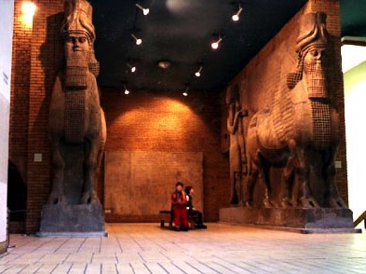
难题:统一性
622
这本书唯一的问题是它的统一性
对那鸿书的可靠性及统一性在19th世纪被挑战
有一相似那鸿书第一章的字母离合体诗的残遗被发现，有些学者否认那鸿书的真实性，只认为 2:1 才是那鸿书开始的叙述.

Slide 69
图表
621
尼尼微的毁灭
预定 |  |  |  | 叙述 |  | 公义
那鸿 1 |  |  |  | 那鸿 2 |  | 那鸿 3
预定的毁灭 |  |  |  | 描述毁灭 |  | 应得的毁灭
报复的判决 |  |  |  | 报复的异象 |  | 报复的刑法
上帝将要作的 |  |  |  | 上帝将如何作 |  | 上帝为什么要如此作
上帝的震怒 |  |  |  | 上帝的作为 |  | 上帝的指责
上帝给犹大的预言 |  |  |  | 上帝给犹大的能力 |  | 上帝给犹大的公义
题目 1:1 | 上帝的属性 1:2-8 | 反抗上帝 1:9-11 | 毁灭是犹大的释放 1:12-15 | 斗争与犹大的辉煌 2:1-2 | 毁灭与掠夺 2:3-13 | 残暴行为的审判 3:1-7 | 在醉酒中被毁灭 3:3-11 | 被火烧 3:12-19
犹大与亚述王国的首都尼尼微
主前 660

Slide 70
Slides on 那鸿 2

Slide 71
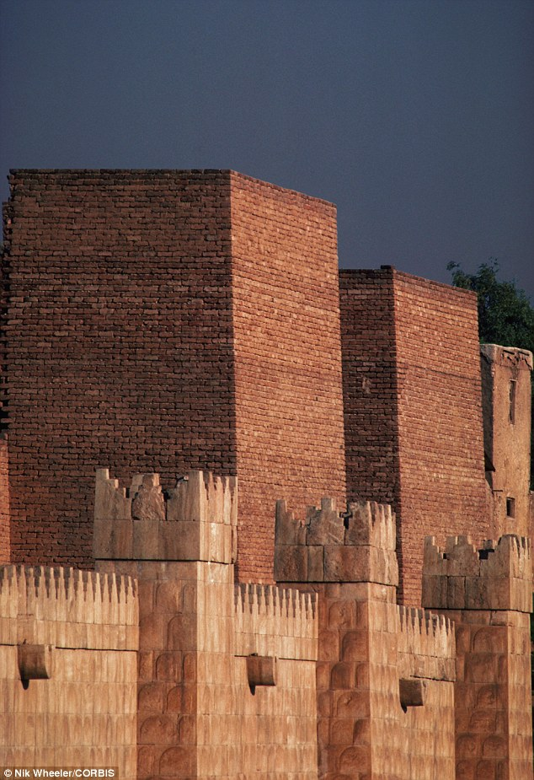
“尼尼微啊！ 那分散邦国的必上来攻 击你，你要固守堡垒， 严防要道，束紧你的腰， 大大增强你的力量。 ² 然而，耶和华必恢复雅各的光荣， 好象以色列的光荣一样； 因为劫掠的人曾把他们劫掠一空， 又把他们的葡萄 枝子毁坏了。” (那鸿 2:1-2 CNV).
Notes:
Attacked: Nineveh should prepare for battle because God considers Judah's splendor a “done deal” (2:1-2).

Slide 72
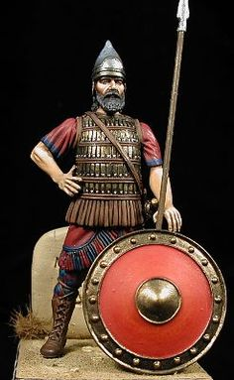
“他勇士的盾牌是红的， 战士的衣服是朱红的。 在他预备出击的时候， 战车的钢铁闪烁如火， 骑兵疾驰。 ⁴ 战车在街上狂奔， 在广场上东奔西驰； 它们看起来像火把， 跑起来像闪电。” (那鸿 2:3-4 CNV).
Notes:
Defeated: The destruction of the city graphically visualizes God's power over the puny Assyrians (2:3-8).
"2:3-4. 那鸿 spoke of the equipment and speed of the “attacker” (v. 1) and his soldiers and chariots. His in the first line of verse 3 probably refers not to the defending Assyrian king but to the unidentified “attacker.” The shields of the Medes and Babylonians were red either from blood, or from red-dyed leather over the wooden shields, or by being covered with copper. The warriors’ scarlet- colored attire (cf. “red” in Ezek. 23:14) would make them awesome in appearance. (Xenophon wrote about the Persians in Cyrus’ army being dressed in scarlet, Cyropaedia 6. 4. 1.) The metal on the chariots glistened in the sun, as the soldiers’ wooden spears were brandished (swung) in their wild attack" (Johnson, "那鸿," BKC).

Slide 73
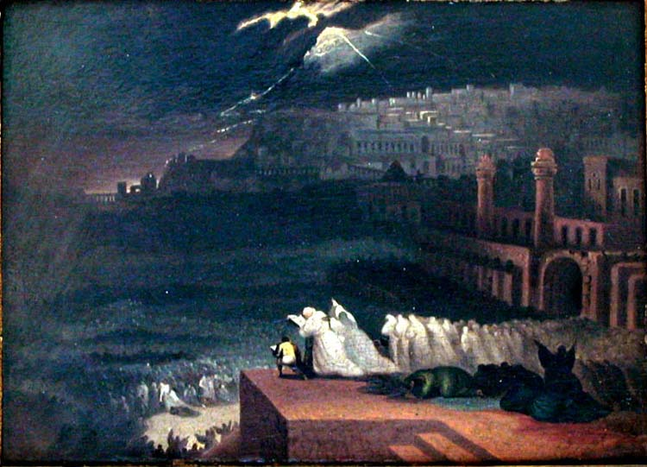
那鸿 2:5-6 (CNV)
623
"亚述王召集他的权臣，
他们跌跌撞撞而来，
急急忙忙走上城墙，
竖起了防御的挡牌。
⁶ 河闸都被打开，
宫殿也给摧毁了。"
Notes:
Defeated: The destruction of the city graphically visualizes God's power over the puny Assyrians (2:3-8).

Slide 74
那鸿's Prophecies Happened
625
那鸿的预言 | 历史的证据
9. When Nineveh would be captured its people would try to escape (2:8): "Nineveh is like a leaking water reservoir! The people are slipping away. 'Stop, stop!' someone shouts, but no one even looks back" (NLT). | 9. “Sardanapalus [another name for King Sin-shar-ishkun] sent away his three sons and two daughters with much treasure into Paphlagonia, to the governor of Kattos, the most loyal of his subjects” (Diodorus, Bibliotheca Historica 2.26.8).
Elliott E. Johnson, “那鸿,” in The Bible Knowledge Commentary (Colorado Springs: SP Pub., 1985), 1:1495.

Slide 75
那鸿's Prophecies Happened
625
那鸿的预言 | 历史的证据
5. Nineveh would be destroyed by a flood (1:8; 2:6, 8) | 5. Nineveh weakened by an unusually heavy & long flood of the Tigris. This carried away a huge section of the rampart around the city, allowing the enemy in. Terrifying thunder (presumably with a storm) accompanied the capture (Diodorus, Bibliotheca Historica 2.26.9; 2.27.13; Xenophon, Anabasis 3.4.12).
Elliott E. Johnson, “那鸿,” in The Bible Knowledge Commentary (Colorado Springs: SP Pub., 1985), 1:1495.

Slide 76
Nineveh's Water System Destroyed
637
"And He will stretch out His hand against the north and destroy Assyria, and He will make Nineveh a desolation, parched like the wilderness" (Zeph. 2:13)
The prophesied destruction of Nineveh (Zeph. 2:13), the capital of Assyria in what is now Iraq, fell in 612 BC into the hands of the neighboring Babylonians, with the whole empire taken by 605 BC. The prediction that God would leave Nineveh "dry as a desert" is remarkable in view of the fame of the city's great irrigation system.

Slide 77
那鸿's Prophecies Happened
625
那鸿的预言 | 历史的证据
8. Plundering and pillaging would accompany the overthrow of the city (2:9-10). | 8. According to the Babylonian Chronicle, “Great quantities of spoil from the city, beyond counting, they carried off. The city [they turned] into a mound and ruin heap” (Luckenbill, Ancient Records of Assyria and Babylonia, 2:420).
Elliott E. Johnson, “那鸿,” in The Bible Knowledge Commentary (Colorado Springs: SP Pub., 1985), 1:1495.
Notes:
Pillaged: The plundering of the city shows how God will humble the proud city (2:9-10).

Slide 78
那鸿述的交叉结构
a 耶和华向他的敌人施报，如大自然毁坏的力量 。(1:2-10）
b 耶和华必释放犹大，必毁灭尼尼微（1:11-15）
c 生动的描述如何攻击尼尼微（2:1-10）
d 哀悼尼尼微的沦陷 （2:11-13）
c’ 生动的描述尼尼微如何被抢夺（3:1-7）
b’ 尼尼微必被毁灭，如底比斯那样脆弱（3:8-13）
a’ 尼尼微被有如大自然毁坏的力量摧毁。（3:14-19）
摘自多尔希，约中之钥:旧约文学结构 (香港:汉语圣经协会出版社，2009)
多尔希透露看哀悼尼尼微的沦陷过重于“狮子坑”，把它翻入此书的中间，加强了尼尼微沦陷的必定性Nineveh’s fall.

Slide 79
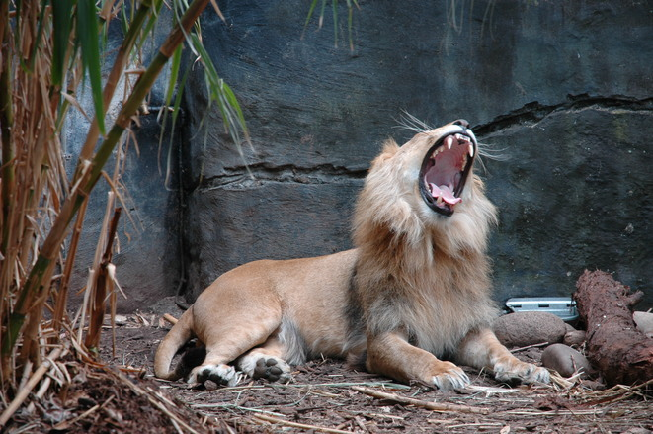
Lion Imagery (2:11-13)
Notes:
Illustrated: God would destroy the powerful Ninevites like destroying a fearless lion in its den (2:11-13).

Slide 80
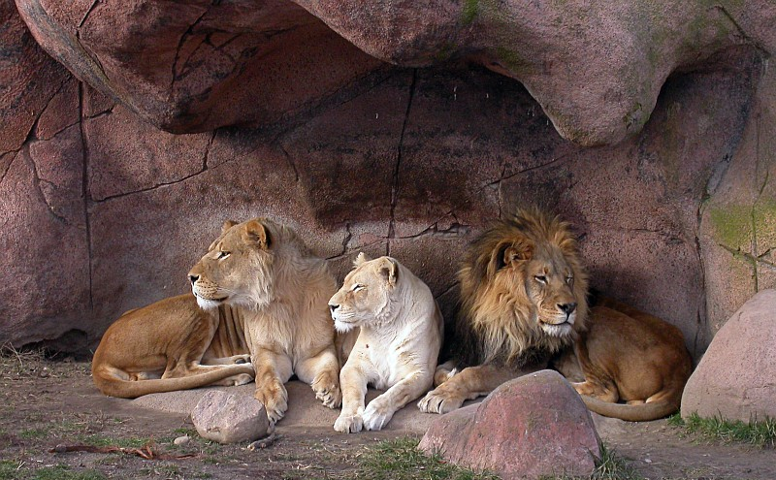
那鸿 2:11-13 (CNV)
623
"狮子的洞穴在哪里？
喂养幼狮的地方在哪里？
公狮、母狮和幼狮不受惊吓之处，可以闲游的地方又在哪里呢？"

Slide 81
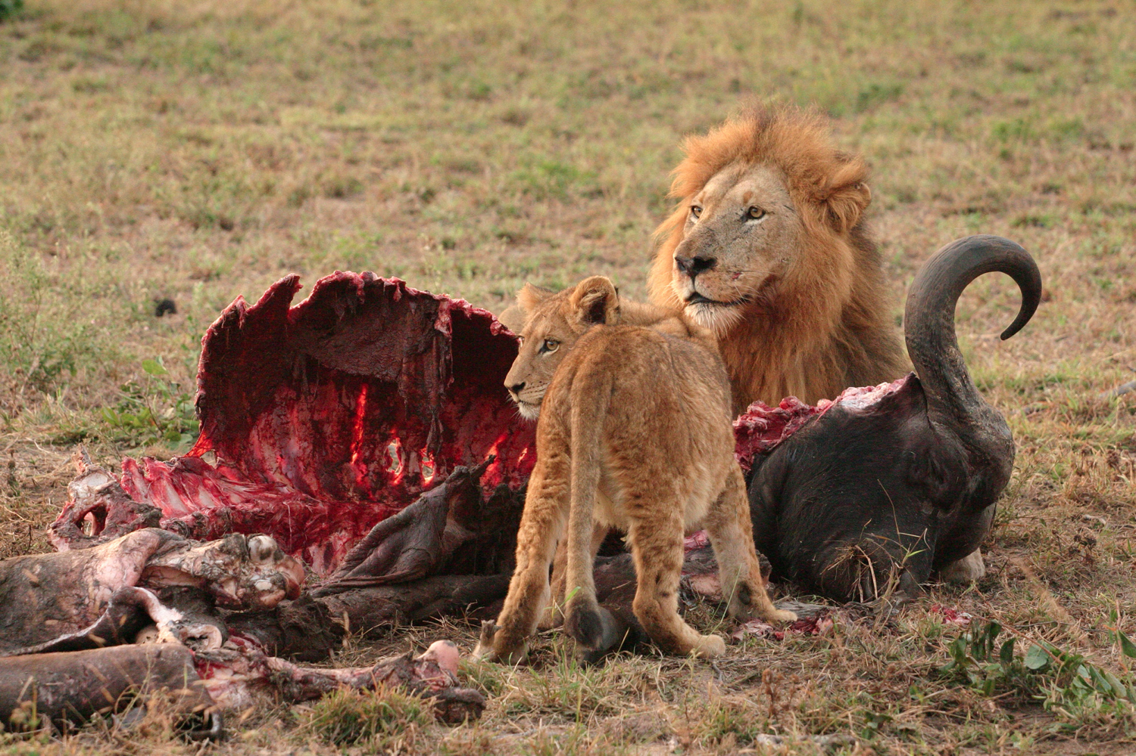
那鸿 2:12 (CNV)
623
"公狮为幼狮撕碎足够的食物，
为母狮掐死活物；
把猎物塞满了牠的洞，
把撕碎的填满了牠的穴。"

Slide 82
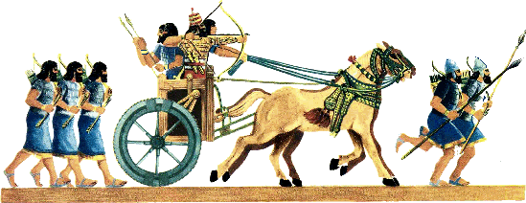
那鸿 2:13 (CNV)
"万军之耶和华说：
看哪！我必攻击你，
我要把你的战车焚烧成烟，
刀剑必吞灭你的幼狮；
我必从地上除去你的猎物，
你使者的声音也必不再有人听见。" (2:13).
623

Slide 83
那鸿's Prophecies Happened
625
那鸿的预言 | 历史的证据
6. Nineveh would be destroyed by fire (1:10; 2:13; 3:15). | 6. Archaeological excavations at Nineveh have revealed chard wood, charcoal, and ashes. “… about 2 inches thick...” (R. Campbell Thomson and R. W. Hutchinson, A Century of Exploration at Nineveh. London: Luzac, pp. 45, 77).
Elliott E. Johnson, “那鸿,” in The Bible Knowledge Commentary (Colorado Springs: SP Pub., 1985), 1:1495.

Slide 84
图表
621
尼尼微的毁灭
预定 |  |  |  | 叙述 |  | 公义
那鸿 1 |  |  |  | 那鸿 2 |  | 那鸿 3
预定的毁灭 |  |  |  | 描述毁灭 |  | 应得的毁灭
报复的判决 |  |  |  | 报复的异象 |  | 报复的刑法
上帝将要作的 |  |  |  | 上帝将如何作 |  | 上帝为什么要如此作
上帝的震怒 |  |  |  | 上帝的作为 |  | 上帝的指责
上帝给犹大的预言 |  |  |  | 上帝给犹大的能力 |  | 上帝给犹大的公义
题目 1:1 | 上帝的属性 1:2-8 | 反抗上帝 1:9-11 | 毁灭是犹大的释放 1:12-15 | 斗争与犹大的辉煌 2:1-2 | 毁灭与掠夺 2:3-13 | 残暴行为的审判 3:1-7 | 在醉酒中被毁灭 3:3-11 | 被火烧 3:12-19
犹大与亚述王国的首都尼尼微
主前 660

Slide 85
Slides on 那鸿 3

Slide 86
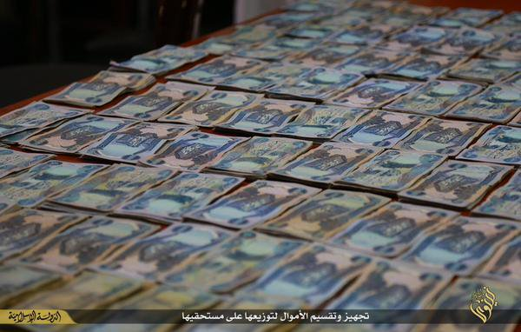
那鸿 3:1 (CNV)
623
"这流人血的城，有祸了！
全城欺诈，
充满劫掠；
抢夺的事总不止息。"
Notes:
Nineveh’s bloodshed, lying and greed humiliated enemies (3:1-4).

Slide 87
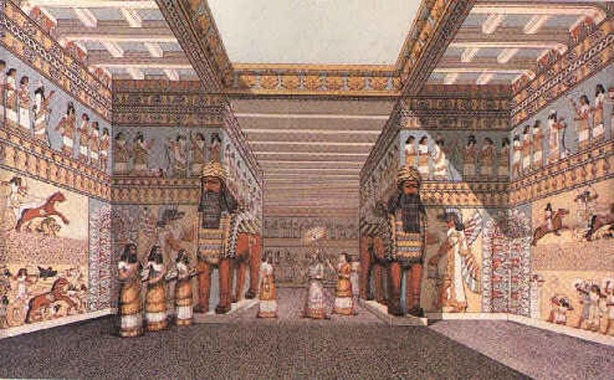
尼尼微 Interior of Sennacherib's Palace

Slide 88
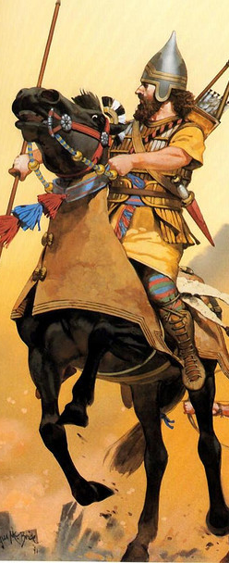
“鞭声飕飕， 轮声辚辚， 骏马奔驰， 战车颠簸跳动。 ³ 骑兵腾跃冲锋； 刀剑烁烁发亮， 枪矛闪闪生光； 被杀的人众多， 死尸成堆； 尸体无数， 众人都被尸体绊倒。” (那鸿 3:2-3 CNV).

Slide 89
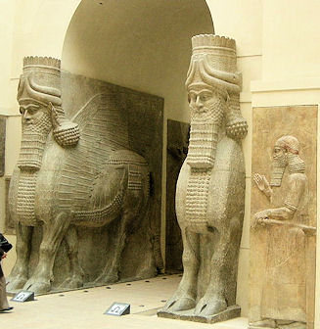
Llamsu Guarded Nineveh's Gates
British Museum

Slide 90
那鸿's Prophecies Happened
625
那鸿的预言 | 历史的证据
7. The city’s capture would be attended by a great massacre of people (3:3). | 7. “In two battles fought on the plain before the city the rebels defeated the Assyrians… So great was the multitude of the slain that the flowing stream, mingled with their blood, changed its color for a considerable distance” (Diodorus, Bibliotheca Historica 2.26.6-7).
Elliott E. Johnson, “那鸿,” in The Bible Knowledge Commentary (Colorado Springs: SP Pub., 1985), 1:1495.

Slide 91
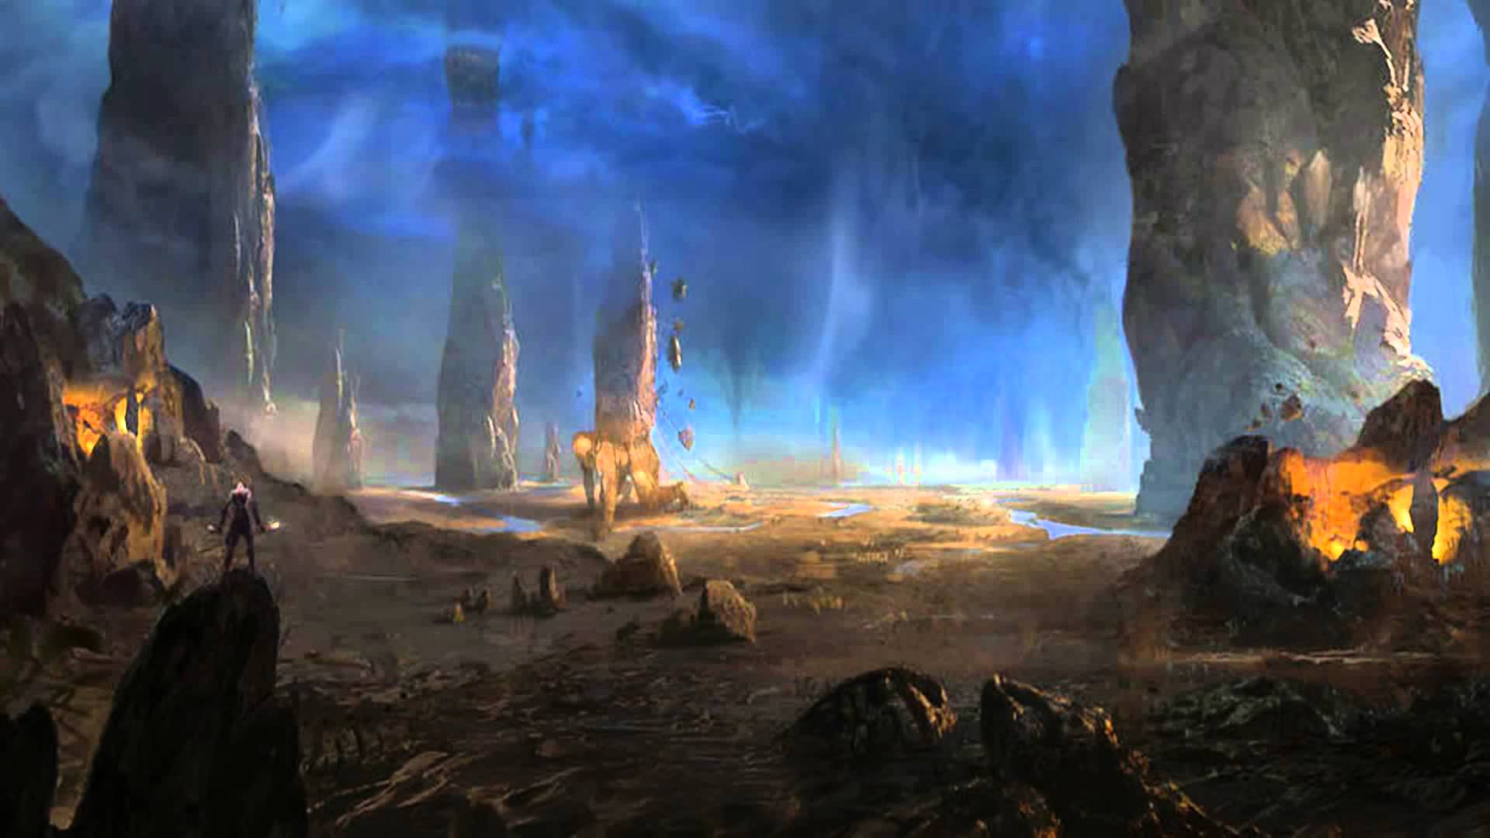
那鸿 3:4 (CNV)
623
"都因妓女多有淫行，
施邪术的美丽女巫，
借着她的淫行诱惑列国，
借着她的邪术欺骗万族。"

Slide 92
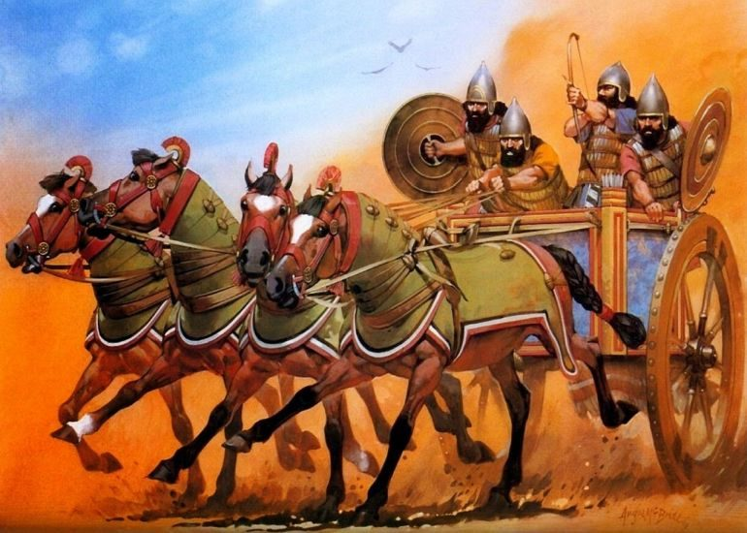
Assyrian Chariots Humbled (3:5-7)
Notes:
The Babylonians will publicly humiliate Nineveh (3:5-7).
3:5-7 Shame
“I am your enemy!”
says the Lord of Heaven’s Armies.
“And now I will lift your skirts
and show all the earth your nakedness and shame.
⁶ I will cover you with filth
and show the world how vile you really are.
⁷ All who see you will shrink back and say,
‘Nineveh lies in ruins.
Where are the mourners?’
Does anyone regret your destruction?”

Slide 93
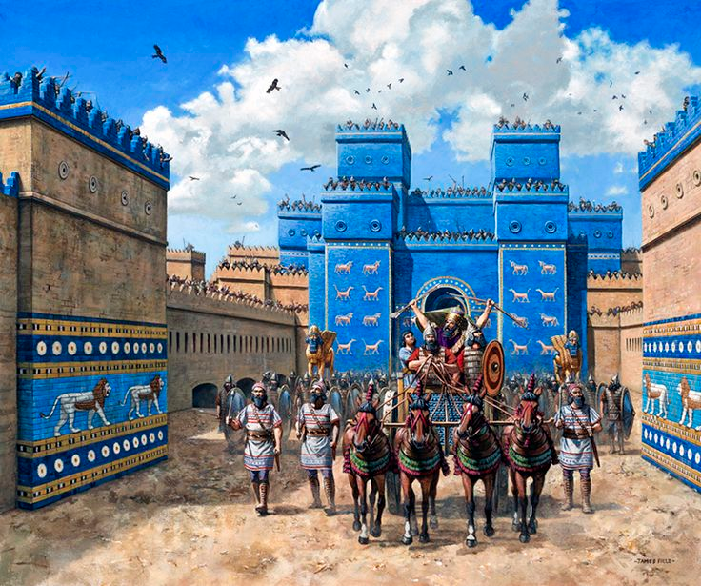
Ishtar Gate of the Conquering Babylonians

Slide 94
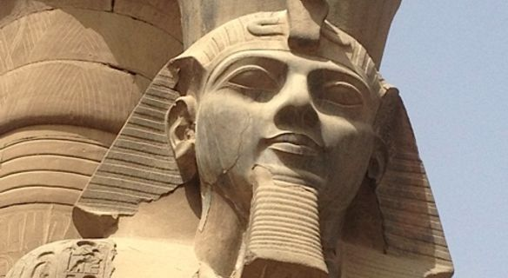
The Benefit of Egyptian Chronology
Notes:
Nineveh will be drunk when destroyed and will go into hiding for its cruel treatment of Thebes in Egypt in 663 BC (3:8-11).

Slide 95
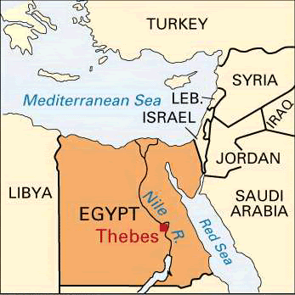
Fall of Thebes (663 BC)
那鸿 3:8-10
Notes:
"Are you any better than the city of Thebes,
situated on the Nile River, surrounded by water?
She was protected by the river on all sides,
walled in by water" (NLT).

Slide 96
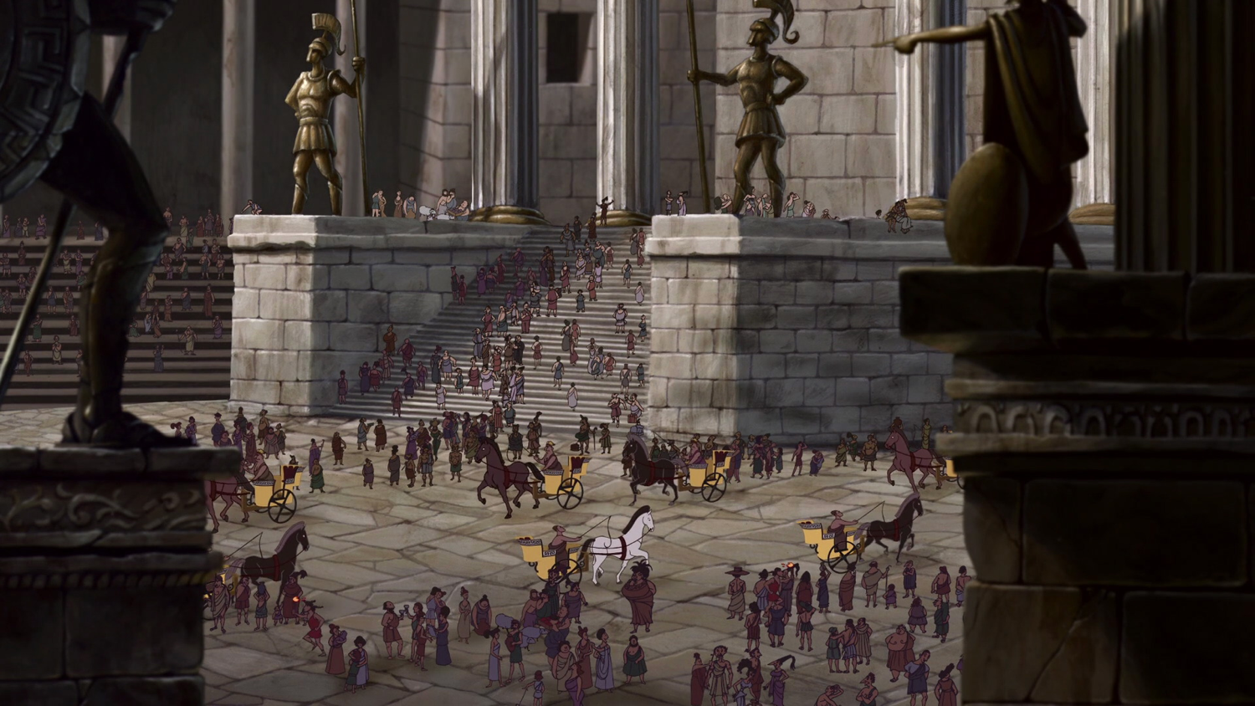
Fall of Thebes (663 BC)
Notes:
⁹ Ethiopia and the land of Egypt
gave unlimited assistance.
The nations of Put and Libya
were among her allies" (NLT).

Slide 97
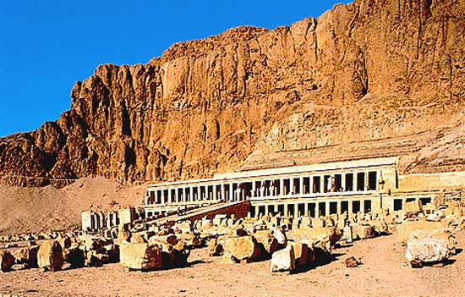
Fall of Thebes (663 BC)
Notes:
¹⁰ Yet Thebes fell,
and her people were led away as captives.
Her babies were dashed to death
against the stones of the streets.
Soldiers threw dice to get Egyptian officers as servants.
All their leaders were bound in chains" (NLT).

Slide 98
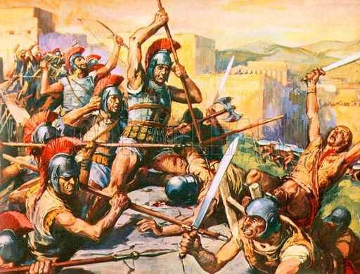
Thebes Conquered again by Alexander in 335 BC

Slide 99
那鸿's Prophecies Happened
625
那鸿的预言 | 历史的证据
1. The Assyrian fortresses surrounding the city would be easily captured (3:12) | According to the Babylonian Chronicle the fortified towns in Nineveh’s environs begin to fall in 614 BC, including Tabris, present-day Sharis-Khan, a few miles northwest of Nineveh.
Elliott E. Johnson, “那鸿,” in The Bible Knowledge Commentary (Colorado Springs: SP Pub., 1985), 1:1495.

Slide 100
那鸿's Prophecies Happened
625
那鸿的预言 | 历史的证据
2. The besieged Ninevites would prepare bricks and mortar for emergency defense walls (3:12). | 2. A. T. Olmstead reported: “To the south of the gate, the moat is still filled with fragments of stone and of mud bricks from the walls, heaped up when they were breached” (History of Assyria, Chicago: University of Chicago Press, 1951, p. 637).
Elliott E. Johnson, “那鸿,” in The Bible Knowledge Commentary (Colorado Springs: SP Pub., 1985), 1:1495.

Slide 101
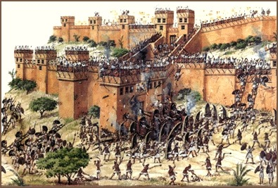
Nineveh Destroyed by Flood (3:14) & Fire (3:12)

Slide 102
那鸿's Prophecies Happened
625
那鸿的预言 | 历史的证据
3. The city gates would be destroyed (3:13). | 3. Olmstead noted: “The main attack was directed from the northwest and the brunt fell upon the Hatami gate at this corner… Within the gates are traces of the counter wall raised by the inhabitants in their last extremity” (History of Assyria, Chicago: University of Chicago Press, 1951, p. 637).
Elliott E. Johnson, “那鸿,” in The Bible Knowledge Commentary (Colorado Springs: SP Pub., 1985), 1:1495.

Slide 103
那鸿's Prophecies Happened
625
那鸿的预言 | 历史的证据
4. In the final hours of the attack the Ninevites would be drunk (1:10; 3:11) | 4. After the Assyrians had repulsed the enemy's attack, they got drunk and feasted, and as a result were surprised by the Medes and the city was taken. (Diodorus, Bibliotheca Historica 2.26.4).
Elliott E. Johnson, “那鸿,” in The Bible Knowledge Commentary (Colorado Springs: SP Pub., 1985), 1:1495.

Slide 104
那鸿's Prophecies Happened
625
那鸿的预言 | 历史的证据
10. The Ninevites officers would weaken and flee (3:17). | 10. The Babylonian Chronicle states that “[the army] of Assyria deserted [lit., ran away before] the king” (Luckenbill, Ancient Records of Assyria and Babylonia, 2:420).
Elliott E. Johnson, “那鸿,” in The Bible Knowledge Commentary (Colorado Springs: SP Pub., 1985), 1:1495.

Slide 105
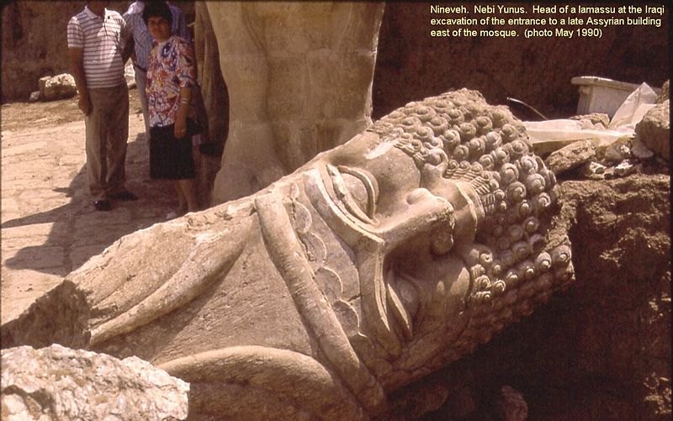
那鸿 3:19 最后一节 (CNV)
623
"你的创伤无法医治；
你受的打击非常严重。
听见你这消息的，
都必向你鼓掌；
因为你不断行恶，
谁没有受过害呢？

Slide 106
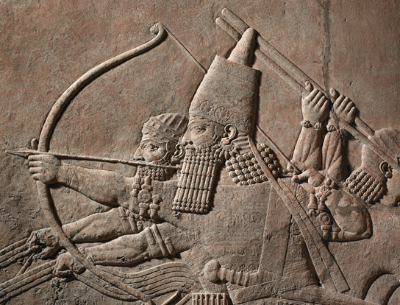
Detail of relief from the North Palace of Ashurbanipal, Nineveh, northern Iraq.

Slide 107
God has spoken by His prophets

Slide 108
II. God will judge the wicked and deliver the righteous in the future too.
Be patient.
Notes:
The LORD is watching over your future, including his promise to punish all who reject him.

Slide 109
Be patient.
Notes:
God is a God of holiness who must judge sin—so just be patient.

Slide 110
And more patient.

Slide 111
Some Nineveh Walls Remained

Slide 112
Modern Map

Slide 113
尼尼微 ISIS captured Modern-Day Mosul

Slide 114
尼尼微 ISIS forced out 200,000 Christians

Slide 115
尼尼微 Walls destroyed by ISIS in 2015
Notes:
January 2015 before ISIS invasion

Slide 116
尼尼微 Walls destroyed by ISIS in 2015
Notes:
January 2015
Ancient: Ruins at the ancient Assyrian city of Nineveh, which Islamic State militants have vowed to destroy when the Iraqi army comes to try to liberate Mosul, Iraq's second largest city Read more: http://www.dailymail.co.uk/news/article-2900530/ISIS-plan-destroy-walls-Nineveh-capital-Assyrian-Empire-one-important-archaeological-sites-Iraq.html#ixzz4LcEZWyuW Follow us: @MailOnline on Twitter | DailyMail on Facebook
Over the past month the Islamic State has seized hundreds of Assyrian relics from Mosul's cultural museum as well as destroyed Assyrian monuments in the city, which it claims 'distort Islam', AINSA reported.
Assyrians believe themselves to be Iraq's original indigenous people, with a documented history stretching back to 4750 BC. They now comprise 95 per cent of the country's Christian population.
Nearly 200,000 were forced to flee their homes around the Nineveh plain last summer as Islamic State made its lightning advance across Iraq.
Most now live as refugees in Iraq's Kurdish areas.
Read more: http://www.dailymail.co.uk/news/article-2900530/ISIS-plan-destroy-walls-Nineveh-capital-Assyrian-Empire-one-important-archaeological-sites-Iraq.html#ixzz4LcEENuP2 Follow us: @MailOnline on Twitter | DailyMail on Facebook

Slide 117
尼尼微 Jonah’s Tomb Destroyed by ISIS

Slide 118
The Recapture of Mosul (2017)

Slide 119
Oprah Winfrey
Notes:
Lakeside Church in Houston, Texas, is the largest church in the USA with 40,000 attending. The pastor, Joel Osteen, is often featured on the cover of Success magazine.

Slide 120
Joel Osteen
No preaching on sin
Led in prayer at gay "wedding"
Notes:
One key rule in the pulpit there is: you cannot talk about sin or judgment.

Slide 121
Motivational Speaking
Magical prayers, feel good messages, have it your way theology; surely this is too awesome to be what Paul warned us about
http://www.conservativecut.com/blog/?tag=false-teacher
Notes:
http://www.conservativecut.com/blog/?tag=false-teacher

Slide 122
The Judgment of God
Notes:
But at CIC we are not afraid to talk about what God warns us about—and judgment is all over the face of the Bible.
God told Ezekiel that he must warn the people—and if he didn’t, then their blood was on his head (cf. Ezek. 33:1-9)!
Hey, I don’t want your blood on my head, so we preach the full gospel here, including God’s wrath!
Who really wants the mamby-pamby God that does not hold people accountable?
Do you have respect for parents that do not discipline their children?
Do you respect governments that let people get away with murder?
Then why do we have a problem with God being a God of justice?

Slide 123
We have a tremendous future ahead of us in Christ (Rev. 20:1-6).
第二
次来
Second Advent
=
苦难
千年
教会时代
永恒国度
7年
1000 年
判决
判决
Notes:
123

Slide 124
一个字面， 政治王国
²⁸ 耶稣对他们说：”我实在告诉你们，到了万物更新，人子坐在他荣耀的宝座上的时候，你们这些跟从我的人，也会坐在十二个宝座上，审判以色列的十二个支派。”
(马太 19:28 新译本)

Slide 125
Our Future
Jesus will bring worldwide truth, peace, prosperity, holiness and protection

Slide 126
主旨
不要误将神的忍耐看作是神的无能。
—黄石玟牧师
那鸿书

Slide 127
耐心.

Slide 128
Wait. It's biblical.
Notes:
But don’t let your impatience make you think God can’t resolve things. This issue isn’t that God can’t solve issues. It’s that he is more patient than you give him credit for. He had many people through history have to wait (Joseph 13 years, Abraham 25 years, Moses 40 years, Jesus 30 years).

Slide 129
Barry Huddleston, The Acrostic Summarized Bible 圣经总意离合诗集 (Grand Rapids: Baker, 1992)
I. 神会摧毁尼尼微但是拯救犹大 (1–3章)。
1 God’s character and judgment
2 Overthrow of Nineveh imminent
3 Details of Nineveh’s judgment
那鸿书
Notes:
The capital of Assyria would have capital punishment for its capital crimes, yet the southern kingdom of Israel could gain comfort from this as the LORD would preserve them.

Slide 130
II. 神会审判恶人并且 在将来拯救义人。
要有耐性
那鸿书
Notes:
The LORD is watching over your future, including his promise to punish all who reject him.

Slide 131
关键节
621
"耶和华不轻易发怒，可是大有能力；
他绝不以有罪的为无罪。"
(那鸿 1:3a).
那鸿

Slide 132
你在等什么?
三个神对你祷告的回应:
好。
现在还不是时候。
我有更好的给你。
那鸿书

Slide 133
Black

Slide 134
旧约全书讲章 • BibleStudyDownloads.org
免费获得该讲解!
圣经学习下载
Notes:
The explanation for free
OT Preaching link address

Slide 135
弥迦与以赛亚
内容相似
主题是弥撒亚
地点是耶路撒冷
对象是以色列与犹大
对希西家影响很大
着重神的国
同一代的先知

Slide 136
REVIEW QUIZ on 那鸿
那鸿 prophesied the destruction of _________.
那鸿's prophecy completes the story begun by the prophet ______.
那鸿 uses vivid imagery (e.g., _____).
This book teaches that each generation must experience a fresh _______.

Slide 137
REVIEW QUIZ on 那鸿
那鸿 prophesied the destruction of Ninevah (Assyria).
那鸿's prophecy completes the story begun by the prophet ______.
那鸿 uses vivid imagery (e.g., _____).
This book teaches that each generation must experience a fresh _______.

Slide 138
REVIEW QUIZ on 那鸿
那鸿 prophesied the destruction of Ninevah (Assyria).
那鸿's prophecy completes the story begun by the prophet Jonah.
那鸿 uses vivid imagery (e.g., _____).
This book teaches that each generation must experience a fresh _______.

Slide 139
REVIEW QUIZ on 那鸿
那鸿 prophesied the destruction of Ninevah (Assyria).
那鸿's prophecy completes the story begun by the prophet Jonah.
那鸿 uses vivid imagery (e.g., lion).
This book teaches that each generation must experience a fresh _______.

Slide 140
REVIEW QUIZ on 那鸿
那鸿 prophesied the destruction of Ninevah (Assyria).
那鸿's prophecy completes the story begun by the prophet Jonah.
那鸿 uses vivid imagery (e.g., lion).
This book teaches that each generation must experience a fresh revival.

Slide 141
亚述的毁灭应允了那鸿的预言
625
那鸿的预言 | 历史的证据
"有一人从你那里出来，图谋邪恶，设恶计攻击耶和华。…” (1:11-12) | 亚述王撒缦以色在主前701向犹大与耶路撒冷作出傲慢的恐吓 (cf. 2 Kings 18–19).
"现在我必从你颈项上折断他的轭，扭开他的绳索。” (1:13) | 当尼尼微被毁灭，亚述奴役犹大的日期也满了 (王下18:14; 2代下. 33:11)
Hobart E. Freeman, An Introduction to the Old Testament Prophets (Chicago: Moody Press, 1977).

Slide 142
那鸿's Prophecies Happened
625
那鸿的预言 | 历史的证据
1. The Assyrian fortresses surrounding the city would be easily captured (3:12) | According to the Babylonian Chronicle the fortified towns in Nineveh’s environs begin to fall in 614 BC, including Tabris, present-day Sharis-Khan, a few miles northwest of Nineveh.
Elliott E. Johnson, “那鸿,” in The Bible Knowledge Commentary (Colorado Springs: SP Pub., 1985), 1:1495.

Slide 143
那鸿's Prophecies Happened
625
那鸿的预言 | 历史的证据
2. The besieged Ninevites would prepare bricks and mortar for emergency defense walls (3:12). | 2. A. T. Olmstead reported: “To the south of the gate, the moat is still filled with fragments of stone and of mud bricks from the walls, heaped up when they were breached” (History of Assyria, Chicago: University of Chicago Press, 1951, p. 637).
Elliott E. Johnson, “那鸿,” in The Bible Knowledge Commentary (Colorado Springs: SP Pub., 1985), 1:1495.

Slide 144
那鸿's Prophecies Happened
625
那鸿的预言 | 历史的证据
3. The city gates would be destroyed (3:13). | 3. Olmstead noted: “The main attack was directed from the northwest and the brunt fell upon the Hatami gate at this corner… Within the gates are traces of the counter wall raised by the inhabitants in their last extremity” (History of Assyria, Chicago: University of Chicago Press, 1951, p. 637).
Elliott E. Johnson, “那鸿,” in The Bible Knowledge Commentary (Colorado Springs: SP Pub., 1985), 1:1495.

Slide 145
那鸿's Prophecies Happened
625
那鸿的预言 | 历史的证据
4. In the final hours of the attack the Ninevites would be drunk (1:10; 3:11) | 4. After the Assyrians had repulsed the enemy's attack, they got drunk and feasted, and as a result were surprised by the Medes and the city was taken. (Diodorus, Bibliotheca Historica 2.26.4).
Elliott E. Johnson, “那鸿,” in The Bible Knowledge Commentary (Colorado Springs: SP Pub., 1985), 1:1495.

Slide 146
那鸿's Prophecies Happened
625
那鸿的预言 | 历史的证据
5. Nineveh would be destroyed by a flood (1:8; 2:6, 8) | 5. Nineveh weakened by an unusually heavy & long flood of the Tigris. This carried away a huge section of the rampart around the city, allowing the enemy in. Terrifying thunder (presumably with a storm) accompanied the capture (Diodorus, Bibliotheca Historica 2.26.9; 2.27.13; Xenophon, Anabasis 3.4.12).
Elliott E. Johnson, “那鸿,” in The Bible Knowledge Commentary (Colorado Springs: SP Pub., 1985), 1:1495.

Slide 147
那鸿's Prophecies Happened
625
那鸿的预言 | 历史的证据
6. Nineveh would be destroyed by fire (1:10; 2:13; 3:15). | 6. Archaeological excavations at Nineveh have revealed chard wood, charcoal, and ashes. “… about 2 inches thick...” (R. Campbell Thomson and R. W. Hutchinson, A Century of Exploration at Nineveh. London: Luzac, pp. 45, 77).
Elliott E. Johnson, “那鸿,” in The Bible Knowledge Commentary (Colorado Springs: SP Pub., 1985), 1:1495.

Slide 148
那鸿's Prophecies Happened
625
那鸿的预言 | 历史的证据
7. The city’s capture would be attended by a great massacre of people (3:3). | 7. “In two battles fought on the plain before the city the rebels defeated the Assyrians… So great was the multitude of the slain that the flowing stream, mingled with their blood, changed its color for a considerable distance” (Diodorus, Bibliotheca Historica 2.26.6-7).
Elliott E. Johnson, “那鸿,” in The Bible Knowledge Commentary (Colorado Springs: SP Pub., 1985), 1:1495.

Slide 149
那鸿's Prophecies Happened
625
那鸿的预言 | 历史的证据
8. Plundering and pillaging would accompany the overthrow of the city (2:9-10). | 8. According to the Babylonian Chronicle, “Great quantities of spoil from the city, beyond counting, they carried off. The city [they turned] into a mound and ruin heap” (Luckenbill, Ancient Records of Assyria and Babylonia, 2:420).
Elliott E. Johnson, “那鸿,” in The Bible Knowledge Commentary (Colorado Springs: SP Pub., 1985), 1:1495.

Slide 150
那鸿's Prophecies Happened
625
那鸿的预言 | 历史的证据
9. When Nineveh would be captured its people would try to escape (2:8): "Nineveh is like a leaking water reservoir! The people are slipping away. 'Stop, stop!' someone shouts, but no one even looks back" (NLT). | 9. “Sardanapalus [another name for King Sin-shar-ishkun] sent away his three sons and two daughters with much treasure into Paphlagonia, to the governor of Kattos, the most loyal of his subjects” (Diodorus, Bibliotheca Historica 2.26.8).
Elliott E. Johnson, “那鸿,” in The Bible Knowledge Commentary (Colorado Springs: SP Pub., 1985), 1:1495.

Slide 151
那鸿's Prophecies Happened
625
那鸿的预言 | 历史的证据
10. The Ninevites officers would weaken and flee (3:17). | 10. The Babylonian Chronicle states that “[the army] of Assyria deserted [lit., ran away before] the king” (Luckenbill, Ancient Records of Assyria and Babylonia, 2:420).
Elliott E. Johnson, “那鸿,” in The Bible Knowledge Commentary (Colorado Springs: SP Pub., 1985), 1:1495.

Slide 152
那鸿's Prophecies Happened
625
那鸿的预言 | 历史的证据
11. Nineveh’s images and idols would be destroyed (1:14). | 11. The statue of the goddess Ishtar lay headless in the debris of Nineveh’s ruins (“The British Museum Excavations on the Temple of Ishtar at Nineveh, 1930-1,” Annals of Archaeology and Anthropology 19, pp. 55-56).
Elliott E. Johnson, “那鸿,” in The Bible Knowledge Commentary (Colorado Springs: SP Pub., 1985), 1:1495.

Slide 153
那鸿's Prophecies Happened
625
那鸿的预言 | 历史的证据
12. Nineveh's destruction would be final (1:9,14) | 12. Many cities of the ancient Near East were rebuilt after being destroyed (e.g., Samaria, Jerusalem, Babylon) but not Nineveh.
Elliott E. Johnson, “那鸿,” in The Bible Knowledge Commentary (Colorado Springs: SP Pub., 1985), 1:1495.

Slide 154
旧约全书概论链接地址 BibleStudyDownloads.org
免费获取这讲解!
圣经学习下载
Notes:
The explanation for free!
OT Survey link address

Slide 155
Black

