Slide 1

所罗门
的诗歌
Dr. Rick Griffith • 博士 • 新加坡神学院 • BibleStudyDownloads.org

Slide 2
关键字
425
343
爱
雅歌

Slide 3
主题
425
婚恋的对话
雅歌

Slide 4
关键节
425
“我属我的良人，
他也恋慕我。”
(雅歌 7:10)
雅歌

Slide 5

信息声明
343
对神掌权的顺服带来婚姻之爱的最高境界。
雅歌

Slide 6

雅歌
信息声明
425
346
所罗门和他的书拉密女妻子
之间的爱情故事描绘了
从求爱到坚固婚爱的过程。
不论在婚前性约束方面，
还是在婚姻成长中所需的努力方面，都树立了一个良好的榜样。

Slide 7

圣约
347a
婚姻是丈夫与妻子之间无条件的约，但它仍要求婚前的节制与婚后的努力经营。
雅歌

Slide 8

救赎
347a
正如所罗门将他的新妇从卑微艰苦的葡萄园中拯救出来，基督也拯救罪人让他们在永恒的家中得享祝福。
雅歌

Slide 9

弥赛亚
347a
神爱以色列如同祂的妻子（旧约），基督爱教会如同祂的新妇（旧约）， 所罗门对书拉密女的爱类比了这两种爱。
雅歌

Slide 10

概述
425
婚恋的对话
从追求到婚礼
在婚姻中成长
1:1–5:1
5:2–8:14
爱的开始
爱的增长
自私的爱
“我的良人属我，我也属他” (2:16a)
无私的爱
“我属我的良人，我的良人也属我” (6:3a)
单身
已婚
早恋
爱情未经考验
经过考验的爱情 和真爱
回顾爱
求爱
1:1–3:5
婚礼
3:6–5:1
成长
5:2–8:4
回忆
8:5-14
渴望
1:1-11
加强
1:12–3:5
进程
3:6-11
圆满
4:1–5:1
挣扎
5:2–6:13
赞美和回应
7:1–8:4
爱的力量
8:5-7
爱的贞洁
8:8-14
都在葡萄园
蜜月开始
蜜月结束
都在葡萄园
分手
5:2-16
和好
6:1-13
约一年

Slide 11
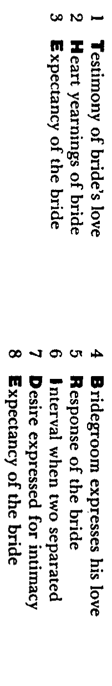
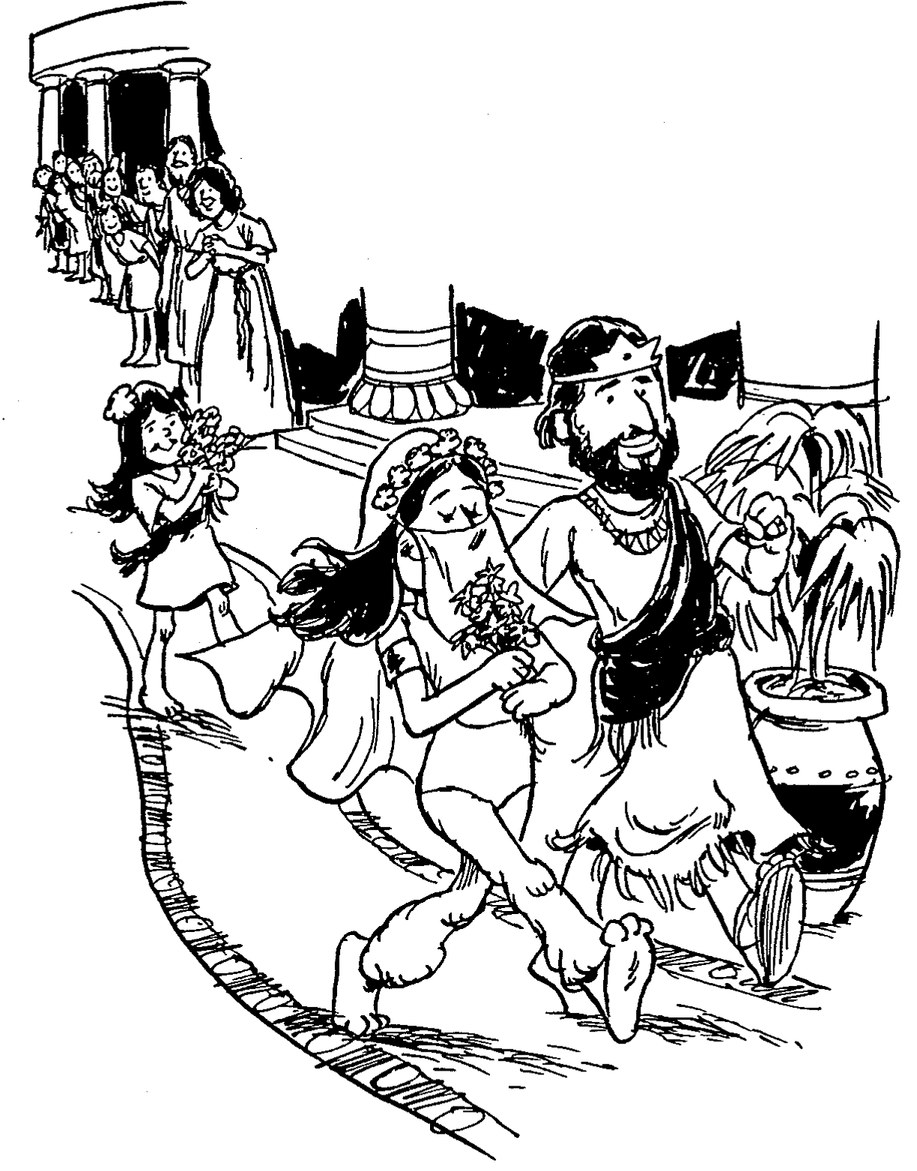
Barry Huddleston, The Acrostic Summarized Bible (Grand Rapids: Baker, 1992)
1 Inception of the world
2 Newlyweds placed in Eden
3 Temptation and man's fall
4 Hatred and first murder
5 Entire genealogy of Adam
6 Lessons on proper priorities
7 Outline for personal relationships
8 Faith of the centurion
雅歌
29 Genealogy of Jesus Christ
30 Opposition of King Herod
31 Spirit's descent upon Jesus
32 Power over Satan's temptations
33 Expounding Sermon on Mount
34 Lessons on proper priorities
35 Outline for personal relationships
36 Faith of the centurion
9 Matthew's call from Jesus
10 Apostles sent to preach
11 Testimony about John's message
12 True Messiah called demonic
13 Hidden message of parables
14 Execution of the Baptist
15 Wisdom is answering Pharisees
37 Matthew's call from Jesus
38 Apostles sent to preach
39 Testimony about John's message
40 True Messiah called demonic
41 Hidden message of parables
42 Execution of the Baptist
43 Wisdom is answering Pharisees
1.佳偶爱之宣言
2. 佳偶心之渴望
3. 佳偶心所期盼
4. 良人倾诉爱意
5. 佳偶回应良人
6. 暂别时的思念
7. 渴望更加亲密
8. 佳偶再诉期盼
16 Keys of the kingdom
17 Impact of Jesus' transfiguration
18 Need for true forgiveness
19 Grounds for divorce clarified
20 Opportunities in the vineyard
21 Fig tree is cursed
44 Keys of the kingdom
45 Impact of Jesus' transfiguration
46 Need for true forgiveness
47 Grounds for divorce clarified
48 Opportunities in the vineyard
49 Fig tree is cursed
22 Taxes paid to Caesar
23 Hypocrisy denounced by "woes"
24 Events of second coming
25 Judgment of the nations
26 Events on Calvary's eve
27 Way of the cross
28 Savior's resurrection and commission
50 Taxes paid to Caesar
51 Hypocrisy denounced by "woes"
52 Events of second coming
53 Judgment of the nations
54 Events on Calvary's eve
55 Way of the cross
56 Savior's resurrection and commission

Slide 12

作个有爱心的人
雅歌
Dr. Rick Griffith • Crossroads International Church Singapore
CICFamily.com • BibleStudyDownloads.org

Slide 13
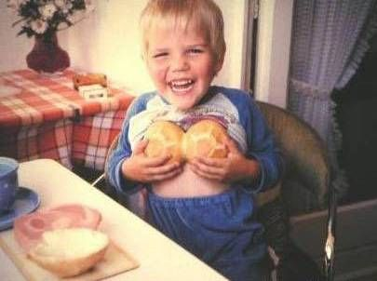
我们从小就会对性产生天然的好奇
但古犹太人只允许30岁以上的男性阅读雅歌

Slide 14

如何让婚姻之爱成为神所定意的?
Notes:
What can you do now to have the fantastic marriage that God desires if he has marriage in his plan for you?

Slide 15

I. 婚前等待性 (雅歌 1:1–5:1)
Notes:
Be loving to God's person for you by preserving yourself now.
Solomon and the Shulammite begin their love relationship in courtship and marriage as an example of the need for premarital sexual restraint (1:1–5:1).

Slide 16

II. 经营美好婚姻
(雅歌 5:2–8:14).
Notes:
No relationship is built without sweat and tears.
The love of the couple matures through various events until it is very strong to show the effort needed to grow in marital love (5:2–8:14).

Slide 17

雅歌中心思想
通过等待与经营来相爱
Notes:
Restatement

Slide 18

那又如何?
425
禁止婚前性行为可以让婚姻充分被享受 (i.e.,让爱在它自己的时间绽放).
“不要惊动，不要叫醒我所亲爱的，等他自己情愿”
(2:7下 CNV).
“不要惊动，不要叫醒我所亲爱的，等他自己情愿”
(3:5下 CNV).
“不要惊动，不要叫醒我所亲爱的，等他自己情愿”
(8:4下 CNV).

Slide 19
那又如何?
425
禁止婚前性行为可以让婚姻充分被享受 (i.e.,让爱在它自己的时间绽放).
预见美好的婚姻需要努力，然后付出努力.
赞美你配偶的外在与内在.

Slide 20
Black

Slide 21

所罗门
的诗歌
作者
Dr. Rick Griffith • 博士 • 新加坡神学院 • BibleStudyDownloads.org

Slide 22
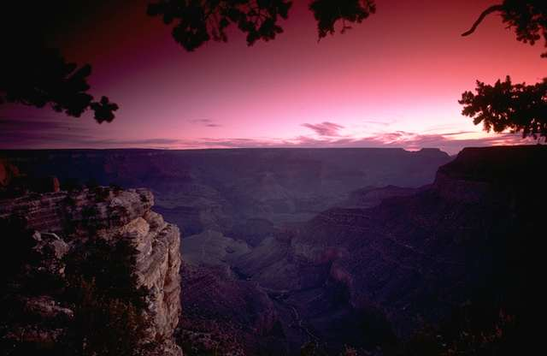
Title
426
The name 雅歌 (~yrIßyVih; ryviî) says this song is the best song possible.
所罗门的歌，是歌中之歌。
(1:1)

Slide 23
书名
426
雅歌（又名歌中之歌）(~yrIßyVih; ryviî)一词可能说明这首诗歌是最好的诗歌。
因此，这首诗歌是所罗门创作的1005首诗歌中最好的诗歌 (列王纪上4:32), 他的名字(hmol{v.)和希伯来文形容词shalom (~Alv’)相关,意为“完成，平安，和平。”
这就是名为“和平”的所罗门视此书为他所有诗歌中最好的。

Slide 24

作者
外部证据
426
最早的犹太传统认为此书出自于所罗门之手.
这一观点在列王记上4:32中得到支持，所罗门作诗歌一千零五首，因此我们应该在经文中期待那最好的。

Slide 25
作者
外部证据
426
此书的在希伯来正典中的实用性经常被质疑，Rabbi Akiba却对此书做出了极大的肯定(ca. AD 100):
“整个世界的价值都不能与以色列拥有雅歌相提并论，所有的作品都是圣洁的,雅歌更是至圣的”
(Mishnah, Tractate Yadaim 3.5).
反对可能是因为它的情色性质。

Slide 26

作者
426
一些证据支持所罗门是雅歌的作者:
所罗门被明确地认为是作者(1:1).
犹太传统视他为不二的人选.
所罗门的1005首诗歌和箴言 (如箴言书) 都展现了写雅歌一书所需的文学技巧 (王上4:32-33).
所罗门的名字在雅歌中被提到六次(1:5; 3:7, 9, 11; 8:11, 12) 以及多次被称为“王”(1:4, 12; 7:5).

Slide 27

作者
426
一些证据支持所罗门是雅歌的作者:
所罗门对自然有着浓厚的兴趣（王上4：33）这些特点在此书中都有明显的体现，如植物(1:17), 动物 (1:8, 9), 矿物 (8:11),珠宝(4:9)。
此书提到了整个帝国的18个的地方。暗指是在君主国分裂之前的时期。
很多所罗门进口的价值不菲的物品都被提及 (1:12-13; 3:6, 9).

Slide 28
情况
426-427
写作时间
所罗门做王四十年(971-931 BC) , 可能他写此书在他早年时期，特别是被提到的“六十王后、八十妃嫔”若真是属他的(6:8)。
不承认所罗门是作者的评论家认为写作时期要推迟很多，甚至可能是公元前4世纪。
接收者
有人认为书中有很多奢华的描述(如 3:6-11)
是关于波斯帝国的铺张和苏萨以及波斯波利斯的豪华宫殿。然而以以色列为基点贯穿始终，鉴于其早期的日期，这无疑是写给希伯来人的 (虽然拉比不让未满30岁的男人阅读此书!).

Slide 29
理由
认为此书只有两个人物的观点似乎更好. 故事发生在所罗门巴力哈的葡萄园里 (8:11-12). 如果这个城市靠近书念，那便和书拉密女在同个城市 (6:13),有可能她在所罗门的园子里工作. H. A. Ironside 认为故事是有关以法莲族一个贫穷的家庭，有一个类似于灰姑娘的女孩被强迫在葡萄园里工作，然后遇到了一个年轻的牧人(1:5-7). 他们坠入爱河，他离开并承诺他会回来。有一天宣布所罗门王将要来 (3:7). 年轻的女子完全没有兴趣，直到她听说王要见她。她很困惑，直到见到他，才认出所罗门王竟是她的爱人。他带她进入他耶路撒冷的宫殿，也就是大部分雅歌发生的地方。
427
有少数人认为此书有三个人物，所罗门想用他国度的荣华来追求书拉密女，让她离开她的真爱牧人，尽管他想让她成为他众多妻子中的一位，但是书拉密女成功的拒绝了他，最后和她的真爱复合。然后，这个观点认为4:1-6 是所罗门发言，4:7-15 是牧人发言--一个看似毫无根据的区别。另外所罗门拥有羊群（传2：7）

Slide 30
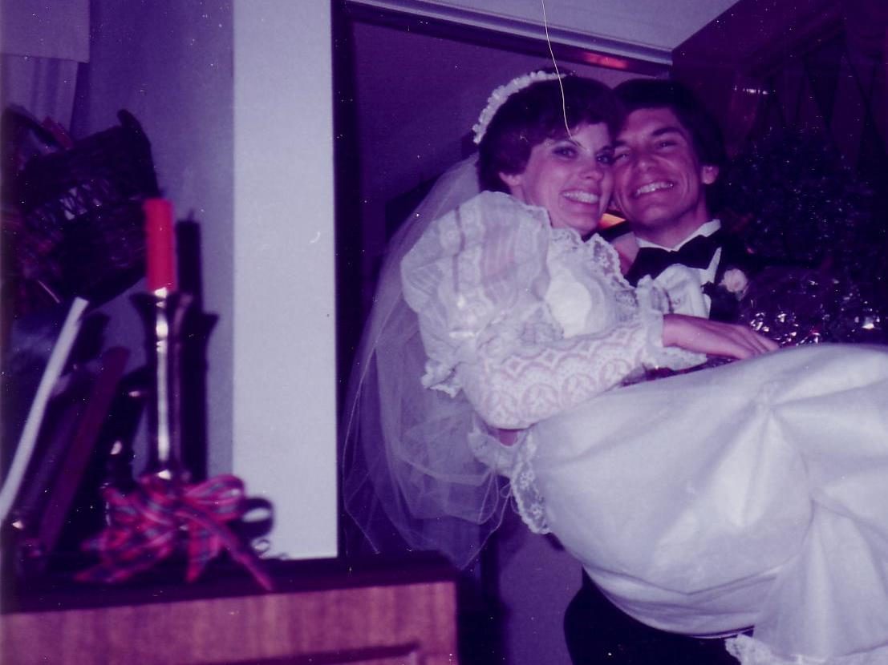
两大问题
427
1) 所罗门为什么描写爱情?
2) 一个多妻者如何表达对一个女人的忠贞之乐。

Slide 31
所罗门是伪君子吗?
427
有人说这个记述不是真实的历史.
一夫多妻制本身激励一夫一妻制，就如神所定意的。 (创世纪 2:24)。
所罗门大多数的婚姻都是出于政治原因 (没有性关系)。
他后来才成为一夫多妻者 (书拉密女是他堕落前的第一个妻子）

Slide 32
特点
427-428
雅歌是圣经中仅有的两本没有提到“上帝”的书之一 (以斯帖记提到禁食，但是完全没有宗教事象)
雅歌完全没有被圣经其他书卷所提到（不管是引用还是暗指）
“所罗门的雅歌是第一本五经卷，这5个经卷经常被犹太人在各种节日中诵读：:所罗门之歌(逾越节), 路得记 (五旬节),传道书(住棚节), 以斯帖(普林节), 耶利米哀歌(以色列毁坏的周年日).”
这是唯一一本古犹太人禁止30岁以下的人阅读的书。

Slide 33
特点
428
:其中八处甚至更多的经文难以确定准确的发言人。以下是有人尝试按这个方向来确定真正的发言人:
雅歌的发言人
所爱的人
所爱的人的朋友
所罗门
(爱人)
上帝
所爱的人的兄弟
1:2-4a
1:4b
1:4c-7
1:8
1:9-10
1:11
1:12-14
1:15
1:16-2:1
2-2
2:3-13
2:14
2:15-3:11
4:1-15
4:16
5:1a-d
5:1e
5:2-8
5:9
5:10-16
6:1
6:2-3
6:4-9
6:10
6:11-12
6:13a
6:13b-7:9a
7:9b-8:4
8:5a
8:5b-7
8:8-9
8:10-12
8:13
8:14

Slide 34
特点
428
在整本圣经中，雅歌是其中拥有最多解释的一本。事实上，它是中世纪被研究最多的书！下面大概总结了几种观点：
1. 寓言观点认为此书是没有历史环境的（人爱），此书只涉及圣爱。然而所有的寓言都是推测得出的，而不是基于文本的，导致太多过激。
在中世纪寓言观点十分盛行，对此书的评论远胜于其他书卷。

Slide 35
特点
429
在整本圣经中，雅歌是其中拥有最多解释的一本。事实上，它是中世纪被研究最多的书！下面大概总结了几种观点：
2. 类型观点认为此书是有历史环境的（人爱），视人爱为圣爱的一种。此观点包含几种关系：神和以色列，神和教会，基督和教会，基督和个人。
此观点也是靠推测得出，缺乏来自此书自己本身以及新约的支持。

Slide 36
特点
429
在整本圣经中，雅歌是其中拥有最多解释的一本。事实上，它是中世纪被研究最多的书！下面大概总结了几种观点：
3. 文字观点视此书是由历史环境的，描述人爱，并无其他深层含义。
a. 乡村婚礼歌曲理论
b. 人类学理论.
c. 葬礼爱宴理论.
d. 戏剧理论.
e. 婚姻爱情理论.
f. 婚姻性理论.
雅歌自然意义上描述了一段婚爱的对话，从而鼓励赞美自己配偶的独特。此观点获得事实的支持：整本书是一段对话以及婚爱发展的流动轨迹。

Slide 37

特点
430
G. 为什么此卷书有这么多版本的解释?
结构欠缺
很难决定书中有多少个人物以及是谁在说话。
解释者想要尝试将它和性爱联系起来时，会觉得尴尬。
象征性的语言总是不易解释。

Slide 38
大纲
430-432
(1:1–5:1) 所罗门和书拉密女的关系从开始的求爱到后来的结婚，树立了一个婚前性约束的好榜样
II. (5:2–8:14) 丈夫和妻子之间的爱情在经历各种不同的情况后而变得成熟，因此可以看到婚姻成长中所需要的努力。

Slide 39
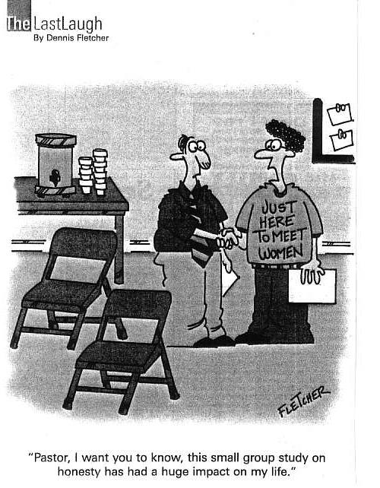
我们
是性动物!
来这只为遇到女人
“牧师，我想让你知道，小组学习真的
对我的生活影响巨大。”

Slide 40
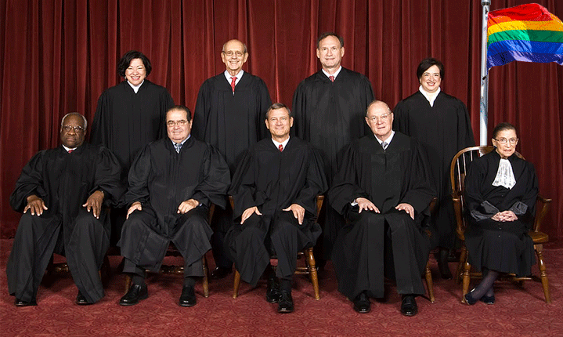
美国最高法院对婚姻重新定义
2015年6月26日

Slide 41
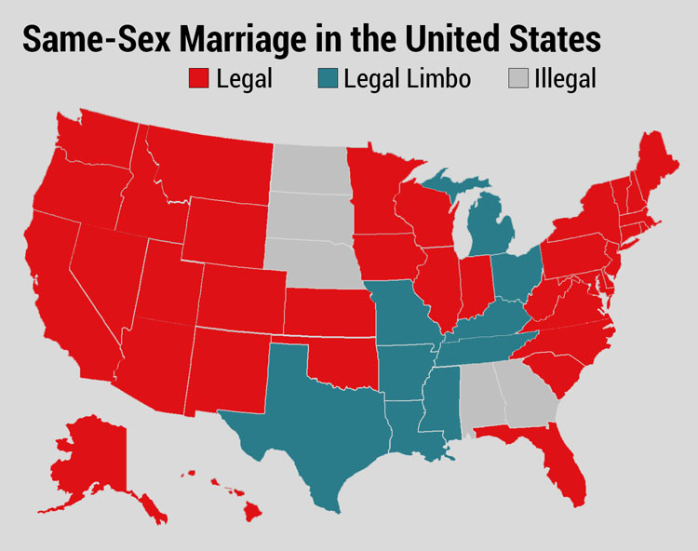
决定前
美国的同性婚姻
合法
中间地带
不合法
Notes:
Before the decision, the states were divided on the issue of same-sex marriage.

Slide 42

决定后
Notes:
The Supreme Court overturned all states that prohibited homosexual marriage, making the entire USA redefine this thousands-of-years-old institution.

Slide 43
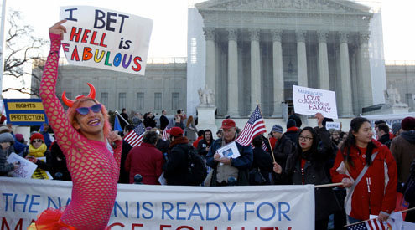
美国最高法院对婚姻重新定义
2015年6月26日

Slide 44
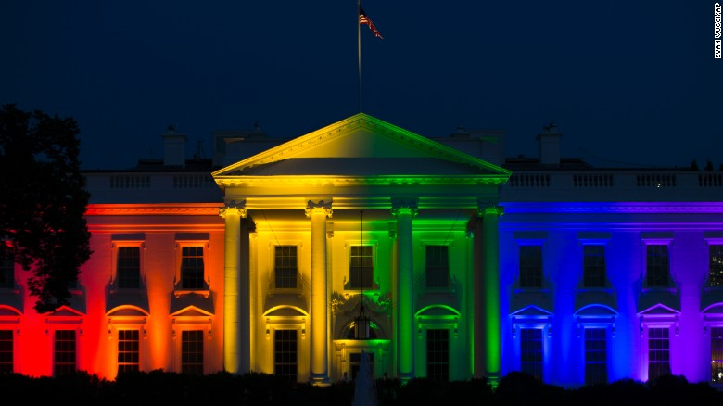
美国最高法院对婚姻重新定义
2015年6月26日
Notes:
President Obama even ordered the White House lit in the homosexual rainbows in celebration.

Slide 45
影响

Slide 46
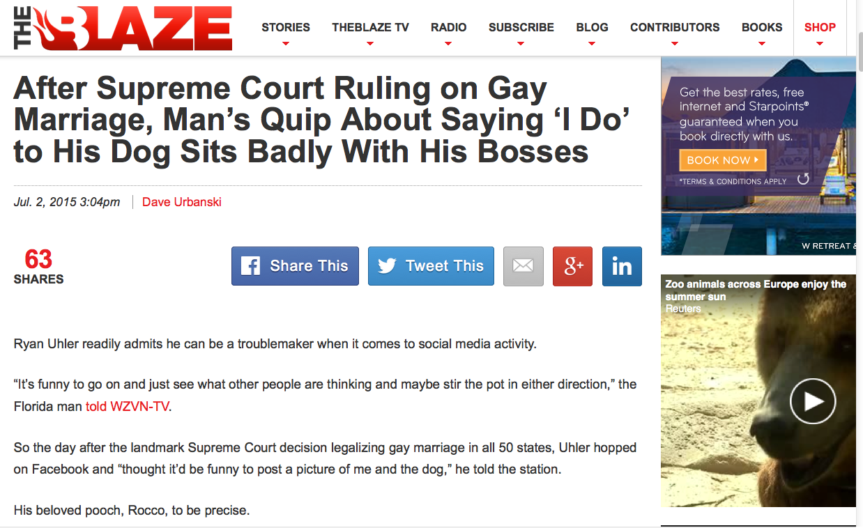
婚姻的重新定义可以多离谱?
在美国最高法院裁决同性婚姻是合法后，美国佛罗里达州的一名男子在脸谱网上发布消息，表示想与自己养的狗狗结婚，结果遭到老板解雇。
Notes:
Dave Urbanski, "After Supreme Court Ruling on Gay Marriage, Man's Quip About Saying 'I Do' to His Dog Sits Badly With His Bosses"
His tech computer fired him for this facebook quote.
"Uhler said the company where he'd worked as a digital marketing specialist for the last two years — Grace Tax Advisory Group in Fort Myers — fired him because of his post.
"What happened was, they took it out of context," he told WZVN.
Trial lawyer Scot Goldberg told the station that while the company's actions are "a little bit over the line," Uhler's former bosses have legal recourse since Florida is an "at will" state — meaning no reason is needed for firing without notice.
Now relegated to hoofing it for a new job — you might call it "Ryan Uhler's Day Off" and then some — his affection for Rocco remains steadfast.
"God, I love my dog," he told the station, "just as much as I love my wife and my kid."
No word yet on how that's going over with the family."
July 2, 2015 (accessed 3 July 2015) at http://www.theblaze.com/stories/2015/07/02/after-supreme-court-ruling-on-gay-marriage-mans-quip-about-saying-i-do-to-his-dog-sits-badly-with-his-bosses/

Slide 47
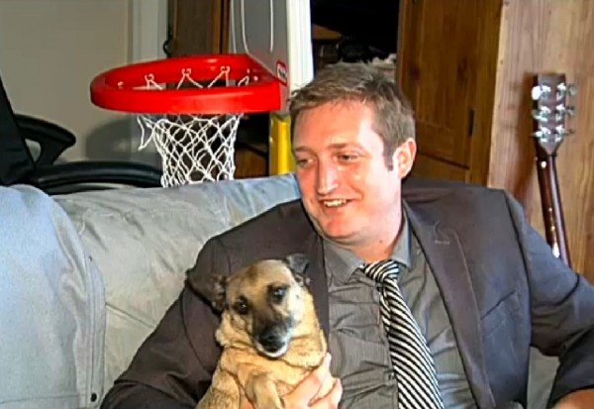
“如果你爱你的狗狗，那么与狗狗结婚和与同性结婚又有什么不同?我爱我的狗狗Rocco,他也爱我。希望有一天我们可以结婚。”
Notes:
Dave Urbanski, "After Supreme Court Ruling on Gay Marriage, Man's Quip About Saying 'I Do' to His Dog Sits Badly With His Bosses"
His tech computer fired him for this facebook quote.
"[Ryan] Uhler said the company where he'd worked as a digital marketing specialist for the last two years — Grace Tax Advisory Group in Fort Myers — fired him because of his post.
"What happened was, they took it out of context," he told WZVN.
Trial lawyer Scot Goldberg told the station that while the company's actions are "a little bit over the line," Uhler's former bosses have legal recourse since Florida is an "at will" state — meaning no reason is needed for firing without notice.
Now relegated to hoofing it for a new job — you might call it "Ryan Uhler's Day Off" and then some — his affection for Rocco remains steadfast.
"God, I love my dog," he told the station, "just as much as I love my wife and my kid."
No word yet on how that's going over with the family."
July 2, 2015 (accessed 3 July 2015) at http://www.theblaze.com/stories/2015/07/02/after-supreme-court-ruling-on-gay-marriage-mans-quip-about-saying-i-do-to-his-dog-sits-badly-with-his-bosses/

Slide 48
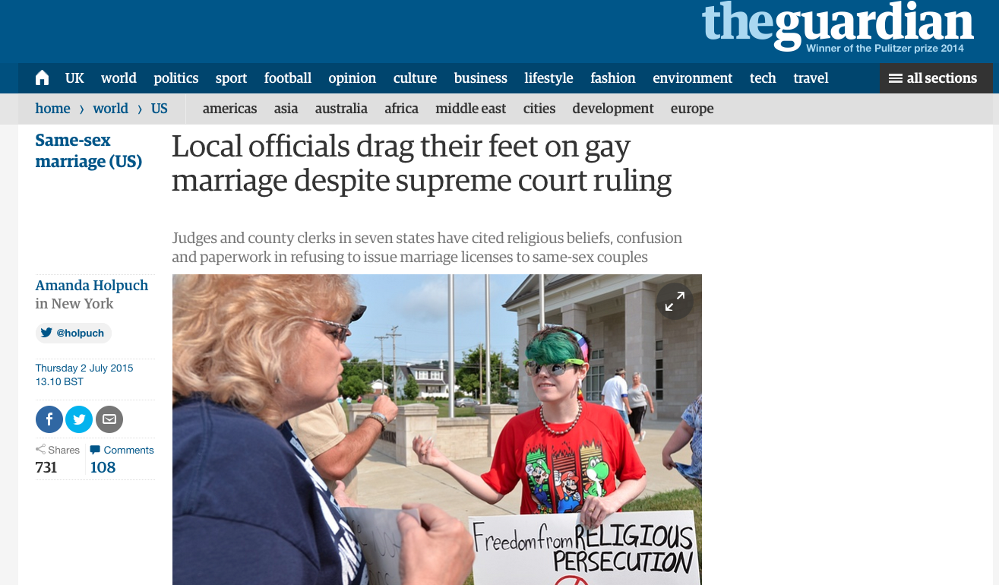
美国最高法院对婚姻重新定义
2015年6月26日
尽管最高法院已经做出裁定，但是地方官员拖拽他们的脚步。
Notes:
Tony Perkins (President of Family Research Council) wrote on 1 July 2015 at http://www.frc.org/updatearticle/20150701/keep-calm-clerk-on
The five justices of the Supreme Court weren't the only ones with a strong opinion on marriage. And dozens of county clerks are risking everything to prove it. Five days after five justices bulldozed the votes of 50 million people, the Left was wrong to assume everyone would just fall in line. They didn't count on an army of local officials standing in the wreckage of judicial activism, refusing to budge.
For most of them, it wasn't a question of if their beliefs would come under attack, but when. Like Jennifer Schoenrock, the wife of a disabled veteran and family breadwinner, they knew the day was coming when they'd have to choose between their convictions and their career. "I want to do the right thing," Jennifer explained. And that means obeying God's law -- not man's. After last week, these clerks take seriously the reality that their offices are the new front lines in the battle for religious liberty -- and many of them have no intention of going quietly. As far as they're concerned, a lot of things have changed since Friday, but their First Amendment rights weren't one of them.
From small counties in Arkansas to busy towns in Texas, there are hundreds of people ready to defend the ground five unelected justices took from voters. The Court may have changed their definition of marriage, Kentucky clerk Chris Cockrell explained, but he isn't prepared to change his. If that means going to jail, so be it. And according to the state's ACLU, that's no empty threat. "Two things can happen if a Kentucky clerk won't issue a marriage license to a same-sex couple," warned one law professor. "They can resign or go to jail."
And don't think the Left won't send them. This week, the Kentucky County Clerks Association says it's been swamped with cries for help from local officials after Governor Steve Beshear (D) ordered government workers to abide by the ruling. Resistance comes with a heavy price: a year in prison for "first-degree official misconduct." That doesn't scare Rowan County clerk (and Democrat) Kim Davis. Like a lot of offices, hers shut down the marriage license window altogether -- in part because so many of her co-workers object. "What has happened is that five lawyers have imposed their personal view of what the definition of marriage should be on the rest of us. And I, as a Christian, have strong views too. And I know I don't stand alone."
Gay activists have started picketing Davis's office, but she refuses to resign. If the government won't force her, the ACLU vows to. Which may be why the only people busier than state officials are U.S. attorneys. On both sides, offices have been inundated with requests for legal help. In Texas, Attorney General Ken Paxton has promised to find legal representation for any government official whose beliefs are under attack.
That could be several. Of the 254 counties in Texas, less than half (114) told the AP they were "ready and willing" to issue same-sex marriage licenses. Nationally, nonprofit groups like Alliance Defending Freedom and Liberty Institute are already responding to the marriage whirlwind, flying to the aid of clerks and other officials everywhere.
In some states, the turmoil is even splitting the executive and legislative branches. After Governor Asa Hutchinson (R) insisted that Arkansas comply with the Court, state representatives swore to stand by clerks who refuse. "We affirm our support for Amendment 83 of the Arkansas Constitution as overwhelmingly passed by the people in 2004. We refuse to simply shrug our shoulders and abandon basic principles that have guided our country successfully the past 239 years. We will work with other conservative leaders in our state and across the nation... [to] explore all available options."
Down in Mississippi, the handful of clerks handing in their resignation letters includes Linda Barnette. After 24 years, the Grenada County Baptist said that when it came to her job or her faith, there was never any real debate. "My final authority is the Bible," she told Fox News's Todd Starnes. In her mind, the battle is finally at the church's door. "Christians are being put to the test," she said. 'We're going to see the true Christians who stand. It's going to be time to stop talking the talk. It's going to come down to that."
One man who knows about walking the walk is Governor Bobby Jindal (R-La.). Fortunately, the Louisiana governor was as prepared for this as he would be for any local disaster and had the foresight to protect religious liberty in law. People in Indiana and Arizona weren't so lucky. Their governors either watered down their legislation -- or refused to pass it altogether -- leaving officials without the legal firewall they need to keep the Left at bay. If the ACLU wants to sue Governor Jindal, let them. "The Left likes to pick and choose which liberties they support at any given time," he jabbed.
The reality is, the First Amendment has been around a lot longer than whatever "rights" the Court invented June 26. And with a growing chorus of conservative leaders, Bobby Jindal is willing to go to the mat to defend them. Your state officials should too. Contact your leaders and ask them to follow in the footsteps of courageous conservatives like Governor Jindal and Ken Paxton. Also, don't miss the Governor in his own words from yesterday's radio interview on "Washington Watch."

Slide 49
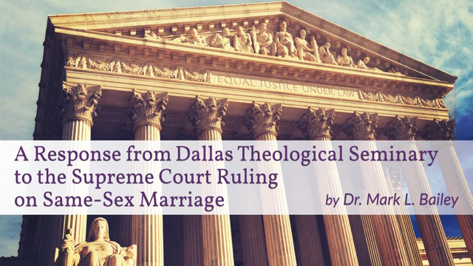
我们如何回应这5∶4的票数?
就最高法院裁定同性婚姻合法一事，
美国达拉斯神学院做出回应。
Mark L. Bailey 博士
Notes:
Tony Perkins (President of Family Research Council) wrote on his Action Alert on 30 June 2015:
"Last week, the Supreme Court ruled in Obergefell v. Hodges that all states must license and recognize marriages between same-sex couples. This decision could have devastating implications for institutions and individuals that hold the belief that marriage is between one man and one woman. We have seen state discrimination, and we need you to urge Congress to prevent federal discrimination against those who support natural marriage!"

Slide 50


我们可以说“不”吗?
爆炸新闻
华盛顿法院判决斯图兹曼(Barronelle Stutzman)违反保护消费者和禁止歧视的法律
罚款135,000美金
Notes:
Tony Perkins (President of Family Research Council) wrote on his Action Alert on 30 June 2015:
"Businesses and organizations continue to be threatened because of their owners' faith. An Oregon bakery owned by Aaron and Melissa Klein was fined $135,000 simply for declining to make a wedding cake for a same-sex wedding. Barronelle Stutzman, a grandmother in Washington state, had to close her floral business because of the crippling fees imposed on her for not providing flower arrangements for a same-sex wedding.
Child welfare organizations, such as Lutheran Community Services and Catholic Charities, are being threatened by this decision to recognize same-sex marriage or face losing their ability to participate in federal programs or apply for federal grants.
Our Founders envisioned a nation where the moral and religious beliefs of individuals, faith-based organizations, and business owners would be protected, not a nation where one's convictions about marriage could be used as a disqualifying factor for interaction with the federal government.
To stop the federal government from discriminating against people because of their beliefs in marriage, Senator Mike Lee (R-UT) has introduced the First Amendment Defense Act, S.1598, in the Senate, and Representative Raúl Labrador (R-UT) has introduced the companion bill, H.R. 2802, in the House. Simply put, FADA would prohibit the federal government from penalizing persons for their personal moral or religious beliefs in natural marriage in areas such as federal employment, grants, contracts, tax treatment, and other programs.

Slide 51
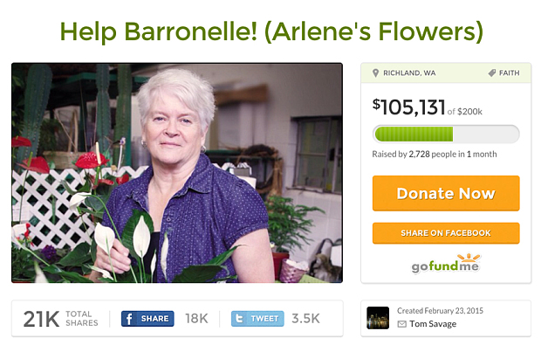

我们可以帮助吗?
帮帮斯图兹曼！（阿琳花店Arlene‘s Flowers）
立刻捐助
立刻捐助

Slide 52

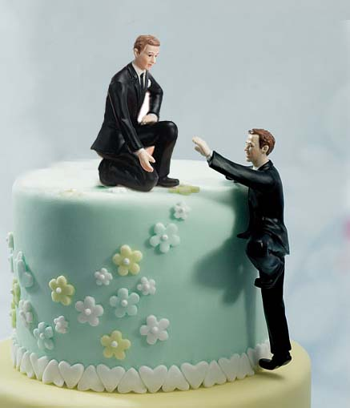
其他案例

Slide 53

“你最好已经预备好，或者赶紧预备起来，基督徒将会因为坚持自己的立场而备受迫害”
Rev. Franklin Graham

Slide 54

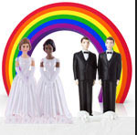

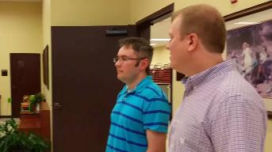
Kim Davis
( 2015年9月1日)
Notes:
Scout FinchFollowRSS
Daily Kos staff
Profile
Diaries (list)
Stream
Wed Jul 08, 2015 at 01:39 PM PDT
Kentucky clerk filmed refusing to issue marriage license to same-sex couple
by Jen HaydenFollow
24 Comments / 24 New
attribution: screenshot from video
It's our belief Kim Davis needs a new job that is more suited to her personal convictions.
David V. Moore and David Ermold have been together for 17 years and have lived in Rowan County, Kentucky, for the last 10 of those years together. With the Supreme Court ruling in hand (they literally brought a copy of it with them, along with a letter from Governor Beshear directing clerks to issue licenses), they walked into the County Clerk's office to get their marriage license. And that's when they ran into trouble as staffers in the clerk's office first ignored them entirely, then rudely told them to go to another county while onlookers began mocking them. Rowan County Clerk Kimberly Davis is at the center of a lawsuit filed by the ACLU for refusing to issue the marriage licenses.
"It's a deep-rooted conviction; my conscience won't allow me to do that," Davis told The Associated Press. "It goes against everything I hold dear, everything sacred in my life." Davis is an elected employee who swore an oath of office to uphold the laws of Kentucky, which now provides for same-sex marriages. It is her duty to issue these licenses and if she is not up to the task, it is probably time for her to move along to a job more suited to her beliefs. For what it's worth, Kimberly Davis is a Democrat and won her primary in 2014 by a mere 24 votes. Her mother, Jean Bailey, preceded Kimberly in the very same elected position for more than 30 years before retiring.
A friend of the couple came along to film the interaction. Someone in the clerk's office even called the police to intimidate the couple as they patiently waited their turn to speak with the clerk, who demanded they stop filming, even though it was their legal right to do so. WATCH the video…
http://www.dailykos.com/story/2015/07/08/1400496/-Kentucky-clerk-filmed-refusing-to-issue-marriage-license-to-same-sex-couple
Accessed 2 Sep 2015
A judge ruled that she must issue the license on 1 September 2015, but she also refused that day.

Slide 55
以赛亚书 5:20 （CNV）
“那些称恶为善，称善为恶，以暗为光，以光为暗，以苦为甜，以甜为苦的人，有祸了！”

Slide 56
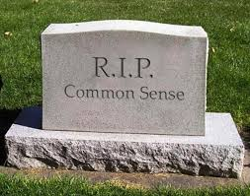
为什么常识不再寻常?
我们缺乏把根基
建立在经文上

Slide 57
作个有爱心的人
雅歌
Dr. Rick Griffith • Crossroads International Church Singapore
CICFamily.com • BibleStudyDownloads.org

Slide 58

Marriage is under attack.

Slide 59
美国最高法院对婚姻重新定义
2015年6月26日

Slide 60
决定前
美国的同性婚姻
合法
中间地带
不合法

Slide 61
决定后

Slide 62
美国最高法院对婚姻重新定义
2015年6月26日

Slide 63
美国最高法院对婚姻重新定义
2015年6月26日

Slide 64
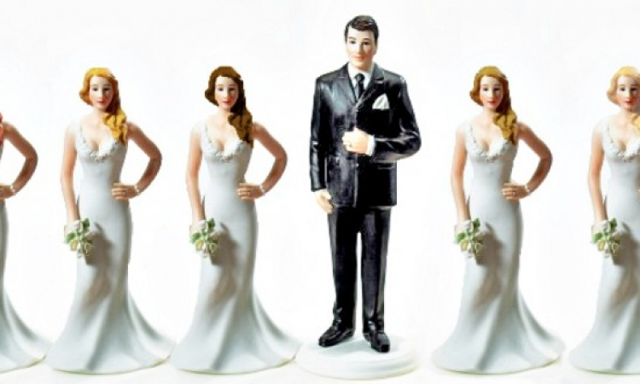
Where will it stop?
Notes:
Legalizing of polygamy is a natural future fear.
Now we are told there are 70 different sexes. This will not strengthen marriage!

Slide 65
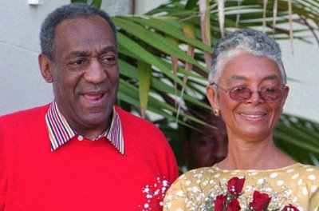

Bill Cosby
Notes:
Bill Cosby’s sexual failures and the #MeToo movement have highlighted how women have become abused.

Slide 66
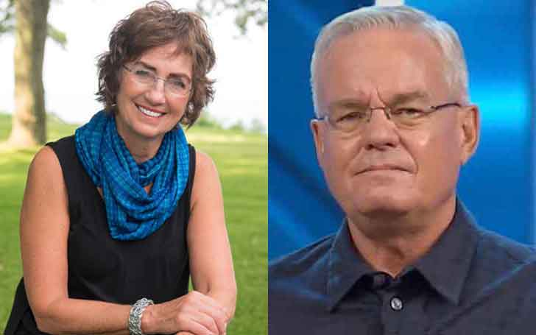
Bill Hybels
Notes:
Many of us here have been blessed by the ministry of Bill Hybels, who has been married since 1974.
____
Bill Hybels is Living Happily With Wife Lynne Hybels and Children; Know about his Married Life and Children
May 18, 2018 First published on:May 18, 2018

Slide 67
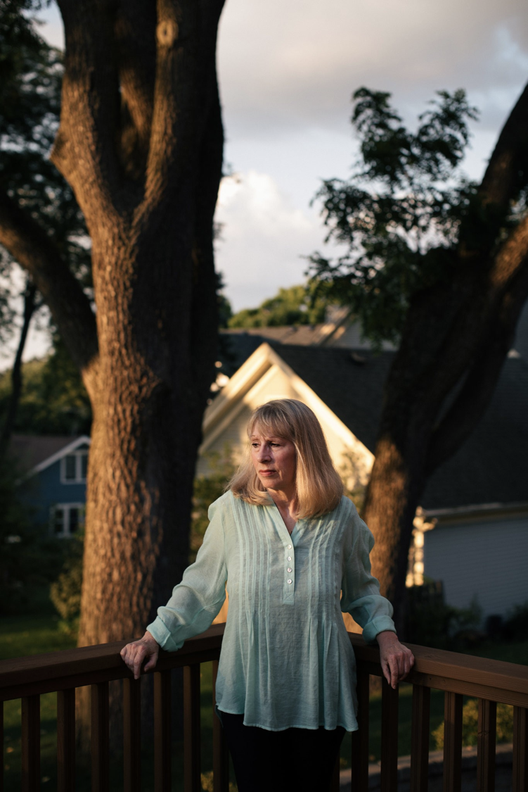

Bill Hybels
Pat Baranowski
Notes:
But in April 2018 Hybels resigned from Willow Creek over sexual allegations.
______
He’s a Superstar Pastor. She Worked for Him and Says He Groped Her Repeatedly: Bill Hybels built an iconic evangelical church outside Chicago. A former assistant says that in the 1980s, he sexually harassed her.
By Laurie Goodstein
Aug. 5, 2018
https://www.nytimes.com/2018/08/05/us/bill-hybels-willow-creek-pat-baranowski.html
Pat Baranowski was the executive assistant to the Rev. Bill Hybels at the Willow Creek Community Church in South Barrington, Ill., one of the largest megachurches in the country.CreditAlyssa Schukar for The New York Times
SOUTH BARRINGTON, Ill. — After the pain of watching her marriage fall apart, Pat Baranowski felt that God was suddenly showering her with blessings.
She had a new job at her Chicago-area megachurch, led by a dynamic young pastor named the Rev. Bill Hybels, who in the 1980s was becoming one of the most influential evangelical leaders in the country.
The pay at Willow Creek Community Church was much lower than at her old job, but Ms. Baranowski, then 32, admired Mr. Hybels and the church’s mission so much that it seemed worth it. She felt even more blessed when in 1985 Mr. Hybels and his wife invited her to move into their home, where she shared family dinners and vacations.
Once, while Mr. Hybels’s wife, Lynne, and their children were away, the pastor took Ms. Baranowski out for dinner. When they got home, Mr. Hybels offered her a back rub in front of the fireplace and told her to lie face down.
Advertisement
Stunned, she remembered feeling unable to say no to her boss and pastor as he straddled her, unhooked her bra and touched her near her breasts. She remembered feeling his hands shake.
That first back rub in 1986 led to multiple occasions over nearly two years in which he fondled her breasts and rubbed against her. The incidents later escalated to one occasion of oral sex. Ms. Baranowski said she was mortified and determined to stay silent.
You have 4 free articles remaining.
Subscribe to The Times
[Read about the resignation of Willow Creek Church’s lead pastor and board of elders.]
“I really did not want to hurt the church,” said Ms. Baranowski, who is now 65, speaking publicly for the first time. “I felt like if this was exposed, this fantastic place would blow up, and I loved the church. I loved the people there. I loved the family. I didn’t want to hurt anybody. And I was ashamed.”
Mr. Hybels denied her allegations about her time working and living with him. “I never had an inappropriate physical or emotional relationship with her before that time, during that time or after that time,” he said in an email.
Since the #MeToo movement emerged last year, evangelical churches have been grappling with allegations of sexual abuse by their pastors. A wave of accusations has begun to hit evangelical institutions, bringing down figures like the Rev. Andy Savage, at Highpoint Church in Memphis, and the Rev. Harry L. Thomas, the founder of the Creation Festival, a Christian music event.
EDITORS’ PICKS
The Big Business of Being Gwyneth Paltrow
Love Filled Their Trip. On Day 369, ISIS Struck.
Maria Butina, Suspected Secret Agent, Used Sex in Covert Plan, Prosecutors Say
Advertisement
Ms. Baranowski is not the first to accuse Mr. Hybels of wrongdoing, though her charges are more serious than what has been reported before.
In March, The Chicago Tribune and Christianity Today reported that Mr. Hybels had been accused by several other women, including co-workers and a congregant, of inappropriate behavior that dated back decades. The allegations included lingering hugs, invitations to hotel rooms, comments about looks and an unwanted kiss.
The accusations did not immediately result in consequences for Mr. Hybels. At a churchwide meeting where Mr. Hybels denied the allegations, he received a standing ovation from the congregation.
The church’s elders conducted their own investigation of the allegations when they first surfaced four years ago and commissioned a second inquiry by an outside lawyer, completed in 2017. Both investigations cleared Mr. Hybels, though the church’s two lead pastors have since issued public apologies, saying that they believe the women.
In April, Mr. Hybels announced to the congregation he would accelerate his planned retirement by six months and step aside immediately for the good of the church. He continued to deny the allegations, but acknowledged, “I too often placed myself in situations that would have been far wiser to avoid.” The congregation let out a disappointed groan. Some shouted “No!”
On Sunday, one of the church’s two top pastors severed his ties with Willow Creek. After services, the Rev. Steve Carter announced that he was resigning immediately in response to Ms. Baranowski’s “horrifying” allegations about Mr. Hybels.
Mr. Carter said he had a “fundamental difference” with the church’s elders over how they had handled the allegations against Mr. Hybels, and had been planning to resign for some time.
Advertisement
Mr. Carter did not appear as scheduled at Sunday services at the church’s main campus, and the congregation at the second service was told that he was so sick that he was vomiting backstage.
No mention was made of Mr. Hybels or the allegations against him at either service at the main campus.
In many evangelical churches, a magnetic pastor like Mr. Hybels is the superstar on whom everything else rests, making accusations of harassment particularly difficult to confront. Such a pastor is seen as a conduit to Christ, giving sermons so mesmerizing that congregants rush to buy tapes of them after services.
In the evangelical world, Mr. Hybels is considered a giant, revered as a leadership guru who discovered the formula for bringing to church people who were skeptical of Christianity. His books and speeches have crossed over into the business world.
Mr. Hybels built a church independent of any denomination. In such churches, there is no larger hierarchy to set policies and keep the pastor accountable. Boards of elders are usually volunteers recommended, and often approved, by the pastor.
But the most significant reason sexual harassment can go unchecked is that victims do not want to hurt the mission of their churches.
“So many victims within the evangelical world stay silent because they feel, if they step forward, they’ll damage this man’s ministry, and God won’t be able to accomplish the things he’s doing through this man,” said Boz Tchividjian, a former sex crimes prosecutor who leads GRACE, an organization that works with victims of abuse in Christian institutions.
Advertisement
“Those leaders feel almost invincible,” said Mr. Tchividjian, a grandson of Billy Graham who has consulted with some former staff members accusing Mr. Hybels of wrongdoing. “They don’t feel like the rules apply to them, because they’re doing great things for Jesus, even though their behavior doesn’t reflect Jesus at all.”
A Sign
In 1984, Ms. Baranowski was walking to her car in the vast parking lot of Willow Creek one night after services. She had just been praying about whether to apply for a job at the church she saw posted.
Suddenly a car screeched to a stop beside her, and the driver rolled down his window. It was the church’s pastor.
“Could I drive you to your car or something?” offered Mr. Hybels, who was then 33. Her car was nearby, but she accepted the ride.
It seemed like a sign from God.
Mr. Hybels later also described the meeting as a miracle: He had been driving out of the parking lot when God urged him to go back and find the woman he drove by.
“That night I had no idea how offering help to a person who probably didn’t need it would affect my life and ministry,” he wrote in one of his first books.
Soon after, she left her position as a computer systems manager. She found great purpose in working for a church that was adding more than 1,000 new members a year. She served as Mr. Hybels’s gatekeeper, fielding calls from pastors across the country eager to tap him for advice.
Advertisement
“It was a wonderful time,” she said. “I thought maybe God was just being good to me, and I think he was. But I couldn’t understand: Why did he select me? Because I didn’t think that highly of myself.”
Ms. Baranowski kept handwritten notes she received from Mr. Hybels. In one, Mr. Hybels praised her work and said, “I am praying that your new small group” at church “will be a source of much happiness and strength in your life.” Then he added, “P.S. Plus, you are a knockout!”
Image
A letter Mr. Hybels wrote to Ms. Baranowski ends with a postscript saying “Plus, you are a knockout!”CreditAlyssa Schukar for The New York TimesMr. Hybels was regarded as a maverick in the evangelical world for giving women leadership positions.
Nancy Beach, who joined the staff soon after Ms. Baranowski, said the work was exhilarating.
“We were at the center of this grand adventure,” said Ms. Beach, the first woman appointed by Mr. Hybels to be a “teaching pastor,” meaning she could preach at services.
Ms. Beach recalled that Mr. Hybels was an exacting boss who got angry if the sound system was fuzzy or if a Christmas drama wasn’t performed smoothly. And he didn’t tolerate personal misconduct. After one staff member had an affair and another was discovered with pornography, she said, “They had to speak publicly to everyone affected. They lost their jobs.”
Ms. Beach is among the women who have recently come forward in articles accusing Mr. Hybels of harassment. She said that on a work trip to Spain in 1999, he invited her to his hotel room and gave her a long hug that made her feel uncomfortable.
Advertisement
She didn’t speak up until recently, when she heard there were other women with similar experiences.
“That’s what makes some of this so confusing, because he has been a champion for women,” said Ms. Beach, who has since left Willow but still preaches widely.
‘Humiliated, Guilty and Ashamed’
In the late 1980s, crusading against pornography was a top priority for evangelicals. Mr. Hybels told Ms. Baranowski that he had been told to educate himself on the issue by James Dobson, founder of the ministry Focus on the Family, who had been appointed by President Ronald Reagan to an anti-pornography commission.
Calling it research, Mr. Hybels once instructed Ms. Baranowski to go out and rent several pornographic videos, she said, to her great embarrassment. He insisted on watching them with her, she said, while he was dressed in a bathrobe.
One night, she said, Mr. Hybels felt too sick to go to a church event, so he sent his wife in his stead to introduce the guest speaker, a famous evangelist from India. He asked Ms. Baranowski to bring him something to eat, and fondled her again, she said.
Ms. Baranowski said that during the years of harassment, Mr. Hybels never kissed her, and they never had intercourse. She was particularly ashamed about the oral sex. She grew increasingly wracked by guilt and tried to talk with him. One day in his office, she told him that it was unfair to his wife, that it was sin, and that she felt humiliated.
That night she recorded in her journal what he had said in response: “It’s not a big deal. Why can’t you just get over it? You didn’t tell anyone, did you?”
Image
Mr. Hybels at Willow Creek in April. He announced his early retirement and acknowledged, “I too often placed myself in situations that would have been far wiser to avoid.”CreditMark Black/Daily Herald, via Associated PressHis attitude toward her slowly began to change, she said. She moved out of the house after two years. In the office, he began to suggest she was incompetent and unstable. He berated her work in front of others. She grew depressed and poured out her feelings to God, filling 20 spiral-bound journals.
Advertisement
On May 11, 1989, she wrote, “I feel like an abused wife.”
She feared that she would be forced to stand in front of the congregation and confess, like the other employees who were fired. She was relocated to work in a converted coat closet.
Mr. Hybels finally sketched out an exit plan for her on a piece of note paper, which she kept. She resigned from Willow after more than eight years.
Mr. Hybels said in an email last week that Ms. Baranowski had “wanted a bigger challenge than being my assistant” and changed jobs “on good terms.”
She saw a counselor, who said in an interview that she remembered only that Ms. Baranowski was “humiliated, guilty and ashamed” because of her relationship with Mr. Hybels. The counselor, who spoke with Ms. Baranowski’s permission, requested anonymity because she did not want to be part of the controversy.
She recalled of Ms. Baranowski, “She felt she had lost her connection to God.”
Since leaving the church, Ms. Baranowski said she has struggled to keep a job, lost her condominium, moved from state to state, and had migraines and panic attacks.
“I carried Bill’s responsibility, for things he should have been responsible for,” she said.
Ms. Baranowski told only one friend, the Rev. Don Cousins, about one month after she left the Willow staff. She begged him to stay silent, and he did, until now.
Advertisement
The entanglement with Mr. Hybels “altered the trajectory of her life,” said Mr. Cousins, a well-known evangelical leader who worked at Willow for 17 years.
“She had been a very high-performing person, committed, high-caliber, responsible,” said Mr. Cousins, now a pastor in Orlando, Fla. “And the church was her life.”
Mr. Hybels went on to expand Willow to eight sites with 25,000 worshipers. He published more than 50 books, many on ethics, like “Who Are You When No One’s Looking.”
He was a spiritual adviser to President Bill Clinton and stuck with him through his impeachment. He drew speakers like Colin Powell, Bono and Sheryl Sandberg to his annual Global Leadership Summit, which has continued and will be held later this week.
When news of the other allegations against Mr. Hybels broke, Mr. Cousins encouraged Ms. Baranowski to get in touch with Ms. Beach. The two women had a tearful reunion. Both wish they had confronted Mr. Hybels at the time so they could have spared other women from harassment.
Ms. Beach remembers traveling to 27 countries representing Willow Creek and hearing pastors say hundreds of times that they owed their churches’ success to Mr. Hybels.
“How could he have done all this good,” she asked, “when there were such dark things happening behind the scenes?”
Mitch Smith contributed reporting.
A version of this article appears in print on Aug. 6, 2018, on Page A1 of the New York edition with the headline: ‘I Loved the Church’: An Accuser and Her Pastor. Order Reprints | Today’s Paper | Subscribe
____
See also Willow Creek Members React to Bill Hybels' Resignation as Accuser Stands by Story
By Leonardo Blair , Christian Post Reporter | Apr 11, 2018 12:56 PM
https://www.christianpost.com/news/willow-creek-members-react-to-bill-hybels-resignation-as-accuser-stands-by-story-222796/

Slide 68
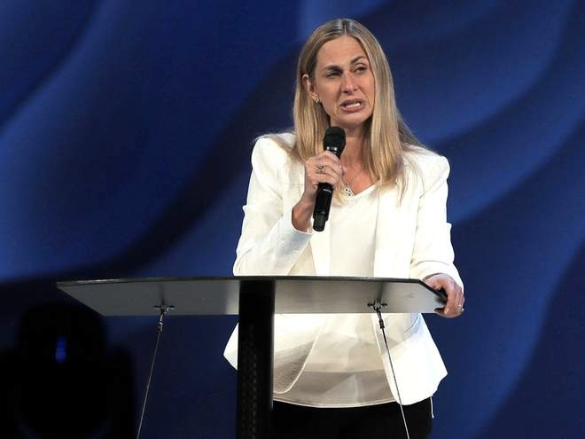
Bill Hybels
Notes:
The latest 10 August 2018 report now is: "The lead pastor of one of the largest evangelical churches in the US has said she is stepping down along with the entire Board of Elders after a string of sexual harassment allegations against its founder, Bill Hybels.
Heather Larson said the Willow Creek Community Church needed new leadership.
"To all of the women who have come forward, the church should always follow in Jesus’ footsteps to help the wounded find healing, and we are sorry we added to your pain,” she said in an announcement on the Chicago-area church’s website.
It has eight locations dotted around the Illinois city.
“That was not our intention, and we regret that it has taken us this long to acknowledge that. While we will probably never know with certainty everything that’s true about each of your stories, we have no reason not to believe you. We are sorry that our initial statements were so insensitive, defensive, and reflexively protective of Bill. We exhort Bill to acknowledge his sin and publicly apologise.”
Mr Hybels former assistant, Pat Baranowski, alleged to The New York Times that he repeatedly demanded oral sex and groped her while she worked for him the 1980s. After leaving her job, she struggled for 25 years with depression, becoming unemployed and homeless.
A number of other women have also accused Mr Hybels of sexual misconduct.
Although he denies the allegation, Mr Hybels resigned from the church in April.
The announcement from the Board of Elders came as the Willow Creek Association ahead of the megachurch's 23rd annual Global Leadership Summit.
Heather Larson, lead pastor at the Willow Creek Commnity Church, says the church needs new leadership in the wake of sexual harassment allegations against Bill Hybels (Steve Lundy/Daily Herald via AP)
Several speakers have backed out and over 100 churches cancelled plans to broadcast the event, after the allegations against Mr Hybels surfaced.
At least five participants, including Oscar winner Denzel Washington, also cancelled their scheduled appearances at the event, according to The Chicago Tribune.
Previous guests to appear at the summit over its 26-year history include U2 frontman Bono, Bill Clinton and Tony Blair.
Mr Hybels will not appear at the event, which he has previously hosted."
Willow Creek: Megachurch's lead pastor and board of elders resign in wake of sexual harassment allegations against founder Bill Hybels: 10 August 2018
https://www.independent.co.uk/news/world/americas/willow-creek-church-bill-hybels-sexual-harassment-pastor-elders-resign-chicago-a8484071.html accessed 11 Aug 2018

Slide 69
耶利米 5:20 CNV
那些称恶为善，称善为恶，
以暗为光，以光为暗，
以苦为甜，以甜为苦的人，
有祸了！

Slide 70
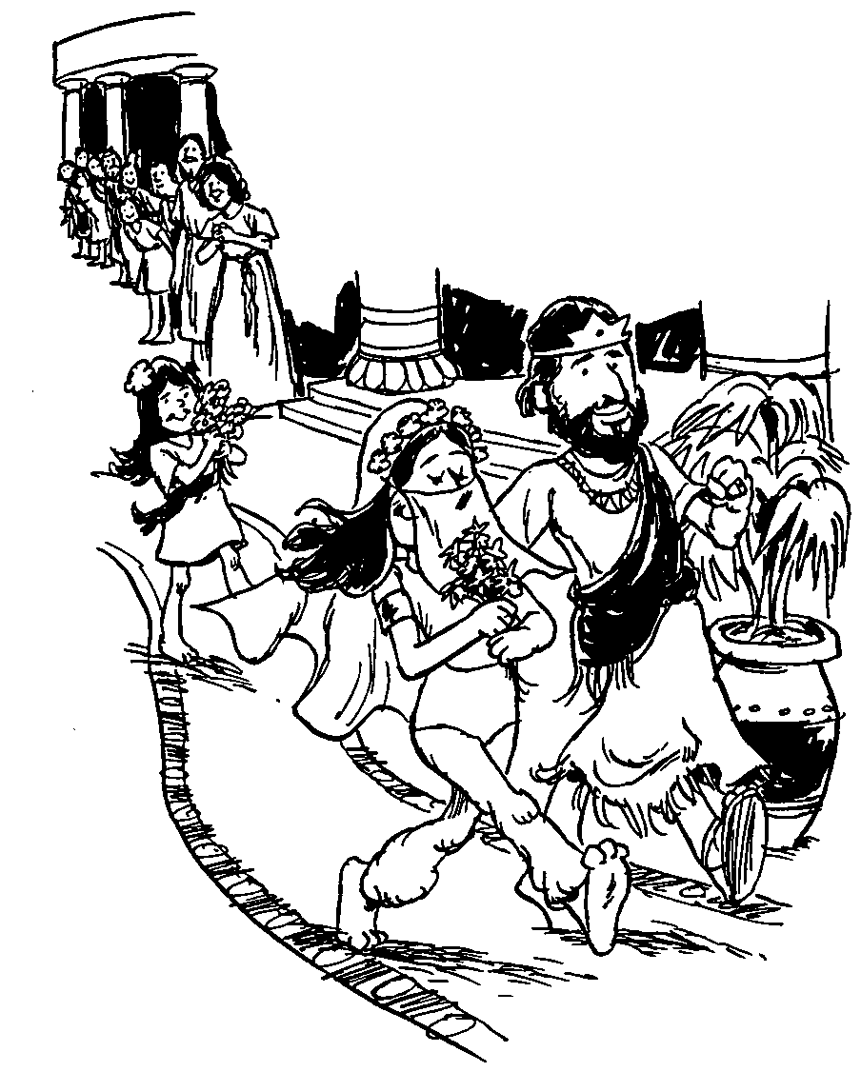
所罗门的雅歌
婚爱的对话

Slide 71

爱
钥字
425
钥句
“我属我的良人，他也恋慕我。”
(雅歌 7:10) CNV

Slide 72
作个有爱心的人
雅歌
Dr. Rick Griffith • Crossroads International Church Singapore
CICFamily.com • BibleStudyDownloads.org

Slide 73
我们对性的好奇
从小就自然具有
然而，传统的犹太教不允许男子阅读雅歌书，直到他们三十岁才可以。

Slide 74
概述
425
婚恋的对话
从追求到婚礼
在婚姻中成长
1:1–5:1
5:2–8:14
爱的开始
爱的增长
自私的爱
“我的良人属我，我也属他” (2:16a)
无私的爱
“我属我的良人，我的良人也属我” (6:3a)
单身
已婚
早恋
爱情未经考验
经过考验的爱情 和真爱
回顾爱
求爱
1:1–3:5
婚礼
3:6–5:1
成长
5:2–8:4
回忆
8:5-14
渴望
1:1-11
加强
1:12–3:5
进程
3:6-11
圆满
4:1–5:1
挣扎
5:2–6:13
赞美和回应
7:1–8:4
爱的力量
8:5-7
爱的贞洁
8:8-14
都在葡萄园
蜜月开始
蜜月结束
都在葡萄园
分手
5:2-16
和好
6:1-13
约一年

Slide 75
如何让婚姻之爱成为神所定意的?
Notes:
What can you do now to have the fantastic marriage that God desires if he has marriage in his plan for you?

Slide 76
I. 婚前等待性 (雅歌 1:1–5:1)
Notes:
Be loving to God's person for you by preserving yourself now.
Solomon and the Shulammite begin their love relationship in courtship and marriage as an example of the need for premarital sexual restraint (1:1–5:1).

Slide 77
Slides on
雅歌 1

Slide 78

综述
430
婚爱的对话
1:1–5:1 求爱到婚礼
5:2–8:14 在婚姻中成长

Slide 79

所罗门的歌，是歌中之歌。
(1:1 CNV).

Slide 80

愿他用口中的热吻与我亲嘴，因为你的热爱比酒更美。
3你的膏油香气芬芳；你的名字如同倒出来的膏油；
所以众童女都爱你。
(1:2-3 CNV).
Notes:
Solomon and the Shulammite express longing, insecurity, and praise as a prelude to the content of the entire poem (1:2-11).

Slide 81

愿你吸引我，我们必快跑跟随你。王领我进入他的内室。
王啊！ 我们要因你欢喜快乐；
我们要提说你的爱，
胜过提说美酒；
(1:4a-b CNV).
我們要提說你的愛，勝過提說美酒；
她們愛你是合理的。
(1:4b CUV).

Slide 82

The beloved’s “friends” (see NIV marg.), elsewhere referred to as the “daughters of Jerusalem”
(v. 5; 3:10; 5:8, 16) and “daughters of Zion” (3:11)
她们爱你是合理的
(1:4b CNY).
Notes:
The femaile inhabitants of Jerusalem as "The chorus is a literary device in the Song whereby the beloved and her lover express their emotions and thoughts more fully. By praising Solomon (you is masc. sing.) in 雅歌 1:4 the “daughters” seemed to be agreeing with one another that the couple had an ideal romance. The last line in verse 4 may be the words of the beloved (see niv marg.) or, perhaps better, the words of the friends" (Jack S. Deere, "雅歌," In The Bible Knowledge Commentary, 1:1014).

Slide 83

耶路撒冷的众女子啊！ 我虽然黑，却是秀美，
如同基达的帐棚，
好像所罗门的幔幕。
6你们不要因为我黑，就盯着我，因为太阳把我晒黑了。
我母亲的儿子生我的气；
他们叫我看守家里的葡萄园，
我自己私人的葡萄园，我却没有看守。
(1:5-6 CNV).

Slide 84
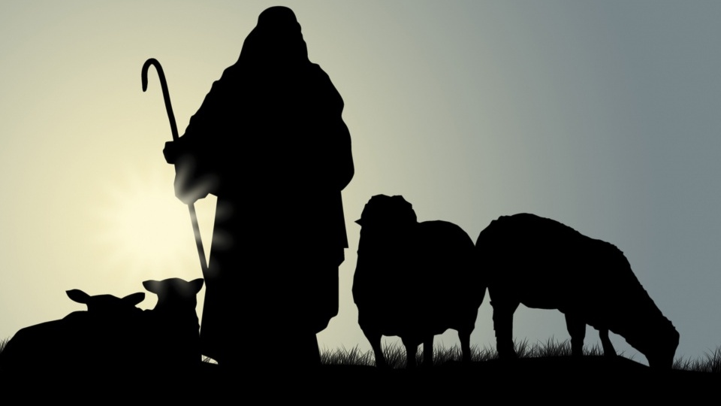
The Shepherd
Notes:
Text

Slide 85
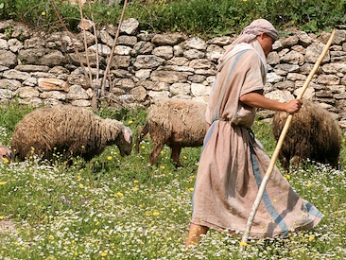
我心所爱的啊！ 求你告诉我，你在哪里放羊？
中午你在哪里使羊群躺卧休息。
我为甚么在你众同伴的羊群旁边，
好像蒙着脸的女人呢？
(1:7 CNV).

Slide 86
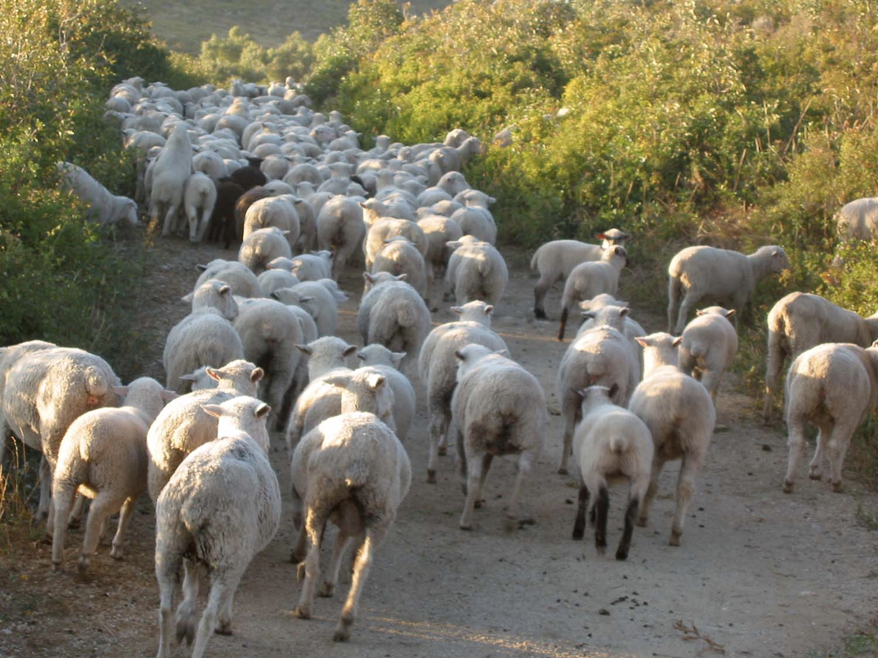
你这女子中最美丽的啊！ 你若不知道，
可以出去，跟随羊群的脚踪，
在牧人的帐棚边，
牧放你的山羊羔。
良人对佳偶的称讚
(1:8 CNV).

Slide 87

我的佳偶啊！ 我把你比作套在法老车上的骏马。 10 你的两腮因耳环显得秀丽；你的颈项因珠炼显得华美。
11我们要为你制金耳环，用银珠点缀。
(1:9-11 CNV).

Slide 88

12 王正坐席的时候，我的哪哒香膏散发芬芳的香味， 13 我以我的良人为一袋没药，挂在我的胸怀之中。 14 我以我的良人为一束凤仙花，开放在隐．基底的葡萄园里。
(1:12-14 CNV).
Notes:
The courtship between lover and beloved intensifies but they remain patient until their wedding day (1:12–3:5).

Slide 89

我的佳偶啊！ 你很美丽；你很美丽。
你的眼好像鸽子的眼睛。
(1:15 CNV).

Slide 90

字面理解 或喻意理解?
年轻女子
¹⁶ ‪我的良人，你很英俊，你很可爱。
我们的床榻是青绿的树木；‬
¹⁷ ‪我们房屋的栋梁是香柏树，
房屋的椽子是松树。‬ (1:16-17 CNV).
年轻女子
¹⁶ 我的良人哪！你甚美丽可爱！
我们以青草为床榻，;
¹⁷ 以香柏树为房屋的栋梁，
以松树为椽子。 (1:16-17CUV).

Slide 91

Figurative
我的良人，你很英俊，你很可爱。
我们的床榻是青绿的树木； 17 我们房屋的栋梁是香柏树，房屋的椽子是松树。
(1:16-17 CNV).
Notes:
"The beams of cedars and the rafters made of firs probably do not refer to a literal building but figuratively to the pastoral setting in which they first met. This is also suggested by the verdant (green) bed (couch). The field where they fell in love and sat talking was green" (Jack S. Deere, "雅歌," In The Bible Knowledge Commentary, 1:1014).

Slide 92
Slides on
雅歌 2

Slide 93

Where to sleep?
他的左手托住我的头，他的右手拥抱着我。
(2:6).
Notes:
On my marriage night, my Beloved Susan and I approached our bed for the first time and I was at a loss which side of the bed I should sleep. However, I recalled Song 2:6…
• I figured the only way for me to get my left arm under her head was to lay on the left side of the bed. So, in an effort to sleep biblically, I have slept on that side sin 1983. (It also helps being right handed to embrace her with my stronger arm.)

Slide 94
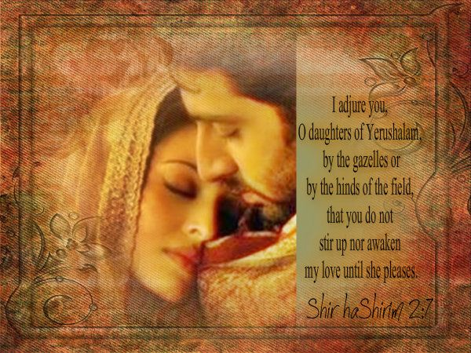
Wait (Song 2:7)
I adjure you, O daughters of Jerusalem, by the gazelles or by the hinds of the field, that you do not stir up nor awaken my love until she pleases
(Song 2:7)
Notes:
The young woman feels blessed to have waited for God's best for her. She also wants other women to see the benefits of waiting for sex until marriage.

Slide 95
那又如何?
425
禁止婚前性行为可以让婚姻充分被享受 (i.e.,让爱在它自己的时间绽放).
“不要惊动，不要叫醒我所亲爱的，等他自己情愿”
(2:7下 CNV).

Slide 96
Slides on
雅歌 3

Slide 97
那又如何?
425
禁止婚前性行为可以让婚姻充分被享受 (i.e.,让爱在它自己的时间绽放).
“不要惊动，不要叫醒我所亲爱的，等他自己情愿”
(2:7下 CNV).
“不要惊动，不要叫醒我所亲爱的，等他自己情愿”
(3:5下 CNV).

Slide 98
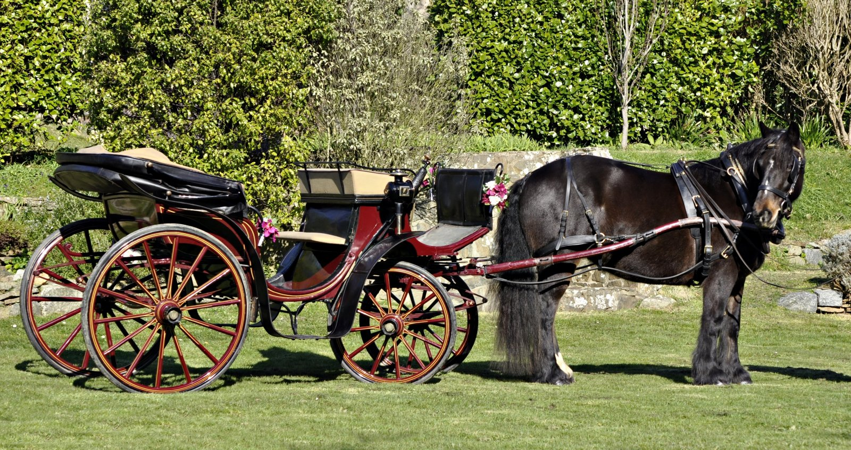
Solomon's Wedding?
那从旷野上来，好像烟柱；
用商人贩卖的各种香粉、
没药和乳香薰过的，是谁呢？ 7 看哪！ 是所罗门的御轿，四周有六十个勇士，
都是以色列中的勇士。
(3:6-7 CNV).

Slide 99
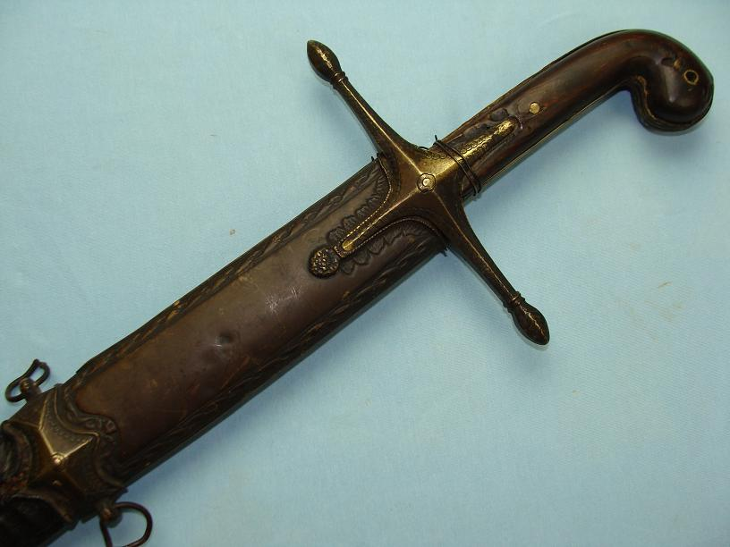
"They are all skilled swordsmen, experienced warriors."
"Each wears a sword on his thigh, ready to defend the king against an attack in the night" (3:8 NLT).

Slide 100
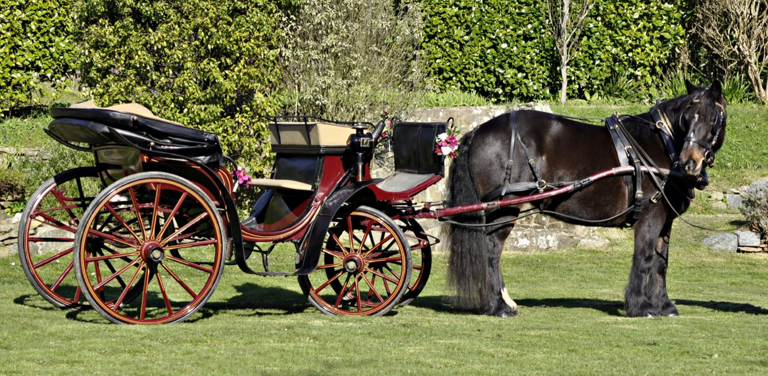
"King Solomon’s carriage is built of wood imported from Lebanon. ¹⁰ Its posts are silver, its canopy gold; its cushions are purple. It was decorated with love by the young women of Jerusalem" (3:9-10 NLT).

Slide 101
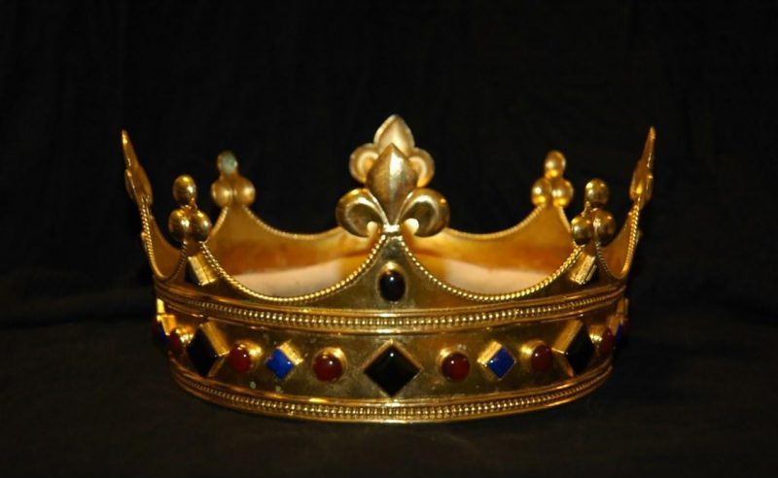
Young Woman
"Come out to see King Solomon, young women of Jerusalem.
He wears the crown his mother gave him on his wedding day, his most joyous day"
(3:11 NLT).

Slide 102
Slides on
雅歌 4

Slide 103
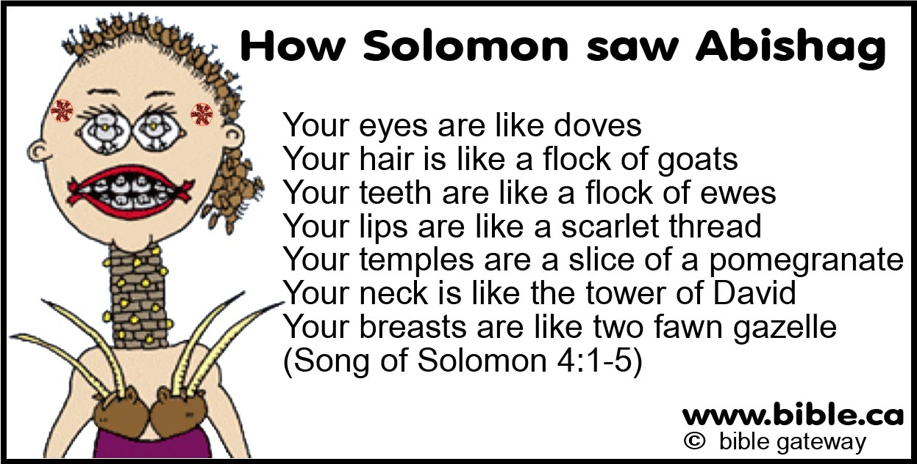
如何按字面理解雅歌?
所罗门如何看亚比煞？
你的眼睛像鸽子
你的头发如同山羊群
你的牙齿如新剪毛的一群母羊
你的唇好象一条朱红线
你的颈项好象大卫的高台
你的两乳好象一对小鹿
（雅歌4：1-5）

Slide 104


? R(A) 级
“北风啊！兴起。南风啊！吹来。吹进我的园里，让其中的香气散播出来。愿我的良人进入他自己的园中，享用他佳美的果子。”
(雅4:16 CNV)

Slide 105
Slides on
雅歌 5

Slide 106

我的妹妹，我的新妇啊！ 我进了我的园中；我采了我的没药与香料；
我吃了我的蜂房与蜂蜜；
我喝了我的酒和奶。(5:1 CNV).

Slide 107
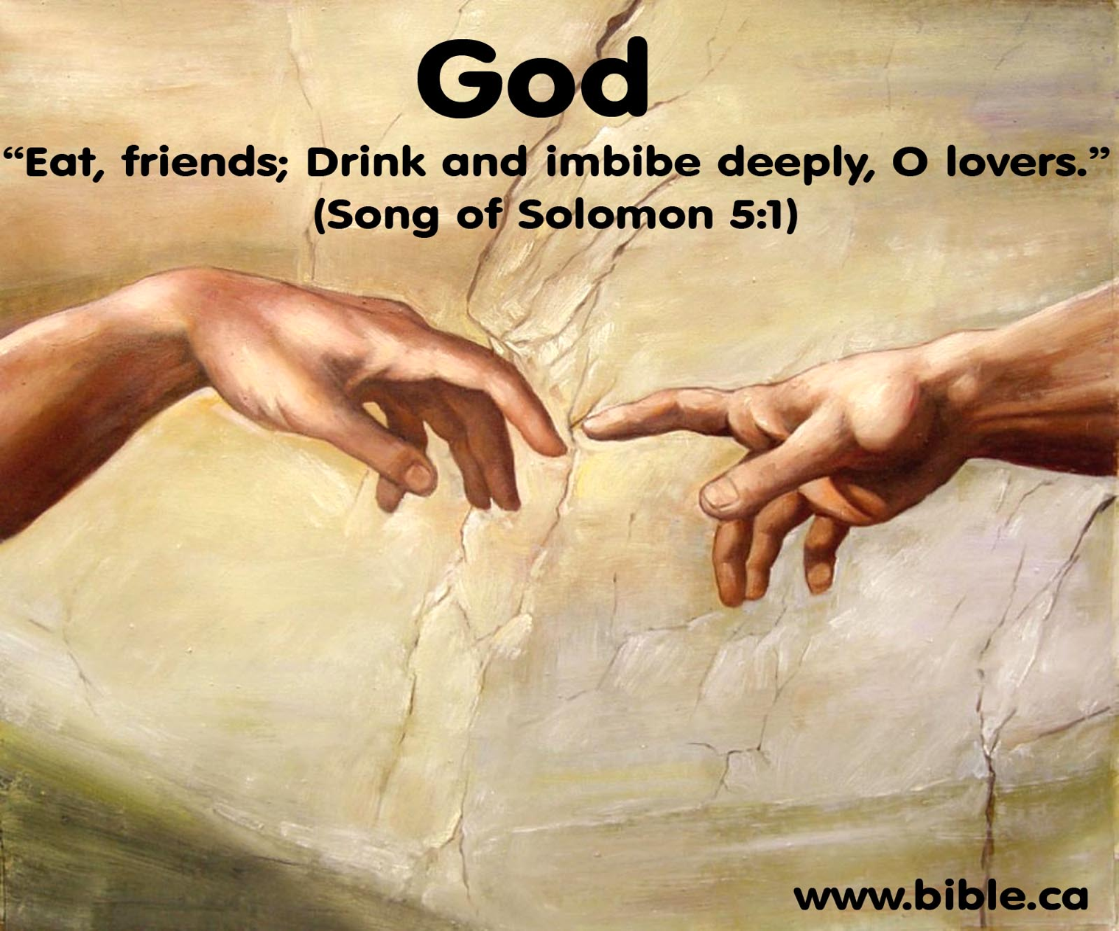
"Young Women of Jerusalem
Oh, lover and beloved, eat and drink!
Yes, drink deeply of your love!"
(5:1b NLT).
Notes:
"The NIV margin attributes the last part of the verse, Eat, O friends, and drink; drink your fill, O lovers, to the “friends” of the couple. However, it is unlikely that friends, wedding guests, or any other persons would have been present in the bedroom at the consummation of the couple’s marriage. A more plausible suggestion is that the speaker was God Himself. Only their Creator would have been a “guest” on that occasion. Since their love was from Him it was fitting that He approve it. He invited them to enjoy sexual love in marriage as if it were a banquet (“eat ... and drink”). This clearly indicates God’s approval of marriage, which He designed in the Garden of Eden (cf. Gen. 2:24)" (Deere, BKC, 1:1020).

Slide 108
如何让婚姻之爱成为神所定意的?
Notes:
What can you do now to have the fantastic marriage that God desires if he has marriage in his plan for you?

Slide 109
I. 婚前等待性 (雅歌 1:1–5:1)
Notes:
Be loving to God's person for you by preserving yourself now.
Solomon and the Shulammite begin their love relationship in courtship and marriage as an example of the need for premarital sexual restraint (1:1–5:1).

Slide 110
II. 经营美好婚姻
(雅歌 5:2–8:14).
Notes:
No relationship is built without sweat and tears.
The love of the couple matures through various events until it is very strong to show the effort needed to grow in marital love (5:2–8:14).

Slide 111
大纲
430-432
(1:1–5:1) 所罗门和书拉密女的关系从开始的求爱到后来的结婚，树立了一个婚前性约束的好榜样
II. (5:2–8:14) 丈夫和妻子之间的爱情在经历各种不同的情况后而变得成熟，因此可以看到婚姻成长中所需要的努力。

Slide 112

Young Woman
"I slept, but my heart was awake, when I heard my lover knocking and calling:
'Open to me, my treasure, my darling, my dove, my perfect one.
My head is drenched with dew, my hair with the dampness of the night'"
(5:2 NLT).
Notes:
1. The Problem: The Wife’s Indifference and the Husband’s Absence (5:2-8)
5:2. In a dream (I slept but my heart was awake; cf. another recorded dream, 3:1-4) the wife was approached by her husband, who said Open to me (cf. 5:6). The fact that the lover no longer addressed her as “my bride” indicates there is a time lapse between verse 1 (the wedding night) and verse 2. The couple should no longer be regarded as newlyweds. But he did address her by other affectionate terms: my sister (see comments on 4:9), my darling (cf. 1:9, 15; 2:2, 10, 13; 4:1, 7; 6:4), my dove, and my flawless one (cf. 4:7). This is the first record of his using all these terms of endearment. His head and hair were covered with dew, as he had been outside. Dew in Israel was often heavy.
—Deere, BKC, 1:1020

Slide 113

"But I responded,
'I have taken off my robe.
Should I get dressed again?
I have washed my feet.
Should I get them soiled?'"
(5:3 NLT).
Notes:
She is indifferent to him at first.

Slide 114

"My lover tried to unlatch the door, and my heart thrilled within me.
⁵ I jumped up to open the door for my love, and my hands dripped with perfume.
My fingers dripped with lovely myrrh as I pulled back the bolt" (5:4-5 NLT).
Notes:
But after he kept pursuing her, she then changed her mind about him.

Slide 115

"I opened to my lover, but he was gone!
My heart sank.
I searched for him but could not find him anywhere.
I called to him, but there was no reply.
⁷ The night watchmen found me as they made their rounds.
They beat and bruised me and stripped off my veil, those watchmen on the walls"
(5:6-7 NLT).

Slide 116

"Make this promise,
O women of Jerusalem—
If you find my lover, tell him I am weak with love"
(5:8 NLT).

Slide 117

他的口甜蜜；他全然可爱。
耶路撒冷的众女子啊！
这就是我的良人，
我的朋友。
(5:16 CNV).

Slide 118
你尴尬吗?
428
“我看牧师又要讲 ‘雅歌’ 了!”

Slide 119
Slides on
雅歌 6

Slide 120

我的佳偶啊！ 你美丽如得撒，秀丽如耶路撒冷，
威武如展开旗帜的军队。 5请你转眼不要看我，
因为你的眼使我心动！
你的头发如同从基列山下来的山羊群。
(6:4-5 CNV).

Slide 121
Slides on
雅歌 7

Slide 122
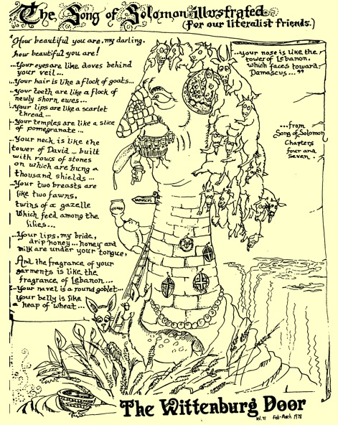
雅歌插画
436

Slide 123

我属我的良人，他也恋慕我。
(7:10).
Notes:
She responds to his request but also requests a countryside stroll and deeper intimacy in their marriage (7:9b–8:4).

Slide 124
Slides on
雅歌 8

Slide 125
"Place me like a seal over your heart, like a seal on your arm.
For love is as strong as death, its jealousy as enduring as the grave.
Love flashes like fire, the brightest kind of flame.
⁷ Many waters cannot quench love, nor can rivers drown it.
If a man tried to buy love with all his wealth, his offer would be utterly scorned"
(8:6-7 NLT).
Notes:
The beloved exults in the awesome strength of genuine love by declaring that it is as universal and irresistible as death (8:5-7).

Slide 126
The Young Woman’s Brothers
"We have a little sister too young to have breasts.
What will we do for our sister if someone asks to marry her?
⁹ If she is a virgin, like a wall, we will protect her with a silver tower.
But if she is promiscuous, like a swinging door, we will block her door with a cedar bar"
(8:8-9 NLT).
Notes:
The brothers of the Shulammite protected her from losing her virginity while she was young (8:8-9).

Slide 127
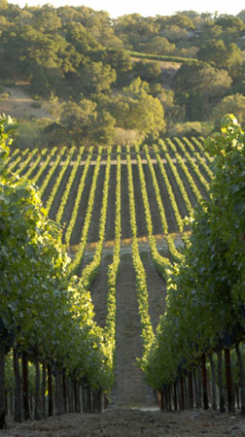
"Solomon has a vineyard at Baal-hamon, which he leases out to tenant farmers. Each of them pays a thousand pieces of silver for harvesting its fruit.
¹² But my vineyard is mine to give, and Solomon need not pay a thousand pieces of silver. But I will give two hundred pieces to those who care for its vines"
(8:11-12 NLT).
Notes:
The love story of Solomon and the Shulammite is reviewed in flashback form (8:8-14).

Slide 128
结语
425
所罗门和他的书拉密女妻子
之间的爱情故事描绘了
从求爱到坚固婚爱的过程。
不论在婚前性约束方面，
还是在婚姻成长中所需的努力方
面，都树立了一个良好的榜样。

Slide 129
如何让婚姻之爱成为神所定意的?
Notes:
What can you do now to have the fantastic marriage that God desires if he has marriage in his plan for you?

Slide 130
I. 婚前等待性 (雅歌 1:1–5:1)
Notes:
Be loving to God's person for you by preserving yourself now.
Solomon and the Shulammite begin their love relationship in courtship and marriage as an example of the need for premarital sexual restraint (1:1–5:1).

Slide 131
II. 经营美好婚姻
(雅歌 5:2–8:14).
Notes:
No relationship is built without sweat and tears.
The love of the couple matures through various events until it is very strong to show the effort needed to grow in marital love (5:2–8:14).

Slide 132
雅歌中心思想
通过等待与经营来相爱
Notes:
Restatement

Slide 133

We need to help marriages in trouble.

Slide 134

Virgins Until Marriage
how women who waited
feel about their choice

Slide 135
Fornication Rate in USA
100%
Source: USA Today
95%
1%
0%
1900
2002
Notes:
Most Americans have had premarital sex, study finds
Updated 12/19/2006 9:29 PM ET
usatoday30.usatoday.com/news/health/2006-12-19-premarital-sex_x.htm
Accessed 29 Feb 2016 (ten years later)

Slide 136
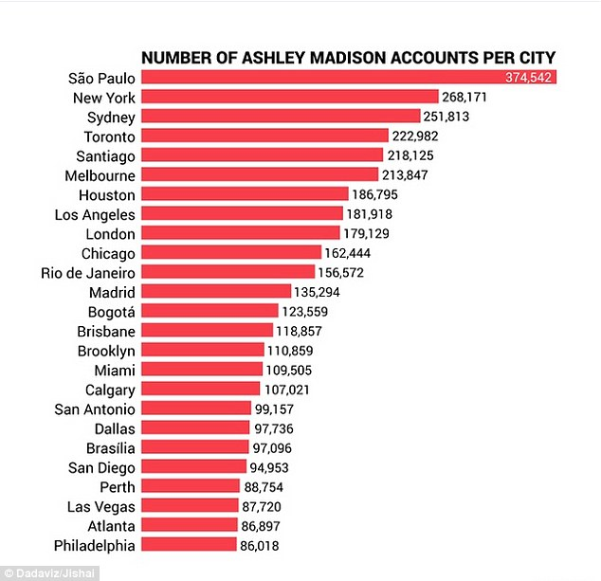
Number of Accounts Per City
Over 20,800,000 anonymous members to a website to facilitate adultery

Slide 137

“和妇人通奸的，实在无知；
行这事的，是自我毁灭。
他必遭受击打，被凌辱，
他的耻辱永不能涂抹。”
(箴言6:32-33).

Slide 138
那又如何?
425
禁止婚前性行为可以让婚姻充分被享受 (i.e.,让爱在它自己的时间绽放).
“不要惊动，不要叫醒我所亲爱的，等他自己情愿”
(2:7下 CNV).
“不要惊动，不要叫醒我所亲爱的，等他自己情愿”
(3:5下 CNV).
“不要惊动，不要叫醒我所亲爱的，等他自己情愿”
(8:4下 CNV).

Slide 139
那又如何?
425
禁止婚前性行为可以让婚姻充分被享受 (i.e., 让爱在它自己的时间绽放–2:7b; 3:5b; 8:4b).
期待一个美好的婚姻，然后为之努力.
称赞你配偶的优点--不论是身体上的还是非身体上的.

Slide 140
Black

Slide 141


旧约全书讲章 • BibleStudyDownloads.org
免费获得该讲解!
圣经学习下载
Notes:
The explanation for free
OT Preaching link address

Slide 142
内容提要
430
雅歌表达了所罗门和他的书拉密女妻子之间深厚的感情，描述了他们从追求，到恋爱，以及到最后委身在婚姻中。
雅歌有两大部分. 第一大部分(1:1–5:1)描述两人渴望彼此进入恋爱 (1:1–3:5)，他们的婚礼以及洞房花烛夜使爱达到极点(3:6–5:1)，也是一个很好的婚前性约束的例子。
第二大部分(5:2–8:14)描述获得坚固的婚爱所要面对 的困难以及要付出怎样的努力从而使爱得到成长。
整卷雅歌都是用对话或沟通的方式呈现，这也是发展所有深厚紧密关系的关键—特别是婚姻

Slide 143
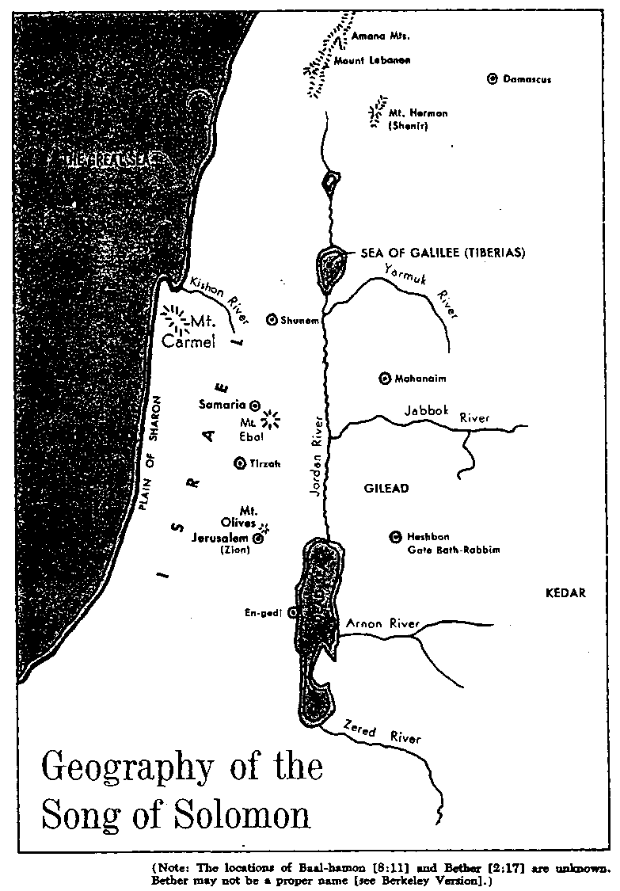
所罗门之歌的所在地
Irving L. Jensen, Ecclesiastes & 雅歌: A Self-Study Guide, 59
433
所罗门之歌
的地理

Slide 144
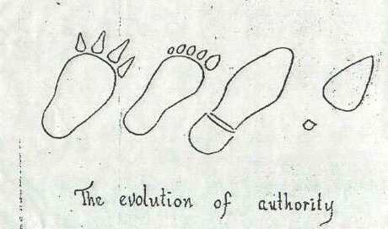
女人在社会中的影响逐渐增强
权利的发展

Slide 145
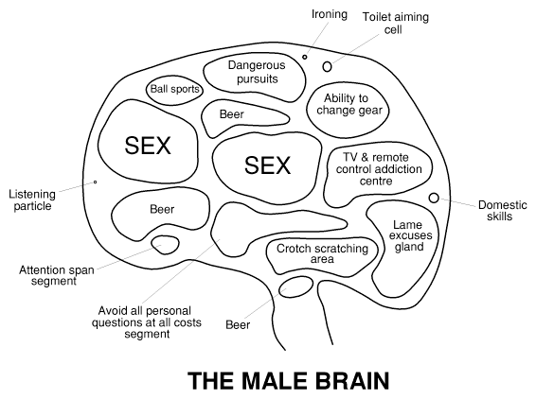
The Male Brain
熨衣服
上厕所时瞄准细胞
危险的追求
球类运动
开车换档能力
啤酒
性
性
沉溺于电视及遥控器的区域
听力
啤酒
做家事技巧
没有说服力的借口
跨部挠抓区
注意力
避免被人问私人问题的区域
啤酒
男性大脑
Notes:
http://www.jwolfe.clara.net/Humour/MedPicts/BrainMaleFemale.gif

Slide 146
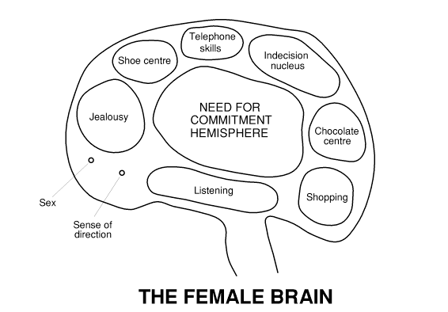
The Female Brain
电话技巧
鞋子中心
优柔寡断区
对承诺的渴望半球
嫉妒
巧克力中心
倾听
购物
性
方向感
女性大脑
Notes:
http://www.jwolfe.clara.net/Humour/MedPicts/BrainMaleFemale.gif

Slide 147
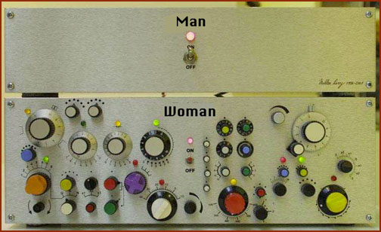
生活解释
男人
女人

Slide 148

模糊的性别
是男人还是女人?

Slide 149
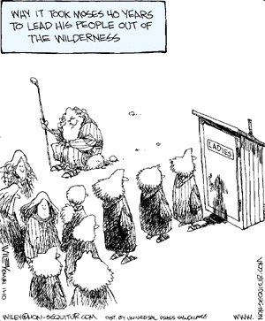
为什么摩西花了四十年带领他的
人民离开旷野?

Slide 150
爱 的各方面
434
身体的
美
吸引力
爱
满足感
纯洁
付出和得到
身体
在一起和分离
性本能
婚姻生活
欲望
非身体的
吸引力
牺牲
陪伴
忠诚
联盟和共融
赞美
希望
美
快乐
爱
付出和得到
纯洁
在一起和分离
全心全意的
温和
谦逊

Slide 151
Communication Differences Between the Sexes
如何区分! | 男性 | 女性
感情 | ”行动者" | ”被动者"
领导力 | 完成者 | 帮助者
精神价值 | 不太重要 | 更重要
语言内容 | 工作 | 家庭
关注 | 概要 | 细节
源头 | 头脑 | 心
追求 | 冒险 | 安全
资料处理 | 文件柜(储存资料) | 雪橇铃(一次全敲)
客观性 | 客观的 | 主观的
主要沟通 | 语言 | 非语言因素
每日说话字数 | 25,000 | 30,000
时间取向 | 现在 | 不受时间影响的
朋友数量 | 较少 | 更多
花更多的精力在... | 任务 | 关系
分心 | 容易分心 | 多重任务
压抑感 | 沉默的 | 表达的
沟通焦点 | 定向的 | 多方面的
沟通风格 | 直接的/坦率 | 间接的/机智
435

Slide 152
婚前性行为的增加
由Danny Goh博士编辑, 新加坡神学院, 2002年1月
436a
性行为
在美国，70%的女孩未满16岁就已经不是处女
在英国，大部分人在15岁之前就失去了他们的处子之身
只有7-8%的新郎和新娘在新婚之夜前保留贞洁。
新加坡：1990，（新加坡）海峡时报报道，10月23日，10%的男孩，5%的女孩，在14-19岁就在交往中发生性行为。
女孩的首次性行为的平均年龄：16.4岁
男孩的首次性行为的平均年龄：15.6岁
盖洛普民意测验（2001年5月）
道德上 道德上 视情况而定
可接受 不接受 /不是道德问题
婚前同居 52% 41% 7%
婚前性行为 53% 42% 5%
离婚 59% 28% 13%

Slide 153
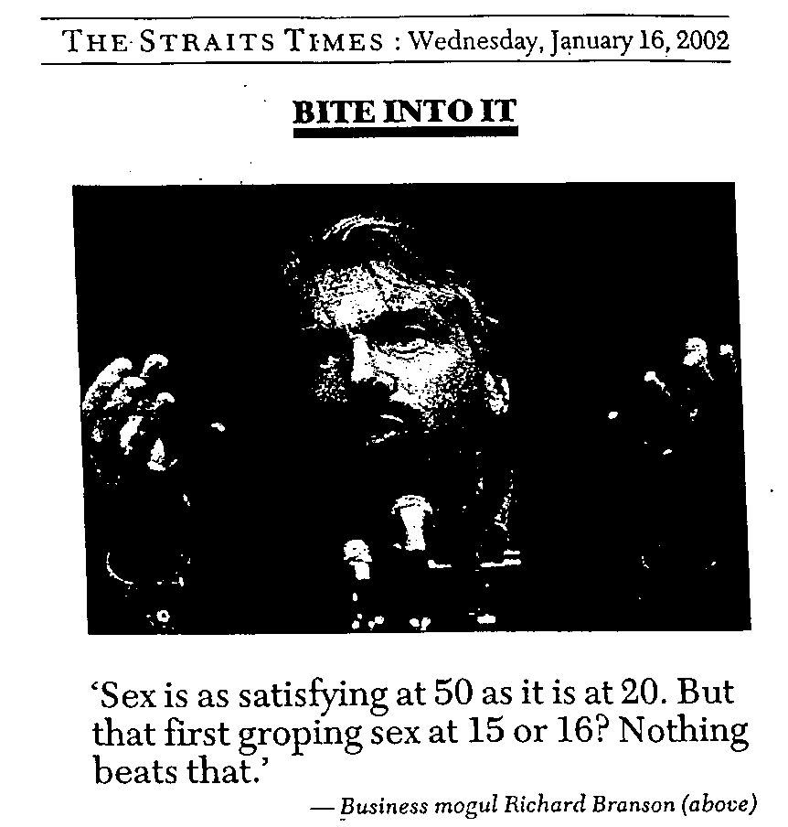
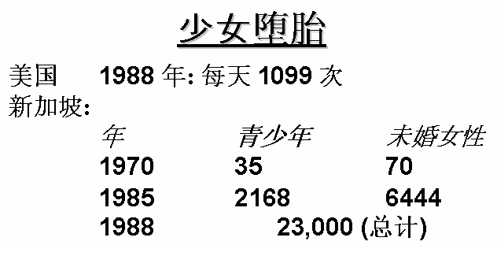
婚前性行为的劝勉
由Danny Goh博士编辑, 新加坡神学院, 2002年1月
436b

Slide 154
禁止婚前性行为的原因
436c
一对潜在的婚姻配偶必须相信他/她在婚后将会是一个忠诚的配偶
  如果一个男人在婚前就可以和一个不是他配偶的人上床，那什么让他可以认为婚后能奇迹般的清理他的性道德？同样适用在女性身上。
  即便是订婚男女，如果他们在婚前发生性关系表明他们也没有足够的信任度可以相信不会发生婚外性关系。
  一个身陷婚前性行为的人逻辑上是不能争辩拒绝婚外性关系的。这样做很虚伪的。
那些由“处子”之身开始婚姻的人会有最好的的机会拥有成功的婚姻.
很多关系在婚前性行为后结束.
性关系传染疾病(最糟糕的是艾滋病) ，由性放纵的人导致.
上帝说要保留性到婚姻中.
  这是禁止婚前性行为的最好原因.
  作为婚姻和性的创作者，他知道什么对我们最好.

Slide 155


婚前禁止性行为的原因
“歌中之歌” (2014) 一次在当地的葡萄园收获节演出的时候，杰德意外与葡萄园主人的女儿相识了，自此一见钟情并步入了婚姻的殿堂。他们结婚后不久，杰德新创作的“这首歌”成为了他歌唱生涯的一次成功突破。突然成名的杰德却在生活中变得左右摇摆，他们的婚姻也岌岌可危

Slide 156

“歌中之歌” 预告片
Notes:
This trailer is also uploaded to the OT Survey link at biblestudydownloads as file 22-"The Song" Trailer #2 (2014).mp4
Downloaded from:
http://en.savefrom.net/#url=http://youtube.com/watch?v=DjS-cKX-rKQ&utm_source=youtube.com&utm_medium=short_domains&utm_campaign=www.ssyoutube.com

Slide 157
触摸 尺度
他
她
性别
性别
爱抚
爱抚
亲吻嘴唇
亲吻嘴唇
亲吻脸颊
亲吻脸颊
拥抱
拥抱
搂腰或楼肩
搂腰或楼肩
所以在恋爱中出现分歧时，他应该如何定界限?
亲吻手部
亲吻手部
牵手
牵手

Slide 158
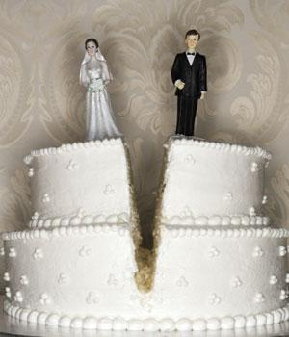
When You Say "I Don't"
Matthew 5:31-32
Dr. Rick Griffith, Crossroads International Church
www.BibleStudyDownloads.org

Slide 159

Black on White
Notes:
Don't you just love talking to children? I do.

Slide 160

Kids on Marriage
Notes:
Researchers have discovered that kids have interesting views on marriage. This is evident in their answers to some basic questions, such as…

Slide 161

How Does a Person Decide Who to Marry?

Slide 162

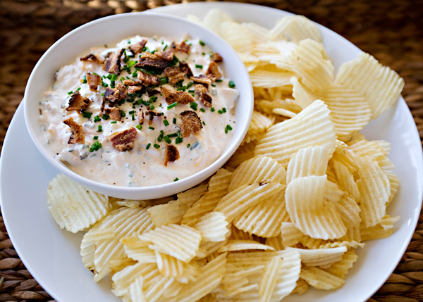
"You got to find somebody who likes the same stuff. Like if you like sports, she should like it that you like sports, and she should keep the chips and dip coming." Allan, age 10

Slide 163

"No person really decides before they grow up who they're going to marry.
…God decides it all way before, and you got to find out later who you're stuck with." Kirsten, age 10

Slide 164

How Can a Stranger Tell if Two People are Married?

Slide 165

"Married people usually look happy to talk to other people." Eddie, age 6

Slide 166

"You might have to guess based on whether they seem to be yelling at the same kids." Derrick, age 8

Slide 167

What Do Most People Do on a Date?

Slide 168

"Dates are for having fun, and people should use them to get to know each other. Even boys have something to say if you listen long enough."
—Lynnette, age 8

Slide 169

"On the first date, they just tell each other lies, and that usually gets them interested enough to go for a second date."
—Martin, age 10

Slide 170
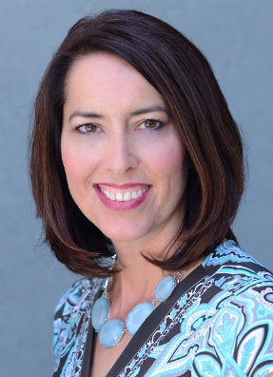

The Great Debate: Is It Better to Be Single or Married?

Slide 171

"It's better for girls to be single but not for boys. Boys need somebody to clean up after them!"
—Anita, age 9

Slide 172

Do you personally defend marriage?
Notes:
These kids don't seem to be great at defending marriage. How about you? Do you personally defend marriage?

Slide 173

As marriage goes…

Slide 174

…so goes the family...

Slide 175

Her scars are on the inside…

Slide 176

…as the family goes...

Slide 177

…so goes the entire world.

Slide 178
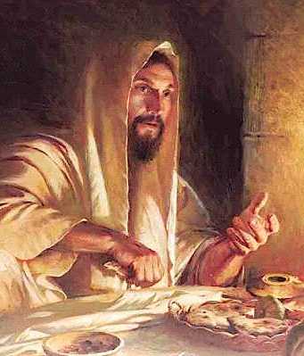
Jesus, though single, saw the priority of marriage
Notes:
Although single, Jesus knew that the state of marriage is the single most important human relationship.
Therefore, when marriage was attacked, we will see today that Jesus was quick to come to its defence.

Slide 179

Jesus confronted the Pharisees
Notes:
Most Jewish teachers of Jesus' day influenced first-century Jews to justify divorce for many silly reasons

Slide 180
Back to Basics (Matt. 5:21-48)
"You have heard that it was said…"
6 Issues:
"But I tell you…"
Murder
Adultery
Divorce
Vows
Revenge
Enemies
God's True Intent
Pharisee Teaching
External purity won't enter the kingdom (20)
Notes:
Here we see how "Jesus rejected the traditions of the Pharisees (vv. 21-48) … Six times Jesus said, "You have heard that it was said. ... But I tell you" (5:21-22, 27-28, 31-32, 33-34, 38-39, 43-44). These words make it clear that Jesus was presenting (a) what the Pharisees and teachers of the Law were saying to the people and, by contrast, (b) what God's true intent of the Law was. This spelled out His statement (v. 20) that Pharisaic righteousness is not enough to gain entrance into the coming kingdom" (Barbieri, BKC, 2:30).

Slide 181

Marriage is in trouble today.

Slide 182

Marriage

Slide 183

Singles, don't tune out.

Slide 184

How can you defend marriage?
• 2 ways
• Matthew 5:31-32
Notes:
We know that God has a high view of marriage, but how can you defend marriage?
• Today we will see two ways we can defend marriage like Jesus.
• The two verses of Matthew 5:31-32 are among the most important verses in the Bible on marriage.
So what's the first way that you can defend marriage?

Slide 185

I. Don't let marriage be devalued (Matt 5:31).

Slide 186

Jewish leaders attacked marriage by supporting frivolous divorce (Matt 5:31).

Slide 187

"You have heard the law that says,
'A man can divorce his wife by merely giving her a written notice of divorce'"
(Matt 5:31 CNV).
Notes:
The main OT stipulation on marriage was the command that a man divorcing his wife had to give her a written certificate of divorce (Deut. 24:1). But why was this commanded?

Slide 188

Did Deuteronomy 24:1 just leave the divorced woman alone?
Notes:
Some societies think so poorly of women (and marriage) that a simple verbal declaration of divorce dissolves the marriage. This leads to ambiguity on whether a man said it, which persons heard it as witnesses, and a host of other problems. The result was that some wives did not even know if they were married anymore!

Slide 189

The Right to Remarriage Guaranteed
“You are free to marry any [Jewish] man you wish”

Slide 190
What About Remarriage?
Read the small print. Read an actual divorce certificate from around the time of Christ.
—A Jewish divorce certificate says:
"You are now free to marry anyone you wish."
—Divorce certificates have much more,
but these are the only necessary words.
—In other words, the essence of the divorce certificate was the right to remarry
(slideshare.com)

Slide 191

Rabbinic Grounds for Divorce?
School of Hillel
School of Shammai
Liberal
Conservative
Divorce for any reason
Divorce Only for adultery
Notes:
Pharisees used this OT protection to justify their frivolous divorces (Matt 5:31b).

Slide 192

“法利赛人前来试探耶稣，说：“人根据某些理由休妻，
可以吗？”
(马太 19:3 CNV)
Notes:
Later, in Matthew 19, the leaders put the question to Jesus which school he favored. But here in Matthew 5 Jesus brings the issue up himself and turns the tables on not upholding divorce but upholding marriage.

Slide 193

We must defend marriage today from attacks.

Slide 194

Lip Service
"The greatest single cause of atheism in the world today is Christians, who acknowledge Jesus with their lips and walk out the door, and deny him by their lifestyle. That is what an unbelieving world simply finds unbelievable."
—Brennan Manning—

Slide 195

Watch your talk.
If you were my husband, I’d poison your coffee
If you were my wife, I’d drink it

Slide 196

Teach True Marriage

Slide 197

什么是婚姻?

Slide 198

Side

Slide 199

"No Fault Divorce"

Slide 200

Mutuality in Marriage
Notes:
Some teach that Christian marriage is the husband as king and the wife as slave.
Tell them that it is more like the difference between the Prime Minister and the President.

Slide 201
How can you defend marriage?
• 2 ways
Notes:
We know that God has a high view of marriage, but how can you defend marriage?
So what's the first way that you can defend marriage?

Slide 202
I. Don't let marriage be devalued (Matt 5:31).
Notes:
Don't let it be devalued, but now we see one of the most important ways to preserve it in the next verse…

Slide 203

II. Defend marriage against adultery (Matt 5:32).
Notes:
The way to preserve the marital union is by keeping sex within marriage.

Slide 204

“可是我告诉你们，凡休妻的，如果不是因她不贞，就是促使她犯奸淫”
(马太 5:32a CNV).
Notes:
Jesus defended marriage by prohibiting divorce unless promiscuity had led to adultery (Matt 5:32).
When Jesus said, "But I say…" was he disagreeing with the OT (32a)?
No, Jesus didn't actually contradict the Scripture.
What Jesus did was to prohibit the Pharisees from using a law that managed divorce in order to encourage divorce.

Slide 205

Jesus honored marriage by declaring that divorce also leads to adultery for the person who marries the divorcee (Matt 5:32b)

Slide 206

How does a man divorcing his wife cause her to commit adultery (32b)?
Notes:
God made marriage for life and considers us married to our spouse until death. The only exception is when there exists a biblically allowed divorce.
Without such a God-approved reason for divorce, a woman who remarries (which is assumed she will do) commits adultery since she is—in the sight of God—still married to her first husband.

Slide 207
What is porneia?
”…a man who divorces his wife,
unless she has porneia,
causes her to commit adultery”
(Matt 5:32a).

Slide 208

What is porneia?
"unfaithful" (CNV, NIV)
"fornication" (KJV)
"unchastity" (NAS)
"immorality" (ESV, NET)

Slide 209

The Vow
"I, [name], take you [name], to be my [husband/wife], to have and to hold from this day forward, for better or for worse, for richer, for poorer, in sickness and in health, to love and to cherish; from this day forward until
death do us part."

Slide 210

Porneia refers to any sexual sin that violates the vow made at marriage

Slide 211

“无论谁娶了被休的妇人，也就是犯奸淫了。”
(马太 5:32b CNV).
Notes:
In God's opinion—which is the one that matters most—a woman who is not legitimately divorced is obviously still married to her first husband.
That means that a second man who has sex with her becomes an adulterer, as he enters into a sexual relationship with another man's wife.

Slide 212

Does the adultery here refer to a constant state of perpetual adultery or a single act of adultery?
Notes:
It argues more than the text is saying to refer to this as a continual state of adultery.
The idea is that this first sexual act is adulterous. However, it seems to me that subsequent sex is not deemed adulterous to God.

Slide 213

“亲爱的，我劝你们作客旅和寄居的人，要禁戒肉体的私欲，这私欲是与灵魂争战的。”
(彼前2:11 ).
Put safeguards in your own marriage to guard your own purity

Slide 214

Adultery
"Adultery occurs in the head
long before it occurs in the bed."
— Chuck Swindoll

Slide 215

Google Safe Search

Slide 216

Use Strict Filter

Slide 217

Train Your Computer

Slide 218

Nurture Relationships with those of Your Own Sex

Slide 219

Nurture Relationships with those of Your Own Sex

Slide 220

Nurture Relationships with those of Your Own Sex

Slide 221

Guard against divorce.
Main Idea

Slide 222
How can you defend marriage?
• 2 ways
Notes:
We know that God has a high view of marriage, but how can you defend marriage?
So what's the first way that you can defend marriage?

Slide 223
I. Don't let marriage be devalued (Matt 5:31).
Notes:
Don't let it be devalued, but now we see one of the most important ways to preserve it in the next verse…

Slide 224
II. Defend marriage against adultery (Matt 5:32).
Notes:
The way to preserve the marital union is by keeping sex within marriage.

Slide 225

Success in marriage is the sum of small efforts, focused on showing love and appreciation, repeated every day.

Slide 226
Black

Slide 227
旧约全书概论链接地址 BibleStudyDownloads.org
免费获取这讲解!
圣经学习下载
Notes:
The explanation for free!
OT Survey link address

