Slide 1
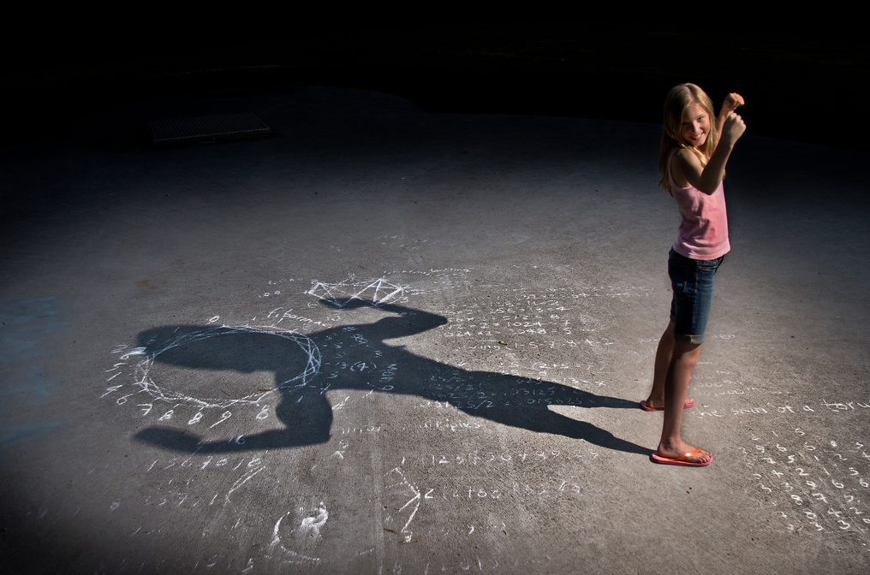
作个勇敢的人
约书亚
Dr. Rick Griffith • Crossroads International Church Singapore
CICFamily.com • BibleStudyDownloads.org

Slide 2
Starting a School in 1992
no money no backers no parents no teachers no principal no campus
Notes:
One of the greatest challenges of my life was helping begin a K-12 international school. It soon became quite discouraging to me to realize that we had… [list above]

Slide 3
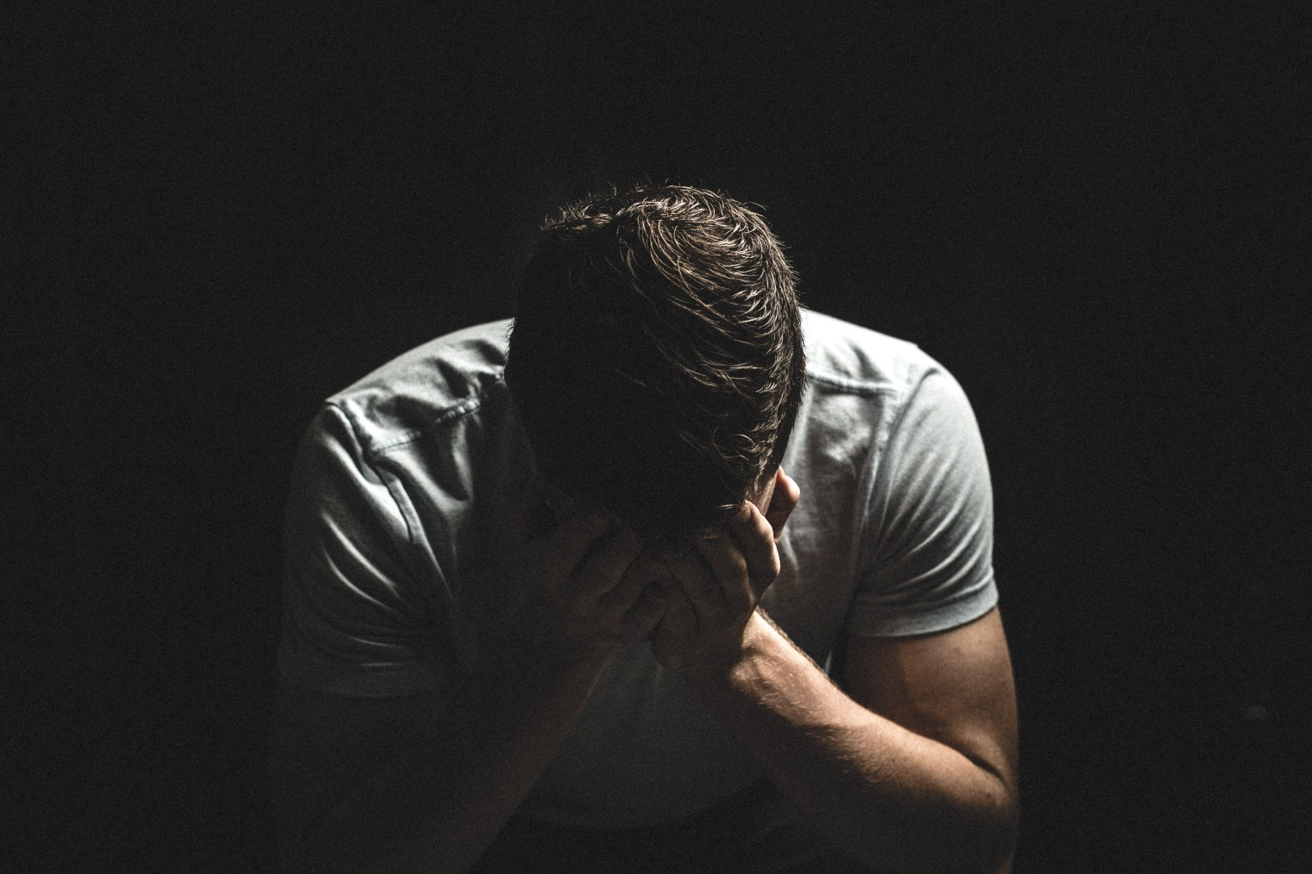
Discouragement
Notes:
Discouragement hits us all.

Slide 4
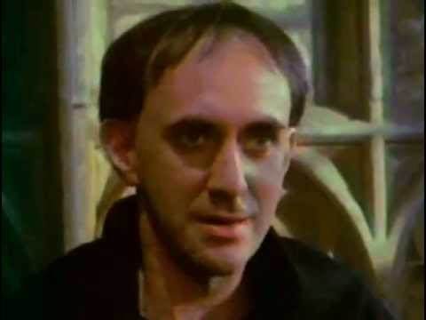
Discouragement
Notes:
Discouragement was real to an obscure monk roughly 500 years ago.

Slide 5
Discouragement
Martin Luther's parents were pious people, but they were shocked when he abandoned his legal studies at Erfurt and entered the Augustinian monastery. Martin was 21 years old when, in July 1505, he gave away all his possessions—including his lute, his many books and clothing—and entered the Black Cloister of the Augustinians.

Slide 6
Discouragement
Notes:
But being a monk made Luther's discouragement even worse. He would spend hours each day confessing every sin he could think of. But no peace of mind came.

Slide 7
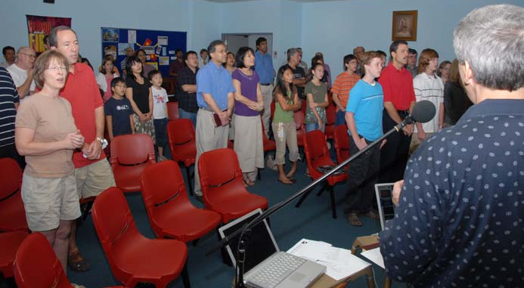
First Worship Service 19 November 2006
Notes:
Our church had a very encouraging start with 58 people at our first service.

Slide 8
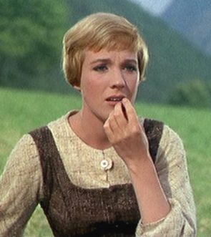
Bank Balance
Why?
Decreased Offerings
$1001/week decrease in offerings
• Oct 07-Sept 08 = $1620/week
• Oct 08-Nov 08 = $ 619/week
Unpaid Bills
$16,700 unpaid rent
$2,573 legal fees
Higher Monthly Costs
$2600 Honorariums
$1452 Rent Increase
$300 Church Dinner
Notes:
But two years later the economic crisis hit us hard.
__________
Honorariums = Tom ($1000), Susan ($1000), Enriko ($300), Amaraa ($300), guest speakers not par of our body ($100/sermon)

Slide 9
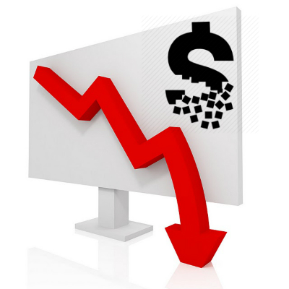
The Bottom Line
At the present rate of $600 weekly offerings and $2000 weekly expenses, our $7300 bank balance will be gone in 5.2 weeks.
Notes:
So I shared this PPT slide with the people. Our church in 2008 had no money, no backers, no morning worship slot, one part-time pastor, and frequent turnover of internationals. It was discouraging.

Slide 10
Are you discouraged?
Notes:
Are you discouraged? How would you know if you are?

Slide 11
The "Good Ole Days"
Notes:
When discouraged, we tend to look back at the “good ole days” instead of looking forward.
Which way are you looking?

Slide 12
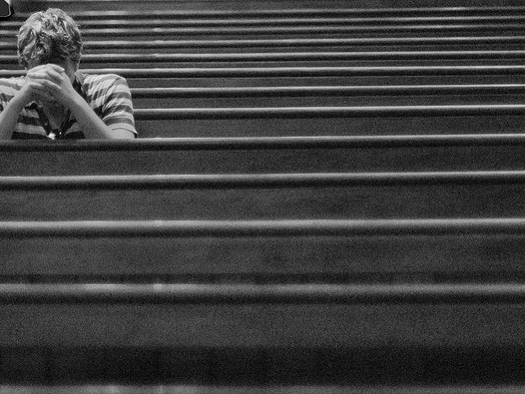
Discouragement

Slide 13
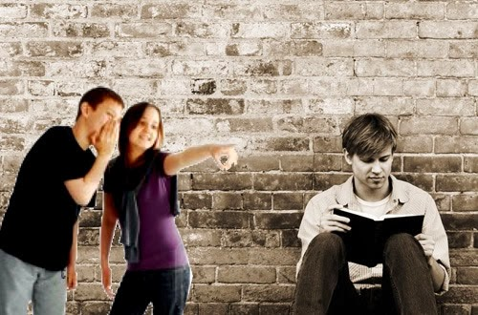
Discouragement
Notes:
Discouragement sometimes comes when we’re ridiculed for our faith.

Slide 14
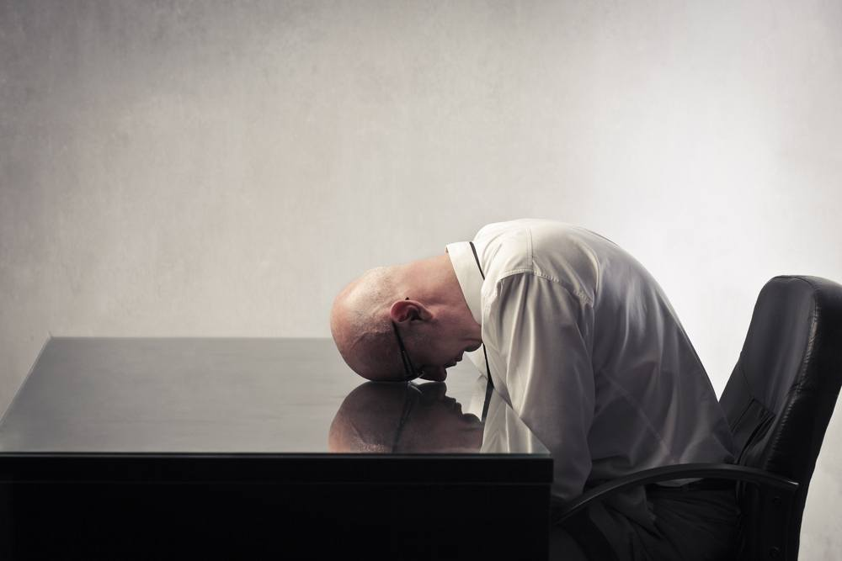
Discouragement
Notes:
It comes when we feel that it is the same ol' same ol' and we lack purpose.

Slide 15
Discouragement.
courage
Notes:
Discouragement means lack of courage.
• The word "courage" is the root word, you know.
• When courage is missing, life makes no sense.
So we need courage! But what does it look like?

Slide 16
Courageous (The Movie)
Notes:
The movie plays automatically

Slide 17
Courageous (The Movie)
Notes:
Discouragement hits us all.

Slide 18
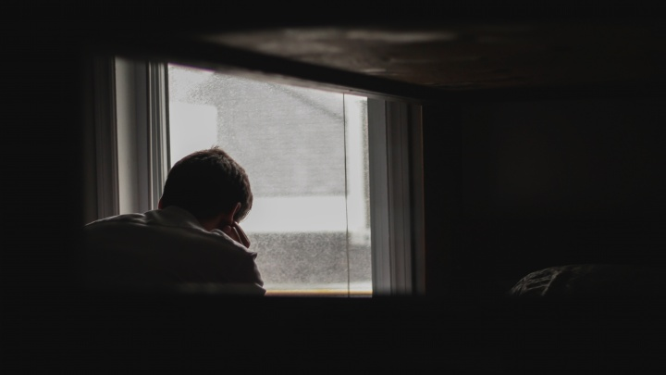
Do you need courage today?

Slide 19
How can you defeat discouragement that prevents you from doing God’s will?
Notes:
How can you have the courage you need to serve the King?

Slide 20
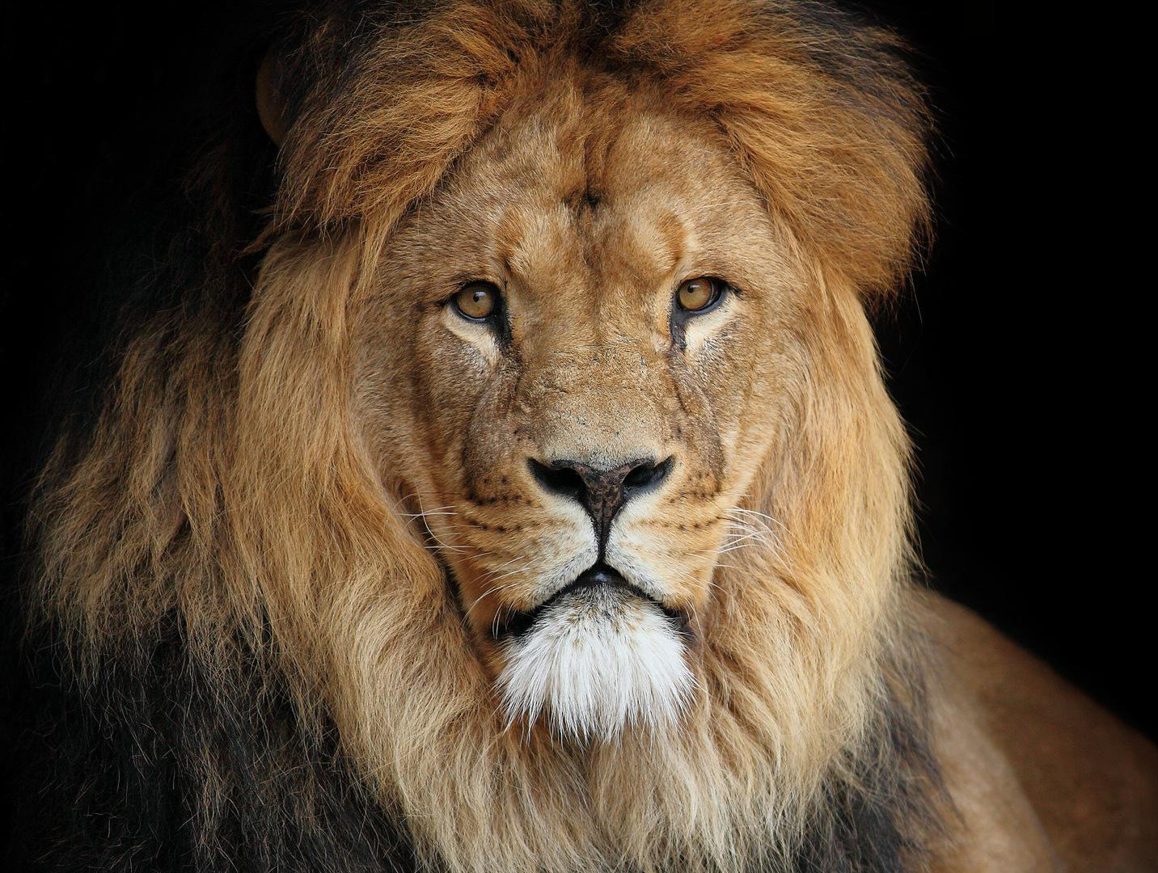
How can you gain courage that enables you to do God’s will?
Notes:
The reality of discouragement is something that everyone faces.
We all must see that God has a solution for discouragement—a way that we can be infused with courage.

Slide 21
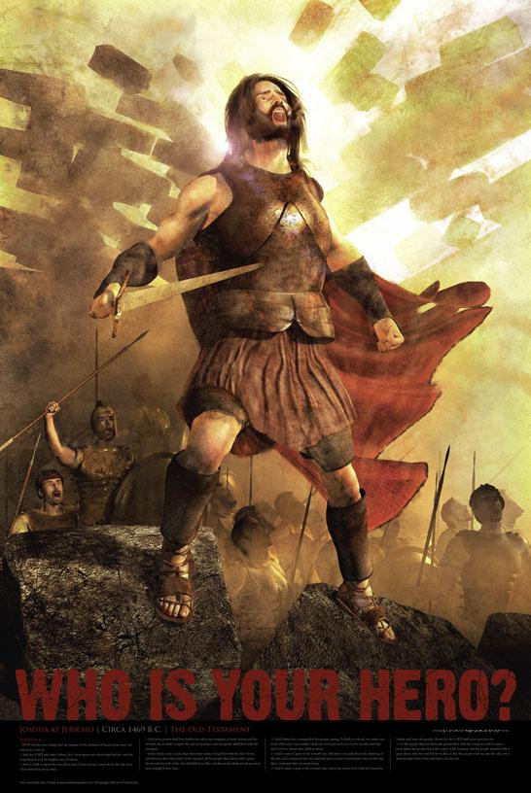
JOSHUA
MISSION
IMPOSSIBLE
OCCUPATION
Dr. Rick Griffith, Singapore Bible College
BibleStudyDownloads.org
Notes:
The reality of discouragement is something that everyone faces.
We all must see that God has a solution for discouragement—a way that we can be infused with courage.
Today we will study a man named Joshua who embodied courage.

Slide 22
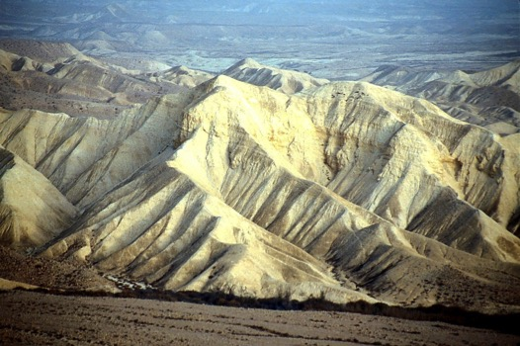
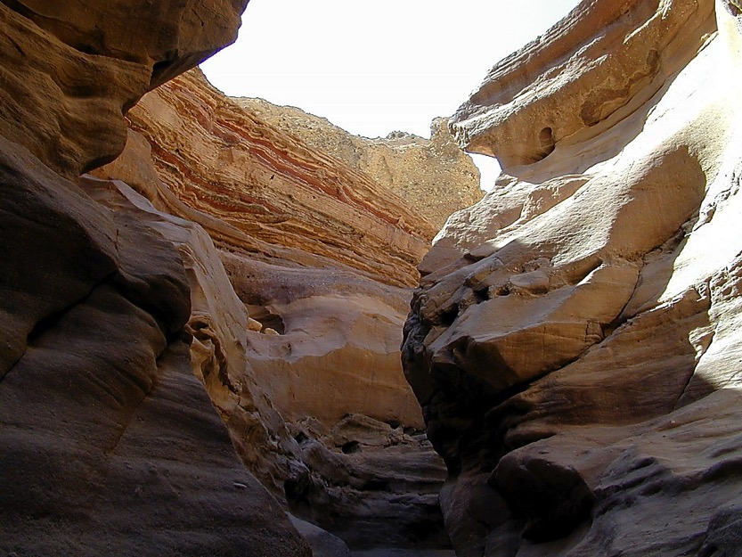
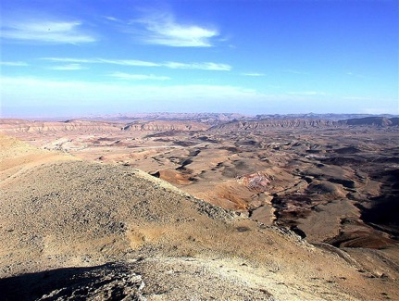
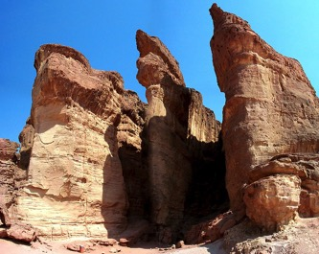
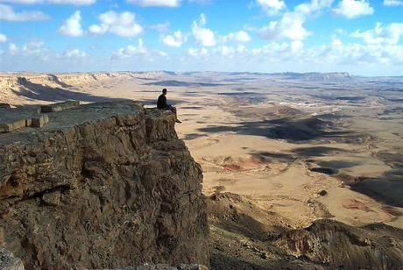
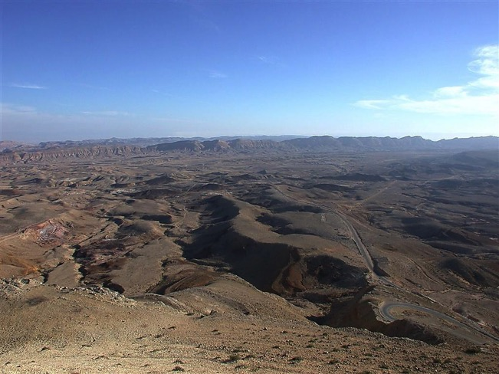
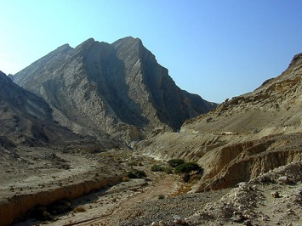
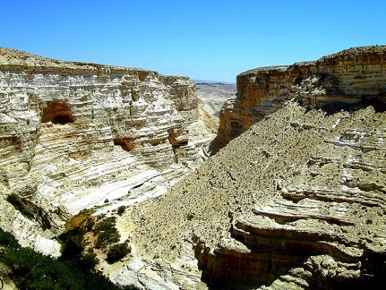
民 32:49; 34:1
历史
舞台
不会吧…
在此地?
四十年?
不会吧…
在此地?
四十年?
不会吧…
在此地?
四十年?
摩西
出埃及
西奈山
德 – 民 – 礼
加低斯巴尼亚
40
40
学生手册第26-29页
1
23

Slide 23
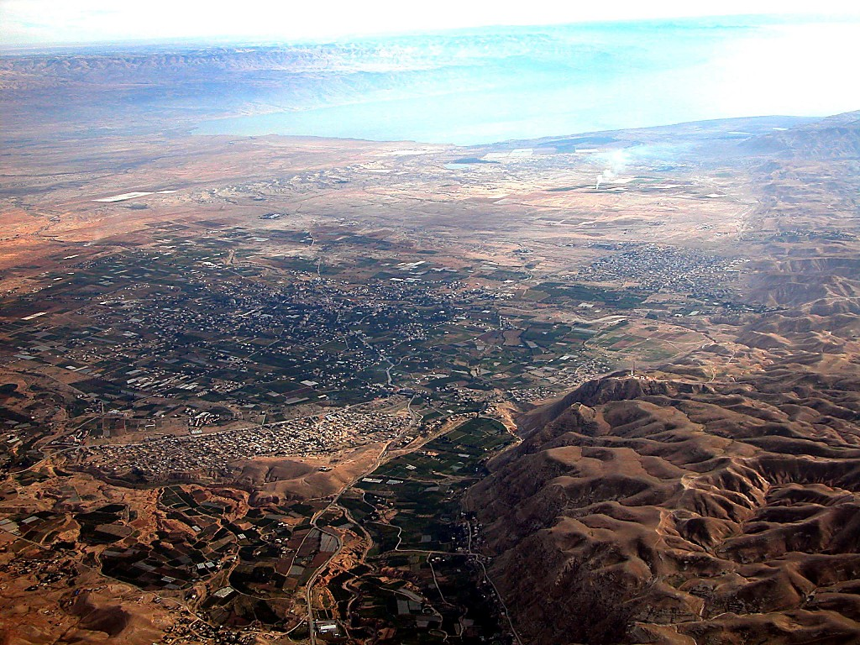
死海
约旦河
现代的耶利哥城
摩西
出埃及
西奈山
德 – 民 – 礼
古代的耶利哥城
加低斯巴尼亚
40
40
从耶利哥的东面观望约旦
学生手册第26-29页
42

Slide 24
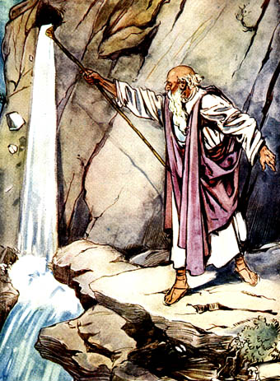
民族的诞生
出埃及记
利未记
民数记
约书亚记
他们
形成
成圣
预备
占领
我们
救赎
指示
同行
安息

Slide 25
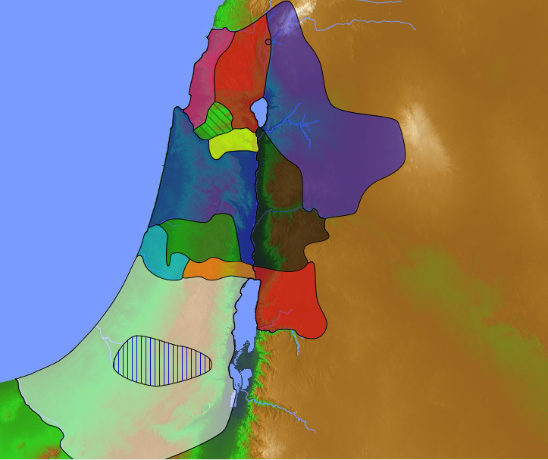
KEY WORD
占领
162
关键字

Slide 26
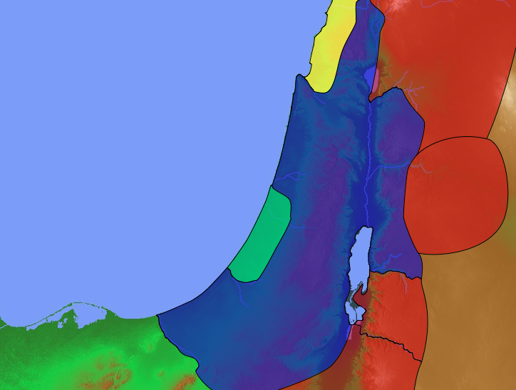
Conquest Promise
Lebanon
Euphrates
Joshua 1:3-5 NLT
"I promise you what I promised Moses: ‘Wherever you set foot, you will be on land I have given you— ⁴from the Negev wilderness in the south to the Lebanon mountains in the north, from the Euphrates River in the east to the Mediterranean Sea in the west, including all the land of the Hittites.’ ⁵No one will be able to stand against you as long as you live. For I will be with you as I was with Moses. I will not fail you or abandon you."
Canaan
Egypt
Negev
Notes:
Yet the possibility of discouragement must have faced Joshua, who had to fill the sandals of Moses! Who could imagine taking over from the only person ever with whom God talked face to face! So God told him…

Slide 27
"Be strong and courageous, for you are the one who will lead these people to possess all the land I swore to their ancestors I would give them. ⁷Be strong and very courageous. Be careful to obey all the instructions Moses gave you. Do not deviate from them, turning either to the right or to the left. Then you will be successful in everything you do. ⁸Study this Book of Instruction continually. Meditate on it day and night so you will be sure to obey everything written in it. Only then will you prosper and succeed in all you do. ⁹This is my command—be strong and courageous! Do not be afraid or discouraged. For the Lord your God is with you wherever you go”" (Joshua 1:6-9 NLT).
Notes:
Joshua was one of the twelve spies who surveyed the land of Canaan 39 years earlier. He had shown himself faithful to trust in the LORD to bring them into Canaan.
However, Moses had just died (Joshua 1:1-2) and in many ways Joshua was untested as a leader of all Israel.

Slide 28
How can you defeat discouragement that prevents you from doing God’s will?
Notes:
What do we need to conquer discouragement and what results from it? That's what we will see today.
The entire book of Joshua helps us defeat discouragement.
Joshua tells us first that we can conquer discouragement when we…

Slide 29
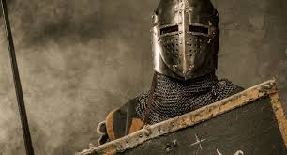
I. Act like God will keep his Word (Joshua 1–12).
Notes:
Discouragement is inaction, so serve God with faith in his promises.

Slide 30
Slides on 约书亚 1

Slide 31
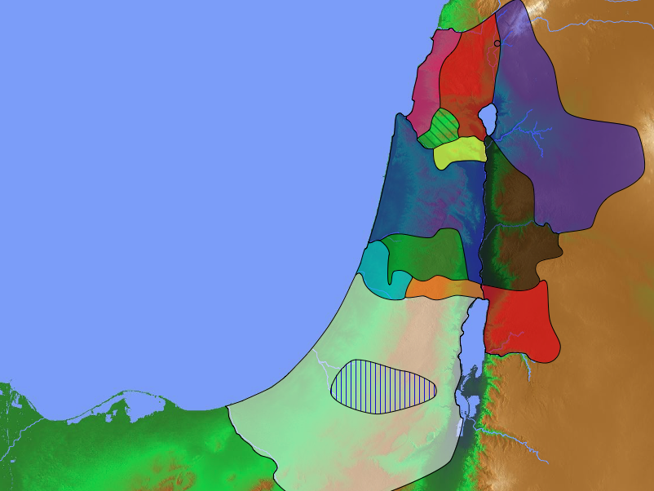
The Agreement with the Eastern Tribes
140
Manasseh
Numbers 32
Gad
Reuben
Notes:
Israel conquered most of Canaan by courageous actions based on God fulfilling his promise (Joshua 1–12).
But Joshua had already seen God's faithfulness to clear the land east of the the Jordan for three tribes.

Slide 32
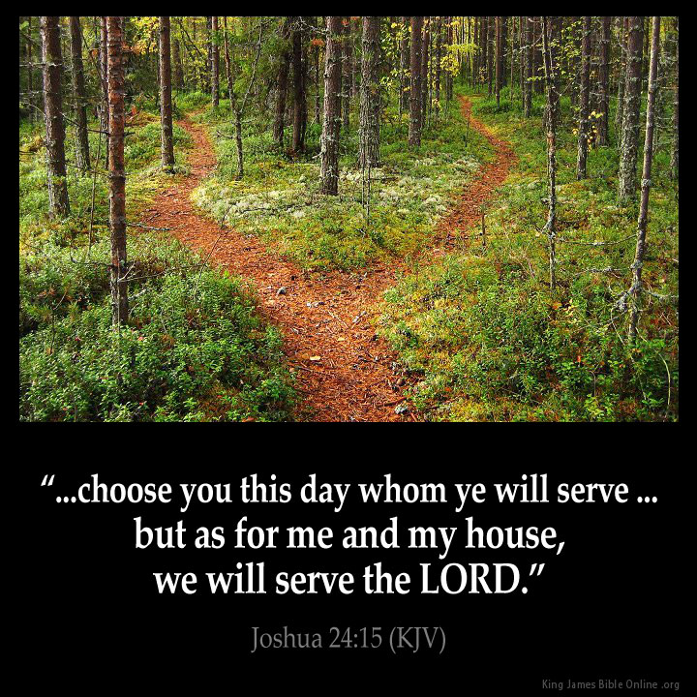
The Goal & the Means
Asher
Naphtali
TRIBAL RESPONSIBILITIES
Manasseh
Zebulun
Issachar
Manasseh
Ephraim
Gad
Dan
Reuben
"Choose this day whom you will serve… but as for me and my house, we will serve the LORD" Joshua 24:15
Benjamin
Judah
Simeon
Notes:
The goal was to give land to all the tribes, but the means was to do this by serving the LORD, which Joshua affirms in the final chapter.

Slide 33
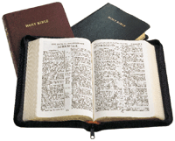
162
钥节
“这 律 法 书 不 可 离 开 你 的 口 ， 总 要 昼 夜 思 想 ， 好 使 你 谨 守 遵 行 这 书 上 所 写 的 一 切 话 。 如 此 ， 你 的 道 路 就 可 以 亨 通 ， 凡 事 顺 利 。 这 律 法 书 不 可 离 开 你 的 口 ， 总 要 昼 夜 思 想 ， 好 使 你 谨 守 遵 行 这 书 上 所 写 的 一 切 话 。 如 此 ， 你 的 道 路 就 可 以 亨 通 ， 凡 事 顺 利 ”
- 约书亚记 1:8

Slide 34
Slides on 约书亚 2

Slide 35
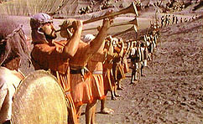
JERICHO
耶利哥

Slide 36
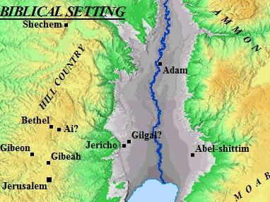
耶利哥的位置

Slide 37
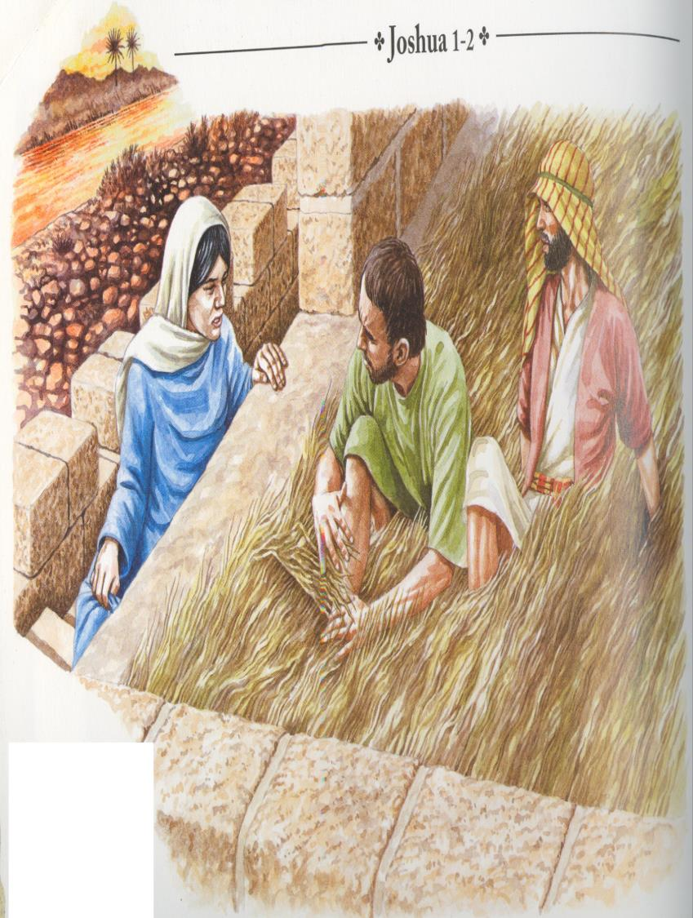
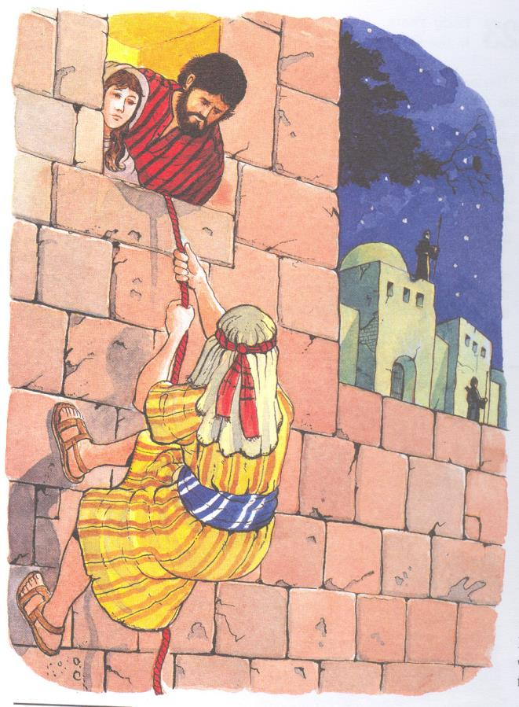
.. 女 人 说 ， 照 你 们 的 话 行 吧 。
于 是 打 发 他 们 去 了 ，
又 把 朱 红 线 绳 系 在 窗 户 上
（书2：21）
现 在 我 既 是 恩 待 你 们 ， 求 你 们 指 着 耶 和 华 向 我 起 誓 ， 也 要 恩 待 我 父 家 ， 并 给 我 一 个 实 在 的 证 据 （书2:12）

Slide 38
Slides on 约书亚 3

Slide 39
Two Crossings
REED (RED) SEA
JORDAN RIVER
Exodus 14
A sea
Moses
Begins the Wanderings
Leaving Egypt
Entering Sinai
Song memorial
Narrow Channel
Took all night
Gave Freedom
Signifies Salvation
168
Joshua 3
A river
Joshua
Ends the Wanderings
Leaving Moab
Entering Canaan
Stone memorial
30km Plain
Took a few hours
Gave Rest
Signifies Glorification

Slide 40
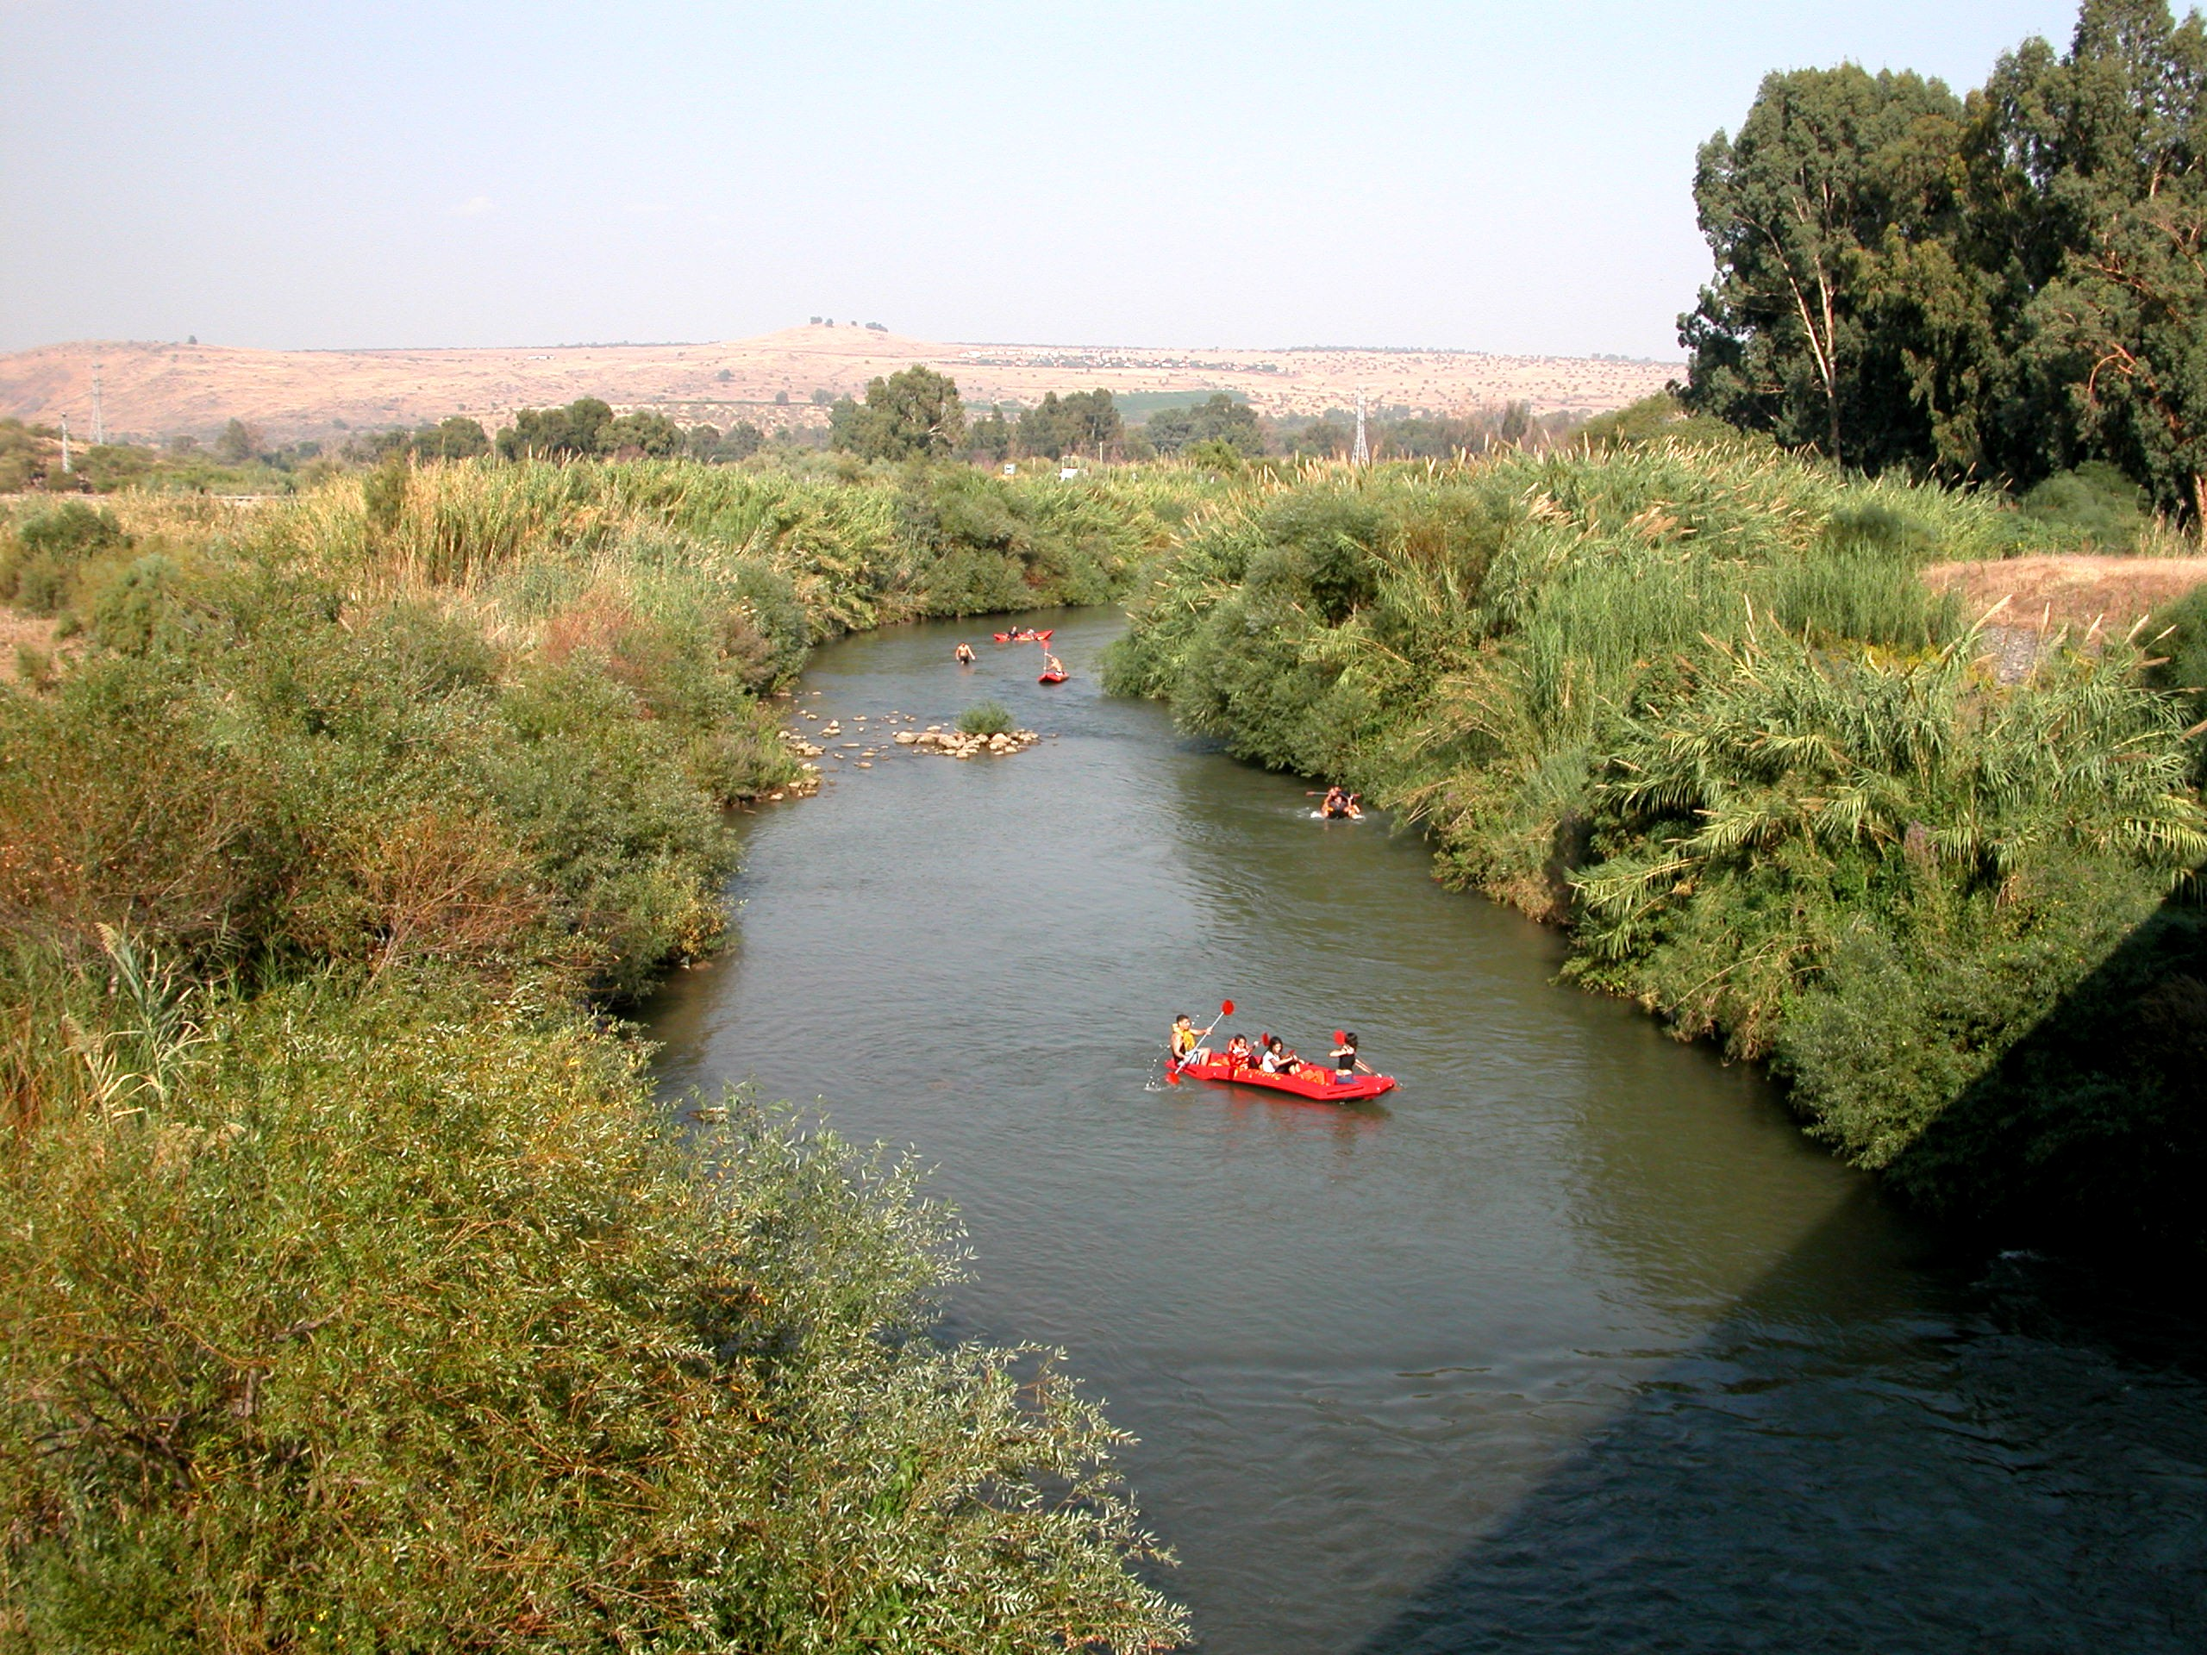
Kayaks on the Jordan

Slide 41
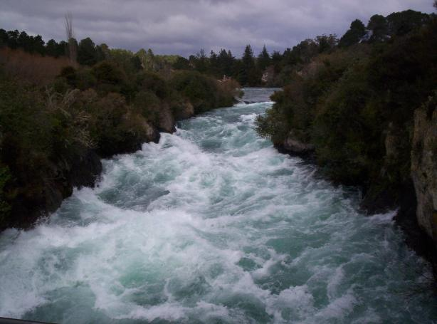
The Raging Jordan!

Slide 42
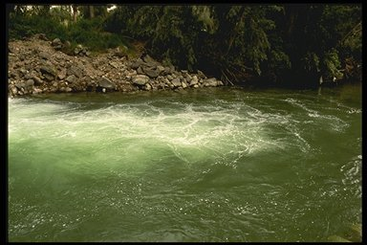
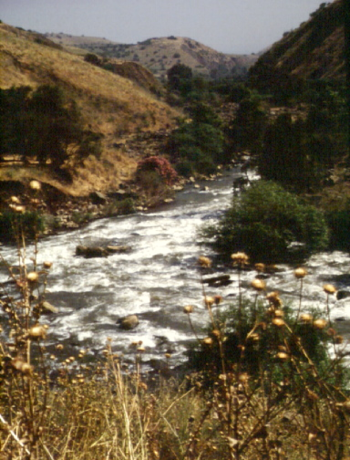
他 们 到 了 约 旦 河 ， 脚 一 入 水 （ 原 来 约 旦 河 水 在 收 割 的 日 子 涨 过 两 岸 ）……
横渡约但河
他 们 到 了 约 旦 河 ， 脚 一 入 水 （ 原 来 约 旦 河 水 在 收 割 的 日 子 涨 过 两 岸 ） ， 那 从 上 往 下 流 的 水 便 在 极 远 之 地 ， 撒 拉 但 旁 的 亚 当 城 那 里 停 住 ， 立 起 成 垒 。 那 往 亚 拉 巴 的 海 ， 就 是 盐 海 ， 下 流 的 水 全 然 断 绝 。 于 是 百 姓 在 耶 利 哥 的 对 面 过 去 了 。 (书 3:15-16 )

Slide 43
Slides on 约书亚 4

Slide 44
One Man From Each Tribe Set Up Memorial Stones to Recall the Crossing

Slide 45
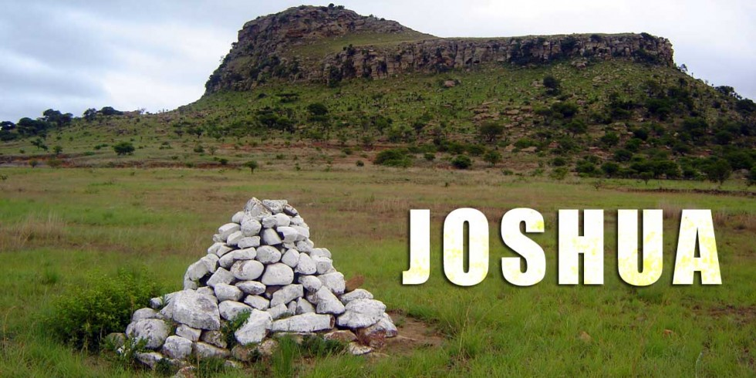
Stones of Remembrance
Joshua 3–4

Slide 46
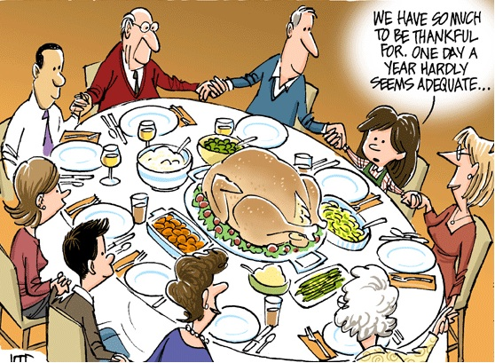
We have so much to be thankful for. One day a year hardly seems adequate…

Slide 47
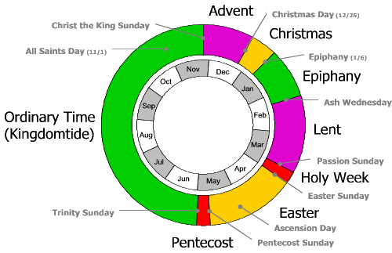
Communal Christian Year
Advent
Christmas Day (12/25)
Christ the King Sunday
Christmas
All Saints Day (11/1)
Epiphany (1/6)
Nov
Dec
Oct
Epiphany
Jan
Sep
Ash Wednesday
Ordinary Time (Kingdomtide)
Feb
Lent
Aug
Mar
Jul
Passion Sunday
Apr
Jun
May
Holy Week
Easter Sunday
Trinity Sunday
Easter
Ascension Day
Pentecost
Pentecost Sunday

Slide 48
Slides on 约书亚 5

Slide 49
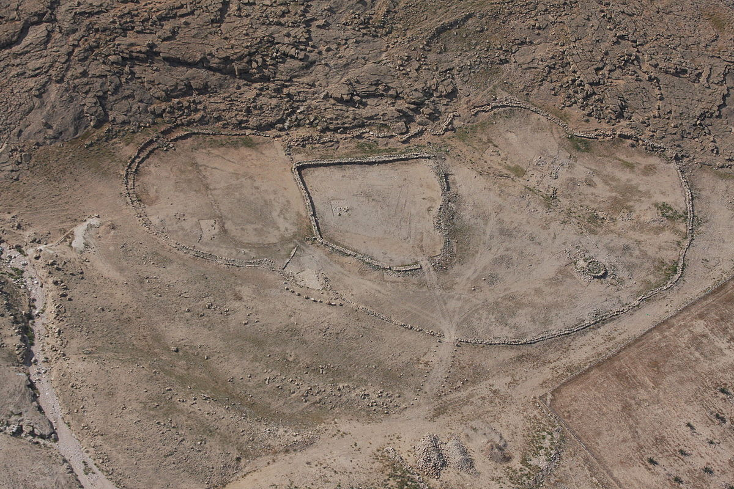
Israelites Enter Gilgal in Canaan

Slide 50
Taking Care of Priorities (Josh 3:2; 5:2-3)
"At that time the LORD told Joshua, 'Make flint knives and circumcise this second generation of Israelites.' ³So Joshua made flint knives and circumcised the entire male population of Israel at Gibeath-haaraloth" (Joshua 5:2-3 NLT).
171
Zebulun
Issachar
Manasseh
Gilgal
Acacia Grove
Jericho
Notes:
Rather than Israel going straight across the Jordan River to Jericho, God had them stop at Gilgal to the north. But why? Their parents had not believed God could bring them into the land 39 years earlier in the desert city of Kadesh-Barnea, and therefore been judged to die in the wilderness (Numbers 13–14). But this older generation also had not followed the covenant sign of circumcision given to Abraham (Genesis 17) by circumcising their baby boys born in the desert. How could they go attack the land as uncircumcised people of God? So God had them do something amazing—to be circumcised right there with Jericho in sight. They named the place Gibeath-haaraloth, or "Hill of Foreskins," for over 600,000 foreskins were stacked on the ground. This took days to heal and left them defenseless against the giants of the land. However, it underscored the priority of spiritual preparation over military readiness.

Slide 51
“你 制 造 火 石 刀 ， 第 二 次 给 以 色 列 人 行 割 礼 。”
约 书 亚 就 制 造 了 火 石 刀 ， 在 除 皮 山 那 里 给 以 色 列 人 行 割 礼 。
(书 5:3)
在吉甲举行的割礼

Slide 52
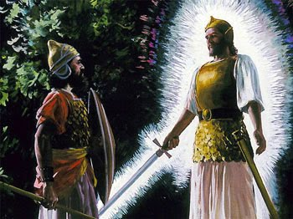
Heroes: Amazing Stories of Faith
我 来 是 要 作 耶 和 华 军 队
的 元 帅
与神相遇
- 书 5:13-15 -

Slide 53
Slides on 约书亚 6

Slide 54
关键的功课
喇合选择敬畏神
一个凭信心，不凭眼见生活的榜样
没有目击事件，但却信服神有足够能力照顾她和她一家。
她的行动证明她对神能够拯救的信心

Slide 55
关键的功课
喇合 向我们透漏了神要拯救外邦人的计划
她全家都得救了
她在耶稣基督的家谱中有份
神持守与亚伯拉罕所立之约的信实：
“.. 地 上 的 万 族 都 要
因 你 得 福 。 ”
(创12:1-3)

Slide 56
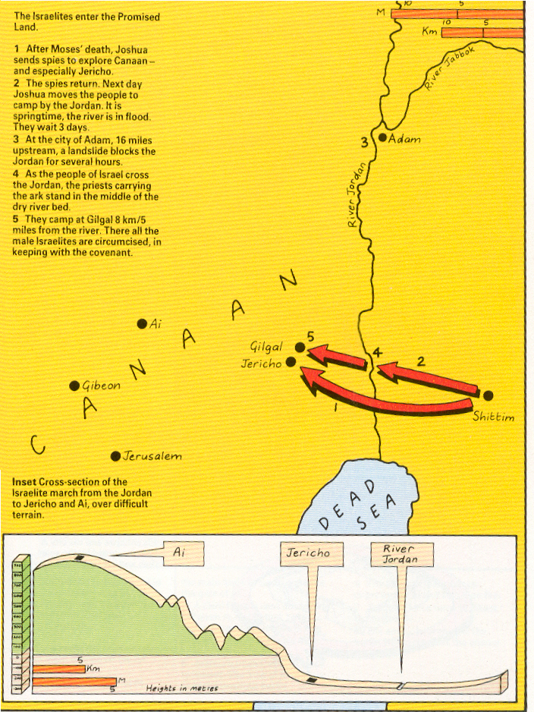
Entering the Promised Land

Slide 57
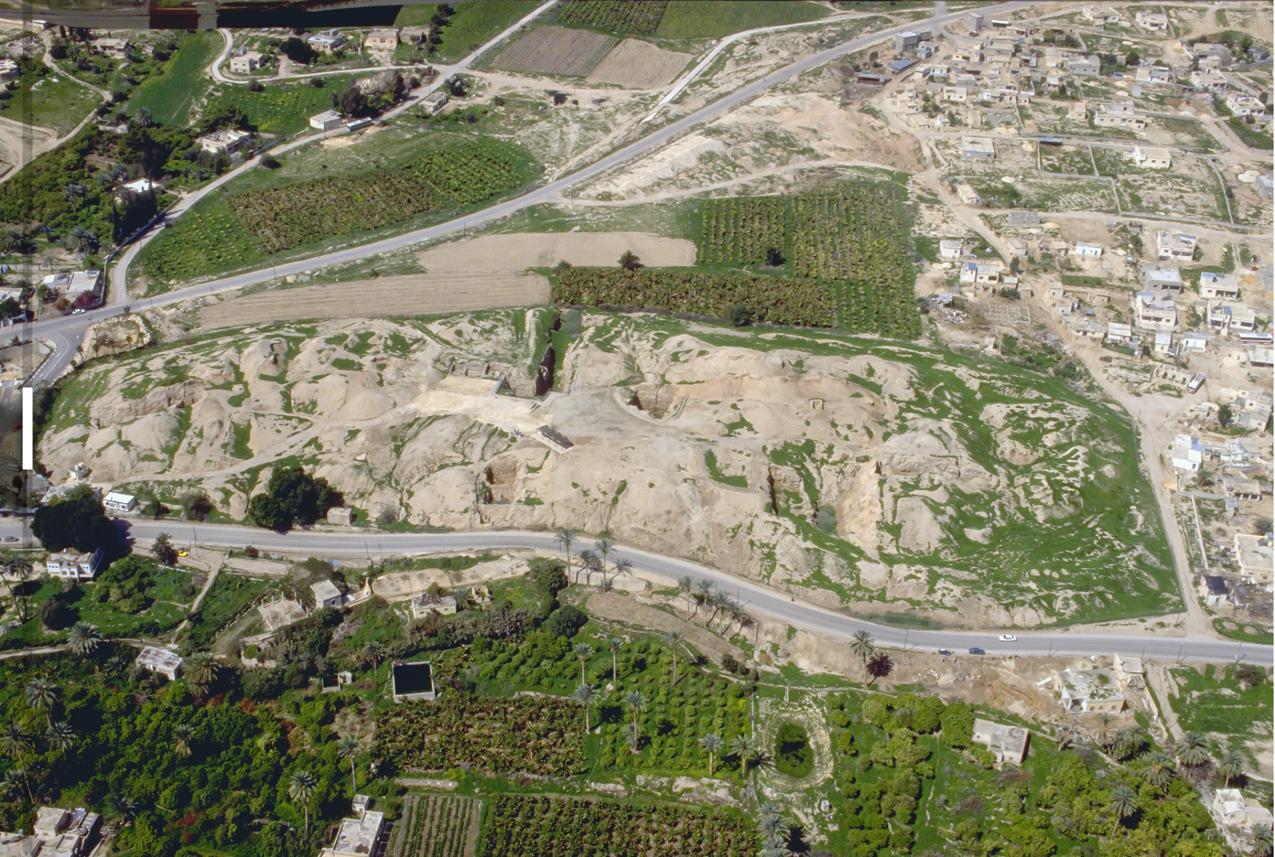
Jericho Ruins Today

Slide 58
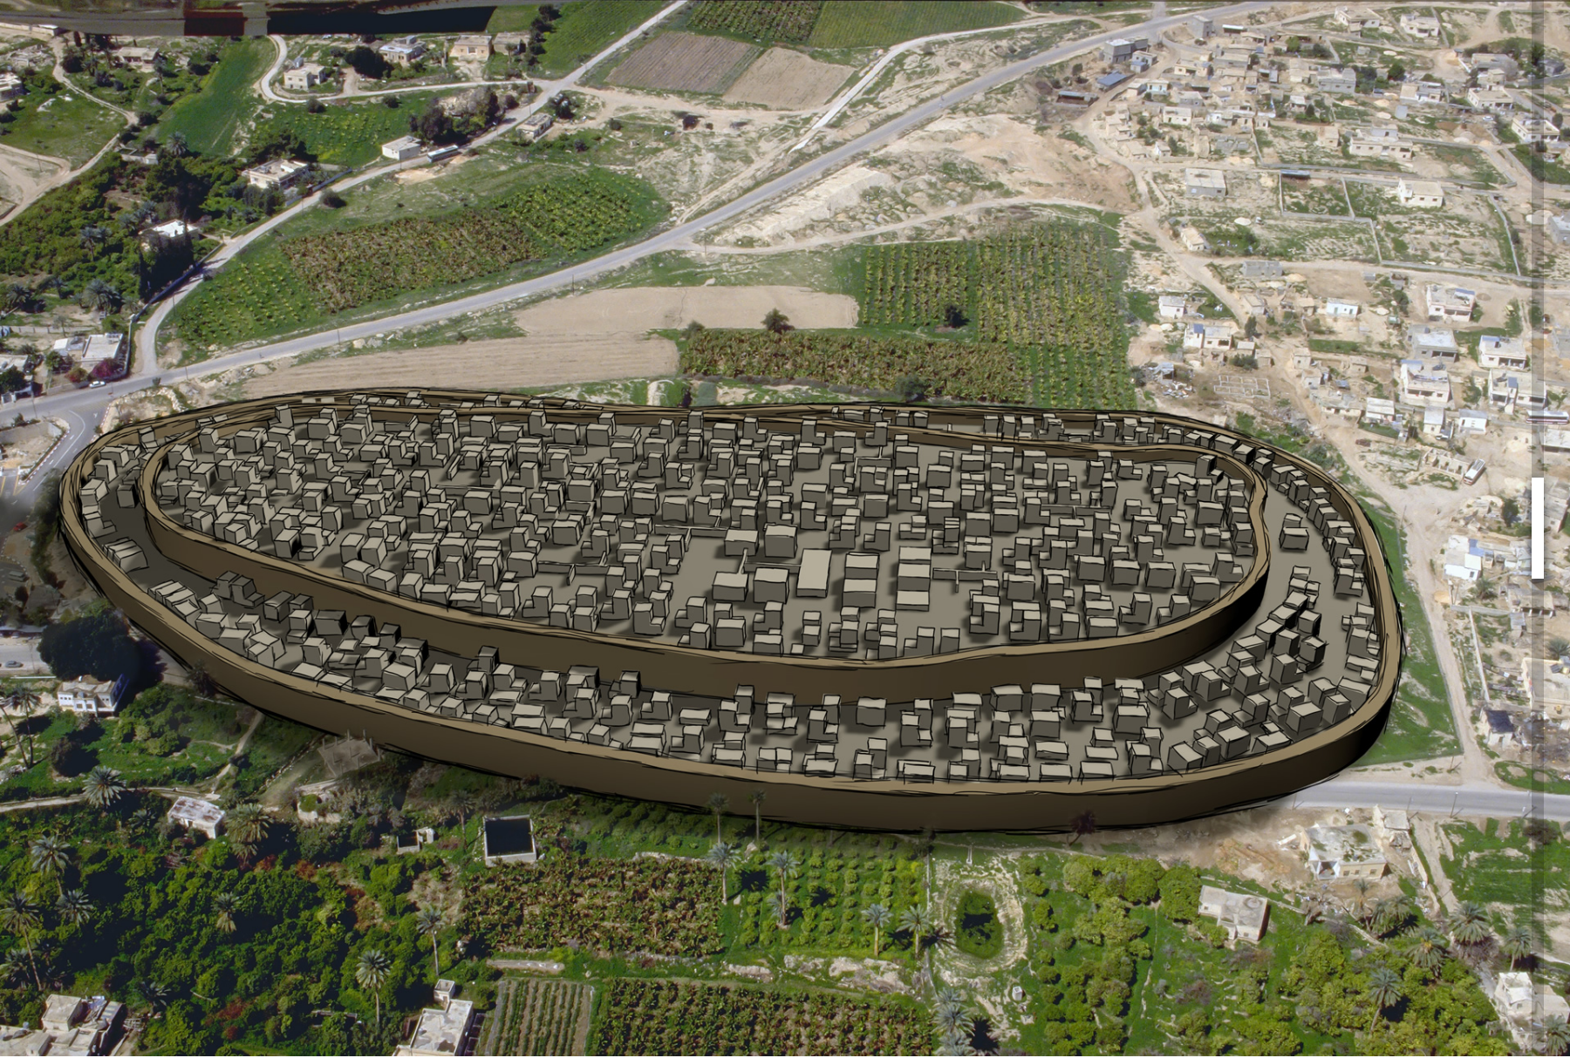
Jericho City Then

Slide 59
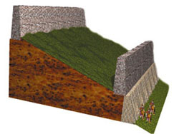
2nd Brick
Rampart
15 m.
2 m. thick,
5-6 m. high
3-4 m. high
Tell Sultan—Schematic cross-section diagram of the fortification system at Jericho based on Kenyon's west trench.—AiG

Slide 60
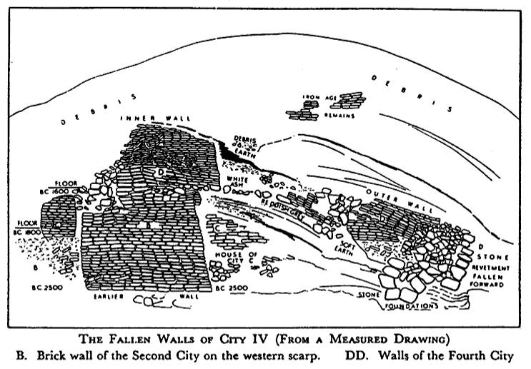
Jericho City
Inner Wall
D
Outer Wall
D
B
The Fallen Walls of City IV (From a Measured Drawing)
B. Brick wall of the 2nd City on the western scarp. DD. Walls of 4th City
Notes:
Note how the walls DD fell outwards to the right which is unique among ancient cities.
Normally battering rams from the outside on the right would cause walls to fall into the city or on top of themselves.
However, God caused an earthquake that was so unique that it forced the walls to fall outwards.
God's grace did not allow Rahab's portion of the wall to collapse, though!

Slide 61
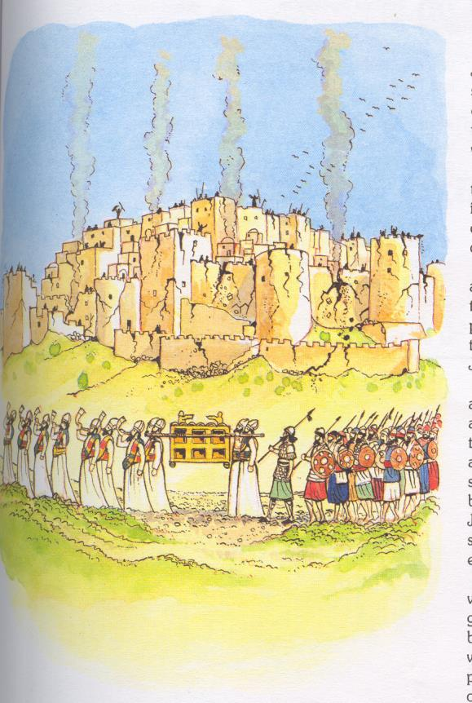
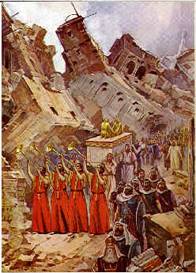
中部战役
耶利歌
齐步绕城
占领
耶利歌

Slide 62
Slides on 约书亚 7

Slide 63
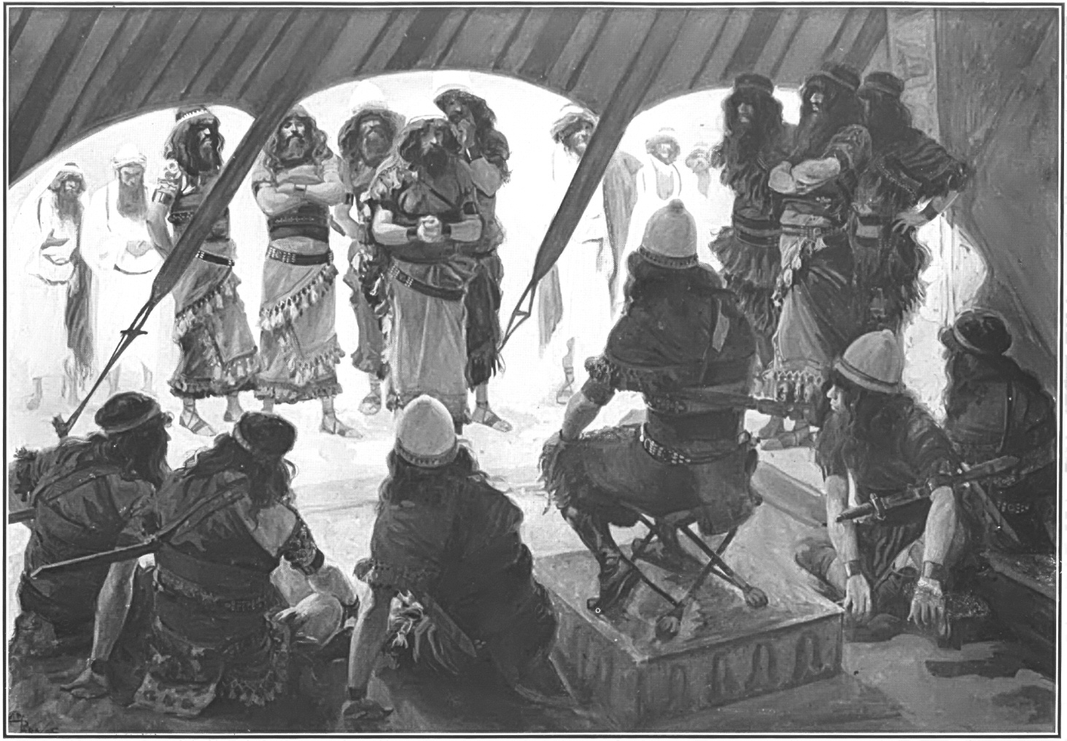
亚干犯罪 (约书亚 7)

Slide 64
中部战役
战胜
艾城居民
亚干犯罪
败仗于
艾城
罪恶
消除

Slide 65
Slides on 约书亚 8

Slide 66
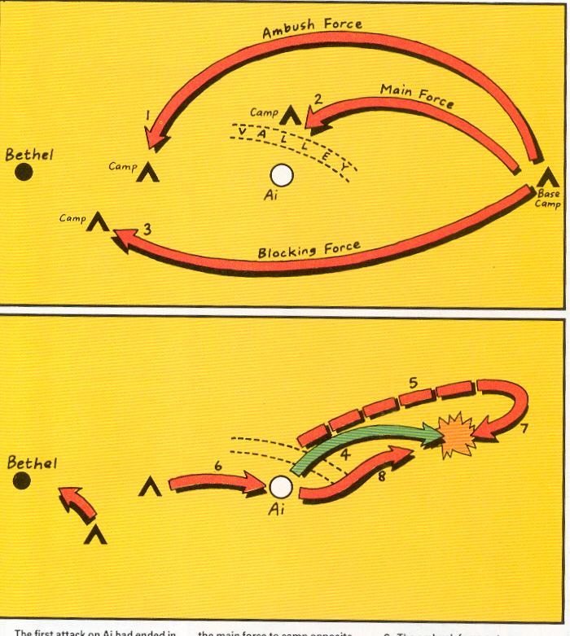
攻击艾城

Slide 67
攻击艾城

Slide 68
约书亚 8

Slide 69
Slides on 约书亚 9

Slide 70
书 9
关键功课
自作主张，
不依靠神或他的话，
将使我们容易被欺骗
自满与悖逆能够将胜利
变成悲剧性的挫败
以色列
被欺骗
(没有
询问神)
… 魔鬼…… 他本来是说谎的,
也是说谎之人的父。
(约8:44)

Slide 71
中部战役 – 拯救基遍

Slide 72
中部战役 – 拯救基遍

Slide 73
南部战役
穆迪 圣经地图, 别特则尔 97
以色列
被欺骗
(没有
询问神)
对抗5位
亚摩利王
的战争
战胜
5位
亚摩利王
南部城市被征服
书 9
书 10

Slide 74
Slides on 约书亚 10

Slide 75
于 是 日 头 停 留 ，月 亮 止 住 ，直 等 国 民 向
敌 人 报 仇 。 这 事 岂 不 是 写 在 雅 煞 珥 书上
吗 ？ 日 头 在 天 当 中 停 住 ， 不 急 速 下 落 ，
约 有 一 日之 久 。 在 这 日 以 前 ， 这 日 以 后 ，
耶 和 华听 人 的 祷 告 ， 没 有 像 这 日 的 ， 是
因 耶 和 华为 以 色 列 争 战 。
书 10 :13-14

Slide 76
南部战役

Slide 77
Slides on 约书亚 11

Slide 78
北部战役

Slide 79
关键功课
成功建基于对神的信心和顺从

Slide 80
Slides on 约书亚 12

Slide 81
Conquered Cities (Joshua 12)

Slide 82
We are courageous when we act as if God will fulfill his promises to us.

Slide 83
Starting a School in 1992
no money no backers no parents no teachers no principal no campus
Notes:
Remember that school we helped start? Despite the disadvantages, we still had to take action. We signed the lease for $23,000 monthly with only $1000 in the bank!

Slide 84
Take action.
Notes:
Martin Luther acted in faith by taking on the pope’s claim that paying the church money could pardon sins. The public way to do this was to nail notices on the church door.

Slide 85
Take action.
Notes:
How public are you in your faith?
We are courageous when we act as if God will fulfill his promises to us

Slide 86
The Bottom Line
At the present rate of $600 weekly offerings and $2000 weekly expenses, our $7300 bank balance will be gone in 5.2 weeks.
Notes:
CIC in 2009 received enough funds to last a few years but still no backers. Yet the biggest thing God did was to change my attitude about the need for long-term commitments. Lately we have got morning worship slot and a “new” pastor—me!

Slide 87
The Seminary Guys
Notes:
At the church, God gave me the responsibility to raise up other pastors too. I need to act on this. Three key pastors attend three different seminaries in Singapore, and keeping the church going provides these brothers the training and finances they need.

Slide 88
How can you defeat discouragement that prevents you from doing God’s will?

Slide 89
I. Act like God will keep his Word (Joshua 1–12).
Notes:
Discouragement is inaction, so serve God with faith in his promises.

Slide 90
What results?
Notes:
We conquer discouragement when we actively trust God to keep his Word. So what results from this faith?)

Slide 91
II. Courageous faith brings victory (Joshua 13–24).
Notes:
Trust in God results in his rewards.

Slide 92
Slides on 约书亚 13

Slide 93
Transjordan Tribes
140
Joshua 13
Manasseh
Gad
Reuben
Eastern tribes

Slide 94
Slides on 约书亚 14

Slide 95
以色列的 部落边界
171
玛拿西
约书亚 13–17
玛拿西
迦得
以法莲
流本
犹大
东部的部落
Firstborn double portion & kingly tribe

Slide 96
Slides on 约书亚 18

Slide 97
撵阄

Slide 98
Slides on 约书亚 19

Slide 99
以色列的 部落边界
拿弗他利
171
亚设
西布伦
玛拿西
以萨迦
约书亚 13:1–19:48
玛拿西
迦得
以法莲
但
亚们
便雅悯
流本
犹大
西缅
摩押
Eastern tribes
Firstborn double portion & kingly tribe
Seven tribal allotments by lot
Neighboring nations related by blood
以顿

Slide 100
Slides on 约书亚 20

Slide 101
Populations by Tribe
171
Asher 53,400
Naphtali 45,400
Numbers 26 Joshua 13:1–19:48
Zebulun 60,500
Manasseh
Issachar 64,300
Manasseh 52,700
Levi 23,000 Spread Throughout Israel
Gad 40,500
Ephraim 32,500
Dan 64,400
Benjamin 45,600
Reuben 43,730
Judah 76,500
Simeon 22,200

Slide 102
Cities of Refuge
Israel lived in a nomadic culture of personal vengeance by family members against the offending family (blood feuds).
Yet the nation was not ready for legal procedures by an objective village assembly (civil law).
Therefore, God instituted an intermediate step of six nearby cities where one who accidently killed someone could flee.
142
Kedesh
Golan
Ramoth
Shechem
Bezer
Hebron
Numbers 35; Josh. 20:1-9
Notes:
"The idea of providing cities of refuge (Josh. 20:1-9) for capital offenses is rooted in the tension between customary tribal law (retaliation or revenge, in which the blood relative is obligated to execute vengeance) and civil law (carried out less personally by an assembly according to a standard code of justice)" (The Bible Visual Resource Book, 35).

Slide 103
Slides on 约书亚 21

Slide 104
48 利未人的城邑
171a
6 逃城
约书亚 21

Slide 105
Slides on 约书亚 22

Slide 106
God Unites, Sin Divides
Joshua 22

Slide 107
Slides on 约书亚 23

Slide 108
Singapore Civilian War Memorial
Four pillars represent WWII unity among the Chinese, Malays, Indians and Westerners

Slide 109
Slides on 约书亚 24

Slide 110
Mount Gerizim Looking East (Deut. 27:9-13)
Shechem
Mount Ebal (cursing)
Mount Gerizim (blessing)
Notes:
“Then Moses and the Levitical priests addressed all Israel as follows: ‘O Israel, be quiet and listen! Today you have become the people of the Lord your God. ¹⁰ So you must obey the Lord your God by keeping all these commands and decrees that I am giving you today.’ ¹¹ That same day Moses also gave this charge to the people: ¹² ‘When you cross the Jordan River, the tribes of Simeon, Levi, Judah, Issachar, Joseph, and Benjamin must stand on Mount Gerizim to proclaim a blessing over the people. ¹³ And the tribes of Reuben, Gad, Asher, Zebulun, Dan, and Naphtali must stand on Mount Ebal to proclaim a curse’” (Deut. 27:11-13).

Slide 111
The Goal & the Means
Asher
Naphtali
TRIBAL RESPONSIBILITIES
Manasseh
Zebulun
Issachar
Manasseh
Ephraim
Gad
Dan
Reuben
"Choose this day whom you will serve… but as for me and my house, we will serve the LORD" Joshua 24:15
Benjamin
Judah
Simeon

Slide 112
重订昔日之约
约书亚的命令
以色列人的回应
立石为纪
“至 于 我 和 我 家 ， 我 们 必 定 事 奉 耶 和 华 ” 书24:15

Slide 113
"But for me and my household, we will serve the LORD"
Joshua 24:15

Slide 114
God will also reward your courage when you stick your neck out for him

Slide 115
International Community School (est. 1993)

Slide 116
ICS now has 480 students!
UK
SWEDEN
KOREA
SWITZERLAND
JAPAN
ITALY
USA
THAILAND
INDIA
MEXICO
ICS
VENUZELA
INDONESIA
BRAZIL
SOUTH AFRICA
AUSTRALIAN

Slide 117
Crossroads People Oct 2017
UK
RUSSIA
FRANCE
MONGOLIA
ITALY
JAPAN
NETHERLANDS
KOREA
LEBANON
CHINA
HONG KONG
TAIWAN
GERMANY
CANADA
MYANMAR
EGYPT
INDIA
USA
MALAYSIA
PHILIPPINES
ZIMBABWE
SINGAPORE
NEW ZEALAND
CIC
INDONESIA
Notes:
Our Oct 2017 church 40 people stem from 13 different countries around the world (44 vcards). Canada (Gloria Lee), China (Charles), Netherlands (Dies & Desiree), Hong Kong (Larry Pun), Cynthia (India), Rena (Indonesia), Yoshie & Kaori (Japan), Naomi (Malaysia), Peng (Myanmar), Miriam (USA), Micah (Philippines), Singapore (Albina), Sarah (UK)
This does not include people who have recently attended only once: Dowon (Korea)
Nor does it include missionaries living back in their countries but still are members of CIC: Maple (Taiwan), Budmaa (Mongolia)

Slide 118
Luther = Reformation

Slide 119
How can you defeat discouragement that prevents you from doing God’s will?

Slide 120
162
信息声明
约书亚记记载以色列人攻占大部分迦南地，
为要显明神因着约书亚的信心而信实地
成就他的应许，以此教导以色列民，
凭信心的顺服会带来神应许的祝福。

Slide 121
Main Idea of Joshua
God rewards those who take him seriously.

Slide 122
I. Act like God will keep his Word (Joshua 1–12).

Slide 123
What results?

Slide 124
II. Courageous faith brings victory (Joshua 13–24).

Slide 125
How specifically can we defeat discouragement?

Slide 126
关键功课
必须让神带领
在艰巨的情况（洪水泛滥）中，神的同在确保胜利。
需要自我提醒，也提醒他人神的信实
数算神的恩典和见证他的作为-“立石为纪”

Slide 127
关键功课
须要为了神的旨意而分别为圣
- 割礼
神信守与亚伯拉罕所立的约
.. 我 必 叫 你 成 为 大 国 ，
我 必 赐 福 给 你 (创 12:1-3)
神是唯一的拯救者与供应者
“他 们 吃 了 那 地 的 出 产 …” (书 5:11-12 )

Slide 128
Black

Slide 129
旧约全书讲道链接地址 BibleStudyDownloads.org
免费获取这讲解!
圣经学习下载
Notes:
The explanation for free!
OT Survey link address

