Slide 1
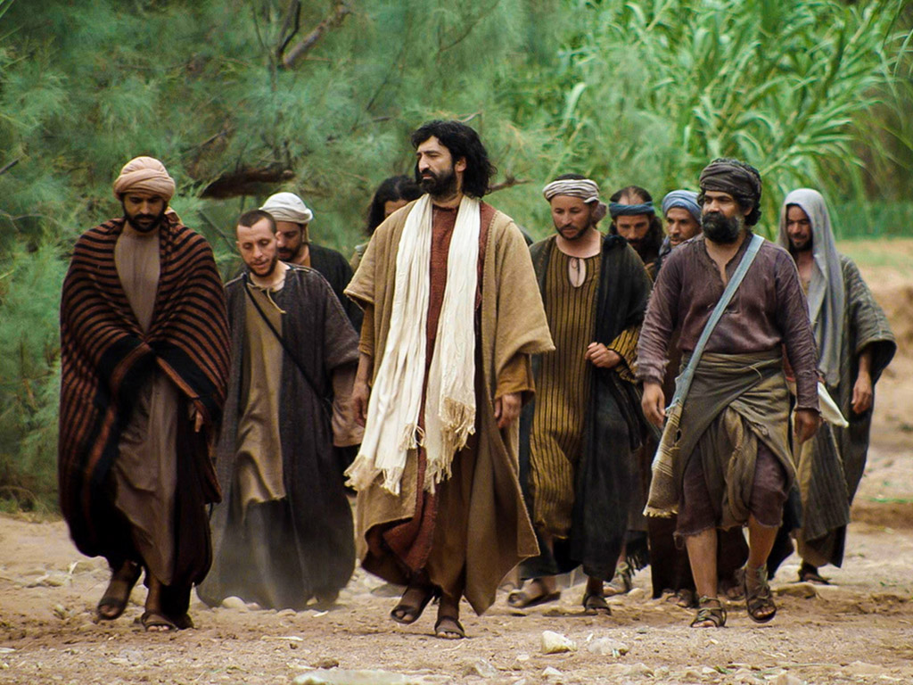
Preparation of the Disciples by the King
§§ 120-137
Christ ministers privately to the twelve disciples to prepare them for the ministries they will have after His departure
Section summaries based on J. Dwight Pentecost, A Harmony of the Words and Works of Jesus Christ (Grand Rapids: Zondervan, 1981)
Dr. Rick Griffith • Singapore Bible College • BibleStudyDownloads.org

Slide 2
A. Withdrawal from Judea
§ 120
约翰 10:40-42
Christ withdraws from Judea so that He might die by crucifixion at God's appointed time rather than being stoned prematurely by mob, because all doors for ministry are closed in Judea, and so that He might instruct His disciples how to minister in His behalf

Slide 3
B. Instruction Concerning Entrance Into the Kingdom
§ 121
路加 13:22-35
Since Israel as a nation has rejected Christ, He invites individuals to decide for Him and enjoy the kingdom in order to encourage those who were fearful due to His rejection and to prepare the apostles for future ministry

Slide 4
C. Instruction in a Pharisee's House
§ 122
路加 14:1-24
Christ teaches that the Pharisees would not enter the kingdom because of their physical relation to Abraham but would be excluded while "unworthy Jews" and Gentiles will enter by faith so that the Pharisees would understand that response to Christ's invitation guaranteed blessing, not just being invited

Slide 5
D. Instruction Concerning Discipleship
§ 123
路加 14:25-35
Christ warns that, in view of Israel's rejection, being His disciple involves a decision of the will to reject every other authority, count the cost, and then identify with Christ so that one would not profess discipleship then later defect

Slide 6
E. Instruction Concerning God's Attitude Toward Sinners
§ 124
路加 15:1-32
Since the Pharisees believed that God hated and withdrew from sinners Jesus told three parables to emphasize God's love for sinners which seeks them out and experiences great joy in their repentance

Slide 7
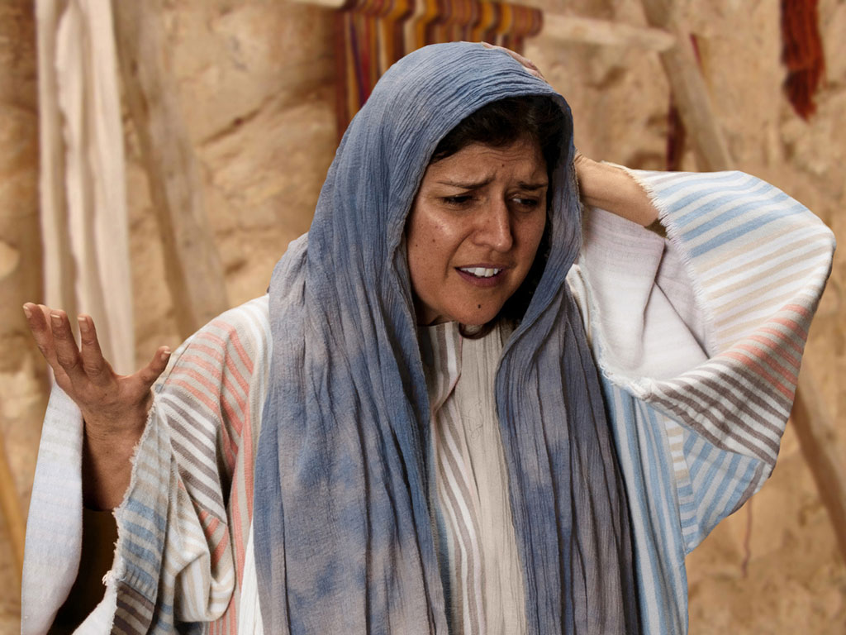
免费
圣经
图片
失银币的比喻
路加 15:8-10
Notes:
路加 15 v 8: Woman wonders where she may have lost it.

Slide 8
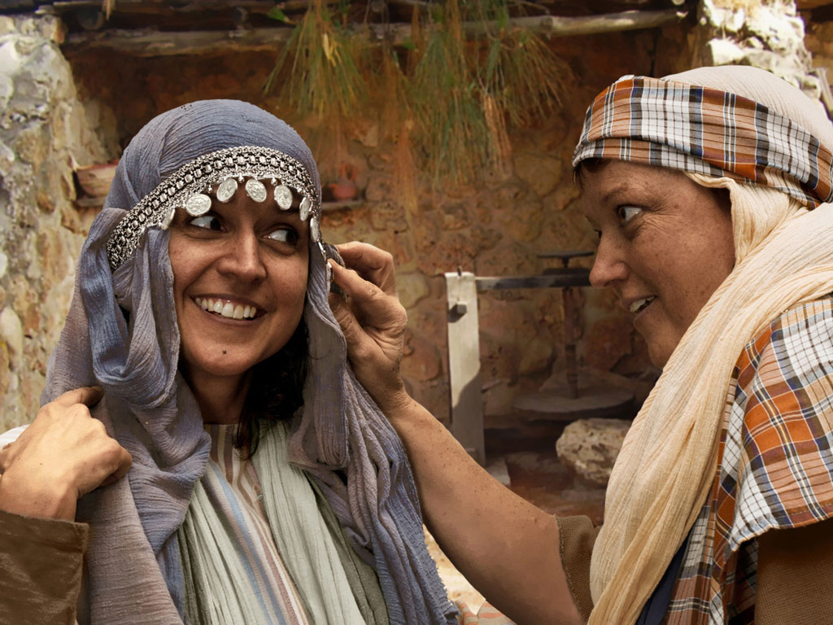
Notes:
路加 15:8 Woman with 10 silver coins.
Most think that the silver coin (drachma) the woman lost was from the adornment of coins that women wore around her head and would have been her dowry. If so it was poor woman's dowry as a drachma was a day's salary for a peasant working for someone else. In the culture of the time, loss of a coin from a dowry could represent unfaithfulness and this would bring real shame and disgrace to her family and husband.

Slide 9
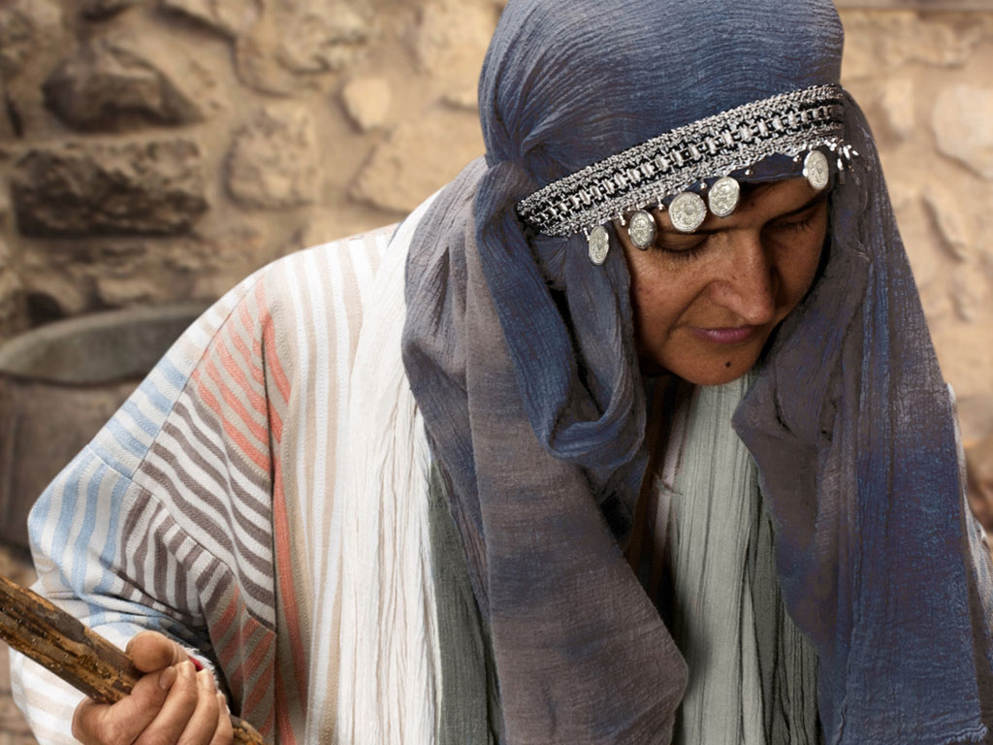
Notes:
路加 15 v 8: Woman shown with coin missing.

Slide 10
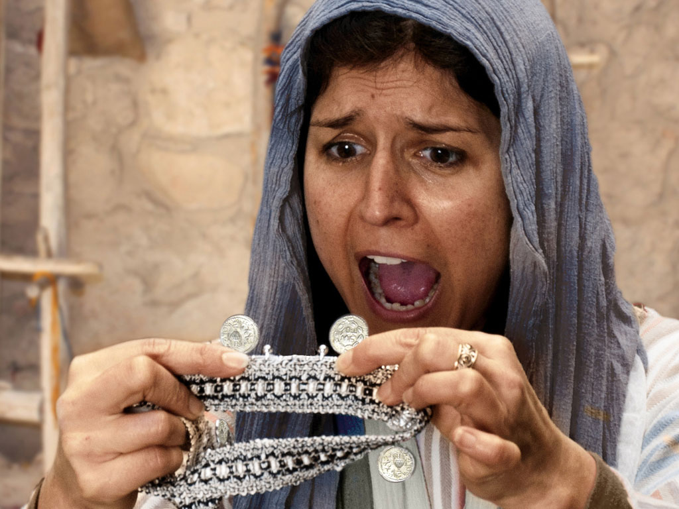
Notes:
路加 15 v 8: Woman discovers a silver coin is missing.

Slide 11
Notes:
路加 15 v 8: Woman wonders where she may have lost it.

Slide 12
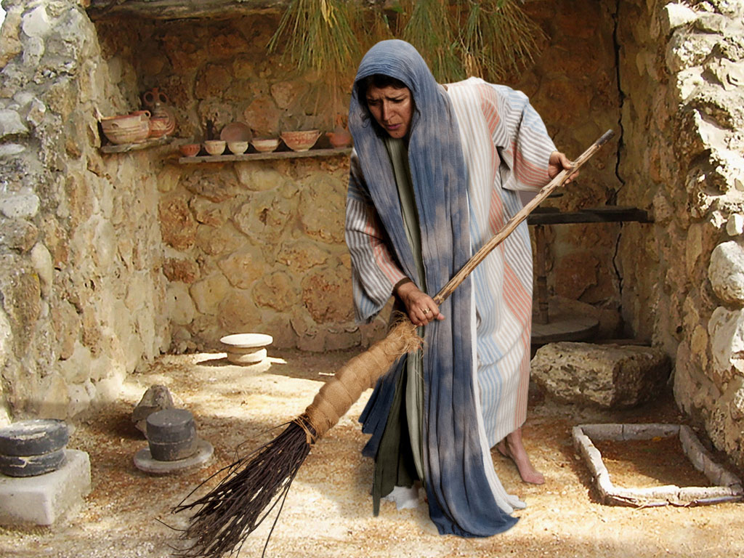
Notes:
路加 15 v 8: Woman searches using broom.

Slide 13
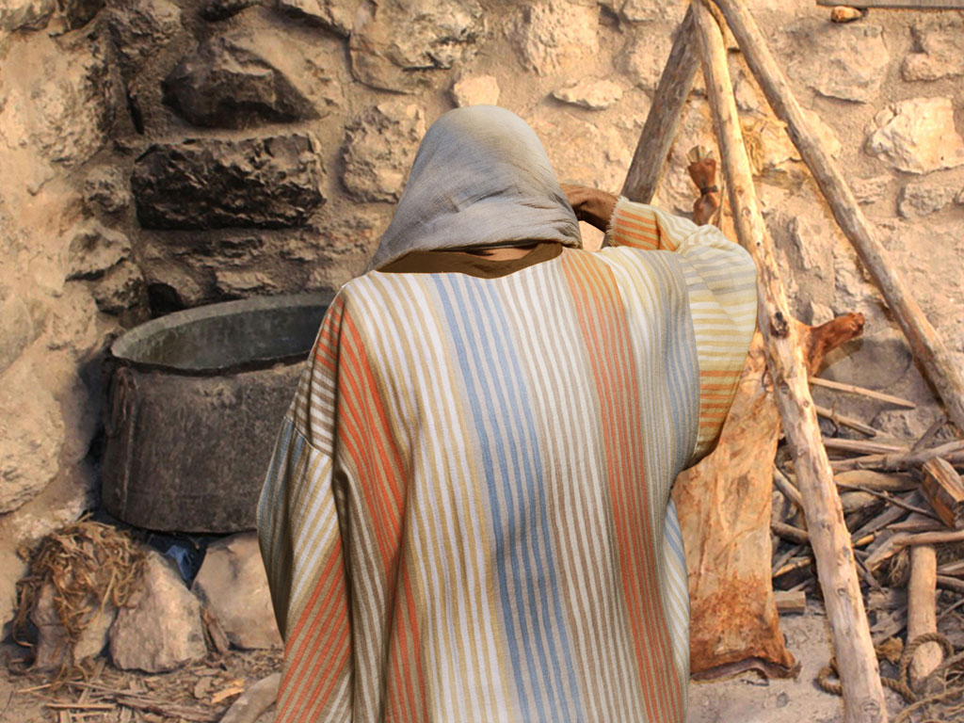
Notes:
路加 15 v 8: Woman searches in courtyard.

Slide 14
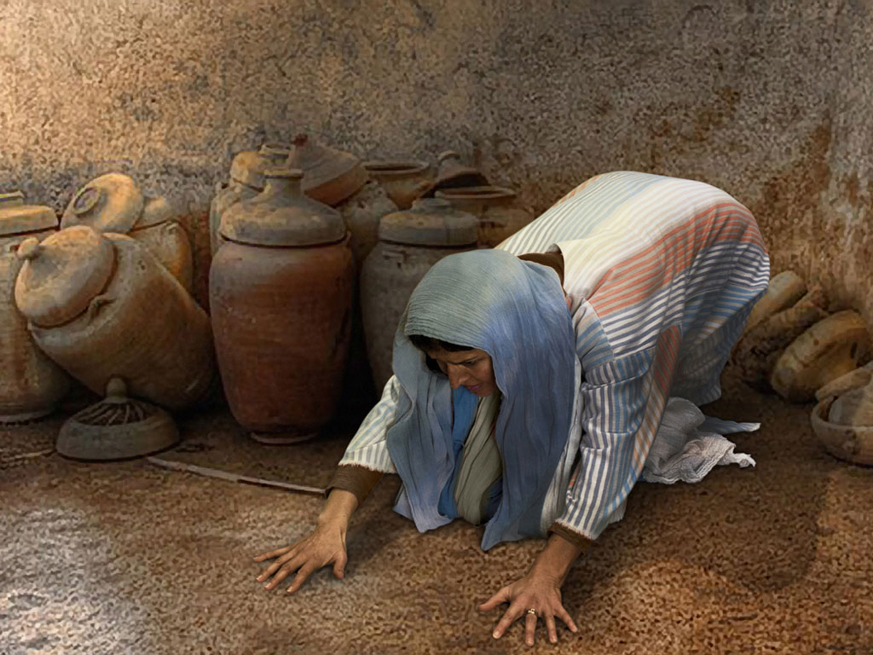
Notes:
路加 15 v 8: Woman searches floor.

Slide 15
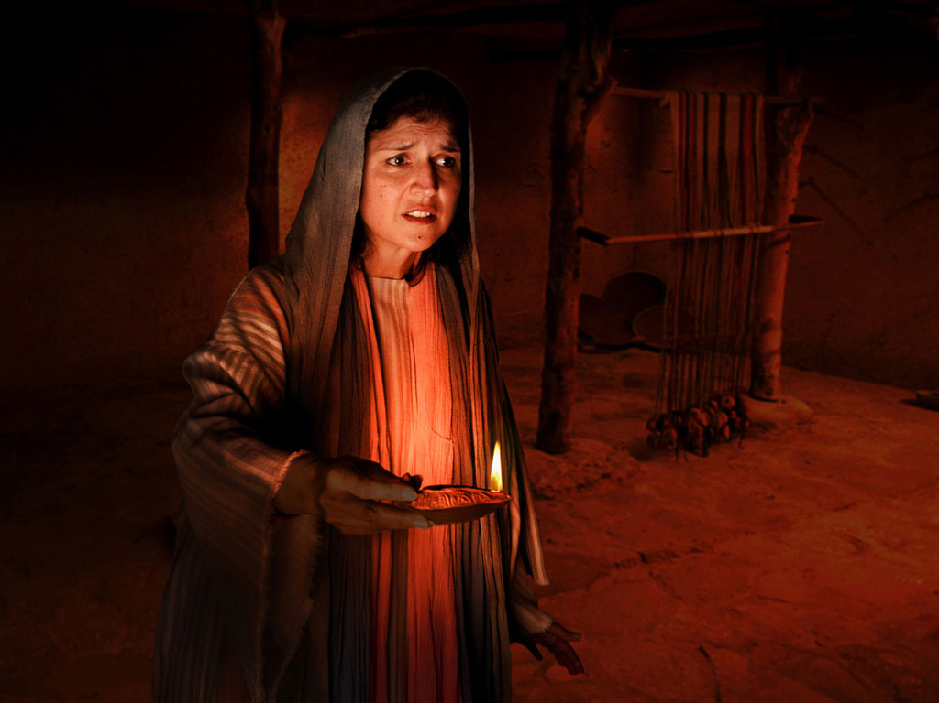
Notes:
路加 15 v 8: Woman lights lamp and searches house. Many poor homes had very small windows and rooms were dark.

Slide 16
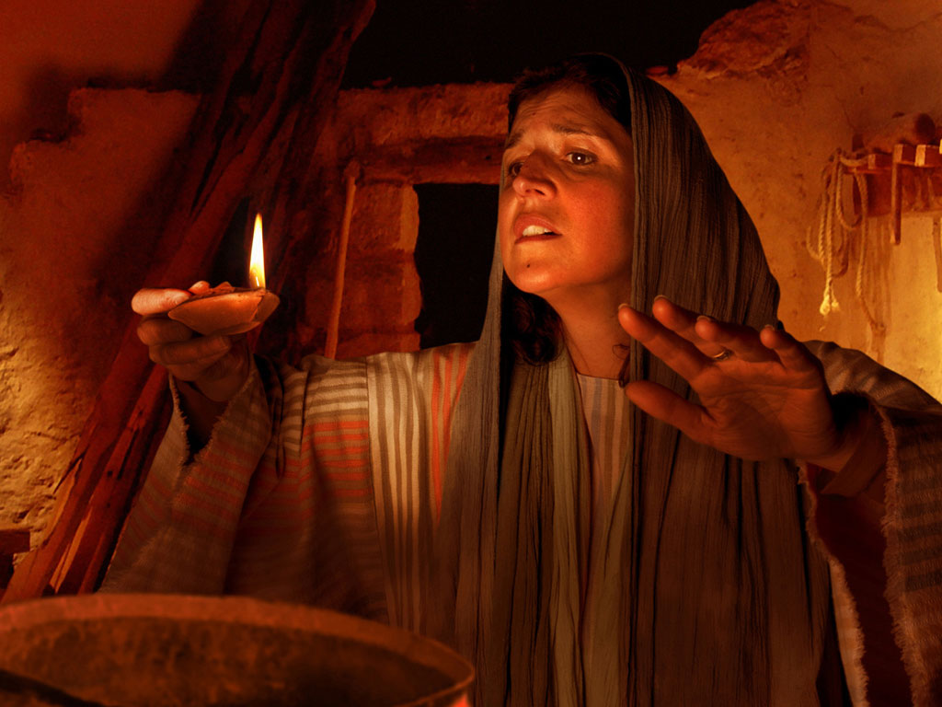
Notes:
路加 15 v 8: Woman searches house by lamp light.

Slide 17
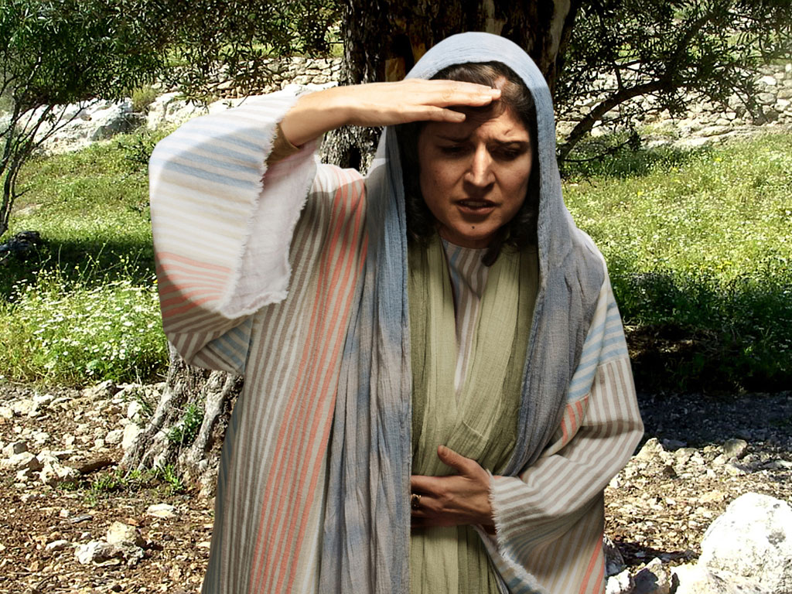
Notes:
路加 15 v 8: Woman continues search.

Slide 18
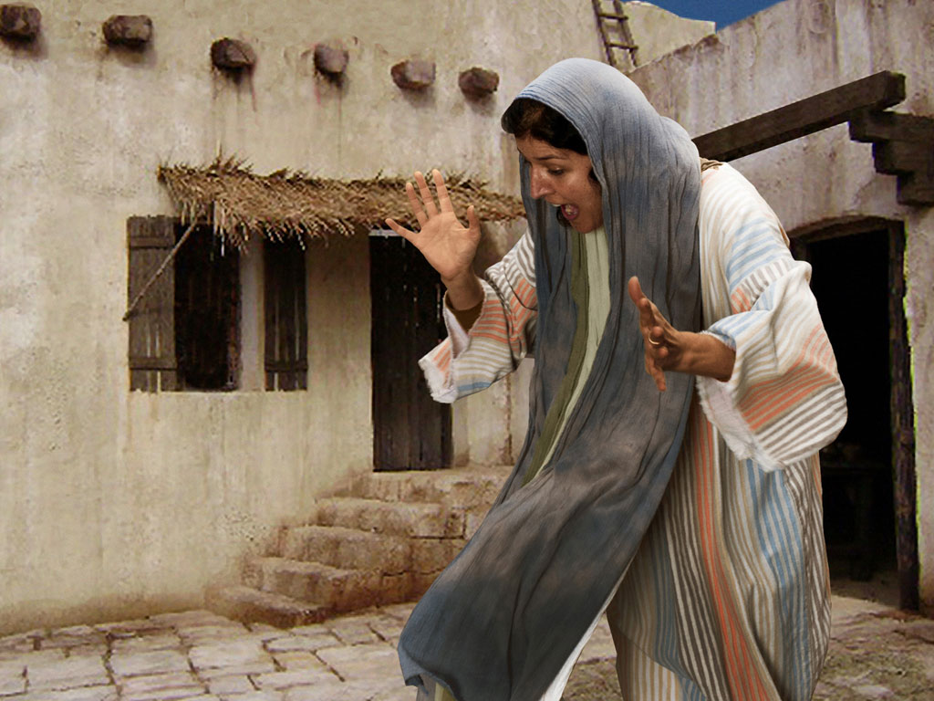
Notes:
路加 15 v 9: Woman search is rewarded as she sees silver coin.

Slide 19
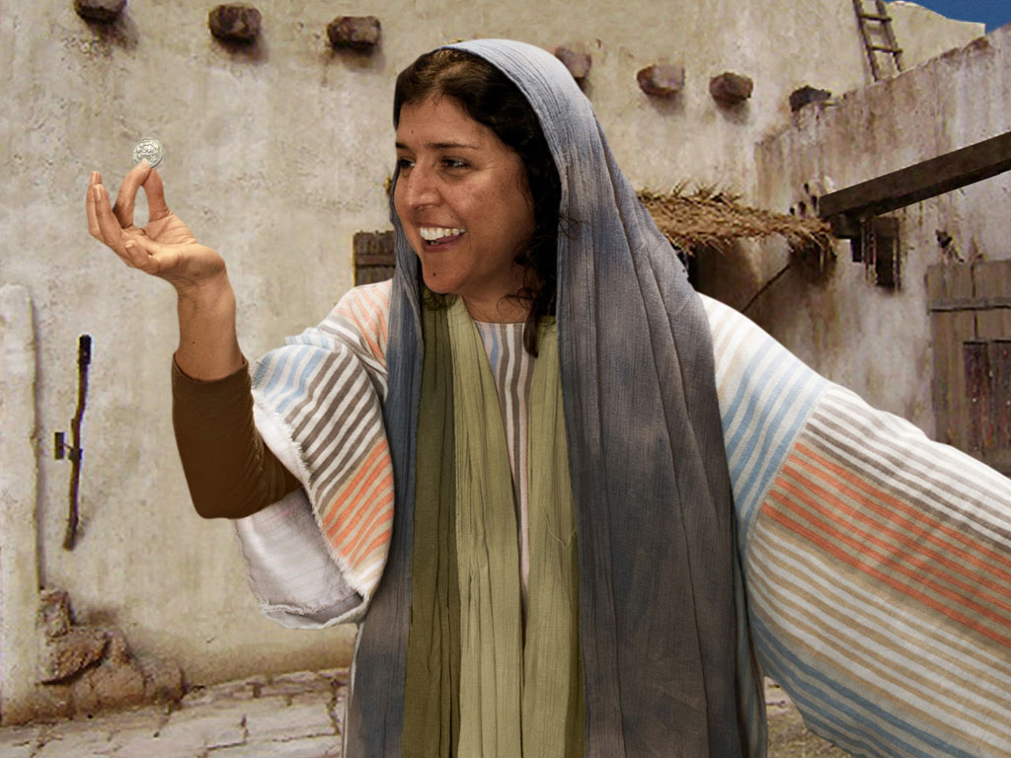
Notes:
路加 15 v 9: Woman is full of joy as she finds coin.

Slide 20
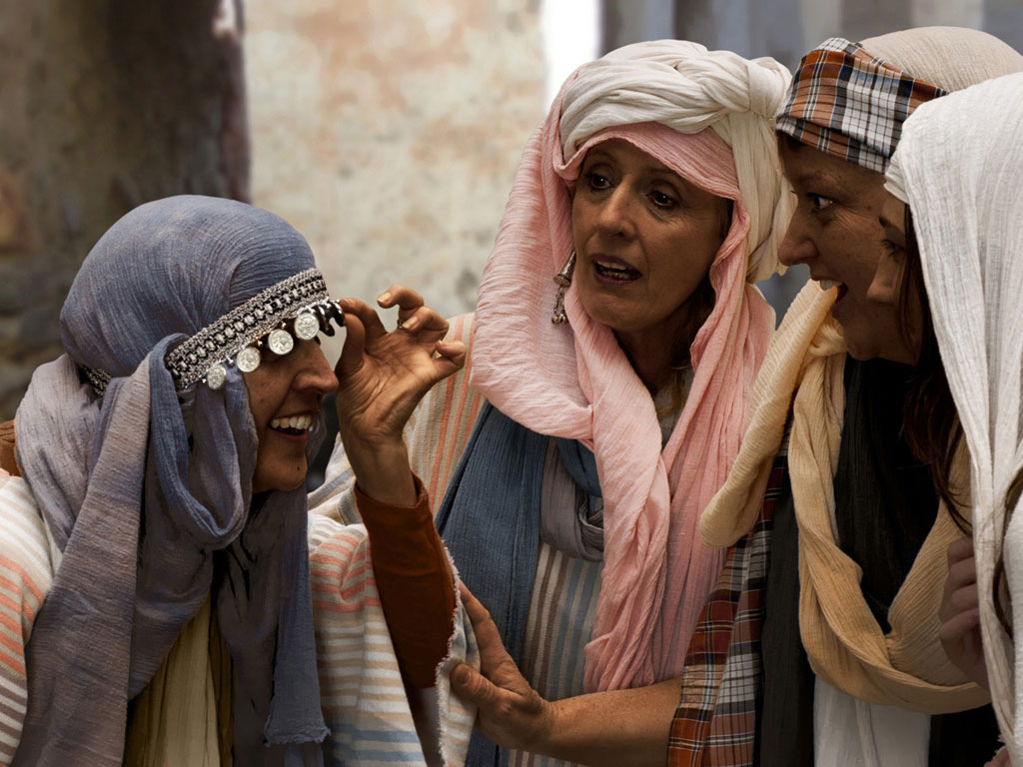
Notes:
路加 15 v 9: Woman shares her good news with neighbours and friends.

Slide 21
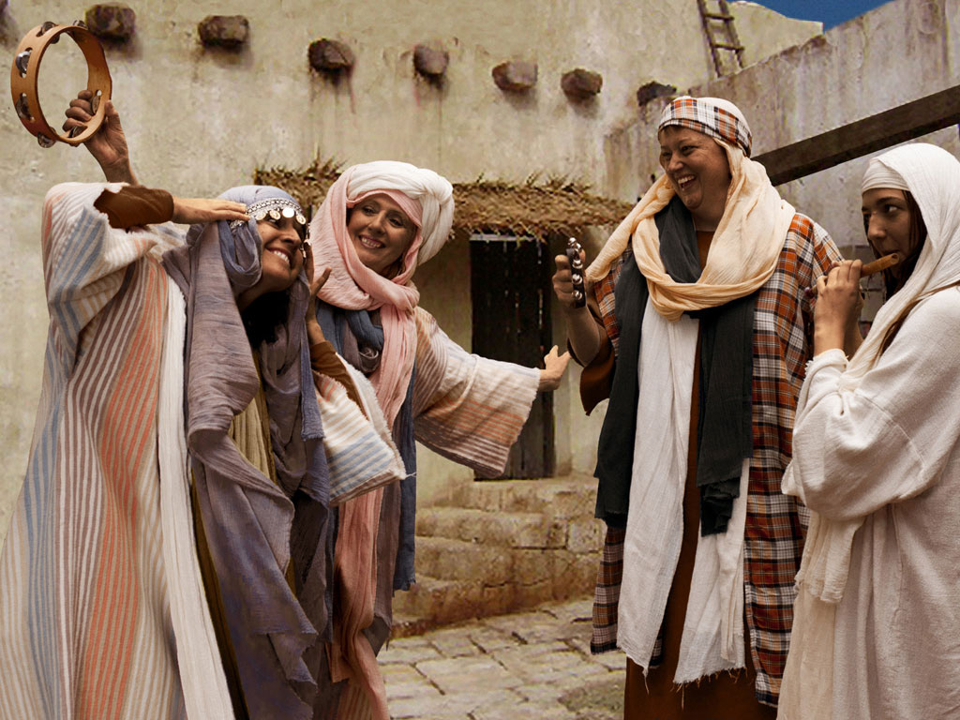
Notes:
路加 15 v 9: Woman celebrates her good news with neighbours and friends. 'Rejoice with me; I have found my lost coin.'

Slide 22
Free Bible Images
授权使用
免费
圣经
图片
图片中的文字

Slide 23
FreeBibleimages would like to thank Peter Hutley and Wintershall Players for the use of their cast, costumes and facilities in creating these images.

Slide 24
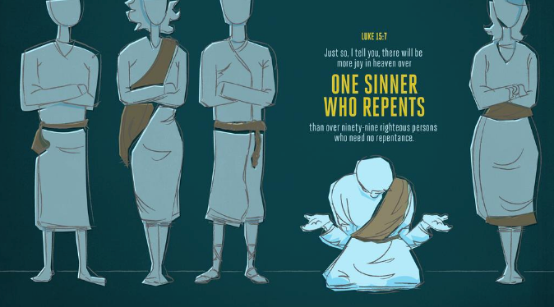
路加 15:7
我 告 诉 你 们 ，
一 个 罪 人 悔 改 ，
在 天 上 也 要
这 样 为 他 欢 喜 ，
较 比 为 九 十 九 个 、不 用 悔 改 的 义 人
欢 喜 更 大 。
Adapted from Logos Bible Software

Slide 25
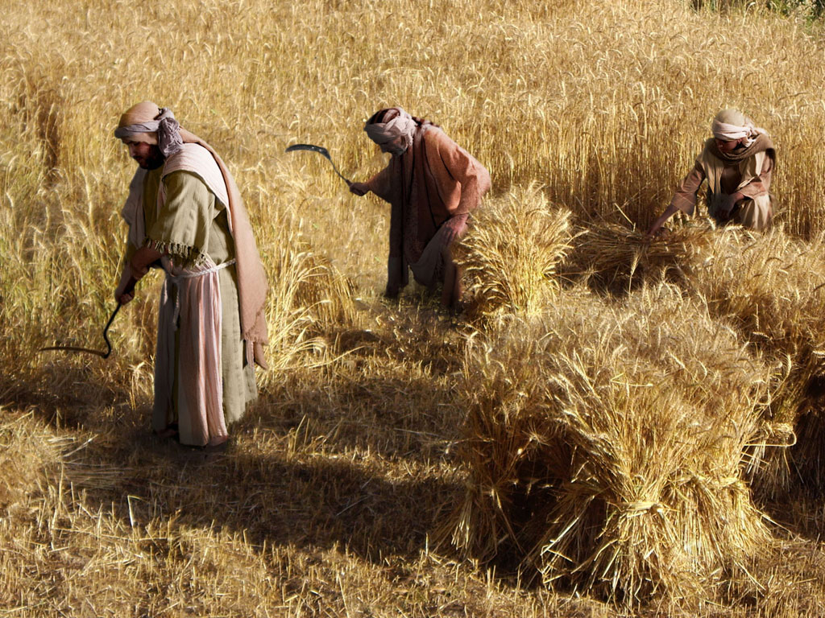
两个儿子的比喻
(浪子)
免费
圣经
图片
路加 15:11-32

Slide 27
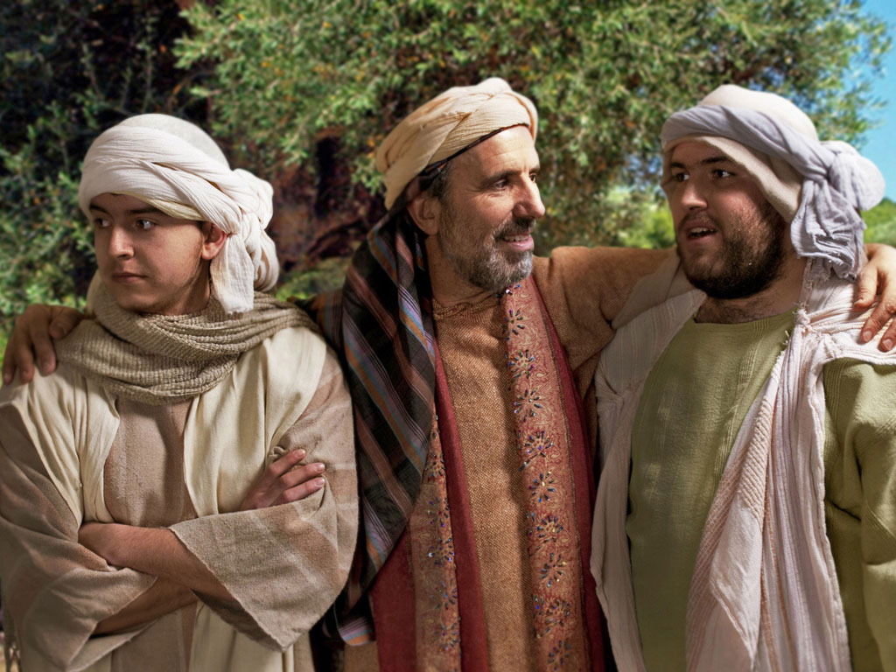

Slide 28
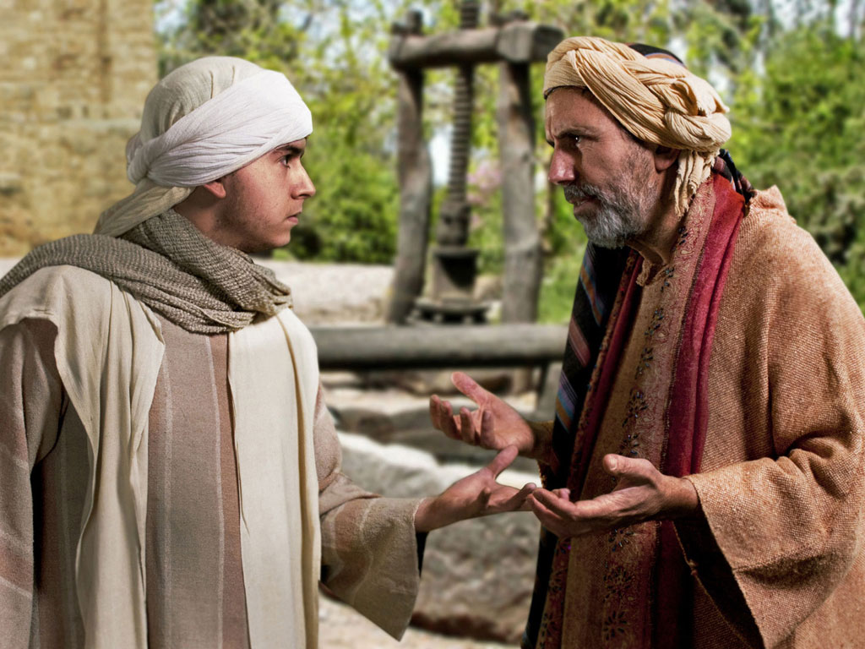

Slide 29
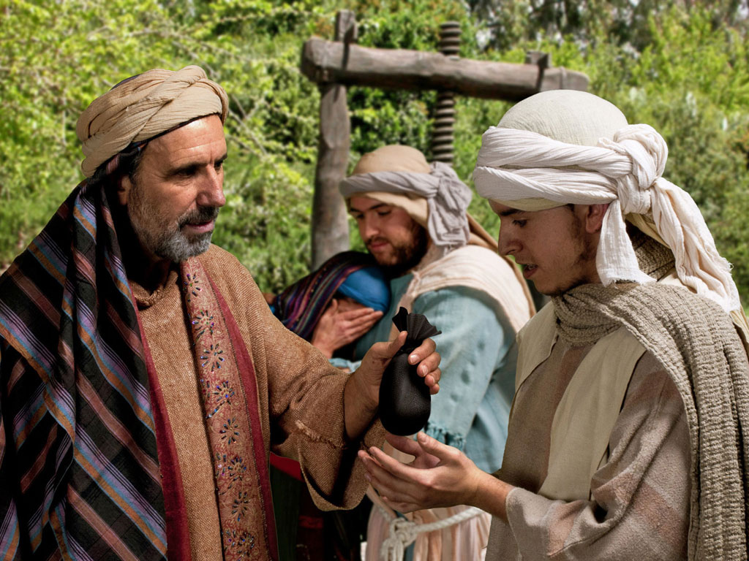

Slide 30
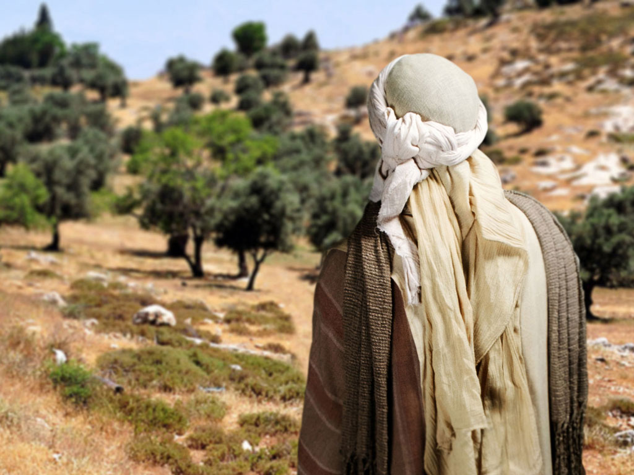

Slide 31
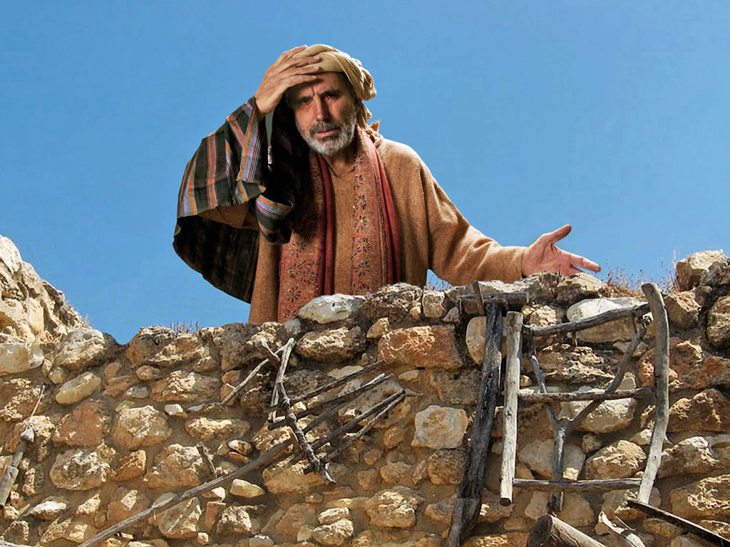

Slide 32
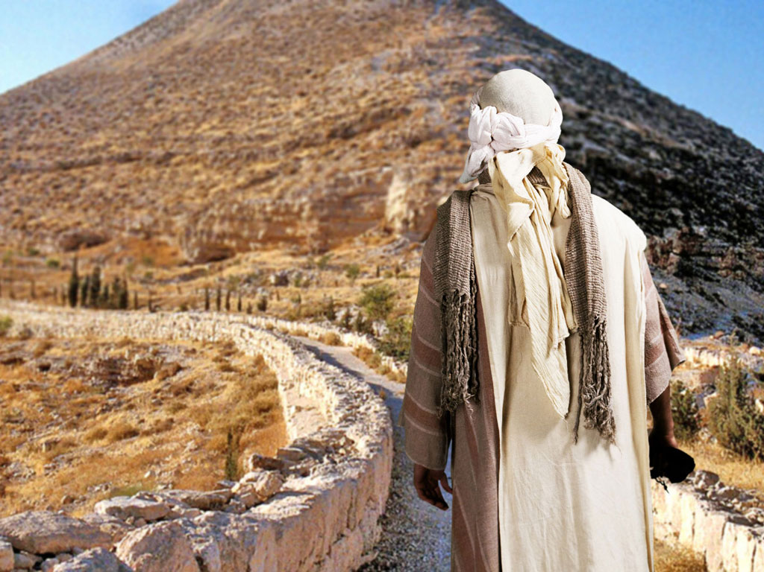

Slide 33
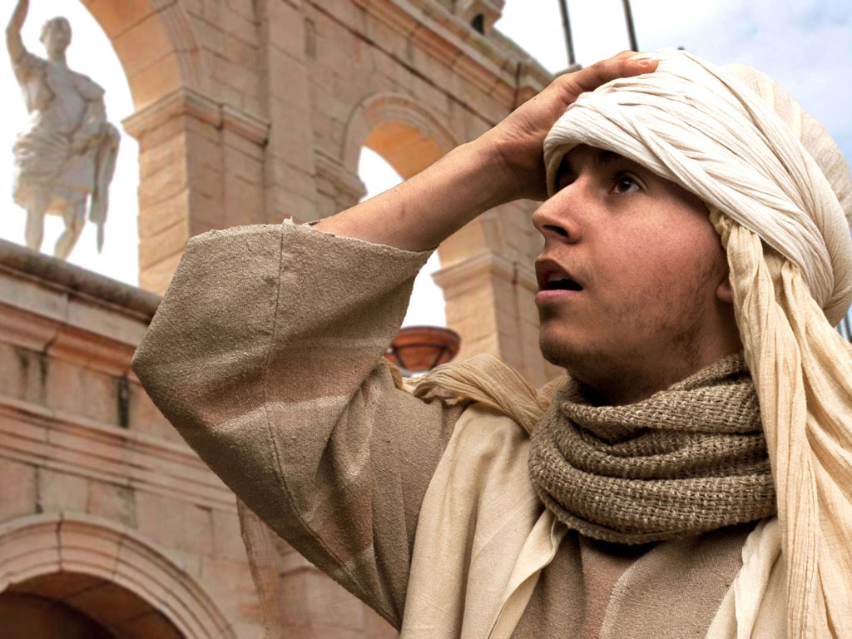

Slide 34
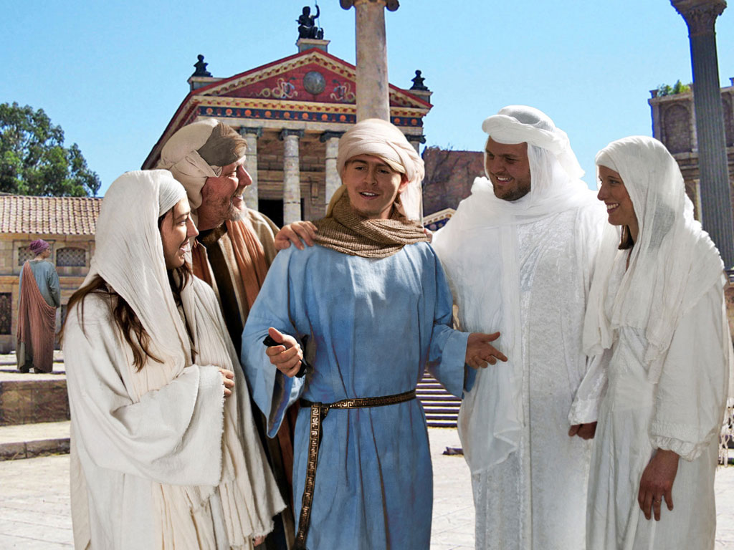

Slide 35
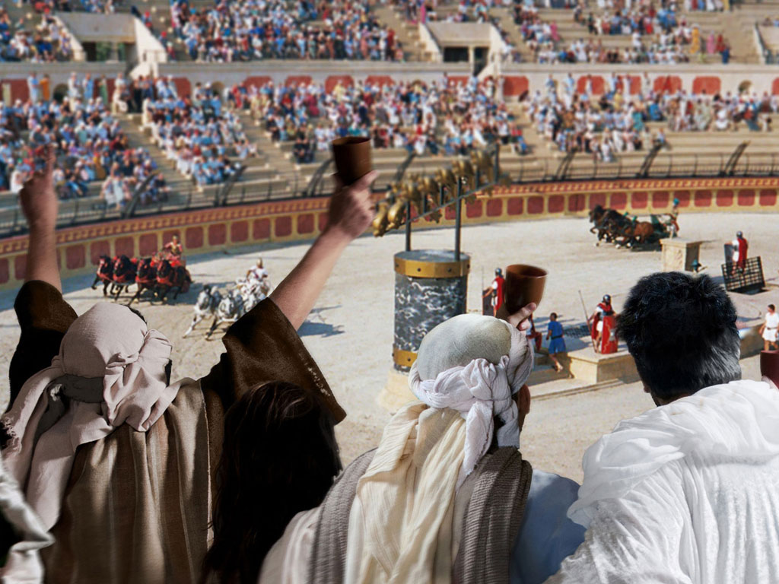

Slide 36
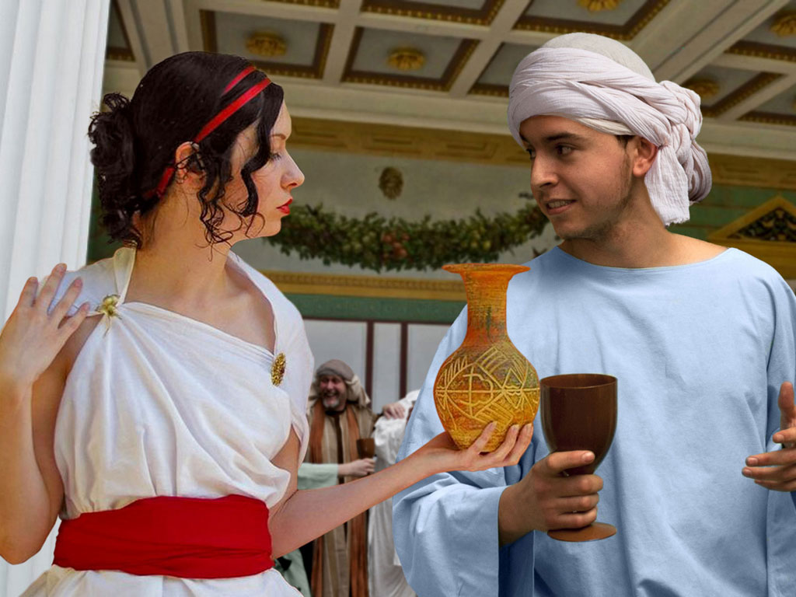

Slide 37
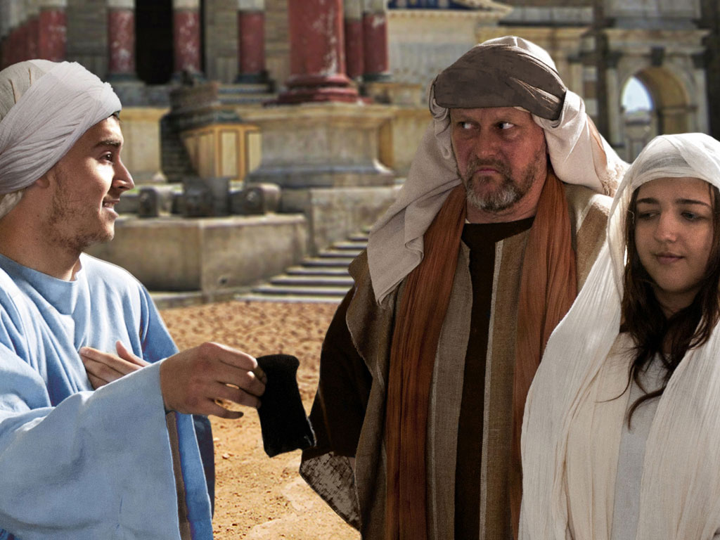

Slide 38
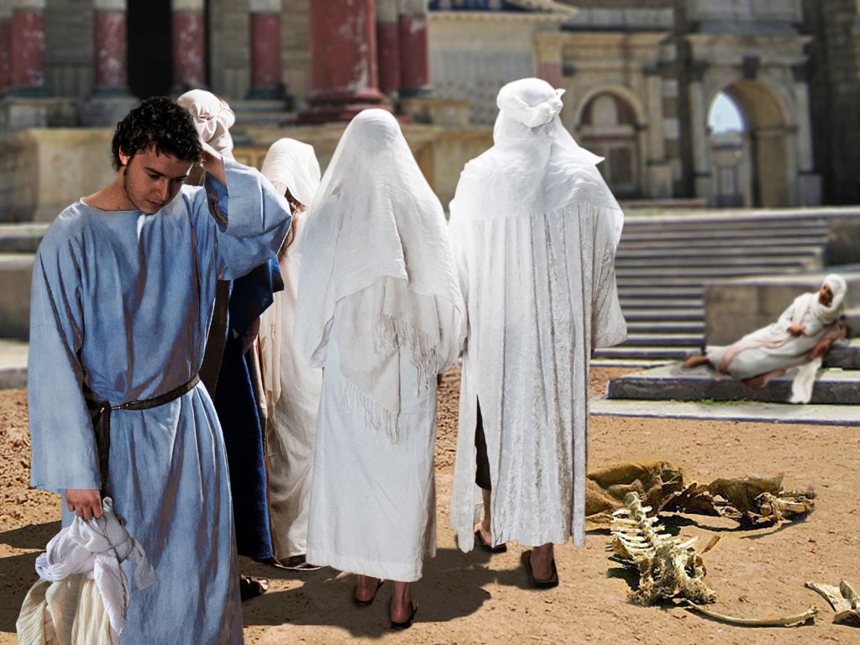

Slide 40
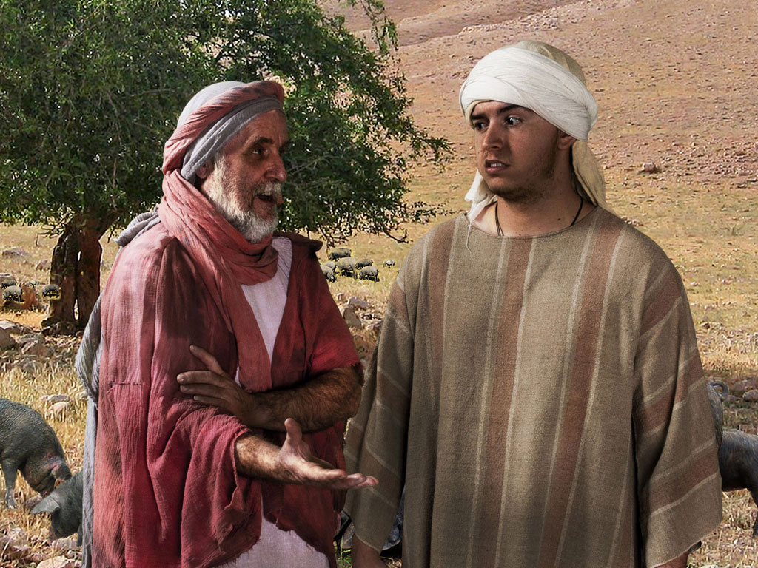

Slide 41
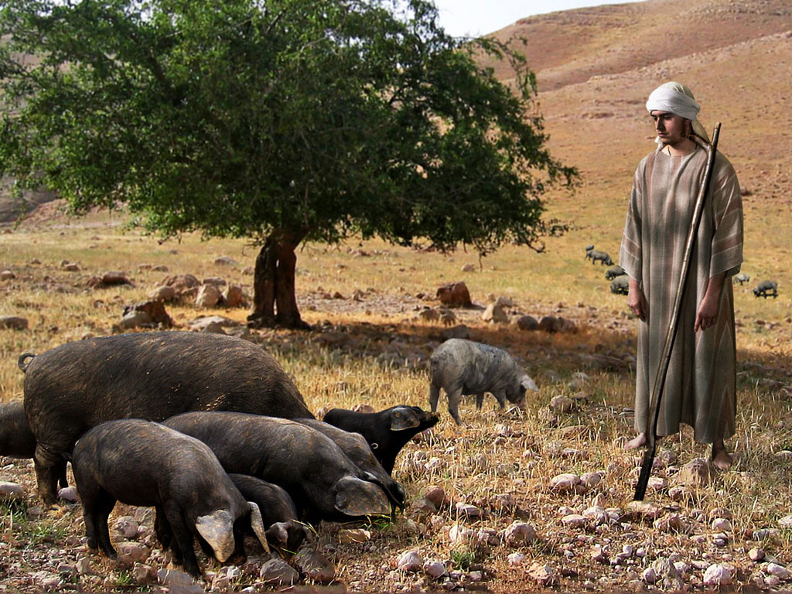

Slide 42
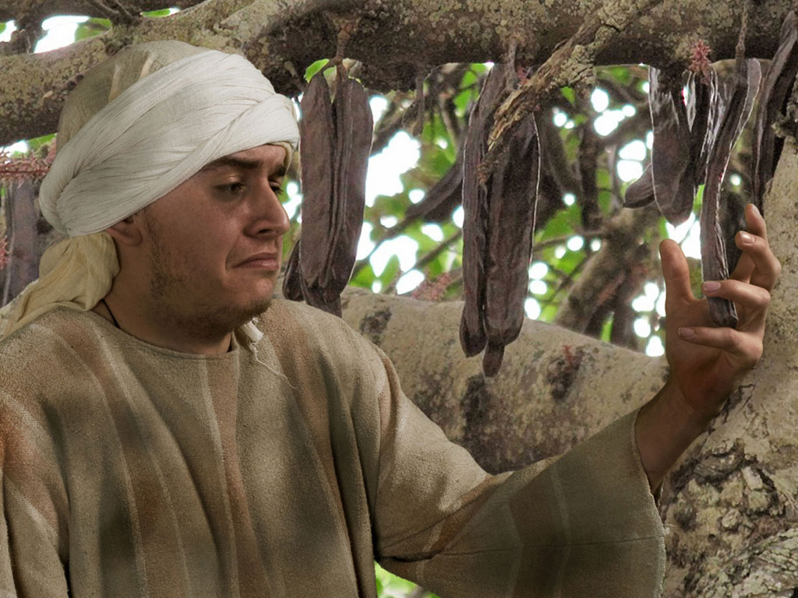

Slide 43
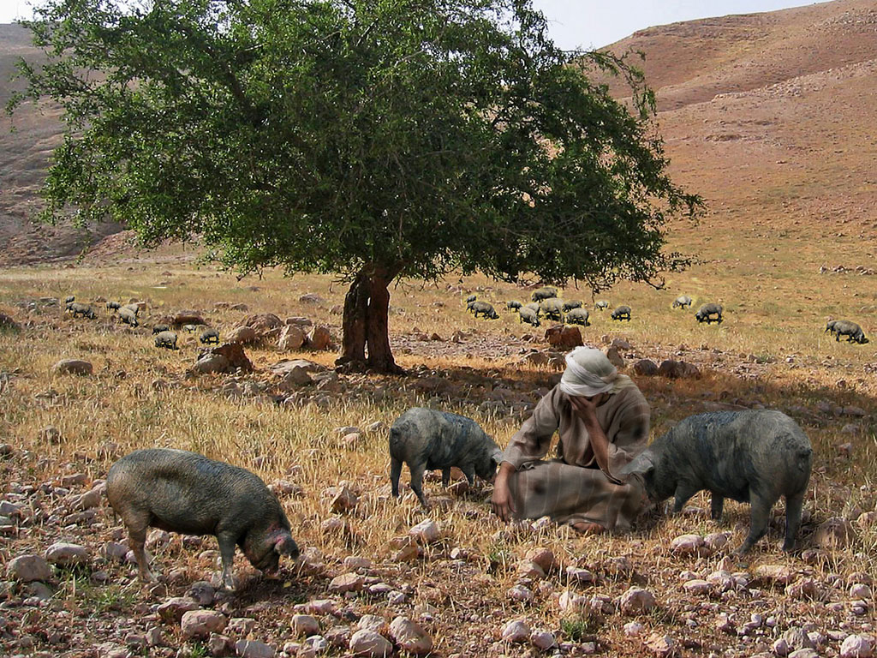

Slide 44
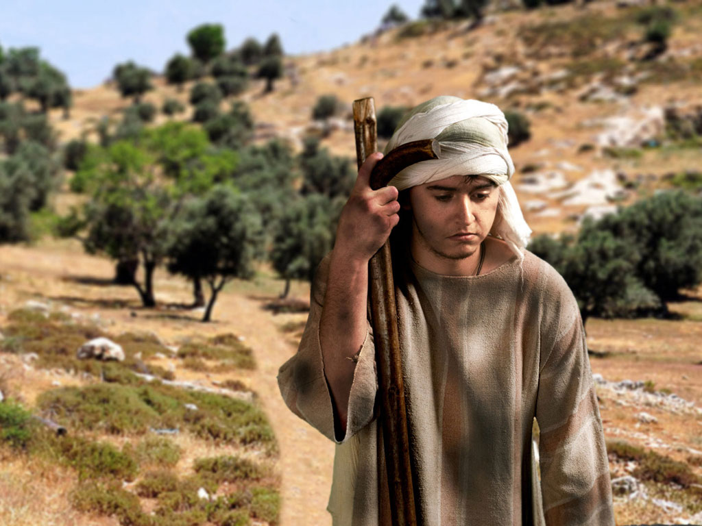

Slide 45
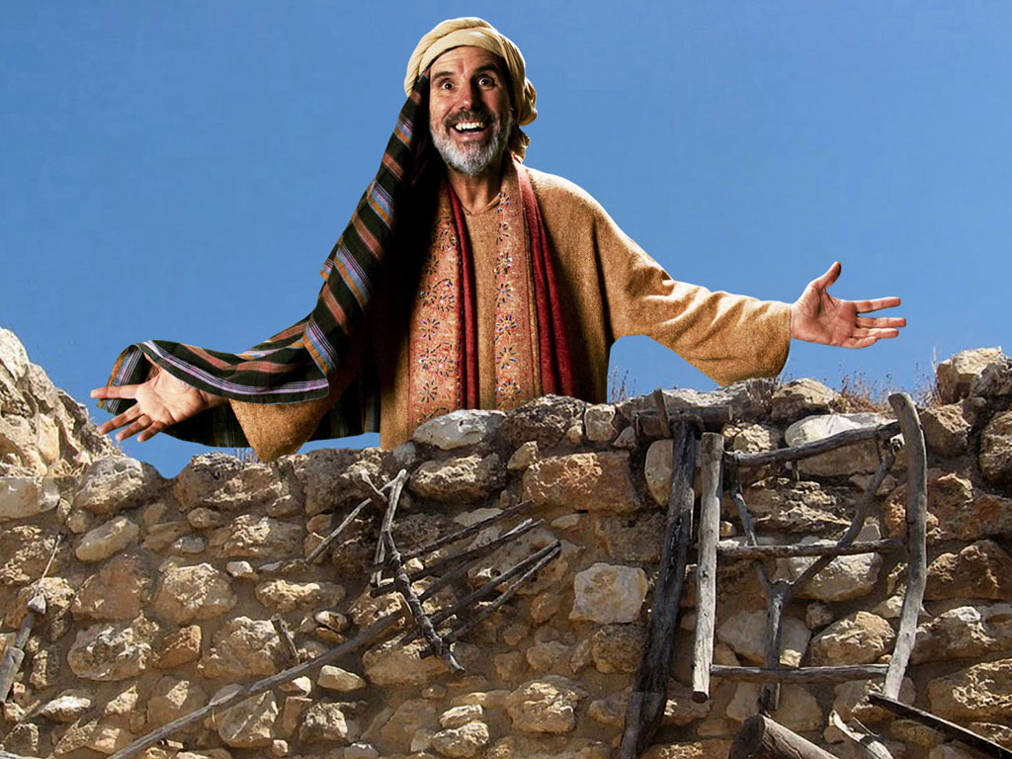

Slide 46
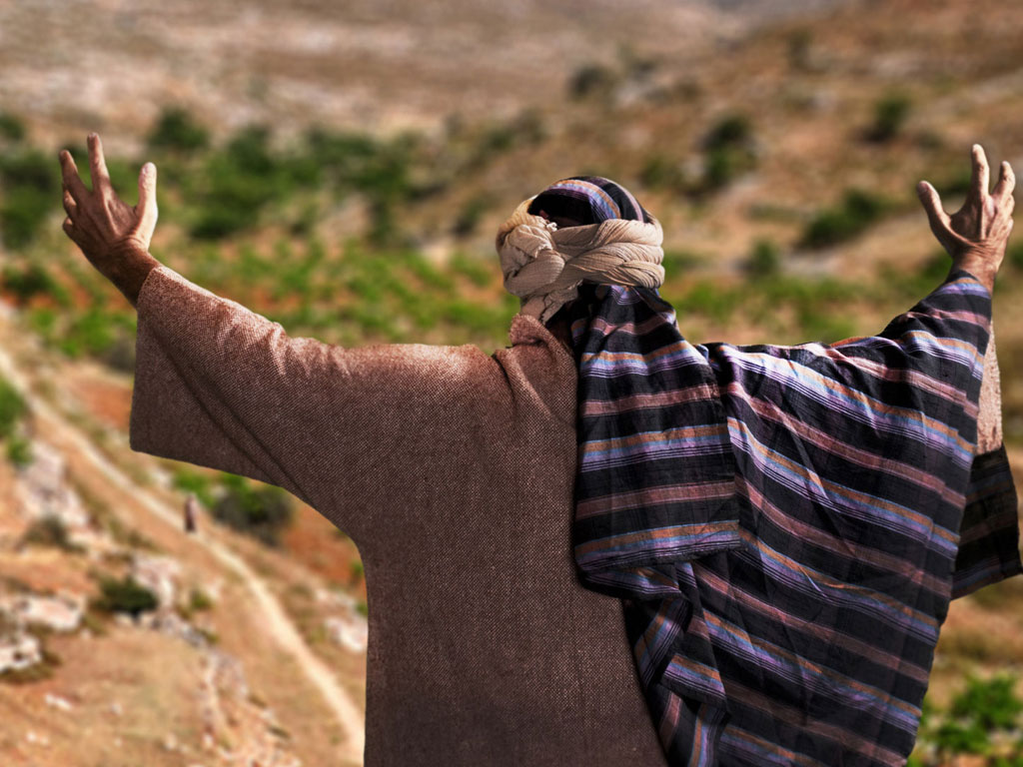

Slide 47
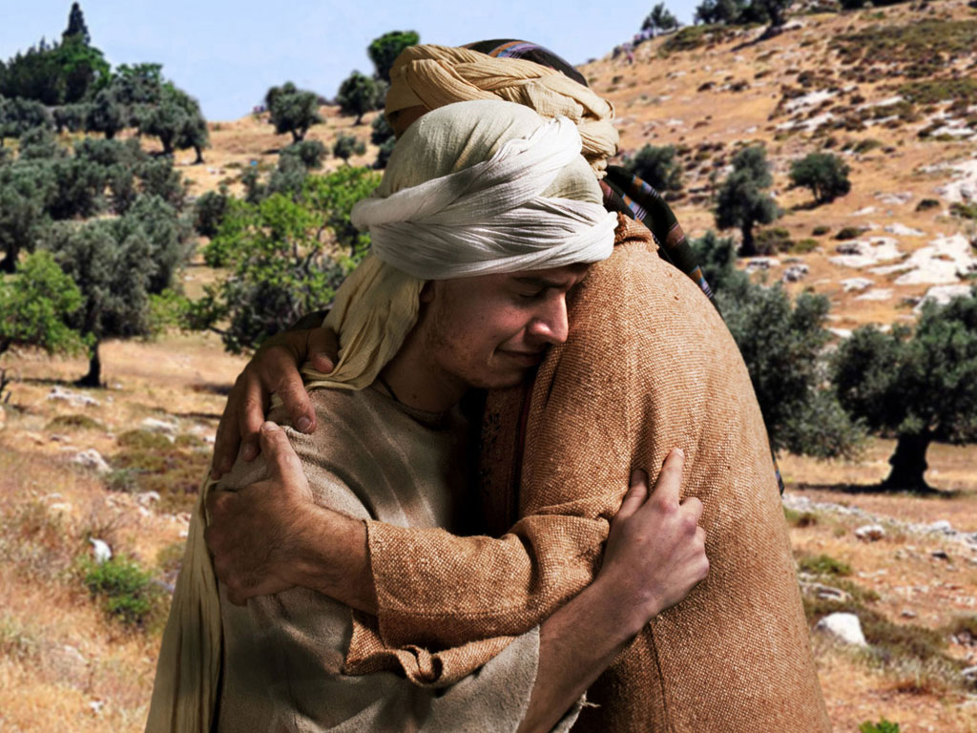

Slide 48
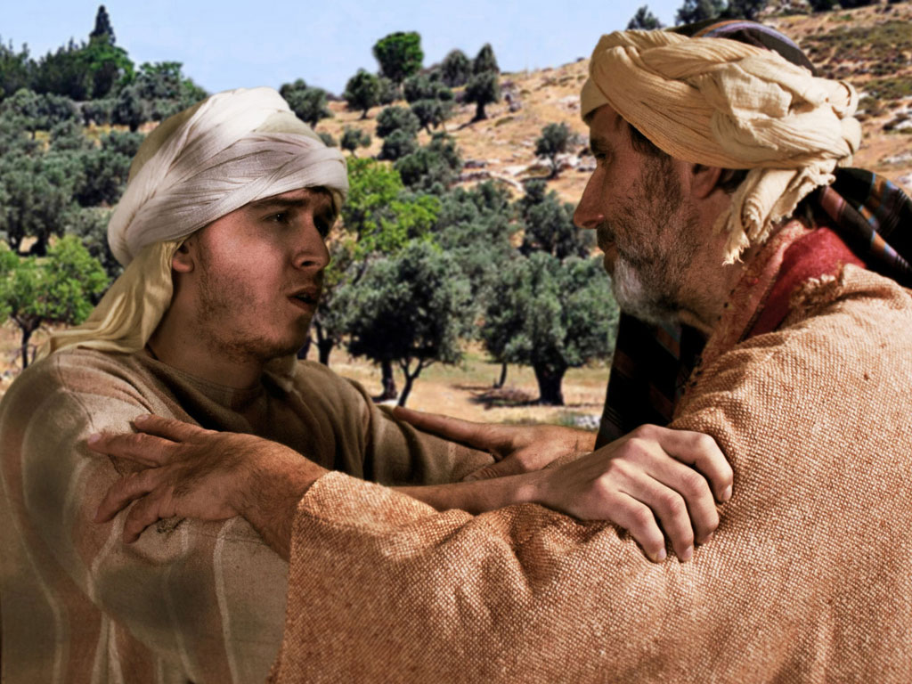

Slide 49
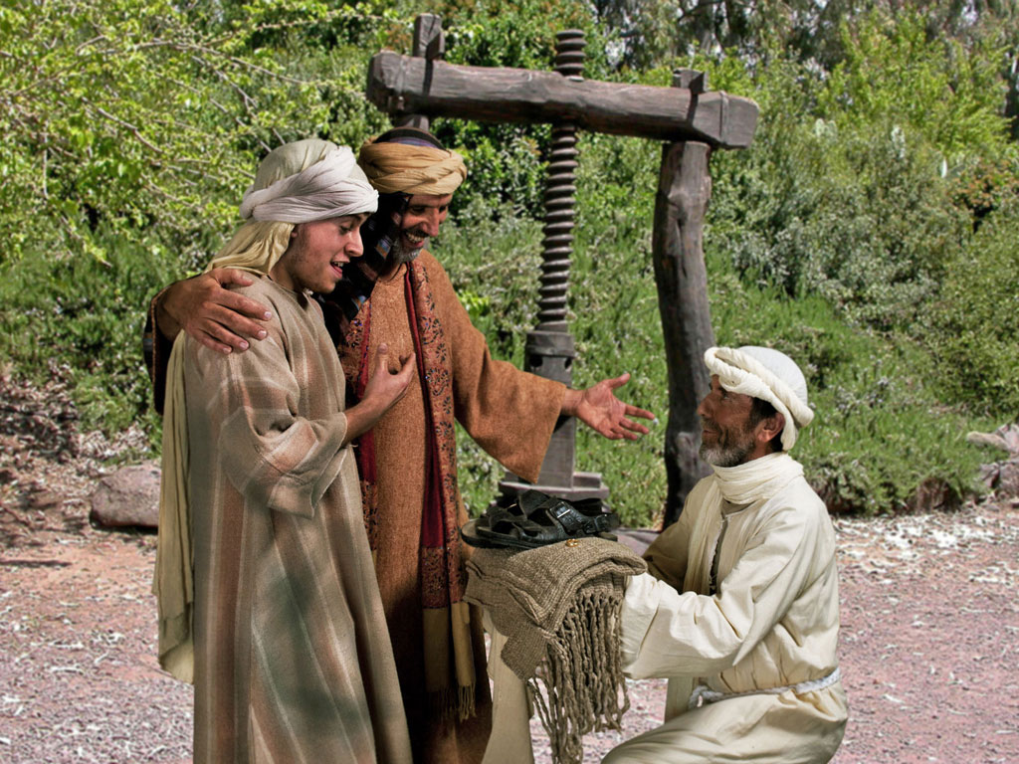

Slide 50
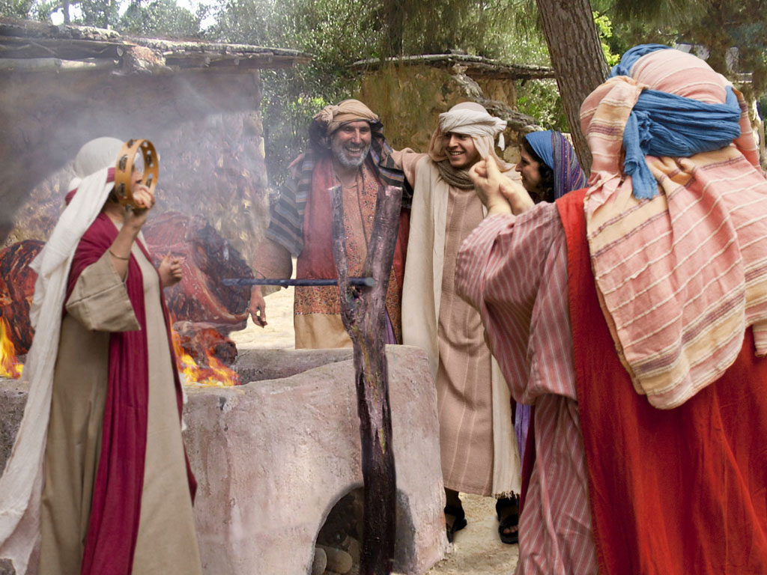

Slide 51
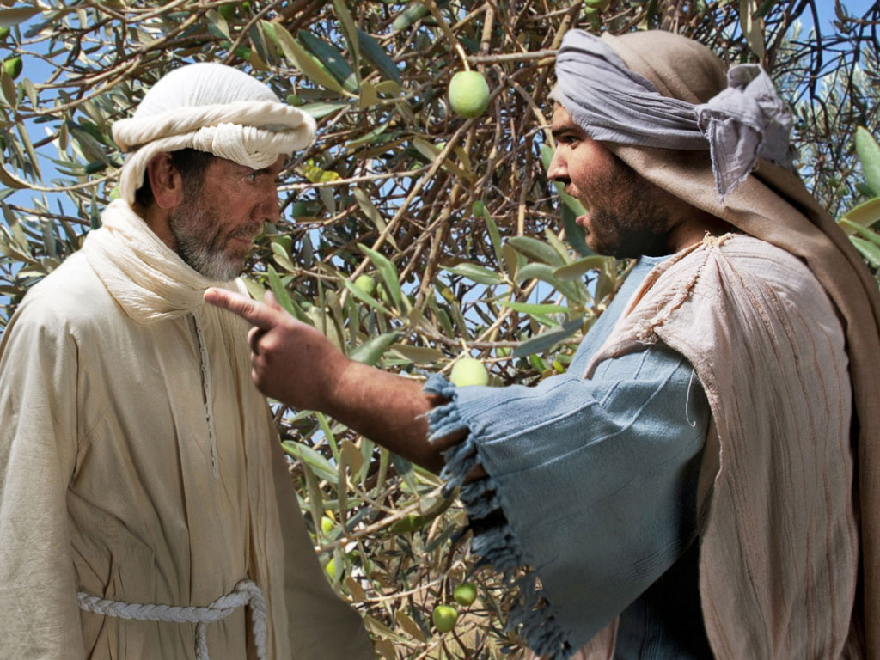

Slide 52
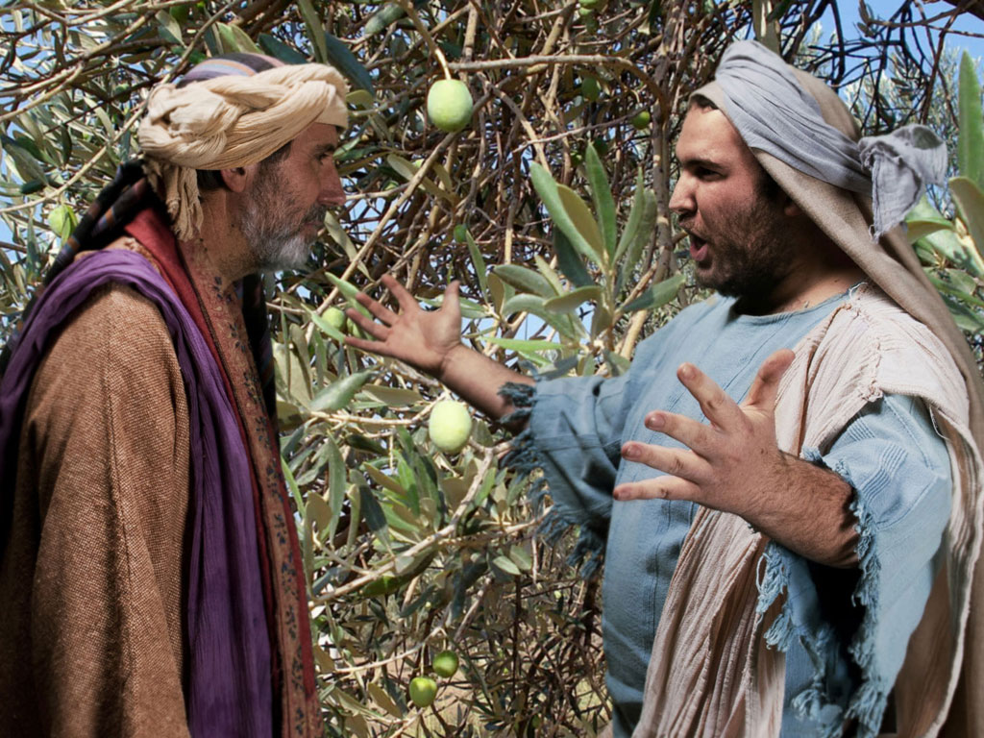

Slide 53
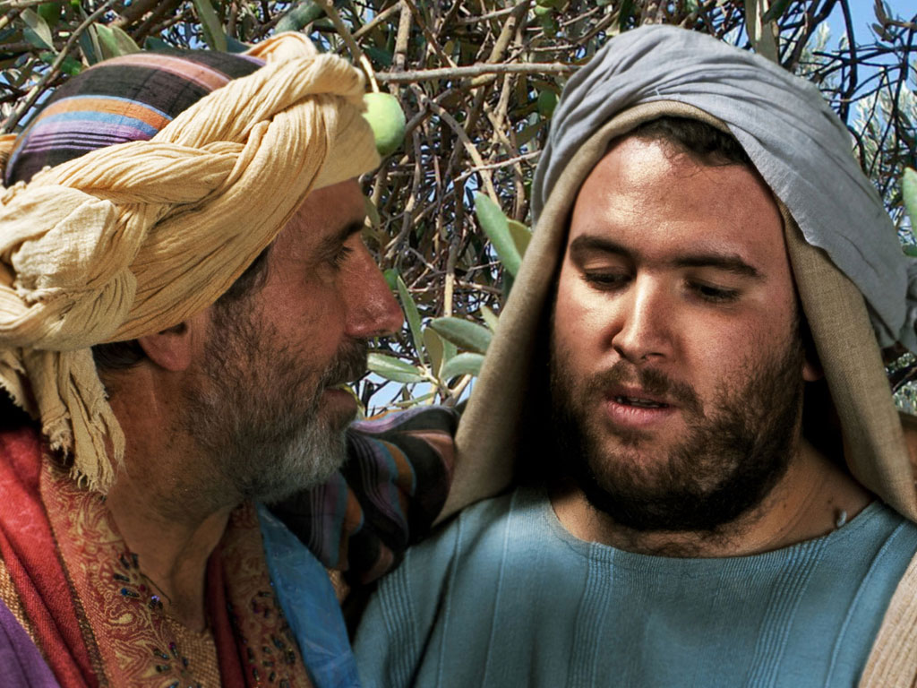

Slide 54
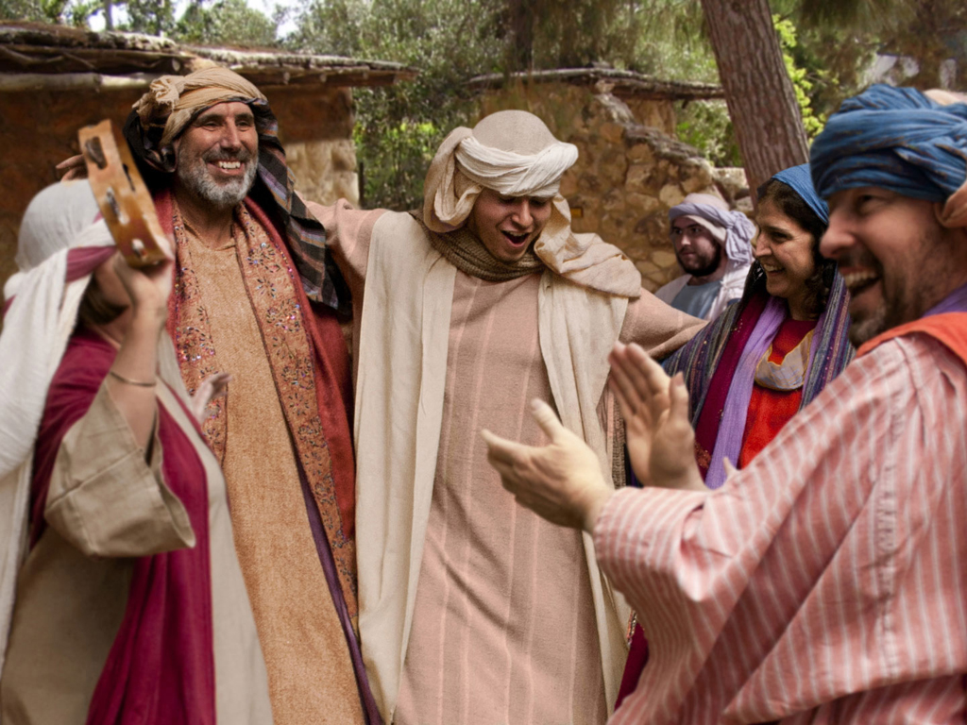

Slide 55
Free Bible Images
授权使用
免费
圣经
图片
图片中的文字

Slide 56
FreeBibleimages would like to thank Peter Hutley and Wintershall Players for the use of their cast, costumes and facilities in creating these images.

Slide 57
F. Instruction Concerning Wealth
§ 125
路加 16:1-31
Christ advises the use of material wealth for eternal rather than temporal investments to motivate the disciples to renounce material gain in favor of becoming servants of God and to caution against the Pharisaical perspective of trusting money as a basis for eternal security

Slide 58
G. Instruction Concerning Forgiveness
§ 126
路加 17:1-6
Christ instructs His disciple that they could hate Pharisaical teachings without hating the Pharisees themselves to assure that the disciples' attitudes against them would not prevent anyone from coming to Christ or limit their ability to forgive another believer

Slide 59
H. Instruction Concerning Service
§ 127
路加 17:7-10
Christ reminded His disciples that responsibility to Him as servants of the Master are never fulfilled so that they would realize that obedience is their minimal duty to Christ

Slide 60
I. The Raising of Lazarus
§ 128
约翰 11:1-54
Christ raises Lazarus from the dead in order to teach that resurrection and life are found only in Him, not in some program of God

Slide 61
1. The Miracle of Restoration
约翰 11:1-44
Christ restores life to Lazarus so as to confirm the faith of those who had already believed in Him

Slide 62
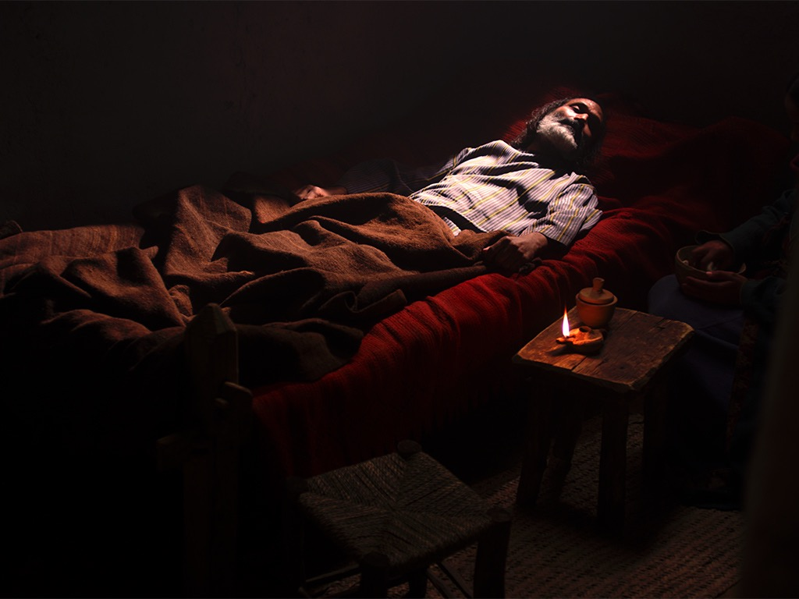
免费
圣经
图片
约翰 11:1–12:2
耶稣使拉撒路复活

Slide 64
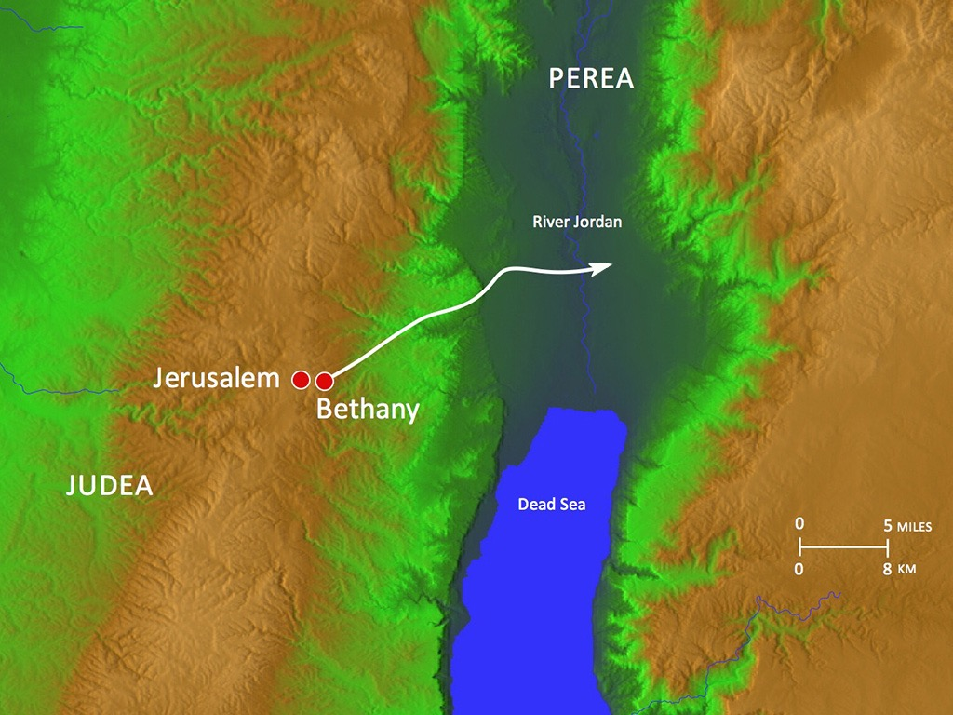

Slide 65
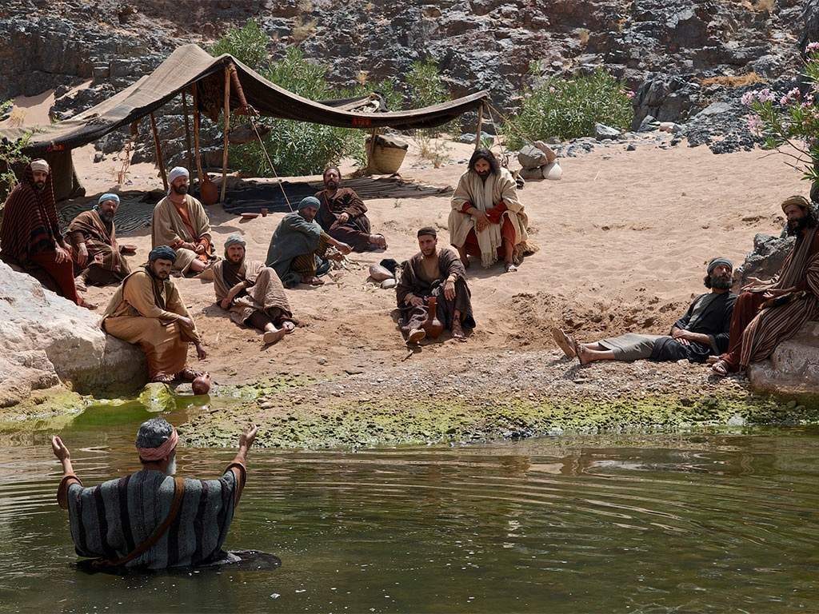

Slide 66
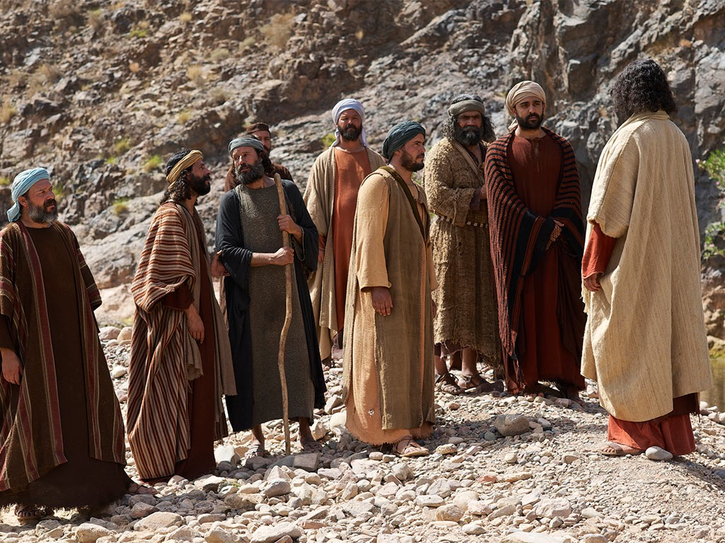

Slide 67
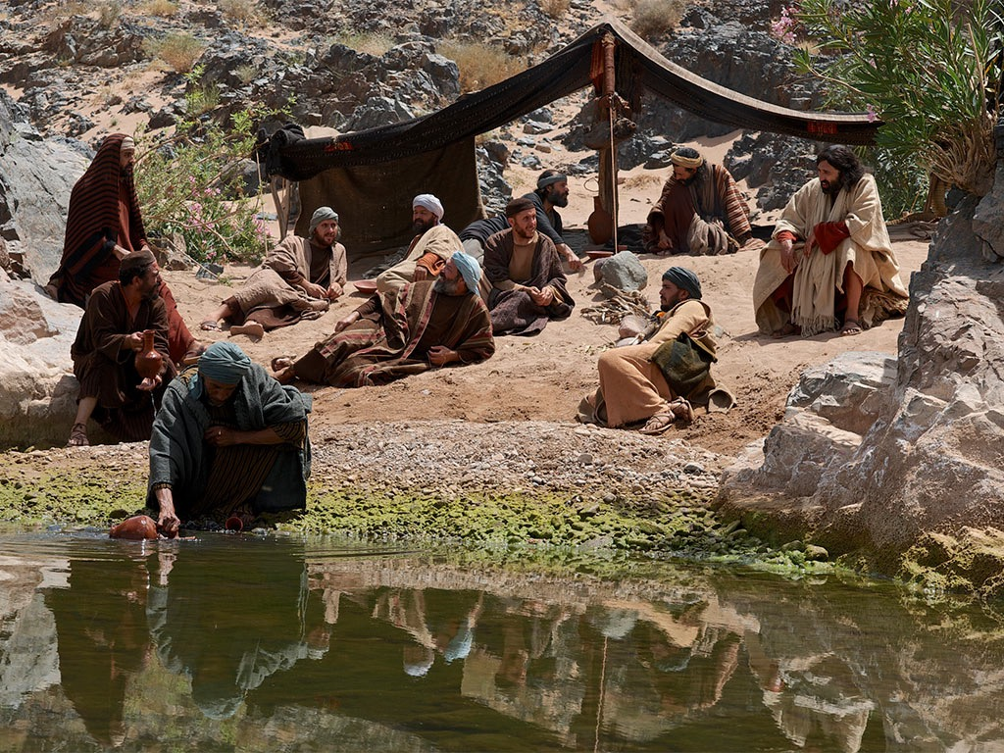

Slide 68
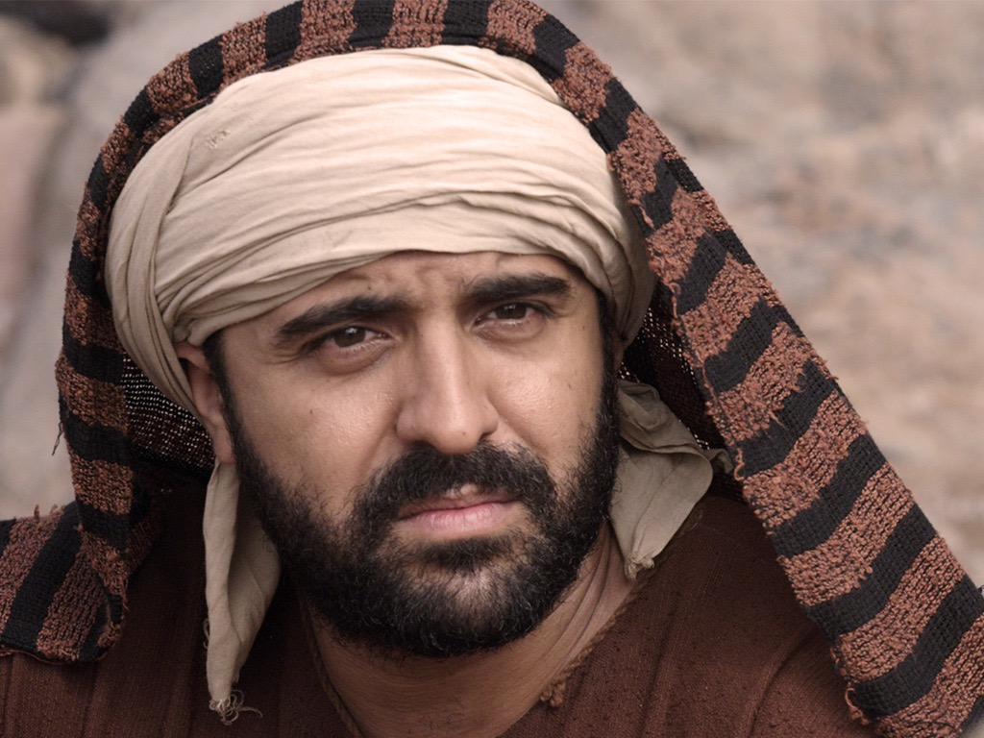

Slide 109
授权使用
马太福音
d
马可福音
o
路加福音
0
约翰福音
0
由Lumo Project出版独家资源，我们特此通知您我们不授权将这些图片发放给除freebibleimages.org客户以外的任何人。
所有图片不授权用于视频制作、epublishing或者其他媒体。所有下载的图片和文件不可通过除freebibleimages.org以外的其他网站传播，亦不可用于任何破坏基督信仰和福音的处境中。
o
图片仅供教育展示、博客和社交媒体使用；所有用途均需注明出处 www.LumoProject.com
图片声明 BBM © 版权所有
www.bigbookmedia.com

Slide 110
耶稣, 马利亚 和 马大 (约翰 11)
耶稣素来爱马大、和他妹子、并拉撒路。 (11:5)
他们已经信了祂 (“主” 在 11:3; cf. 11:27).
这马利亚就是后来在葬礼用香膏抹主 (11:2; cf. 12:1-8).
Notes:
Jesus loved these two sisters who lived in Bethany, close to Jerusalem (11:5).
They had already believed in Him ("Lord" in 11:3; cf. 11:27).
Mary later anointed Him for his burial in worship (11:2; cf. 12:1-8).
这马利亚就是那用香膏抹主

Slide 111
马大 (约翰 11)

Slide 112
马利亚 (约翰 11)

Slide 113
马利亚 和 马大 (约翰 11)

Slide 114
马大和马利亚的对比 约翰 11
##
事件 | 马大 | 马利亚
走向耶稣 | 即刻去找耶稣（20上）- 私自“去做” | 迟缓及呆在家里（20下），然后公然在外带有更多情感的
对耶稣说的话 | 埋怨但有信心（21） | 埋怨但很敬虔(32)
疑虑的话 | 没有立刻活过来的希望 (24, 39) | 无

Slide 115
马大和马利亚的对比 约翰 11
##
事件 | 马大 | 马利亚
耶酥的反应 | 考验她对耶稣能否救活拉撒路的信心（23），称有能力起死回生（25），问她是否相信（26） | 没考验她—祂问尸体在哪儿（34） 就哭了（35）
对基督信心的宣扬 | 两次: 基督能医治 (21) 以及“你是弥撒亚… 神子… 从神" (27) | 没宣扬
信心的证实 | 仍有怀疑，埋怨尸体发臭(39) 对安慰的话没听到 | 带来信的众人(45) 但有些出卖耶稣给法利赛人 (46)
Notes:
Tested her faith whether He could raise Lazarus (23), claimed to be the resurrection and life (25), and asked if she believed (26)
考验她对耶稣能否救活拉撒路的信心（23），称有能力起死回生（25），问她是否相信（26）

Slide 116
那个献上真哪哒香膏的女人是抹大拉的马利亚吗?
不. 在路加福音并没有提她的名, 但在其他福音书是清楚的写明她是伯大尼的马利亚

Slide 117
2. Conflict Over the Miracle
约翰 11:45-54
The miracle of Lazarus' restoration results in confirmation of the disciples' faith, several new believers, and further rejection of Christ in the planning of His death by the religious leaders

Slide 118
J. Instruction Concerning Thankfulness
§ 129
路加 17:11-19
Christ commends a cleansed leper for his thankfulness and condemns the other nine cleansed lepers for their lack of indebtedness to remind the disciples of their indebtedness to Him and to contrast Israel's rejection of His blessings with the gratefulness the nation should have shown

Slide 119
K. Instruction Concerning His Coming
§ 130
路加 17:20-37
Christ teaches that although the kingdom and King are among them He was rejected and would suddenly return in judgment of Israel at the Second Advent to take away the unsaved from the earth

Slide 120
L. Instruction Concerning Prayer
§ 131
路加 18:1-14
Christ teaches that people should persist in prayer for the kingdom even though it had been postponed and one who trusts God’s provision for sin in Him as the Lamb of God must offer that acceptable prayer

Slide 121
M. Instruction Concerning Divorce
§ 132
马太 19:1-12; 马可 10:1-12
Christ teaches that the only exception to God's prohibition of divorce involves the cancellation of the marriage contract in the Jewish betrothal period, thus avoiding the Pharisee debate about divorce and escaping the trap to slander Herod for marrying his brother's wife

Slide 122
N. Instruction Concerning Entrance Into the Kingdom
§ 133
马太 19:13-15; 马可 10:13-16; 路加 18:15-17
Jesus blesses little children to illustrate to the disciples that confidence and trust in Christ are necessary to enter the kingdom

Slide 123
O. Instruction Concerning Eternal Life
§ 134
马太 19:16-20; 16; 马可 19:32-45; 路加 18:31-34
Christ shows the impossibility of entering the kingdom through riches to refute the Pharisaical belief that material wealth indicates divine approval and eternal life

Slide 124
Free Bible images
富有的青年向耶稣问问题
马太 19:16-30; 马可 10:17-31; 路加 18:18-30

Slide 135
授权使用
马太福音
d
马可福音
o
路加福音
0
约翰福音
0
由Lumo Project出版独家资源，我们特此通知您我们不授权将这些图片发放给除freebibleimages.org客户以外的任何人。
所有图片不授权用于视频制作、epublishing或者其他媒体。所有下载的图片和文件不可通过除freebibleimages.org以外的其他网站传播，亦不可用于任何破坏基督信仰和福音的处境中。
o
图片仅供教育展示、博客和社交媒体使用；所有用途均需注明出处 www.LumoProject.com
图片声明 BBM © 版权所有
www.bigbookmedia.com

Slide 136
P. Instruction Concerning His Death
§ 135
马太 20:17-28; 马可 10:32-45; 路加 18:31-34
Christ announces His coming death and resurrection to His disciples to instruct them about the importance of being servants rather than lords

Slide 137
Q. Instruction Concerning Israel's Need
§ 136
马太 20:29-34; 马可 10:46-52; 路加 18:35-43
Jesus heals two blind men as illustrations of Israel's spiritual blindness and His ability to help the nation see if it would turn to Him in faith

Slide 138
R. Instruction Concerning the Kingdom Program
§ 137
路加 9:1-28
Christ reiterates the postponement of the kingdom but also encourages any individual trusting in His person that his entrance into the kingdom is guaranteed

Slide 139
1. A Lesson in Personal Faith
路加 19:1-10
Christ accepts the corrupt but repentant Zacchaeus to show that He would forgive anyone who places faith in Him, thus allowing them to enter the kingdom by simple faith

Slide 140
2. Instruction Concerning the Postponed Kingdom
路加 19:11-28
Christ instructs the disciples through the parable of the man of noble birth how the kingdom had been postponed until Christ returns at the Second Advent to judge Israel

Slide 141
Black

Slide 142
基督生命链接地址 BibleStudyDownloads.org
免费获得该讲解!
圣经学习下载
Notes:
Bible Geograhpy (bg)

