Slide 1
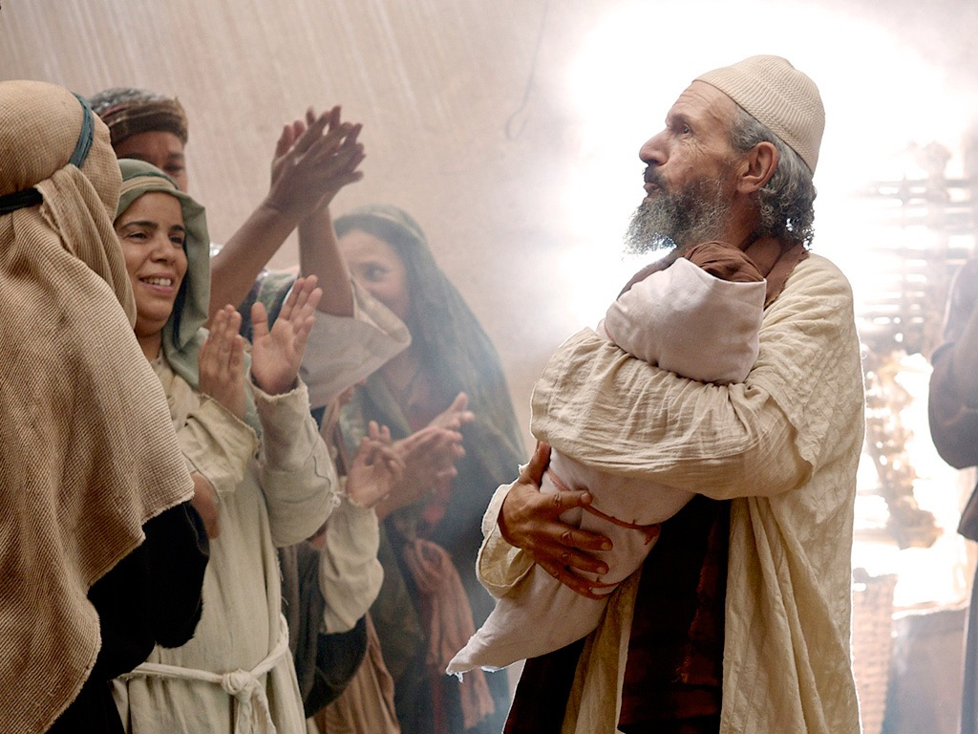
君王介绍
The Messianic identity of Jesus Christ is evident in his arrival, the testimony by 约翰, and his approval in his baptism and temptation
Section summaries based on J. Dwight Pentecost, A Harmony of the Words and Works of Jesus Christ (Grand Rapids: Zondervan, 1981)
Dr. Rick Griffith • Singapore Bible College • BibleStudyDownloads.org
Notes:
Intro: Fact or Fiction...

Slide 2

A. 君王的降生
§§ 3-19
The lineage, birth, infancy, and childhood of Christ show that He is the Messiah of Israel
Notes:
Intro: Fact or Fiction...

Slide 3
1. 他的家谱
§ 3
马太 1:1-17; 路加 3:23b-38
The genealogy of Christ establishes his legal and physical right to the throne of David in fulfillment of the Davidic Covenant
Notes:
Intro: Fact or Fiction...

Slide 4
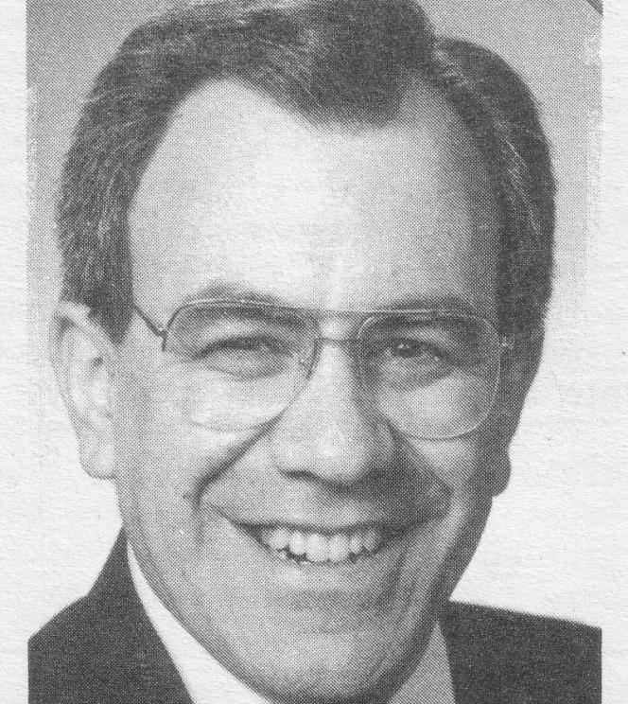
一个纳闷的前序?
1:1 亚伯拉罕的后裔,戴维的子孙(后裔,子孙:原文是儿
子；下同），耶稣基督的家谱：
1:2 亚伯拉罕生艾萨克；艾萨克生雅各布；雅各布生犹大和他的
弟兄；
1:3 犹大从她玛氏生法勒斯和谢拉；法勒斯生希斯仑；
希斯仑生亚兰；
1:4 亚兰生亚米拿达；亚米拿达生拿顺；拿顺生撒门；
1:5 撒门从喇合氏生波阿斯；波阿斯从路得氏生俄备得
；俄备得生耶西；
1:6 耶西生戴维王。戴维从乌利亚的妻子生所罗门；
1:7 所罗门生罗波安；罗波安生亚比雅;亚比雅生亚撒;
1:8 亚撒生约沙法；约沙法生约兰；约兰生乌西雅；
1:9 乌西雅生约坦；约坦生亚哈斯；亚哈斯生希西家；
1:10 希西家生玛拿西；玛拿西生亚们；亚们生约西亚;
1:11 百姓被迁到巴比伦的时候，约西亚生耶哥尼雅和
他的弟兄。
1:12 迁到巴比伦之后，耶哥尼雅生撒拉铁；撒拉铁生
所罗巴伯；
1:13 所罗巴伯生亚比玉；亚比玉生伊莱贾敬；伊莱贾
敬生亚所；
1:14 亚所生撒督；撒督生亚金；亚金生以律；
1:15 以律生伊莱贾撒；伊莱贾撒生马但；马但生雅各布;
1:16 雅各布生约瑟，就是马利亚的丈夫。那称为基督的
耶稣是从马利亚生的。
“第一节使我受惊,” 杰里回顾 “他说耶稣和我的祖先有亲戚关系.”

Slide 5

证明
耶稣是君王
Notes:
"Persons traveling by plane to another country must identify themselves. Picture identification, like a driver's license and a passport, are usually required. These identifiers are carefully examined to ensure that all the passengers are safe from harm. A man who identifies himself as the Messiah also needs the correct identification. For instance, He must be descended from the line of David, be born in the right city, be born at the right time, and be able to perform amazing works" (Rick Griffith, "Advanced Studies in the NT," Lesson 1, Topic 3, internetseminary.org accessed 17 Jan 2016).

Slide 6
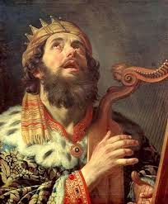
大卫列在亚伯拉罕之前
“亚伯拉罕的后裔、大卫的子孙、
耶稣基督的家谱．”

Slide 7
马太:
论文福音
前言:诞生,早期生活,洗礼,诱惑
1:1-4:11
叙事 4:12-25 | 论文 5:1-7:29
叙事 8:1-9:38 | 论文 10:1-11:1
叙事 11:2-12:50 | 论文 13:1-53
叙事 13:54-17:27 | 论文 18:1-19:2
叙事 19:3-23:39 | 论文 24:1-26:2
创世记
出埃及记
利未记
民数记
申命记
从“马太”新约全书调查
(MBI学习),片4转用
结论:末后的异象,死亡,复活
26:3-28:20

Slide 8
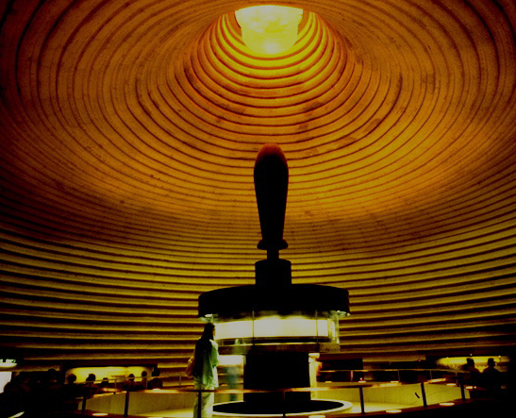
神呼召
亚伯拉罕
创 12:1-3
亚伯拉罕
立约
立约
创:15:9-18
永恒
字义上
无条件
创13:15
创 13:14-16
创15:9-18
土地
后裔
祝福
创12:1
创 12:2
创 12:3
扩大微观的盟约
土地
大卫支派
申 30: 1-10
撒下 7: 4-16
整个圣经启示的基础
18
©2004 TBBMI
7.2.05B.

Slide 9
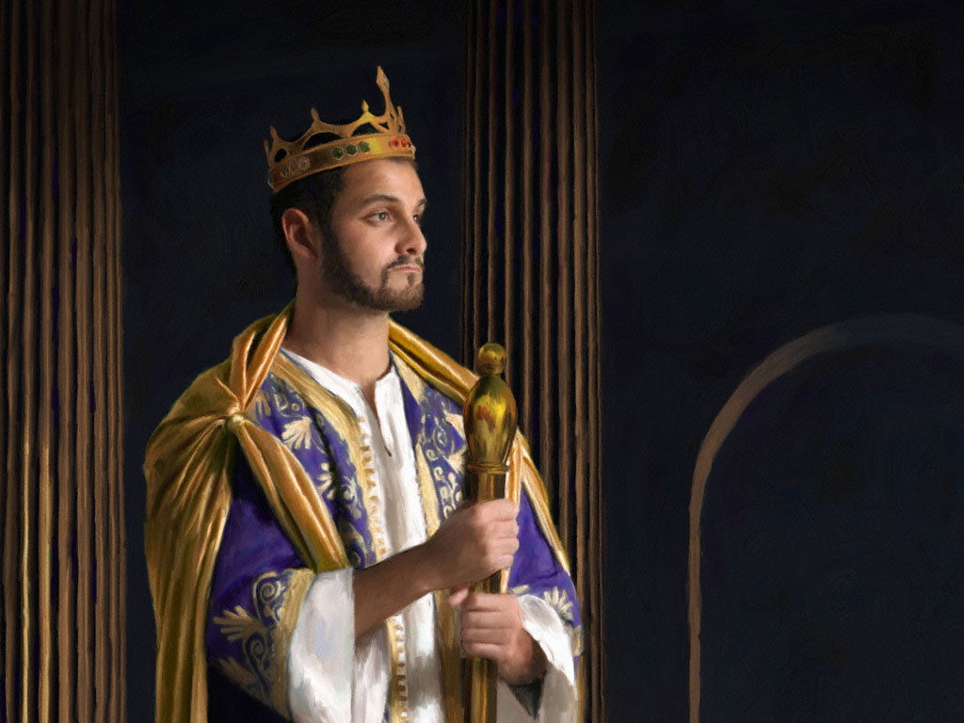
主要经节:
撒后7:12-13
209
“到了你的寿数满足，你与你的列祖一起长眠的时候，我必兴起你亲生的后裔接替你，并且我要坚固他的国。 ¹³ 他必为我的名建造一座殿宇，我要永远坚固他的国位。

Slide 10

大卫之约
三个保证
撒母耳记下 7章
你的家和你的王国，也必在我的面前永远坚定，你的王位也必永远坚立。
永远
永远
8.0.05B.
6
©2006 TBBMI
19

Slide 11
所以，我们必须问:
到底谁有资格
继承
大卫的王位?
8.0.05B.
©2006 TBBMI
20

Slide 12
大卫的朝代
耶稣基督的王室家谱
学习帮助 #16
8.0.05B.
1
©2006 TBBMI
21

Slide 13
大卫的后裔: 耶稣基督的王室家谱*
*有很多省略
22
1

Slide 14
大卫的后裔: 耶稣基督的王室家谱*
亚当 夏娃
圣经的记载:
创世记 3:20
*有很多省略
23

Slide 15
大卫的后裔: 耶稣基督的王室家谱*
亚当 夏娃
圣经的记载:
创世记 4:1-2, 4:8
该隐 亚伯
*有很多省略
24
1

Slide 16
大卫的后裔: 耶稣基督的王室家谱*
亚当 夏娃
圣经的记载:
创世记 4:25
该隐 亚伯 塞特
*有很多省略
25

Slide 17
大卫的后裔: 耶稣基督的王室家谱*
亚当 夏娃
圣经的记载:
创世记 5:29
该隐 亚伯 塞特
挪亚
*有很多省略
26

Slide 18
大卫的后裔: 耶稣基督的王室家谱*
亚当 夏娃
圣经的记载:
创世记 11:26
该隐 亚伯 塞特
挪亚
亚伯拉罕
*有很多省略
27

Slide 19
大卫的后裔: 耶稣基督的王室家谱*
亚当 夏娃
圣经的记载:
路得记 4:22
该隐 亚伯 塞特
挪亚
亚伯拉罕
(撒拉)
*有很多省略
大卫
28

Slide 20
大卫的后裔: 耶稣基督的王室家谱*
亚当 夏娃
圣经的记载:
撒母耳记下 12:24
该隐 亚伯 塞特
挪亚
亚伯拉罕
*有很多省略
大卫
拔示巴
29

Slide 21
大卫的后裔: 耶稣基督的王室家谱*
亚当 夏娃
圣经的记载:
撒母耳记下 5:14
该隐 亚伯 塞特
挪亚
亚伯拉罕
*有很多省略
大卫
拔示巴
拿单 所罗门
30

Slide 22
大卫的后裔: 耶稣基督的王室家谱*
亚当 夏娃
圣经的记载:
路加福音 3:23 和其他
该隐 亚伯 塞特
挪亚
亚伯拉罕
*有很多省略
大卫
拔示巴
拿单 所罗门
路加福音3:23
(对照其它资料)
马利亚
31

Slide 23
大卫的后裔: 耶稣基督的王室家谱*
路加福音3:23 (对照其它资料)
路3:23:“耶稣开始传道，年纪约有三十岁。依人看来, 他是约瑟的儿子。 ” (和合本)
“路加追踪了马利亚的家谱。许多 [抱着不同观点] 解经家认为，路加提供了马利亚的家谱,是为了表明她也是大卫的后裔，那么耶稣之所以能符合弥赛亚的身份，除了因着约瑟 (他是年纪最长的合法继承人)，也是因着马利亚的缘故。
The Bible Knowledge Commentary, John Walvoord & Roy Zuck, editors, Victor Books, 1983. 212页.
32
1

Slide 24
大卫的后裔: 耶稣基督的王室家谱*
亚当 夏娃
圣经的记载:
马太福音 1:16
该隐 亚伯 塞特
挪亚
亚伯拉罕
*有很多省略
大卫
拔示巴
拿单 所罗门
马利亚 约瑟
33

Slide 25
大卫的后裔: 耶稣基督的王室家谱*
亚当 夏娃
圣经的记载:
马太福音 1:16
该隐 亚伯 塞特
挪亚
亚伯拉罕
*有很多省略
大卫
拔示巴
拿单 所罗门
马利亚 约瑟
耶稣基督
34

Slide 26
大卫的后裔: 耶稣基督的王室家谱*
亚当 夏娃
该隐 亚伯 塞特
挪亚
亚伯拉罕
大卫
拔示巴
拿单 所罗门
血源承传
合法承传
家族 权利
路 3: 23-38
合法 权利
太 1: 1-17
马利亚 约瑟
耶稣基督
35
3

Slide 27
大卫的后裔: 耶稣基督的王室家谱*
亚当 夏娃
该隐 亚伯 塞特
挪亚
亚伯拉罕
大卫
拔示巴
拿单 所罗门
家族 权利
路 3: 23-38
合法 权利
太 1: 1-17
血源
的权利
马利亚 约瑟
耶稣基督
36

Slide 28
大卫的后裔: 耶稣基督的王室家谱*
亚当 夏娃
该隐 亚伯 塞特
挪亚
亚伯拉罕
大卫
拔示巴
拿单 所罗门
家族 权利
路 3: 23-38
合法 权利
太 1: 1-17
血源
的权利
合法 的权利
马利亚 约瑟
耶稣基督
37

Slide 29

你是否认为耶稣的诞生与生平 只不过是难以置信的概率巧合呢?
是一个 巧合的 诞生吗?
学习帮助 #17
8.0.05B.
2
©2006 TBBMI
39

Slide 30
你是否认为耶稣的诞生与生平 只不过是难以置信的概率巧合呢?
*
耶稣的诞生是一件巧合的事吗?
在旧约里, 超过三百处的预言是有关即将来到的弥赛亚的诞生、生平与受苦。这些都成就在耶稣基督的身上了!
学习帮助 #17
资料来源: Josh MacDowell, Evidence That Demands A Verdict, 1972, 175页; Peter Stoner, Science Speaks, Moody Press, 1963.
*
40

Slide 31
是一个巧合的诞生吗?
有关弥赛亚的预言一共有 8 项。从古至今若要全部成就在一个人身上，成就的机率会有多高?
_{答案:10} ¹⁷_{分之一}
_{1:100,000,000,000,000,000}
资料来源: Josh MacDowell, Evidence That Demands A Verdict, 1972, 175页; Peter Stoner, Science Speaks, Moody Press, 1963.
41
2

Slide 32
是一个巧合的诞生吗?
然而…从古至今,仅仅 48 (300之中) 个预言成就在任何一个人的生活中的机率:
_{答案: 10}¹⁵⁷_{分之一}
1:10,000,000,000,000,000,000,000,000,000,000,000,000,000, 000,000,000,000,000,000,000,000,000,000,000,000,000,000, 000,000,000,000,000,000,000,000,000,000,000,000,000,000, 000,000,000,000,000,000,000,000,000,000,000,000
资料来源: Josh MacDowell, Evidence That Demands A Verdict, 1972, 175页; Peter Stoner, Science Speaks, Moody Press, 1963.
3
42

Slide 33
从约瑟到基督族谱的三部份 (1:1-17):
从亚伯拉罕到戴维王
-14 代
从大卫王到被掳到巴比伦
-14 代
被掳到巴比伦到耶稣降生
-14 代

Slide 34
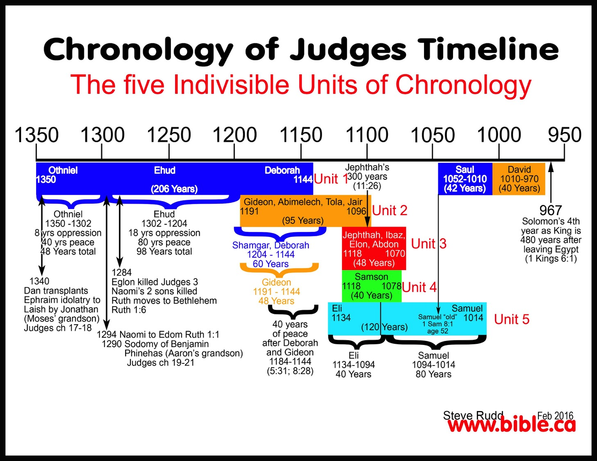
Chronological Overlaps
士师记的年代循序排列表
五个不可分割的年代学单位
俄陀聂
1350
以笏
(206 年）
底波拉
1144
单元1
耶弗他
300年
(11:26)
扫罗
1052-1010
（42年）
大卫
1010-970
（40年）
基甸，亚比米勒，陀拉，睚珥
1191 1096
（95年）
单元2
俄陀聂
1350-1302
8年的逼迫
40年的和平
总数48年
以笏
1302-1204
18年的逼迫
80年的和平
总数98年
所罗门作为君王的第四年即离开埃及后的480年
(列王记上6:11)
耶弗他，以比赞
以伦， 押顿
1118 1070
(48年)
单元3
珊迦
1204 1144
60年
1284
伊矶伦被杀 - 士师记3
拿俄米的双子被杀
路得迁移至伯利恒
路得1:6
参孙
1118 1078
（40年）
单元4
1340
但移植了以法莲的偶像
到拉亿由约拿单（摩西的孙子）当祭司
士师记17-18章
基甸
1191 1144
48年
以利 撒母耳
1134 1014
（120年）
单元5
在底波拉
与基甸后
40年的和平
1184-1144
(5:31; 8:28)
撒母耳“年老”
撒母耳记上 8:1
52 岁
1294 拿俄米迁移至以东-路得1:1
1290 亲男色的便雅悯
非尼哈(亚伦的孙子）
士师记19-21章
以利
1134-1094
40年
撒母耳
10944-1014
80年

Slide 35
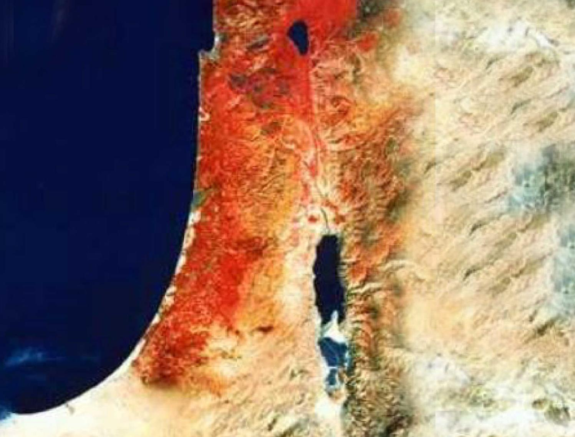

日期
家谱
186
大卫被指定而尚未作王
大卫作王
士师时代
1373
1105
1049
1030
1010
971
俄陀聂
参孙
撒母耳
路得一生
路得记写作时期
族谱（四18-21）以大卫（不是所罗门）作结束，指出这很可能是在大卫被膏为王之后的作品（公元前1030年）， 最晚在所罗门继承王位以前（公元前971年)。
如果以撒母耳为作者， 撰写日期应该在公元前1030-1020年。
路得记的事件发生在土师时代（一1；公元前1373-1049年）
路得是大卫的曾祖母（四17），而大卫在公元前1010年左右作王，因此有学者认为路得活在十二世纪的后半部。
因此撒母耳记载了一个世纪以前的事件。

Slide 36


大卫之约的应许
9g
神在撒母耳记下7:12-16给大卫什么允诺呢？
新王朝
(撒下 7)

Slide 37

王朝与立约时间表
9g
王朝的教导...
亚当与上帝一起统治
(创 1:26, 28; 2:19)
撒但是这个世界的统治者
(创 3:15;
林后4:4)
上帝和亚伯拉罕立约为了要重新让人类统治并托过以色列作“祭司的国度” (创 12:1-3;出 19:6)
因以色列没以祭司国度的身份向各民族作见证，所以上帝让他们被流放到别国的统治下
以色列拒绝弥赛亚赐给他们王朝 (太12:41-42; 23:37-39)
耶稣以奥秘形式扩展他的王国与教会
(太13)
基督征服以色列的敌人而民族相信他 (罗11:26-27)
基督与圣人统治一切 (弗1:9-10;启20:1-6; 22:5b)
人类的堕落
(创 3)
诺亚的圣约
创 6:18; 9:8-17
以色列
教会
弥塞亚的 王国
地区的集约
(国家的重点)
新人 (以弗所书2:15)
千福年 永恒
地区
创 15:18 (cf. 申 30:1-10) 应许:
地从大河直到埃及小河 (赛27:12)
放逐和重建之后，赐这地为永远为业 (创 17:8)
通过这偏地全世界得福 (赛14:1-2)
以色列因拒绝弥赛亚而被上帝
惩罚，十九个世纪(公元 70–公元 1948),被疏散到别地。
现在已经有些被恢复了。
(以西结书37:1-7)
全部恢复 (结37:8-28)
耶路撒冷成为
世界首都
(赛2:1-5)
新耶路撒冷
(启21)
大卫的圣约
基督是教会的头。
教会是属灵的圣殿
(弗2:19-22; 林后6:16)
基督跟圣人
(启 5:10)
统治
全世界
(赛11)
基督把王国交给圣父
(林前15:24)
种子
撒母耳记下7:12-16 永远的应许:
儿子 (家庭永存)
王国 (政治的朝代)
宝座 (后裔有统治的权利)
圣殿 (由儿子建造)
创 12:1-3
亚伯拉罕的圣约
新约
国家的恢复完成所有五个要素(撒迦利亚书8)
一切都
更新
(启 21:5)
耶利米书31:31-34 的应许:
饶恕
圣灵存在内心
新心, 新性格, 新智力
以色列跟犹大再结合
不需要传福音
新约的前三个要素代替了摩西的律法 (路 22:20;
林后3:6)
祝福
摩西的圣约
在十字架上，摩西的律法被废除，应验, 并取代了
(罗7:1-6;林前9:19-21;
希 8:13)
暂时的(加3:19)和有条件的(申28)显示罪恶(罗7:7)并管理以色列
(加3:23-25)
Second Edition
2 January 1998
圣经包含两大王国和契约的重点。从亚伯拉罕到基督，上帝扩大了以色列的任务，包括教会 (连续性)。但教会从没代替以色列作新的以色列。 (不连续)
当耶稣再来的时候，以色列相信他，必将享有全世界的名声。

Slide 38
应许与大卫所立的约
9g
神在撒母耳记下 7:12-16 应许大卫什么呢？
后裔: “家” 不被灭绝
王朝: 政治王国 (耶路撒冷的每一位王将是他的后裔)
宝座: 为永恒的约 (v. 16), 他家族会拥有永远统治的权柄
圣殿: 所罗门将会建造圣殿
惩罚: 神虽会惩罚不服从的王，但却会毫无条件的守他所立的约
新王朝
(撒下 7)

Slide 39

在马太的国度 1
国度的灭亡
建立永恒的国度
亚伯拉罕
所罗门
撒拉铁
艾萨克
所罗巴伯
罗波安
雅各布
亚比玉
亚比雅
犹大
亚撒
以利亚敬
法勒斯
约沙法
亚所
这样，从亚伯拉罕到大冲共有十四代；从大卫到迁至巴比伦的时候也有十四代；从迁至巴比伦的时候到基督又有十四代。
马太福音1:17
希斯仑
撒督
约兰
亚兰
乌西亚
亚金
亚米拿达
约坦
以律
拿顺
亚哈斯
以利亚撒
撒门
希西家
马但
波阿斯
玛拿西
雅各布
俄备得
亚们
约瑟+
马利亚
耶西
约西亚
国度的升起
大卫王
耶哥尼雅(流亡)
耶稣基督

Slide 40
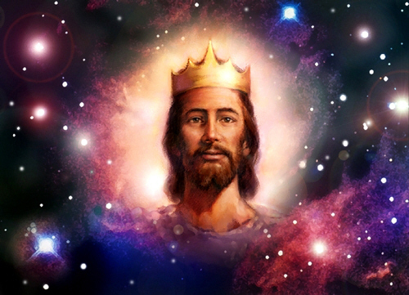
马太宣说耶稣是君国！

Slide 41
Criswell, W. A.
Danker, Frederick
Ellis, E. Earle
Fitzmeyer, Joseph
Godet, F. A.
Hendricksen, William
Hoehner, Harold
Ironside, F. A.
Marshall, I. Howard
McGee, J. Vernon
Morgan, G. Campbell
MacArtuhur, John
Scofield, C. I
Swindoll, Charles
Unger, Merrill
Walvoord, John
Zuck, Roy
其他写耶稣
族谱的作者:
38
©2004 TBBMI
8.0.05B.

Slide 42
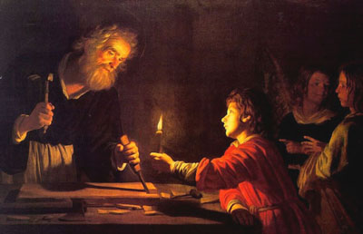
Birth & Childhood of Jesus
Adapted from a 2006 Class Presentation by Connie Tong for
Dr. Rick Griffith • Singapore Bible College • BibleStudyDownloads.org

Slide 43
Genealogy of Jesus
马太
from
Abraham
down to
Jesus

Slide 44
15
P1 Million
14
P500,000
How many generations were there from Abraham to Jesus?
13
P250,000
12
P125,000
11
P64,000
10
P32,000
9
P16,000
8
P8,000
7
P4,000
6
P2,000
5
P1,000
4
P500
3
P300
2
P200
50:50
1
P100
A: 14 x 3
B: 14 x 4
C: 13 x 5
D: 15 x 2

Slide 45
Genealogy of Jesus
马太
Abraham
David
Babylonian exile
Jesus
from
Abraham
down to
Jesus

Slide 46
Genealogy of Jesus
马太
from
Abraham
down to
Jesus
Adam
up to
Jesus
from
路加

Slide 47
Jesus'
Focus
Davidic heritage
messianic role

Slide 48
2. 他的来临
§§ 4-11
The arrival of both 约翰 and Christ are announced and fulfilled to show through their births that Jesus is the promised Messiah
Notes:
Intro: Fact or Fiction...

Slide 49
Birth & Childhood of Jesus
Adapted from a 2006 Class Presentation by Connie Tong for
Dr. Rick Griffith • Singapore Bible College • BibleStudyDownloads.org

Slide 50

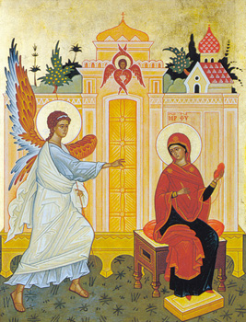
same main details
Of
马太 & 路加
Mary & Joseph were godly parents
virginal conception of Mary
an angel announced the birth of Jesus

Slide 51
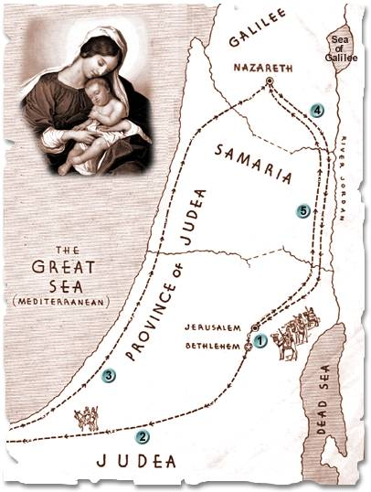
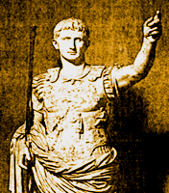
name the child in advance
born in
Bethlehem in
the time
of Herod
Nazareth
Bethlehem
the family settled in Nazareth

Slide 52
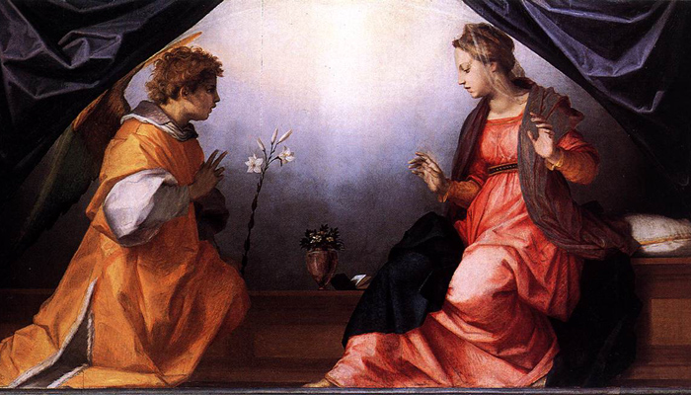
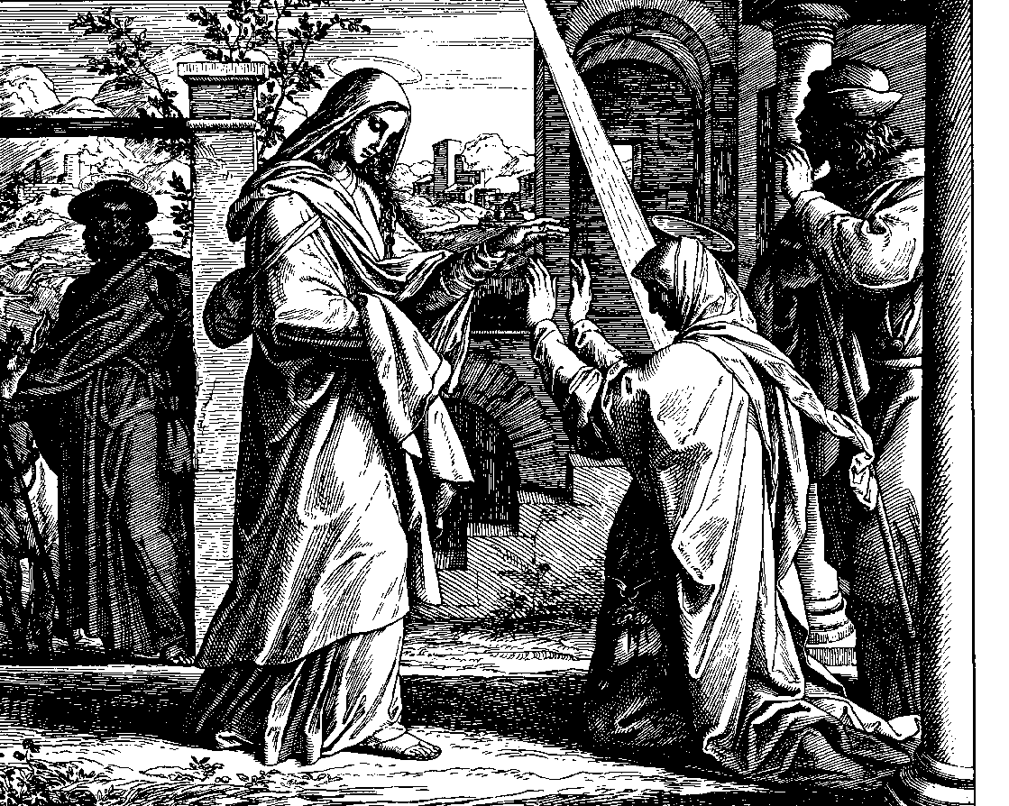
Timeline of
Infancy stories of Jesus
M
A
T
T
H
E
w
路加
birth of 约翰 predicted
birth of Jesus predicted
Mary conceived
Mary & Elizabeth met

Slide 53
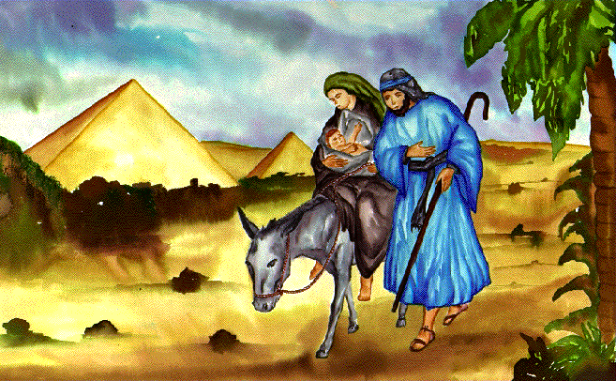
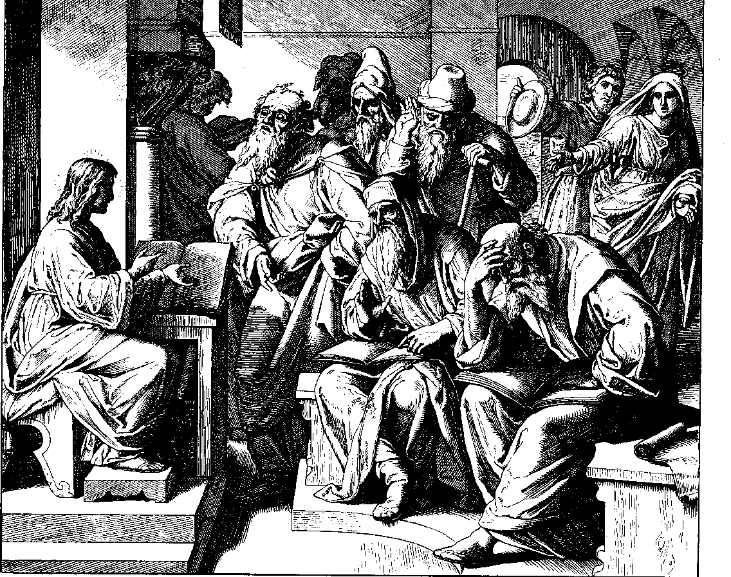
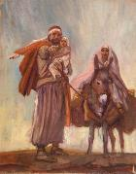
birth of 约翰
Jesus born
in Bethlehem
birth of Jesus
flight to Egypt
killing of the infants
returned to Nazareth
Jesus in the temple
at the age of 12

Slide 54
a. The Annunciation of the Birth of 约翰 to Zechariah
§ 4
路加 1:5-25
Gabriel announces to Zechariah that his wife Elizabeth would miraculously give birth to the forerunner of Messiah to set 约翰 apart for God's service before his birth
Notes:
Intro: Fact or Fiction...

Slide 55
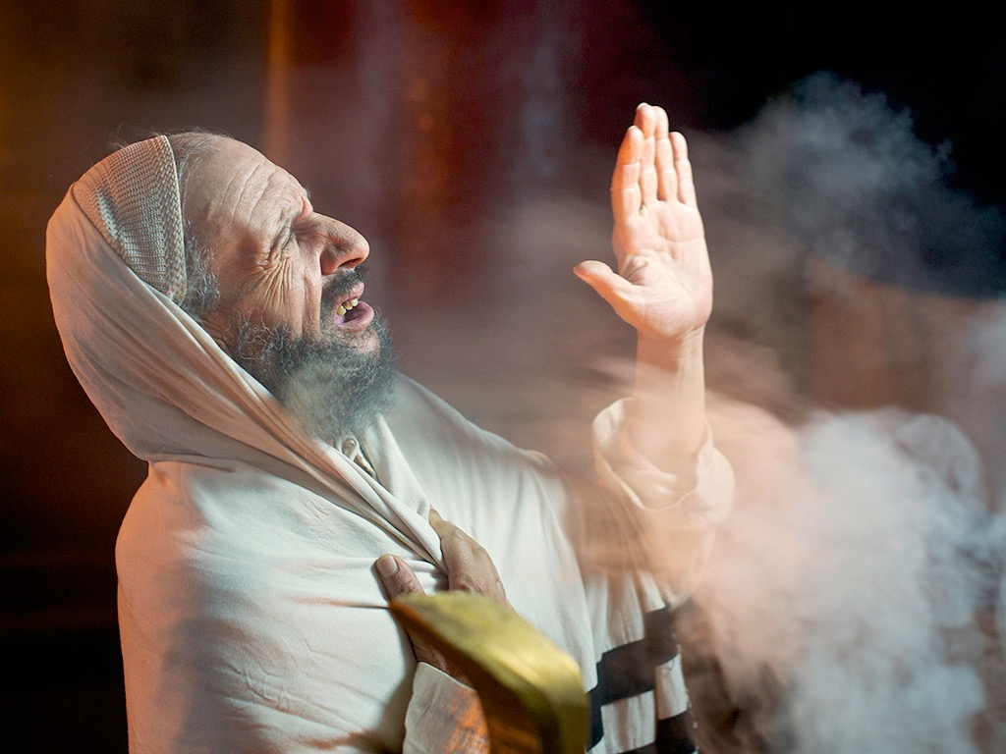

路加 1:5-25, 39-45, 57-80
ZECHARIAH IS PROMISED A SON
Free
Bible
images
Notes:
路加's gospel is known for its many parables by Jesus.

Slide 56
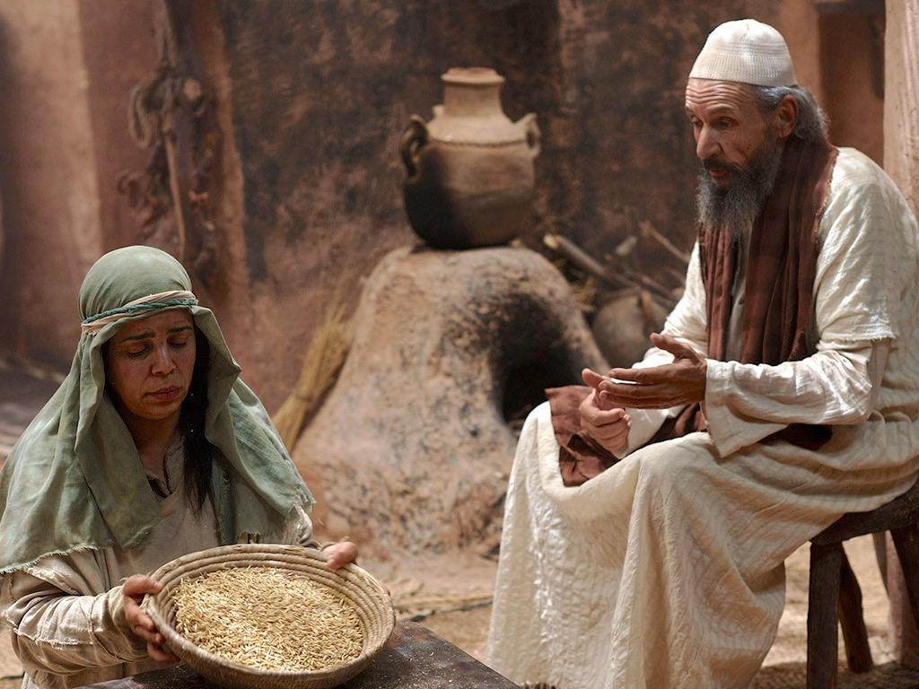

Slide 57
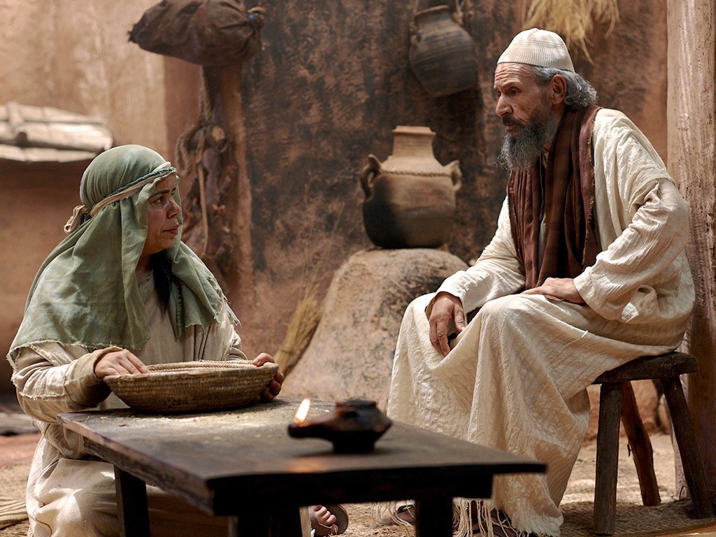

Slide 58
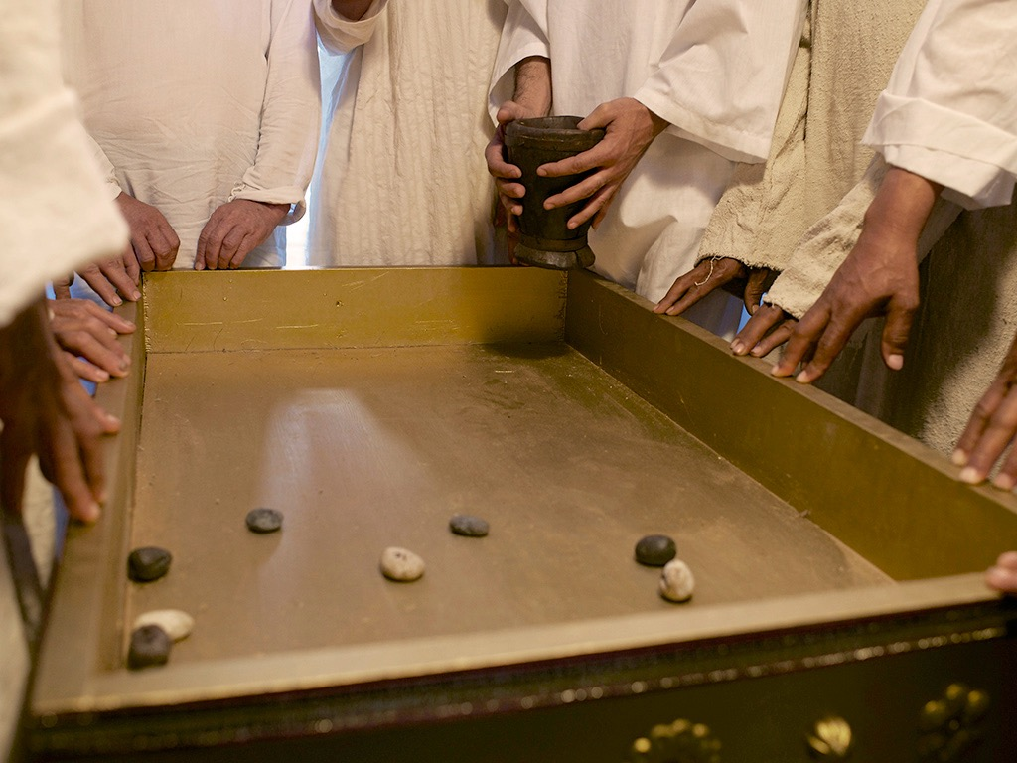

Slide 59
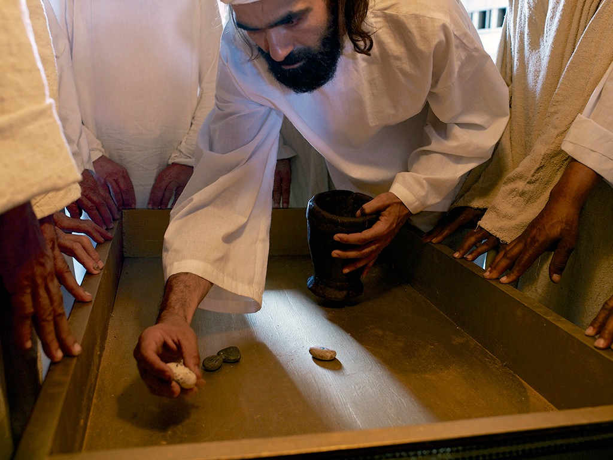

Slide 60
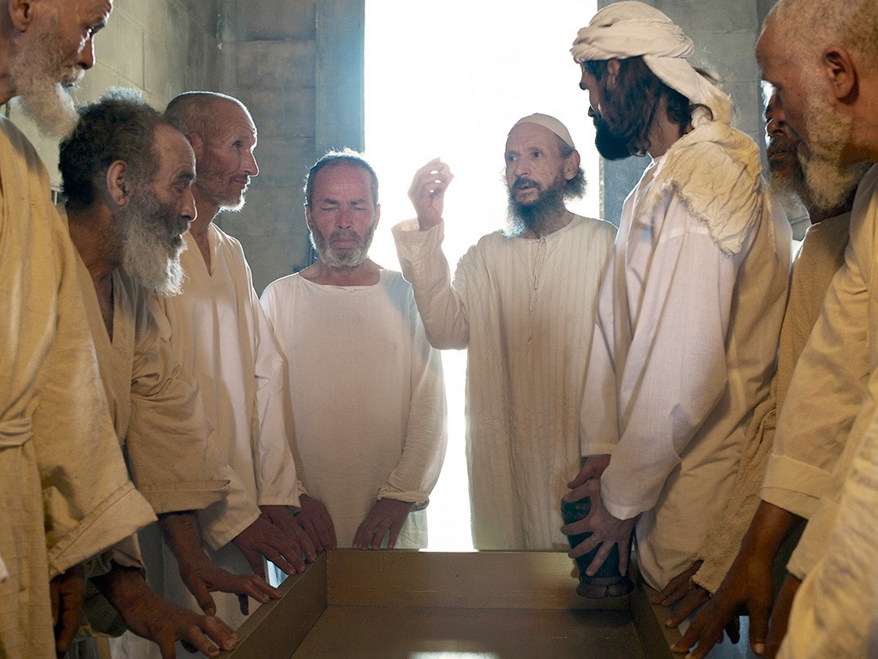

Slide 61
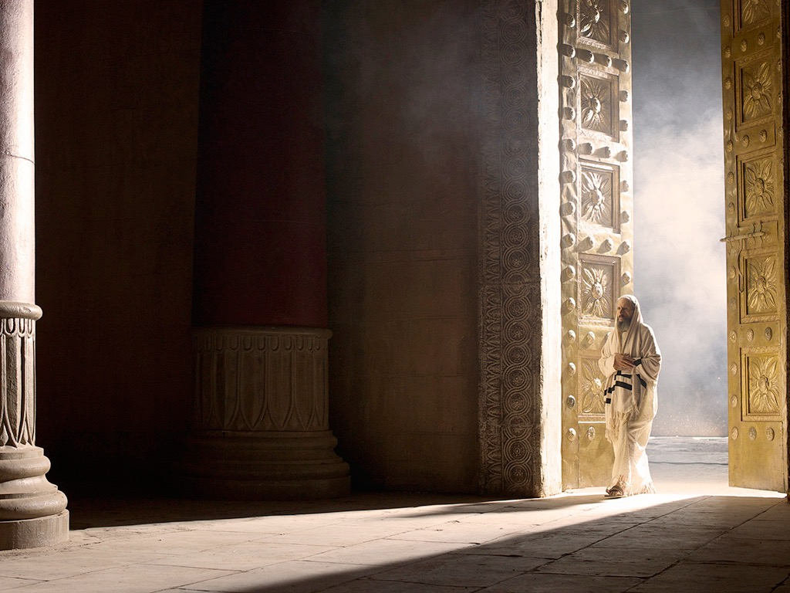

Slide 62
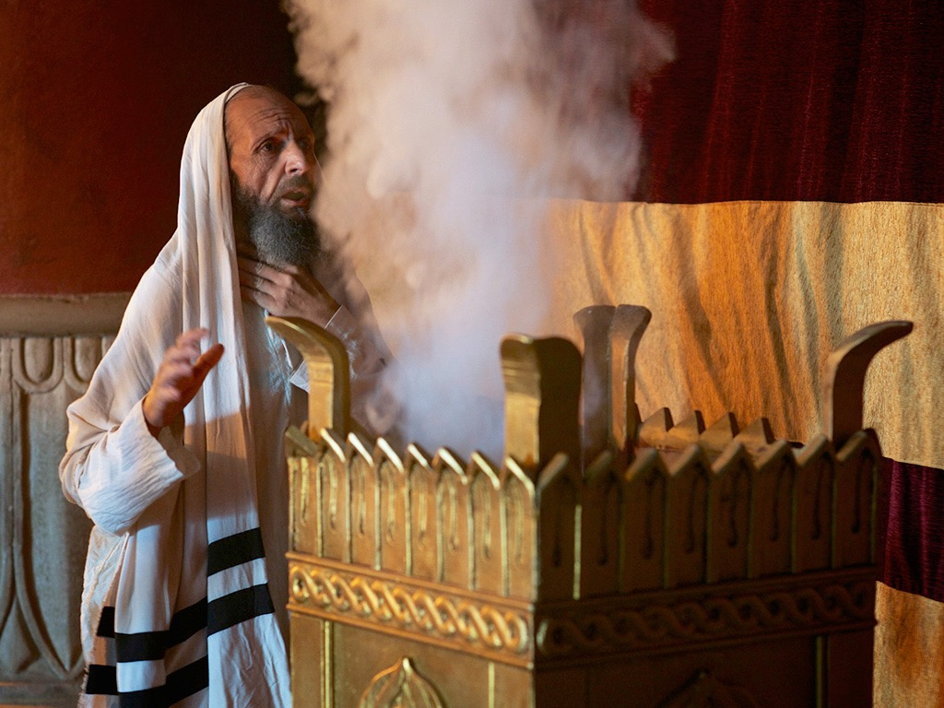

Slide 63
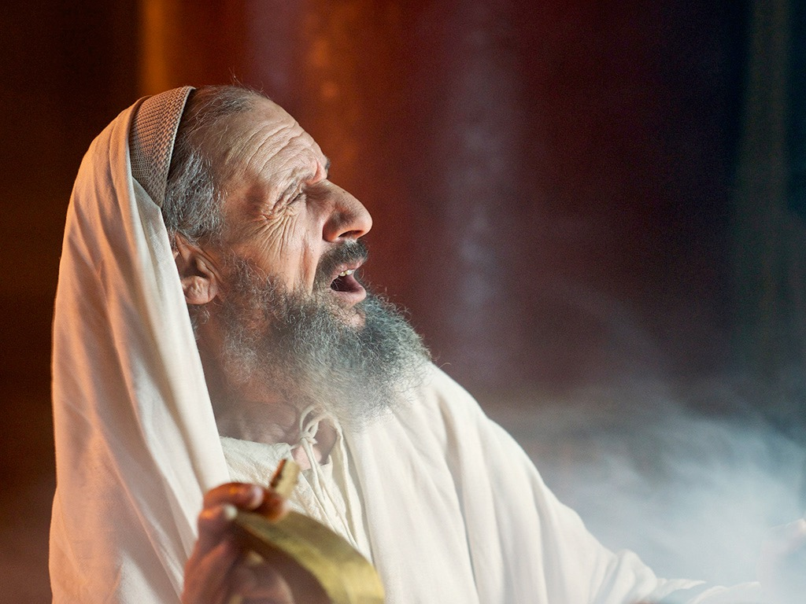

Slide 64
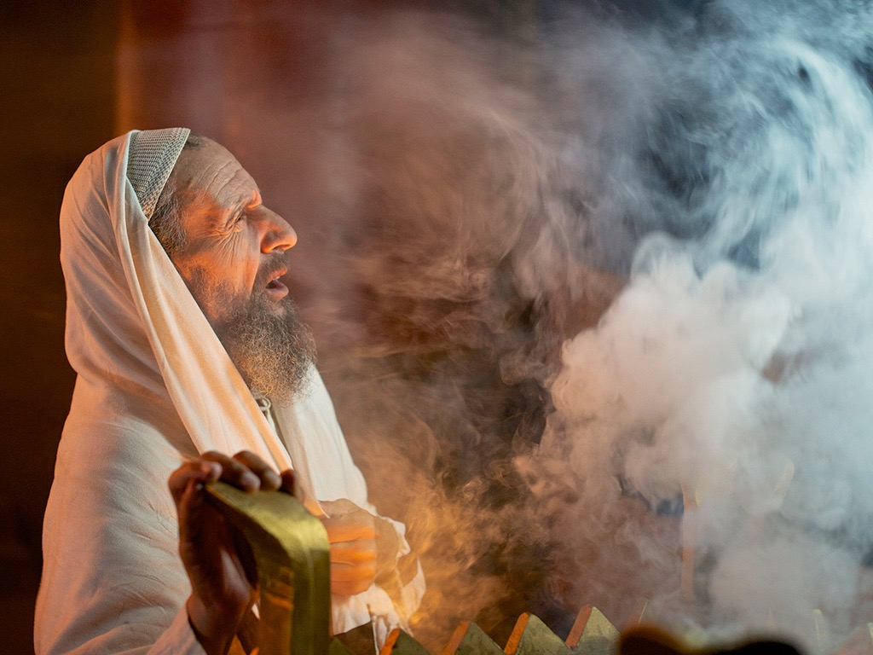

Slide 66
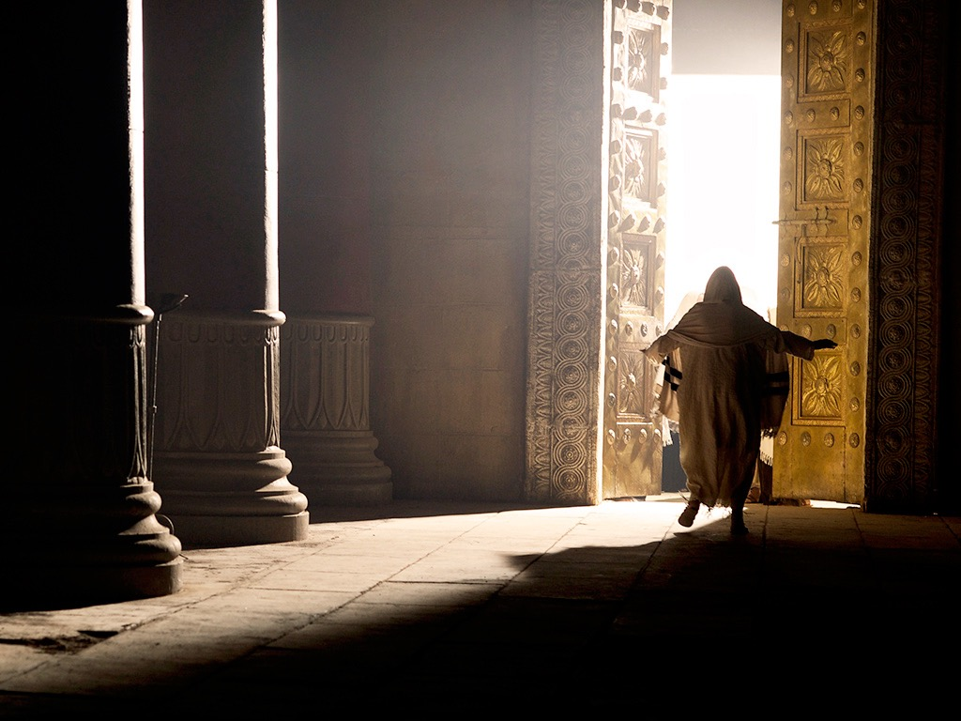

Slide 67
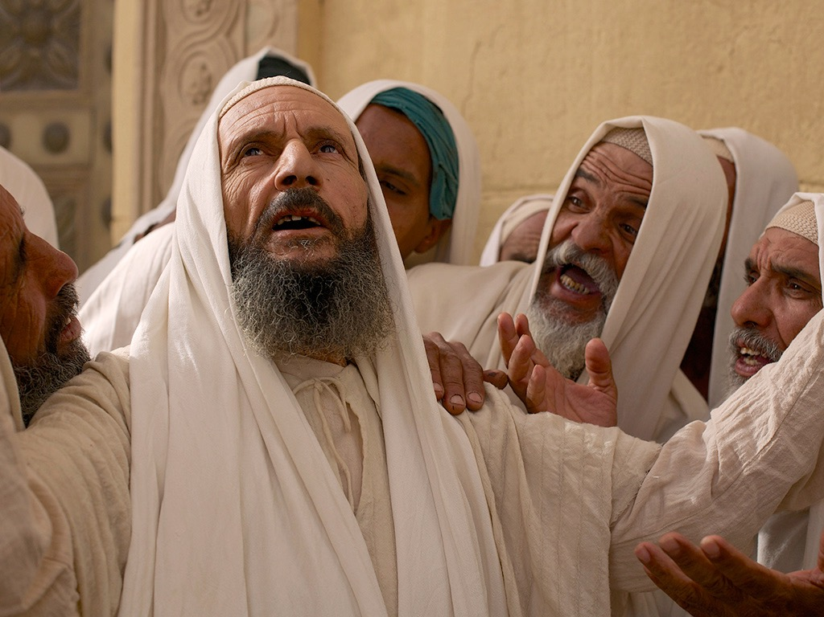

Slide 68
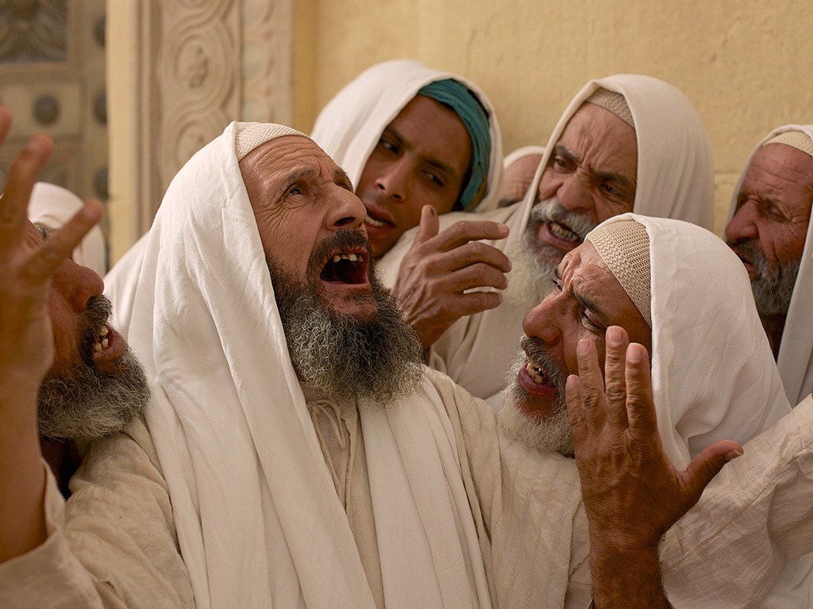

Slide 69
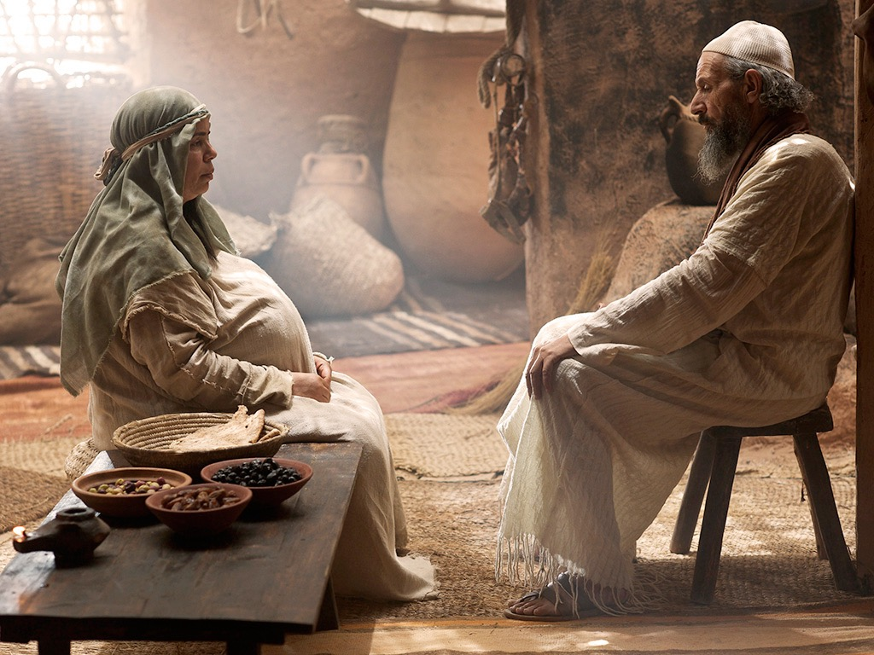

Slide 70
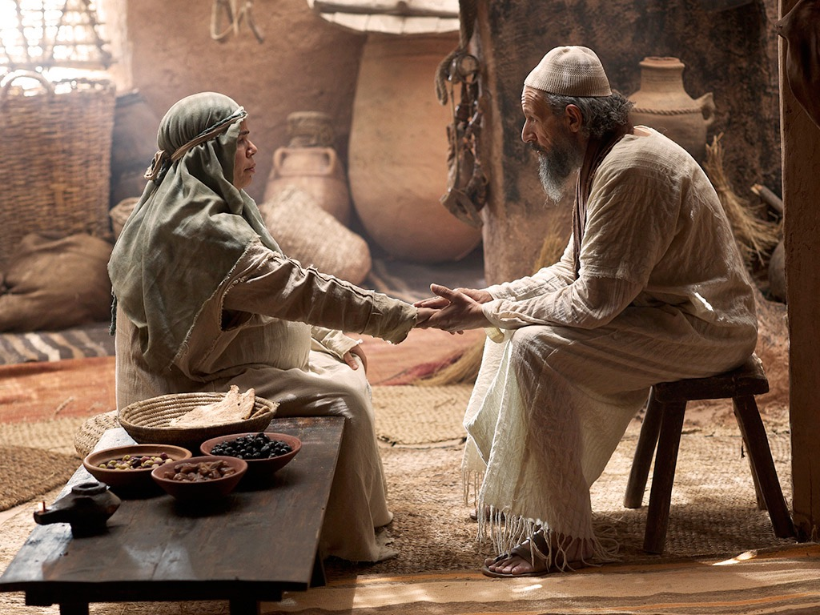

Slide 71
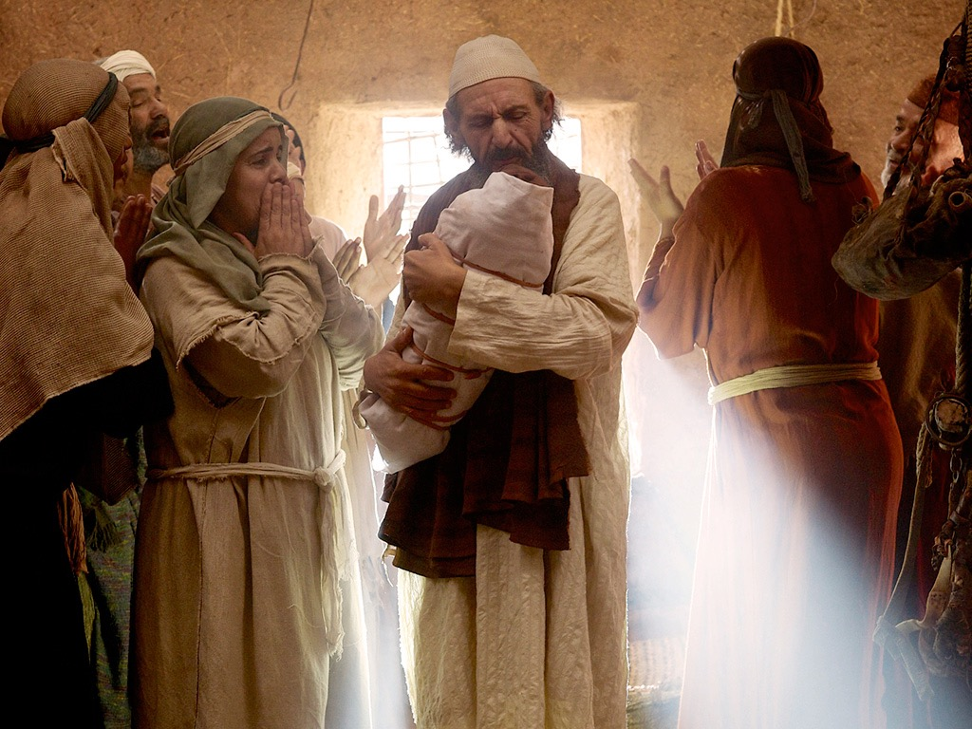

Slide 72
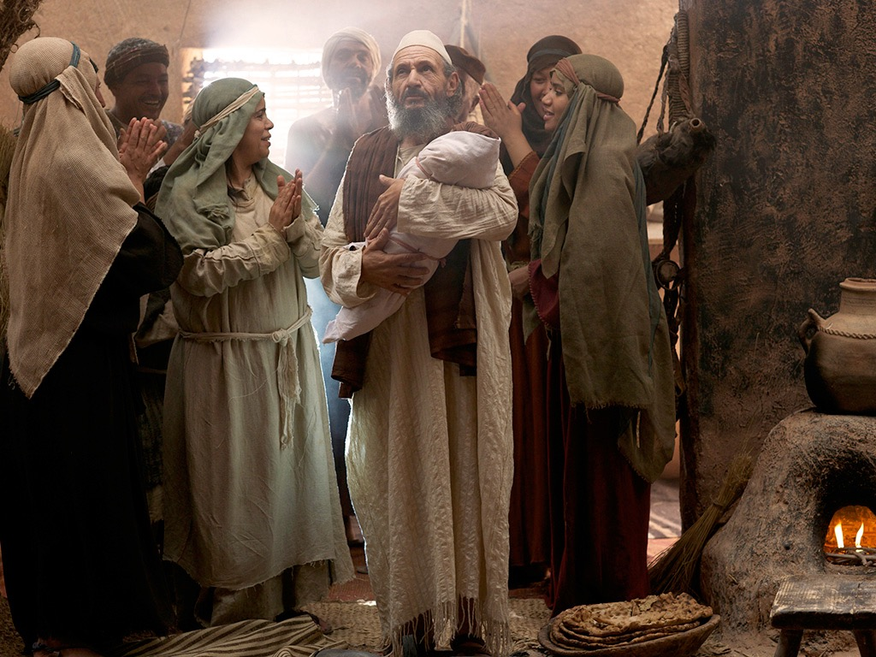

Slide 73
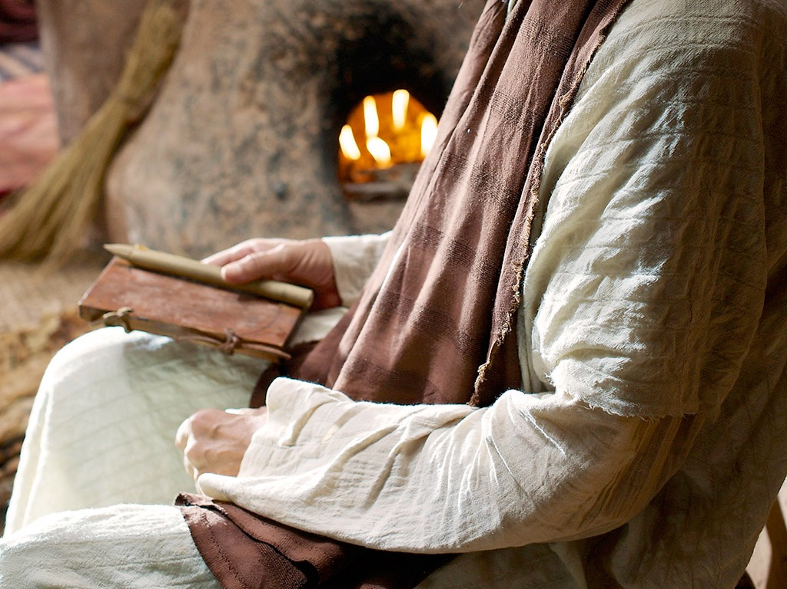

Slide 74
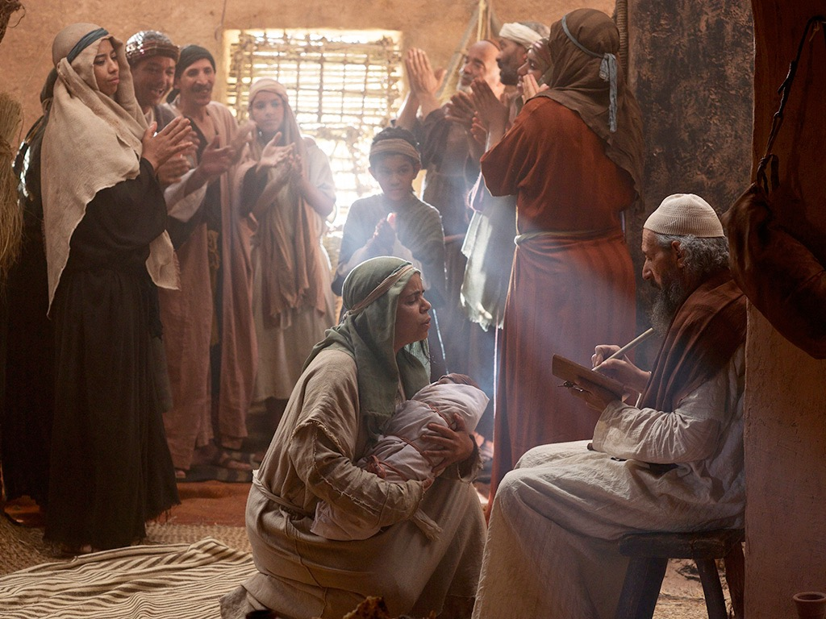

Slide 75
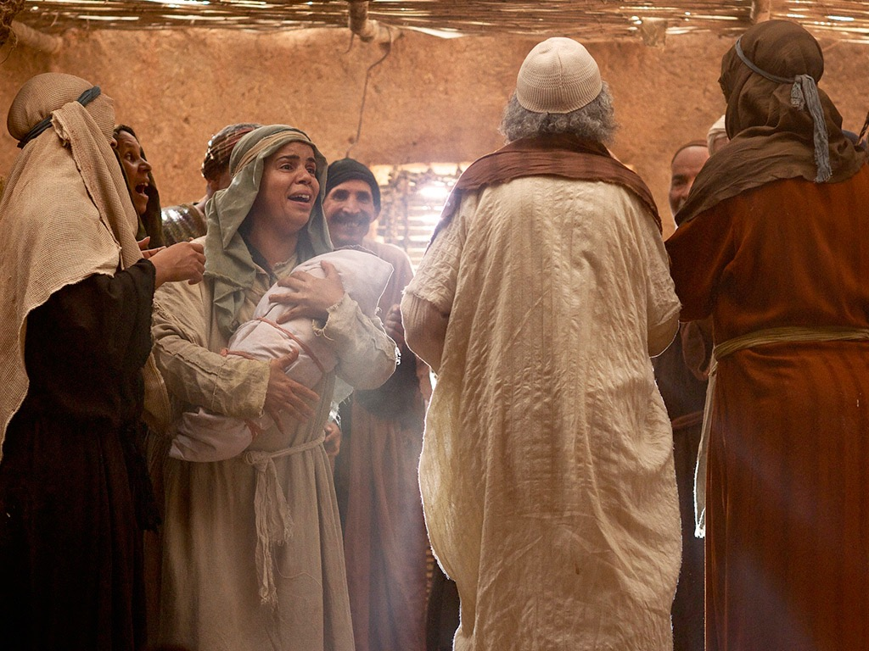

Slide 76
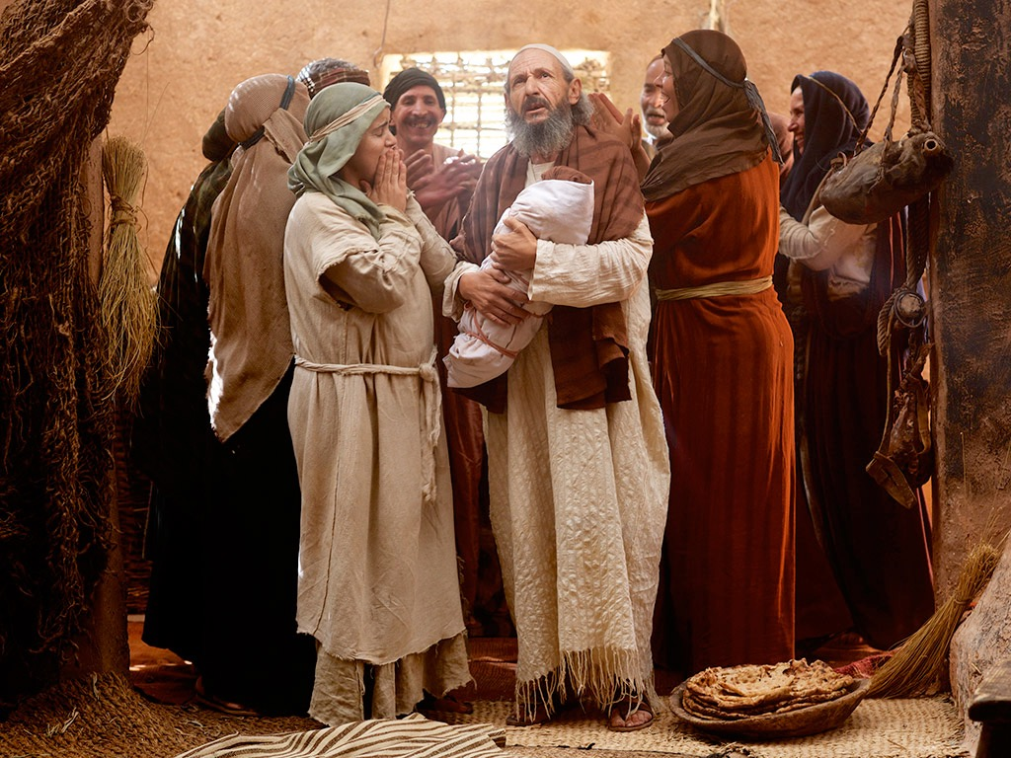

Slide 78
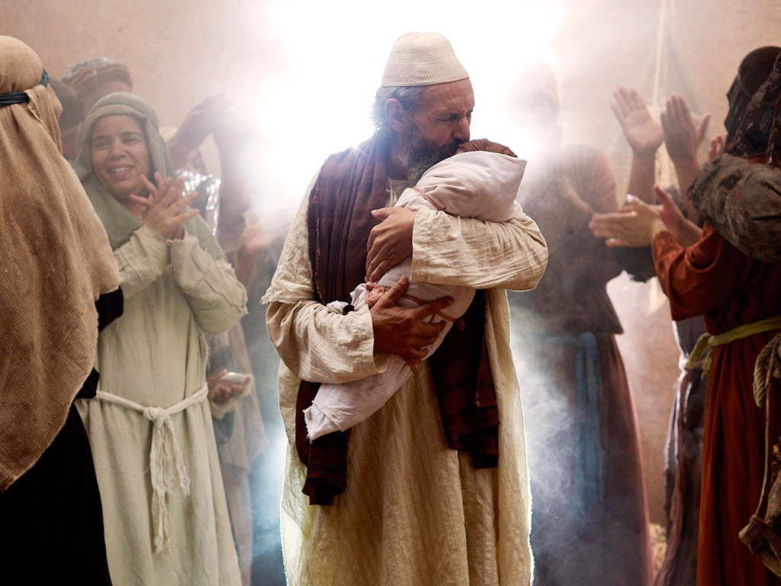

Slide 79
Free Bible Images
授权使用
免费
圣经
图片
图片中的文字

Slide 80

授权使用
马太福音
d
马可福音
o
路加福音
0
约翰福音
0
由Lumo Project出版独家资源，我们特此通知您我们不授权将这些图片发放给除freebibleimages.org客户以外的任何人。
所有图片不授权用于视频制作、epublishing或者其他媒体。所有下载的图片和文件不可通过除freebibleimages.org以外的其他网站传播，亦不可用于任何破坏基督信仰和福音的处境中。
o
图片仅供教育展示、博客和社交媒体使用；所有用途均需注明出处
www.LumoProject.com
图片声明 BBM
© 版权所有
www.bigbookmedia.com

Slide 81
b. The Annunciation of the Birth of Jesus to Mary
§ 5
路加 1:26-38
Gabriel announces to the Virgin Mary that she would miraculously conceive and bear the Messiah, Jesus, so that God could become incarnate without a fallen nature and in order that Mary might know that she became pregnant by the Holy Spirit
Notes:
Intro: Fact or Fiction...

Slide 82
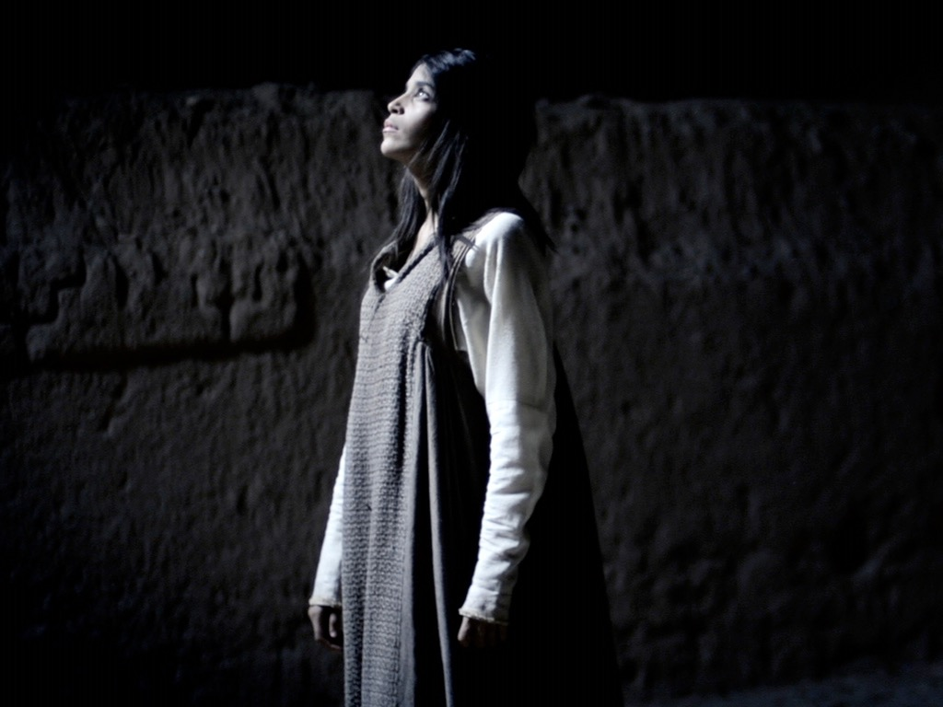
AN ANGEL VISITS MARY
Free
Bible
images
路加 1:26-38
Notes:
路加's gospel is known for its many parables by Jesus.

Slide 83
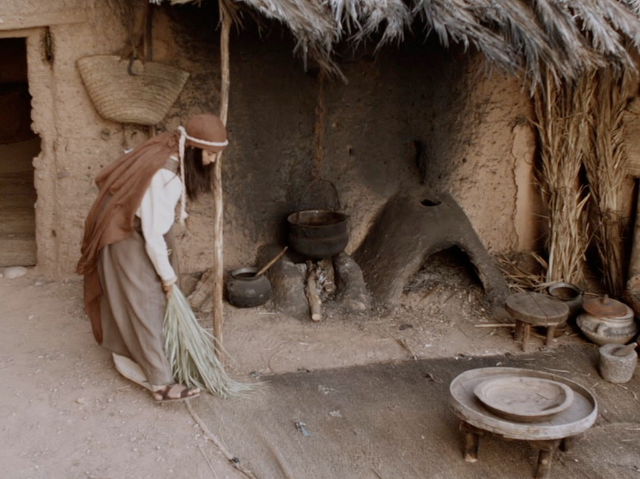

Slide 84
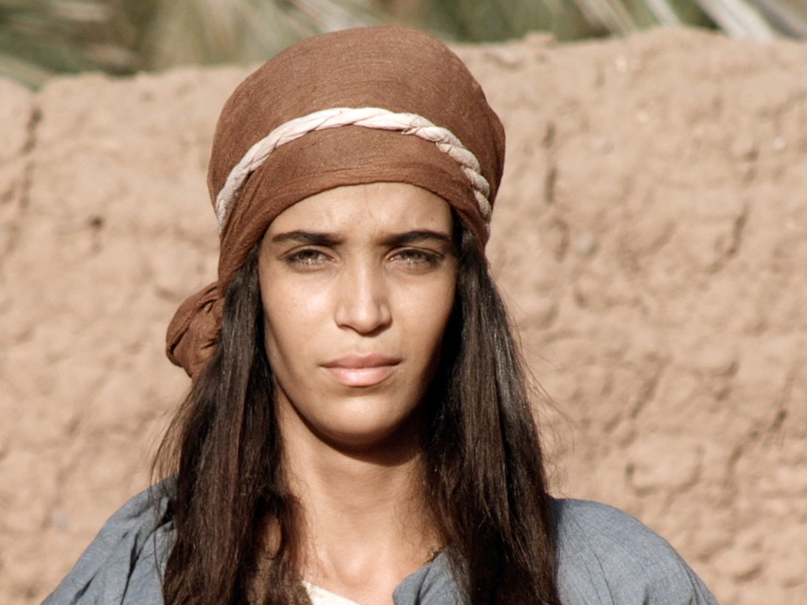

Slide 85
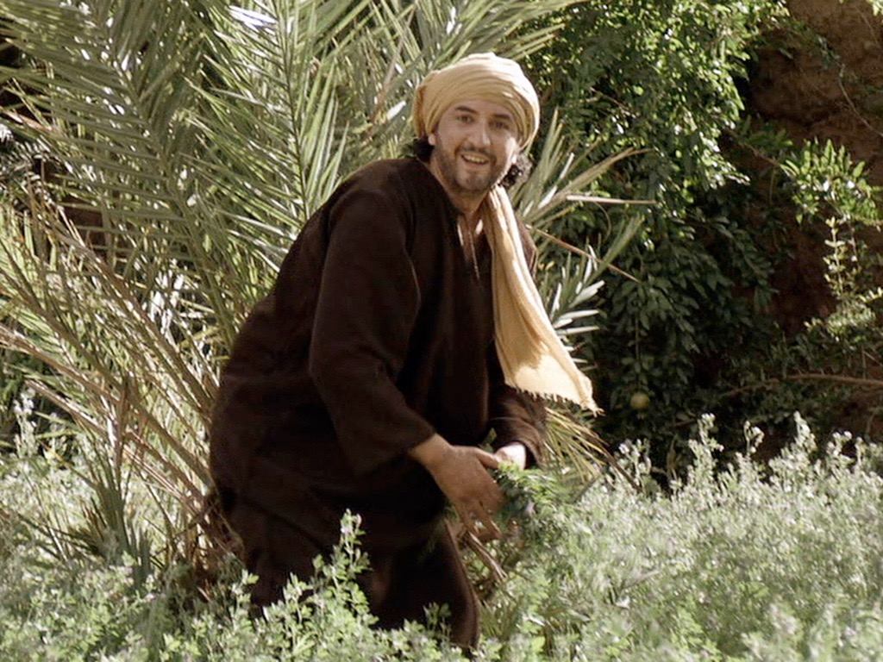

Slide 86


Slide 87


Slide 88


Slide 90


Slide 91
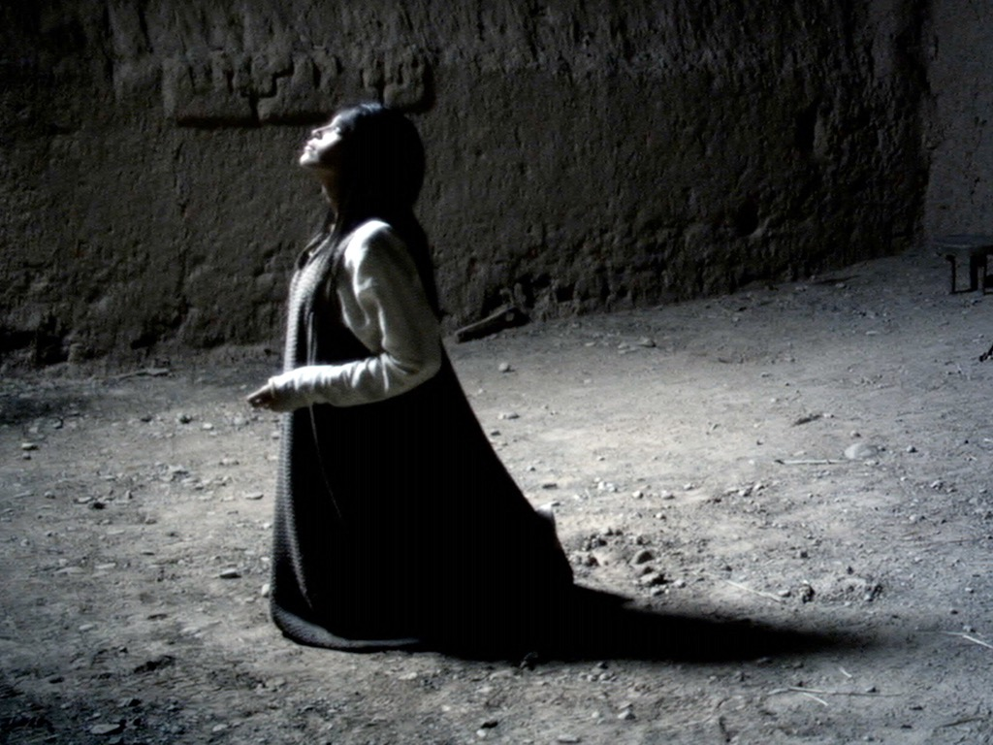

Slide 92
Free Bible Images
授权使用
免费
圣经
图片
图片中的文字

Slide 93
授权使用
马太福音
d
马可福音
o
路加福音
0
约翰福音
0
由Lumo Project出版独家资源，我们特此通知您我们不授权将这些图片发放给除freebibleimages.org客户以外的任何人。
所有图片不授权用于视频制作、epublishing或者其他媒体。所有下载的图片和文件不可通过除freebibleimages.org以外的其他网站传播，亦不可用于任何破坏基督信仰和福音的处境中。
o
图片仅供教育展示、博客和社交媒体使用；所有用途均需注明出处
www.LumoProject.com
图片声明 BBM
© 版权所有
www.bigbookmedia.com

Slide 94
c. The Arrival of Mary in Judea
§ 6
路加 1:39-45
Mary visits her cousin Elizabeth perhaps to encourage Elizabeth, to confirm what Gabriel had said about her pregnancy or to have time to think away from Joseph, but this visit brings confirmation to Zechariah, Elizabeth and Mary that God's prophetic declarations regarding the babies 约翰 and Jesus would indeed come to pass
Notes:
Intro: Fact or Fiction...

Slide 95
d. The Anthem of Mary
§ 7
路加 1:46-56
Mary praises God for His grace in allowing such a humble woman as her to bear the Messiah demonstrating that she understood the Messianic implications of this conception as fulfilling the Abrahamic Covenant by the power of God
Notes:
Intro: Fact or Fiction...

Slide 96
e. The Advent of 约翰
§ 8
路加 1:57-80
约翰's birth and Zechariah's prophecy at the boy's circumcision are recorded as a testimony of God's sovereign means of fulfilling the Abrahamic, Davidic, and New Covenants through the Messiah of whom 约翰 would precede as forerunner in the desert rather than temple priest
Notes:
Intro: Fact or Fiction...

Slide 97
f. The Announcement of the Birth of Jesus to Joseph
§ 9
马太 1:18-25
An angel of the Lord announces to Joseph that Mary would bear the Messiah as a virgin so that Joseph would be prepared as the foster father to marry her and Joseph acts in implicit faith by keeping her a virgin until Jesus' birth
Notes:
Intro: Fact or Fiction...

Slide 98
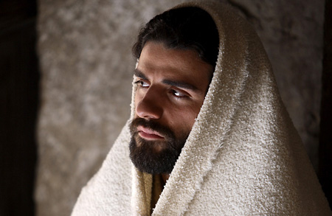
马利亚的丈夫约瑟

Slide 99


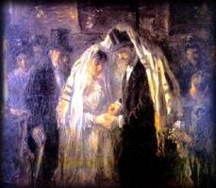
1. The Virgin Birth (1:18 – 25)
Marriage custom
betrothal, binding
marriage contract
wedding took place
a year later

Slide 100
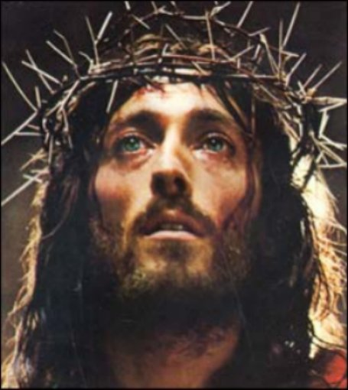
马太 1:21
“She will give birth to a son, and you are to give him the name Jesus, because he will save his people from their sins.”
YHWH saves or YHWH is salvation

Slide 101
g. The Advent of Jesus
§ 10
路加 2:1-7
Jesus is born of humblest means in Bethlehem during the census under Caesar Augustus (December 5-January 4 BC) as proof of His lineage from David and in fulfillment of Micah 5:2 in order that He would die as God made man, the Messiah, pictured in His swaddling clothes
Notes:
Intro: Fact or Fiction...

Slide 102
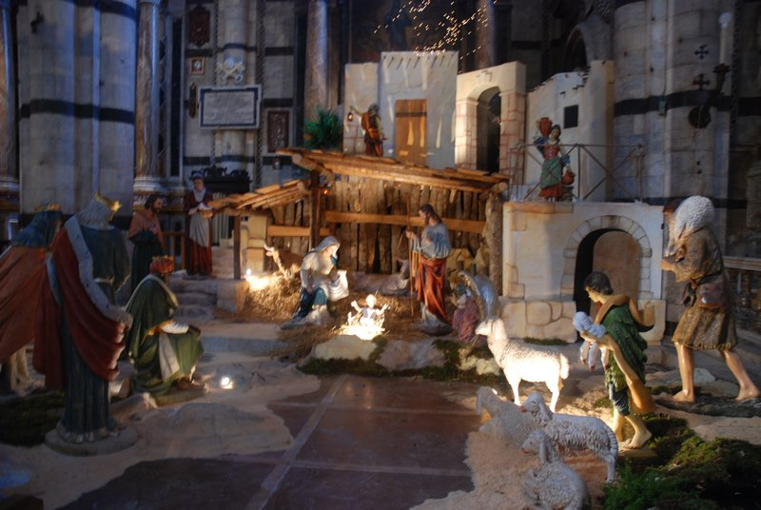
Church Nativity Scene

Slide 103
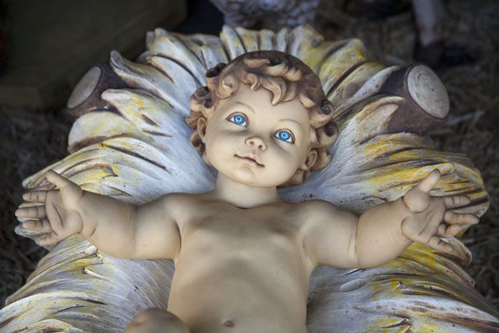
Insure that Baby!

Slide 104
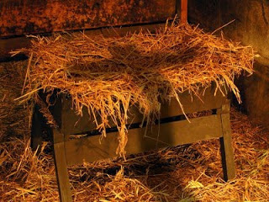

Church Nativity Scene

Slide 105

Church Nativity Scene

Slide 106

The Target of Theft

Slide 107

Church Nativity Scene

Slide 108

Church Nativity Scene

Slide 109

Church Nativity Scene

Slide 110

Church Nativity Scene

Slide 111

Brickhouse Security GPS Device
Notes:
Brickhouse security has come to the rescue of frustrated church owners in New Jersey which keep having their Mary, Joseph and Jesus taken by crazy crooked Christians, reports MyFoxDC.
The GPS provided by Brickhouse is given to qualified religious institutions and placed inside the dolls. The CEO of Brickhouse Todd Morris said that "we then monitor it from our cloud-based mapping system, and set up alerts so that they'll get a text message or an e-mail if Baby Jesus is in motion," So for those that are tempted to steal these holy figures, they may receive a surprise knock on the door this Christmas.
http://hexus.net/ce/news/gadgets/64061-churches-use-gps-trackers-stem-stolen-baby-jesus-problem/

Slide 112

Church Nativity Scene

Slide 113

Church Nativity Scene
Notes:
This Jesus figure was stolen two years running in Florida, but was recovered after being stolen this year as a GPS device had been fitted Photo: AP
By Tom Leonard in New York
5:18PM GMT 10 Dec 2008
http://www.telegraph.co.uk/news/worldnews/northamerica/usa/3702961/Baby-Jesus-watched-over-by-GPS.html
Faced with rising thefts and vandalism, churches, community officials and ordinary people across the United States are fitting their displays with satellite tracking devices and hidden cameras.
Around 70 churches have so far taken up a New York security company's offer to use its GPS and camera systems for a month to safeguard mangers and menorahs.
Some families are doing the same and the new security measures are already showing success.
After its expensive life-size, £1,350 ceramic Jesus figure was stolen two years running, the community of Wellington, in Palm Beach County, Florida, installed a GPS device inside it this year.
When it was stolen again, police were able to track it down to a nearby home where it was found face down on a carpet. An 18-year-old woman is being prosecuted over the theft.
Related Articles
Mystery 'Jesus' pebbles
10 Dec 2008
Vase discovery linked to Mary Magdalene
10 Dec 2008
Brickhouse Security in New York said it got the idea to offer 200 religious organisations a month's free use of its high-tech equipment after a few churches asked if they could hire the devices just for December.
This year's tally of baby Jesus thefts so far includes one from a Methodist church in Pennsylvania in which the figurine was replaced by a pumpkin and another in Arkansas in which the thief not only stole the plastic baby but also the concrete block and chain to which it was attached.
In the past, some have been defaced with swear words and Satanic symbols. However, it is unclear whether most of the thefts are harmless pranks or the result of anti-Christian sentiment.
Brickhouse said its GPS device can track objects virtually anywhere in the world. If it is moved, a silent alarm is triggered, and police or the owner can go on the internet to see on a map where the object is going.

Slide 114

The Date of Jesus' Birth
Adapted from a 2006 Class Presentation by Jordan Tan for
Dr. Rick Griffith • Singapore Bible College • BibleStudyDownloads.org
Notes:
Intro: Fact or Fiction...

Slide 115
Fact or
Fiction
Jordan Tan #172
Notes:
Intro: Fact or Fiction...

Slide 116

Born in the 11th year of Singapore’s independence.
Started my studies in Singapore Bible College at the age of 28.
Which year was I born in?
1965
July 2004
1976
Notes:
I was born in 1976...

Slide 117
The Historical
JESUS
Notes:
Today, we will continue to look at JESUS...
more precisely, the historical Jesus..

Slide 118
The New Testament Bookshelf
The Gospels
History
马太
Acts
马可
路加
约翰
Letters by Paul
路加
1 Thessalonians
1 Corinthians
2 Thessalonians
2 Corinthians
Philippians
Romans
Galatians
Ephesians
Colossians
1 Timothy
2 Timothy
Philemon
Titus
General Letters
Prophecy
Hebrew
James
1 Peter
2 Peter
1 约翰
2 约翰
3 约翰
Revelation
Jude
Notes:
Our text for today comes from the book of 路加....

Slide 119
The Structure of 路加
Birth of Jesus
Jesus in Galilee
Ministry in or near Jerusalem
Infancy
Infancy
1-2
3:1-4:13
4:14-9:50
9:51 ---------- 18:34
18:35-21:38
22-24
Introduction to Jesus’ Ministry
Travel Narrative
Passion & Resurrection
Notes:
and as our sister, Mary, has given us the structure of 路加 last week.
Today, i will focus on the infancy... or rather the birth of Jesus.

Slide 120
The Birth of Christ
Dionysus Exiguus A.D. 1
King Herod 4-6 B.C.
The Star of Bethlehem 6-7 B.C.
Quirinius A.D. 6
Blomberg, 188
Notes:
As many of you know, our calendar division of BC and AD is actually a Christian invention.
Before Christ and Anno Domini (The Year of the Lord)
1. Dionysus Exiguus in the early sixth century dated the birth of Jesus and since the Roman Empire was Christian, they decided that the calendar should be based on Christ. What Dionysus didn't factor in was the evidence from Josephus.
2. King Herod... once again, we know from Josephus that King Herod died in 4 BC and together with other data we can derive Christ birth between 4-6 BC
3. There are also attempts to link the star of Bethlehem with an unusual conjunction of planets and even a comet or supernova around 5-7 BC. (But this theory diminishes the supernatural power of God in creating the star just for the occasion of Christ's birth)
4. Quirinius and his census literally places Christ's birth as 6 A.D

Slide 121
Biblical Texts
路加 2:2 (NIV)
2 (This was the first census that took place while Quirinius was governor of Syria.)
路加 3:23 (NIV)
23 Now Jesus himself was about thirty years old when he began his ministry. He was the son, so it was thought, of Joseph, the son of Heli
Notes:
We will focus on 2 verses today for our search of the Historical Jesus...
路加 2:2 and 路加 3:23

Slide 122

Info #1
Jesus was born during the census of Quirinius
Info #2
Jesus was about thirty years old when he began his ministry
THE BIG
QUESTION
SO WHAT ABOUT QUIRINIUS AND THE CENSUS?
Notes:
The big question is...
so what about Quirinius and the census? what's so important or interesting?

Slide 123
Quirinius was sent by Augustus to be governor of Syria (and Judea) in A.D. 6 (not 6 B.C.) and thereafter did take a notable census for the empire. Josephus tells us that Quirinius visited Judea in A.D. 6-7 to assess the property of the Jews in preparation for the registering and taxing of that property. There is no evidence that he was governor of the region twice or that he undertook a census of the region twice. It has been suggested that 路加 may have confused Quirinius with P. Quintilius Varus who was legate of Syria during the period 6-3 B.C. Against this is the fact that 路加 was apparently knowledgeable about Latin names and would have known a cognomen (Quirinius) from a mere nomen (Quintilius).
Notes:
read....
that's too much info so i'll just give you some points.

Slide 124
A Roman census would not have required Jews to travel to their ancestral home for registration. In any case, is it probable that the Romans would undertake such a census in a client state that already had its own ruler (Herod)? In response to these problems various answers have been given. In the first place, if there was a census that affected Judea during the reign of Herod the Great, it would probably proceed along the lines of a Jewish census, not a Roman one. In that case it is plausible that Jews would return to their ancestral homes and that both adults would go (especially if Mary was also of Davidic descent).
Notes:
read....
that's too much info so i'll just give you some points.

Slide 125
Second, elsewhere 路加 manifests a knowledge of the later census by Quirinius which prompted the revolt of Judas the Galilean in A.D. 6-7 (Acts 5:37). Is it likely that he would have confused this census, which he knew to be a later one, with one during the reign of Herod? It is not certain that 路加 in 2:1 means that Augustus took one enormous census of the whole empire. The language is general and may mean no more than that the various parts of the empire were subject to various censuses during the time of Augustus…
Notes:
read....
that's too much info so i'll just give you some points.

Slide 126

QUIRINIUS
Quirinius was sent by Augustus to be governor of Syria in A.D. 6-7 whereby he conducted a notable census for the Roman Empire.
Quirinius was also appointed as consul in the Syria area earlier in 12 B.C.
“Governor” can actually refer to many leadership roles. Certain inscriptions show that between 7-10 B.C. Quirinius performed military functions in Syria.
Joel B. Green, Dictionary of Jesus and the Gospels (IVP), 66
Notes:
so although Quirinius was officially governor of Syria and Judea only in 6 AD, it does not mean he wasn't around doing a census or something else...

Slide 127
THE CENSUSES
Roman censuses were conducted every fourteen years.
(prōtē) First or former?
路加’s precise wording could mean that he is either referring to the first or former census under Quirinius rule of Syria.
This means before A.D. 6.
Joel B. Green, Dictionary of Jesus and the Gospels (IVP), 66
Notes:
Therefore, the census in 路加 2:2 could mean the one before Quirinius was governor, or the one before Quirinius census in 6 AD

Slide 128
THE NEXT BIG
QUESTION
WHAT ABOUT HEROD?
Notes:
HOW ABOUT HEROD??

Slide 129
KING HEROD
From the records of Josephus, we see that Herod died about 4 BC.
马太 2:1 (NIV)
After Jesus was born in Bethlehem in Judea, during the time of King Herod, Magi from the east came to Jerusalem
马太 2:16 (NIV)
When Herod realized that he had been outwitted by the Magi, he was furious, and he gave orders to kill all the boys in Bethlehem and its vicinity who were two years old and under, in accordance with the time he had learned from the Magi.
Blomberg, 188
Notes:
from Josephus, we know that King Herod died about 4 BC.
Matt 2:1 tells us that Jesus was born when King Herod was still alive
Matt 2:16 tells us that Jesus could possibly be 2 years old when Herod ordered the massacre of the innocents... before 4BC... possibly 6 or even 7 BC.

Slide 130

Putting it together
Prior
Census
8-7 BC
Death of
King Herod
4 BC
Census by Quirinius
AD 6-7
14 years
Therefore, we can conclude that Jesus was born between 8-4 BC
Notes:
now let's put what we have together...

Slide 131
Jesus was born between 4-7 BC
Biblical Texts
路加 2:2 (NIV)
2 (This was the first census that took place while Quirinius was governor of Syria.)
路加 3:23 (NIV)
23 Now Jesus himself was about thirty years old when he began his ministry. He was the son, so it was thought, of Joseph, the son of Heli,
Notes:
looking at 路加 2:2...
my conclusion is that Jesus was born between 5-7 BC

Slide 132
ONE MORE BIG
QUESTION
Jesus was about thirty when he began his ministry…
SO??
Notes:
Now 路加 3:23 says Jesus was about thirty when he began his ministry...
SO??

Slide 133
We know from Jewish history that the Levites began service about the age of thirty.
However, traditional Jewish historiography uses estimates rather than definitive numbers for age.
This would lead us to believe that Jesus began his ministry between AD 25-27
Notes:
In 路加 2:2, we could link the information provided by 路加 to Roman history...
here in 路加 3:23 however, we see certain links to Jewish history.
The levites and jewish historiography...
But for sure, it helps us to the conclusion that ....

Slide 134

However, we should also consider this definitive work

Slide 135
追溯耶稣基督的诞生。
56
出生日期：大约-公元12月5年前/公元1月4年前
耶稣在这两个日期之间出生的：
居里纽 /古利奈的户口普查 (路加 2:1-5)
希律大帝的死亡
(马太2:1; 路加 1:5)
公元前6年
三月29日至四月11日
公元前4年
Harold W. Hoehner, Chronological Aspects of the Life of Christ (Zondervan, 1977), 114

Slide 136
追溯到基督传道的开始
56
展开事工：大约. 公元29年的秋季
耶稣大概在这两个日期之间开始了他的事工：
第15年凯撒提庇留统治时期*（路加3:1-3）
公元28年八月19日
公元29年 十二月31日
*估摸着无论是从儒略历或堤庇留王国的年份
Harold W. Hoehner, Chronological Aspects of the Life of Christ (Zondervan, 1977), 114

Slide 137
基督事工持续时间
56
公元29年的秋季 至 公元33年4月3日（3.5年）
约翰独自笔记三个逾越节
因此，基督的事工是至少2.5年
逾越节#1
公元30年4月7日
逾越节#3
公元32年4月25日
逾越节#4
公元33年4月3日
展开基督事工
逾越节#2
公元29年的秋季
约翰 2:13, 23
约翰未述说·
马克2:23-28
路加6:1-5
马太12:1-8
约翰 6:4
约翰 11:55–12:1
Harold W. Hoehner, Chronological Aspects of the Life of Christ (Zondervan, 1977), 114
Notes:
Christ's 3½ year ministry spanned four Passovers. However, the Synoptics mention only one Passover (#2 on this timeline), which could give the impression of only a year-old ministry. John fills in the details, though, by showing three other Passovers not mentioned by Matthew, Mark, or Luke.

Slide 138
耶稣与使徒行传的年表
39
4 公元
1公元
西元 1
14
29
30
33
35
耶稣
的出世
–1 年–
该撒提
庇留奉王
该撒提庇留
在位第十五年
–
约翰
&
耶稣
耶稣
的死
保罗
相信
“该撒提庇留在位第十五年
…约 翰 宣 讲” (路加 3:1-3)
33-34 年
“耶稣开头传道，年纪约有三十岁…” (路加 3:23)

Slide 139
耶稣开始事奉的岁数
1年
3 年
28 / 29 年
4 3 2 1 1 2 3 4 5 6 7 8 …………………………………………………………………………26 27 28 29
BC AD
3 + 1 + 28 = 32 年 (不计算 AD 29)
3 + 1 + 29 = 33 年 (计算 AD 29)
Adapted from Michele Ang (NT Survey student, SBC, 2006)

Slide 140
IN CONCLUSION
路加 affirms to us, the readers of the book, that Jesus existed historically by showing when he was born according to world history current to his time.
When we acknowledge and show Jesus as a true, genuine historical figure, it helps us to debunk arguments regarding whether he really existed or was just a myth.
FACT OR FICTION?

Slide 141
h. The Announcement to the Shepherds
§ 11
路加 2:8-20
The angels of God announce to shepherds as the most unlikely yet most unprejudiced witnesses that they might know that God had provided a sign of His presence in the birth of the Savior who had come as Messiah, Ruler and Redeemer of Israel in the Messianic Kingdom
Notes:
Intro: Fact or Fiction...

Slide 142

Bored Shepherds
“没有什么令人激动的事曾经在这工作上发生”

Slide 143

“因 今 天
在 大 卫 的 城 里 ，
为 你 们 生 了 救 主 ，
就 是 主 基 督 ” (路加 2:11 CUVS)

Slide 144
3. His Infancy and Childhood
§ 12-19
Selected events from the infancy and childhood of Jesus are recorded in order to affirm that Jesus is the promised Messiah
Notes:
Intro: Fact or Fiction...

Slide 145
a. His Circumcision
§ 12
路加 2:21
Jesus is circumcised as a sign of the Abrahamic Covenant in order to make Him eligible to fulfill the promises that God had given to Abraham
Notes:
Intro: Fact or Fiction...

Slide 146
b. His Presentation
§ 13
路加 2:22-38
Jesus is presented in the temple in obedience to the Law in order for Mary to be ceremonially clean and for Jesus to be redeemed from the Aaronic priesthood
Notes:
Intro: Fact or Fiction...

Slide 147

Simeon blessed Jesus at the temple (路加 2:21-32)

Slide 148
c. His Infancy
§14-16
The worship by Magi, escape to Egypt and escape to Nazareth all fulfill prophecy in order to substantiate Christ as Israel's Messiah
Notes:
Intro: Fact or Fiction...

Slide 149


Chapter Two
Bethlehem
Egypt
Nazareth

Slide 150
“All this took place to fulfill what the Lord had said through the prophet”
“completing”
or
“filling full”
fulfill

Slide 151
OT Prophecies
1. Literal
Straightforward predictions
Birthplace in Bethlehem
Matt. 2:6
Micah 5:2

Slide 152

OT Prophecies
2. Typological
Correspondence between
OT & NT events
e.g. Hosea 11:1 ----- > Matt 2:15
“Out of Egypt I called my son.”

Slide 153


Hosea 11:1
God called
Israel out of Egypt
马太 2:15
Jesus also fled and return from Egypt

Slide 154
OT Prophecies
3. = Literal + Typological
Isaiah 7:14 … give you a sign: the virgin will be…
____________________________________________
you: Hebrew is plural
virgin: Hebrew means “a young woman of marriageable age”

Slide 155
OT Prophecies
3. = Literal + Typological
ultimate prediction pointed to Jesus
Ahaz
Jesus

Slide 156
(1) In Bethlehem
c. His Infancy
§ 14
马太 2:1-12
Jesus is worshipped as King of the Jews by Gentiles in Bethlehem to fulfill Micah 5:2 and as an indication that this same Babe will someday rule as King of kings and Lord of lords, the Sovereign Messiah over all the nations in the world
Notes:
Intro: Fact or Fiction...

Slide 157

伯利恒
“犹大地的伯利恒啊！你在犹大的领袖中，并不是最小的， 因为必有一位领袖从你那里出来， 牧养我的子民以色列。”
(弥迦书5:2中所报马太 2:6 新译本)

Slide 158

去伯利恒的旅程

Slide 159

One King 19/30
耶稣是很容易辨认的

Slide 160
2. Birth in Bethlehem …
“But you, Bethlehem, in the land of Judah, are by no means least among the rulers of Judah; for out of you will come a ruler who will be the shepherd of my people Israel.”
(Micah 5:2)

Slide 161

…and visit of the Magi (2:1-12)

Slide 162

Who Were the Magi?

Slide 163


What Kind of Kingdom Did Isaiah
(and 马太) Envision?
78b
Political
Physical
Emotional
Intellectual
Spiritual

Slide 164

What is the contemporary application of following the star?

Slide 165

What was the Star?
It's a thousand points for getting
the star above the stable !

Slide 166
Where did the Magi come from?
15
P1 Million
14
P500,000
13
P250,000
12
P125,000
11
P64,000
10
P32,000
9
P16,000
8
P8,000
7
P4,000
6
P2,000
5
P1,000
4
P500
3
P300
2
P200
50:50
1
P100
A: Babylon
B: Assyria
C: Persia
D: Arab Peninsula?

Slide 167

Arab Magi?
Their Location:
  East can mean southeast as much as northeast
  Assyria, Babylonia and Persia were always called lands of the north (Jer. 1:13-15; 6:22; 25:9).
Notes:
After this slide, will go to Dr Rick's NT Survey: 马太, p78f, “Arab Magi in 马太 2”

Slide 168
Arab Magi?
Their Gifts (Matt. 2:11):
  These all came from Spice Trade route southeast of Israel.
  "And all from Sheba will come, bearing gold and incense" (Isa. 60:6; cf. Ps. 72:10). Sheba was the land of present-day southern Saudi Arabia.
Notes:
After this slide, will go to Dr Rick's NT Survey: 马太, p78f, “Arab Magi in 马太 2”

Slide 169
Arab Magi?
Their Gifts (Matt. 2:11):
  Frankincense came only from southern Arabia, although it was sold throughout the Middle East.
  Gold came from the Arabian Peninsula in the land of Ophir that is present-day Yemen
Notes:
After this slide, will go to Dr Rick's NT Survey: 马太, p78f, “Arab Magi in 马太 2”

Slide 170
Arab Magi?
Their Role: Arabs redeem Israel!
  Joseph saved from his brothers by Ishmaelites of Arabia who brought him to Egypt (Gen. 37:27-28).
  Opposition to Moses by Israel's own elders forced him to seek refuge in Midian of Arabia (Exod. 2:13-15).
Notes:
After this slide, will go to Dr Rick's NT Survey: 马太, p78f, “Arab Magi in 马太 2”

Slide 171
Arab Magi?
Their Role: Arabs redeem Israel!
  Even in the future tribulation, Israel will find refuge in the desert (Rev. 12:14), presumably in Arabia
Notes:
After this slide, will go to Dr Rick's NT Survey: 马太, p78f, “Arab Magi in 马太 2”

Slide 172


Slide 173
(2) In Egypt
c. His Infancy
§ 15
马太 2:13-18
Joseph, Mary and Jesus flee to Egypt to escape the Babe's potential death by Herod so that Hosea 11:1 might be fulfilled and that Christ might not die before He would redeem the world
Notes:
Intro: Fact or Fiction...

Slide 174

Journey to Bethlehem, Flight to Egypt & Return to Nazareth (马太 2)
79
79

Slide 175

3. Flight to Egypt (2:13-15)

Slide 176


4. Killing of the innocents

Slide 177
(3) In Nazareth
c. His Infancy
§ 16
马太 2:19-23; 路加 2:39
The family returns to Israel by angelic revelation and choose Nazareth rather than Bethlehem to avoid Archelaus so that the prophecies concerning the Messiah's humble origins might be fulfilled
Notes:
Intro: Fact or Fiction...

Slide 178


5. Return to Nazareth (2:19-23)
“He will be called a
Nazarene.”

Slide 179
Theme
Jesus' birth fulfilled
the OT Prophecies
2. Men's obedience fulfilled
God's plan

Slide 180
Birth & Childhood of Jesus
Connie Tong

Slide 181
d. His Boyhood
§ 17-19
The selected events from the early life of Christ argue that while He grew physically, intellectually, spiritually and socially He was fully aware of His deity as well as his humanity
Notes:
Intro: Fact or Fiction...

Slide 182
(1) His growth
d. His Boyhood
§ 17
路加 2:40
Jesus grew physically, intellectually and spiritually, giving evidence that He received training in the Scriptures from his youth in a godly home
Notes:
Intro: Fact or Fiction...

Slide 183
(2) His visit to Jerusalem
d. His Boyhood
§ 18
路加 2:41-50
Jesus' instruction of the teachings of the law in the temple at age twelve shows that He was not merely a "son of the law" but fully understood His deity, mission and relationship with the Father even at an early age
Notes:
Intro: Fact or Fiction...

Slide 184
(3) His development
d. His Boyhood
§ 19
路加 2:51-52
In the eighteen years of unrecorded events in Jesus' life He grew intellectually, physically, spiritually and socially, thus substantiating His manhood as perfect and His obedience complete
Notes:
Intro: Fact or Fiction...

Slide 185
The Ambassador of the King
§ 20-23
约翰 the Baptist precedes Jesus Christ to prepare Israel to receive Him as the long awaited Messiah
Notes:
Intro: Fact or Fiction...

Slide 186
1. The Message to 约翰
§20
马可 1:1; 路加 3:1-2
约翰 receives a prophetic message from God in the desert to separate Israel to the Lord in preparation for the Messiah
Notes:
Intro: Fact or Fiction...

Slide 187

施洗约翰
路加
3:1-6
该 撒 提 庇 留 在 位 第 十 五 年 ， 本 丢 彼 拉 多 作 犹 太 巡 抚 ， 希 律 作 加 利 利 分 封 的 王 ， 他 兄 弟 腓 力 作 以 士 利 亚 和 特 拉 可 尼 地 方 分 封 的 王 ， 吕 撒 聂 作 亚 比 利 尼 分 封 的 王 ，
亚 那 和 该 亚 法 作 大 祭 司 。 那 时 ， 撒 迦 利 亚 的 儿 子 约 翰 在 旷 野 里 ， 神 的 话 临 到 他 。

Slide 188
2. The Message from 约翰
§ 21
马太 3:1-6; 马可 1:2-6; 路加 3:3-6
约翰 preaches repentance for the forgiveness of sins and baptizes in preparation for the Messianic kingdom to be established on earth with the King as its ruler
Notes:
Intro: Fact or Fiction...

Slide 189
施洗约翰
路加
3:1-6
他 就 来 到 约 但 河 一 带 地 方 ， 宣 讲 悔 改 的 洗 礼 ， 使 罪 得 赦 。
正 如 先 知 以 赛 亚 书 上 所 记 的 话 ， 说 ： 在 旷 野 有 人 声 喊 着 说 ： 预 备 主 的 道 ， 修 直 他 的 路 ！

Slide 190
施洗约翰
路加
3:1-6
一 切 山 洼 都 要 填 满 ； 大 小 山 冈 都 要 削 平 ！ 弯 弯 曲 曲 的 地 方 要 改 为 正 直 ； 高 高 低 低 的 道 路 要 改 为 平 坦 ！
凡 有 血 气 的 ， 都 要 见 神 的 救 恩 ！

Slide 191

施洗约翰
马太 3:1-16
马可 1:1-11
路加 3:1-22
约翰 1:1-34
免费
圣经
图片

Slide 192


Slide 193


Slide 194


Slide 195


Slide 196


Slide 197


Slide 198


Slide 199


Slide 200


Slide 201


Slide 202


Slide 203


Slide 204


Slide 205


Slide 206


Slide 207


Slide 209


Slide 210


Slide 211


Slide 212
Free Bible Images
授权使用
免费
圣经
图片
图片中的文字

Slide 213
3. The Explanation by 约翰
§ 22
马太 3:7-10; 路加 3:7-14
约翰 preaches of the judgment to be meted out to the nation at the advent of Messiah in order to convince both the leaders and the people to exhibit the changed lives resulting from repentance
Notes:
Intro: Fact or Fiction...

Slide 214
4. The Promise by 约翰
§ 23
马太 3:11-12; 马可 1:7-8; 路加 3:15-18
约翰 preaches a message of hope and promise that the Messiah would give the Holy Spirit in fulfillment of Joel 2:28 and Ezekiel 36:25-27 and judge the nation to remove all that was worthless and unfit for the kingdom
Notes:
Intro: Fact or Fiction...

Slide 215
The Approval of the King
§§ 24-27
The Father, Satan and 约翰 all testify through Christ's baptism, temptation and herald, respectively, that Jesus is the Messiah
Notes:
Intro: Fact or Fiction...

Slide 216

耶稣的受洗
与受试探
(3:23–4:11)
79
迦百农
提比哩亚
加 利 利 海
在施洗约翰早期的事工,周围的事件因耶稣受洗引起了宗教与社会的激烈反应.周围的事件如希律王的贪婪和奢侈,罗马军队的苛刻.在26公元,从检察官的更变引起了激烈的反应.大多数人希望宗教能解决他们的不良政治命运.当他们得知有个新先知,他们前往沙漠去聆听他教导.耶稣在约旦河外伯大尼受洗 (约翰1:28).约翰也在撒冷的哀嫩施洗. (约翰3:23)
拿撒勒
他泊山
约旦河
撒 冷
传统推测这是耶稣施洗的位置.圣经记载的位置尚未确定.
许多学者认为约翰在约旦河的中央施洗.
耶利哥城
伯大尼?
试探发生在
约旦山谷下的沙漠地区
高山 (耶利哥城的山岩下)
圣殿的巅峰
耶路撒冷
死海

Slide 217
1. At His Baptism
§ 24
马太 3:13-17; 马可 1:9-11; 路加 3:21-23a
At the baptism of Christ divine approval is confirmed in that the Father officially confirms Christ's appointment to His messianic work through the designated forerunner with God's full approval of His person and work
Notes:
Intro: Fact or Fiction...

Slide 218
2. Through His Temptation
§ 25
马太 4:1-11; 马可 1:9-11; 路加 4:1-13
At the temptation of Christ moral approval of Jesus as Messiah is accomplished in His demonstration that He could not be made to sin, this perfection thus authenticating the Father's approval
Notes:
Intro: Fact or Fiction...

Slide 219

世上的事与这里的几段关键经文的对比
世界
(约一 2:15-16)
试探的
源头
夏娃
(创 3)
基督
(太 4)
“肉体的情欲”
不属神的欲望
• 婚外情
• 贪食
• 其它
“好作食物”
“石头变面包”
“眼目的情欲”
贪婪
(第十诫)
“悦人的眼目”
全世界都归他
今生的骄傲
骄傲和自夸
• 工作
• 地位
• 属世的成就
• 其它
“能使人有智慧”
人的赞赏

Slide 220

The Ministry Beginning & Temptation of Jesus
Adapted from a 2006 Class Presentation by William Heng for
Dr. Rick Griffith • Singapore Bible College • BibleStudyDownloads.org

Slide 221

The Servant King
Graham Kendrick

Slide 222
From heaven You came, helpless babe
Entered our world, Your glory veiled
Not to be served but to serve
And give Your life that we might live

Slide 223
This is our God, the SERVANT KING;
He calls us now to follow Him
To bring our lives as a daily offering
Of worship to the SERVANT KING.

Slide 224
There in the garden of tears
My heavy load He chose to bear;
His heart with sorrow was torn,
Yet not my will, but Yours he said.

Slide 225
This is our God, the SERVANT KING;
He calls us now to follow Him
To bring our lives as a daily offering
Of worship to the SERVANT KING.

Slide 226
Come see His hands and his feet,
The scars that speak of sacrifice
Hands that flung stars into space
To cruel nails surrendered

Slide 227
This is our God, the SERVANT KING;
He calls us now to follow Him
To bring our lives as a daily offering
Of worship to the SERVANT KING.

Slide 228
So let us learn how to serve,
And in our lives enthrone Him
Each other's needs to prefer
For it is Christ we're serving

Slide 229
This is our God, the SERVANT KING;
He calls us now to follow Him
To bring our lives as a daily offering
Of worship to the SERVANT KING.
Of worship to the SERVANT KING.

Slide 230

马太 4:1-11
Satan tempted Jesus
—But what preceded this?
Notes:
Selling your ideas is challenging. First, you must get your listeners to agree with you in principle. Then, you must move them to action. Use the Dale Carnegie Training® Evidence – Action – Benefit formula, and you will deliver a motivational, action-oriented presentation.

Slide 231
Presentation Agenda
Review
The Beginnings of Jesus' Ministry
马太 3 – The Baptism of Jesus
Historical Setting
Exposition of 马太 4 Temptation
Theme
Application

Slide 232
Review
The Genealogy of Christ
The Certainty of the Gospel
Jesus was a Genuine Historical Figure
The Birth of Christ was the Fulfillment of God's Salvation Plan
Notes:
Open your presentation with an attention-getting incident. Choose an incident your audience relates to. The incidence is the evidence that supports the action and proves the benefit. Beginning with a motivational incident prepares your audience for the action step that follows.

Slide 233

The Beginnings of Jesus' Ministry
Jesus comes from Galilee to be baptized
Jesus returns to Jordan to call disciples
约翰 the Baptist preaches in the wilderness of Judea and baptizes in River Jordan
2
1
5
4
3
Jesus returns to Galilee (first miracle in Cana)
The Holy Spirit leads Jesus into the wilderness to be tested
Notes:
Jesus begins His return to Galilee

Slide 234

The Baptism of Jesus had two purposes:
1. The Father confirmed Christ's appointment to His messianic work
2. The manifestation of the Trinity

Slide 235

Historical Setting
Time: AD 28 (约翰 the Baptist AD 27)
Then (4:1) – immediately (马可 1:12)
Place: Led up into the wilderness – Likely the wilderness was higher than the bed of the Jordan River in the barren region northwest of the Dead Sea

Slide 236

Exposition on 马太 4:1-11
"Then Jesus was led by the Spirit into the desert to be tempted by the devil" (4:1)
Verse 1 sums up the whole passage
The Spirit is the same Spirit noted in (3:16)……….the Spirit of God

Slide 237

"After fasting forty days and forty nights, he was hungry" (4:2)

Slide 238
To be tempted had two-fold meaning:
Incite or entice to evil; seduce
Vs
Test
God does not tempt men with evil
(James 1:13; e.g., Abraham in Gen 22:1)

Slide 239

The tempter came to him and said, "If you are the Son of God, tell these stones to become bread."
Repeated phrase: "If you are the Son of God" (4:3, 6)
1st Temptation
"does not live" (4:4): The verb in Greek is in future tense but it is unclear whether it is meant as a command or a statement of reality.

Slide 240

2nd Temptation
Ps 91:11-12 (4:6): Is not incorrect citation but rather using it in wrong context (misapplication)
"holy city": The temple in Jerusalem
"highest point of the temple": Southeast temple wall with a vertical drop of 500 to 600 feet into the Kidron Valley.

Slide 241

3rd Temptation
"bow down" (4:9): To throw oneself to the ground as a sign of devotion before a divine being or a high-ranking person.
"very high mountain": Likely symbolic as the traditional Mount of Temptation was not high enough to view all the kingdoms of the world

Slide 242
Theme
The Victorious King
Notes:
To complete the Dale Carnegie Training® Evidence – Action – Benefit formula, follow the action step with the benefits to the audience. Consider their interests, needs, and preferences. Support the benefits with evidence; i.e., statistics, demonstrations, testimonials, incidents, analogies, and exhibits and you will build credibility.

Slide 243
The temptation is in all three Synoptic Gospels. 路加 and 马可 add:
路加 4:1-13
Full of the Holy Spirit
2nd and 3rd temptation in the reverse order
马可 1:12-13
At once the Spirit sent Him out………
He was with the wild animals

Slide 244
Contextual Relationships
In Context of the Bible:
Jesus was the fulfillment of God's promises to Israel, coming as Messiah and Redeemer: Savior of the world as well as Savior of Israel

Slide 245
In Context of 马太
马太 proved that Jesus was the fulfillment of God's promises to Israel. It also explained that the Kingdom is postponed due to Israel's rejection of Christ as King and for believing Jews to see His present Kingdom authority residing in the Church.

Slide 246
In the Context of the Passage
To show Jesus as King
To show Jesus is sinless
To model for us how to fight temptation
To show us Christ is qualified to help us have victory over Satan

Slide 247

Application
Today we have seen the importance of spiritual preparation and seen how Jesus used God's Word to have victory over Satan

Slide 248

God's testing increases our faith and develops perseverance in us so that we will remain faithful to our calling (James 1:2-4)

Slide 249

In your next trial, look to Jesus' model since he is qualified to help us resist the devil

Slide 250
3. By His Herald
§§ 26-27
约翰 testifies before the leaders and to Christ that he is the forerunner of Messiah in fulfillment of Malachi 4:5 in order to approve of Christ's person and works and to prepare Israel and her leaders before the beginning of Christ's public ministry
Notes:
Intro: Fact or Fiction...

Slide 251
a. Testimony of 约翰 Before the Leaders
§26
约翰 1:19-28
约翰 answers the questioning by Israel's leaders regarding his person that he is the forerunner of Messiah in fulfillment of Malachi 4:5 to prepare these leaders to accept Christ and His message
Notes:
Intro: Fact or Fiction...

Slide 252
唯独基督是光
施洗约翰 (1:6-9)
从神那里差来的 (6)
被他创造的(6)
有一个人 (6)
为光作见证 (7-8)
耶稣 (1:1-5)
万物是借着他造的 (3)
太初有道 (1a)
道就是神 (1c)
他就是真光 (9)

Slide 253
b. Testimony of 约翰 to Christ
§ 27
约翰 1:29-34
约翰 testifies publicly for the first time that Christ is the Messiah of Israel through a soteriological testimony of Christ's work as the Lamb of God and Christ's person as the Son of God in order to prepare Israel before the inception of Christ's public ministry
Notes:
Intro: Fact or Fiction...

Slide 254


How Well Do You Know the Life of Christ?
你对于基督的生平了解多少?
53
4
在婚筵中作客人
你能将这些事件按次序排列吗?
6
尼哥底母的探访
3
敌人的试探
7
登山宝训
1
诞生在伯利恒
5
洁净圣殿
10
为门徒洗脚
8
天国的比喻
2
拿撒勒的木匠
9
拉撒路的坟墓
特里 哈勒，圣经全景, 121页

Slide 255
AN ALPHABETIZED LIFE OF JESUS
54
AN ALPHABETIZED LIFE OF JESUS (Adapted from Terry Hall, Bible Panorama, 139)
Angels | 路加 1:5-38; 马太 1:18-25 | Nazareth, Jerusalem
Birth | 路加 2:1-20; 马太 2:1-12 | Bethlehem
Carpenter | 马太 2:19-23; 路加 2:39-52 | Nazareth
Dove | 马太 3:11-17; 路加 3:15-23 | Jordan River
Enemy | 马太 4:1-11; 路加 4:1-13 | Wilderness, northeast Judea
Followers | 约翰 1:19-51; 马可 3:14-19 | Perea, Galilee
Guest | 约翰 2:1-11 | Cana
Housecleaning | 约翰 2:13-22 | Jerusalem
Interview | 约翰 3:1-21 | Jerusalem
Jacob's well | 约翰 4:5-42 | Samaria
Kin | 路加 4:16-31 | Nazareth
Location | 马太 4:13-22 | Capernaum
Message | 马太 5–7 | Capernaum area
Nature | 路加 7:1-35 | Capernaum area, Galilea
Opposition | 马太 12:22-50 | Capernaum
Parables | 马太 13:1-53; 马可 4:1-34 | Capernaum area
Question | 马太 16:13-28; 路加 9:22-36 | Caesarea Philippi
Revelation | 马太 17:1-13 | Iturea, Mt. Hermon
Stoning | 约翰 10:22-39 | Jerusalem
Tomb | 约翰 11:1-54 | Bethany near Jerusalem
Upset | 马太 21–23 | Jerusalem
Vision | 马太 24–25 | Jerusalem, Mt. Olivet
Washing | 约翰 13 | Jerusalem, Upper Room
Xecution | 马太 26:30–27:56 | Jerusalem
Yes! | 马太 28; 路加 24:1-49 | Jerusalem, Judea, Galilea
Zion | 路加 24:50-53; Acts 1:1-12 | Jerusalem, Mt. Olivet

Slide 256

Great Periods in the Life of Christ
55
“The Son of Man… came to minister and to give his life a ransom for many” (马可 10:45)
Climactic Galilean
Early Samaritan
Later Samaritan
Early Judean
Later Judean
Early Perean
Later Perean
Opening Events
Closing Events
Preparation
Confirmation
Walk Thru the New Testament seminar (used with permission)

Slide 257
Free Bible Images
授权使用
免费
圣经
图片
图片中的文字

Slide 258
授权使用
马太福音
d
马可福音
o
路加福音
0
约翰福音
0
由Lumo Project出版独家资源，我们特此通知您我们不授权将这些图片发放给除freebibleimages.org客户以外的任何人。
所有图片不授权用于视频制作、epublishing或者其他媒体。所有下载的图片和文件不可通过除freebibleimages.org以外的其他网站传播，亦不可用于任何破坏基督信仰和福音的处境中。
o
图片仅供教育展示、博客和社交媒体使用；所有用途均需注明出处
www.LumoProject.com
图片声明 BBM
© 版权所有
www.bigbookmedia.com

Slide 259
Black

Slide 260


基督生命链接地址 BibleStudyDownloads.org
免费获得该讲解!
圣经学习下载
Notes:
Bible Geograhpy (bg)

