Slide 1

巴比伦
(启示录 17:1–19:10)
396
末世论
Dr. Rick Griffith • 博士 • 新加坡神学院 • BibleStudyDownloads.org

Slide 2
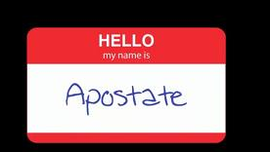
Apostates don't wear nametags
叛教者不穿名牌
你好
我的名字是
叛教者

Slide 3
叛教者从内部销毁
叛 教 者
叛教者: 摧毁基督教西方国家的人

Slide 4
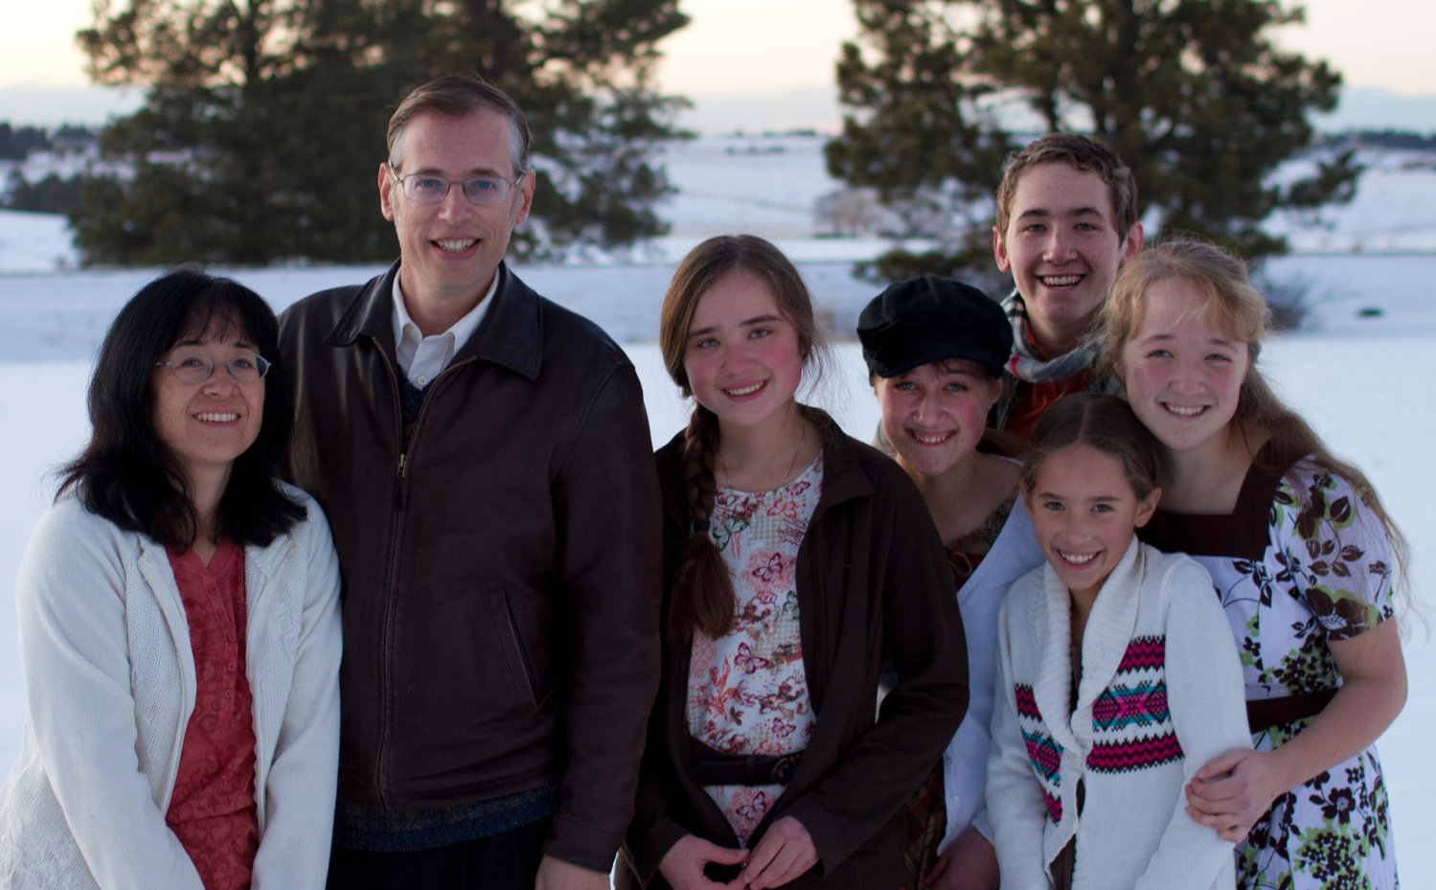
叛教者的书本
基思 斯旺森 和家人

Slide 5
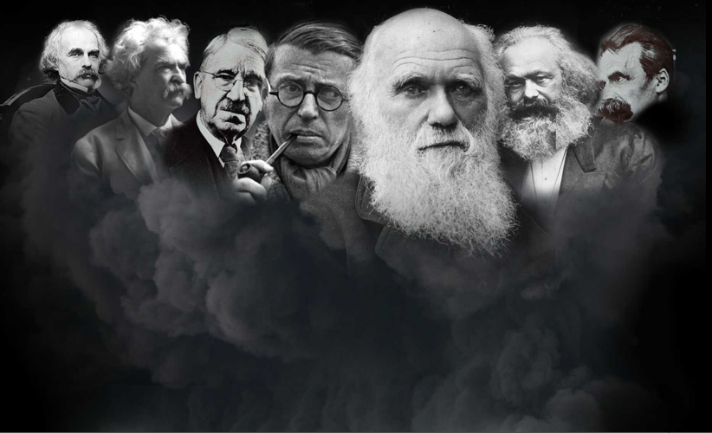
谁是叛教者？
查尔斯*达尔文
Charles Darwin
纳撒尼尔*霍桑 Nathaniel Hawthorne
约翰*杜威 John Dewey
弗里德里希*尼采Friedrich Nietzsche
马克*吐温 Mark Twain
卡尔*马克思 Karl Marx
让-保罗*萨特Jean-Paul Sartre
欧内斯特*海明威
（Ernest Hemingway）
可可夫人 （Lady Gaga）

Slide 6

为什么他们重要?
“这是西方文明衰落和堕落的故事。这是一个非常强大的男人，不可思议的邪恶男人的故事......叛教者”– 基思 斯旺森

Slide 7
叛教者教导
了什么?
弗里德里希*尼采Friedrich Nietzsche
查尔斯*达尔文
Charles Darwin
纳撒尼尔*霍桑
Nathaniel Hawthorne
约翰*杜威 John Dewey
马克*吐温 Mark Twain
卡尔*马克思 Karl Marx
让-保罗*萨特Jean-Paul Sartre
"消除家庭学校!"
“没有上帝！”
“上帝没有创造。我们进化了！”

Slide 8
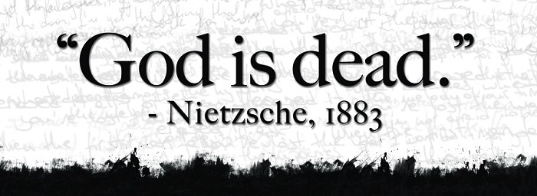
无神哲学
" 上帝死了."
–尼采, 1883
“尼采死了."
–上帝, 1900
Used with permission

Slide 9
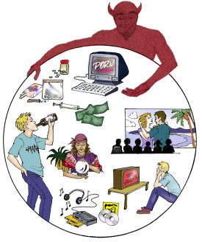
你是如何抗拒世界和欢迎基督的？

Slide 10


我们为何对世界应有排斥？
启示录
…并拥抱上帝的王国?

Slide 11

审判的内容
339
 | 印记 | 号角 | 金碗
1 | 白色: 征服者 | 冰雹&火: 1/3 植物 | 褥疮
2 | 红色: 战争 | 火: 1/3 海物 | 海水变成血
3 | 黑色: 饥荒 | 星星: 1/3 鲜水 | 鲜水变成血
4 | 苍白: 死亡 | 黑暗: 1/3 太阳, 月亮, 星星 | 日头用火烤人
 |  | (号角 5-7是灾祸)
5 | 圣徒被安慰 | 灾祸#1: 蝗虫 | 兽的皇国被暗
6 | 烈怒: 地震, 记号 | 灾祸#2: 伯拉河预备 | 伯拉干了
 | (144,000 被印) | (号角#7 = 神的奥秘)
7 | 半小时的寂静 | 灾祸#3: 胜利将来临 | 地震 & 冰雹
H O R S E S
W O E S
Adapted from Robert Gromacki, NT Survey and H. Wayne House, Chronological & Background Charts of the NT, 19

Slide 12
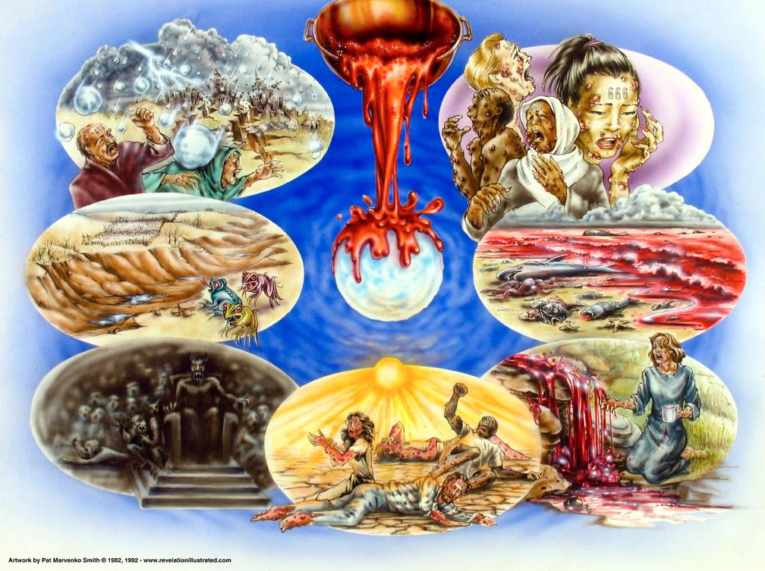
金碗的审判 (启示录 16)
392
Used with permission

Slide 13

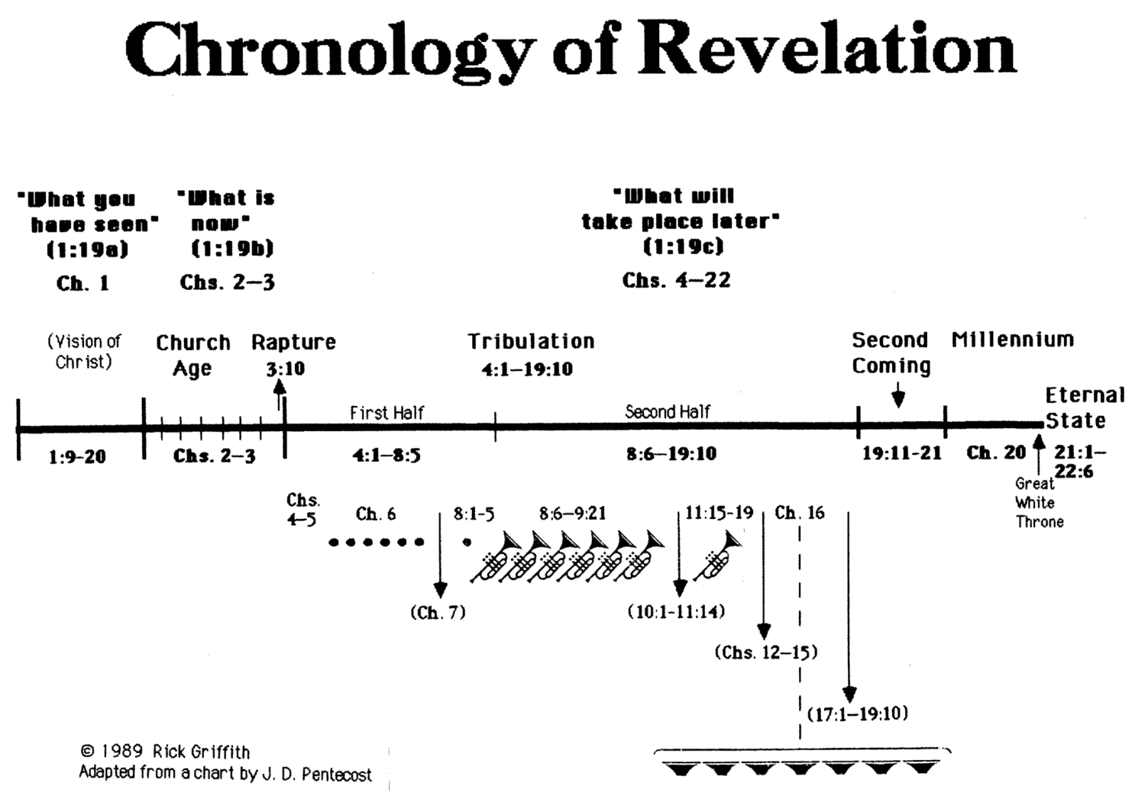
启 示 录 的 年 表
340
“你看到什么”
(1:19a)
第 1 章
“现在是什么”
(1:19b)
第 2–3 章
“以后会发生什么”
第 4–22 章
基督揭露
教会揭露
被提
3:10
苦难
4:1 – 19:10
第二
次来
千禧年
永恒的状态
上半
下半年
白色的大宝座的审判
Copyright 1989 Rick Griffith
Adapted from a chart by J. D. Pentecost
Notes:
The 3 main divisions of Revelation are summarized in 1:19
The 3 main cycles of judgment are squared in blue
The 4 parenthetical sections appear in parentheses within the scrolls. They do not advance the chronology but add important information that is not associated with a particular judgment.

Slide 14
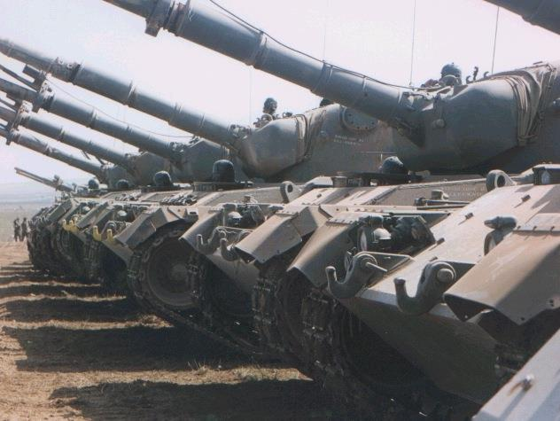
备注：
从我们赞助者的话，
苦难已经结束。
395

Slide 15

“巴比伦”
我们该怎么办呢？
(启示录18:1
–19:10)?
她会怎
样呢
（启示录17)?

Slide 16
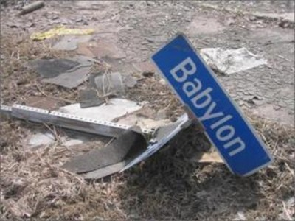
I. 这个世界的关键实体将落于大灾难中 (启示录 17).
世界上最邪恶的势力将会发生什么后果?
巴比伦

Slide 17
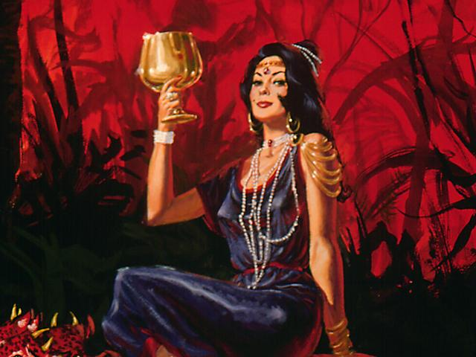
大淫妇
(17:1-2)
1 拿 着 七 碗 的 七 位 天 使 中 ， 有 一 位 前 来 对 我 说 ： 你 到 这 里 来 ， 我 将 坐 在 众 水 上 的 大 淫 妇 所 要 受 的 刑 罚 指 给 你 看 。
2 地 上 的 君 王 与 他 行 淫 ， 住 在 地 上 的 人 喝 醉 了 他 淫 乱 的 酒 。

Slide 18
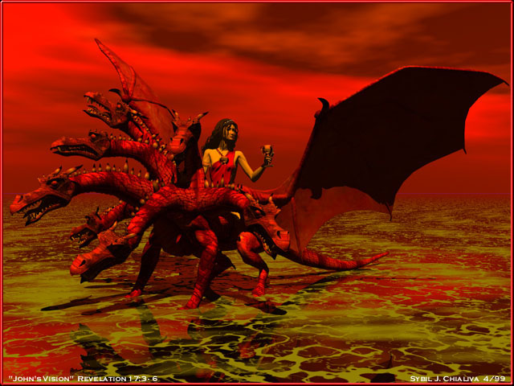
大淫妇
与兽
3 我 被 圣 灵 感 动 ， 天 使 带 我 到 旷 野 去 ， 我 就 看 见 一 个 女 人 骑 在 朱 红 色 的 兽 上 ； 那 兽 有 七 头 十 角 ， 遍 体 有 亵 渎 的 名 号 。

Slide 19
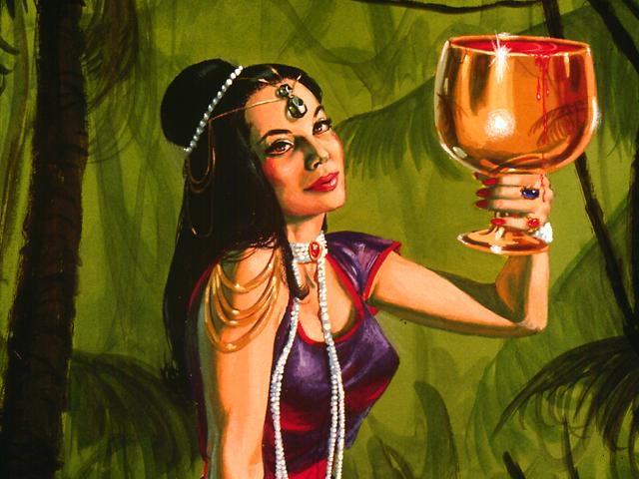
美丽却污秽
4 那 女 人 穿 着 紫 色 和 朱 红 色 的 衣 服 ， 用 金 子 、 宝 石 、 珍 珠 为 妆 饰 ； 手 拿 金 杯 ， 杯 中 盛 满 了 可 憎 之 物 ， 就 是 他 淫 乱 的 污 秽 。
（17：4）

Slide 20
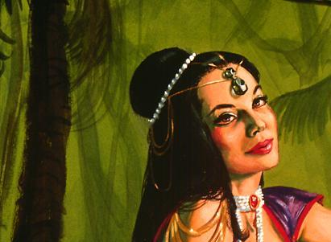
巴比伦
的奥秘 (17:5-6)
5 在 他 额 上 有 名 写 着 说 ： 奥 秘 哉 ！ 大 巴 比 伦 ， 作 世 上 的 淫 妇 和 一 切 可 憎 之 物 的 母 。
6 我 又 看 见 那 女 人 喝 醉 了 圣 徒 的 血 和 为 耶 稣 作 见 证 之 人 的 血 。 我 看 见 他 ， 就 大 大 的 希 奇 。

Slide 21



Fall of Babylon
巴比伦的糟蹋
巴比伦的糟蹋(539 BC)
古列从水门低下进攻
末日的巴比伦也不会继续存在!
但以理5
(伯沙撒的盛宴)

Slide 22
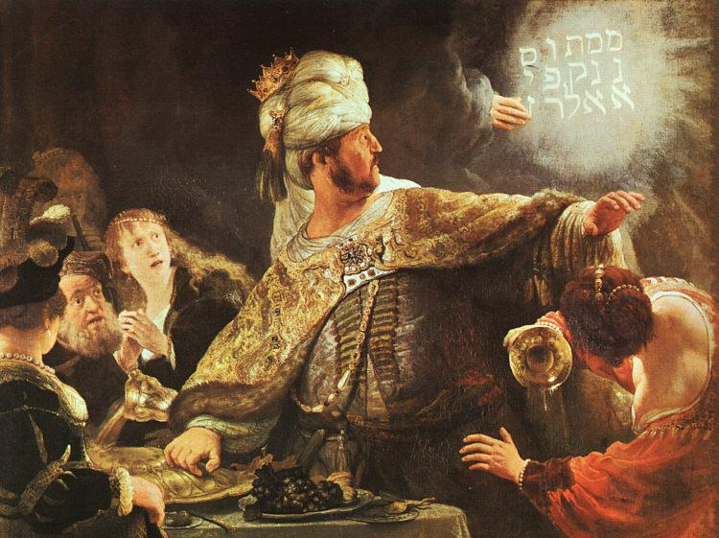
伯沙撒使谦卑
伦勃朗

Slide 23
那些启示录第17章的主要玩家？
110a
大淫妇 (17:1-6)
巴比伦 (17:5)
有权统治地上的众王的那座大城(17:18)
怪兽 (17:3a, 7-8)
第八个王 (17:11)
七头兽 (17:3b, 7)
七座山 (17:9)
七位王 (17:10)
十角怪兽(17:3c, 7, 16)
十个还没有得势的王(17:12-13)
然而，真的有十个玩家吗？

Slide 24
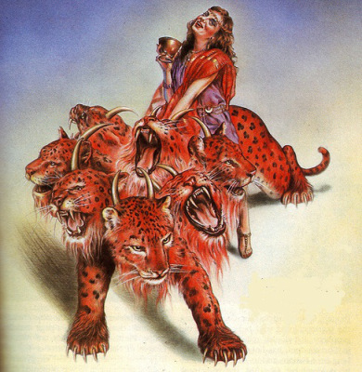
启示录17的相同的符号
110a
大淫妇
(17:1)
巴比伦大城
(17:5, 18)
=
怪兽
(17:3a)
反对基督者的第八位王
(13:1; 17:11)
=
七头兽
(17:7)
七座山 (17:9)
=
七位王(17:10)
十角兽
(17:3c,
7, 16)
十位王
(17:12-13)
=

Slide 25
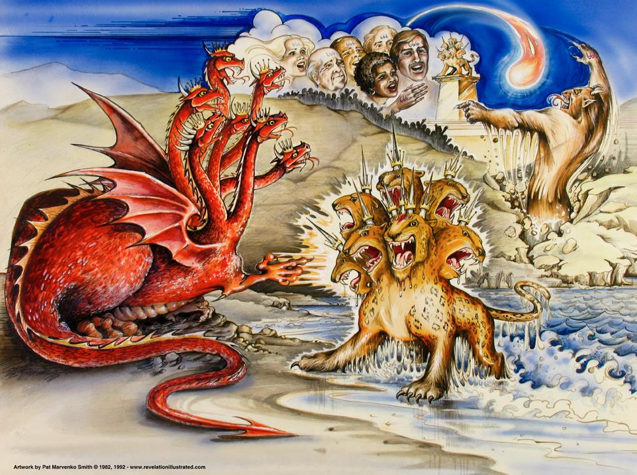
启 示 录 13 章 的 兽
龙 =
撒但
陸野兽 =
假先知
海野兽 =
敌基督
Used with permission
Notes:
Slides needing translation as of 12 Sep 2013: slides 90-91, 146

Slide 26
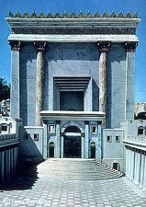

谁是七位国王？(17:9-10)?
39-41, 320
" 这里需要智慧才能明白，它的七个头代表那妇人坐镇的七座山，又代表七个王。 ¹⁰ 其中五个已经衰亡，一个还在，另外一个还未来到，他来后只能短暂存留" (CCB).
基督订在十字架上
公元33年
耶路撒冷被毁公元 70 年
启示录的记录
公元 95 年
提庇留
14-37
卡里古拉
37-41
克劳狄
41-54
尼禄 54-68
维斯帕先
69-79
泰特斯
79-81
多米提安
81-96
Notes:
Emperors in black persecuted Christians
This course teaches that Revelation was written during the reign of Domitian at the end of the first century.

Slide 27
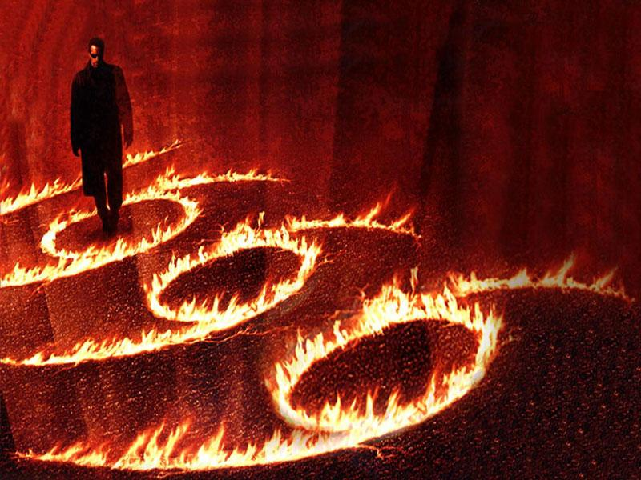
启示录 13:18
478
已过看到作为黑色的启示录13：18
在666，这样的启示必须已经写在尼禄的时间

Slide 28

回应：未来取向
478
启示录1:1 与 4:1
约翰（作者）将显示“必须尽快采取什么地方”，“必须采取这个地方。”这消除兽的数目必须是未来而不是过去或现在的任何疑问。

Slide 29
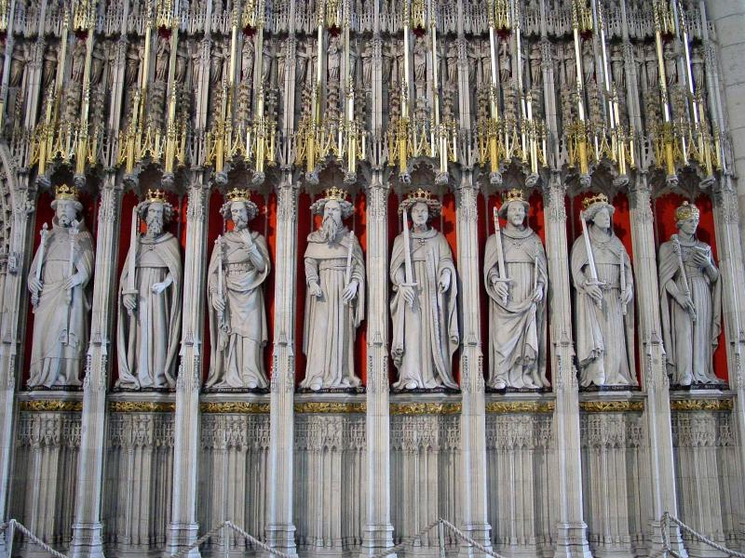
启示录 17:10
478
已过看到“七王”七个一世纪的罗马国王。然后，他们认为，第六届国王是尼禄人。

Slide 30
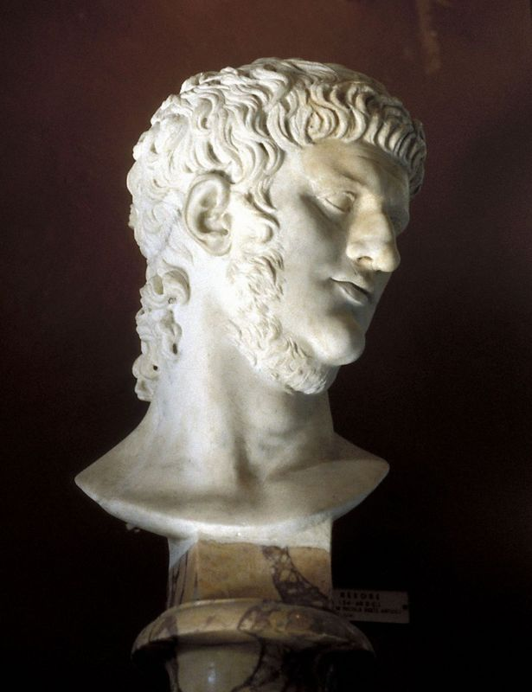
回应：为什么不能使用尼禄是666吗？
479
尼禄从公元54-68行使权力，而不是所需的40-两个月内吗？（启13:5）。
地球上所有居民没有崇拜尼禄（启13:8）。

Slide 31
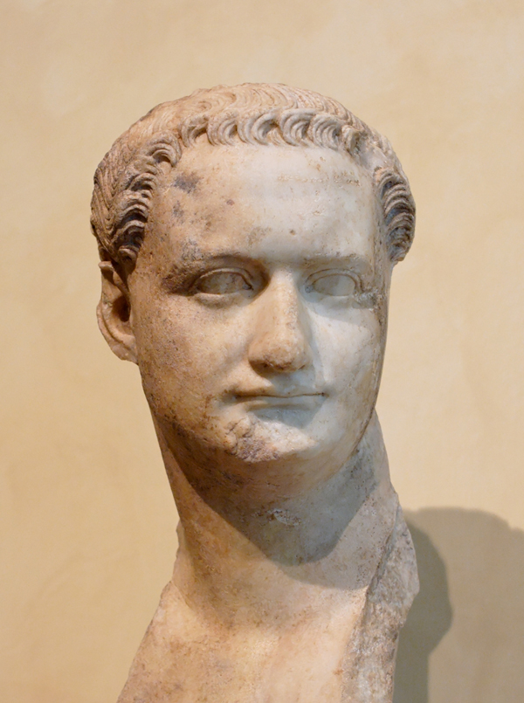
启示录 17:10比尔肯定没有尼禄或多米提安参考。
480
Nero (A.D. 37-68)
Domitian (A.D. 81-96)

Slide 32

与丹尼尔的相关性
479
丹尼尔 7:1-8 | 启示录 13:1-2; 17:9-12
四兽（狮，熊，豹，可怕的十角兽） | 有兽像豹，熊，狮子十角（13:2）（13:1，17:3）
七个头代表连续四个王国 | 七个头代表连续七个王国
四个王国 | 七个国王
十角 (v. 7) | 十角 (13:1; 17:3,12)
希区柯克

Slide 33
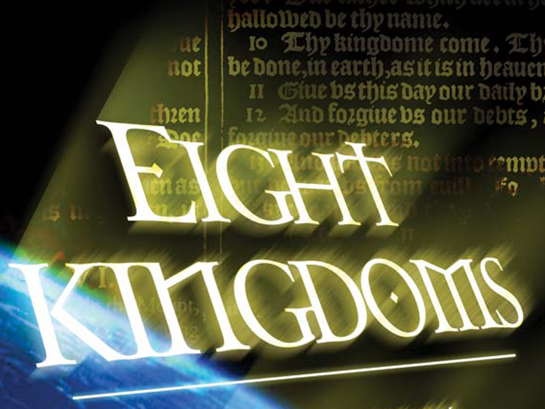
八个连续王国
(17:10-11)
479
1。埃及（法老）
2。亚述（亚述国王）
3。新巴比伦（尼布甲尼撒）
4。玛代波斯（居鲁士）
5。希腊（亚历山大大帝）
6。罗马（凯撒“一”）
7。重新统一罗马帝国（十王“尚未”）
8。最后詹蒂莱世界王国（敌基督）
希区柯克

Slide 34
支持查看历届三国
479-480
“连续王国视图避免了象征性的观点含糊不清的性质，是一致的丹尼尔7约与旧图像，并提供了一个一致的解释”八大天王。由于这些原因，这是首选的观点。因此，启示录17:9-11提供不支持基于Nero是第六届国王的想法，为早期的启示日期。“
希区柯克

Slide 35
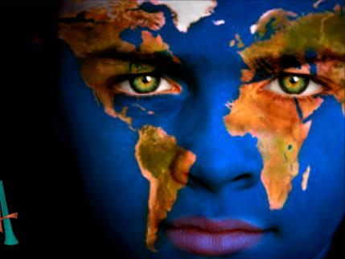
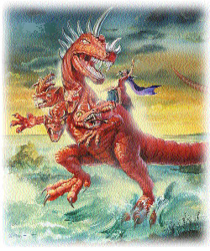
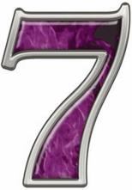
控制世界政治制度：
10
398
10
10
10
10
10
10
10
10
10
七个头
罗马
连续
过去
17:9-11
十个王
全世界
同时
为来
17:12
走兽 (八王)
全世界
控制十个国王
未来
17:13

Slide 36
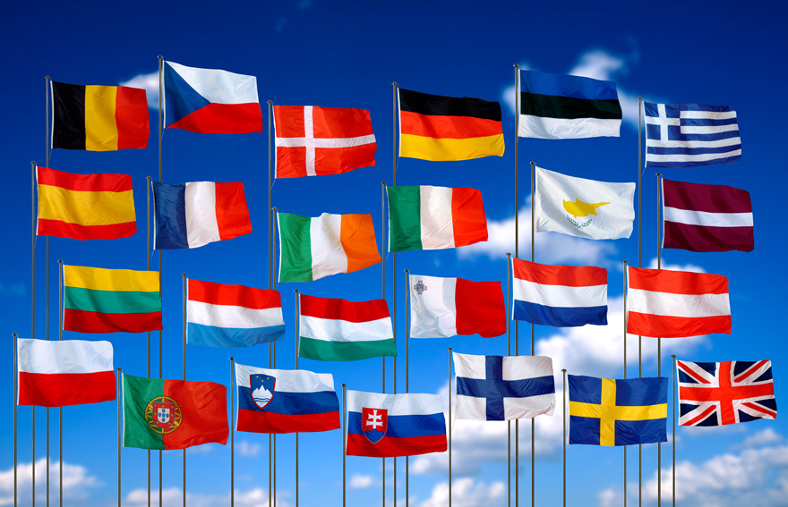
欧盟国家
398

Slide 37
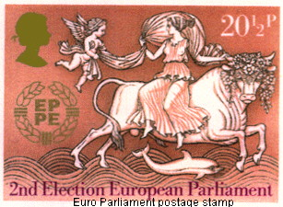
欧盟国会的官方邮票
140
今日的巴比伦神秘宗教

Slide 38
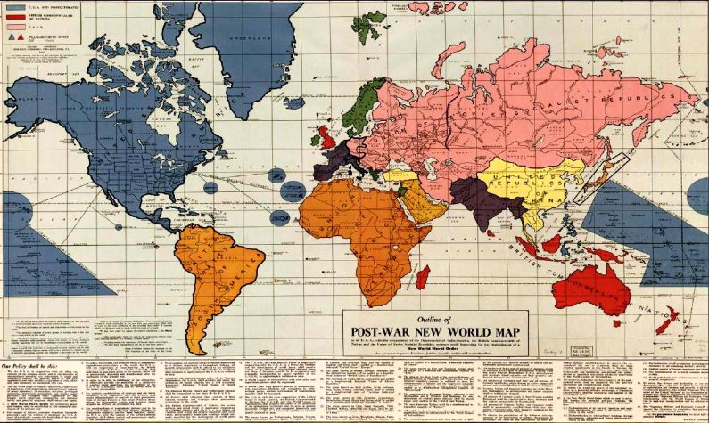
战后的世界地图
398
Notes:
After WWII it was proposed to have the following structures:
1. A North American Union of States: This dominant world power that would include the US, Canada, all Central American and Caribbean states, most Atlantic islands (including Greenland and Iceland), most Pacific islands, Taiwan, Hainan, the Philippines and several now Indonesian islands, including Sulawesi. This was to be the dominant power in the world, military and otherwise.
2. A union of socialist republics led by Russia: The Soviet Union was to be rewarded with Persia (Iran), Mongolia, Manchuria, Finland, and all of Eastern Europe, which subsequently would form part of the Eastern Bloc (excluding Albania, but including the real-life maverick state of Yugoslavia, socialist but anti-Soviet) . All of theses states were simply to become member-states of the USSR. Austria and most of Germany, although 'quarantined' are shown within the Soviet sphere.
3.The United States of South America (USSA): including all South American states, as a single constituent state and the Falkland Islands as part of the USSA.
4. The Union of African Republics (UAR): All of Africa as a federation of republics.
5. The Arabian Federated Republics (AFR): covering Saudi and all other states now occupying the Arabian Peninsula, plus present-day Iraq and Syria.
6. The Federated Republics of India (FRI): Present day Afghanistan, Pakistan, India, Nepal, Bhutan, Bangladesh and Burma (Myanmar).
7. The United Republics of China (URC): A federation including all parts of present-day China, Korea, the erstwhile French colony of Indochina (now Vietnam, Laos and Cambodia), Thailand and Malaya.
8. The United States of Scandinavia (USS): Norway, Sweden, Denmark.
9. The United States of Europe (USE): the Benelux countries, the German Rhineland, France, Switzerland, Spain, Portugal and Italy.
10. And finally the British Commonwealth of Nations(BCN), including Great Britain,
Australia, New Zealand, Sri Lanka, Madagascar and most of Indonesia.
Smaller entities include Eire (the whole of Ireland), Greece (including Albania), Turkey (excluding European Turkey), Hebrewland (the Holy Land plus Jordan) and Japan. The three axis states (Germany, Italy and Japan) were to be 'quarantined' until they could be readmitted in the family of nations.
http://www.discerningtheworld.com/2012/01/31/10-kingdoms-the-abolition-of-sovereignty/#more-10755

Slide 39

Characteristics of Babylon
366
末日的巴比伦大城
(启示录 17–18)
他有什么特性呢？

Slide 40

协会
(17:1–19:2)
结束时间巴比伦（妓女）
398
起初
坐在 (17:3)
后来被走兽
毁灭 (17:16)
走兽
七个头
十个喇叭
(17:3,12)
统治规则
(17:2)
欲望统治 (17:17)
地球之王
(17:2)
地球上所有的人民
(17:2, 15)

Slide 41
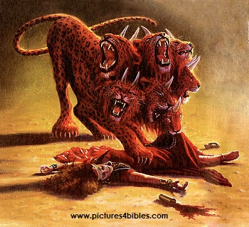
协会
(17:1–19:2)
结束时间巴比伦（妓女）
398
起初
坐在 (17:3)
后来被走兽
毁灭 (17:16)
走兽
七个头
十个喇叭
(17:3,12)

Slide 42
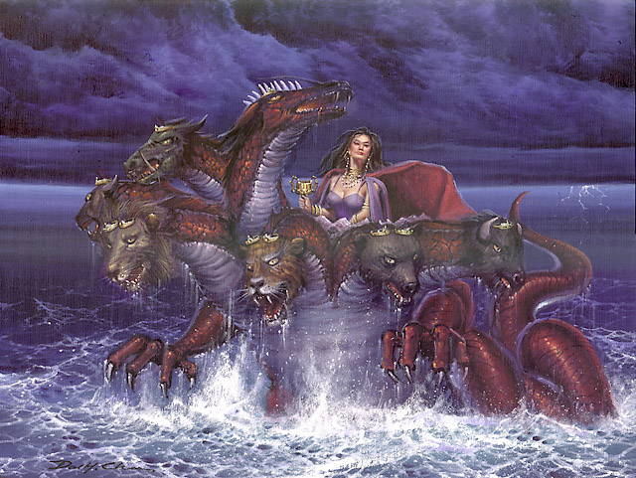
在结束时报“巴比伦的意见
400
世界体系
宗教
（伊斯兰教，天主教，占星术，世界宗教/新时代）
城市（巴比伦，罗马，耶路撒冷）
国家

Slide 43
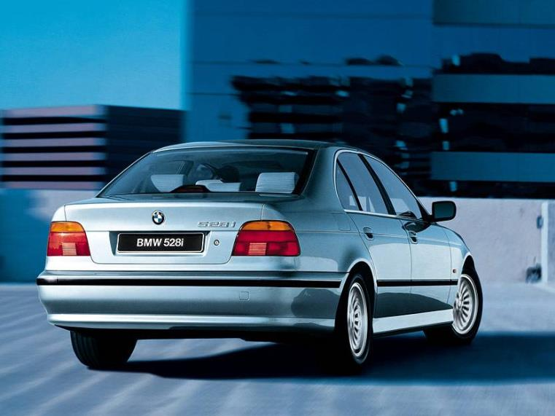
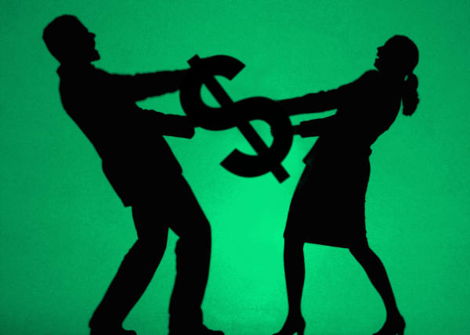

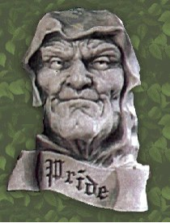

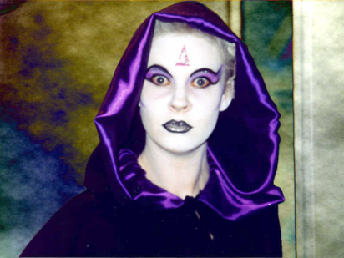
巴比伦是…
401
世界体系?

Slide 44
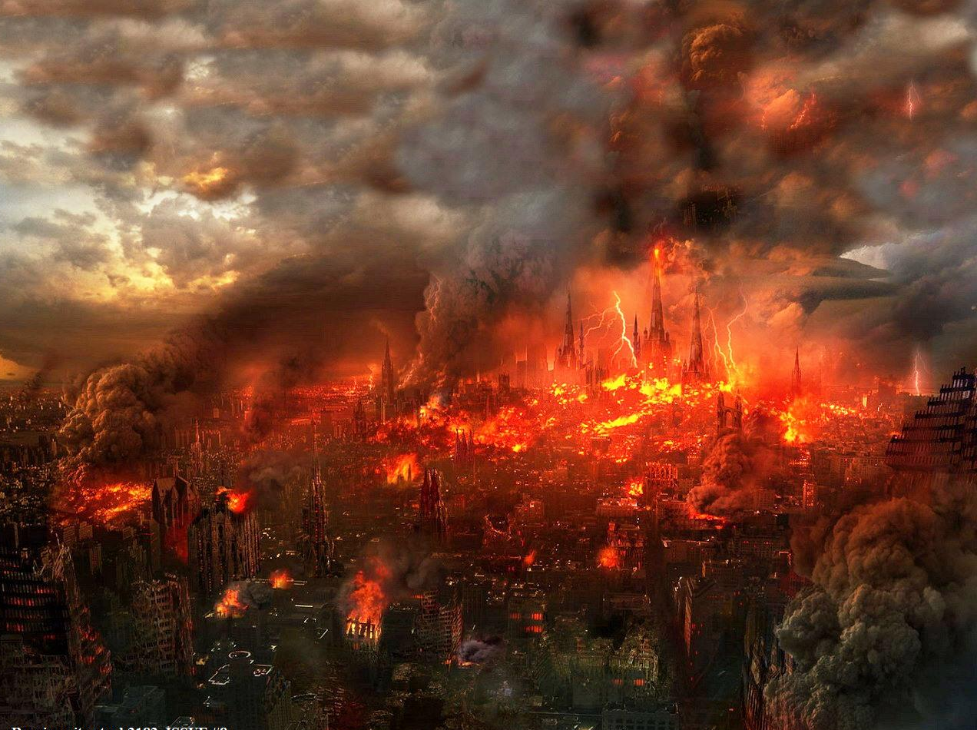
巴比伦在一小时内被火烧毁
406
Pt. 6
"时之间， 这么大的财富竟荡然无存!" (18:17a)
那么，作为世界体系一部分的人如何能够对世界体系的小王感到沮丧?
Used with permission
Notes:
She will be completely destroyed by the Antichrist and his ten-nation confederacy (17:16a) by fire (17:16b; 18:8) in only one hour (18:10, 17, 19).

Slide 45
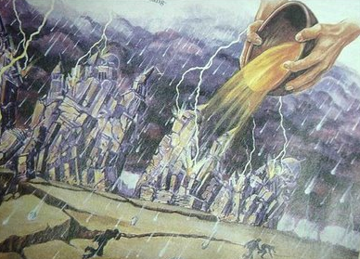
第七碗
(启示录. 16:18-19a CNVS)
395
" ¹⁸ 于是有闪电、响声、雷轰和大地震，自从地上有人以来，没发生过这么大的地震， ¹⁹ 那大城裂为三段，列国的城也都倒塌了."
世界体系怎么能分为三个地理区域？
Notes:
The cities of "many" (NLT) changed to the Greek text of "the cities of the nations…"

Slide 46

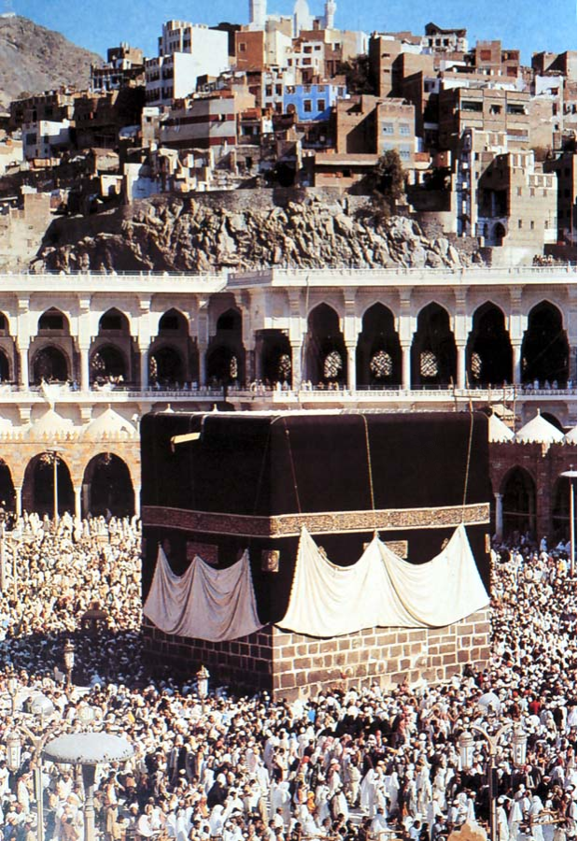
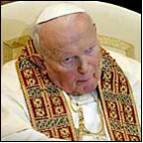
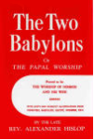
巴比伦是不是一个宗教？
401
Islam

Slide 47
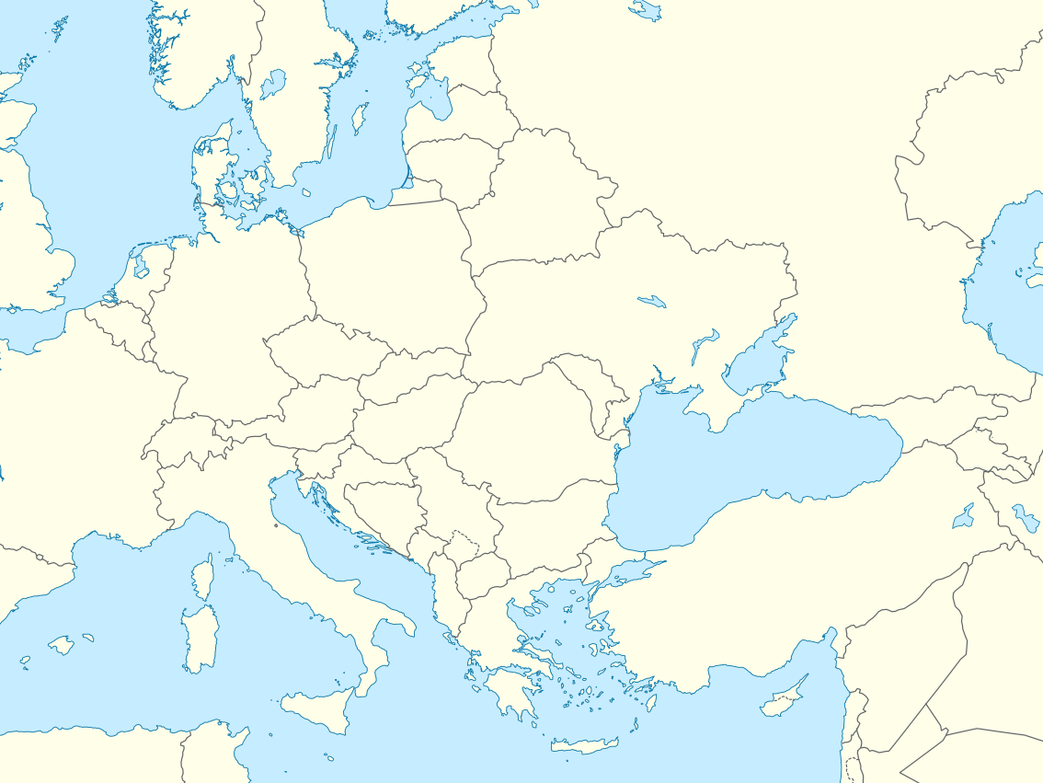
巴比伦宗教向西转移
罗马
帕加马
巴比伦
Notes:
"After the Persians took over Babylon in 539 B.C., they discouraged the continuation of the mystery religions of Babylon. Subsequently the Babylonian cultists moved to Pergamum (or Pergamos) where one of the seven churches of Asia Minor was located (cf. Rev. 2:12-17)… When the teachers of the Babylonian mystery religions later moved from Pergamum to Rome, they were influential in paganizing Christianity and were the source of many so-called religious rites which have crept into ritualistic churches" (Walvoord, BKC).

Slide 48
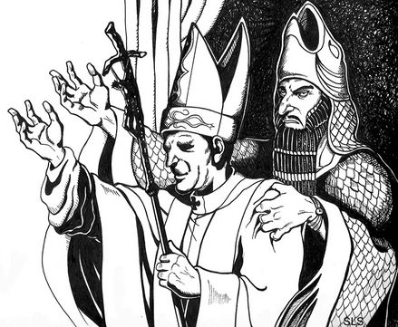
巴比伦宗教向西转移
Pontifex Maximus
“桥梁的主要守护者"
人与撒旦之间的桥梁的守护者
罗马
Pergamum
巴比伦
Notes:
"Crowns in the shape of a fish head were worn by the chief priests of the Babylonian cult to honor the fish god. The crowns bore the words "Keeper of the Bridge," symbolic of the "bridge" between man and Satan. This handle was adopted by the Roman emperors, who used the Latin title Pontifex Maximus, which means "Major Keeper of the Bridge." And the same title was later used by the bishop of Rome. The pope today is often called the pontiff, which comes from pontifex. " (Walvoord, BKC).

Slide 49
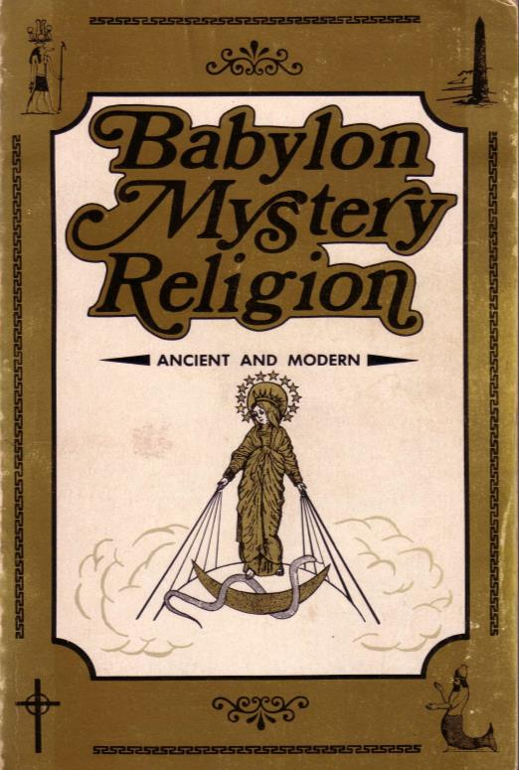
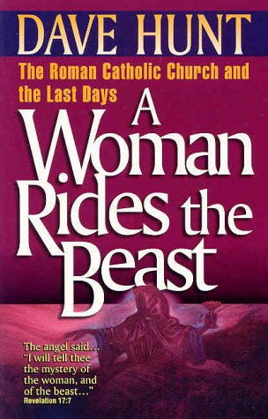
天主教会重复巴比伦的误区
401
巴比伦神秘宗教今日里昂
来源：
戴夫追捕
巴比伦神秘宗教
罗马天主教教会和最后一天
一个女人骑兽
拉尔夫·
伍德罗

Slide 50
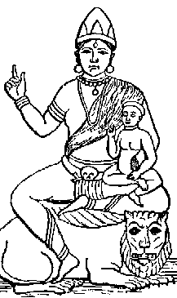
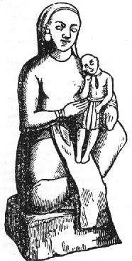
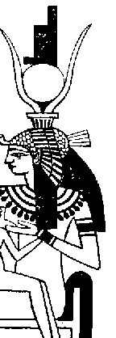
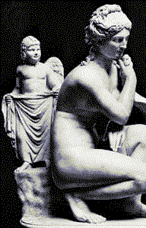
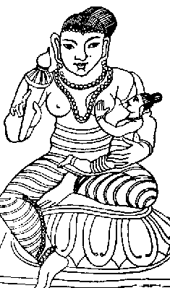
母亲和儿童崇拜
401
巴比伦神秘宗教的今天
Babylonians
The goddess mother Semiramis held her child Tammuz in her arms
印度教
希腊
佛教徒
巴比伦
埃及

Slide 51
母亲和儿童崇拜
401
巴比伦神秘宗教的今天
巴比伦人
母亲塞米勒米斯作为尼姆罗德妻子的女神被称为“女王的天堂”
以色列
耶利米7:18：“[犹太人]孩子捡柴，父亲轻火，妇女揉面团和蛋糕面包
女王的天堂，他们倒出来奠祭其他神挑衅。我发怒。“

Slide 52
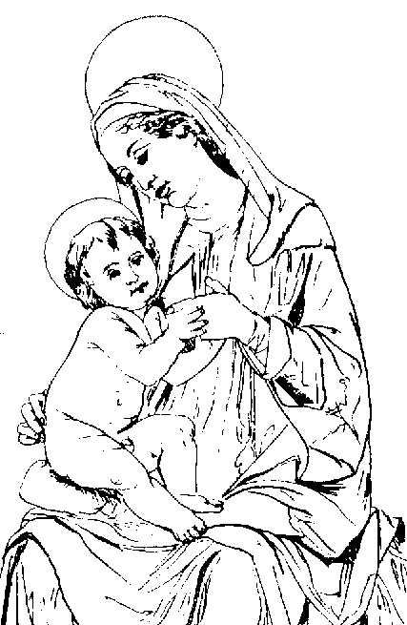
母亲和儿童崇拜
401
巴比伦神秘宗教的今天
巴比伦人
女神母亲塞米勒米斯她的孩子抱在怀里塔穆兹
天主教徒
玛丽被崇拜她的儿子耶稣一起在巴比伦时尚

Slide 53
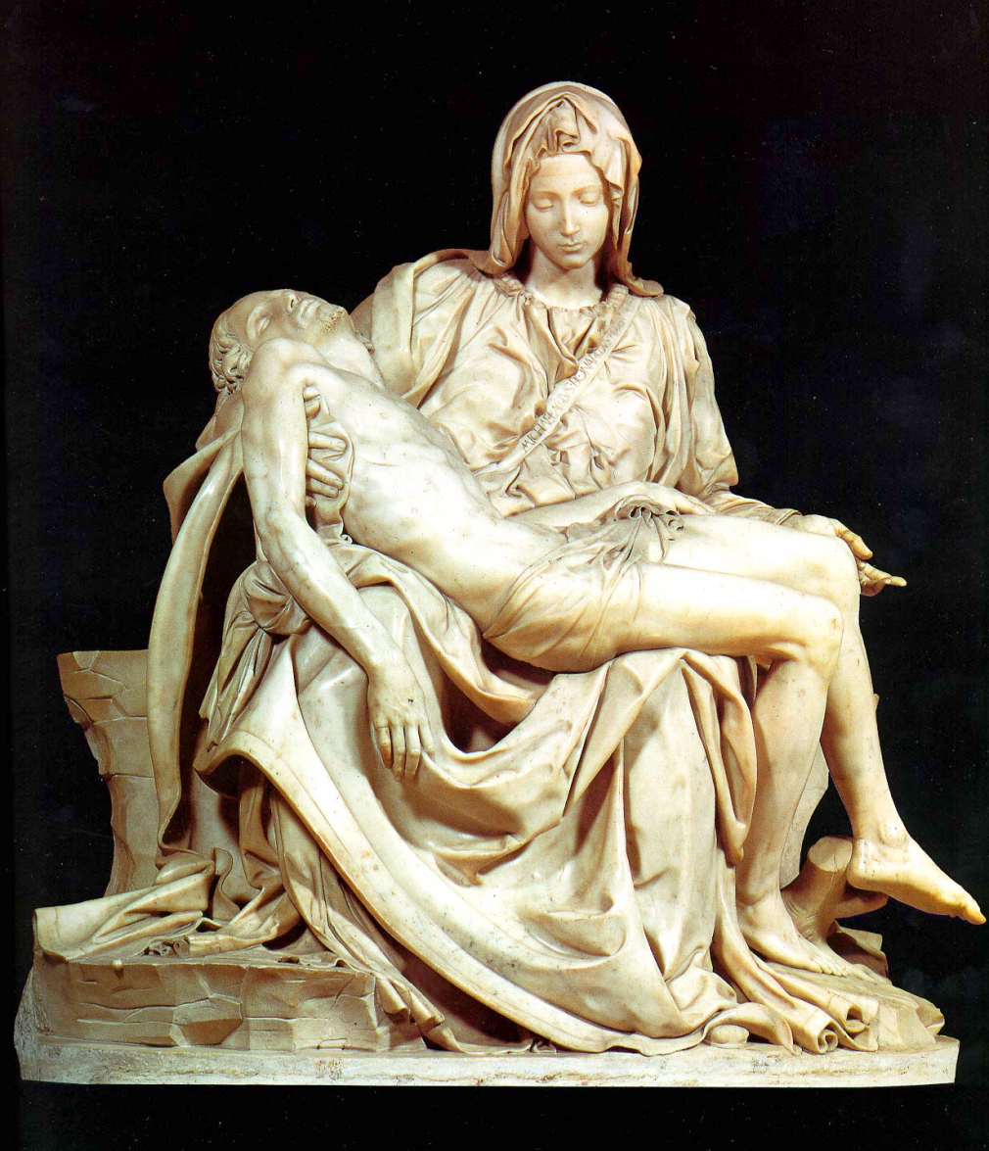
圣母怜子图
401
谁是米开朗基罗的圣母怜子的联络点？
耶稣是玛丽少得多！

Slide 54


方尖碑
401
巴比伦神秘宗教的今天
巴比伦人
图片90英尺x9英尺（但以理书3）
天主教徒
皇帝卡利古拉（公元37-41年）带来了罗马的圣彼得大教堂广场的方尖碑焦点从埃及神庙的太阳崇拜。教皇西斯五动议，在公元1586到梵蒂冈。他判处死刑，如果它被打破了！

Slide 55


在圣伯多禄广场的埃及方尖碑
401
Notes:
The Washington Monument in Washington DC is also an obelisk with origins back to Babylonian Mystery Religion!

Slide 56
其他异教徒的相似之处：
401
巴比伦神秘宗教的今天
巴比伦人
文物
朝圣
放纵
炼狱
教宗
独身牧师
陷于
复活节音乐节
冬节
天主教徒
文物
朝圣
放纵
炼狱
教宗
独身牧师
陷于
复活节音乐节
圣诞节节

Slide 57


巴比伦占星术吗？
402

Slide 58

世界统一宗教
403

Slide 59

以罗马为中心、背教的教会
403

Slide 60


世界基督教协进会
403

Slide 61

美国宗教国际
成立于2000年6月26日“结束宗教动机的暴力”
404
Notes:
Recently (June 26, 2000), a charter was signed in Pittsburgh, Pennsylvania. An organization was born which was aptly named, United Religions. The purpose of this organization is to be the spiritual equivalent of the United Nations. Their purpose is to "to end religiously motivated violence" and "respect the uniqueness of each tradition. "While these ideas sound lofty and exalted, they also assert "Members of the URI shall not be coerced to participate in any ritual or be proselytized." Members of this organization come from a variety of traditions, as evidenced by their emblem above. This is not a Biblically based doctrine, which would say "for there is none other name under heaven given among men, whereby we must be saved (Acts 4:12)." This is, indeed, the case. We must now allow ecumenism and interfaithism to destroy the foundation of a Biblically based belief in Jesus Christ as the Savior of the world. No other figure fulfills this position. Absolutely none other! This organization should not be endorsed by any Christian. It is just one in a series of steps that is paving the way for the Antichrist. www.pastorlewis.com/ uri/uri.html

Slide 62


巴比伦是一个城市吗？
404
巴比伦

Slide 63

达拉斯神学院的教授说，20世纪80年代重建，伊拉克巴比伦发现神秘巴比伦
404
巴比伦的崛起
Slide 2
签署的结束时间

Slide 64

1986年的巴比伦拼花
404
110f
萨达姆·侯赛因和古代世界的征服者，尼布甲尼撒。他们不仅看起来很像，但他们的任务是相同的 - 控制世界。和统治这个世界的象征，是一个古老的城市...
巴比伦：决战的前奏？

Slide 65


巴比伦是代号
为罗马？
407

Slide 66

罗马有七个山丘（17：9）
407

Slide 67


是巴比伦对耶路撒冷的代号名称吗？
407

Slide 68


USA?
408
陈启乐博士说，
她是美国人
神秘的巴比伦是谁？

Slide 69

巴比伦必须是一个国家。为什么呢？
408
a
世界上没有任何一个城市在地球上统治（十七点18分）
一个“城市”是一个民族在圣经象征

Slide 70

美国是象征着一个女人在自由女神像
408
b

Slide 71

结束时间巴比伦是精神通奸罪。这意味着她离开了她神圣的遗产。
408
c

Slide 72

美国作为一个基督教国家开始
408
c

Slide 73

普利茅斯朝圣者
408
c

Slide 74

然而，他们屠杀的​​Pequot族
408
c

Slide 75

美国作为一个基督教国家开始
408
c
“独立宣言”（1776）指出神的4倍
开国元勋，早期总统和最高法院称为美国“基督教国家”，直到1947年（见http://www.afn.org/~govern/Christian_Nation.htm）
美国派出最传教士在1900年
“我们相信上帝”是国家的座右铭
上帝帮助每50呼吁各国之间的单一国家的序言
Notes:
http://www.afn.org/~govern/Christian_Nation.html says…
WAS THE UNITED STATES FOUNDED AS A CHRISTIAN NATION?
Recently, many authors have debated whether or not the United States of America was founded as a Christian nation. I wish to provide a few historical quotes from our Founding Era that lend credence to the supposition that we indeed were founded as a Christian nation.
Granted, God is not mentioned in the Constitution, but He is mentioned in every major document leading up to the final wording of the Constitution. For example, Connecticut is still known as the "Constitution State" because its colonial constitution was used as a model for the United States Constitution. Its first words were: "For as much as it has pleased the almighty God by the wise disposition of His Divine Providence…"
Most of the fifty-five Founding Fathers who worked on the Constitution were members of orthodox Christian churches and many were even evangelical Christians. The first official act in the First Continental Congress was to open in Christian prayer, which ended in these words: "...the merits of Jesus Christ, Thy Son, our Savior. Amen". Sounds Christian to me.
Ben Franklin, at the Constitutional Convention, said: "...God governs in the affairs of men. And if a sparrow cannot fall to the ground without His notice is it probable that an empire can rise without His aid?"
John Adams stated so eloquently during this period of time that; "The general principles on which the fathers achieved Independence were ... the general principles of Christianity ... I will avow that I then believed, and now believe, that the general principles of Christianity are as etemal and immutable as the existence and attributes of God."
Later, John Quincy Adams answered the question as to why, next to Christmas, was the Fourth of July this most joyous and venerated day in the United States. He answered: "...Is it not that the Declaration of Independence first organized the social compact on the foundation of the Redeemer's mission upon earth? That it laid the cornerstone of human government upon the first precepts of Christianity?" Sounds like the founding of a Christian nation to me. John Quincy Adams went on to say that the biggest victory won in the American Revolution was that Christian principles and civil government would be tied together In what he called an "indissoluble" bond. The Founding Fathers understood that religion was inextricably part of our nation and government. The practice of the Christian religion in our government was not only welcomed but encouraged.
The intent of the First Amendment was well understood during the founding of our country. The First Amendment was not to keep religion out of government. It was to keep Government from establishing a 'National Denomination" (like the Church of England). As early as 1799 a court declared: "By our form of government the Christian religion is the established religion; and all sects and denominations of Christians are placed on the same equal footing." Even in the letter that Thomas Jefferson wrote to the Baptists of Danbury Connecticut (from which we derive the term "separation of Church and State") he made it quite clear that the wall of separation was to insure that Government would never interfere with religious activities because religious freedom came from God, not from Government.
Even George Washington who certainly knew the intent of the Constitution and the Bill of Rights, since he presided over their formation, said in his "Farewell Address": "Of all the dispositions and habits which lead to political prosperity, religion and morality are indispensable supports. In vain would that man claim the tribute of patriotism, who should labor to subvert these great pillars." Sure doesn't sound like Washington was trying to separate religion and politics.
John Jay, the first Chief Justice of the United States Supreme Court, and one of the three men most responsible for the writing of the Constitution declared:
"Providence has given to our people the choice of their rulers, and it is their duty-as well as privilege and interest- of our Christian nation to select and prefer Christians for their rulers." Still sounds like the Founding Fathers knew this was a Christian nation.
This view, that we were a Christian nation, was hold for almost 150 years until the Everson v. Board of Education ruling in 1947. Before that momentous ruling, even the Supreme Court knew that we were a Christian nation. In 1892 the Court stated:
"No purpose of action against religion can be imputed to any legislation, state or national, because this is a religious people...This is a Christian nation." There it is again! From the Supreme Court of the United States. This court went on to cite 87 precedents (prior actions, words, and rulings) to conclude that this was a "Christian nation".
In 1854, the House Judiciary Committee said: "in this age, there is no substitute for Christianity...That was the religion of the founders of the republic, and they expected it to remain the religion of their descendants.'
It should be noted here that even as late as 1958 a dissenting judge warned in Baer v. Kolmorgen that if the court did not stop talking about the "separation of Church and State", people were going to start thinking it was part of the Constitution.
It has been demonstrated in their own words: Ben Franklin, George Washington and John Adams, to the House of Representatives and the Supreme Court, how our founding fathers felt about the mix of politics and religion.
When we read articles such as "What's God got to do with it?" (Primack, 5/4) and "The wall between state and church must not be breached" (Tager, 5/7) it just reaffirms how little, even intelligent people, understand about the founding of our great Republic. To say that this nation was not founded as a Christian nation or that the Constitution was not founded on Christian principles is totally at odds with the facts of history.
Tex Browning
Back to Citizens for Better Government
Last Modified May 1, 2003

Slide 76

美国作为一个基督教国家开始
408
c

Slide 77


你相信上帝吗？
Notes:
For over 200 years America has unashamedly declared trust in God in all forms of money--paper and coins alike. Since 1954 by law each currency and coin must say on it, "In God We Trust."

Slide 78

我们相信上帝吗？
Notes:
But do we really trust in God? (Click) I found it interesting that in 2007 the news broke that our new dollar coin produced in the previous month actually didn't have this phrase on the front or the back. Some have said that it didn't appear on the coin at all.

Slide 79


你在上帝的信任不为难你吗？
Notes:
But the phrase does appear--only it's on the side--at least on most of the 300 million coins minted! The news broke that an unknown amount of coins were missing the phrase totally. Interestingly, these coins are more valuable and at first sold for $600 on eBay. Now that we know there's as many as 100,000 of them, the price has dropped to $50. It seems that we are too embarrassed about Christ to put this phrase on the font or back anymore.

Slide 80

的耻辱的一个原因？
“是谁，我很好，我不是说我是克里斯蒂娜？，但我不说，我与相邻”
Notes:
That reminds me of some Christians. Ask them if they are believers and they want to know why you want to know! Worse yet, they won't admit that they trust in Christ.

Slide 81

The USA began as a Christian nation but has left its godly heritage.
408
c
奥巴马电子邮件向CBN新闻“无论我们曾经是，我们不再仅仅是一个基督教国家，我们也是一个犹太国家，一个穆斯林国家，一个佛教国家，一个印度教国家，以及非信徒组成的国家

Slide 82


美国开始作为一个基督教国家，但已经离开了其神圣的遗产。
408
c
“我们不再是一个基督教国家”
奥巴马
全美自由板

Slide 83






The Christian heritage is now激烈的辩论！
美国是一个基督教国家！
408
c
新闻周刊
基督教美国的衰亡
美国
基督教国家

Slide 84


美国贸易
408
d
华尔街
世贸组织
Used with permission

Slide 85



轮胎贸易
（以赛亚书23）
从遥远的国家进口原料和出口成品：
青铜 - 出口到亚述，塞浦路斯，希腊，意大利和
象牙 - 从叙利亚进口再出口成品到西部
玻璃运作，羊毛东西染成紫色等

Slide 86


腓尼基殖民地
EUROPE
(Tarshish)
ASIA MINOR
AFRICA
Phoenician Shipping Routes
Land of Phoenicia
Trade Routes

Slide 87

腓尼基的贸易
精明的商业使用的贸易条约和政治联盟：
贸易与大卫（2萨姆5:11;1国王5时01分）
西贡国王帮助所罗门在建设和海外企业
油，酒和木材出口
被称为妓女（以赛亚书23:16-17）

Slide 88


美国财富
110k
e
Total Net Worth of US Households and Nonprofit Organizations 1945-2009
70
65
60
55
50
45
40
35
Trillions of Dollars
30
25
20
15
10
5
0
Used with permission

Slide 89


美国财富
110k
e

Slide 90

美国控制其他国家
409
f
Used with permission

Slide 91

美国控制的野兽
409
g
Used with permission

Slide 92


美国享乐主义
409
h
享乐主义
白白而道歉
Used with permission

Slide 93

美国荣耀
410
i
Used with permission

Slide 94


美国的神秘主义
410
j
Used with permission

Slide 95





美国不道德
410
k

Slide 96

美国欺骗联合国与她的巫术
411
l
你的商人大地的伟人，因为所有国家的巫术欺骗（farmakei,a）“
（18:23b 北亚利桑那大学）

Slide 97



美国欺骗联合国与她的巫术
411
l

Slide 98

美国作为一个王后坐在
411
m
她荣耀自己，住在豪华的，所以现在的痛苦和悲伤与匹配。
她在她的心里放言，黄先生是我的宝座上的女王。
我无助的寡妇
（18:17 NLT）
Used with permission

Slide 99

美国杀神的先知
411
n
“上帝死了.”
–尼采, 1883
“尼采死了.”
–上帝, 1900
Used with permission

Slide 100

美国杀神的先知
411
n
多少先知的声音，已通过美国谋杀流产？
答案 :
55万
Used with permission

Slide 101
巴比伦的神秘与美国存在的问题
412
美国国家的象征，是不是一个女人，但秃鹰
必须证明声称，俄罗斯是野兽
破坏美国在1993年没有发生，以及其他的“预言”的失误
陈博士的书，有许多其他的神学问题
Used with permission

Slide 102

什么或谁，那么，是巴比伦的奥秘吗？
412
没有人能确定肯定的启示17-18巴比伦。
然而，这是不可能的，这是世界体系中，一个城市或国家的邦联。
美国可能是目前最好的选择，但没有人真正知道一个“包括我！
Used with permission

Slide 103

敌基督者在大灾难的后半期领导十个地区的联盟时摧毁末日巴比伦。(17:7-18).
七斗和
十角
Used with permission

Slide 104
八个连续王国
(17:10-11)
479
1。埃及（法老）
2。亚述（亚述国王）
3。新巴比伦（尼布甲尼撒）
4。玛代波斯（居鲁士）
5。希腊（亚历山大大帝）
6。罗马（凯撒“一”）
7。重新统一罗马帝国（十王“尚未”）
8。最后詹蒂莱世界王国（敌基督）
希区柯克

Slide 105

起初她骑着怪兽
(17:7-14)
Used with permission

Slide 106

但后来这只怪兽把她毁灭 (17:15-18)

Slide 107
I.这个世界的关键实体将落于大灾难中(启示录 17)
世界上最邪恶的势力将会发生什么后果?
巴比伦

Slide 108


II. 世界的关键影响力将被基督的王国所取代 (18:1–19:10).
我们为何对世界应有排斥并拥抱上帝的王国?

Slide 109

"这些事以后，我看见有另一位掌大权柄的天使，从天上降下来，他的荣光照亮了大地。
² 他用强有力的声音呼喊"
(18:1-2a CNV).

Slide 110

"倾倒了！大巴比伦倾倒了！
成了鬼魔的住处，
各样污灵的监狱，
一切污秽可憎之雀鸟的牢笼，
3 因为各国都喝她淫乱烈怒的酒醉了；
地上的君王与她行淫，
世上的商人因她奢华挥霍就发了财。"
(18:2b-3 CNV).

Slide 111

"从那城出来吧" (18:4)

Slide 112

"我听见另一个声音从天上来，说：
“从那城出来吧，我的子民！
免得在她的罪上有分，
受她所受的灾难；
⁵ 因为她的罪恶滔天，
神已经想起她的不义来。
⁶ 她怎样待人，你们也要怎样待她；
照着她所作的，加倍报应她；
用她调酒的杯，加倍调给她。
⁷ 她怎样炫耀自己，怎样奢华挥霍，
你们也要怎样给她痛苦悲哀。'"
(18:4-7a CNV).

Slide 113

"从那城出来吧" (18:4)

Slide 114

大地哭泣悲哀 (18:9-24)
414
Used with permission

Slide 115

"地上的众王，就是跟她一同行邪淫、骄奢无度的，看见焚烧她的烟的时候，就必为她痛哭捶胸。
¹⁰ 他们因为害怕她所受的痛苦，
就远远地站着，说：
‘有祸了！有祸了！这大城，
巴比伦，这坚固的城啊！
一时之间你的审判就来到了！"
(18:9-10 CNV).

Slide 116

“地上的商人也为她悲哀痛哭..”
(18:11）
商人们说， “有祸了， 有祸了。”

Slide 117

Babylon Ruined in One Hour by Fire
406
Pt. 6
"时之间， 这么大的财富竟荡然无存!"
(18:17a)
Used with permission
Notes:
She will be completely destroyed by the Antichrist and his ten-nation confederacy (17:16a) by fire (17:16b; 18:8) in only one hour (18:10, 17, 19).

Slide 118

Babylon Destroyed Quickly
406
Pt. 6
有一位大力的天使， 把一块好像大磨石一样的石头， 举起来抛在海里， 说： “巴比伦大城也必这样被猛力地抛下去， 决不能再找到了！(18:21 CNV)
Notes:
She will be completely destroyed by the Antichrist and his ten-nation confederacy (17:16a) by fire (17:16b; 18:8) in only one hour (18:10, 17, 19).

Slide 119

淫妇会下沉…

Slide 120

"灯的亮光，
在你中间决不能再照耀了！
新郎新娘的声音，
在你中间决不能再听到了！
你的商人一向都是地上的大人物，
万国都因你的邪术受了迷惑。" (18:23 CNV).

Slide 121

"先知、圣徒和地上一切被杀的人的血，
都在这城里找到了！"
(18:24 CNV).

Slide 122


天上欢欣 (19:1-2)
414
¹ 此 後 ， 我 听 见 好 像 群 众 在 天 上 大 声 说 ： 哈 利 路 亚 （ 就 是 要 赞 美 耶 和 华 的 意 思 ） ！ 救 恩 、 荣 耀 、 权 能 都 属 乎 我 们的 神 ！
² 他 的 判 断 是 真 实 公 义 的 ； 因 他 判 断 了 那 用 淫 行 败 坏 世 界 的 大 淫 妇 ， 并 且 向 淫 妇 讨 流 仆 人 血 的 罪 ， 给 他 们 伸 冤 。.”
Used with permission

Slide 123

" 他们再一次说：
“哈利路亚！
烧淫妇的烟往上冒，
直到永永远远!"
(19:3 CNV).
Used with permission

Slide 124

羔羊的婚礼与婚宴
Notes:
124

Slide 125

启示录 19:7-9
的邀请
    19：7 我 们 要 欢 喜 快 乐 ， 将 荣 耀 归 给 他 。 因 为 羔 羊 婚 娶 的 时 候 到 了 ， 新 妇 也 自 己 预 备 好 了 。 19:8 就 蒙 恩 得 穿 光 明 洁 白 的 细 麻 衣 ， 这 细 麻 衣 就 是 圣 徒 所 行 的 义 。 19:9 天 使 吩 咐 我 说 ， 你 要 写 上 ， 凡 被 请 赴 羔 羊 之 婚 筵 的 有 福 了 。 又 对 我 说 ， 这 是 神 真 实 的 话 。
415
Notes:
125

Slide 126

“大灾难之前”被提
主再来
被提
(婚礼 )
(晚餐 )
磨难
千禧年
教会时代
永远的国度
7 年
1000 年
审判
Notes:
126

Slide 127
婚礼和婚宴的对比（启示录19章）
77a
象征 | 婚礼 | 节期
经节 | 7 | 9
语法时态 | 过去的 | 现在的
参与 | 教会为新娘 | 以色列为客人
时段 | 大灾难 | 千禧年
地点 | 天堂 | 地上
特征 | 婚礼，行列 | 朋友受邀参加婚宴
解释 | 新娘（教会）被领到父家 | 新娘（教会）被介绍给朋友（以色列）
经文 | 罗 7:1-4; 林前6:17; 林后11:2; 弗 5:27 | 赛 25:6-8; 太 8:11; 26:29; 路 12:35-37
Notes:
127
NLT adds "feast" to 19:7

Slide 128

主要观点:
这个世界不会持续，
但基督的国度将会存在!

Slide 129

巴比伦不会持久

Slide 130

基督的国度将持续!

Slide 131
I.这个世界的关键实体将落于大灾难中(启示录 17).
世界上最邪恶的势力将会发生什么后果?
巴比伦

Slide 132
II. 世界的关键影响力将被基督的王国所取代 (18:1–19:10).
我们为何对世界应有排斥并拥抱上帝的王国?

Slide 133

"从那城出来吧" (18:4)

Slide 134

你怎样走出她的罪，免得在她的罪上有份?
“他的新娘也自己预备好了" (19:7 CNS)
Notes:
免得在她的罪上有分，
受她所受的灾难

Slide 135


耶利米中的应用: “离开耶路撒冷"
在巴比伦的围困期间，耶利米书24 将所有犹太人描绘成两种无花果:
拒绝服从上帝使用巴比伦人来惩罚的纪律， “坏无花果” 会因留在城里而违背上帝而死亡.
“好无花果” 将通过离开这座城市向外面的巴比伦人投降来挽救他们的生命。!
公元70年是没有什么不同！
犹太人像
无花果
好
坏
巴比伦人
耶利米 24 无花果

Slide 136


应用: “离开耶路撒冷"
"所以耶稣也是这样在城门外受苦，为的是要借着自己的血使人民成圣。"
(希伯来 13:12 CNV)
¹³ 那么，让我们也出到营外到他那里去，担当他的凌辱。“
(希伯来 13:13 CNV)
Leen & Kathleen Ritmeyer, "Akeldama: Potter's Field or High Priest's Tomb?" BAR 20 (Nov/Dec 94): 34
Notes:
The application to leave Jerusalem is in Hebrews 13.

Slide 137

你怎样走出她的罪，免得在她的罪上有份?
您的眼睛
你的嘴唇
你的双手
你的脚

Slide 138

7 Heads & 10 Horns
要穿戴 神所赐的全副军装，使你们能抵挡魔鬼的诡计。
以弗所 6:11
Used with permission

Slide 139

耶稣胜利!
关于启示的系列文章

Slide 141


末世论 • BibleStudyDownloads.org
免费获得该讲解!
圣经学习下载
Notes:
The explanation for free!
Future (Eschatology) link address

