Slide 1


Template Suite 1-Title 01359
《讲员名字》
物种的起源
达尔文是否是对是错?
创世记答案机构
Designed by Dr. Terry Mortenson
Dr. Rick Griffith • 博士 • 新加坡神学院 • BibleStudyDownloads.org
Notes:
This template is intended for talk titles. Although it can be used for significant section titles, its “cover page” feel makes it best used once at the beginning of a presentation. Subtitle can be as its name suggests or the speaker's name. Presentation Team recommends title text size as 50–72 and subtitle size as 30–48 with optimal sizes already used in this example. This also contains a floating AiG logo that can be repositioned or removed as appropriate for the overhead's content.

Slide 2

AiG web site #1
启示录的答案网页

Slide 3

NAS 1998—no debate
“科学界内没有辩论进化是否发生过,
也没有证据表明进化没发生过。”
英文书：
Teaching about Evolution and the Nature of Science (Washington, DC: Nat. Acad. of Science, 1998), p. 4.
Notes:
The book is intended for teachers, parents, school administrators and policy makers.

Slide 4
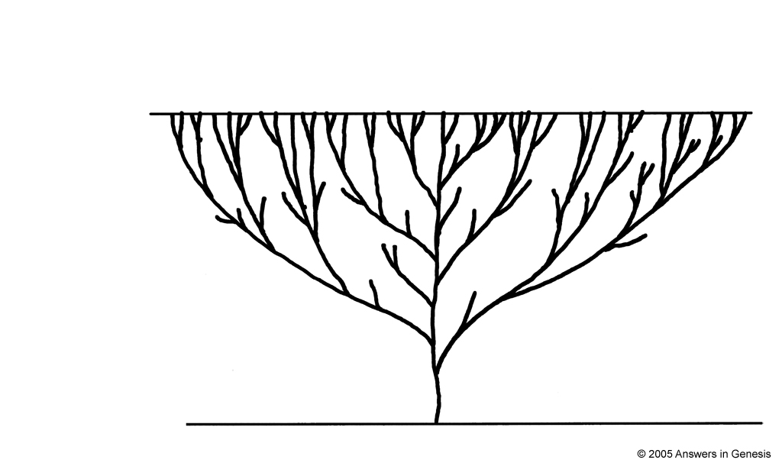
进化的生命之树
原始
今天
微生物-至-微生物学家
Notes:
Evolutionists say that the beginning of life was about 1.9-3.8 billion years ago in the ocean. The trunk of the tree before any branch would actually be much longer than the upper part of the tree as in the evolutionary view it took a very long time (1.4-3.3 bill yrs) to go from single celled to multicelled creatures (about 550 million years ago).

Slide 5
哲学大自然主义的定义
所存在的仅有大自然和物质。
2. 一切可以，也一定能够以时间，偶然性和大自然的法则在物质上的作用。
无神论的宗派

Slide 6

Gen. 1:11-12 “kinds” NAS
创 1:11-12
11 神 说 ： 地 要 发 生 青 草 和 结 种 子 的 菜 蔬 ， 并 结 果 子 的 树 木 ， 各 从 其 类 ， 果 子 都 包 着 核 。 事 就 这 样 成 了 。
12 於 是 地 发 生 了 青 草 和 结 种 子 的 菜 蔬 ， 各 从 其 类 ； 并 结 果 子 的 树 木 ， 各 从 其 类 ； 果 子 都 包 着 核 。 神 看 着 是 好 的 。

Slide 7
Gen. 1:21, 25 “kinds” NAS
创 1:21, 25
21 神 就 造 出 大 鱼 和 水 中 所 滋 生 各 样 有 生 命 的 动 物 ， 各 从 其 类 ； 又 造 出 各 样 飞 鸟 ， 各 从 其 类 。 神 看 着 是 好 的 。
25 於 是 神 造 出 野 兽 ， 各 从 其 类 ； 牲 畜 ， 各 从 其 类 ； 地 上 一 切 昆 虫 ， 各 从 其 类 。 神 看 着 是 好 的 。

Slide 8
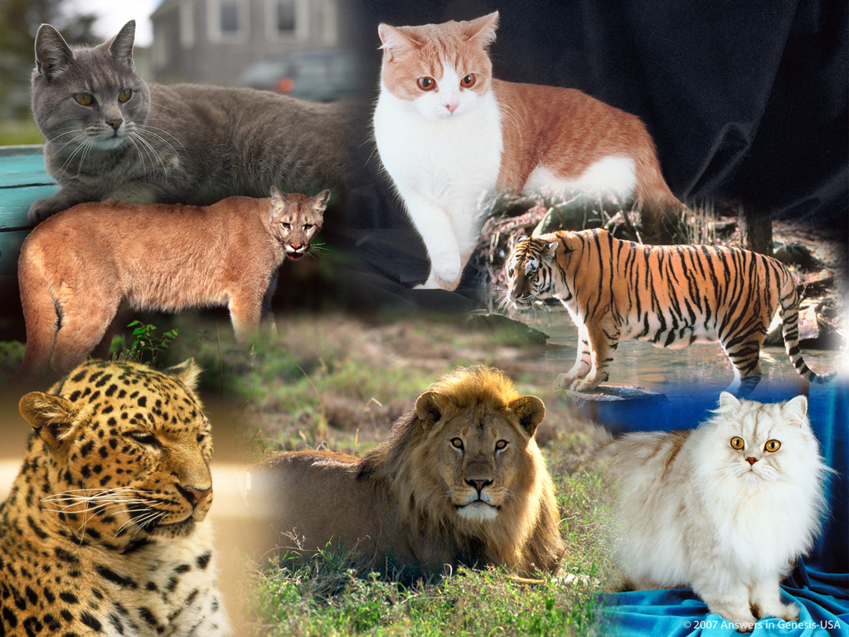
Cat Kind 03118

Slide 9
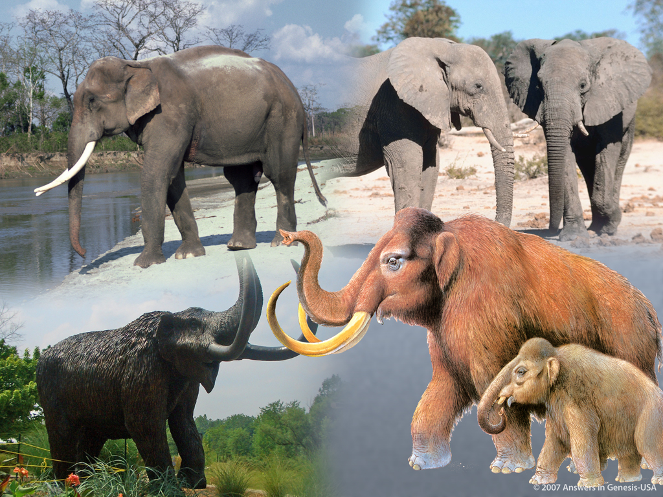
Elephant Kind 03120

Slide 10
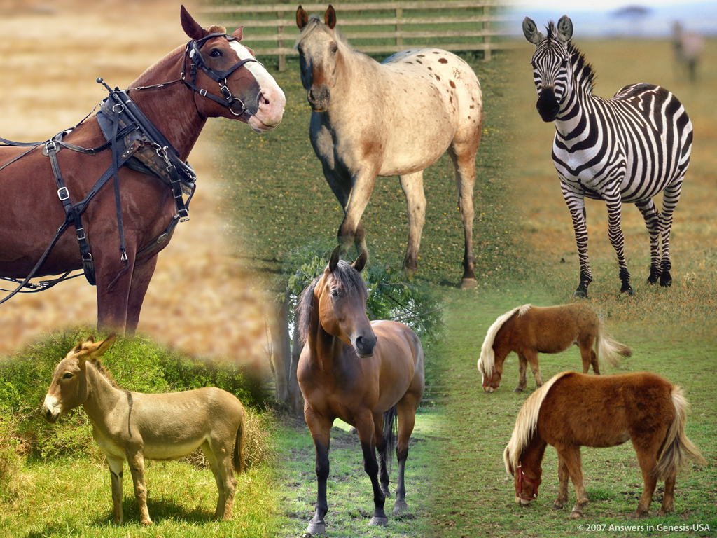
Horse Kind 03121

Slide 11
Gen. 6:19-20 “kinds” NAS
创 6:19-20
19 凡 有 血 肉 的 活 物 ， 每 样 两 个 ， 一 公 一 母 ， 你 要 带 进 方 舟 ， 好 在 你 那 里 保 全 生 命 。
20 飞 鸟 各 从 其 类 ， 牲 畜 各 从 其 类 ， 地 上 的 昆 虫 各 从 其 类 ， 每 样 两 个 ， 要 到 你 那 里 ， 好 保 全 生 命 。

Slide 12
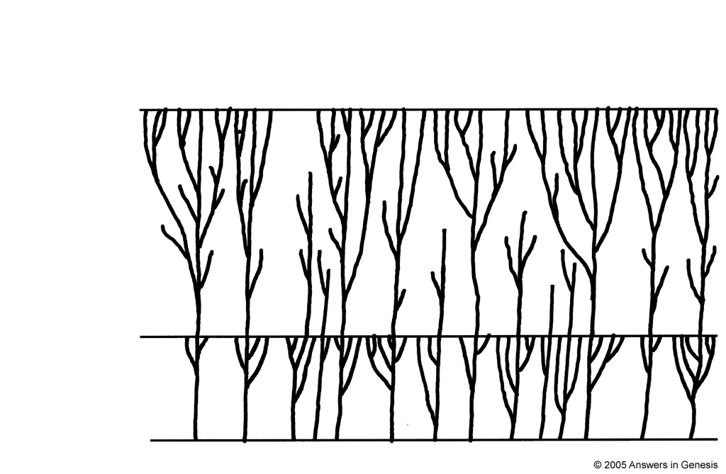
Creation forest
创造的生命之森林
今日
大洪水
创造
Notes:
For a technical overview of this model see Wayne Frair, “Baraminology—Classification of Created Organisms,” Creation Research Society Quarterly, 37:2 (Sept. 2000), pp. 82-91. Also, on created kinds with latent genetic potential for variation within the kinds, see Todd Charles Wood, “Mediated Design,” ICR Impact #363 (Sept. 2003), available from www.icr.org.
Variation within the created kinds would probably have occurred more quickly after both creation week and the Flood than my picture is capable of showing.

Slide 13
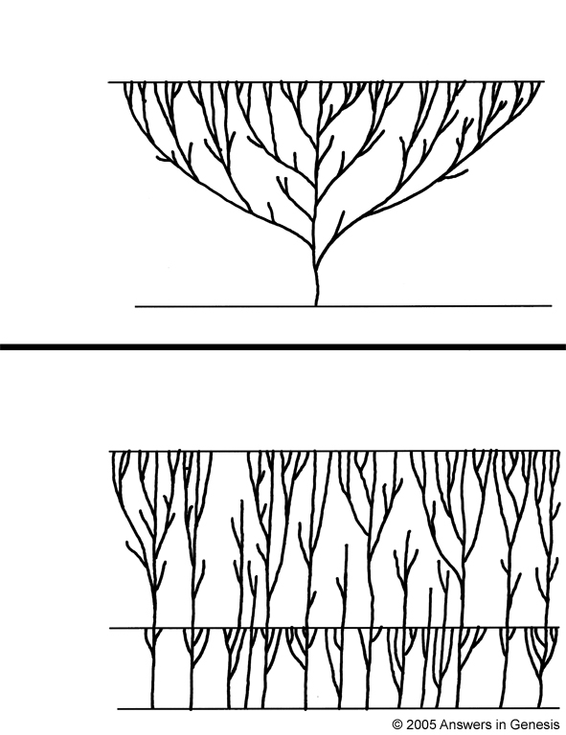
Evolution tree vs creation forest
进化的生命之树
今日
Present
Beginning
起初
创造的生命之森林
Present
今日
Flood
大水灾
被造
Creation

Slide 14
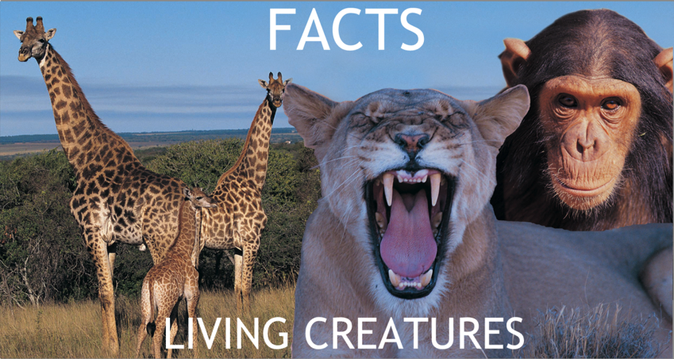
Assumptions Facts-Interpretations astronomy
自然主义的假设
圣经的假设
事实
生物
进化
创造
Notes:
14

Slide 15


2 Guys Books-Dog Kind 2 01879
神的话语是真理
人类决定的真理
GOD'S WORD IS TRUTH
MAN DECIDES TRUTH
Notes:
15

Slide 16
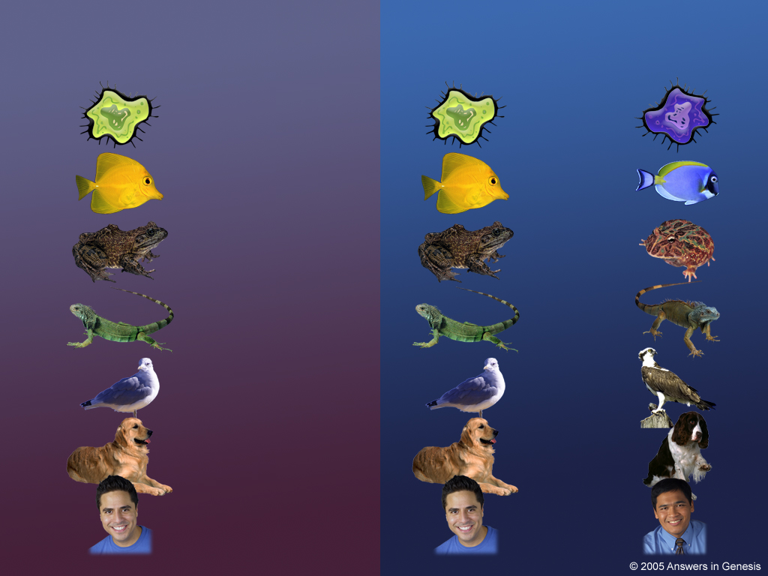
Evol V vs Crea H 01427
Evol V vs Crea H 01427
进化
创造

Slide 17
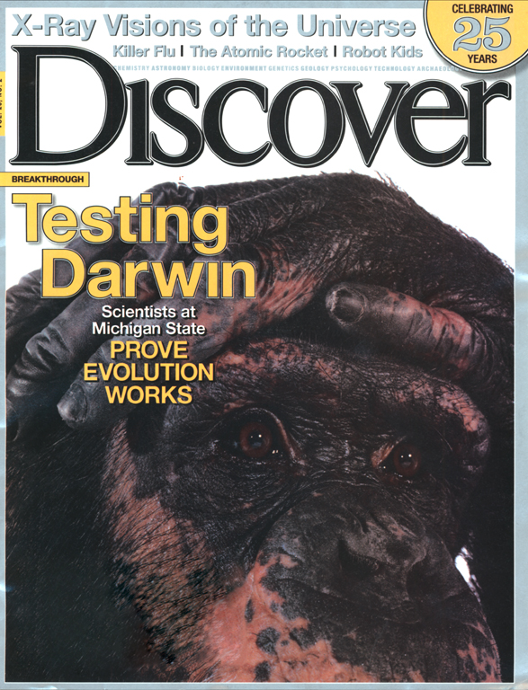
Discover cover 2005
试探
达尔文
密歇根州立大学的科学家证明进化是真实的
February 2005

Slide 18
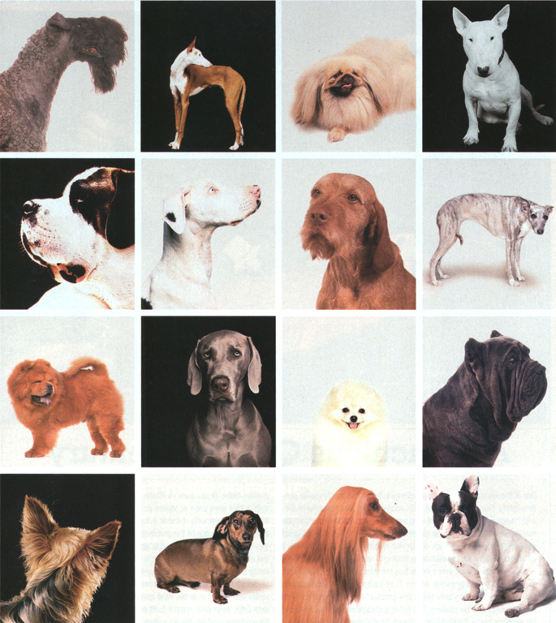
Dogs--Discover
“达尔文以狗的多样品种表示加速进化的一种类型。”
Carl Zimmer （卡尔·齐默）, “Testing Darwin,” Discover (Feb. 2005), p. 28.
Notes:
The caption also says, “Few domesticated dogs look like wolves—their ancient ancestors—with whom they can still mate. … If humans could crossbreed such diversity in just a few hundred years, he reasoned, other organisms could evolve in a similar fashion over millions of years.”
Notice the confusion of intelligently directed artificial selection with blind unintelligent, direction-less natural selection. Time alone overcomes the lack of intelligence!

Slide 19
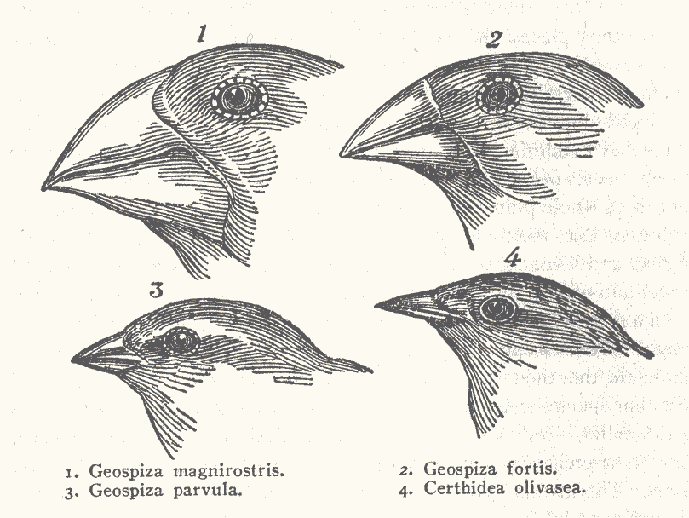
Darwin's Finches--Discover
“雀鸟在达尔文思想自然选择的进化过程是一个关键的例子。”
Carl Zimmer （卡尔·齐默）, “Testing Darwin,” Discover (Feb. 2005), p. 34.
Notes:
Finches picture scanned from Carl Zimmer, “Testing Darwin,” Discover (Feb. 2005), p. 34.
Darwin collected specimens of 13 Finch species, each with different beak shape for eating different food.
Finch beaks: http://www.oeb.harvard.edu/faculty/donohue/Finches.html, downloaded 24 Feb. 2006

Slide 20
Does the fossil record confirm E or C?
化石记录是否能够证明
进化
或
创造？

Slide 21
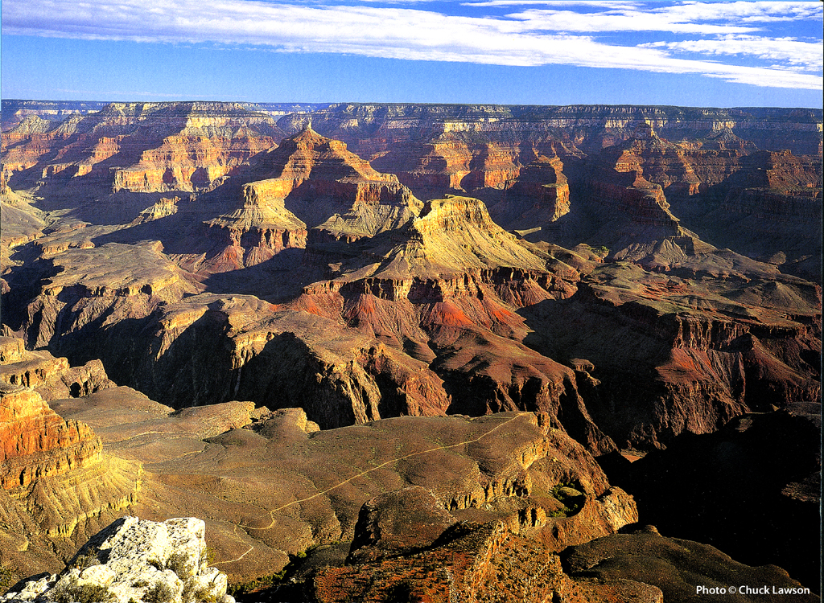
Grand Canyon – calendar 2004 Aug.
Notes:
Photo from “Grand Canyon 2004 Engagement Calendar” (August) produced by Smith-Southwestern, Inc., P.O. box 20100, Mesa, AZ 85277-100.

Slide 22
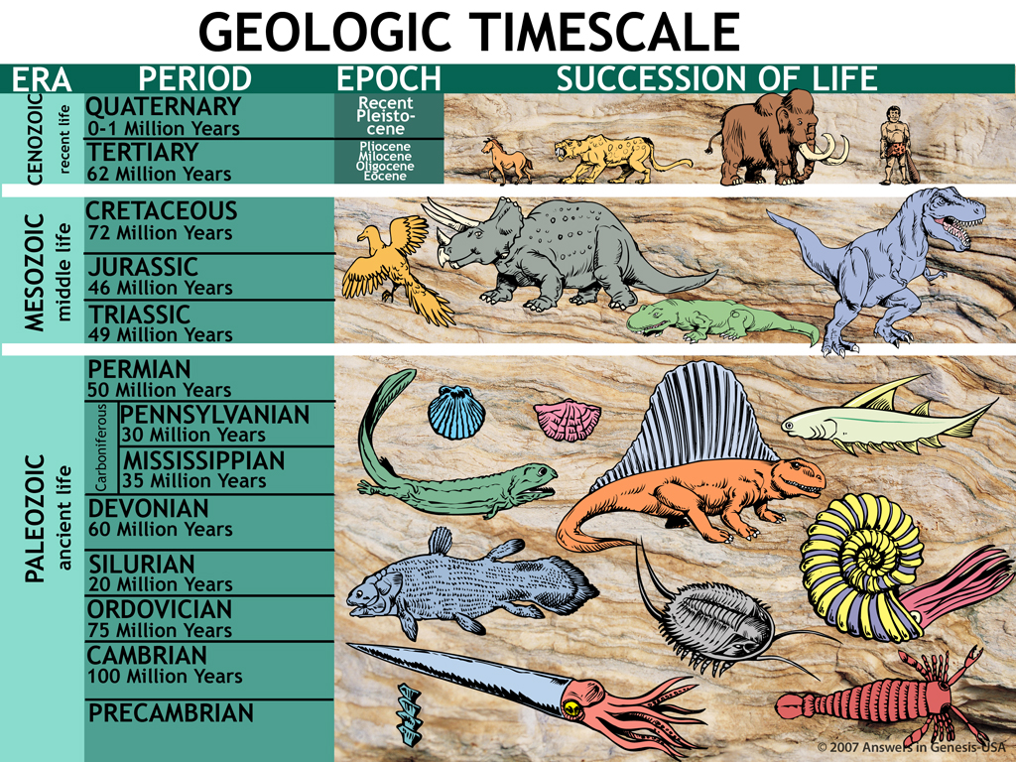
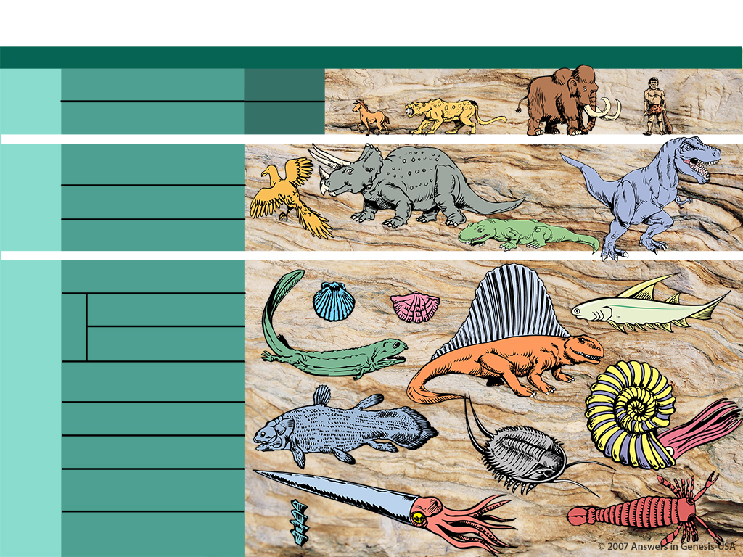
Geologic Timescale 00089
地质时间尺度
时代 时期 时代 一连串的生活
新生代
（近代的生活）
第四纪 （0至一百万年）
更新世
第三纪 （62百万年）
上新世
中新世
渐新世
始新世
中生代
（中代的生活）
早白垩世 （72百万年）
侏罗纪 （46百万年）
三叠纪 （49百万年）
古生
（古代的生活）
二叠纪 （50百万年）
宾夕法尼亚纪 （50百万年）
石炭系
密西西比纪 （35百万年）
泥盆系 （60百万年）
志留纪 （20百万年）
奥陶系 （75百万年）
寒武纪 （100百万年）
寒武纪前

Slide 23
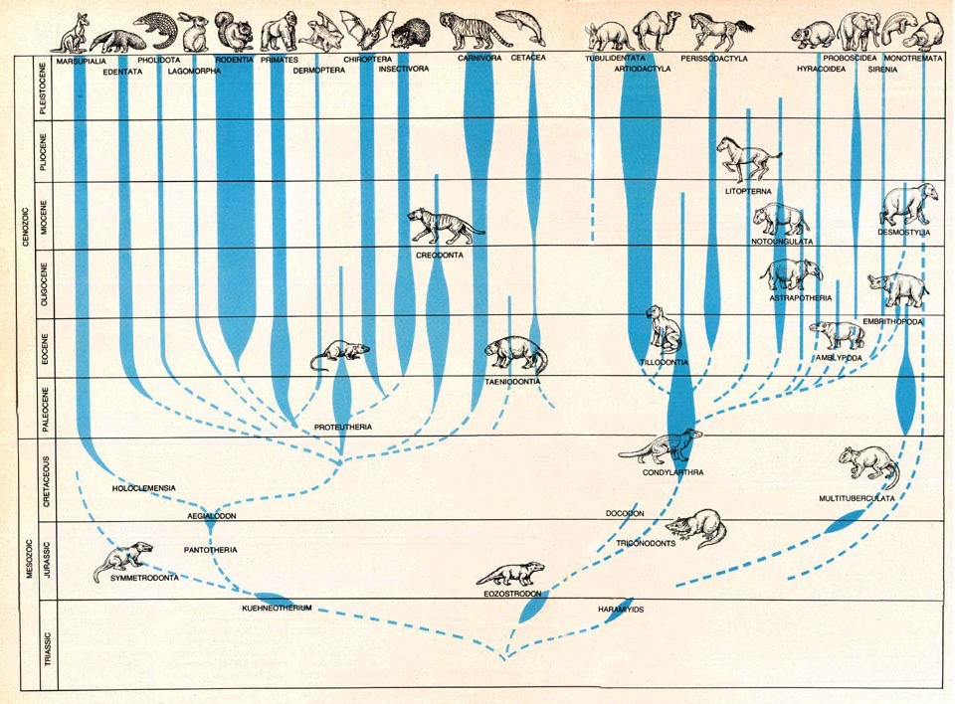
“哺乳动物的进化”
英文刊： Scientific American (Sept. 1978), pp. 152-53.
Notes:
James W. Valentine, “Evolution of Multicellular Plants and Animals,” Scientific American (Sept. 1978), pp. 152-53.

Slide 24
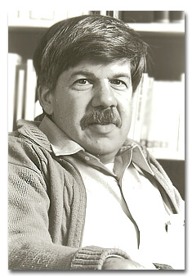
Gould 1977—on fossils—trade secret
“古生物学的商业秘密仍然是极端罕见的过渡形式化石记。我们的科学课本内的进化树唯有微妙的资料；其他资料只是推论而不能证明化石的存在。”
英文书：Stephen J. Gould, “Evolution's Erratic Pace,” Natural History, Vol. 86:5 (May 1977), p. 14.
Notes:
Gould died in summer of 2002.
Another evolutionist admission (David Raup):
“Well, we are now about 120 years after Darwin and the knowledge of the fossil record has been greatly expanded. We now have a quarter of a million fossil species but the situation hasn't changed much. The record of evolution is still surprisingly jerky and, ironically, we have even fewer examples of evolutionary transition than we had in Darwin's time. By this I mean that some of the classic cases of Darwinian change in the fossil record, such as the evolution of the horse in North America, have had to be discarded or modified as a result of more detailed information—what appeared to be a nice simple progression when relatively few data were available now appears to be much more complex and much less gradualistic. So Darwin's problem has not been alleviated in the last 120 years and we still have a record which does show change but one that can hardly be looked upon as the most reasonable consequence of natural selection.”
David M. Raup (Prof. of Paleontology, Univ. of Chicago), “Conflicts Between Darwin and Paleontology,” Field Museum of Natural History Bulletin, Vol. 50, No. 1, January 1979, p. 25.

Slide 25
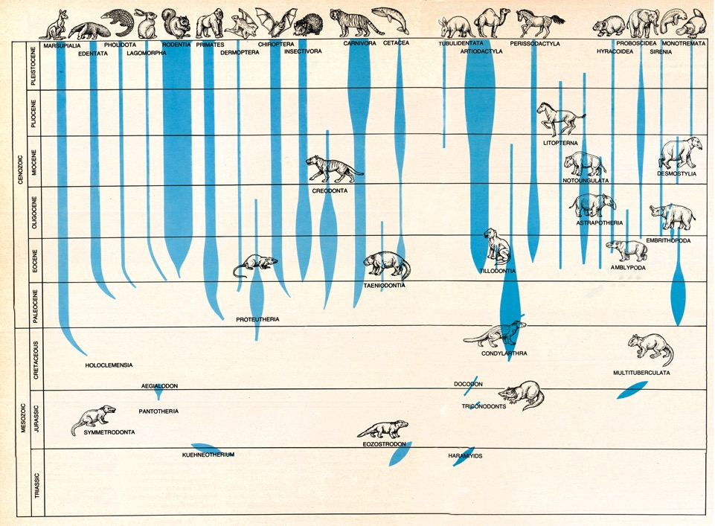
Mammal evolution 2

Slide 26
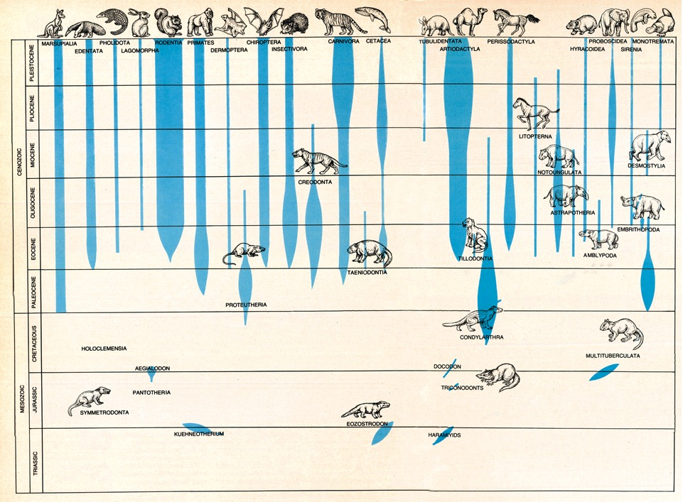
Mammal evolution 3

Slide 27
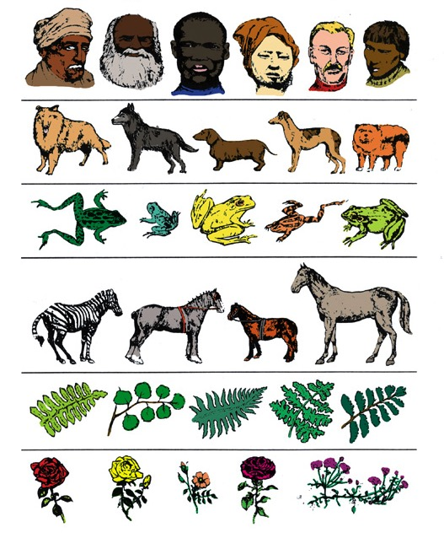
Abrupt appearance and stasis
突然出现 与 瘀
被造后
的种类
Notes:
Graphic adapted from John Morris, The Young Earth (Master Books), p. 144.
“The history of most fossil species includes two features particularly inconsistent with gradualism:
1. Stasis. Most species exhibit no directional change during their tenure on earth. They appear in the fossil record looking much the same as when they disappear; morphological change is usually limited and directionless.
2. Sudden appearance. In any local area, a species does not arise gradually by the steady transformation of its ancestors, it appears all at once and 'fully formed'.”
Stephen J. Gould, The Panda's Thumb (New York: W.W. Norton, 1980), 182.

Slide 28
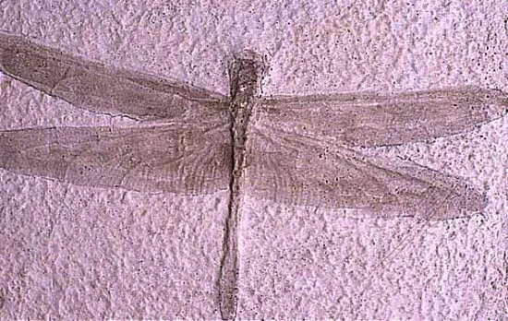
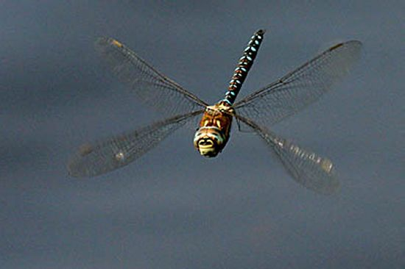
蜻蜓 “二十千万 岁”
取自英文书：Atlas of Creation
Notes:
This fossil dragonfly was found in France and is over four times the size of a modern dragonfly (biggest dragonfly ever foundd in fossil record had a wingspan of 30 inches)

Slide 29
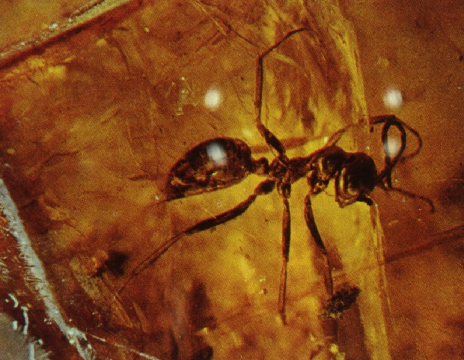
蚂蚁“十三千五百万 岁”
Notes:
Sphecomyrma, a fossil ant (Cretaceous 135 myo)

Slide 30
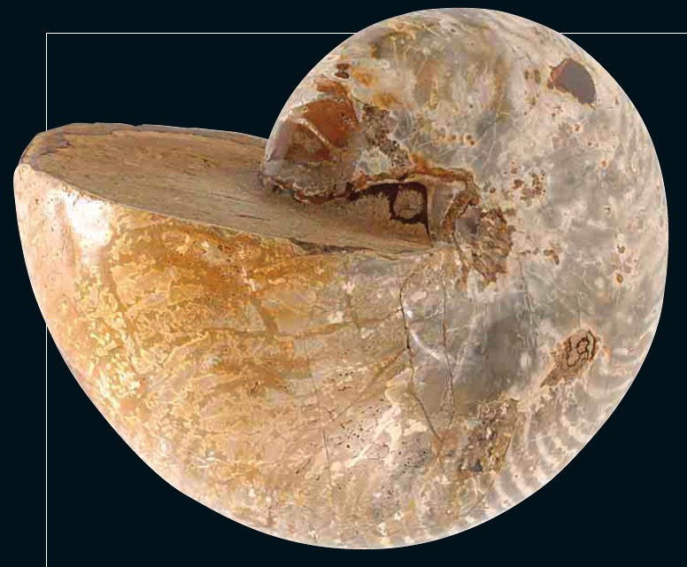
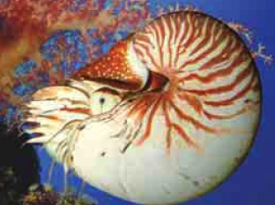
鹦鹉螺 “十一千四百万 岁”
Atlas of Creation
Notes:
Nautilus from Madagascar, Cretaceous 114 myo

Slide 31
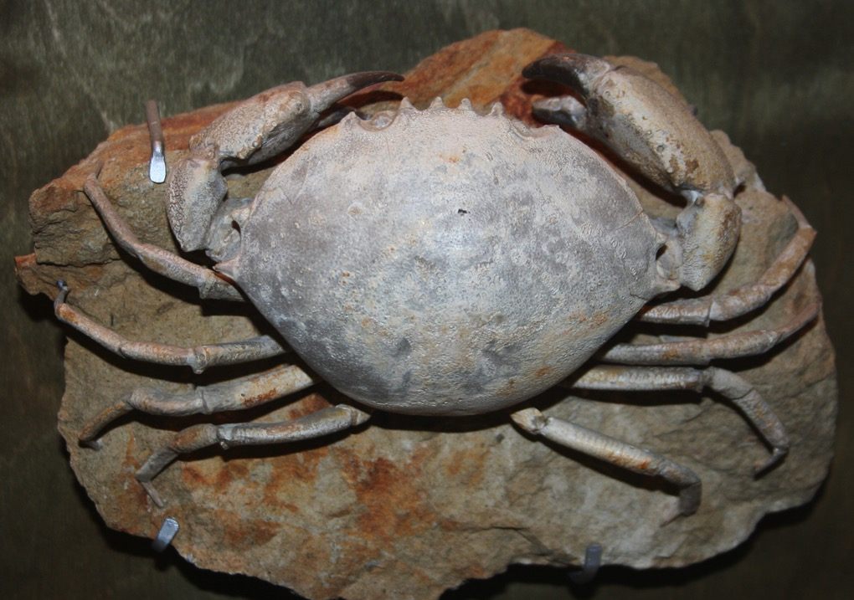
螃蟹 “五千万 岁”
The Creation Museum
Notes:
Crab Harpactocarcinus punctulatus. Eocene Monte Baldo Verona Italy

Slide 32
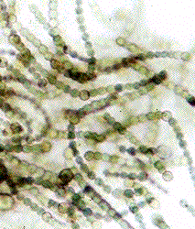
Blue-green algae unchanged in 3.5 billion years
蓝藻
“最古老的活化石”
“科学家们从微观检验发现这些化石虽可追溯至3.5亿岁，但基本上是和今天仍然生活的蓝绿色藻类相同。”
－ 美国加州大学伯克利分校古生物博物馆的网页
Notes:
Cyanobacteria are aquatic and photosynthetic (manufacture their own food) and are the oldest know fossils (“more that 3.5 billion years old”). They are often called “blue-green algae, but are not related to the other organisms called algae. Info and picture from http://www.ucmp.berkeley.edu/bacteria/cyanointro.html, downloaded 31 March 2005. This is the web site of the Museum of Paleontology at the Univ. of Calif., Berkeley.

Slide 33
Evolution tree vs creation forest
进化的生命之树
X
今日
Present
Beginning
起初
创造的生命之森林
Present
今日
Flood
大水灾
被造
Creation

Slide 34
生物研究是否能够证明
进化
或
创造？

Slide 35
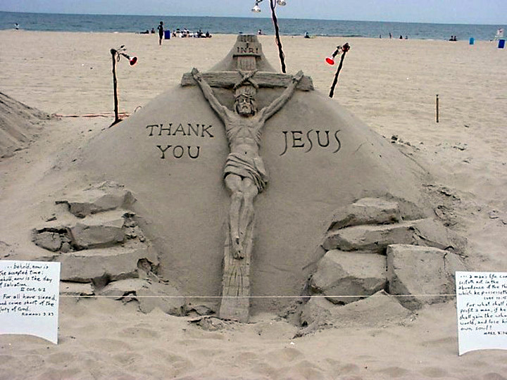
Sand art--cross
Notes:
On a Florida beach

Slide 36
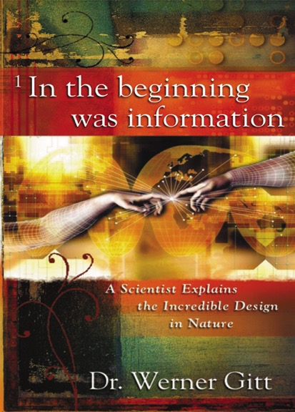
Gitt 1997—no known law
“目前没有已知的大自然法则，没有已知的过程和没有已知序列的事件能够使物质从自兴起。”
Werner Gitt, In the Beginning was Information (Bielefeld, Germany: CLV, 1997), p. 107.
Notes:
Gitt is Dir. & Prof. at the German Federal Institute of Physics and Technology, and a YEC.

Slide 37

时间，偶然性和大自然法则的结果

Slide 38
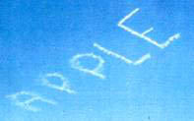
这是时间，偶然性和大自然法则的结果吗？

Slide 39
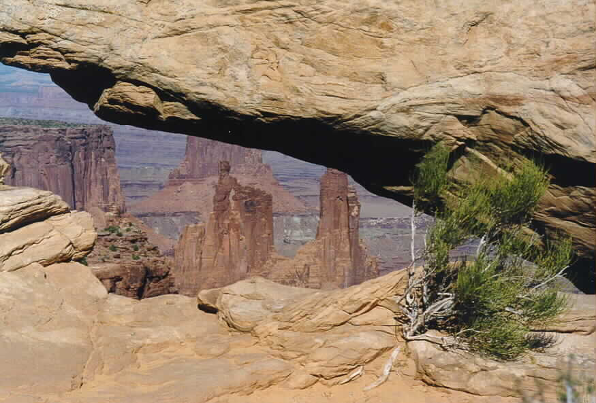
时间，偶然性和大自然法则的结果

Slide 40
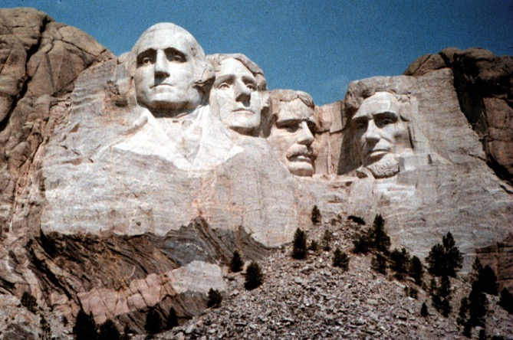
智力的结果

Slide 41
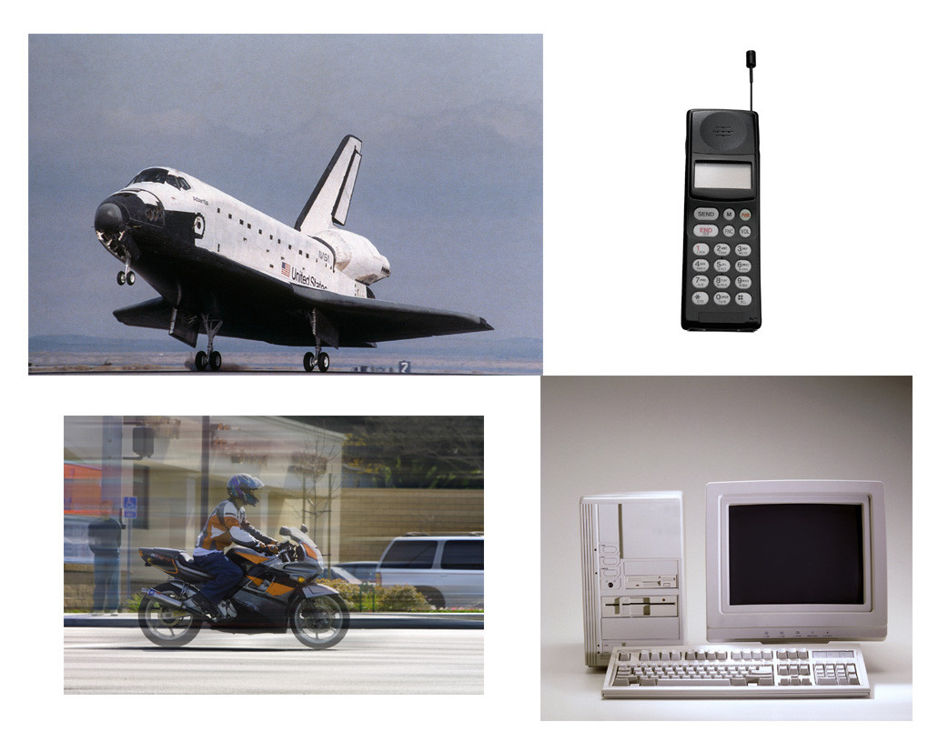
Products operation science

Slide 42
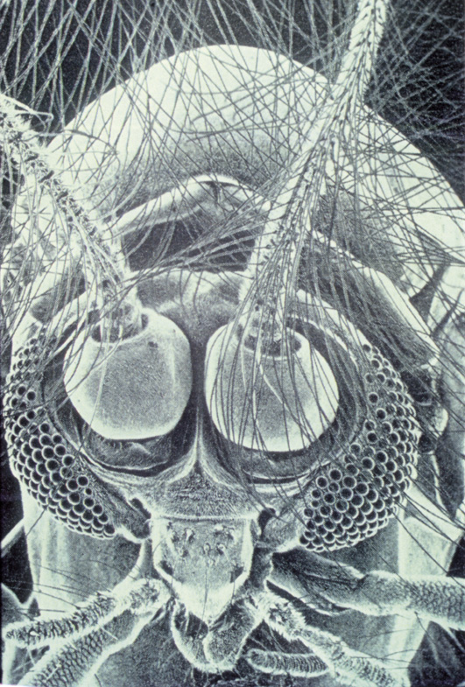
Midge

Slide 43
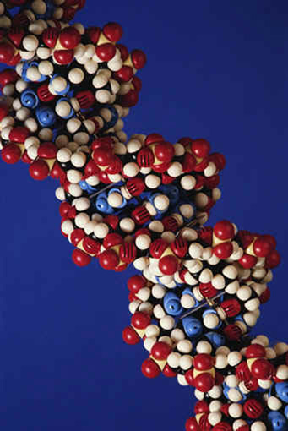
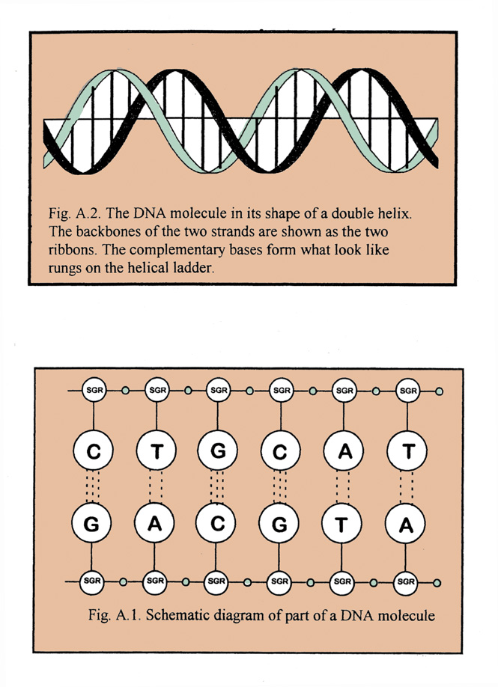
DNA picture and letters
脱氧核糖核酸 （DNA）
Notes:
DNA is organized into chromosomes (people have 46) upon which many thousands of genes (units of heredity, comprised of nucleotide bases called T, G, C and A) are found. A chromosome is made up of 1 DNA molecule and associated proteins. DNA is a sequence of genes.
UK evolutionist, Richard Dawkins, says that the amount of information in the DNA molecule of every cell of the human body is equivalent to about 3-4 sets of the 20 volumes of Encyclopedia Britannica.
For comparison, the amount of information that could be stored in a pinhead's volume of DNA is equal to a pile of paperback books (each different in content) 500 times as high as the distance from the earth to the moon. Or, a pinhead of DNA could hold 100 million times more information than a 40 gigabyte hard drive.
Source: Jonathan Sarfati, “DNA: marvellous messages or mostly mess?,” Creation, 25:2 (March-May 2003), pp. 27-28.

Slide 44
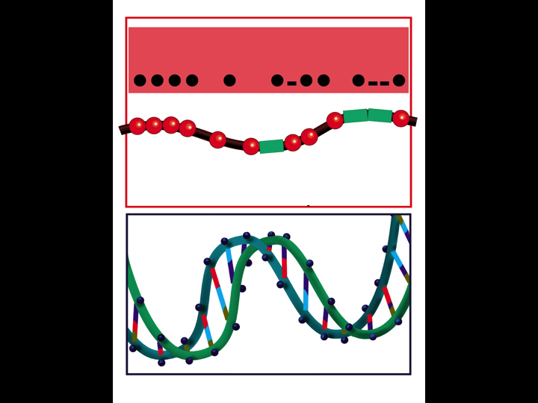
H
E
L
P
P
H
E
L
一条绳子上的珠子
脱氧核糖核酸 （DNA）
Notes:
44

Slide 45
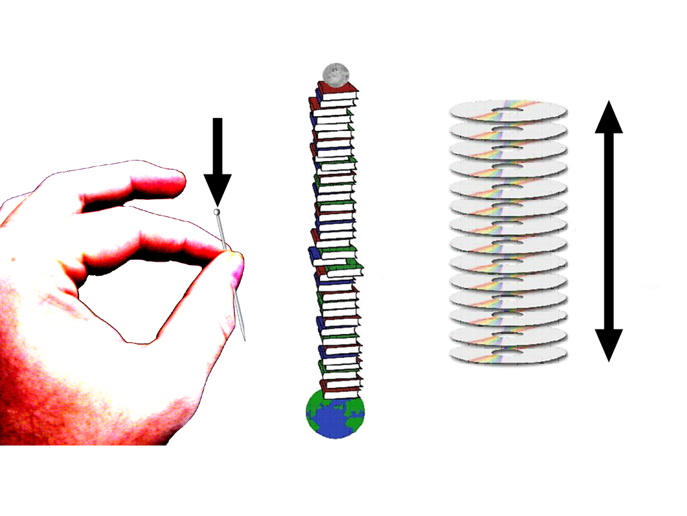

脱氧核糖核酸 （DNA）： 最顶尖的信息存储系统
一个针子头上大约可有1.55亿​​人的DNA分子
1810 km
X 240
Notes:
Werner Gitt said here “Let's look at the amount of information that could be contained in a pinhead volume of DNA. If all this information were written into paperback books, it would make a pile of such books 500 times higher than from here to the moon!” His appendix calculates this with a 160-page, 250,000-letter book.
See his article “Dazzling Design in Miniature” http://www.answersingenesis.org/creation/v20/i1/design.asp.
The volume of a pinhead that is 2mm in diameter is probably about 1.4mm3 (I used the formula for the volume of a sphere [4/3πr3] and multiplied it times one-third [1/3] thus getting an estimated volume for a pinhead [4/9πr3]; I chose one-third because a pinhead looks to be about one-third of a sphere). Now, the average length of a human DNA molecule (all 46 chromosomes plus 2 sex chromosomes) is about 2m (or 2000mm) and the width is about 2.4x10-6mm (or 24 angstroms; http://webphysics.davidson.edu/alumni/jocowan/FinalP/finres.htm), thus it can cover a volume of about 9.0x10-9mm3 (using the volume formula for a cylinder [πr2h] because of the DNA's helical shape). Which means you could fit about 154,733,972 human DNA molecules in the volume of a pinhead that is 2mm in diameter. Calculation by David Wright in the AiG office.

Slide 46
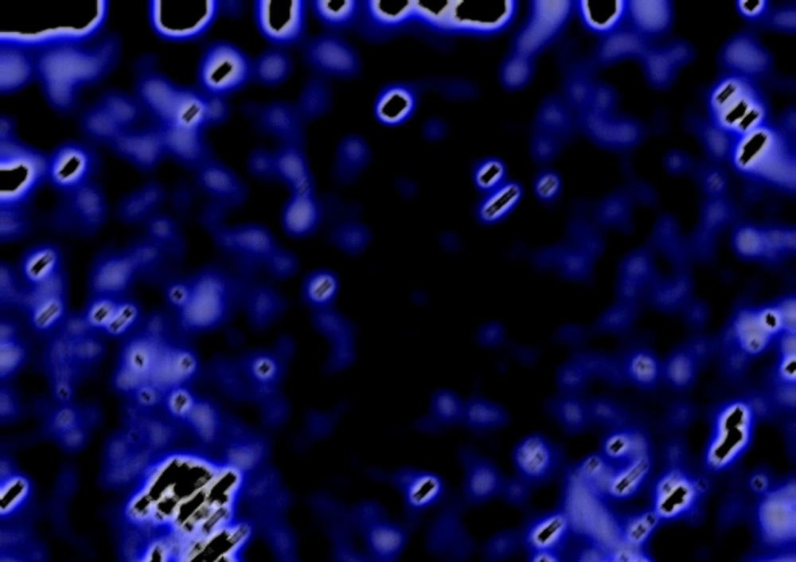

“DNA似乎像个软件程序，但它是我们所能够设计来得复杂许多。”
Bill Gates
Microsoft

Slide 47
关键问题
第一个微观生物的DNA信息如何产生的？

Slide 48
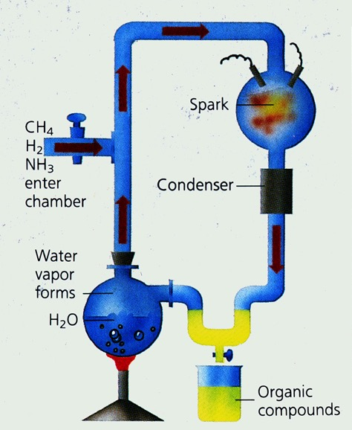
Miller's Experiment
斯坦利·米勒
&
Dr. 哈罗德·尤里
1953
Notes:
Harold Urey (prof) and Stanley Miller (grad student); 1953 experiment at Univ. of Chicago.
Although secular textbooks continue to show this experiment and state that Miller was successful in creating amino acids necessary for life, the textbooks and media fail to mention that what Miller actually produced was a mixture of left and right-handed amino acids, which is detrimental to life. What Miller produced was actually a soup of potent poisons, not the basic ingredients for producing the first living cell. Since then, similar experiments have also failed to prove this idea.
Also the experiment had a trap to collect what was created because Miller and Urey knew that the same environment that produced them would destroy them (even more easily that they were made), if left in the system. Unfortunately, the primordial oceans had no such trap.
Miller took Urey's assumption of a reducing atmosphere (no free oxygen), but the deepest rocks of the earth have iron oxides showing that this assumption was wrong.
Miller died in 2007 at age 77, still with no idea how the first living cell evolved by chance.

Slide 49

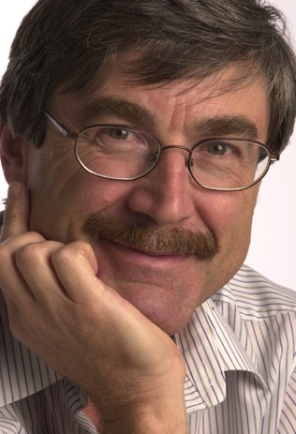
Plain Rock Background - old
“愚蠢的原子怎么自发地写自己的软件… ?
无人知…”
“… 没有已知的物理定律能够从虚无中创造信息…”
英文书：Paul Davies, New Scientist, 163:2204 (18 Sept. 1999), pp. 27-30.

Slide 50
关键问题
第一个微观生物的DNA信息是如何产生的？
2. 第一个微观生物的DNA信息是如何改变和加强，以产生今天我们看到不同的植物和动物的存在与化石记录？
?

Slide 51
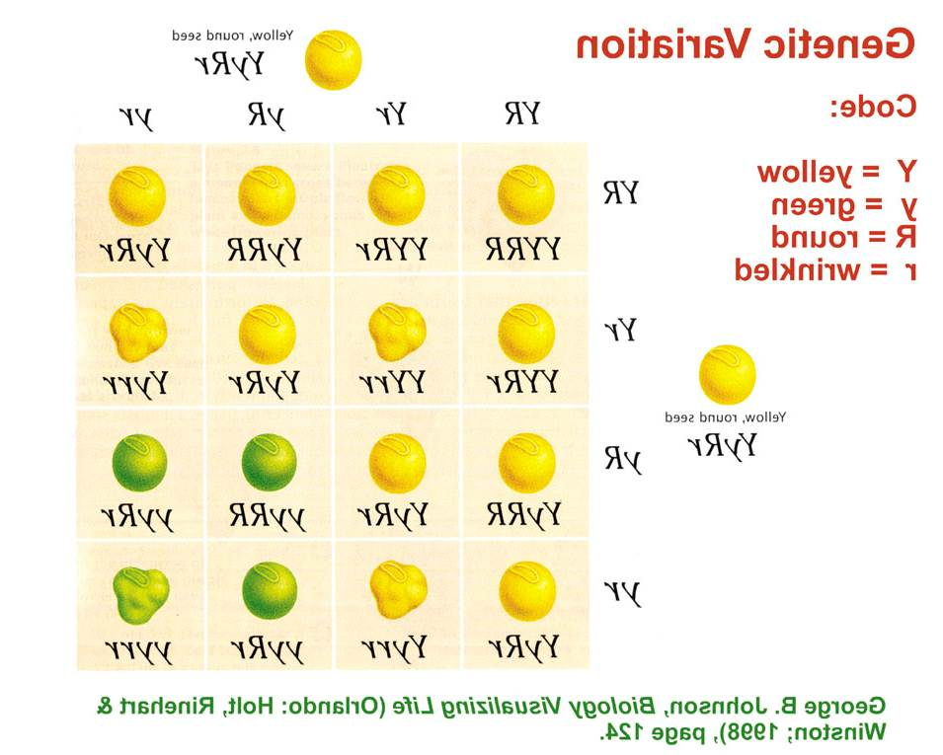
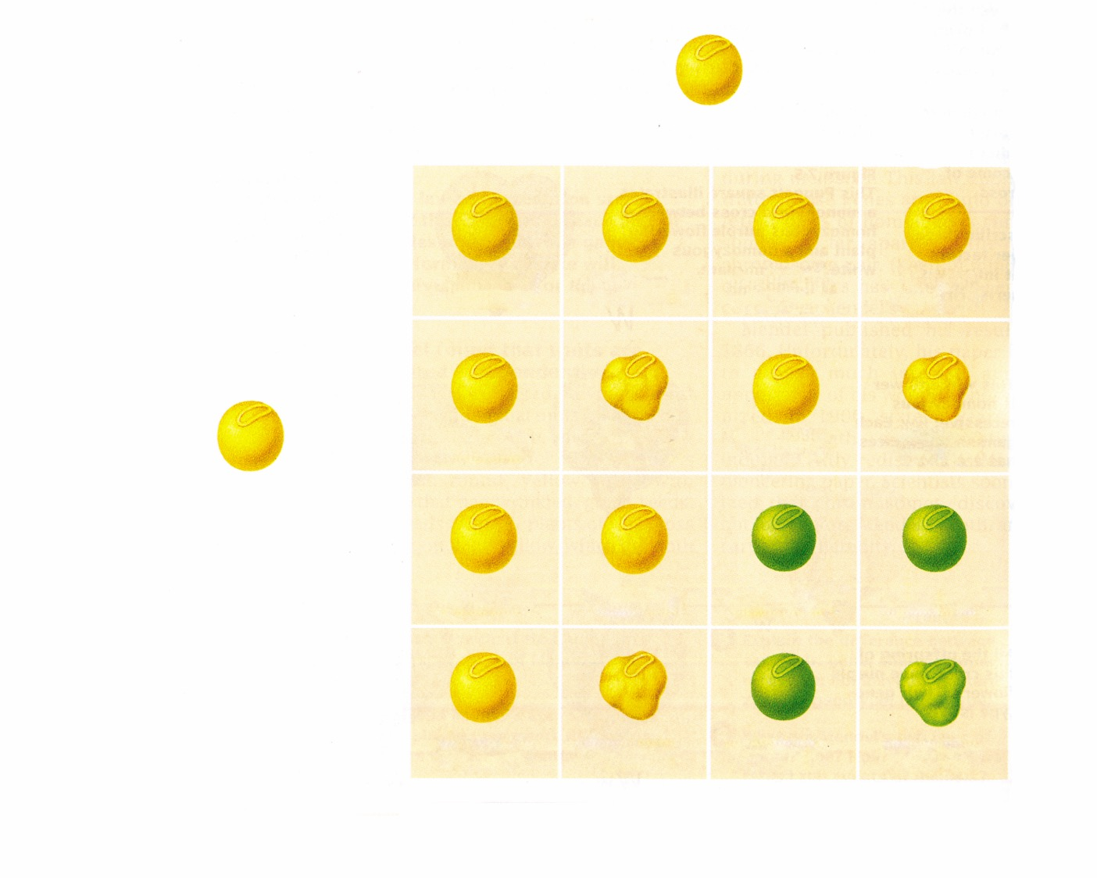
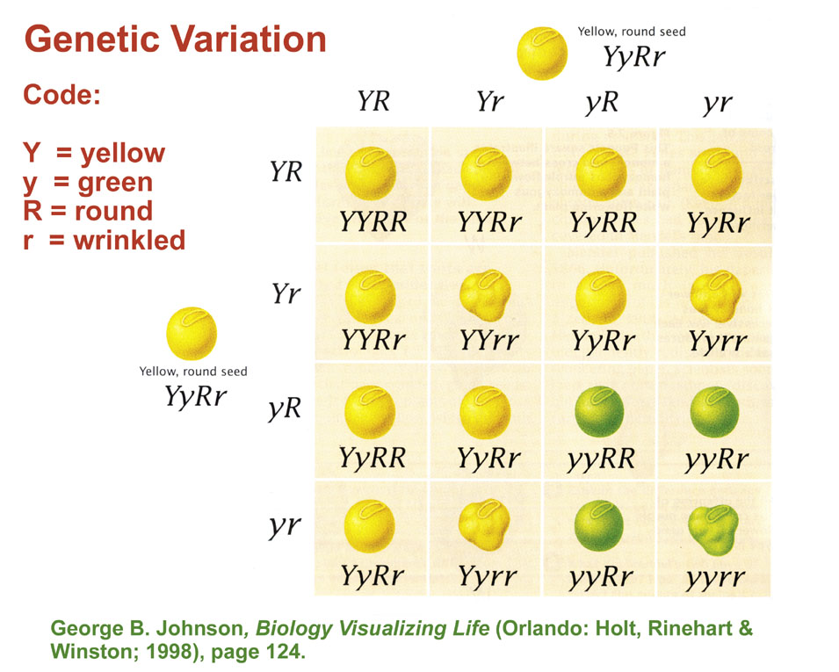
Genetic variation—peas
黄色，圆种子YyRr
遗传变异
YR
Yr
yR
yr
略码:
Y = 黄色
y = 青色
R = 圆
r = 皱
YR
YYRR
YYRr
YyRR
YyRr
Yr
YYRr
YYrr
YyRr
Yyrr
黄色，圆种子YyRr
yR
YyRR
YyRr
yyRR
yyRr
yr
YyRr
Yyrr
yyRr
yyrr
英文书：George B. Johnson, Biology Visualizing Life (Orlando: Holt, Rinehart & Winston; 1998), page 124.
Notes:
51
Gregor Mendel in Brno, Czechoslovakia

Slide 52
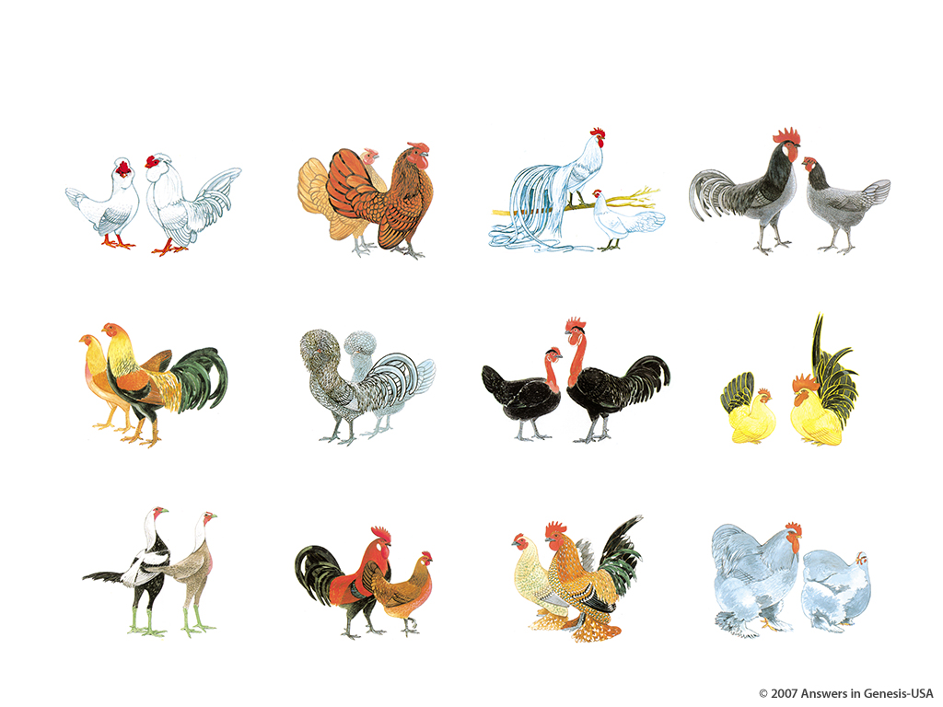
Chicken Variations 03046
鸡的变异

Slide 53
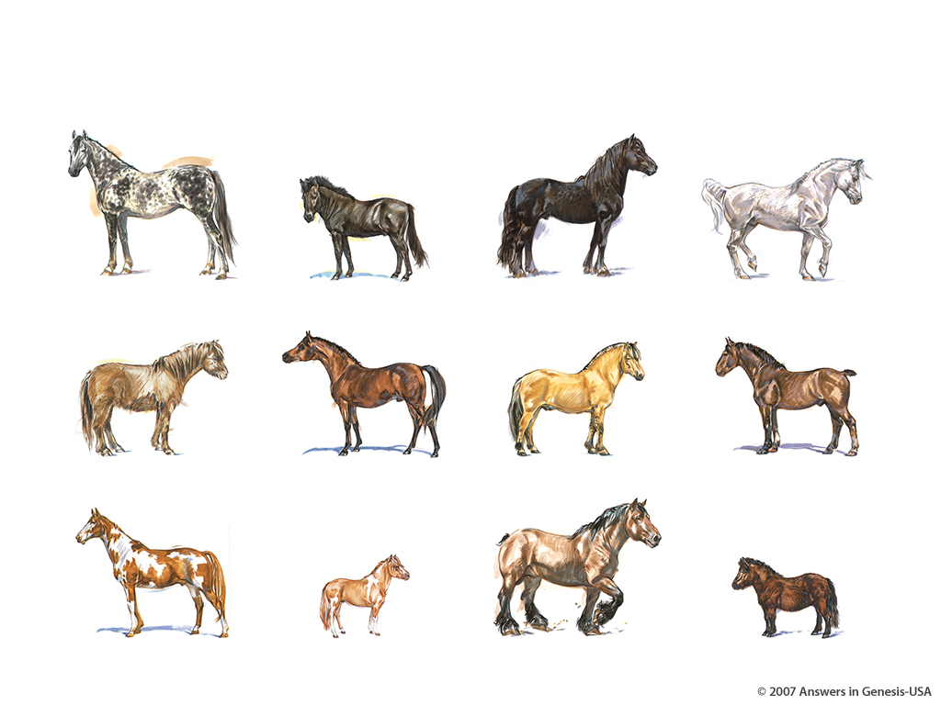
Horse Variations 03047
马的变异

Slide 54
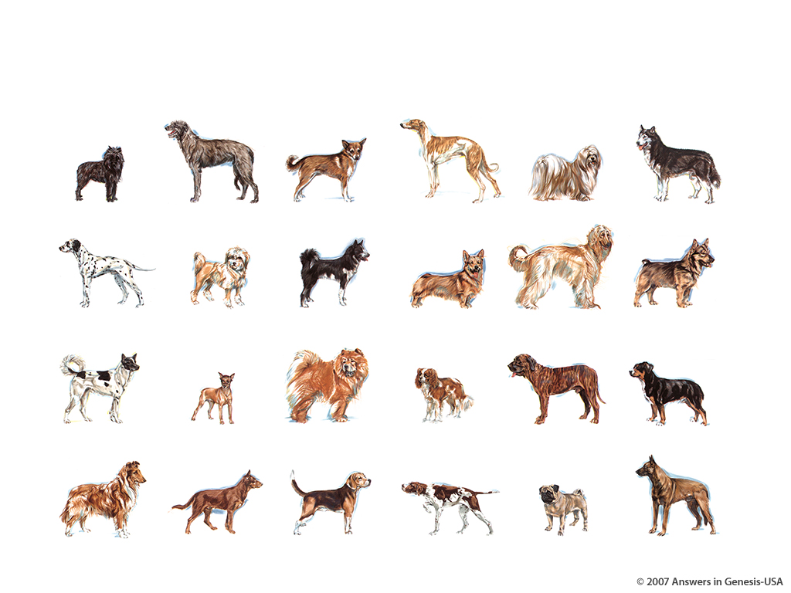
Dog Variations 03045
狗的变异
Notes:
“DNA mutation explains huge variety in dog sizes: study”, April 5, 2007
A single genetic mutation explains why dogs vary in size from the miniature Chihuahua to massive mastiffs, a range unmatched by any other mammal, according to a study released Thursday.
Researchers have long puzzled over the tremendous variation in size seen in canine breeds, particularly since the species diversified over a relatively short period of time from an evolutionary standpoint.
The new study suggests the riddle can be explained by a combination of a genetic accident that created a small dog and ten thousand years of selective dog-breeding that ensured the rapid dissemination of this particular piece of doggy DNA.
The researchers believe the discovery of the DNA mutation could also help explain why humans vary so much in size.
"The study is a major milestone in canine genetics. We have precisely located the major gene that produces our miniature breeds," said study co-author Paul Jones, a genetics researcher at Mars Inc, the US confectionery and pet food giant which supplied DNA samples used in the study.
All told, an international team of researchers examined the DNA of more than 3,000 dogs from 143 breeds ranging from pocket-sized pooches such as the Chihuahua, Maltese, Pomeranian, pug and Pekinese to the huge Great Dane, St. Bernard and Irish Wolfhound.
They found that all dogs under 20 pounds (9 kilos), and virtually all of the small canines studied, carried minute genetic variations on the gene IGF-1 which codes for a protein hormone called insulin-like growth factor 1.
The IGF-1 gene's hormone helps humans and other mammals grow from birth to adolescence. In small dogs, one or more mutations in the DNA next to the gene suppresses its activity, keeping small dogs from growing larger, the researchers reported in the journal Science.
The investigators found the genetic fingerprint in breeds that are distantly related and found in distant regions, suggesting that this hiccup in doggy DNA probably occurred about 12,000 years ago.
"It's as ancient as small dogs," said Gordon Lark, a biologist at the University of Utah in Salt Lake City who worked on the project.
"Dogs are derived from wolves. Since this is found in all small dogs, it either got into dogs when they were first domesticated or it was a small wolf that dogs descended from."
Over time, and under the management of humans, the species saw a rapid diversification into a multitude of domestic dog breeds. The researchers believe there was a bias toward breeding small dogs because they were easier to maintain in the crowded confines of developing cities and villages, and more easily transportable during trade and migration.
The findings have implications far beyond the canine world, the authors said. "By learning how genes control body size in dogs, we are apt to learn something about how skeletal body size is genetically programmed in humans," said Elaine Ostrander, a senior author of the study and chief of cancer genetics at the National Human Genome Research Institute (NHGRI), which is part of the National Institutes of Health.
"Nearly all of what we learn from studying body structure, behavior and disease susceptibility in dogs helps us understand some aspect of human health and biology."
Web page 2
Researchers at NHGRI led the study with help from colleagues at several US and UK institutions including Cornell University in New York, the University of California, Los Angeles, the University of Southern California in Los Angeles, and the Waltham Centre for Pet Nutrition in Leicestershire, England.
http://news.yahoo.com/s/afp/20070405/sc_afp/ussciencedogs2&printer=1;_ylt=AgwSKUvh, accessed 16 April 2007
Copyright © 2007 Agence France Presse. All rights reserved. The information contained in the AFP News report may not be published, broadcast, rewritten or redistributed without the prior written authority of Agence France Presse.
Original research in:
Nathan B. Sutter, et al, “A Single IGF1 Allele Is a Major Determinant of Small Size in Dogs,” Science, Vol. 316 (6 April 2007, pp. 112-115.

Slide 55

Skin Tones Line-up 03051

Slide 56
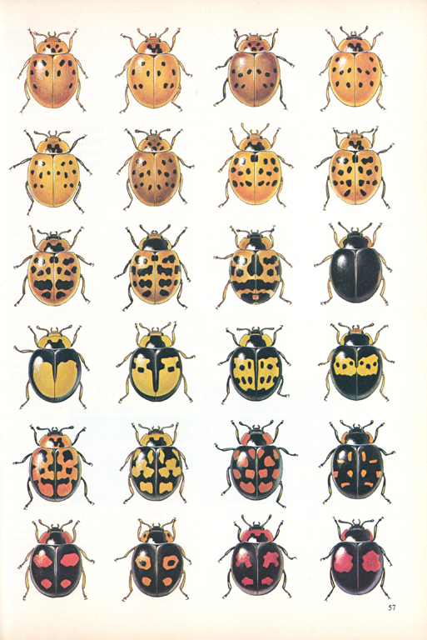
Beetles
“一个物种的遗传变异 … 自然种群怀有着许多未知的变化。”
英文书：Francisco J. Ayala, “The Mechanisms of Evolution,” Scientific American, vol. 239:3 (Sept. 1978), p. 57.

Slide 57
所谓的进化机制
1. 自然选择
2. 随机突变

Slide 58
自然选择是个事实。
但是自然选择不是进化.
而且自然选择是一个守旧 不是创新的过程.

Slide 59

Majerus 2007—peppered moth
进化的证据
“胡椒蛾可说是最有视觉影响，也是最容易了解达尔文进化的例子。这是因该被教的。因为它根本就是进化的证据。”
Dr. Michael Majerus
Michael Majerus 在2007年8月23日瑞典的生物学会议的演讲幻灯片。
Notes:
Michael Majerus, a professor of genetics at Cambridge University I have the whole PPT talk and the WORD text of the speech on file. Capitalization in the quote is in the original. I added the yellow.
Photo, PPT lecture and WORD notes available from http://www.gen.cam.ac.uk/Research/majerus.htm, accessed 22 Oct. 2007.

Slide 60
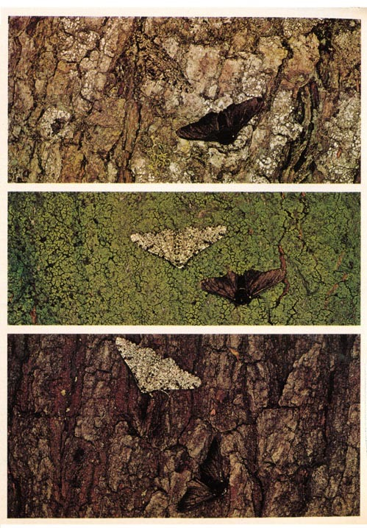
Peppered moths
胡椒蛾(Biston Betularia)
www.AnswersInGenesis.org
Notes:
Photo from Richard Lewontin, “Adaptation,” Scientific American (Sept. 1978), p. 212.
This was actually fraud because dead moths were glued or pinned on trees to provide the fotos. The moths don't rest on tree trunks during the day but on the underside of the leafy canopy at the top of the tree.

Slide 61
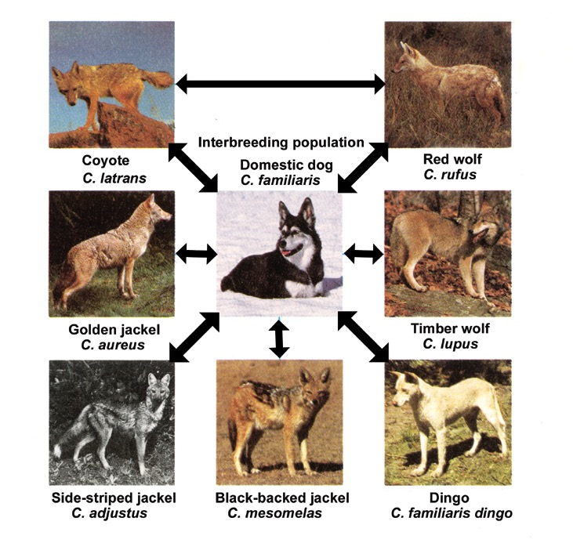
Genetic variation—dogs
属犬座
混种物口
土狼
红狼
家庭狗
金豺
大灰狼
侧条纹豺
黑背胡狼
野狗
Notes:
From Robert A. Wallace, Jack L. King, Gerald P. Sanders, Biology: the Science of Life (Glenview, IL: Scott, Foresman & Co., 1986), p. 395. The lines of interbreeding are in the source. The text on that page says: “The interbreeding situation among the eight species of the genus Canis appears to be more one of unwillingness rather than inability. The eight species are similar enough physiologically to be able to produce fertile hybrid offspring.”
DINGOS “New DNA research has found that Australia's iconic wild dog, the dingo, probably descended from a family pet brought to the continent 5,000 years ago. The research unveiled at a New South Wales University conference and reported in Tuesday's press, said the mother of all dingoes might have been a single pregnant female traveling with a group of migrants from what is now Indonesia. 'All the dingoes have a very similar DNA type,' said Alan Wilton, a molecular biologist and geneticist at the university. 'Any variations we find in a population is only a single mutation away from the main type,' he said.” (30 Sept. 2003, http://animal.discovery.com/news/afp/20030929/dingoes.html)

Slide 62
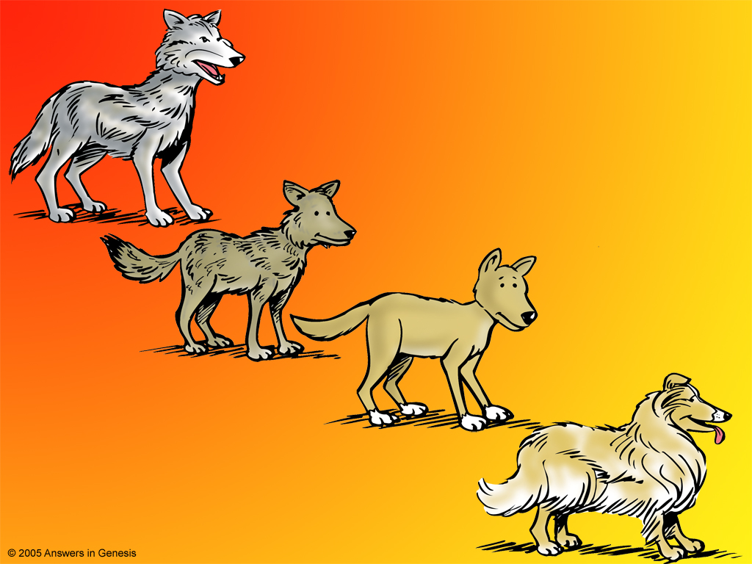
Dog Kind 01146
狼
狗类
Wolf
土狼
Coyote
野狗
Dingo
牧羊犬
Collie

Slide 63

Dog Kind–No New Information 01147
狗类
狼
Wolf
土狼
Coyote
野狗
Dingo
牧羊犬
Collie
越来越少资料
没有增加新资料
吉娃娃
Chihuahua

Slide 64

Dog medium fur length--animated
中等长度的狗毛
L
S
L
S
Note: L = long
S = short
短狗毛
中等狗毛
长狗毛
SS
L
S
LL
LL
LL
LL
LL
LL
LL
LL
这些狗都只能够拥有长性的狗毛
Notes:
David Menton's simplified illustration Hair (fur) length is determined by different alleles for a gene that codes for hair length (Alleles are alternative forms of a single gene)
If they work together as Additive alleles then L+L=L, L+S=M and S+S=S
If they work as Dominant vs Recessive alleles: L would dominate

Slide 65

Dogs – Natural Selection Cold/Hot
冷
北极狼
诺亚方舟的两条狗
非洲野狗
热

Slide 66
自然选择—续航力, 不是来源
自然选择可以解释
生存的续航力,
而不能解释
生存的来源—也就是我们真正想破解的问题

Slide 67
自然选择—续航力, 不是来源
自然选择
是上帝所设计的方法来保存
原创的种类的代表

Slide 68
突变能否提供进化所需要的新信息？

Slide 69

'TNR' mutant
赤裸公鸡突变体
Notes:
Totally Naked Rooster

Slide 70

Notes:
Mutant pig: Sydney Morning Herald, Australia, 7 March 2007, http://www.smh.com.au/news/unusual-tales/this-little-piggys-just-weird/2007/03/07/1173166769353.html, accessed 7 March 2007

Slide 71


Chinese boy w/ 31 toes & fingers
男孩有十六只脚指和十五只手指
网站：www.dailymail.co.uk
24 Mar 2010
Notes:
“The [Chinese] boy has a condition known as polydactyly, in which one of a variety of genetic disorders - which can be inherited, or are new mutations - gives rise to excess digits.”
Surgery gave him 10 toes and 10 fingers
Quote and photo: “Schoolboy with 31 fingers and toes has surgery to remove his extra digits,” http://www.dailymail.co.uk/news/worldnews/article-1260245/Schoolboy-31-fingers-toes-surgery-remove-extra-digits.html, 24 Mar 2010, accessed 25 Mar 2010.

Slide 72

Fruit fly mutations
普通女性
普通男性
流苏
痕迹
无翅
矮胖
短
卷曲
Notes:
From Francisco J. Ayala, “The Mechanisms of Evolution,” Scientific American, vol. 239:3 (Sept. 1978), p. 60.

Slide 73
突变是事实。
但是突变似乎都会减少遗传信息。
它是不会增加实用的遗传信息.
Notes:
Mutations do not increase information—further information for those who object to the points made here: Jonathan Sarfati, "Is antibiotic resistance really due to increase in information?" (27 Sept 2003 "Today's Feature"), http://www.answersingenesis.org/home/area/feedback/negative_22October2001.asp
Jono concludes there: “In conclusion, there is nothing to support any information gain at all. But evolution posits that the information content of the simplest living organisms, the mycoplasma with 580,000 'letters' (482 genes), was increased to, say, the 3 billion letters equivalent in man. If this were so, we should be able to observe plenty of examples of information gain without intelligent input. But we have yet to observe even one.”

Slide 74


Computer

Slide 75

Spetner 1998 (Q569) reduce info
“所有在分子程度被研究的点突变分明显示减少遗传信息而不是增加。”
Lee Spetner, Not by Chance: Shattering the Modern Theory of Evolution (New York: Judaica Press, 1998), p. 138.
Notes:
On Shannon Information—not undermining our position.
The paper at http://www.ideacenter.org/contentmgr/showdetails.php/id/1376 is a must read. It's short and it makes very clear the point that 'Shannon information' is (almost) irrelevant to biological information or any other meaningful information. This is very important to understand if anyone asks questions about Shannon information in the context of mutations adding genetic information. Dawkins and co., like to talk about Shannon information because it fits with their concepts of random mutations creating it, but Shannon information is almost the opposite of meaningful information (specified complexity).
Werner Gitt's TJ paper http://www.answersingenesis.org/tj/v10/i2/information.asp makes similar points to the ones made in the above paper. In the first part of the paper Werner shows how Shannon 'information' has nothing to do with meaning, or what we mean by 'information' in everyday parlance.
I also highly recommend the two-part series of review papers on information by Alex Williams in TJ, 19:2 (2005), pp. 29-41 and part 3 of the series to be printed in the next TJ for further reading, which clarifies many issues regarding information theory.
I think the only mention of Shannon information on our web site is at http://www.answersingenesis.org/tj/v17/i1/dependence.asp where Royal Truman uses the concept of Shannon information incorrectly:
'Evolutionary computer models assume there is a continuum in protein sequence space which links minimally functional to highly optimised variants. Many paths are presumed to be available for evolutionary attempts which can lead to ever narrower sets of variants. This trend, if true, would represent an increase in information content in the Shannon sense.'
(This is not 'in the Shannon sense', because a random sequence has more Shannon 'information' than a non-random sequence).
Dr Don Batten, AiG Australia, 12 Sept 2005 email communication
On 22 Sept 2005 Don wrote again:
It is good that to have a little understanding of this issue if someone asks about information and spouts forth on 'Shannon information'. I sent something recently about this.
Here is a more technical paper (“Information Theory Demystified” by Scott Uminsky, http://www.ideacenter.org/contentmgr/showdetails.php/id/1236) that makes the point that Shannon 'information' is not what we mean normally by information and is not an adequate measure of biological information on the DNA, for example. The Shannon concept might be relevant to the transmission of strings of letters or numbers electronically, but bits of Shannon 'information' (or Shannon entropy or uncertainty) do not measure the meaningful content of the message. A random string of letters has the same Shannon information as a meaningful string. However, if the receiver has knowledge of the system, the possible messages can be constrained and this reduces the Shannon information. For example, if you sent an SMS message “Will I c u @ 8?” the expected replies would be yes or no. The limited range of expected responses constrains the information such that it reduces the uncertainty / Shannon entropy or Shannon information greatly of the message received. So, under the circumstance where an intelligent receiver interprets the message (a la Gitt information theory), the random string has more bits of Shannon information (uncertainty / Shannon entropy) than a meaningful string.
The bottom line: a decrease in the bits of Shannon information / entropy / uncertainty will often accompany an increase in meaningful information.
It's probably best to call it Shannon entropy or Shannon uncertainty, leaving out 'information', to minimize confusion.

Slide 76

阿米巴与马的脱氧核糖核酸
阿米巴的脱氧核糖核酸
新的资料 (基因)
马的脱氧核糖核酸

Slide 77

Rom. 8:22 NAS—groaning creation 00792
我们知道，所有被造之物都一同呻吟、
同受阵痛，
直到如今。
罗马书8:22

Slide 78
突变是事实
突变乃是上帝在被造上注定 的诅咒；是亚当犯罪的后果。
Notes:
Mutations do not increase information—further information for those who object to the points made here: Jonathan Sarfati, "Is antibiotic resistance really due to increase in information?" (27 Sept 2003 "Today's Feature"), http://www.answersingenesis.org/home/area/feedback/negative_22October2001.asp

Slide 79

很好!
死亡存在了多久 (罗馬書. 5:12)?
Biblical View
Answers in Genesis
現在
将来
过去
阿當
没有死亡
死亡
没有死亡
没有死亡

Slide 80


Train: Cinci to Atlanta
北京
Note to translator: In this series of slides substitute Moscow in place of Cincinnati and then a major city north of Moscow (St. Petersburg? In place of Chicago) and a major city south of Moscow (Kazan? In place of Atlanta)
曼谷
新加坡
Notes:
A steam train starting at the brown city traveling south to the city in green ends up with less fuel (coal), and even less by the time it gets to the red city.

Slide 81

Train: NS & M--increased info
增加信息
NS & M Railroad
自然选择与突变的铁路
生物
“THEORY”
“理论”
Notes:
NS & M Railroad stands for Natural Selection & Mutations

Slide 82
Train: NS & M--decreased info
增加信息
FACT!!!
事实!!!
生物
NS & M Railroad
自然选择与突变的铁路
信息减少
Notes:
NS & M Railroad stands for Natural Selection & Mutations

Slide 83
Evolution tree vs creation forest
进化的生命之树
今日
Present
没有真实的证据
Beginning
起初
创造的生命之森林
Present
今日
符合事实！
Flood
大水灾
被造
Creation

Slide 84
自然选选择？
事实！
突变？
事实！
自然选择 + 突变 = 分子至人的进化？
假！

Slide 85
没有证据，没有化石，没有资料
最初的生命是偶然兴起？
资料不是出于物。
原始的阿米巴至人进化？
没有不能辩解的过渡期化石。
自然选择 + 突变 = 进化?
大自然是不会产生新的信息。

Slide 86

Assumptions Facts-Interpretations astronomy
x
圣经的假设
自然主义的假设
这是一个世界观的争论！
圣经能符合事实！
进化不能符合事实。
进化
被造
x

Slide 87




Scientist & Bible—layered new
一切是从一个细胞进化成的。以我的话为真！
我创造了独特的种类就是要让它们保持独特。以我的话为真！
HOLY BIBLE

Slide 88

“根本有没有合理的基础能让我们说只有人类有特殊的权利。当我们说到拥有中枢神经系统，并能够感到疼痛、饥饿和口渴，老鼠、猪、狗、男孩，他们都是动物。”
Ingrid Newkirk (founder of People for the Ethical Treatment of Animals善待动物的人), quoted in Washingtonian magazine, 1 Aug. 1986, activistcash.com.
Notes:
picture: http://www.eugeneweekly.com/2005/graphics/021005calendar2.jpg
Quote: http://activistcash.com/biography_quotes.cfm/bid/456

Slide 89
AiG web site #1
启示录的答案网页

Slide 90

辛辛那提, 美国俄亥俄州
被造博物馆

Slide 91
Rom. 1:18-19 NAS
罗马书 1:18-19
要知道，人用不公义抵挡真理，神的震怒就从天上显明在人的一切不敬虔和不公义上。 实际上，有关神的事，人所能知道的，在他们里面是清清楚楚的，因为神已经向他们显明了。

Slide 92
Rom. 1:20 NAS
罗马书 1:20
原来，自从创世以来，神那不可见的本性，就是他永恒的大能和神性，都藉着所造之物，被人明白、被人看见，以致使人无法推诿。

Slide 93
Black blank------------extras
终结

Slide 94


創造链接地址 BibleStudyDownloads.org
免费获得该讲解!
圣经学习下载
Notes:
The explanation for free!
Creation link address

Slide 95
Extras—below here=========
END

Slide 96
Extras—below here=========
No need to translate slides 97-103

Slide 97

H pylori w/poison

Slide 98

H pylori w/poison

Slide 99

H pylori Mutant

Slide 100

H pylori Mutant

Slide 101

H pylori Dies & Survives
Notes:
In a 2003 review of the scientific literature, Dr. Jerry Bergman shows that in the development of antibiotic or pesticide resistance most of the examples are not due to mutations but built-in genetic and molecular biological defense systems and that in the few cases where mutations are involved it always involves a loss of genetic information. See Jerry Bergman, “Does the acquisition of antibiotic and pesticide resistance provide evidence for evolution?,” TJ 17:1 (2003), 26-32.
Dr. Kevin Anderson in CRSQ 41:4 (Mar. 2005), pp. 318-26, says in the summary:
“Resistance to antibiotics and other antimicrobials is often claimed to be a clear demonstration of "evolution in a Petri dish." However, analysis of the genetic events causing this resistance reveals that they are not consistent with the genetic events necessary for evolution (defined as common "descent with modification"). Rather, resistance resulting from horizontal gene transfer merely provides a mechanism for transferring pre-existing resistance genes. Horizontal transfer does not provide a mechanism for the origin of those genes. Spontaneous mutation does provide a potential genetic mechanism for the origin of these genes, but such an origin has never been demonstrated. Instead, all known examples of antibiotic resistance via mutation are inconsistent with the genetic requirements of evolution. These mutations result in the loss of pre-existing cellular systems/activities, such as porins and other transport systems, regulatory systems, enzyme activity, and protein binding. Antibiotic resistance may also impart some de-crease of "relative fitness" (severe in a few cases), although for many mutants this is compensated by reversion. The real biological cost, though, is loss of pre-existing systems and activities. Such losses are never compensated, unless resistance is lost, and cannot validly be offered as examples of true evolutionary change.”

Slide 102

H pylori Dies & Survives
Notes:
In a 2003 review of the scientific literature, Dr. Jerry Bergman shows that in the development of antibiotic or pesticide resistance most of the examples are not due to mutations but built-in genetic and molecular biological defense systems and that in the few cases where mutations are involved it always involves a loss of genetic information. See Jerry Bergman, “Does the acquisition of antibiotic and pesticide resistance provide evidence for evolution?,” TJ 17:1 (2003), 26-32.
Dr. Kevin Anderson in CRSQ 41:4 (Mar. 2005), pp. 318-26, says in the summary:
“Resistance to antibiotics and other antimicrobials is often claimed to be a clear demonstration of "evolution in a Petri dish." However, analysis of the genetic events causing this resistance reveals that they are not consistent with the genetic events necessary for evolution (defined as common "descent with modification"). Rather, resistance resulting from horizontal gene transfer merely provides a mechanism for transferring pre-existing resistance genes. Horizontal transfer does not provide a mechanism for the origin of those genes. Spontaneous mutation does provide a potential genetic mechanism for the origin of these genes, but such an origin has never been demonstrated. Instead, all known examples of antibiotic resistance via mutation are inconsistent with the genetic requirements of evolution. These mutations result in the loss of pre-existing cellular systems/activities, such as porins and other transport systems, regulatory systems, enzyme activity, and protein binding. Antibiotic resistance may also impart some de-crease of "relative fitness" (severe in a few cases), although for many mutants this is compensated by reversion. The real biological cost, though, is loss of pre-existing systems and activities. Such losses are never compensated, unless resistance is lost, and cannot validly be offered as examples of true evolutionary change.”

