Slide 1

Chin
Lai Siangtho…Abulpi
A Presentation of The Bible…Basically Ministries International Inc. Fort Worth, Texas
Designed by Dr. John Fryman, Texas, USA • BibleBasically.org
Taught by Dr. Rick Griffith, Singapore Bible College
All files in many languages for free download at BibleStudyDownloads.org
www.biblebasically.org
©2004 TBBMI
8.0.01.
01

Slide 2
Pian. 11:26 pan 25:8
AHUN ANAITHEIPEN TUATNA:
ABRAHAM-JOSEPH 2000 B.C.
AHUN HUAM BUPPI PEN
KUM 500 KIM HI
Handbook pg. 19-24
01
1
Notes:
Now…let's begin a biblical timeline. Abraham's date on the timeline: about 2000 B.C. By the way, throughout our study…
//// …most dates will be presented in large, rounded groupings in 500 -year increments.
More precise dating is not needed in this particular study. All dates can be sharpened as your own interests direct.
2135-1960 BC Abraham’s lifespan

Slide 3
7
“Thukhen
Pan’
Thukhen
Kul”
PIANCILNA
ABRAHAM
ABRAHAM
ABRAHAM
JOSEPH
ABRAHAM
MOSI
JOSHUA
UKNA OMLO
KUMPI
SALTANNA
Mi
LITE’
laka
AMASA PEN
DAIHNA
JESU
Handbook pg. 19-24
02
Notes:
The memory tool, A JUDGE MUST JUDGE, brings to mind ABRAHAM…the FIRST OF THE FOUR GREAT PEOPLE...right after the CREATION file folder. Here is ABRAHAM’S folder in the Bible File line up.

Slide 4
Pian. 12:4
A DAWL
DAWL
A ETTOHNA
MS
6
N(A)
H
Leihoihna Kuam
SG
C
ER
B
J
MN
DS
Kipat Khaitna Mun...
E
U
KB
MS
PG
RS
Handbook pg. 19-24
03
1
Notes:
In Chapter 12 of Genesis, this “Quick Chronology” of Abraham’s life] begins – at ancient Ur of the Chaldees – the “U” on your map of the Ancient Near East. That’s the place in Scripture where the Author comes to a quick narrowing of the earlier Biblical perspective.
//// And its setting is in the rich Fertile Crescent of the Middle East,
The stage of this great drama stretches from the Euphrates Valley all the way over to the Mediterranean Sea…
and in between we find some very familiar place names.

Slide 5
A DAWL
DAWL A
ETTOHNA
MUN 10
MS
6
4
N(A)
H
IRAQ
IRAN
KUWAIT
SAUDI ARABIA
SYRIA
ISRAEL
TURKEY
EGYPT
SG
GALILEE TUILI
C
ER
B
CANAAN
J
MN
DS
NILE GUN
CI TUIPI
E
EGYPT
U
KB
SINAI LEIDAWK..
MS
PG
RS
Handbook pg. 19-24
04
14
Notes:
You’ve already identified some of them on your map that we called "Dressing the Stage."
There lie
//// Canaan…today's state of Israel, and the West Bank, Palestine,
//// the Sea of Galilee,
//// and the Dead or Salt Sea…as Scriptures calls it.
//// Also there is Egypt and
//// the great Nile River.
//// The Sinai Peninsula appears, a region in the headlines of recent world events.
But in our world, our own time, we also find
//// Iraq
//// Iran
//// Kuwait
//// Saudi Arabia
//// Syria
//// Modern Israel and the West Bank
//// Turkey and
//// Today’s Egypt

Slide 6
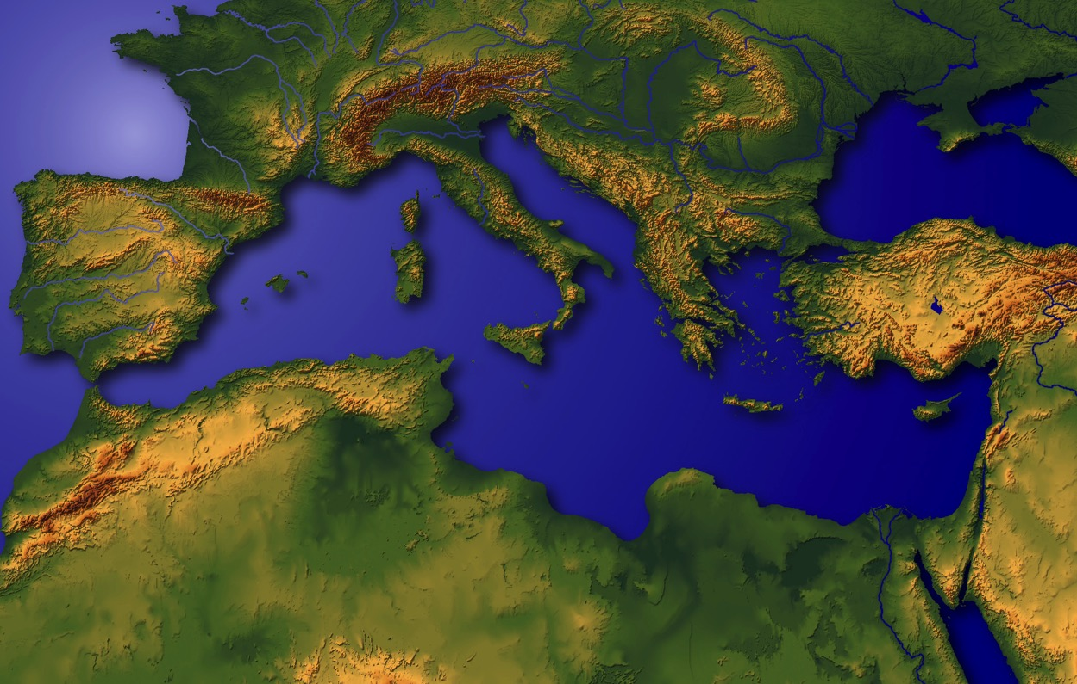
“Leitung I Lai”
Handbook pg. 19-24
05
1
Notes:
This region has been called the very NAVEL OF THE EARTH.
Through this great hinge of history, time and again, great world
powers of the past -- time and again -- have marched in conquest,
//// with Canaan/Palestine/Israel being pulled and stretched by enormous international and internal pressures.

Slide 7
Pian. 11:28
A DAWL
DAWL A
ETTOHNA
MS
N(A)
H
SG
C
ER
B
J
MN
DS
E
KB
U
MS
CHALDEES GAM UR KHUA: TANGLAI NGEINA PHUALPI AHI MESOPOTAMIA GUNKUAM; ABRAHAM TENNA KHUA
PG
RS
Handbook pg. 19-24
06
1
Notes:
So the story of ABRAHAM begins at the head of the Persian Gulf, in that ancient city -- Ur of the Chaldees.
//// Abraham and his family lived in this early cultural center in the Mesopotamian Basin.
This is the "U" on map we named "Dressing the Stage.”
Follow along by tracing on your own map as the story begins to unfold.

Slide 8
7
BABYLON
UR
PHAWKDING! Persian Tuidawk Gaal Iraq Gaal
Handbook pg. 19-24
07
6
Notes:
Here is the map of this region in today’s world. Remember that this was the stage of the earlier Persian Gulf War of the 1990s…
and more recently the War in Iraq that toppled Saddam Hussein.
//// There is the familiar Tigris River…
//// …and the Euphrates…
//// …today’s city of Baghdad…
//// …Kuwait stands at the head of the Persian Gulf…
//// …to the north…the location of ancient Babylon…
//// …and the beginning point of our story…the ancient city of UR.

Slide 9
7
Mesopotamia Gunkuam
SUMERIA TE PHUAT KHIAT TE…
LAIATNA LEH (LENG) PEI
KIPATNA TE…
UPADI
ZATUI
AKSI LAMPILNA
INNLAM SIAMNA
TANGTAWNGPEN KHUAPI KIPATNA
Handbook pg. 19-24
07a
4
Notes:
Here in this Middle Eastern land – bordering the Persian Gulf --
were some of the earliest beginnings of mankind’s discovery of an intellectual life.
//// In this triangular shaped valley,
//// called the Mesopotamian Basin,
//// the ancient Sumerians presented us the gifts of writing and the wheel. And here we see
//// the beginnings of basic concepts of civilization…of law…of medicine… of astronomy and architecture.
//// Archaeologists have also found evidence of some of the very earliest urban centers…
the communities and the cities that, through time, have led directly to the civilization and cultures we know today.

Slide 10
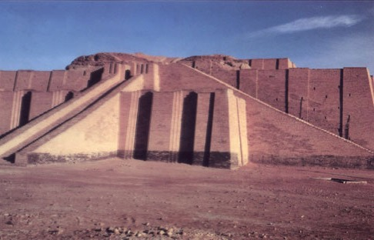
Pian 10:10; 11:28
Chaldee Gam Tanglai Ur a “Ziggurat”: Tulai Iraq Gam ah Om hi
Handbook pg. 19-24
08
Notes:
This kind of temple tower, or ziggurat, was common in that region in Abraham's day in Ur of the Chaldees. In 2000 B.C., Ur was a great city, an international center of learning, culture, commerce and idolatrous spiritual darkness. But think about this: what kind of technology -- literally, brain power -- was required to construct a building of such size and complexity of design? Those thoughts hint at the kind of life, times and talent of those ancient civilizations!

Slide 11
Pian. 11:31
ABRAHAM’ INNKUAN:
• TERAH (A PA)
•ABRAHAM (ABRAM)
• SARAH (A ZI, SARAI)
• LOT (A TUPA)
Handbook pg. 19-24
09
5
Notes:
//// The Biblical narrative tells us about a man named ABRAHAM, living with his family in ancient Ur of the Chaldees.
//// In the family was his aging father…Terah.
//// Terah’s son named Abram, later to be renamed by God, ABRAHAM, as his future place in history is made clear.
//// ABRAHAM’S wife’s name was Sarah (originally named Sarai)...
//// Also in the family group was ABRAHAM’s nephew, Lot

Slide 12

7
ABRAHAM
ABRAHAM
ca. 2000 B.C.
Mi LITE
laka
A Masapen
hi:
ABRAHAM
AJMJ
Piancil 12 pan a mailamteng
Handbook pg. 19-24
10
3
Notes:
So we begin with ABRAHAM's file folder.
Note also a special feature about the visuals you are watching...
//// From this point and on through the chronology there will be a small file folder image floating in most slide frames. They will help guide your thinking as the great story line unfolds. You’ll always know where we are as the BILE FILE folders build out and fill up.
//// Abraham’s story opens in Genesis 12 and forward...
//// Time frame: about 2000 B.C...the first of the four Great People.
It is through this one man, ABRAHAM, that God begins a new program
to provide for His creation the way back to that original intimate relationship that existed in the beginning. Through ABRAHAM unfolds all the rest of the Bible, until we see in the book of Revelation, once again, the broad view of the world and the universe.

Slide 13
7
Pian. 12: 1-3
ABRAHAM
ABRAHAM
ca. 2000 B.C.
SAPNA
Mi LITE
laka
A Masapen
hi: :
ABRAHAM
SAPNA
AJMJ
Piancil 12 pan a mailamteng
Handbook pg. 19-24
11
Notes:
The great story begins in the 12th Chapter of Genesis where ABRAHAM receives God's CALL, telling him to leave Ur and go toward a land that will be shown to him in due time.

Slide 14
7
Pian. 12: 1-3
ABRAHAM
ABRAHAM
ca. 2000 B.C.
SAPNA
AC
AJMJ
Pian. 12: 1-3
ABRAHAM
SAPNA
PASIAN IN ABRAHAM TUNGA APIAK LANGBAI KAMCIAMNA!
Handbook pg. 19-24
12
Notes:
This is the most crucial Biblical event in the life of the old patriarch and also the beginning point in the revelation of God's new Program with Man. On your work sheet, it's represented by the letters AC inside the image of a scroll. AC is to remind us of the great ABRAHAMIC COVENANT -- provided for us in our own Bibles at Genesis 12...verses 1-3. It is an UNCONDITIONAL covenant promise!

Slide 15
7
ABRAHAM
ABRAHAM
ca. 2000 B.C.
SAPNA
AC
L - S - T
AJMJ
Pian. 12: 1-3
LEITANG
SUAN & KHAK
ABRAHAM
SAPNA
L - S - T
THUPHA
LANGBAI KAMCIAM PEN A NUNG CIANG THUCIAMNA SUAK!
Handbook pg. 19-24
13
Notes:
Now…on ABRAHAM’S file folder, add the letters...L...S...B...standing for the words: LAND...SEED...AND BLESSING. Here is the significance of those words. Right there in the book of Genesis, 12th Chapter, verses 1-3, God makes THAT UNCONDITIONAL COVENANT PROMISE to Abraham…later to become an actual legal contract in the culture of that day!

Slide 16
7
Piancilna 12
Topa in Abram kiangah, "Na gam, na beh, leh na pa' inn panin nang kong lah ding gamah pai in.
1
“Thupha a ngah dingin minam lian khatin nang hong bawlin, thupha hong pia-in, na min kong liansak ding hi .
2
Nang thupha hong piate thupha ka pia ding a, nang hong samsiate ka samsia ding hi. Nang' thupha ngah bangin thupha a ngahna dingun leitung midang khempeuh in hong ngen ding uh hi.”
ABRAHAM
3
SAPNA
L - S -T
Handbook pg. 19-24
14
3
Notes:
In Genesis 12, verses 1-3 present God’s three-part promise to Abraham. Here it is:
//// The Lord had said to Abram,
“Leave your country, your people and your father’s household, and go to THE LAND I will show you.
//// “I will make you into A GREAT NATION
and I will bless you;
I will make your name great,
and you will be a blessing.
//// I will bless those who bless you,
and whoever curses you I will curse;
and ALL PEOPLES ON EARTH
WILL BE BLESSED THROUGH YOU.”

Slide 17
7
Genesis 12
Topa in Abram kiangah, "Na gam, na beh, leh na pa' inn panin nang kong lah ding gamah pai in.
1
LEITANG
“Thupha a ngah dingin minam lian khatin nang hong bawlin, thupha hong pia-in, na min kong liansak ding hi.
2
SUAN & KHAK
ABRAHAM
Nang thupha hong piate thupha ka pia ding a, nang hong samsiate ka samsia ding hi. Nang' thupha ngah bangin thupha a ngahna dingun leitung midang khempeuh in hong ngen ding uh hi.”
3
SAPNA
L - S - T
THUPHA
Handbook pg. 19-24
15
3
Notes:
The order of those covenant promises is an important key to Biblical order itself:
//// First is the promise of a LAND…then…
//// a SEED
//// followed by a BLESSING, represented by “L-S-B” on the ABRAHAM file folder.

Slide 18

Abraham Tunga Thuciam
(“Sapna”)
Piancilna 12: 1-3
ABRAHAM
LEITANG
SUAN
THUPHA
SAPNA
L - S - T
12:1
12:2
12:3
“L-S-T”
Handbook pg. 19-24
16
3
Notes:
Now study this plan of organization…the down-to-earth meaning of those three promises…the L-S-B on ABRAHAM’s folder…
//// First…PROMISE #1: GENESIS 12:1...A LAND — real estate, a geographic inheritance that most Jewish people respect politically to this present day.
//// PROMISE #2: GENESIS 12:2...A SEED — a long line of descendants...especially interesting because at the time the Promise is given, ABRAHAM and SARAH are approaching old age and yet they have never had children.
//// The final PROMISE, Number 3: GENESIS 12:3...A BLESSING promised to Abraham personally and to his descendants. Furthermore, God promises that, through His blessing to ABRAHAM, all the families of the earth will be blessed…NOT JUST ABRAHAM’S descendants! Notice that wording! It’s important to an understanding of GRACE!

Slide 19
Abraham Tunga Thuciam
(“Sapna”)
Piancilna 12: 1-3
A Huamkim A Pianzia Thum!
ABRAHAM
LEITANG
SUAN
THUPHA
SAPNA
L - S - T
• AHITAKTAK
• ATAWNTUNG
• THUKHUN OMLO
17
3
Notes:
Now...to the basic outline of the promise...L-S-B-...for LAND, SEED, and BLESSING...we can also add these basic concepts...three additional ideas that describe the characteristics of that Abrahamic Promise...
//// First…that great promise was -- and is -- LITERAL in that the words mean exactly what they say.
//// It is also ETERNAL, an unending arrangement, guaranteed by the maker of the contract, God Himself. And finally...
//// It is UNCONDITIONAL...indicating that no matter what Abraham or his descendants might do in the future, God would, in time…REPEAT: IN TIME…fulfill every element of His promises.
As we move farther through this story, we'll come to see how the entire Bible is built on that set of unconditional and foundational promises.... soon to become a legal contract between God and his friend, Abraham.

Slide 20
Pian. 11:31
A DAWL
DAWL A
ETTOHNA
UPNA TAWH
PAIKHIA
UH HI
MS
N(A)
H
SG
C
R
B
J
MN
ABRAHAM
DS
SAPNA
L - S - T
E
KB
U
MS
PG
RS
Handbook pg. 19-24
18
2
Notes:
After Abraham receives God’s Promises…the entire family leaves Ur of the Chaldees to follow the Lord’s direction.
//// They move toward the northwest with all their flocks and their possessions -- probably a large congregation of people, animals and tents. Biblical evidence shows ABRAHAM’s family was probably wealthy. Again, if you have the map, add to it the map tracing that you see here in bright yellow. The main point here is this:
//// ABRAHAM and his family LEFT IN FAITH! They are moving toward a land that God will show them in due time. But as they leave Ur of the Chaldees they DO NOT know their destination. Their obedience is a profound demonstration of their faith in God’s provision and His total protection as they head out into the unknown under Abraham’s leadership.

Slide 21
Pian. 11:31-32
A DAWL
DAWL A
ETOHNA
MS
N(A)
H
SG
C
ER
B
J
MN
ABRAHAM
DS
SAPNA
L - S - T
E
KB
U
A Lian mahmah Babylon Khuapi
MS
PG
RS
Handbook pg. 19-24
19
Notes:
It is entirely possible that they passed through the region of ancient Babylon, upriver from Ur...that city to which you’ll learn that Abraham's descendants – the Jews -- would be held as prisoners in the centuries to follow.

Slide 22
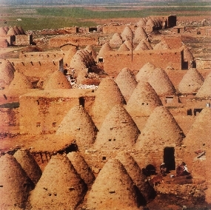
Pian. 11:31-32
A DAWL
DAWL A
ETTOHNA
MS
N(A)
H
A PA TERAH, HARAN AH TEEK SIH HI.
SG
C
ER
B
J
MN
ABRAHAM
DS
SAPNA
L - S - T
E
KB
U
MS
PG
“Khuaibu” Khuapi ahi Harran (TuhunTurkey)
RS
Handbook pg. 19-24
20
1
Notes:
They continue northwestward, finally arriving at ancient Haran…
… still in existence today in modern Turkey.
//// While settled temporarily in Haran, ABRAHAM’s father, Terah, dies.

Slide 23
Pian. 12:5
A DAWL
DAWL A
ETTOHNA
MS
N(A)
H
SG
C
ER
B
J
MN
ABRAHAM
DS
SAPNA
L - S -T
E
KB
U
MS
PG
RS
Handbook pg. 19-24
21
Notes:
Once again, God speaks to ABRAHAM, instructing him to now leave Haran and to move onward toward The Land He had promised to show him. That land is to be Canaan, or the land we call Israel today.

Slide 24

7
Gamsung a lut ciang Abraham…
Kum 75 pha khin a…
A zi, Sarah,Kum 65 pha hi.
Ahizong in…tate kikam ciamlai hi!
ABRAHAM
SAPNA
L - S - T
Handbook pg. 19-24
22
4
Notes:
Now the great stage is set!
//// When he enters The Land,
//// ABRAHAM is already 75 years old and
//// his wife, Sarah, is 65.
//// And yet, God has promised them children? What?
Was God teasing the old couple? Children promised at that age?

Slide 25
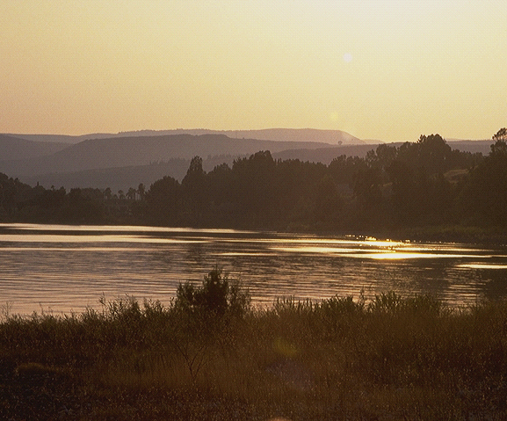
7
Pian. 15:6
_{ABRAHAM IN PASIAN}
KAM CIAM UMHI: LEITANG, SUAN & KHAK, THUPHA!
_{LEITANG}
_{SUAN &KHAK}
_{THUPHA}
Piancilna 15:6!
Pasian in Abraham upna pen
Thutanna in sansak hi!
Muan ziau na!
ABRAHAM
SAPNA
L - S - T
Handbook pg. 19-24
23
3
Notes:
Yes…ABRAHAM continues to believe God’s promise of a LAND, a SEED, and a BLESSING!
//// His simple unquestioning belief is told to us in Genesis 15:6...
//// …where God counts that BELIEF as righteousness on ABRAHAM's part.
//// Just simple belief! This is the first step in the new program of redemption God will introduce to the earth through His old friend.

Slide 26
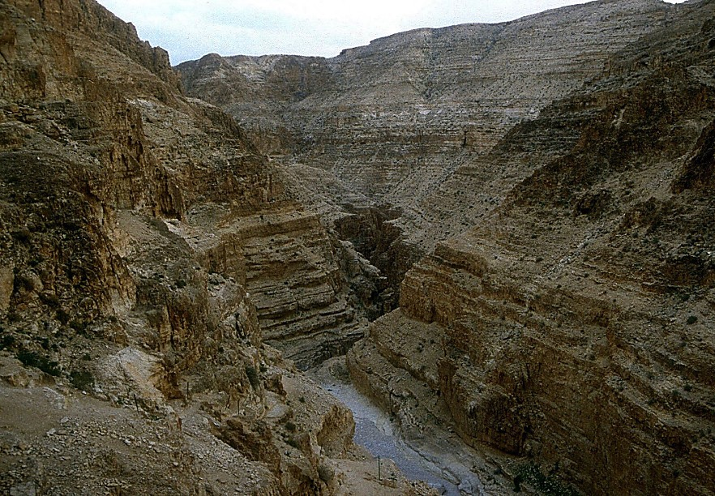
7
Pian. 16:1-4
ABRAHAM IN PASIAN MUANGHI!
Ahizongin: Abraham leh Sarah te in ngakzolo uh hi.
“Abraham…Hagar luppihhi!” (Sarah’ nasemnu)
ABRAHAM
SAPNA
L - S - T
Handbook pg. 19-24
24
3
Notes:
//// Abraham truly believes that God will accomplish what He has promised. And the years pass.
//// In spite of God’s clear promise…ABRAHAM and Sarah become impatient as they wait for the children God had promised would be coming. In her impatience,
//// Sarah suggests that ABRAHAM go in to her Egyptian servant girl, Hagar, hoping that through that union the promised child might be born. That was not unusual in the culture of their day.

Slide 27
7
Pian. 16:11-12; 17:20-21
Asawtlo in…Abraham in Hagar tawh tapa khat nei hi.
Amin: ISHMAEL.
(ISHMAEL PEN PASIAN KAMCIAM TAPA HILO HI).
ABRAHAM
SAPNA
L - S - T
Handbook pg. 19-24
25
3
Notes:
//// Indeed, in time...ABRAHAM does father a son through Hagar.
//// The boy is named ISHMAEL.
//// But, God says, the infant is not the intended son of His covenant Promise to Abraham's descendants.

Slide 28
7
Pian. 17:19
Tuahunin…Abraham kum 85 pha a…Sarah pen kum 75.
Kum 15 khitciang in…
SARAH tungtawn in ABRAHAM in tapa khat ong nei hi.
AMIN: “ISAAC”
ABRAHAM
SAPNA
L - S - T
Handbook pg. 19-24
26
4
Notes:
//// By now, ABRAHAM is 85; Sarah, 75.
//// After another 15 years...
//// …the son of God’s promise to ABRAHAM is finally born...through Sarah.
//// He is named ISAAC, a word that traces its meaning to the Hebrew root term indicating laughter. Yes, ABRAHAM thinks it hilarious that he and Sarah are to become parents at such advanced ages.

Slide 29
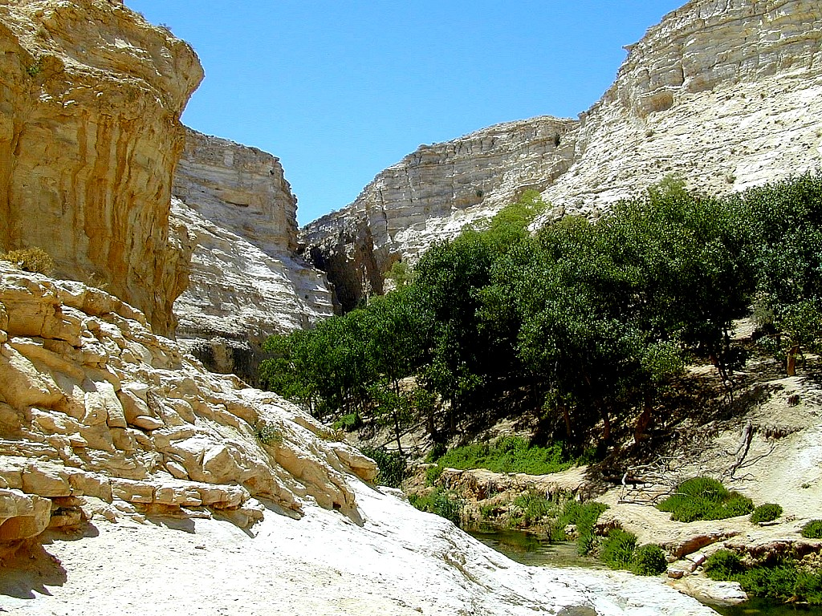
7
Pian. 17:21
Isaac pen sawtpitak a kingak tapa hi a…
… Abraham tunga Pasian kamciam te a ma tungah kipia sawn hi.
ABRAHAM
SAPNA
L - S - T
…ISAAC’ INKUAN TUNGTAWNIN!
Handbook pg. 19-24
27
2
Notes:
ISAAC is indeed the long-awaited son…
//// …through whom God’s promise to ABRAHAM is to be passed down…
//// …through HIS family line.

Slide 30
7
Pian. 17
ABRAHAM
ABRAHAM
ca. 2000 B.C.
SAPNA
AC
L - S - T
AJMJ
I - I
Pian. 12: 1-3
ABRAHAM
SAPNA
L - S - T
I - I
ISHMAEL & ISAAC
Handbook pg. 19-24
28
Notes:
So…the letters I and I appear on ABRAHAM's file folder. From these two sons of Abraham….ISHMAEL and ISAAC...
right here at this crucial historic point…the terrible Jewish-Arab conflict of our own time begins some 4,000 years ago...around 2000 B.C.

Slide 31
7
ABRAHAM
ABRAHAM
ca. 2000 B.C.
The CALL
AC
L - S - B
AJMJ
Pian. 12:1-3
I - I
ABRAHAM
SAPNA
L - S - T
I - I
ARABIC MITE PEN
ISHMAEL SUAN
JEW MITE PEN
ISAAC SUAN
Handbook pg. 19-24
29
2
Notes:
Because...
//// …ISHMAEL is recognized today as the father of the Arab nations…through ABRAHAM…
//// while ISAAC, of course, is revered as one of the founding patriarchs of the Jews…also through ABRAHAM!

Slide 32
7
ABRAHAM
ABRAHAM
ca. 2000 B.C.
The CALL
AC
L - S - B
AJMJ
Pian. 12:1-3
I - I
ABRAHAM
SAPNA
L - S -T
I - I
ARABIC MITE PEN
ISHMAEL SUAN
JEW MITE PEN
ISAAC SUAN
Handbook pg. 19-24
30
Notes:
There is enormous conflict between the two half-brothers and their mothers. And as we watch or read today’s news, we see that that age-old turmoil begun in ABRAHAM's tent 4,000 years ago continues today! Both the Jews and the Arabs claim ABRAHAM as the beginning point of their respective peoples!

Slide 33
7
Pian. 22:2; 2 Khang. 3:1
KATA KUAPEN?
“Amah in, "Na it, na tapa neihsun Isaac, la in la Moriah gamah pai in. Tua lai muna nang kiangah kong gen ding mual khat tungah meihal biakpiakna-in amah hong pia in," a ci hi.” Piancilna 22:2
ABRAHAM
SAPNA
L - S - T
I - I
NIV study note: “Hebrew LST ah, “Isaac” pen “na it” cih kammal in na zui pah a tuapen adeih na abutnang hi: “na tapa, na tapa neih sun, na it -- Isaac.” Isaac bek in “kamciam tapa” hi.
2 Khang 3:1 Laiat pa in hih mun pen Biakinn mual ahihna na gen hi [Tulaitak a Dome of the Rock omnamun].
Handbook pg. 19-24
31
3
Notes:
The question then arises: how do we know WHICH SON was REALLY the inheritor of the Abrahamic promises? Look at Genesis 22:2…
//// “The God said, “Take your son, your only son, Isaac, whom you love, and go to the region of Moriah. Sacrifice him there as a burnt offering, on one of the mountains I will tell you about.”
//// Look at this study note from the NIV translation: “In the Hebrew text, “Isaac” follows the clause “whom you love,” in order to heighten the effect: “your son, your only son, whom you love – Isaac.” Isaac was the only “son of the Promise.”
//// Here also, you’ll find in Second Chronicles 3:1 that God identifies Moriah with the Temple mount, which, today, is the site of the Moslem Dome of the Rock.” Much more on that location a little later.

Slide 34
7
Pian. 17:20-21
KATA KUAPEN?
“Ishmael-a' ding na ngetna ahih leh ka za khin hi. En in, amah thupha pia-in ka pungsak ding a, tampi tak ka phasak ding hi. Amah pen ulian sawmlenihte' pa hi ding a, minam lian khatin ka bawl ding hi. Ahih hangin, kumkik tuhun ciangin Sarah' sung panin nang-a' dinga hong suak ding Isaac tawh ka thuciamna ka kipsak ding hi," a ci hi .”
Pian. 17:20-21
ABRAHAM
SAPNA
L - S - T
I - I
Handbook pg. 19-24
32
2
Notes:
But Ishmael was not forgotten…not at all!
//// Genesis 17: 20-21…”And as for Ishmael, I have heard you. Behold I have blessed him, and will make him fruitful, and will multiply him exceedingly. He shall beget twelve princes, and I will make him a great nation.
//// But My covenant I will establish with Isaac, whom Sarah shall bear to you at this set time next year.”

Slide 35
TUHUNA LETSONG TE TAWH ETKAK NA…
ISAAC
ABRAHAM
ISHMAEL
SAPNA
L - S - T
I - I
BANG HANG HIZAHTA A KILAMDANG HIAM?
Handbook pg. 19-24
33
3
Notes:
It’s interesting to compare those gifts today…
//// Generally speaking…here are the lands populated today by the descendants of Ishmael…the Arab lands of the Middle East.
//// But then…compare that with the descendants of Isaac in the Middle East…right there in tiny Israel.
//// Why the enormous difference?

Slide 36
7
GAMLIM ETKAK NA…
ISRAEL Leh…
ABRAHAM
SAPNA
L - S - T
Arab Gam
I - I
Handbook pg. 19-24
34
Notes:
Practically speaking…just compare the geography…today’s Israel versus the rest of the Arab world!

Slide 37
7
GAMLIM ETKAK NA…
ABRAHAM
SAPNA
L - S - B
I - I
MOHAMMED LEH ISAAC!
Handbook pg. 19-24
35
Notes:
But there is something else at work here. Compare the Middle Eastern influence of Ishmael’s descendant, Mohammed, founder of Islam…with that of Isaac, the great Israelite patriarch, and the brother of Ishmael!

Slide 38
7
GAMLIM ET KAKNA…
ISRAEL leh
ISRAEL leh
ISRAEL leh
IS
ABRAHAM
SAPNA
L - S - T
I - I
Handbook pg. 19-24
36
3
Notes:
In today’s geopolitical world…compare the size of tiny Israel with
Australia…
//// Israel with France…
//// Israel and the United States’ state of Maine…or
//// Israel and California.

Slide 39
7
ISRAEL leh…
UNITED STATES
ABRAHAM
SAPNA
L - S - T
I - I
A KITUAK MAH HIAM?
Handbook pg. 19-24
37
Notes:
And finally…even when Israel is compared to the entire United States…from the north to the south…from east to west: when it comes to size alone, there is enormous disparity between Isaac and Ishmael! Why is this so? How can we explain it?

Slide 40
7
“…Ishmael mite’ gam lian zaw kipia a Israel mite sang in zong hau zaw lai uh hi. Tuhun a meivak thau tawh a hauh na uh gen keileng zong, abei sa aki pan hau zaw tham uh hi. Khalam tatkhiatna thu zong Ishmael mite tung ah ki hong tawntung hi.”
ABRAHAM
SAPNA
L - S - T
I - I
Hal Lindsey, “The Everlasting Hatred: The Roots of Jihad,” 2002, Pg 65
Handbook pg. 19-24
38
Notes:
Look at this passage from Hal Lindsay’s recent book, The Everlasting Hatred: The Roots of Jihad:
“…the Ishmaelites were given more land and ultimately more wealth than Israelites. This was true in their past history, not to mention the vast oil wealth of modern times. And spiritual salvation has always been open to the Ishmaelites.”
[Continue to the next part of the passage below.]

Slide 41
7
“…Ishmael mite’ gam lian zaw kipia a Israel mite sang in zong hau zaw lai uh hi. Tuhun a meivak thau tawh a hauh na uh gen keileng zong, abei sa aki pan hau zaw tham uh hi. Khalam tatkhiatna thu zong Ishmael mite tung ah ki hong tawntung hi.”
Ahihhang in Pasian thuciamna a hi, khalam ading a geelna pen Isaac leh a suan leh khak te ading bek mah hi. Isaac tung akikamciam taksa thuphate in Pasian’ khalam a sap Isaac leh ama sung pan a, piang ding minam te tungah ki pia ding hi.” [Anui kagittawm]
ABRAHAM
SAPNA
L - S - T
I - I
Hal Lindsey, “The Everlasting Hatred: The Roots of Jihad,” 2002, Pg 65
Handbook pg. 19-24
39
Notes:
“But God’s covenant, which concerned His spiritual purposes, was only for Isaac and his descendants. The physical blessings promised to Isaac were to facilitate God’s spiritual call for the nation that would come from him.”

Slide 42
7
LEBANON
ISAAC SUAN LEH KHAKTE
Mediterranean Tuipi
SYRIA
Galilee Tuili
IRAQ
Haifa
Nazareth
Netanya
JORDAN
Tel Aviv-Jaffa
AMMAN
JERUSALEM
Jericho
Gaza
Hebron
Si Tuipi
ABRAHAM
Beersheba
SAPNA
ISRAEL
L - S - T
I - I
ISHMAEL SUAN LEH KHAKTE
EGYPT
SAUDI ARABIA
Eilat
Al’ Aqaba
Gulf of Aqaba
TUHUN ISRAEL GAMA ISHMAEL & ISAAC
TUHUN ISRAEL GAMA ISHMAEL & ISAAC
Handbook pg. 19-24
40
2
Notes:
And inside the ancient Land right now…
//// Here, the descendants of Isaac
//// and the descendants of Ishmael continue today -- that endless conflict begun in Abraham’s tent in ancient Palestine or Canaan – or Israel -- so long ago. Jewish Israel is engulfed by the descendants of Ishmael in surrounding countries on all sides! The implications of that circumstance in our own day are enormous.

Slide 43
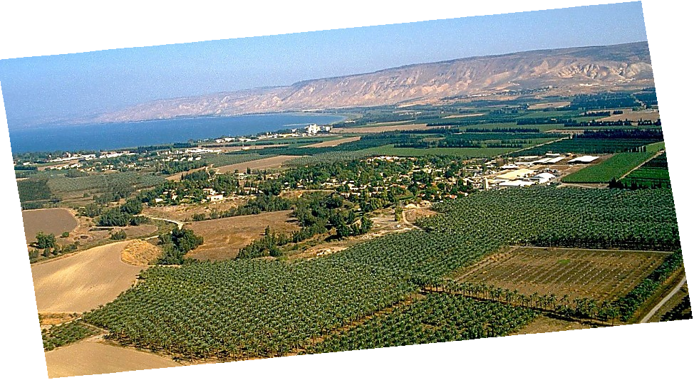
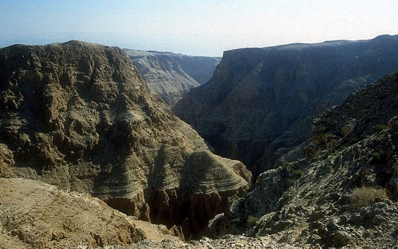
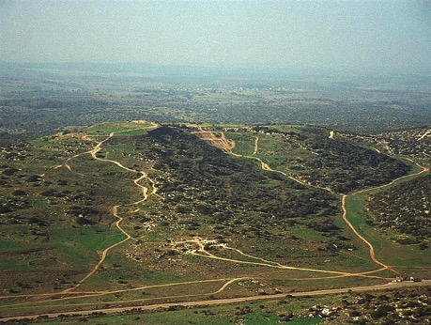
Pian. 13:10-11; Pai 3:8
A PORTION OF ABRAHAM’S PROMISE,,,
ABRAHAM
The CALL
L - S - B
I - I
THE MARVELOUS BEAUTY OF CANAAN…THE LAND OF HIS ANCIENT INHERITANCE!
Israel Laizang a luang Jordan Gun
Handbook pg. 19-24
41
1
© 2006 TBBMI
9.65.03b.
Notes:
And here is that Land today…but only a portion of God’s promise to Abraham…this lush location along Israel’s Jordan River.
//// the Land of his promised inheritance! From the fertile north to the desolate south…”milk and honey” are only the start of the blessings of this special piece of earth’s real estate.

Slide 44
7
Pai. 2:24
ABRAHAM
ABRAHAM
ca. 2000 B.C.
SAPNA
AC
L - S - T
AJMJ
I - I
Pian. 12: 1-3
J - E
12
ABRAHAM
SAPNA
L - S - T
I - I
J - E
Jacob pen kamciam
Tapa hi!
12
KAMCIAM DUNG !
Handbook pg. 19-24
42
7
Notes:
The story now begins to move much faster. ISAAC, ABRAHAM’s son through Sarah, IS the Son of God’s promise.
//// ISAAC then has two sons: JACOB and ESAU (J and E on the ABRAHAM File Folder). JACOB is the son through whom the unconditional Promise now passes on.
//// Jacob, in turn has 12 sons (the number 12 on the Abraham folder).
//// So, then...the Line of the Promise...is
//// Abraham
//// Isaac
//// Jacob and
//// the 12 sons of Jacob.

Slide 45
7
Pian. 35:23-26; Pian. 34:1
ABRAHAM
ABRAHAM
ca. 2000 B.C.
SAPNA
AC
L - S - T
AJMJ
I - I
Pian. 12: 1-3
J - E
12
12
ABRAHAM
1
10
SAPNA
L - S - T
I - I
6
J - E
8
12
4
5
13
7
11
3
9
2
Handbook pg. 19-24
43
Notes:
Here is a graphic representation of those 12 sons of JACOB, born to him and his four wives across the long years of his life. You’ll see there was also a 13th child… one daughter. From those 12 sons of old Jacob emerge the 12 tribes of Israel.

Slide 46
7
Pian. 35:24
ABRAHAM
ABRAHAM
ca. 2000 B.C.
SAPNA
AC
L - S - B
AJMJ
I - I
Pian. 12: 1-3
J - E
12
ABRAHAM
SAPNA
L - S - T
I - I
J - E
12
11
Handbook pg. 19-24
44
Notes:
But notice one particular son of Jacob – number eleven, one of his youngest -- and probably the most remembered of all his children. This son’s story is familiar to almost everyone:

Slide 47
7
Pian. 35:24
ABRAHAM
ABRAHAM
ca. 2000 B.C.
SAPNA
AC
L - S - T
AJMJ
I - I
Pian. 12: 1-3
J - E
12
ABRAHAM
SAPNA
L - S - T
I - I
J - E
12
JOSEPH!
11
Handbook pg. 19-24
45
Notes:
His name is JOSEPH. This great man of legendary character –– his name known throughout the ages -- bridges us over to the next of the four biblical personalities in this mental map of the biblical storyline:

Slide 48
7
Pian. 1 pan 25
PIANCILNA
UKNA OMLO
MI MASATE
Mawhna masa
P
Gospel masa
Innkuan mas
KUMPI UKNA
(1000 B.C.)
Tualthat mas
Tuiciiin/SakhiTuihup
Tausang
(2000 B.C.)
ABRAHAM
(2000 B.C.)
SAPNA
AC
P 7 M J
L - S - T
MIKIPAWLNA 3
I - I
J - E
12
CAPTIVITY
7 = 4 + 3
JOSEPH
ABRAHAM
SAPNA
MI 4
L - S - T
I - I
MOSI
(1500 B.C.)
(500 B.C.)
J - E
S
DAIHNA
12
M
JESU
J
JOSHUA
46
2
Notes:
Now we've completed the second folder in the Bible File collection:
//// first is CREATION,
//// followed by ABRAHAM, the first of the four great names.

Slide 49
7
AJMJ
Mi
LITE
laka
A NIHNA
pa:
?
47
Notes:
Time now to move forward to the second in the group of four great Old Testament characters…the Bible File Folder Number 3.
From "A Judge Must Judge" we know that his name begins with the letter J. Which is…

Slide 50
7
Pian 30:24
AJMJ
Mi
LITE
laka
A NIHNA
pa:
“JOSEPH”
48
Notes:
Joseph. Probably no Biblical character is more famous, more legendary than this one man who -- through his character and his integrity before God -- changed all of human history.

Slide 51
7
Pian. 30:24
AHUN ANAI THEIPEN TUATNA:
ABRAHAM-JOSEPH 2000 B.C.
49
Notes:
And the timeline…let’s keep it generally in that early 2000 B.C. range. It’s unnecessary to be more specific at this point. So don’t feel burdened to remember a long lists of ancient dates. The dates presented in THE BIBLE…BASICALLY are only broad anchor points to help keep events in correct order. You can sharpen them later.

Slide 52
7
Pian. 30:24 pan Pian. 50:26
PIANCILNA
“Thukhen
Pan
Thu a
Khen kul”
ABRAHAM
ABRAHAM
ABRAHAM
JOSEPH
ABRAHAM
MOSI
JOSHUA
UKNA OMLO
KUMPI UKNA
SALTANNA
DAIHNA
JESU
Handbook pg. 24-25
50
Notes:
And here is Joseph’s folder in the Bible File lineup.
“A JUDGE MUST JUDGE”…the first “J” which brings to mind: JOSEPH.

Slide 53
7
JOSEPH
ABRAHAM
Mi
LITE
laka
A NIHNA
pa:
JOSEPH
AJMJ
Handbook pg. 24-25
51
Notes:
JOSEPH's folder appears ready for two significant events to be filled in. The young man is well loved by his father, JACOB — so deeply and obviously, in fact…

Slide 54
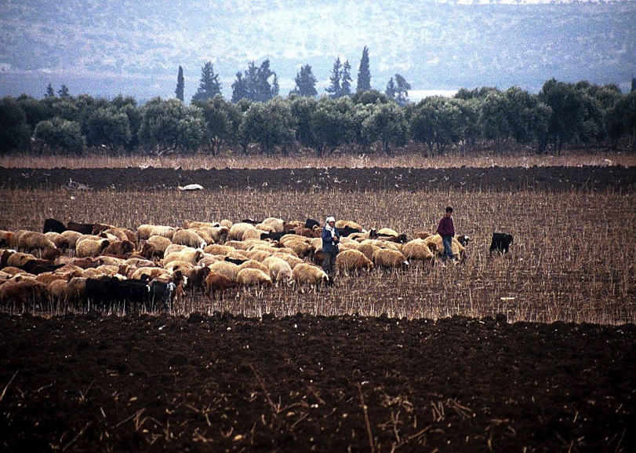
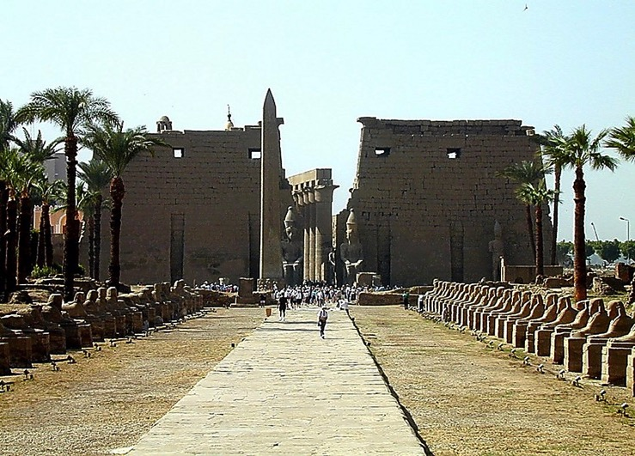
Pian. 37:16-18
Biakinn mai Luxor, Egypt
JOSEPH
Dothan, Israel lolak a tuucing te
Handbook pg. 24-25
52
1
Notes:
…that it arouses the envy of most of his shepherd brothers. Tending flocks at that time in the fields near today’s Dothan in northern Israel…
//// the brothers plot against JOSEPH, selling him into slavery to a passing caravan on its way to Egypt.

Slide 55
Pian. 37:28
JOSEPH
Handbook pg. 24-25
53
Notes:
Once in Egypt…among the fabulous wealth and wonders of that advanced civilization…and after several difficult personal trials…JOSEPH is soon discovered to be a brilliant young man with enormous administrative ability. He learns quickly while remaining faithful and obedient to God’s authority and leading in his life.

Slide 56
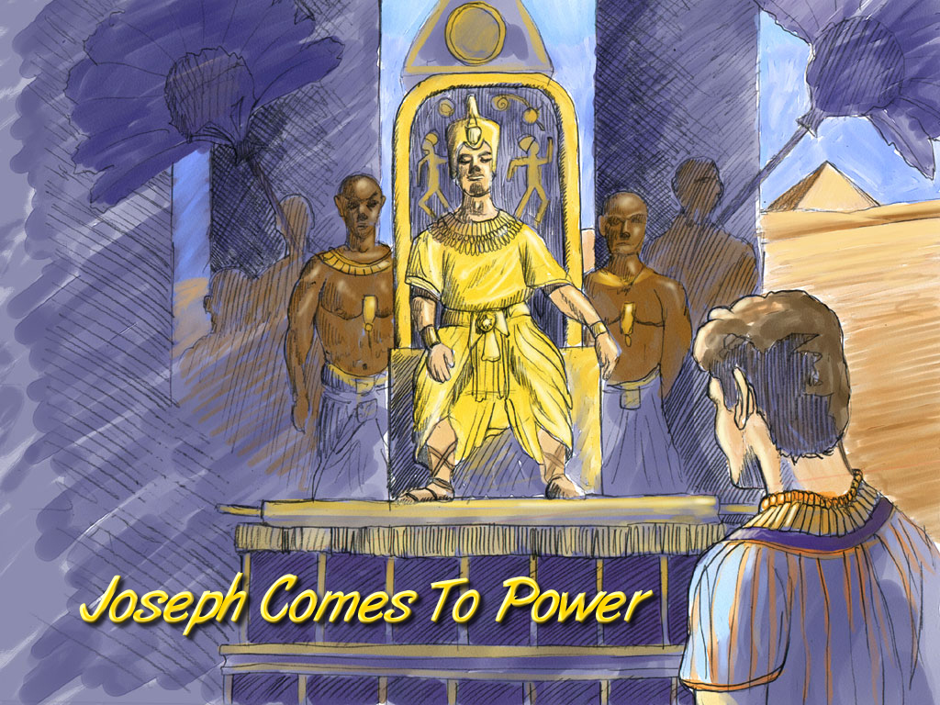
Pian. 41:41-46
JOSEPH
Joseph Comes To Power
Joseph Kumpi suak hi
Handbook pg. 24-25
54
Notes:
In time JOSEPH rises in Egyptian civil authority. He becomes governor of all of Egypt, second only to the Pharaoh himself.

Slide 57
Pian. 42:2
A DAWL
DAWL A
ETOHNA
MS
N(A)
KIALPI!
H
SG
C
ER
B
J
MN
JOSEPH
DS
E
KB
U
TAMPI!
MS
PG
RS
Handbook pg. 24-25
55
1
Notes:
At this same time, back in Canaan, famine strikes The Land.
//// In order to survive the crisis, JOSEPH’s father, old JACOB (now called Israel), sends some of the brothers to Egypt to buy grain. FAMINE IN THE NORTH…PLENTY TO THE SOUTH. (On your map, add the tracing line from Canaan down to Egypt.)

Slide 58
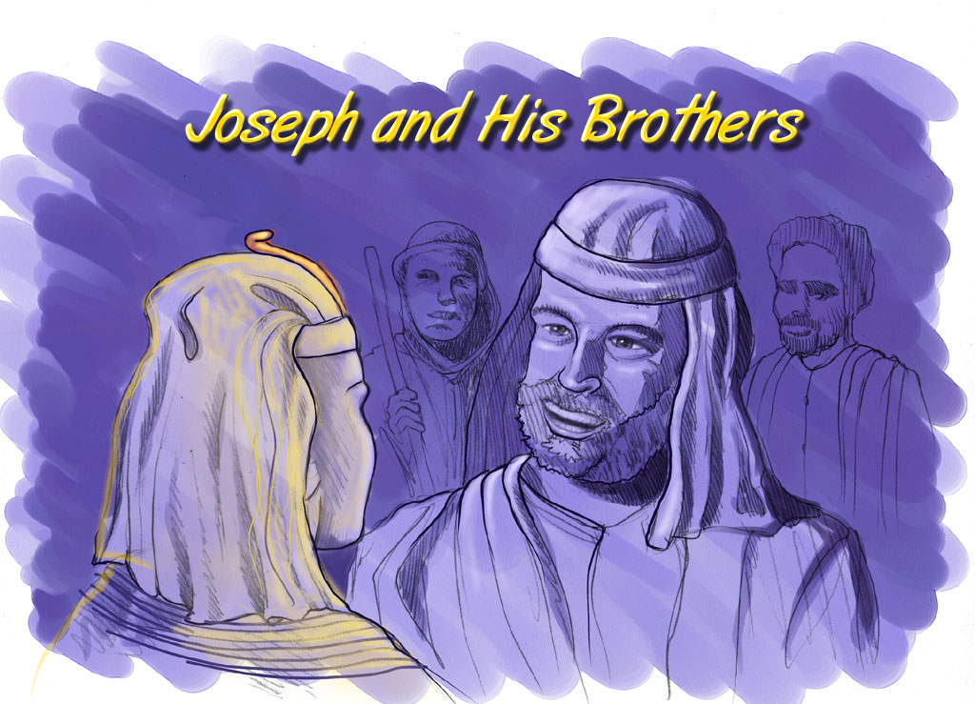
Pian. 42:7
Joseph Leh A Sanggam Te
JOSEPH
Joseph and His Brothers
Handbook pg. 24-25
56
Notes:
Through a series of dramatic events -- told about in great detail in the latter chapters of Genesis – the brothers learn that their sibling, JOSEPH, is now the governor of Egypt

Slide 59
Pian. 46:3-7
A DAWL
DAWL A
ETTOHNA
MS
N(A)
H
SG
C
ER
INNKUAN PIH TEN ZUI…
HIH INNKUAN PEN GAM KHAT ONG SUAKDING!
B
J
MN
JOSEPH
DS
E
KB
U
MS
PG
RS
Handbook pg. 24-25
57
Notes:
The family follows and decides to settle in Egypt permanently. And there...as a family of Hebrews…they begin to multiply into a nation, to be known through later history as the Israelites.

Slide 60
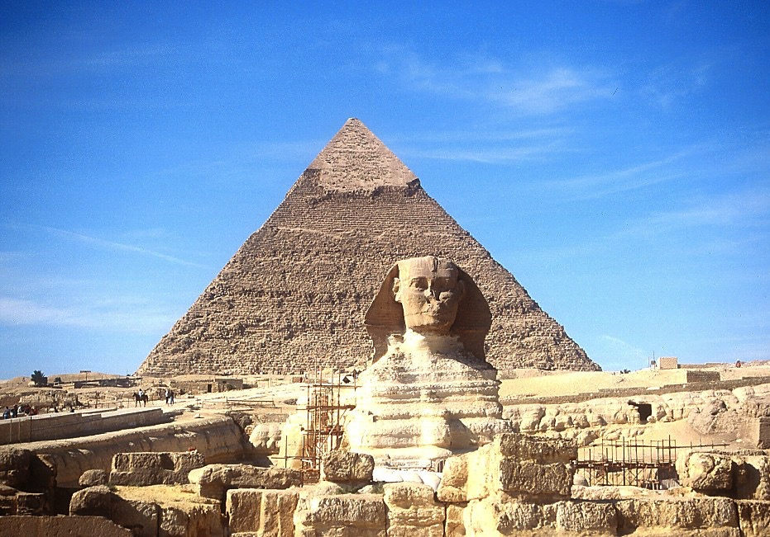
7
JOSEPH
Sphinx leh Pyramid Lianpi
Handbook pg. 24-25
58
Notes:
For a while, they remain in good favor with the Egyptian people and the government administration. After all, they are the family of their respected Governor! Perhaps they even saw the great structures of the Sphinx and the pyramids of Egypt even as they remain for us to marvel at today.

Slide 61
7
JOSEPH
Great Pyramid I Suang Tumte
Handbook pg. 24-25
59
Notes:
We can climb the side of the Great Pyramid today and wonder: are these the quarries where Joseph’s family later slaved through the centuries? Maybe so. Some evidence points in that direction.

Slide 62
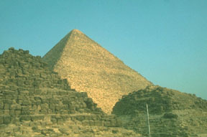
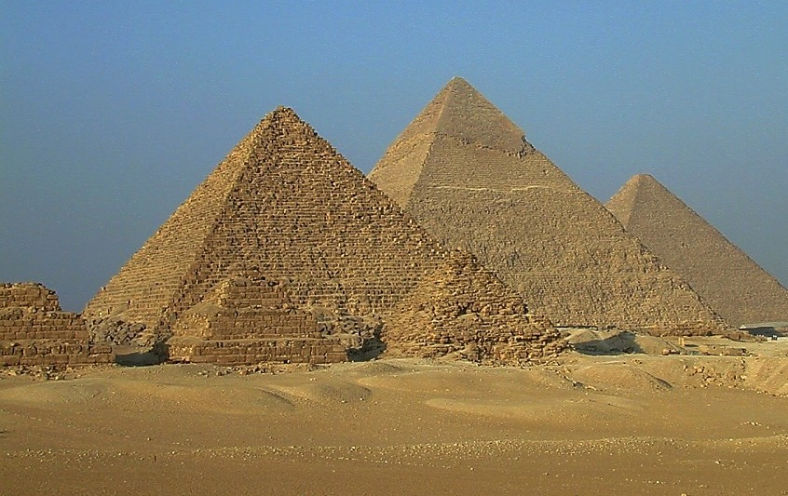
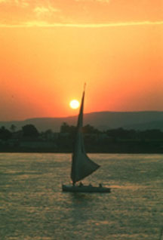
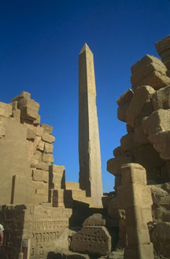
7
ISRAEL MITE’N MU…
JOSEPH
…EGYPT TANGLAI NALAMDANG TE.
Handbook pg. 24-25
60
Notes:
As time passed and Joseph died, these ancient wonders would have seen the throne of Egypt undergo changes of attitude and a loss of respect for the alien Hebrews -- or the Israelites, the old family of Joseph.

Slide 63
Pai. 8:8-10
JOSEPH
ABRAHAM
SALTANNA
Mi
LITE
laka
A NIHNA
pa:
AJMJ
Notes:
After his death, Joseph’s long service to Egypt is soon forgotten.
//// While at the same time, as a population, the Israelites are multiplying rapidly – lots and lots of children –
[NOTE: SEVEN SETS OF “CHILDREN-DOTS” APPEAR]
– soon becoming an enormous social problem and a serious national threat to their Egyptian overlords. So…to take care of that problem…
//// the Israelites, Joseph’s national descendants, become SLAVES to the Egyptians.
//// Israelites are in Egypt for some 430 years. Much of that time is lived out under the terrible bondage of Egyptian slave masters.

Slide 64
7
Pian. 1:1 pan Pai. 1:6
PIANCILNA
UKNA OMLO
Mi masate
Mawhna masa
P
Gospel masa
Innkuan masa
KUMPI UKNA
(1000 B.C.)
Tualthat masa
Tuiciin/Sakhituihup
Tausang
(2000 B.C.)
ABRAHAM
(2000 B.C.)
P 7 M J
SAPNA
AC
L - S - T
MIMIPAWL NA 3
I - I
J - E
12
SALTANNA
7 = 4 + 3
JOSEPH
JOSEPH
SALTANNA
SALTANNA
MI 4
430
430
MOSI
(1500 B.C.)
(500 B.C.)
M
S
DAIHNA
JESU
J
JOSHUA
Handbook pg. 24-25
62
Notes:
Now…THE BIBLE FILE...is filled in to include
CREATION, ABRAHAM, and JOSEPH…

Slide 65
7
AJMJ
Mi
LITE
laka
A THUMNA
pa:
?
63
Notes:
…which brings us now to the third person in the Group of Four great Biblical personalities.
This great person – THE LARGE CAPITAL M – will be…

Slide 66
7
Pai 2:10
AJMJ
Mi
LITE
laka
A THUMNA
pa:
“MOSI”
64
Notes:
...MOSES.
In His time, God raises up the most famous of all the Old Testament characters, MOSES, known as The Great Deliverer…
to take the people out of their Egyptian bondage and on toward the land of Abraham’s promised inheritance.

Slide 67


Lai Siangtho...Abulpi • BibleStudyDownloads.org
Hih thuhilhna a awk na in lain!
Laisiangtho thutuk sina paunam 40 val omhi
Laisiangtho thuthuk hilhna limtawh, laimal tawh paunam 44 omhi
Notes:
The Bible…Basically (bb)

Slide 68
65
©2006 TBBMI
9.65.03b.

