Slide 1

VERSION 9.65
Patheen Chawngbuk... Kungthoi na
A Presentation of The Bible…Basically Ministries International Inc.
Fort Worth, Texas
www.biblebasically.org
01
©2006 TBBMI
9.65.01.
Notes:
Title slide (no narration)
Translators should translate either title on the right, delete the words "Choose either title below…" and delete the non-translated title, then drag that entire section over the main slide on the left so that no English appears on the slide.

Slide 2
Narangai uroh….numpok tak a phone khan teitang nachawk thei kholok ruchuk sunghin narak pe u noroh. Nanglom haina namapak urang nih.
02
1
9.65.01.
Notes:
Same as text above

Slide 3
©
The Bible…Basically Ministries Int'l
Ikhin nei lamkai hai
Dr. John Hannah
Professor of Historical Theology
Research Professor, Historical Theology
Dallas Theological Seminary
Dallas, Texas
Dr. Rick Griffith
Doctor of Ministry Director
Assoc. Professor in Biblical Studies
Singapore Bible College
Republic of Singapore
Dr. Mark Bailey
President
Dallas Theological Seminary
Dallas, Texas
John Maisel • Kurt Nelson
President • Exec. Vice President
East/West Ministries
Dallas, Texas
Dr. William R. Bright
Late Founder
Campus Crusade for Christ
Orlando, Florida
Vasily Dimitrievski
Director for Russia
Global Missions Fellowship (e3)
Penza, Russia
Rev. Douglas Valenzuela
Senior Pastor, Conservative Baptist Missions
Chiesa Battista Evangelica di Casoria
Naples, Italy
Dr. Ted Kitchens
Senior Pastor
Christ Chapel Bible Church
Ft. Worth, Texas
Karyn Granger
Director of Bible Studies
Southwest Christian Schools
Ft. Worth, Texas
Dr. Kenneth Horton
Senior Pastor
McKinney Memorial Bible Church
Ft. Worth, Texas
03
©2006 TBBMI
9.65.01.
Notes:
This seminar has been approved by many respectable leaders in the western world.

Slide 4


Patheen chong Sunga ah awm Ram-mun Rilim
Pathen chong Sunga ah awm Ram-mun Rilim akonpa Todd Bolen deng mapak na korophong uh. Ama na The Bible…Basically chon rang hin rilim, ruirakai kholok nepek thei ujarra. TBB ruchuhaina BiblePlaces.com khan tawk thei, rutoknathei kholok noloi pe uroh. Holyland aput Aegean Mediterranean Basin aput Southern Europe mahin aput richichawi hawngthoi na inih. BiblePlaces.com hina oja hai rangam rekhen nalom awmboi a atha atha numuk thei joi. Mahi ne en pe uroh.
Kanamapak Todd.
04
9.65.01.
Notes:
This presentation has been granted use of almost 150 pictures from the BiblePlaces.com website. We thank Todd Bolen for his support!

Slide 5
VERSION 9.65
Patheen Chawngbuk... Kungthoi na
A Presentation of The Bible…Basically Ministries International Inc.
Fort Worth, Texas
www.biblebasically.org
01
©2006 TBBMI
9.65.01.
9.65.01.
©2004 TBBMI
01
Notes:
Title slide (no narration)
Translators should translate either title on the right, delete the words "Choose either title below…" and delete the non-translated title, then drag that entire section over the main slide on the left so that no English appears on the slide.

Slide 6
The Bible…Basically Project hi a mining, akon, khan amosok
hi John E. Fryman, Ph.D.
Copyright © 2006 The Bible…Basically Ministries Intl. Inc., Ft. Worth, Texas
Cham kholok hi dan thoi a om inih. Mahi Chon hi United States of America dan thoi ah awm inih. Tute nah awm eshik ah kon thei nonih khan rojot nah awm boi ah athar ah moshok thamak. Mahi chon pumi na khut rotho na nepek malalim tu tute na awm dan rakan ah rotok nah awm norosoh.
Kha niah, dan dung jui ah khan rojot na dung jui ah athar ah kon hai tu aruchu hai rang, khan amanih darkar dung jui ah kon nirosoh.
Dr. Todd Bolen, The Master's College, Jerusalem, Israel, khan Pictorial Library of Bible Lands (BiblePlaces.com) deng mapak na korophong uh, rotok na thei rang, cham neina nepek uh jar hin.
Kadesh-Barnea rilim hi Dr. Leen Ritmeyer, Hawthornedene, Australia a put rojot loi ah rotok na inih. Upumi chang hai mehet boi a eshik akon awm atu, upumi chang hai deng arelenga mejet mashak narang hin mejet na kenei. Mahi, rojot na awm boi a rotok na khar narang a inih.
Aruchapa, mik a muk-thei a kon hai khan tute na mahin a awm rilim, khutkon teitang, okho reng a tho tha mak, rojot na awm malalim.
Mahi Behanghi United States of America a emosok inih. International Rights Reserved.
06
©2006 TBBMI
9.65.01.
Notes:
At biblestudydownloads.com you can download all of the PPT for this seminar so you can teach it to your own people. However, as this copyright page notes, we ask you not to change any of the content.

Slide 7


(Chonmun: Bible lungsing ranak a tawk ranga!)
Patheen Chawng…
Kungthoi na
®
Akhat Chang na
"Patheen Chawngbuk“
Mawlawng na
07
©2006 TBBMI
9.65.01.
Notes:
Our goal during this seminar is to mentally manage the Bible.

Slide 8
?
Mahi hawng keei na khotang monih……
Richi choi hai sene
Lungvar athuk met a mahi chon mun hi molong na nei roi!
Richi choi hai tak a sawn na
Patheen chawng a hongthoi Behang kholok:
Patheen behang ruchuk na mun rikip a
Mipui behang mun a
Nata nata behang mun a
Behang ruchuk na mun a
Manmesseh Ram mun rikip a
Chawng akip bir a
KHAN
Patheen chawng a ashok Lungvar
Manmesseh a Richi choi, richi choi boi miring kholok
08
15
©2006 TBBMI
9.65.01.
Notes:
Our lonely planet floats in space while men on its surface struggle – sometimes in vain – to understand it! They ask the questions for which Christians have the valid answers. But too many of the questioners either will not listen…or else have never heard. Believers know very well that the answers have been given between the covers of God's Word…His Bible.
//// So with that fact in mind…let's launch this seminar with one massive thought!
//// What is the source of
//// every Christian doctrine,
//// Every Christian belief system,
//// In every Biblically based book in
//// Every seminary library,
//// Every public library,
//// Every personal library,
//// Every University library,
//// In every country in the world,
//// In almost every language,
//// And…besides all that…
//// The source of every biblically based thought of
//// every believer and nonbeliever across our planet?
//// (DIZ QUESTION MARK)

Slide 9

Tak ah sawn kungthoi na chawngbuk
Behang buk pek. 6
2
09
Notes:
The answer? This book: Because Christian belief is built on personal faith in this Book... However…that faith is also built upon solid fact! The Word of God is an organized record of the facts of the faith.
//// We can call it: the BASIC DOCUMENT OF OUR FAITH!
However, around the world, well-grounded research and experience shows that -- for MOST people -- the facts and historical progression of scriptural storyline are a great and lasting mystery.
//// And a housekeeping note to begin: at the lower right-hand corner of many slides you'll see a reference to locations in the TBB student handbook for your personal reference.

Slide 10

Dr.Henrietta Mears na imejek
Bible kholok hi itina monih!
Itia amana behangbuk khan
Behangbuk pek. 6
10
Notes:
One of the great Bible teachers of the 20th Century, Henrietta Mears....wrote about this idea in her book, "What The Bible Is All About." She said…

Slide 11
Patheen chawng ajet arawp lam na:
Manrawp lung le kon patrui ang a.
Inia aterat det mulung atu…
Behangbuk pek. 6
11
Notes:
SAME
Most people's Bible knowledge is like a string of fine pearls…but in many readers' minds…

Slide 12

…makha patrui kha chat…
Bible rishim ruikon sakha aset a rawchawk mashak!
Behangbuk pek. 6
12
Notes:
…the bead string is broken. The organized progression of the Biblical storyline is disorganized and confused. Each fine gem is separate…disorganized…just strewn about all around. It is impossible to appreciate the beauty of that complete necklace of lovely pearls.

Slide 13
Behangbuk pek. 6
13
Notes:
How can we restring the lovely pearls? In the same way…how can we reassemble the pieces of SCRIPTURE, bringing them together so that, just like the pearls, each piece is in its proper place...one leading to another…each gem or biblical fact placed in ITS proper relationship…as each relates to every other one in that grand panorama of biblical revelation…stretching across 4,000 years?
Only with an organized, mentally accessible knowledge base of Scripture can we begin to comprehend …

Slide 14
Athuk det a Patheen chawng
Artha Me-leh na arop
Ratha retheng lamkai na reeirit
14
2
Notes:
…the depth of Scripture
//// the nuances of its meaning…and
//// the deeper leadings or instructions from the Holy Spirit…Who stands ready to teach us through every page of His Word.
Can that kind of comprehensive, coherent knowledge of Scripture be accomplished? Answer: Yes...it can be done...both swiftly and efficiently.

Slide 15
?
?
?
Patheen na inakhek narangah rasamna.
Abraham khan ronglui Israel
Jisu Khrista jonglarna
Patheen Beek inn hongthoina
?
?
?
?
?
?
15
5
Notes:
In this one book, we are told how to see…
//// The glorious wholeness of God's Plan of Redemption recorded for us in words we can understand…framed by…
//// …the drama of old Abraham and ancient Israel…beginning in the Middle East some 4,000 years ago…
//// ….culminating in the appearance and gospel ministry of the Lord Jesus Christ…
//// …and the birth of the Church. Our part of the story is to understand the movement of the Gospel message of Jesus Christ …progressing right down to our own time.
//// But, sad to say, for the vast majority of people, this is often unfamiliar territory. In fact, for many, it's a downright intellectually fearful place.

Slide 16





  Pathen Chawangbuk hai hi enroh!
16
Notes:
Just look at all these Bibles! All the versions…all the translations…
the special editions for special groups of Bible readers…ALL AROUND THE WORLD!

Slide 17
Makhan aput matat putjoi!
Alentak reignam boi vetna!
• Bawpkhat dawr Reeirit awm
• Raja-raja awm Simchan
• 750,000 Chawng
• 1,200 Temun
• 31,000 Chawngtang
• Tengamboi Chawngtin
Khan melechawng
17
7
Notes:
And that's where the problem begins. For many people…believers included…
//// the Bible is a huge and unruly puzzle.
//// It has thousands of details...
//// hundreds of characters...
//// three/quarters of a million words...many exotic and unfamiliar...
//// 1,200 chapters...
//// 31,000 verses...
//// and those countless versions and translations...in unnumbered languages all across the planet...
Taken together, this situation produces an enormous problem for readers more accustomed to today's quick-in, quick-out approach to reading and to literature and entertainment in our age of high technology.

Slide 18
TUNA EMOTHO?
TUNA EMOTI?
BEHANG
ELOI AMOH?
MIRINGHAI
THAKHO
ELE EMO RUI RAKAI?
18
7
Notes:
Here are some typical worries...
//// what about all those books...
//// all those people, all 3,000 of them...
//// all the dates...
//// and who said what...
//// why did they do what they did...
//// who did what...
//// and what relates to whom or what?

Slide 19
NASANROH!
TUNA EMOTHO?
TUNA EMOTI?
BEHANG
ELOI AMOH?
MIRINGHAI
THAKHO
ELE EMO RUI RAKAI?
18
7
Notes:
Here are some typical worries...
//// what about all those books...
//// all those people, all 3,000 of them...
//// all the dates...
//// and who said what...
//// why did they do what they did...
//// who did what...
//// and what relates to whom or what?

Slide 20
NASANROH!
KEI LOI NGAM LAI MI-ING!!!
KHA JARKHAN PASTORPA MOTHO RANGTANG!
20
Notes:
And many of them go one step farther...they say, I JUST CAN'T TAKE IT! SO...I'LL JUST LET THE PASTOR DO IT…Or whoever the Biblical expert in their world might be at the time.

Slide 21
TUNA MO JET?
21
Notes:
And then again...WHO CARES?
[Often we end up apathetic]

Slide 22
KHA NIT AH EMO?
22
Notes:
And the next question might be...SO WHAT? [But why do we need an overview of Scripture?]

Slide 23
“Tak a sawn nahi adik a kungthoi na net nok ah tu, akipboi, miningdikboi khan chawng balam chang rang nih."
Miles Stanford
Principles of Spiritual Growth
adik
akipboi
miningdikboi
chawng balam
23
4
Notes:
One answer comes from a great Christian writer...hear the words of Miles Stanford:
"Unless our faith is established on
//// facts, it is no more than
//// conjecture,
//// superstition and
//// presumption."

Slide 24
Thirchuk na ikhin ruchuk narang…
“Nijet kha khe tak ah shawn no mini,
Khan natak a sawn na nek khan rashang a ring nawmini."
Albert Mohler, President
The Southern Baptist Seminary Louisville, KY
24
3
Notes:
And think about this anchor point of study…
//// Dr. Albert Mohler, president of The Southern Baptist Seminary in Louisville, Kentucky, wrote this…
//// "We will not believe more than we know…
//// …and we will not live higher than our beliefs. The many fronts of Christian compromise in this generation can be directly traced to biblical illiteracy in the pews and the absence of biblical preaching and teaching in our homes and churches…This generation must get deadly serious about the problem of biblical illiteracy, or a frighteningly large number of Christians will go on thinking that Sodom and Gomorrah lived happily ever after."

Slide 25
Kha nit a tu…put rang roi!
(Ruchuk na khat se awm joboi ah awm noroh. Changkidip a nuk a ruchuk ranga rotawp shom inih!)
25
1
Notes:
Which brings us to the study that lies ahead. We are about to embark on a Biblical voyage named: THE BIBLE…BASICALLY. It's a quick tour through ALL of Scripture, leaving you well equipped to THINK BIBLICALLY and to help others acquire that same skill!
You will have a new set of mental tools that can reshape your view of God's Word and his message for your life and the lives of others around you…both believers and those still searching for life's answers!
//// So here we go…and try to attend every session or class because each new idea steadily builds on those that have gone before!

Slide 26
Patheen chawng…Kungthoina
®
hi mining narang a lam inih!
26
Notes:
TBB is new way of thinking Biblically!
CHANGED FROM THE ORIGINALS (TQC)
Old: We'll first learn THE QUICK CHRONOLOGY of the Biblical story line…that will lead you directly into a new way of thinking Biblically!

Slide 27
Patheen chawng…Kungthoina
®
Lungsing ranak a Patheen chawng hi nang meje ngam rang nih!
27
Notes:
You'll be learning to mentally manage your Bible!
CHANGED FROM THE ORIGINALS (TQC)

Slide 28
Patheen chawng…Kungthoina
®
Alutak chung-chawng: Mahinna put mi nang eruchuk rang awm joi !
K 7 A J
Chawngkung chang narang orolong na awm!!!
28
1
Notes:
And there's an important subtext going on here also: you will be learning something that you can teach to others!
//// And what an opening for witnessing to others around YOU!
So, here we ago…
CHANGED FROM THE ORIGINALS (TQC)

Slide 29
Patheen chawng…Khungthoina
®
Malawng narang
“Nang Bible Thawp"
29
Notes:
…with first things first…Let's begin by opening up "Your Bible File."
CHANGED FROM THE ORIGINALS (TQC)

Slide 30
Bible
Thawp
BIBLE
Thawp
30
Notes:
I'd like to introduce you to our friend, Mike. Mike is about to go into church. He's entering the building with a "Bible File" of information already in his head...well…somewhat!

Slide 31
Bible
Thawp
BIBLE
THAWP
31
Notes:
There he is…walking up the sidewalk right into church with his mental Bible File...

Slide 32
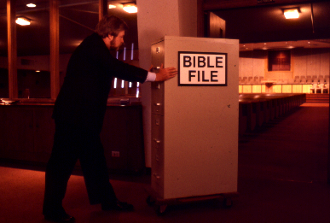
BIBLE
FILE
Bible
Thawp
BIBLE Thawp
32
31
Notes:
... And Mike goes straight into the building, pushing that File Cabinet in his head right into the sanctuary or worship center.

Slide 33
BIBLE
Thawp
33
Notes:
Mike sits himself down ready for the preacher or the teacher to begin. And Mike is getting ready to open his Biblical file cabinet…

Slide 34
34
Notes:
…up there in his head! …….Well, there he sits... his Bible file all primed to plug into whatever the pastor or teacher is about to say.

Slide 35
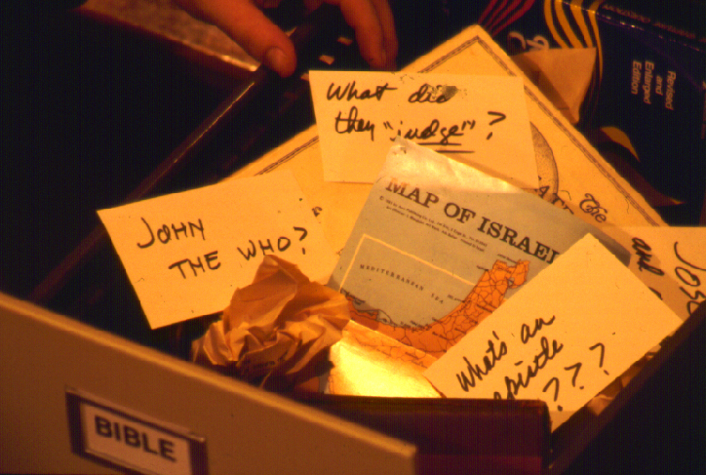
?
?
Khanit ala…ani-niboi tawk narang kutanga mo put rawng?
?
?
35
5
Notes:
When he opens up his mental Bible File…figuratively speaking of course…it is a mess!
//// John the Who? Baptist? Methodist? Catholic? Maybe Jewish? What's that all about?
//// And what in the world did they Judge? Who were those judges anyway? Who elected them in the first place?
//// And ANY map of Israel...now that's a place of Biblical confusion! You mean to tell me, Mike says, that that is the very same place as today's Israel, the one in the newspapers and on TV?
//// And the "Epistles?"....truly, research shows that many people think that an EPISTLE was the wife of an APOSTLE! Yes, some really do think that!
//// So...where do you begin to sort out all that information...and a great deal of MISinformation?

Slide 36
Makha lungvar nakha nei mi-ing!
Khotang mo put ning?
36
Notes:
Most folks will say, "I have absolutely no idea!"
…So..."Where do I begin?"

Slide 37
7
Behang pek. 8-14
37
Notes:
Let's start with the number 7. But look closely and you'll see that dash through the stem of the 7.

Slide 38
7
7
Behang pek. 8-14
1
38
Notes:
And that's important! The dashed line will remind you of something. In just a minute you'll divide that number 7 into two others: 4 and 3.
//// Also, as the visuals move along, many of them will have that 7 with a dashed line through its stem up in the right hand corner of each frame….a handy, continuing reminder of the mental tools we are learning to use.

Slide 39
Nang
BIBLE Thawp
7
C
7
S
J
Behang pek. 8-14
39
Notes:
Now let's think again about a filing cabinet. This will be YOUR BIBLE FILE! Here is a look ahead to where we are going in this study.

Slide 40
7
K
Nang
BIBLE Thawp
7
A
J
EMBEDDED MOVIE SEQUENCE NOT AVAILABLE IN THIS VERSION
Behangbuk pek. 8-14
40

Slide 41
Behang Thawp na som
7
1
2
3
4
K
5
6
7
7
8
9
A
10
J
Behangbuk pek. 8-14
41
Notes:
As a starting point, begin thinking about 10 file folders in a filing cabinet.
You are going to organize your own Bible File into a collection of these ten mental file folders.
Very soon you'll be applying labels to each of those 10 file folders. So…now to begin…and…

Slide 42
Mawlawng narana
“Nang Bible Thawp"
7
7
7
7
7
7
7
7
7
J
K
J
K
A
J
K
A
K
A
J
Behangbuk pek. 8-14
4
42
Notes:
We begin right here...with the single number…. 7.
That's our mental anchor point. Simply the number 7 with that all-important dash through the stem.
//// Next step...surround that number with three alphabet letters. Set them firmly in place in your mind:
C 7 S J
Repeat the letter group aloud several times as you embed it in your mind... Because this is the very core of the Bible's organization and time-line flow:
//// "C 7 S J....
//// C 7 S J....
//// C 7 S J...etc."

Slide 43
Mawlawng narana
“Nang Bible Thawp"
7
7
= 4+3
Behangbuk pek. 8-14
2
43
Notes:
Now...about that European style '7'.
//// You'll remember that it has a dash through its stem... That's an important reminder — a mind clue. Keep it mentally handy. That small dash divides the length of the 7's stem into two parts. So, ask yourself the question: "What two numbers does 7 easily split into?"
//// One possible answer…and the right one…is: 4 and 3.

Slide 44
7
Mawlawng narang
“Nang Bible Thawp"
K 4 3 A J
K 4 3 A J
Behangbuk pek. 8-14
1
44
Notes:
So, in the C 7 S J formula, by changing the 7 to a 4 and a 3, we have
C 4 3 S J.
As before, repeat that changed sequence aloud several times to help it hold tightly in your mind for easy recall.
//// C 4 3 S J.

Slide 45
ALU DET CHAWNG RANGA:
7
K = KHUTKON
4 = MIRING
3 = ROLOPNA
A = ATHIM
J = JISU
Behangbuk pek. 8-14
5
45
Notes:
Now, based on C 4 3 S J, we enlarge that idea into five key words or phrases. They will become the foundation of your mental Bible File. Here they are…say them aloud…
//// C = CREATION
//// 4 = 4 PEOPLE
//// 3 = 3 SOCIETIES
//// S = SILENCE
//// J = JESUS.
And that's an organizational plan for the entire Bible! Those five words and phrases create an abbreviated outline map of the entire Bible's basic design.

Slide 46
ALU DET CHAWNG RANGA:
7
K = KHUTKON
4 = MIRING
3 = ROLOPNA
A = ATHIM
J = JISU
Behangbuk pek. 8-14
6
46
Notes:
Once again...aloud…
//// C = CREATION
//// 4 = 4 PEOPLE
//// 3 = 3 SOCIETIES
//// S = SILENCE
//// J = JESUS.
We will now go back through the phrases, expanding them still farther.
//// CREATION,
of course, remains at the top of the list naturally…because the Bible story itself begins right there.

Slide 47
ALU DET CHAWNG RANGA:
7
K = KHUTKON
4 = MIRING
3 = ROLOPNA
A = ATHIM
J = JISU
Behangbuk pek. 8-14
47
Notes:
We then take the next phrase from the list:
4 PEOPLE.

Slide 48
MIRING MILI HAI:
7
ABRAHAM
JOSEPH
MOSES
JOSHUA
Behangbuk pek. 8-14
5
48
Notes:
Let's break apart "4 PEOPLE" into 4 specific people, in this order:
//// ABRAHAM
//// JOSEPH
//// MOSES
//// JOSHUA
It's helpful to remember the word order by repeating several times the first-letter order of the words:
//// "A-J-M-J ... A-J-M-J ... etc."

Slide 49
A Judge Must Judge
7
ARING
JONJAI
MISAPA
JONGSOKNA!
Behangbuk pek. 8-14
49
Notes:
How can you remember the order of those letters and the names?
This simple sentence..."A JUDGE MUST JUDGE." The first letters of each word: AJMJ and then you have it.

Slide 50
MIRING MILI HAI:
7
A BRAHAM
ARING
J OSEPH
JONJAI
M OSES
MISAPA
J OSHUA
JONGSOKNA
Behangbuk pek. 8-14
8
50
Notes:
Just remember to repeat the four names aloud to yourself several times until you feel the rhythm of the words:
//// "ABRAHAM,
//// JOSEPH,
//// MOSES and
//// JOSHUA."
And here again is that mental tool…
//// A
//// JUDGE
//// MUST
//// JUDGE.

Slide 51
Creation to Joshua
7
KHUTKON
ABRAHAM
JOSEPH
MOSES
JOSHUA
Behangbuk pek. 8-14
5
51
Notes:
Tuntu chung teng a put jung te roh:
//// KHUTKON
//// ABRAHAM
//// JOSEPH
//// MOSES
//// JOSHUA
This step completes the main FOUR PEOPLE of your new Bible File. Of course, there are dozens of other Biblical characters, but these are the only ones we are using to build the Bible File right now. Repeat the four names aloud several times until they are firmly set mentally.

Slide 52
ALU DET CHAWNG RANGA:
7
K = KHUTKON
4 = MIRING
3 = ROLOPNA
A = ATHIM
J = JISU
Behangbuk pek. 8-14
52
Notes:
The next phrase of that beginning list is:
3 SOCIETIES.

Slide 53
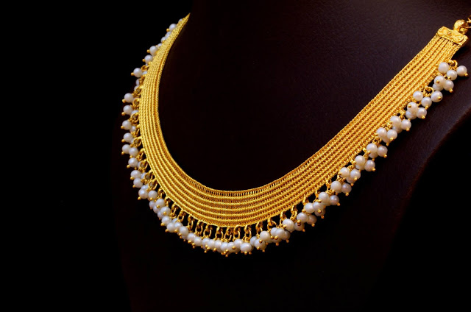
D R S

Slide 54
ROLOP NA THUM:
7
DAN AWM BOI
RENG KHOLO
SHURKHUP
Behangbuk pek. 8-14
6
54
Notes:
Rolopna thum hai…
//// DAN AWM BOI
//// RENG KHOLO
//// SHURKHOP.
Nang jet na het rang, mikir ret, mikir ret roh.
DAN AWM BOI, RENGKHOLO, SHURKHOP...
DAN AWM BOI, RENGKHOLO, SHURKHOP.
KHAN LUNGVAR A MINING THEI:
//// D
//// R
//// S.

Slide 55
OT Review
7
KHUTKON
ABRAHAM
JOSEPH
MOSES
JOSHUA
DAN AWM BOI
RENG KHOLO
SHURKHOP
Behangbuk pek. 8-14
55
Notes:
Now we add the 3 SOCIETIES group to the others, and we have:
CREATION
ABRAHAM
JOSEPH
MOSES
JOSHUA
ANARCHY
ROYALTY
CAPTIVITY

Slide 56
ITHIR RANGA…
7
7
ITHIR RANGA...
K 7 A J
K 4 3 A J
Handbookbuk pg. 8-14
3
56
Notes:
To review the entire sequence so far…
Beginning with the single number
//// 7....
leading to…
//// C 7 S J...
which becomes...
//// C 4 3 S J.
These numbers and letters are then used to develop a mental list of TEN WORDS that will form a dependable mental outline of the entirety of Scripture.

Slide 57
KHUNG
THOI
7
KHUTKON
4 MIRING
3 ROLOPNA
ATHIM
JISU
Behangbuk pek. 8-14
57
Notes:
C 4 3 S J is then expanded into:
CREATION
4 PEOPLE
3 SOCIETIES
SILENCE
JESUS.

Slide 58
Dong teng idi thawp na
7
KHUTKON
ABRAHAM
JOSEPH
MOSES
JOSHUA
DAN AWM BOI
RENG KHOLO
SHURKHOP
ATHIM
JISU
Behangbuk pek. 8-14
2
58
Notes:
Then further expanded into:
CREATION
ABRAHAM
JOSEPH
MOSES
JOSHUA
ANARCHY
ROYALTY
CAPTIVITY.
Finally, now, we add: //// SILENCEand//// JESUS.

Slide 59
Mining "Bible thawp"
KHUTKON
KHUTKON
ABRAHAM
ABRAHAM
ABRAHAM
ABRAHAM
JOSEPH
ABRAHAM
MOSES
JOSEPH
JOSHUA
DANAWMBOI
MOSES
RENG KHOLO
SHURKHOPY
JOSHUA
ATHIM
JISU
DAN AWMBOI
RENGKHOLO
SHURKHOP
ATHIM
JISU
Behangbuk pek. 8-14
59
11
Notes:
Now it's time mentally to apply those ten words as labels to ten mental folders in your new Bible File –
//// right up there in your head. That mental picture might look something like this. And there they are...
//// CREATION//// ABRAHAM//// JOSEPH//// MOSES//// JOSHUA//// ANARCHY//// ROYALTY//// CAPTIVITY//// SILENCE…and…//// JESUS.
Now it's organized in a neat and orderly package in your mind --- ready for recall and use as you need it. Now just a few more
examples to drive home the point...

Slide 60
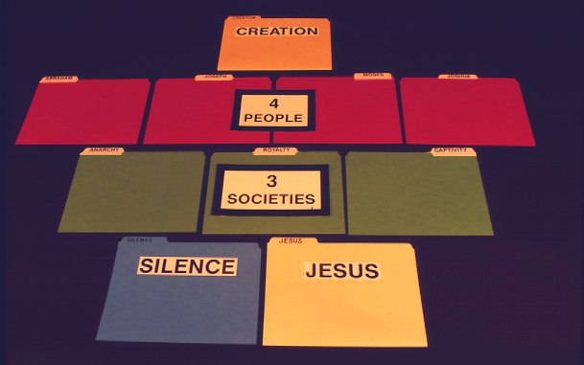
7
KHUTKON
Behangbuk pek. 8-14
60

Slide 61
7
Khutkon
MIRING MILI
Behangbuk pek. 8-14
61

Slide 62
7
KHUTKON
MIRING MILI
ROLOP NA THUM
Behangbuk pek. 8-14
62

Slide 63
7
KHUTKON
MIRING MILI
ROLOP NA THUM
ATHIM
JISU
Behangbuk pek. 8-14
63

Slide 64

7
Manmesseh hi rotho joi!
Behangbuk pek. 8-14
64
Notes:
Here is yet another way to think of your Bible File. Like many of us, this young woman spends hours every day at her computer.

Slide 65



7
KHUTKON
CREATION
ABRAHAM
ABRAHAM
ABRAHAM
ABRAHAM
ABRAHAM
ABRAHAM
JOSEPH
JOSEPH
ABRAHAM
ABRAHAM
MOSES
MOSES
JOSHUA
JOSHUA
ANARCHY
DAN AWMBOI
RENG KHOLO
ROYALTY
SHURKHOP
CAPTIVITY
ATHIM
SILENCE
JISU
JESUS
65
Notes:
So...instead of thinking just of file folders as heavy folded paper, think about them as computer files on a floppy disk or on a computer hard drive.

Slide 66

BIBLE THAWP
66
Notes:
Imagine this as the main screen of your own computer monitor – with a data folder you created named, naturally, Bible File. Double click on that imaginary folder….

Slide 67

C
KHUTKON
ABRAHAM
DAN AWMBOI
ATHIM
JISU
JOSEPH
RENG KHOLO
MOSES
SHURKHOP
JOSHUA
67
10
Notes:
…and you would get this...the ten sub-files, all as folders, named, in
order…and say them along with me…
//// CREATION
//// ABRAHAM
//// JOSEPH
//// MOSES
//// JOSHUA
//// ANARCHY
//// ROYALTY
//// CAPTIVITY
//// SILENCE
//// JESUS.

Slide 68
{
}
K 7 A J
C
KHUTKON
ABRAHAM
DAN AWMBOI
ATHIM
JISU
MIRING MILI
JOSEPH
RENG KHOLO
ROLOP NA THUM
MOSES
SHURKHOP
JOSEPH
68
Notes:
And, with some computer graphics, you might even add the basic building plan over those folders. The now a familiar mental tool... C 7 S J And its 4 PEOPLE and 3 SOCIETIES.

Slide 69
MINING BIBLE THAWP!
KHUTKON
ABRAHAM
ANET
JOSEPH
MOSES
JOSHUA
DAN AWMBOI
ASHUNBIR
RENG KHOLO
SHURKHOP
ATHIM
RUPUMPING
JISU
69
4
Notes:
So there you have the basic building blocks of a complete biblical filing system…in your head…the basic building plan of the Bible…how THE BASIC DOCUMENT OF THE FAITH is organized.
//// It's your personal Mental Bible File!
From this point on, we will construct a
//// sturdy,
//// comprehensive,
//// and coherent mental map of God's Word…each step of its progress built on this reliable basic mental mapping idea.

Slide 70

Tun a hintu Patheen chawng...
Kungthoina, nang iminingna awm joi…
•Lunsing tiah "Bible Thawp"
•Lungsing ranak a mawlawng narang "Bible Thawp"…K 7 A J
1. EMO RUSHOK?
MASANG RANG RODON THUM
2. ELOI A RUSHOK MONIH?
3. EREDEP PUI NA ERIJI EPHO NA?
70
4
Notes:
O.K. Now we're on our way. By this time…you have that idea called THE BIBLE FILE…and the mental key to open it…C 7 S J. The way is clear now for building a new and organized approach to thinking about your entire Bible, everything in its place.
//// We'll be able to answer three fundamental questions:
//// WHAT happened…
//// WHY it happened…and finally…
//// HOW the WHAT and the WHY influence the shape and content of Scripture…the organization of the book itself.

Slide 71
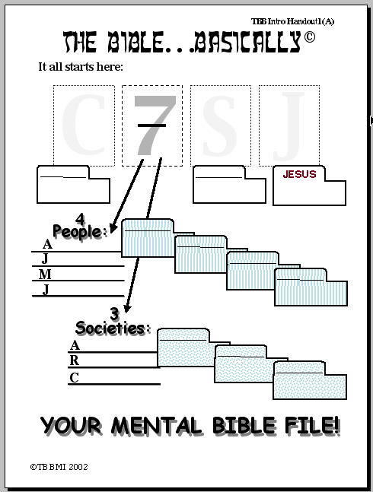
PATHEEN CHAWNGBUK…….KUNGTHOINA
Irikip put na:
K
7
A
J
KHUTKON
ATHIM
JISU
Miring mil:
{
ABRAHAM
A
BRAHAM
JOSEPH
J
OSEPH
MOSES
OSES
M
JOSHUA
OSHUA
J
{
Rolop na thum :
RUCHUK SANNA #01
D
DAN AWMNBOI
AN AWMBOI
R
RENG KHOLO
ENG KHOLO
S
SHURKHOP
HURKHOP
MINING PATHEEN CHAWNG THAWP!
©2006 TBBMI
9.65.01.
20
71
Notes:
Now look at Study Help Number One in the student handbook. That sheet will help you to embed in your thinking how to keep these tools on the front of your mind…while also learning how to teach others.
//// Beginning with a large C…
//// for CREATION then…
//// the Number 7…the dashed line is already there…7 standing for the four people and then the three societies. So…first…the FOUR
PEOPLE…
//// who are ABRAHAM…
//// then added to his File Folder…
//// JOSEPH…
//// onto the JOSEPH folder
//// MOSES…
//// his Folder…and finally…
//// JOSHUA…
//// finishing out the FOUR GREAT PEOPLE and their file Folders in the Bible File. Then on to the THREE SOCIETIES…
//// beginning with ANARCHY…
//// and its folder…
//// ROYALTY…
//// and the folder…
//// finishing with CAPTIVITY…
//// and its folder.
Now we'll finish it out…
//// S for
//// SILENCE…and
//// the culmination of all our thinking…J for JESUS.

Slide 72
PATHEEN CHAWNGBUK…KUNGTHOINA
Now…try your hand at opening your mental Bible File,
either by yourself or by drilling or quizzing someone else.
The key to opening your Bible file is:
K 7 A J
Mejek “K" hi na:
KHUTKON
7 = 4+3 sik-sik a:
MIRING MILI & ROLOPNA THUM
MIRING MILI hai kha:
ABRAHAM JOSEPH MOSES
JOSHUA
RUCHUK SANNA #02
ROLOP NA THUM hai kha:
DAN AWMBOI RENGKHOLO SHURKHOP
KHUTKON
ABRAHAM
Mejek “A" na:
ATHIM
JESUS
JOSEPH
Mejek "J" na:
JISU
...
MOSES
Kha jarkhan chawng som kha, tawp som:
JOSHUA
DAN AWM BOI
RENGKHOLO
SHURKHUP
Nang lungsing Patheen chongbuk thawp
ATHIM
JISU
9
©2006 TBBMI
9.65.01.
72
Notes:
And here is STUDY HELP NUMBER 2….this is the one you can use for your own review-- or to hold in your hand while you teach THE BIBLE FILE idea to others.
//// First the key to open the file:
//// C 7 S J…
//// The letter C stands for CREATION.
//// 7 equals 4 plus 3…for the four people and the three societies.
//// FOUR PEOPLE…ABRAHAM, JOSEPH, MOSES, JOSHUA.
//// THREE SOCIETIES…ANARCHY, ROYALTY, CAPTIVITY.
//// The letter S standing for SILENCE
//// The letter J representing JESUS.
//// FINALLY the TEN WORDS. And there are your ten file folders in your new Bible File. Repeat them one last time:
CREATION, ABRAHAM, JOSEPH, MOSES, JOSHUA, ANARCHY, ROYALTY, CAPTIVITY, SILENCE, and JESUS.

Slide 73
7
73
Notes:
And it all begins right here...the number 7 with that now familiar dash through its stem. Now you know the value of that simple mental tool. It is truly A GATEWAY IDEA!

Slide 74
K
Patheen chawng…Kungthoina
®
7
Mawlawng narang chabi
“Patheen chawng thawp"
A
J
74
Notes:
Now it's time to move forward toward expanding this "key to opening up Your Bible File" -- for what we will call THE QUICK CHRONOLOGY. Through the next hours of THE BIBLE… BASICALLY training, here is what you'll learn…

Slide 75
Tuntu atui kha nang jet joi… nang senarang lam kha hinijoi…
•Lungvar tawk “Patheen chawngbuk tawp"
•Lungsing le mawlawng ranga "Bible Thawp"…K 7 C J
•Lungsing Lampui alen-alen ashok chon muk nathei.
•Bible rishim “shungrei”: “Relen na dawn a muk nathei"
•Abraham hawngthoina le rething chawng Jisu Khrista chonthaw ikhin na.
•” Rishim ah” Bible tawk nathei.
•Rawjawtna Lui le Rawjawtna Thar Chawngbuk khan Chawngpui
 
8
75
Notes:
//// We've introduced the THE BIBLE FILE idea and…
//// The mental key to open that file…Then…
//// You'll learn to make a mental map of the Ancient Near East…that's next.
//// Then the so-called STORY CORE of Scripture, titled THE QUICK CHRONOLOGY…That's the WHAT HAPPENED question to be answered.
//// Then we'll explore the ABRAHAMIC FOUNDATIONS of the Great Plan…the WHY of Scripture…
//// leading to an understanding of the Bible's basic architectural layout…
//// ending with a brief look at the Old and New Testament Books and their general themes or ideas behind them.
//// And through it all, it will become obvious– from start to finish – that SOMETHING IS HAPPENING HERE; GREAT EVENTS ARE TRANSPIRING. God was busy at work then and continues right up to this present moment!
Now it's time to move on into a very valuable experience!
you'll learn to make your own map of the Ancient Near East…AND RIGHT OUT OF YOUR OWN HEAD!

Slide 76
VERSION 9.65
Patheen Chawngbuk... Kungthoi na
A Presentation of The Bible…Basically Ministries International Inc.
Fort Worth, Texas
www.biblebasically.org
01
©2006 TBBMI
9.65.01.
9.65.01.
©2004 TBBMI
01
Notes:
Title slide (no narration)
Translators should translate either title on the right, delete the words "Choose either title below…" and delete the non-translated title, then drag that entire section over the main slide on the left so that no English appears on the slide.

Slide 77
77
©2006 TBBMI
9.65.01.

