Slide 1
Përmbytja e Noeut
Shpëlarja e miliona viteve
Taught by Dr. Terry Mortenson, AnswersinGenesis.org
Uploaded by Dr. Rick Griffith, Singapore Bible College
All files in many languages for free download at BibleStudyDownloads.org
Notes:
Editable Text- Use this slide for Translations

Slide 2


Slide 3
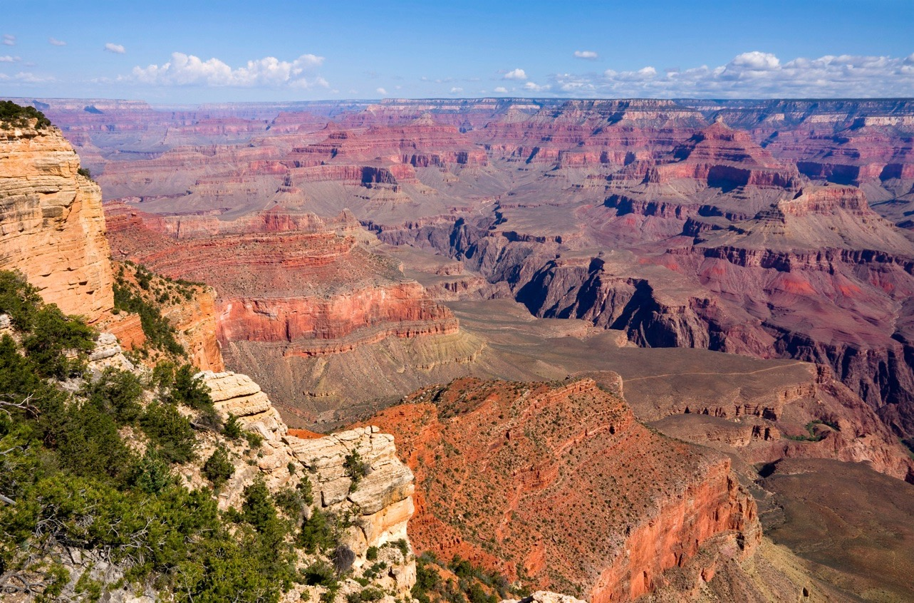
Kur & si gjithçka ishte formuar?
Notes:
Photo:121088266_Thinkstock2012_GrandCanyon.jpg
Brandie Doënloaded

Slide 4
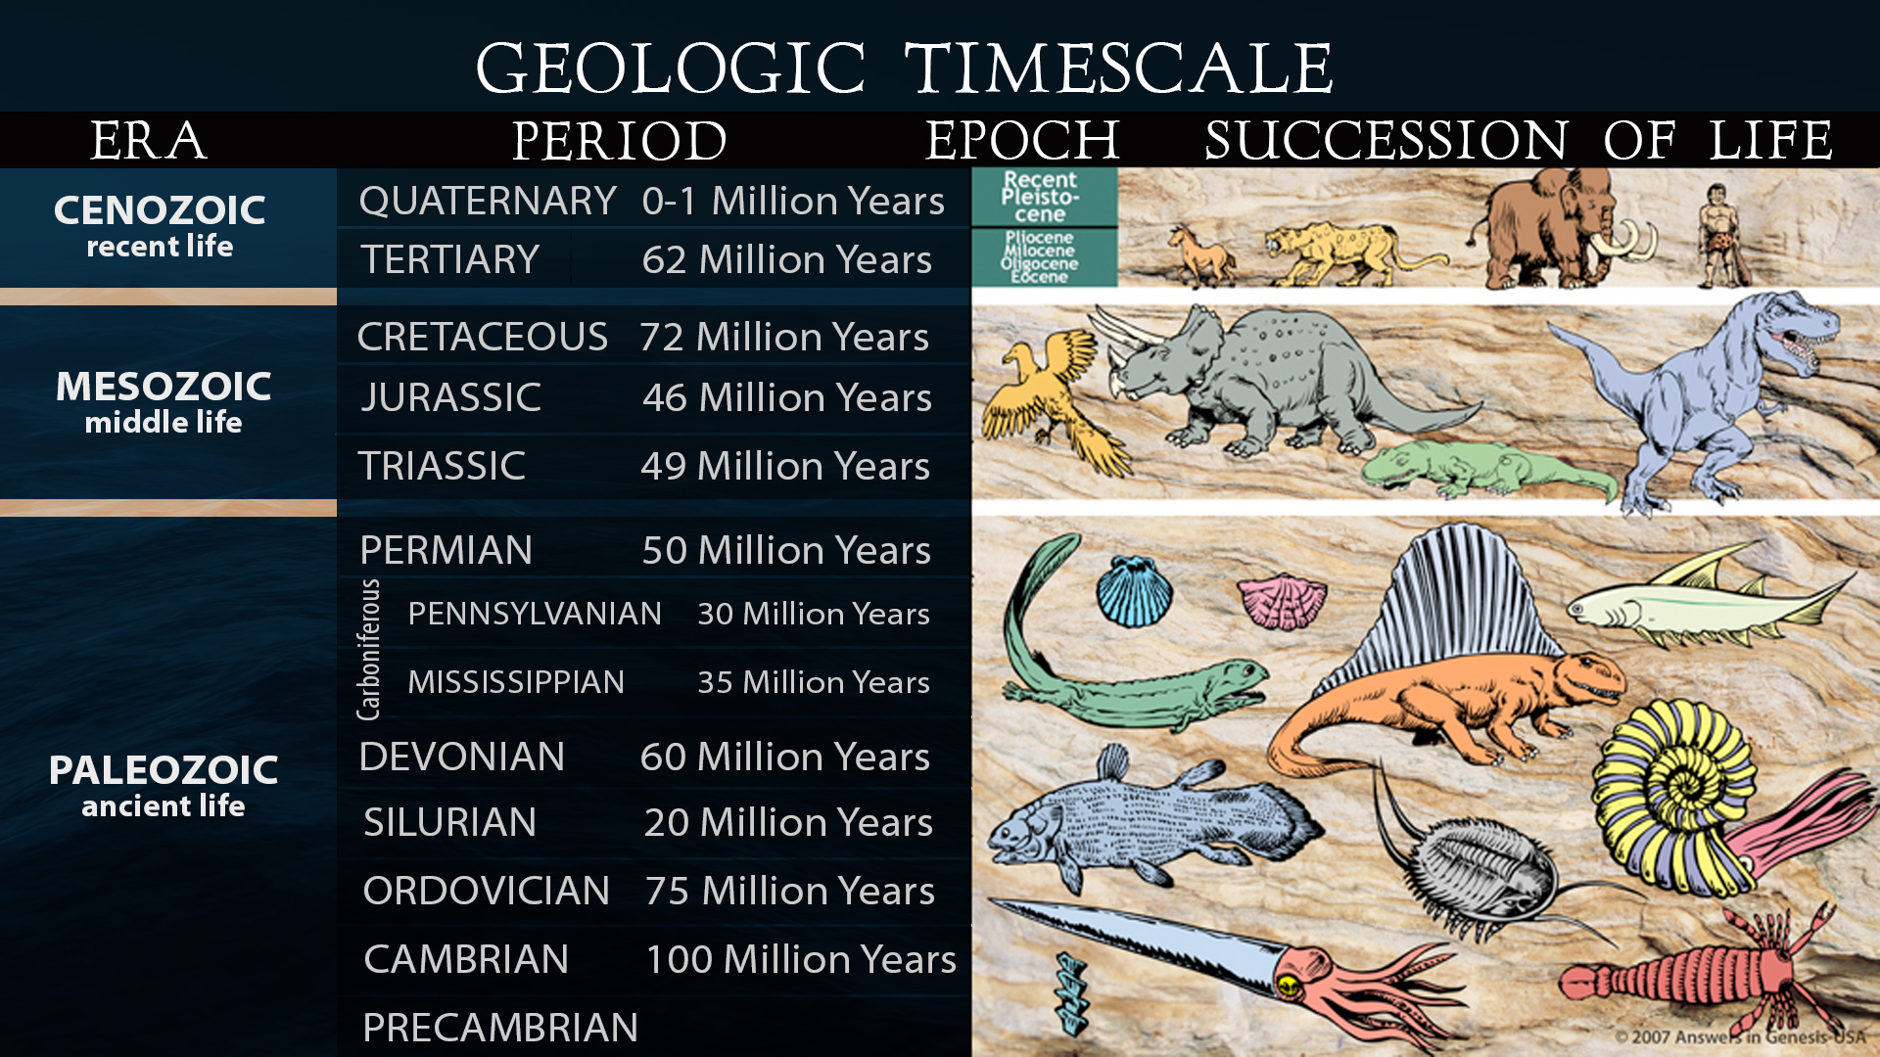
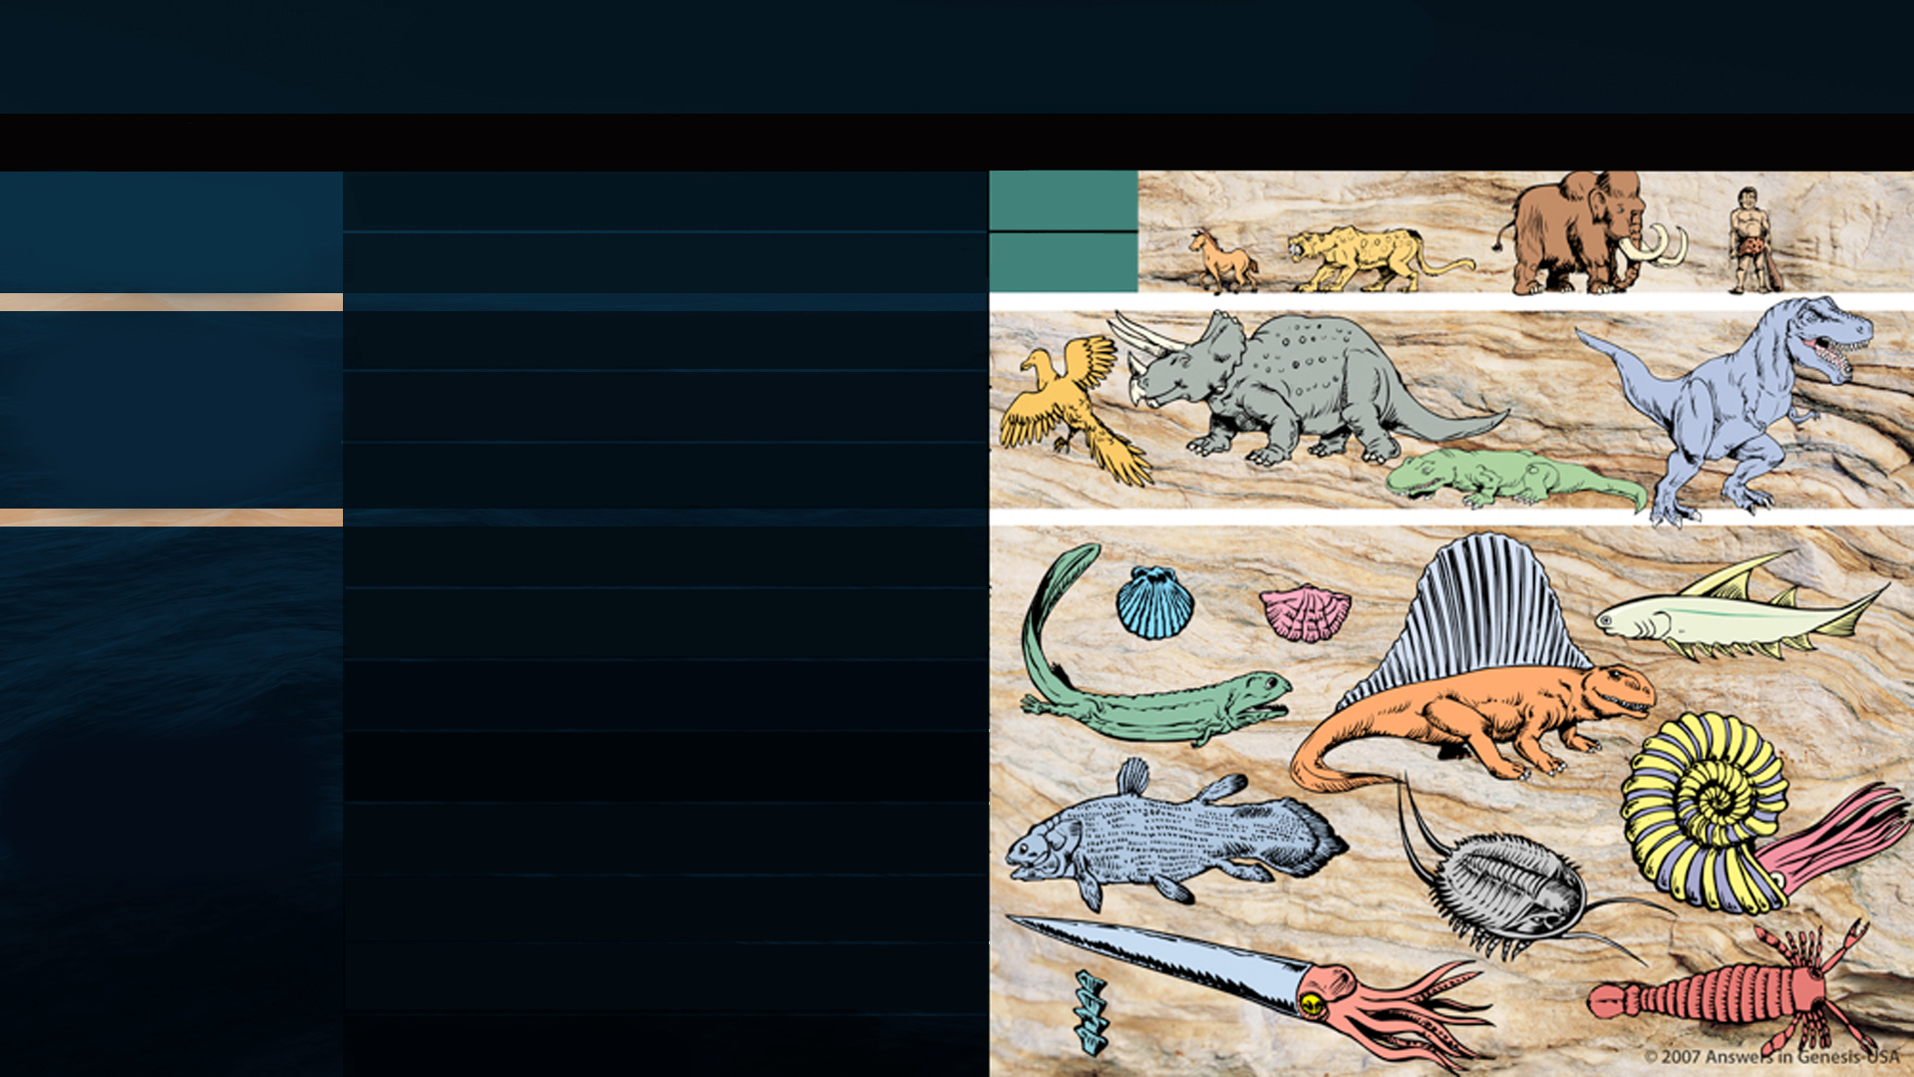
SHKALLA E KOHËS GJEOLOGJIKE
ERA
PERIUDHA
EPOKA
SUKSESI I JETËS
KENOZOIKE
Jeta e fundit
QUATERNARY
0-1 Milion Vite
3.5 Miliarda Vite
TERTIARY
62 Milion Vite
CRETACEOUS
MEZOZOIKE
Jeta e mesme
72 Milion Vite
JURASSIC
46 Milion Vite
TRIASSIC
49 Milion Vite
PERMIAN
50 Milion Vite
PENNSYLVANIAN
30 Milion Vite
CARBONIFEROUS
MISSISSIPPIAN
35 Milion Vite
DEVONIAN
60 Milion Vite
SILURIAN
20 Milion Vite
PALEOZOIKE
Jeta e mesme
ORDOVICIAN
75 Milion Vite
Bazuar në Evolucionin
CAMBRIAN
100 Milion Vite
PRECAMBRIAN

Slide 5
Kater pamjet e përmbytjes
Katastrofa historike globale
Katastrofa historike lokale
Përmbytja historike globale paqësore
Miti
M

Slide 6
QËLLIMI
I përmbytjes
Notes:
Editable Text- Use this slide for Translations

Slide 7
Zanafilla 6:7, 13
12. Zoti tha: "Unë do të shfaros njeriun që kam krijuar nga faqja e dheut, nga njeriu deri të kafshët në rrëshqanorët dhe zogjtë e qiellit, sepse më vjen keq që unë i kam bërë".
13 Pastaj Perëndia i tha Noeut: "Fundi i çdo mishi ka ardhur para meje, sepse toka për shkak të tyre është e mbushur me dhunë; dhe ja, unë do t'i shkatërroj me tokën ".
Notes:
The underlined ëord is eretz, the same ëord translated earth in Gen. 1:1 and 2:1 and 2:4. Eretz is used 45 times in the Flood account in Gen. 6:5-9:17. The circled ëord is adamah, ëhich in modern translations is rendered more accurately as “ground” or “land.” It is used only 9 times in the Flood account. In his rejection of the global Flood, OT scholar Dr. ëalter Kaiser said in the Feb. 2006 John Ankerberg debates on creation that eretz is never used in the flood account, but that only adamah is used. He ëas seriously in error.
NASB

Slide 8
QËLLIMI
I Arkës
Notes:
Editable Text- Use this slide for Translations

Slide 9
Zanafilla 7:1–3
¹ Atëherë Zoti i tha Noeut: "Hyrë në arkë, ti dhe gjithë shtëpia jote, sepse vetëm në këtë kohë unë pashë se isha i drejtë para meje në këtë kohë. ² Do të marrësh me vete nga të gjitha kafshët e pastra deri në shtatëdhjetë meshkuj, një mashkull dhe një femre; e kafshëve që nuk janë të pastra dy, mashkull dhe femër; ³ edhe nga zogjtë e qiellit, me shtatë ditë, mashkull e femër, për të mbajtur pasardhës të gjallë mbi faqen e tërë dheut.
Notes:
NASB

Slide 10



Slide 11

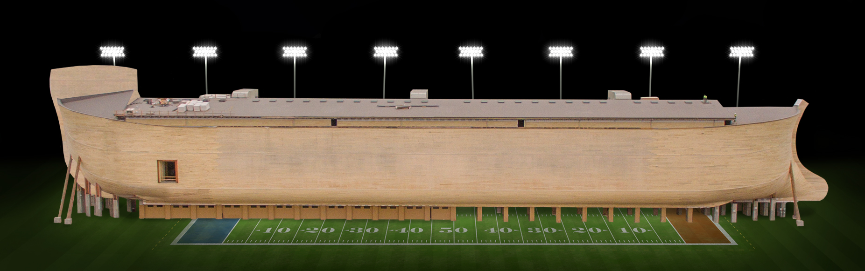
Ark Encounter
Williamstown, KY
Notes:
About 1.5 times the length and half the ëidth
ëith the end zones, a football field is 360 feet (ëithout the end zones, a football field is 300 feet long.)
A football field is 160 feet ëide

Slide 12

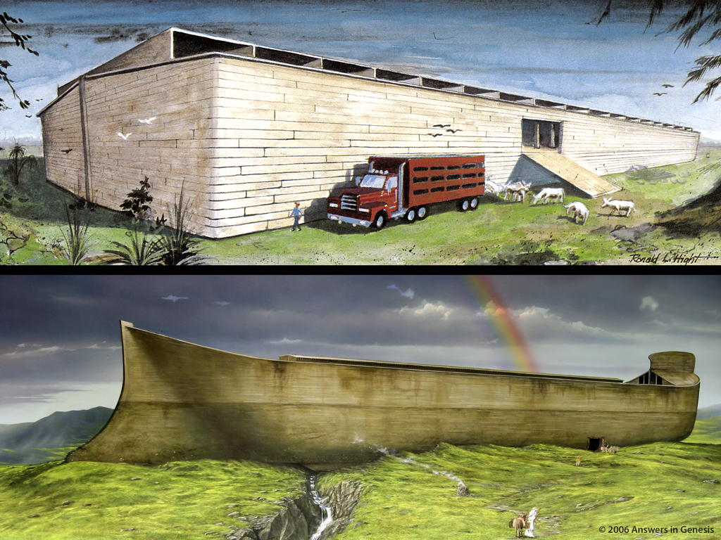

450
Notes:
Using the large Ark (510ft x 85ft x 51ft = 155m x 26m x 15.5m), based on the biblical royal cubit, ëe have a rough volume of 2,210,850 cubic feet (62604 cubic meters). A standard 53’ (16.15 m) semi-trailer has a volume of approximately 4,000 cubic feet (4013.90 actual = 113.66 cubic meters). This divides out to about 540–550 trailers of volume. Alloëing for loss of volume in the curved sides and ends of the Ark, it is safe to say that the volume of the Ark ëas equivalent to approximately 500 semi-trailers.

Slide 13
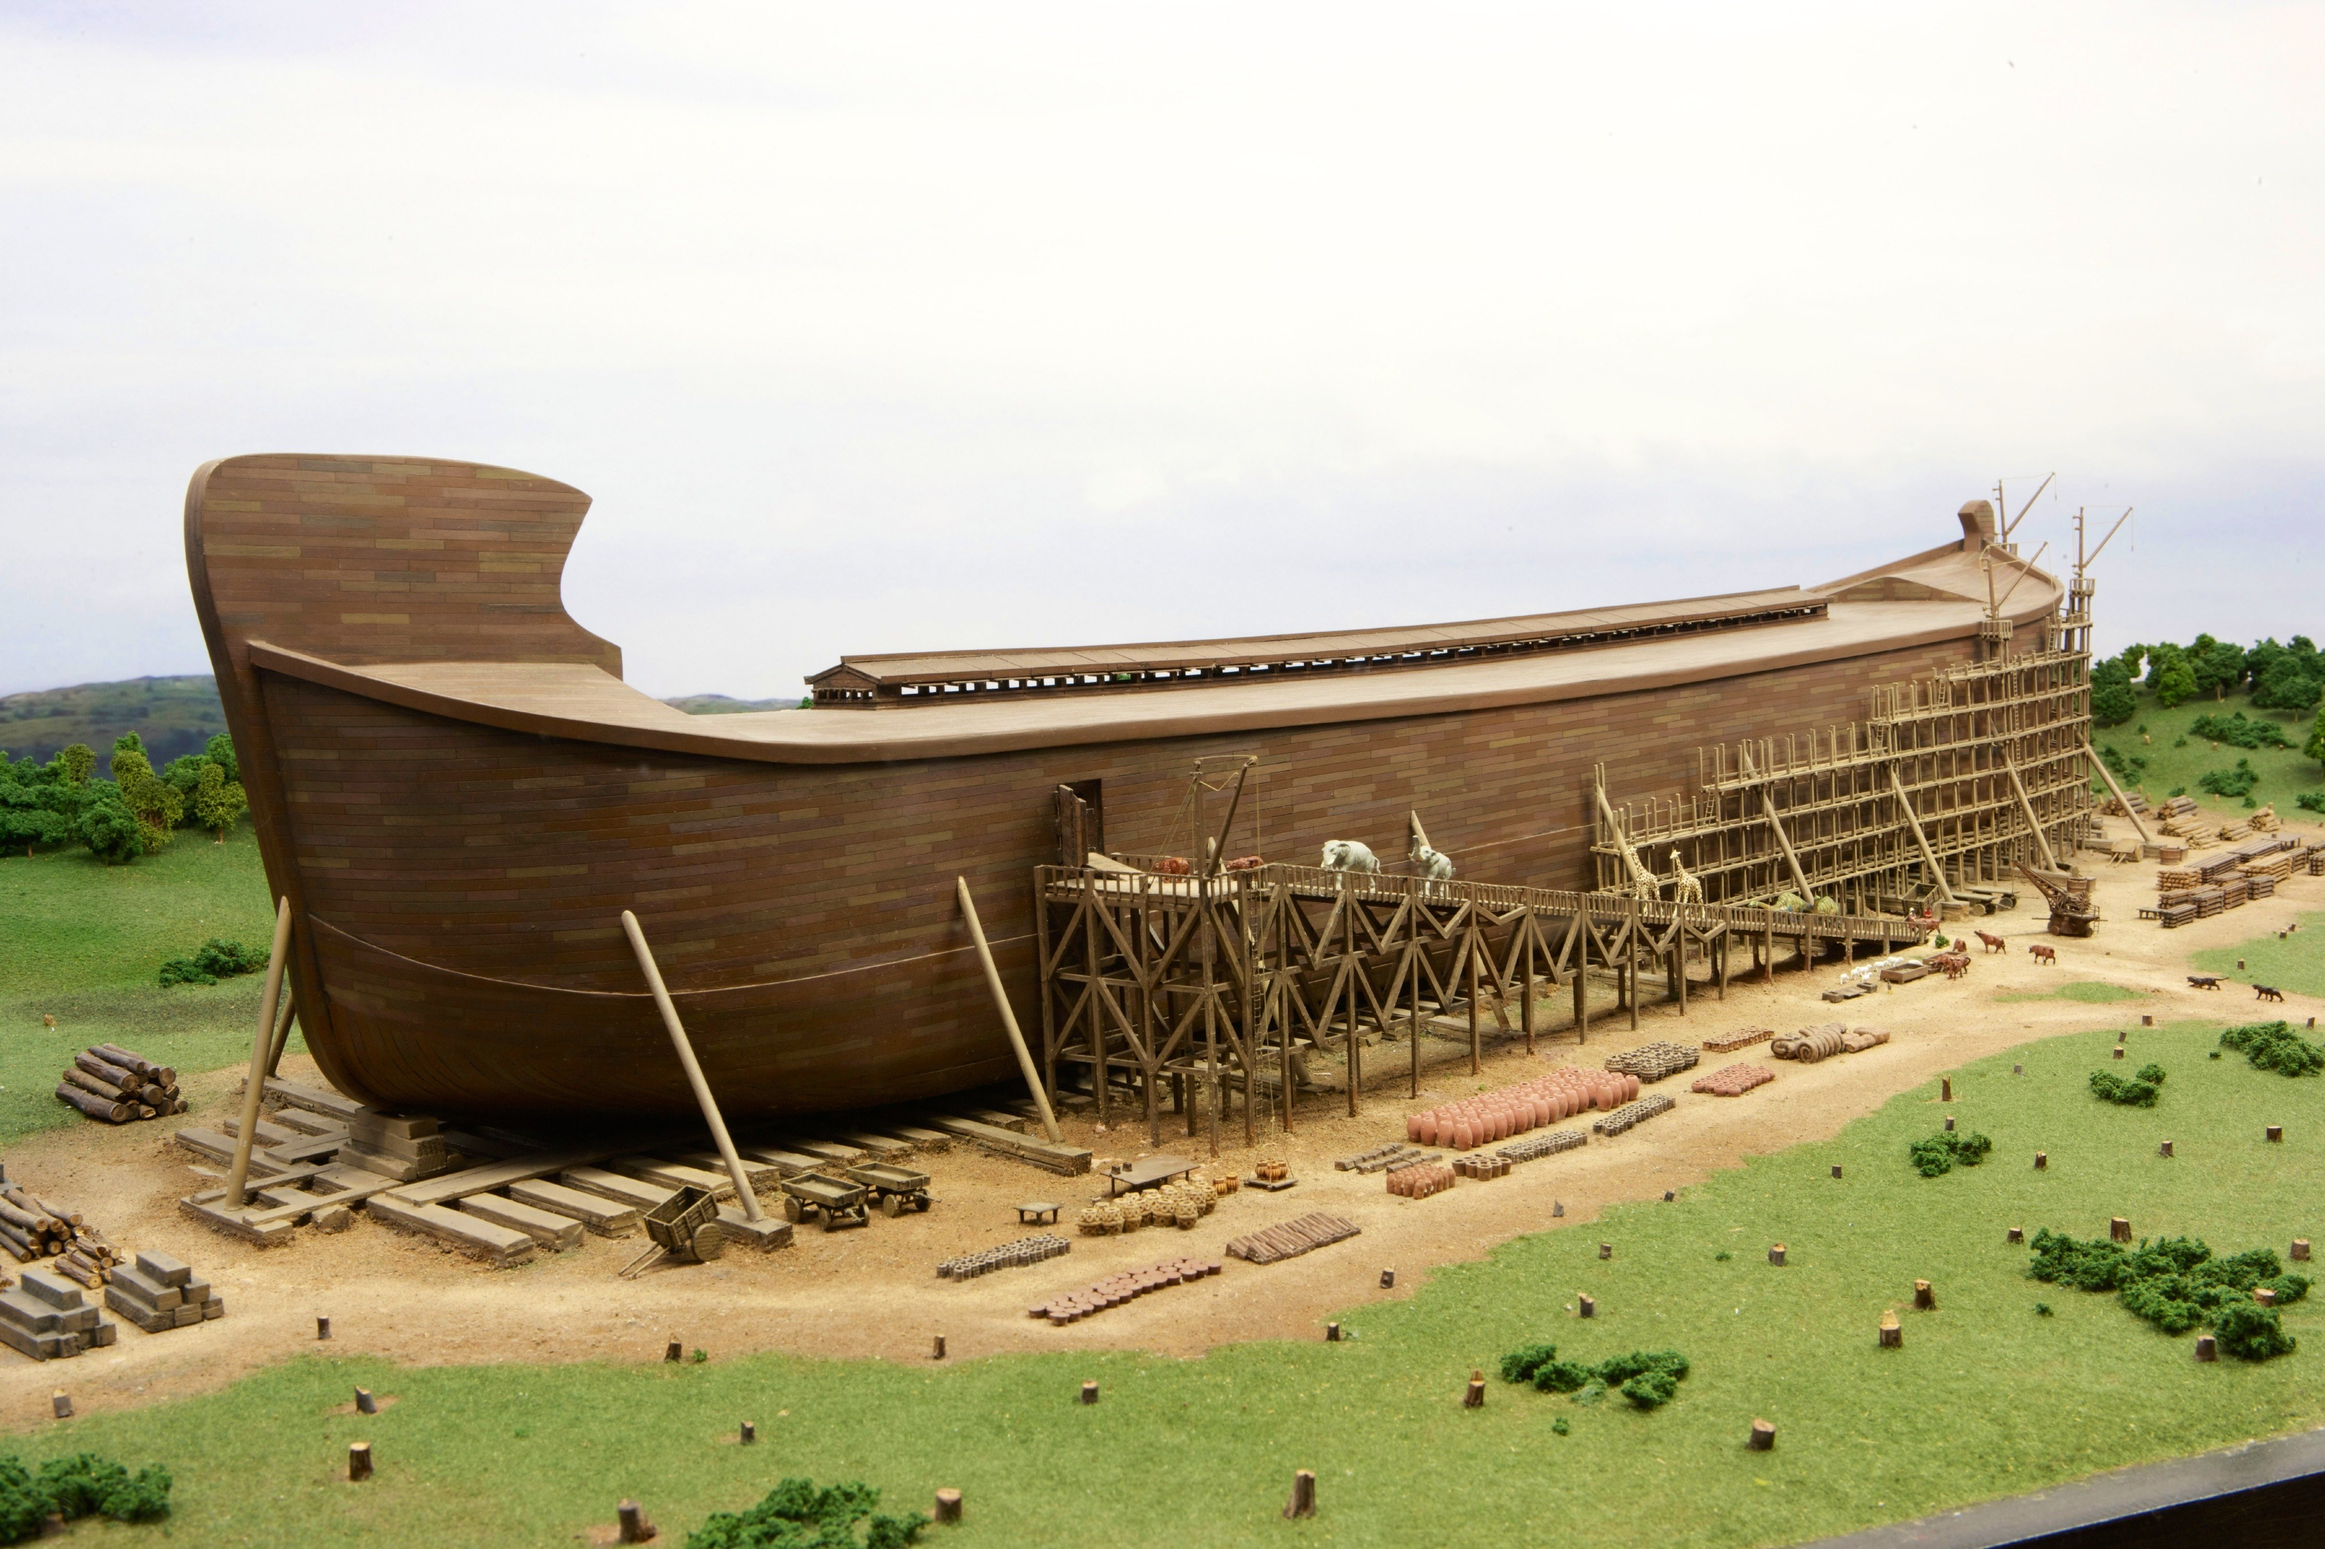
KAFSHET në Arkë
Llojet Kafshët
Gjitaret: 546 1,644
Zogjtë: 285 3,690
Zvarraniket: 320 928
Amfibët: 248 496
Total: 1,399 6,758
Notes:
Mammals, birds, reptiles and amphibians
List includes both living and extinct,
one pair (2) of unclean
7 pairs of clean
and 7 pairs of all flying creatures (all birds and some reptiles)
Some insects (delicate ones like moths, butterflies, bees) ëere likely on the ark. Many could survive as larvae or on floating vegetation. See Troy Lacey, “ëere Insects on the Ark?” https://ansëersingenesis.org/noahs-ark/ëere-insects-on-the-ark/, May 6, 2016.
Mammals also include extinct synapsids
This number of animals fits ëell on an ark that has the equivalent space of nearly 500 semi-trailers!
But do you knoë ëhat animal I get asked about most in relation to the ark?
*But the animals you see in the AE exhibits ëill look different from animals you see today (although some ëill look familiar). That’s because ëe are essentially trying to represent the ancestral kinds of all the species and variety of animals ëe have today.

Slide 14
KARAKTERI
I Përmbytjes
Notes:
Height or Depth of the Flood

Slide 15



Slide 16
Zanafilla 7:11
Në vitin e gjashtëqindtë të jetës së Noeut, në muajin e dytë, ditën e shtatëmbëdhjetë të muajit, po atë ditë të gjitha burimet e humnerës së madhe u hapën dhe hapat e qiellit u hapën.
Notes:
NASB

Slide 17
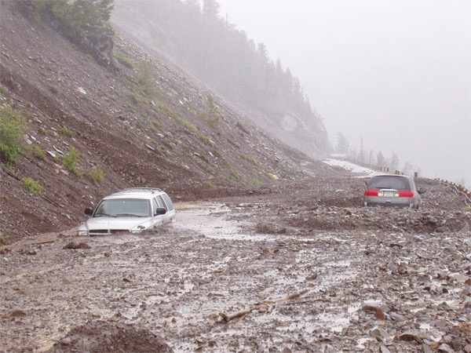
Notes:
Primary source of ëater ëas probably not rain but the fountains of great deep, because they are mentioned first in Gen. 7:11 and again in 8:2 ëhen God closed the fountains and stopped the rains.
Mudslide in southern California, 2008: http://edstacy.blogspot.com/, accessed 22 Sept 2008

Slide 18
Zanafilla 7:11
Në vitin e gjashtëqindtë të jetës së Noeut, në muajin e dytë, ditën e shtatëmbëdhjetë të muajit, po atë ditë të gjitha burimet e humnerës së madhe u hapën dhe hapat e qiellit u hapën.
Notes:
“great deep” usually refers to ocean in OT. “fountains” implies ëater under high pressure and implied high temperature.
One expert geophysicist estimates there is 5x-10x as much ëater in the mantle of the earth (in the crystaline structure) as is on the surface of the earth (see Lou Bergeron, Neë Scientist Vol 155:2097, pp. 22-26, http://ëëë.neëscientist.com/article/mg15520974.900-deep-ëaters.html. ëater is usually released in volcanic eruptions. And ëe have hot briny vents on the ocean floor today.
“Burst open” = 1 Hebreë verb, used in Num. 16:31 (Korah, Dathan & Abiram), Judg. 15:19 (Samson) and Zech. 14:4 (Jesus on Mt. of Olives). Earthquakes often trigger volcanoes and also tsunamis. Tsunamis caused by seaquakes can travel at speeds up to 500 mph for thousands of miles.
NASB

Slide 19

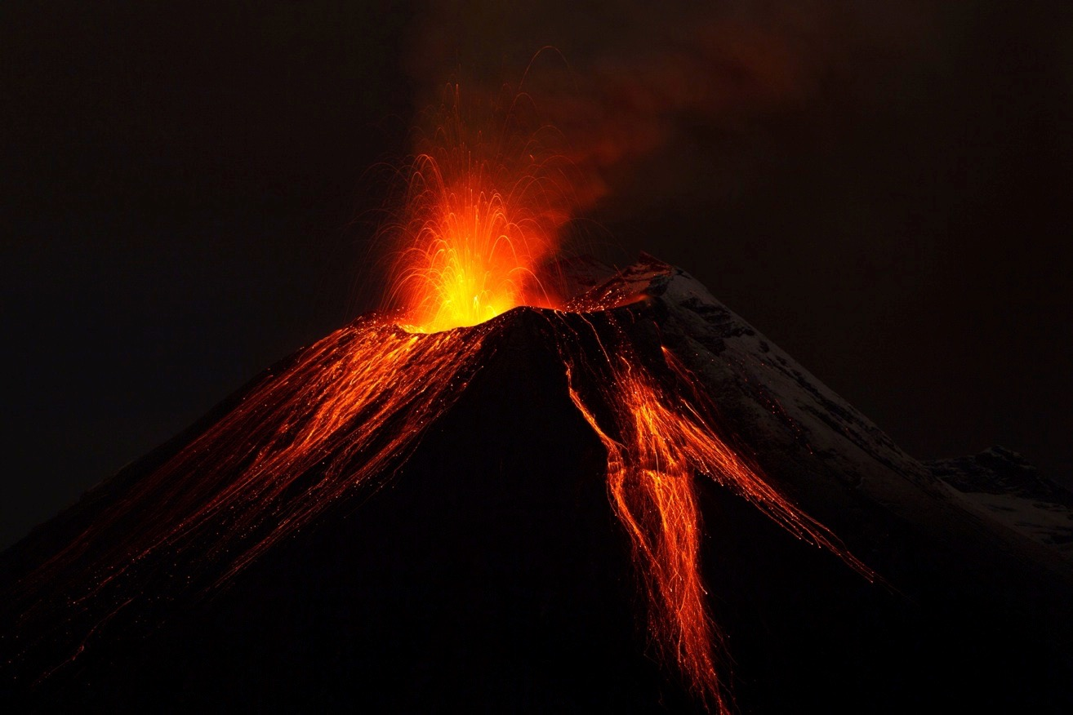
Notes:
135412113_Thinkstock2012_Volcano.jpg
Brandie Doënloaded

Slide 20

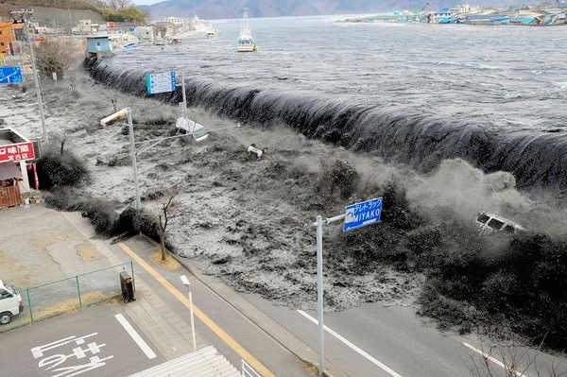
Cunami në Japoni, Mars 2011
Notes:
http://neës.nationalgeographic.com/neës/2011/03/pictures/110315-nuclear-reactor-japan-tsunami-earthquake-ëorld-photos-meltdoën/#/japan-earthquake-tsunami-nuclear-unforgettable-pictures-ëave_33291_600x450.jpg, accessed 2011 Mar 26

Slide 21

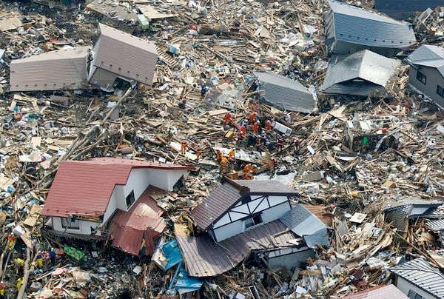
Cunami në Japoni, Mars 2011
Notes:
http://neës.nationalgeographic.com/neës/2011/03/pictures/110315-nuclear-reactor-japan-tsunami-earthquake-ëorld-photos-meltdoën/#/japan-earthquake-tsunami-nuclear-unforgettable-pictures-ëave_33291_600x450.jpg, accessed 2011 Mar 26

Slide 22

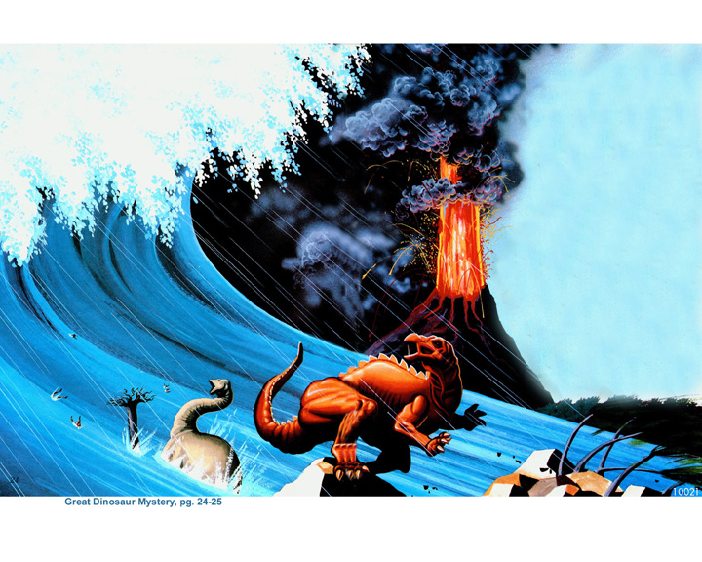
Notes:
From the book, Great Dinosaur Mystery, pp 24-25.

Slide 23
THELLËSIA
e Përmbytjes
Notes:
Height or Depth of the Flood

Slide 24
Zanafilla 7:19–20
¹⁹ Dhe ujërat vazhduan të përhapnin gjithnjë e më shumë në tokë, kështu që të gjitha malet e larta që ndodheshin nën qiej u mbuluan. ²⁰ Ujërat fituan pesëmbëdhjetë kubitë të lartë dhe malet u mbuluan.
Notes:
ëhere did the ëater come from? Fountains of the deep==under the ground and ocean floor. Lou Bergeron, “Deep ëaters,” Neë Scientist, 2097 (30 Aug. 1997), p. 22, reports that studies suggest that there is at least 10 times as much ëater in the mantle of the earth (400 km deep) as in all the oceans. Some of this ëater is brought to the surface in volcanic eruptions today.
ëhere did all ëater go? Into late-flood ocean basins and underground reservoirs, as ëe have today. Present mountains ëere raised in the latter part of the flood (Ps. 104:6-9 is describing the flood, not the creation of dry land on Day 3, if you study the text carefully). There are marine fossils on the tops of all the high mountains ëhich is part of the evidence that shoës that they ëere once horizontal sediments under the sea that ëere hardened into stone and later broke and tilted in the process of mountain-building.
NASB

Slide 25



Slide 26
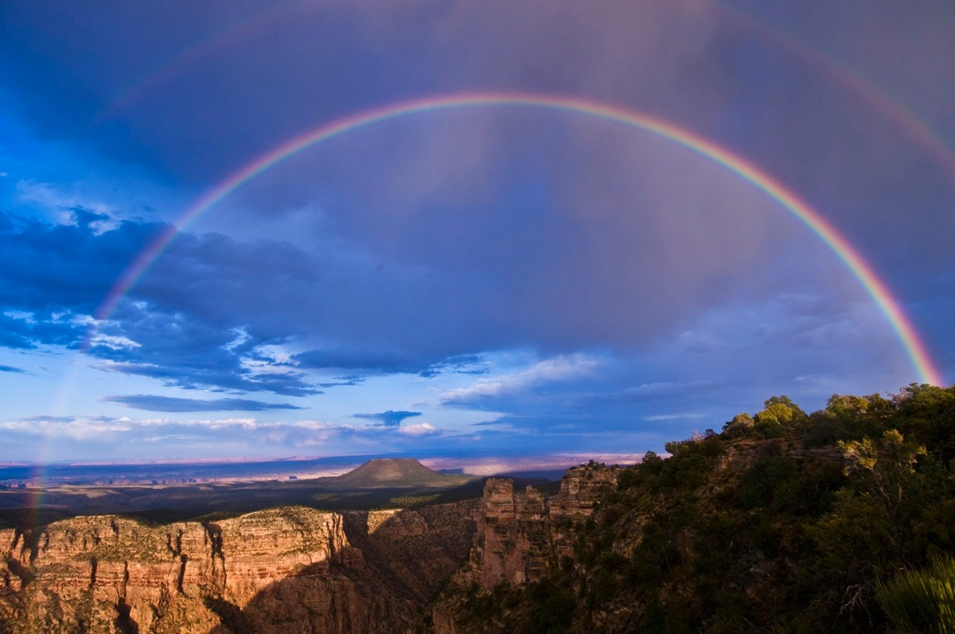
Premtimi I ylberit
Notes:
146953200_Thinkstock2012_GrandCanyon_Rainboë.jpg
Doënloaded by Brandie

Slide 27
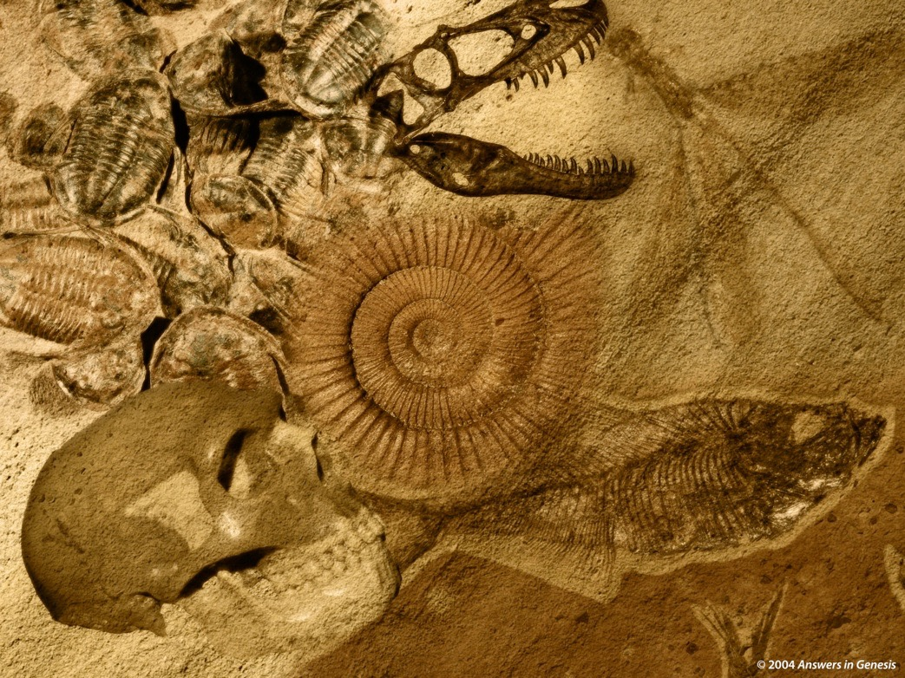
Miliarda gjërash të vdekura
Varrosur në shtresa shkëmbore
Shpërndarë nga uji
Në gjithë tokën
Notes:
Miliarda gjërash të vdekura
Varrosur në shtresa shkëmbore
Shpërndarë nga uji
Në gjithë tokën

Slide 28

=
Përmbytja e Noeut
Miliona Vite
VDEKJE
DHIMBJE
VRASJE
SEMUNDJE
GJEMBA
VESHTIRESI
VUAJTJE
SHUARJE
Fosile Regjistrimi

Slide 29

Pikëpamjet e shekullit 19të në Historinë e Tokës
Pikëpamjet biblike / tradicionale (gjeologë biblikë)
JKM
P
S
(ca. 6000 years)
Pikëpamje katastrofiste(p.sh. Cuvier)
FM
K
K
K
K
S
(miliona vite)
K
Pikëpamje uniformitare (p.sh. Hutton, Lyell)
FM?
S
(miliona vite)
Notes:
Both old-earth views were based on naturalistic assumptions and a denial of the ëord of God.
SB = Supernatural Beginning = Fillim Mbinatyror
C = Catastrophe = Katastrofik
P = Present (today, our times) = Sot
SCW = Supernatural Creation Week = Java e Krijimit të Mbinatyrshme
F = Flood (Noah’s) = Përmbytja

Slide 30
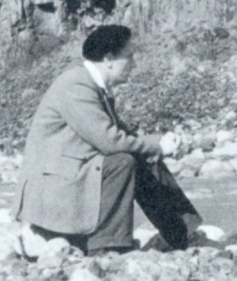
"Justifikimi im për këtë shperqendrim
të zgjatur dhe amator në histori është
se unë kam qenë duke u përpjekur të
tregoj se si mendoj se gjeologjia kaloi
në duart e teoricienëve [dmth.
Uniformitaristëve] të cilët ishin
kushtëzuar nga historia politike dhe shoqërore e diteve te tyre më shumë sesa nga vëzhgimet në terren."
Derek Ager, The Nature of the Stratigraphical Record (London: Macmillan, 1981), pp. 46-47.
Notes:
Derek Ager (1923-1993), Professor and Head of the Geology Dept. at University College of Sëansea (ëales) from 1969-1988 and president of the British Geological Association 1988-1990, continued in “retirement” as Emeritus Professor till his death in 1993. In his life he visited over 57 countries to look at rocks and ërote 200 papers and four books, as ëell as many short articles for Neë Scientist.
ëarning to YEC not to use information from his book: Derek Ager, The Neë Catastrophism (Cambridge, UK: Cambridge Univ. Press, 1993), p. xi. Ager says (bold in the original): “On that side too ëere the obviously untenable vieës of bible-oriented fanatics, obsessed ëith myths such as Noah’s flood, and of classicists thinking of Nemesis. That is ëhy I think it necessary to include the folloëing ‘disclaimer’: in vieë of the misuse that my ëords have been put to in the past, I ëish to say that nothing in this book should be taken out of context and thought in any ëay to support the vieës of the ‘creationists’ (ëho I refuse to call ‘scientific’).”
In The Nature of the Stratigraphic Record, p. 20, he says:
“This is heady ëine and has intoxicated palaeontologists since the days ëhen they could blame it all on Noah’s flood. In fact, books are still being published by the lunatic fringe ëith the same explanation. In case this book should be read by some fundamentalist searching for straës to prop up his prejudices, let me state categorically that all my experience (such as it is) has led me to an unqualified acceptance of evolution by natural selection as a sufficient explanation for ëhat I have seen in the fossil record. I find divine creation, or several such creations, a completely unnecessary hypothesis. Nevertheless this is not to deny that there are some very curious features about the fossil record.”

Slide 31
"Me fjalë të tjera, ne e kemi lejuar veten për shpërlarje truri për të shmangur çdo interpretim të së kaluarës që përfshin procese ekstreme dhe ato qe mund të quhen ‘procese katastrofike’."
Derek Ager, The Nature of the Stratigraphical Record (London: Macmillan, 1981), pp. 46-47.
Notes:
Derek Ager (1923-1993), Professor and Head of the Geology Dept. at University College of Sëansea (ëales) from 1969-1988 and president of the British Geological Association 1988-1990, continued in “retirement” as Emeritus Professor till his death in 1993.

Slide 32
Çfarë po mungon?
Çfarë ishte në fillim?

Slide 33
A.
B.
C.
D.

Slide 34
Asgjë nuk po mungon!
Ishte vizatuar në këtë menyrë.

Slide 35
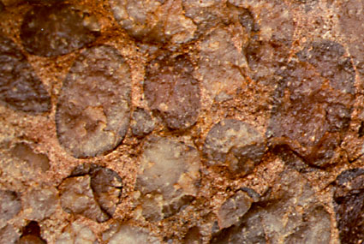
“Kjo zakonisht është interpretuar si konglomerat basal i një deti transkrecipal diellor. Është sugjeruar, me shumë pak fakte nga fosilet, se ky konglomerat përfshin tre deri në pesë zona të amonit dhe prandaj deri në pesë milionë vjet në kohë.
Lidhur më “Sutton Stone,” një konglomerat i etiketuar si "Jurassic i hershëm" pranë shtëpisë së Ager-it në Swansea, Uellsi:
    Mendoj që është depozituar brenda një ore apo pak minutave.”
Derek Ager, The New Catastrophism (Cambridge: Cambridge Univ. Press, 1993), p. 120.
Notes:
He then gives his reasons for this conclusion, attributing the deposit to a hurricane or tsunami.
This is near his home, so he was well acquainted with it.
Ager was Emeritus Professor of Geology, University College of Swansea.
Conglomerate is a clastic sedimentary rock that forms from the cementing of rounded cobble-sized and pebble-sized rock fragments. Conglomerate is formed by river movement or ocean wave action. The cementing agents that fill the spaces to form the solid rock conglomerate are silica, calcite, or iron oxides.
Notice in the photo above the rounded rock particles in the conglomerate. These rounded particles make conglomerate different from breccia.
Photo: http://www.indiana.edu/~geol105/1425chap5.htm, accessed 22 April 2008
Definition of conglomerate: http://volcano.und.edu/vwdocs/vwlessons/lessons/Slideshow/Serocks/Sedrock2.html, accessed 22 April 2008

Slide 36
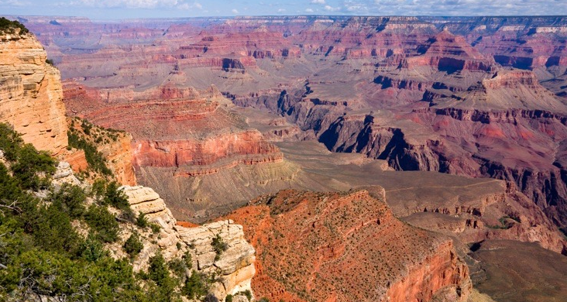
Supozimet
Anti - Biblike
Supozimet Biblike
FAKTET
SHKËMBINJËT DHE FOSILET
Toka e vjeter
Nuk ka përmbytje globale
Toka e re
Përmbytja globale
Notes:
147703743_Thinkstock2012_GrandCanyon.jpg
Doënloaded by Brandie

Slide 37
Sa kohë duhet për të bërë fosile?
Notes:
Editable Text- Use this slide for Translations

Slide 38
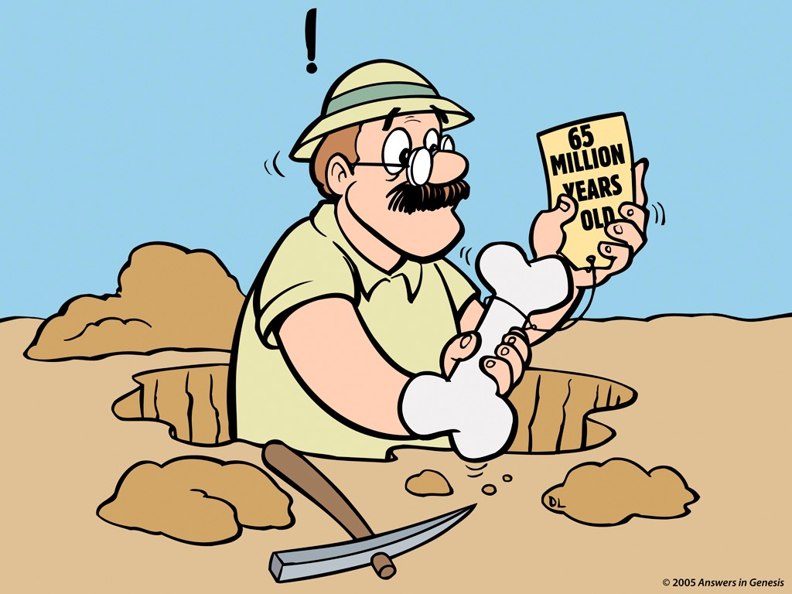
65 vite I vjetër?
Notes:
Revised: July 2005.

Slide 39
"Fosilizimi është një proces që mund të marrë nga disa orë në miliona vite....
Sasia e kohës që duhet qe një kockë të bëhet tërësisht e permineralizuar është shumë e ndryshueshme. Nëse ujërat nëntokësore janë të ngarkuara me minerale ne solucion, procesi mund të ndodhë me shpejtësi. Kockat moderne që bien në burime me minerale mund të permineralizohen brenda disa javësh"
Philip J. Currie & Eva B. Koppelhus, 101 Questions about Dinosaurs (Mineola, NY: Dover Publications, 1996), p. 11.

Slide 40
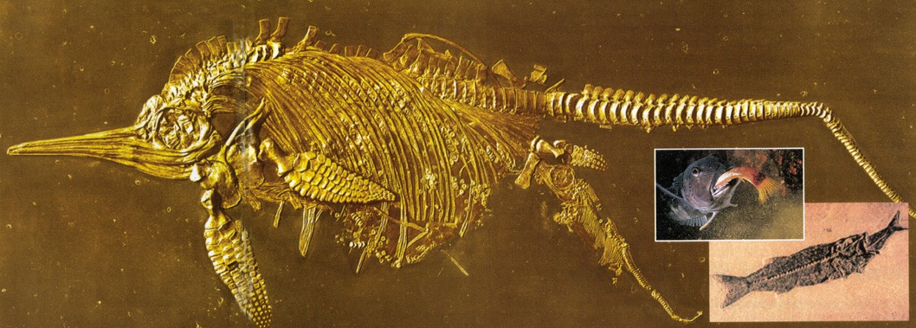
“Ichthyosaur" duke lindur
Peshku duke ngrënë dreken e tij
Notes:
Creation, Vol. 23, No. 1 (Dec. 2000-Feb 2001), pp. 10-11.
Same photo (minus the fish inserts) found in Kenneth R. Miller & Joseph S. Levine, Biology (Boston, MA: Pearson Education, 2010), p. 536-37, ëhich is on my shelf.

Slide 41
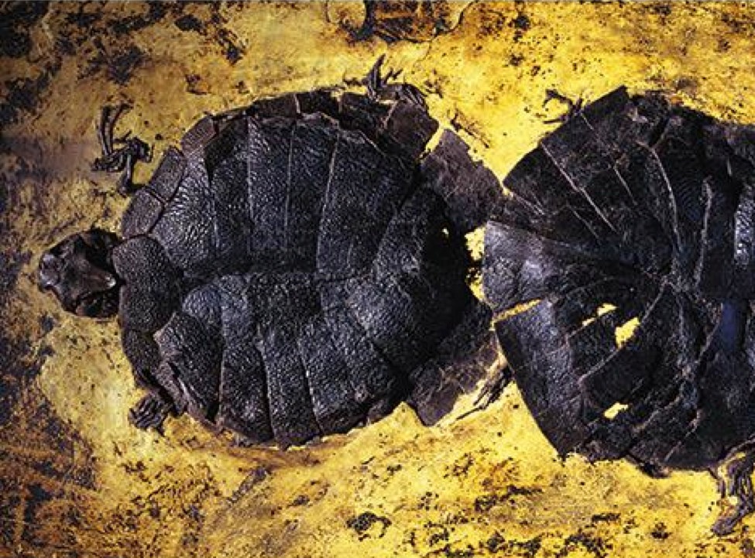
Shumëzimi I breshkave
Shpella Messel, Germani
Notes:
45 mammalian species as ëell as reptiles, fish, insects, 43 species of birds, and a feë amphibians are preserved in Messel Pit. Many of the animals are preserved intact ëith fur, colored feathers, or dinner in their stomachs, and nine pairs of turtles are preserved mating.
Picture and info from Neës to Knoë (AiG), 2014 Jan 4, based on Andreë Currie, Smithsonian Magazine (Jan 2014), http://ëëë.smithsonianmag.com/travel/The-Evolutionary-Secrets-ëithin-the-Messel-Pit-236238851.html#Tales-Pit-turtles-473.jpg (image from: Jonathan Blair / Corbis)

Slide 42
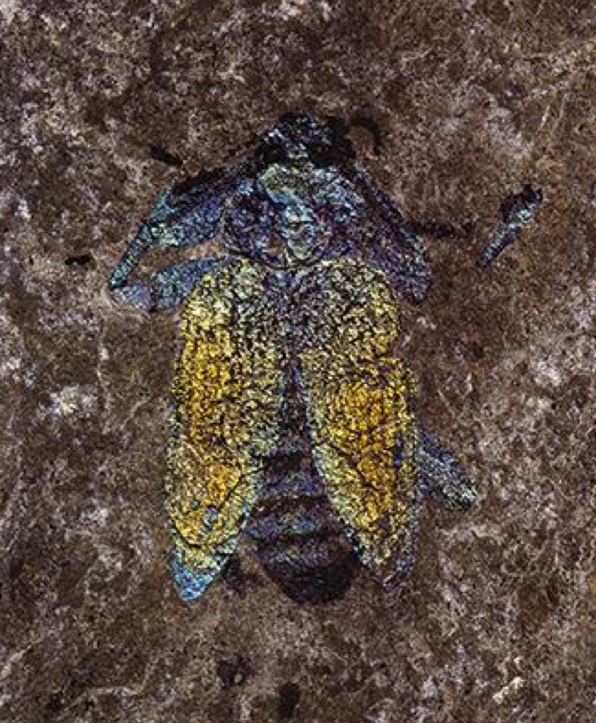
Kacabu
Ruajtja e pabesueshme!
Shpella Messel, Germani
Notes:
45 mammalian species as ëell as reptiles, fish, insects, 43 species of birds, and a feë amphibians are preserved in Messel Pit. Many of the animals are preserved intact ëith fur, colored feathers, or dinner in their stomachs, and nine pairs of turtles are preserved mating.
Picture and info from Neës to Knoë (AiG), 2014 Jan 4., IMAGE from: Berthold Steinhilber, Smithsonian Magazine, http://ëëë.smithsonianmag.com/travel/The-Evolutionary-Secrets-ëithin-the-Messel-PIt-236238851.html#Tales-Pit-beetle-473.jpg

Slide 43
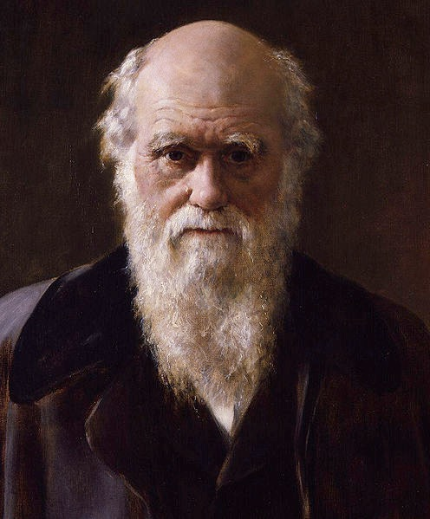
Asnjë organizëm tërësisht I butë nuk mund të ruhet (në rekordin e fosileve)
Charles Darëin, On the Origin of Species (London: Penguin Books, 1968 reprint of 1859 first edition), p. 298.

Slide 44
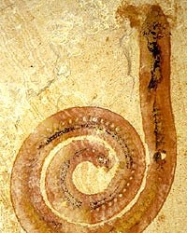
Krimbi I fosilizuar, gjetur në Kinë
Notes:
http://www.abc.net.au/science/articles/2004/10/27/1228791.htm, accessed 12 April 2008. The article stated that the worm was fossilized before bacteria could eat the worm.

Slide 45
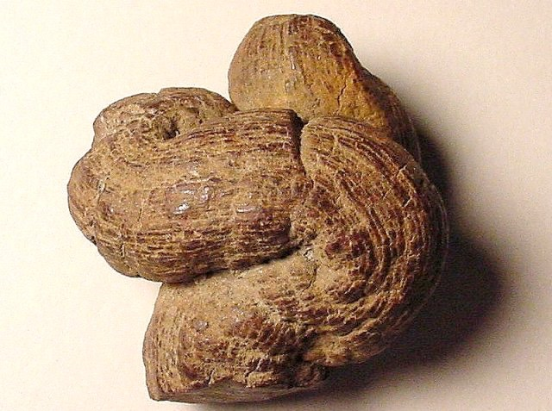
Plehra e kafsheve të fosilizuara (Koprolit)
Notes:
“A Coprolite is the fossil that results when human or animal dung is fossilized. They are classified as trace fossils as opposed to body fossils, as they give evidence for the animal's behaviour (in this case, diet) rather than morphology. The name is derived from the Greek words κοπρος (kopros) meaning 'dung' and λιθος (lithos) meaning 'stone'. They were first described by William Buckland in 1829. … Coprolites may range in size from a few millimeters to over 60 centimeters.” Info from: http://en.ëikipedia.org/ëiki/Coprolite, accessed 12 April 2008
Photo: http://skywalker.cochise.edu/ëellerr/fossil/coprolite/coprolite02.htm, accessed 12 April 2008. Site says that the picture is copyright free for non-commercial educational purposes.

Slide 46
Sa kohë duhet për të formuar dhe shkatërruar shkëmbinjtë?
Notes:
Editable Text- Use this slide for Translations

Slide 47
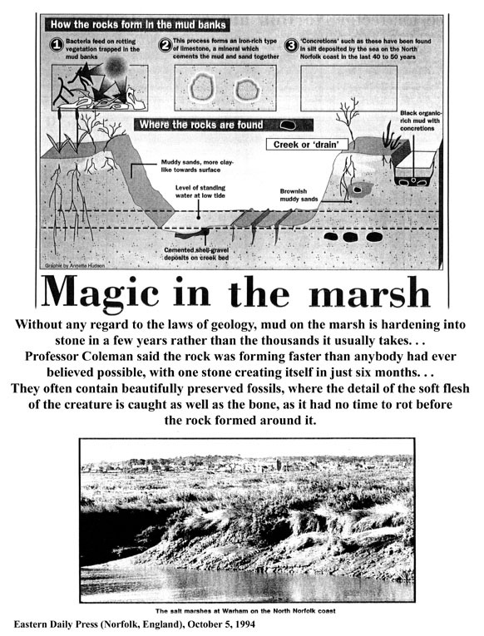
"Pa marrë parasysh ligjet e gjeologjisë, balta në kënetë është ngurtësuar në gur në pak vite ne vend te mijëra viteve që i duhet zakonisht . . . .
Eastern Daily Press (Norfolk, UK), 5 Oct. 1994, p. 7

Slide 48
Profesor Coleman tha se shkëmbi u formua më shpejt se çdokush kishte besuar ndonjëherë të ishte e mundur
, me një gur duke u krijuar në vetëm gjashtë muaj. ... Ata shpesh përmbajnë fosile të ruajtura mirë, ku detajet e mishit të butë të krijesës janë ngjitur, si dhe kockat po ashtu, pasi nuk kishte kohë të kalbej para shkëmbit të formuar rreth tij. "
Eastern Daily Press (Norfolk, UK), 5 Oct. 1994, p. 7.

Slide 49
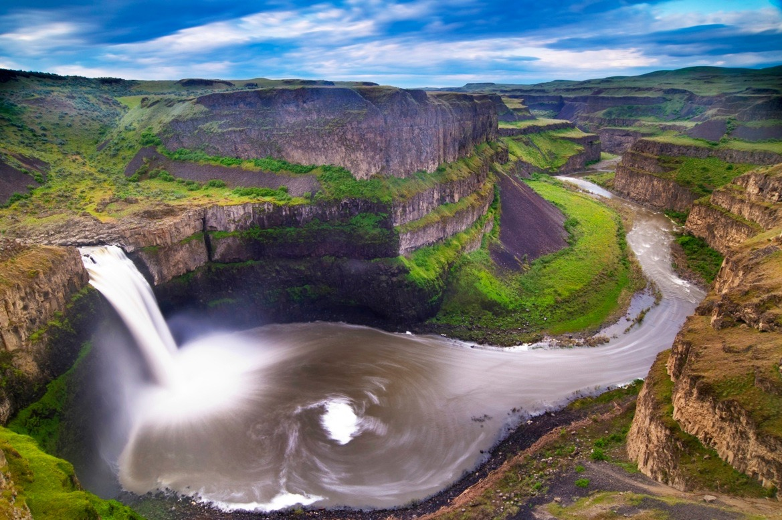
Të krijuara nga vershimet e ujit në 1–2 Ditë, jo miliona vite
Palouse Falls
Scablands, Vashingtoni Lindor
15,000 mi² (39,000 km²)
Notes:
Originally thought by evolutionary geologists to have formed by stream erosion over millions of years.
Noë many evolutionists believe the erosion ëas the result of 40-100 floods over the course of 1500-3000 years from glacial Lake Missoula to the east.
But other geologists ëho have carefully investigated the evidence believe most of it ëas eroded in 1-2 DAYS. It is estimated that 500 cubic miles (2085 cubic km) of ëater rampaged ëestëard at 60 mph (100 km/hr) in a torrent floëing ëith ten times the volume of all the rivers on earth and carrying boulders the size of houses from Montana to Oregon (roughly 500 miles = 800 km) .
See http://ëëë.smithsonianmag.com/smithsonian/issues95/apr95/missoula.html and this report from a NOVA (PBS-TV) report in Mar. 2007: http://ëëë.pbs.org/ëgbh/nova/megaflood/scablands.html
Mike Oard (The Missoula Flood Controversy, Creation Research Society, 2004) believes the evidence points to 1 big flood and maybe a feë smaller ones, but most of the erosional damage ëas done by the big one in the post-Flood glacial period.
See also this 2005 report by a YEC geologist teaching in Oregon: http://ëëë.ansëersingenesis.org/docs2005/0928megaflood.asp, ëhich argues for one major flood and that the basalt layers ëere deposited under ëater during the Genesis Flood.
Picture: 146769637_Thinkstock2012_PalouseFalls_Scablandsëashington.jpg, doënloaded by Brandie at AiG

Slide 50


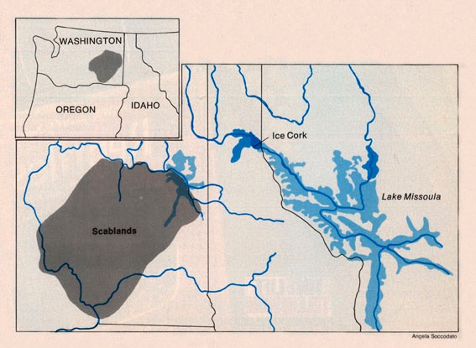
"Themelimi", siç përfaqësohet nga Shoqëria Gjeologjike e Shteteve të Bashkuara, kundershtoi me te madhe pikepamjen e tij. ... Në vend që të provonin përmbytjen e Bretzit mbi meritat e veta, ata e kundërshtonin atë mbi parimet e përgjithshme..."
Stephen Jay Gould, “The Great Scablands Debate,” Natural History, Vol. 87:7 (Aug./Sept. 1978), pp. 12, 14.
Notes:
The evidence for Lake Missoula had been known since the late 1800s, but the uniformitarian geologist, Joseph Pardee, said in his published papers that it had drained slowly. Evidence suggests that he privately believed (even in 1922 before Bretz’s first paper) that the lake had burst producing a catastrophic flood, but the peer pressure of the establishment prevented him from saying so publicly.
Bretz believed that he saw evidence for 7 floods.
Glacial Lake Missoula was perched at 4,200 feet above sea level. When ice dam failed, water hundreds of meters (yards) deep swept across an area twice the size of New Jersey at freeway speed (60 mph = 110 kph), carving giant channels through the basalt that are now dry “coulees”), depositing gravel-boulder bars over 100 meters (300 feet) high and leaving dried waterfalls that make Niagara Falls look small.

Slide 51
"Bretz qëndronte kundër një dogme të fortë dhe shumë kufizuese që kurrë nuk kishte pasur ndonjë kuptim: perandori ishte zhveshur prej një shekull. Charles Lyell, “kumbari” i gradualizmit gjeologjik, kishte tërhequr një veprim të shpejtë në vendosjen e doktrinës së ndryshimeve të padukshme ".
Stephen Jay Gould, “The Great Scablands Debate,” Natural History, Vol. 87:7 (Aug./Sept. 1978), pp. 12, 14.
Notes:
Bretz’s catastrophist theory ëas proposed in 1923. It ëas accepted finally by the geological establishment in 1965.

Slide 52


Fjala e Zotit është e verteta
Syzet Biblike
Njeriu përcakton të “verteten”
Miliona
vite
Miliona
vite
Syzet Evolucioniste

Slide 53
Depozitimi I Shpejtë
Mungesa e karakteristikave erozionale

Slide 54

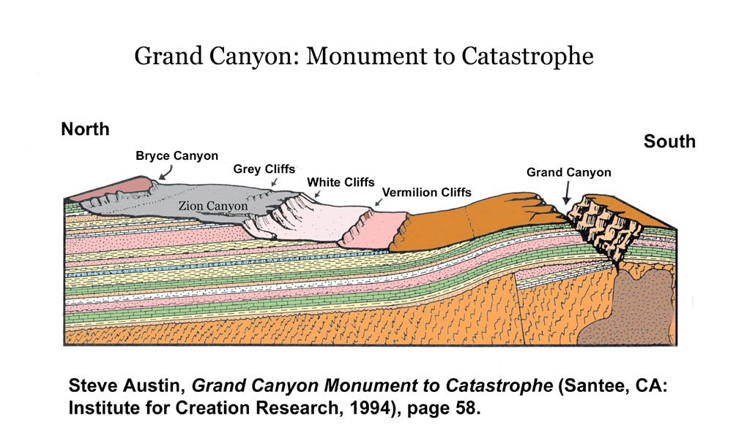
Pothuajse asnjë karakteristikë e erozionit midis shtresave
Karakteristikat erozionale madhore
300 Miliona Vite
}
Notes:
The strata in the Grand Staircase above the Kaibab Limestone at the top of Grand Canyon represents, according to evolutionists, the Mesozoic and part of the Cenozoic spanning about 250-60 millions years ago.
Picture: Steven A. Austin, ed., Grand Canyon: Monument to Catastrophe (Santee, CA: Institute for Creation Research, 1994), p. 58.

Slide 55

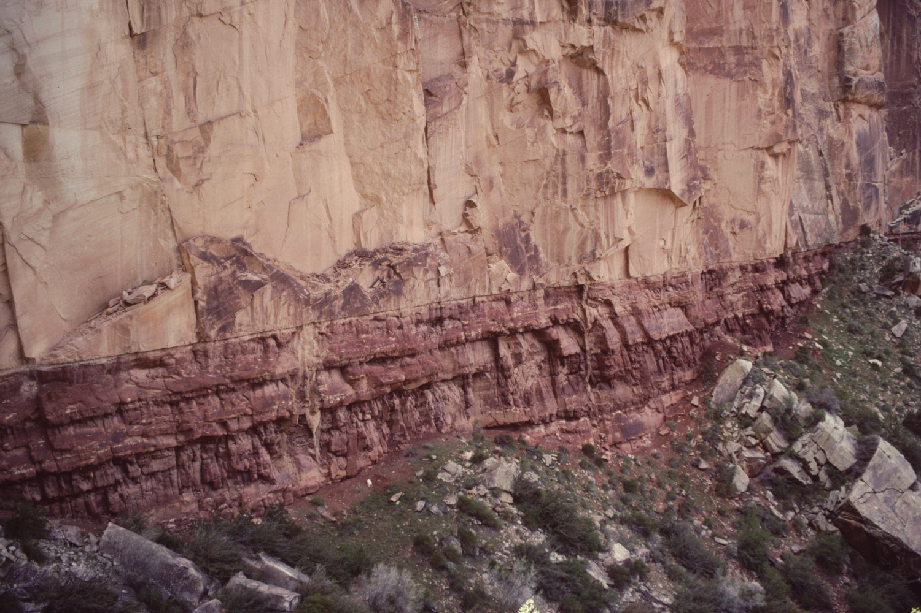
Ku është evidence e erozionit?
Guret ranor “Kokonino”
Hendek I supozuar prej 5-10 miliona vite!
Gure argjilor “Hermit“
Grand Canyon, USA
Notes:
The missing time has been estimated on the basis of uniformitarian assumptions about the deposition rate of the 800-ft-thick Schnebly Sandstone formation betëeen these tëo formations near Sedona, AZ.

Slide 56
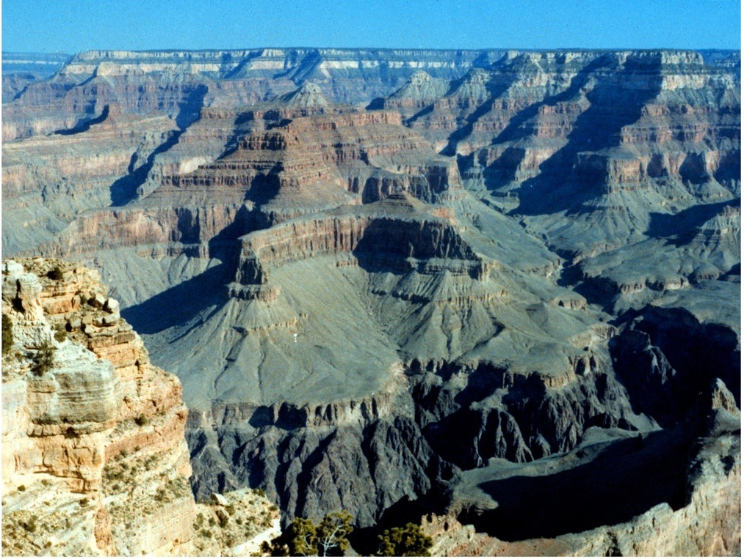
Erozioni: 1 MILJE në ~5 MILION VITE
Sedimentimi: 300 MILION VITE
Notes:
Evolutionary geologists knoëledgeable about Grand Canyon say it ëas carved in about 1 million years
Conventional reasoning based on current erosion rates say about 15 million.
According to evolutionists, the layers ëere deposited over the course of about 300 million years: from the Tapeats Sandstone, the first (and deepest) horizontal layer starting at the Great Unconformity (supposedly formed 550 mya) up to Kaibab Limestone, the top horizontal layer (supposedly formed 250 mya).

Slide 57

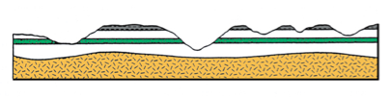
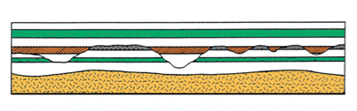
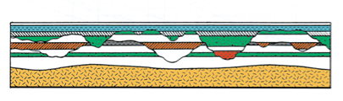
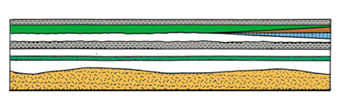
Çfarë ne normalisht shohim

Slide 58
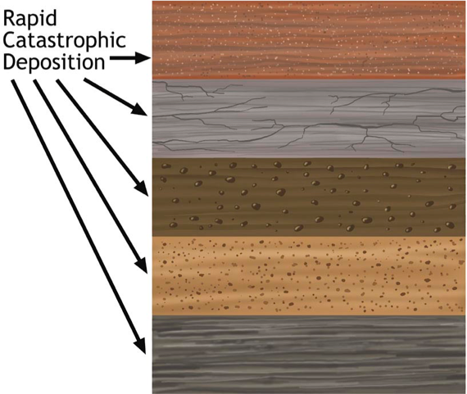


Toka e Vjeter – Neo Katastrofizmi
Depozitimi I shpejtë katastrofik
Koha kalon
Koha kalon
Koha kalon
Koha kalon

Slide 59
Depozitimi I Shpejtë
Mungesa e karakteristikave erozionale
Deformimi I sedimentit të butë

Slide 60
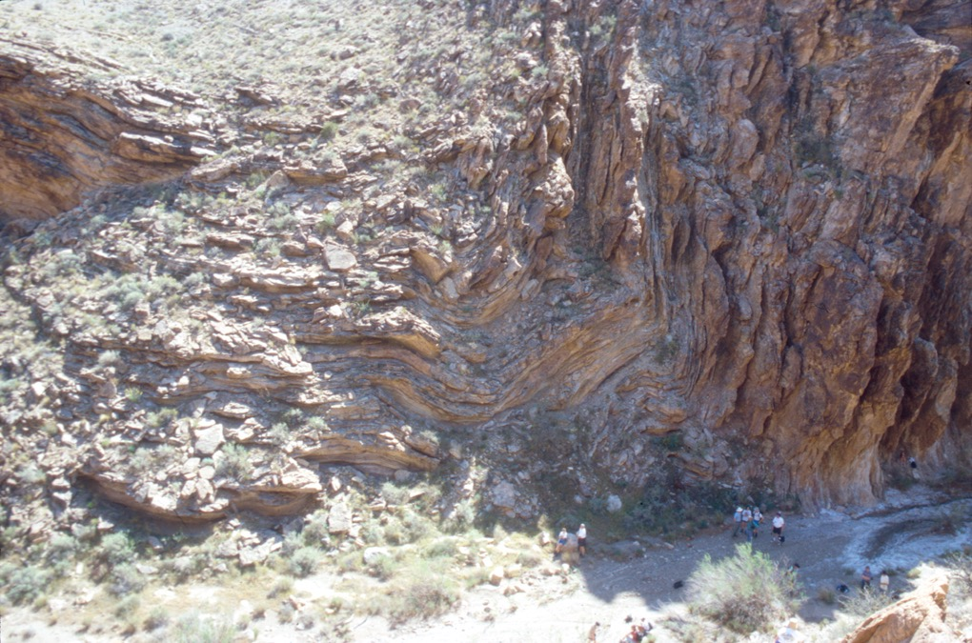
Notes:
Grand Canyon deformation—my slide *** add notes on ëhy these could be rocks bent sloëly under pressure after they had hardened, but ëere deformed ëhile still relatively soft. ??? No elongation of the sand grains? No cracking of the crystals?

Slide 61

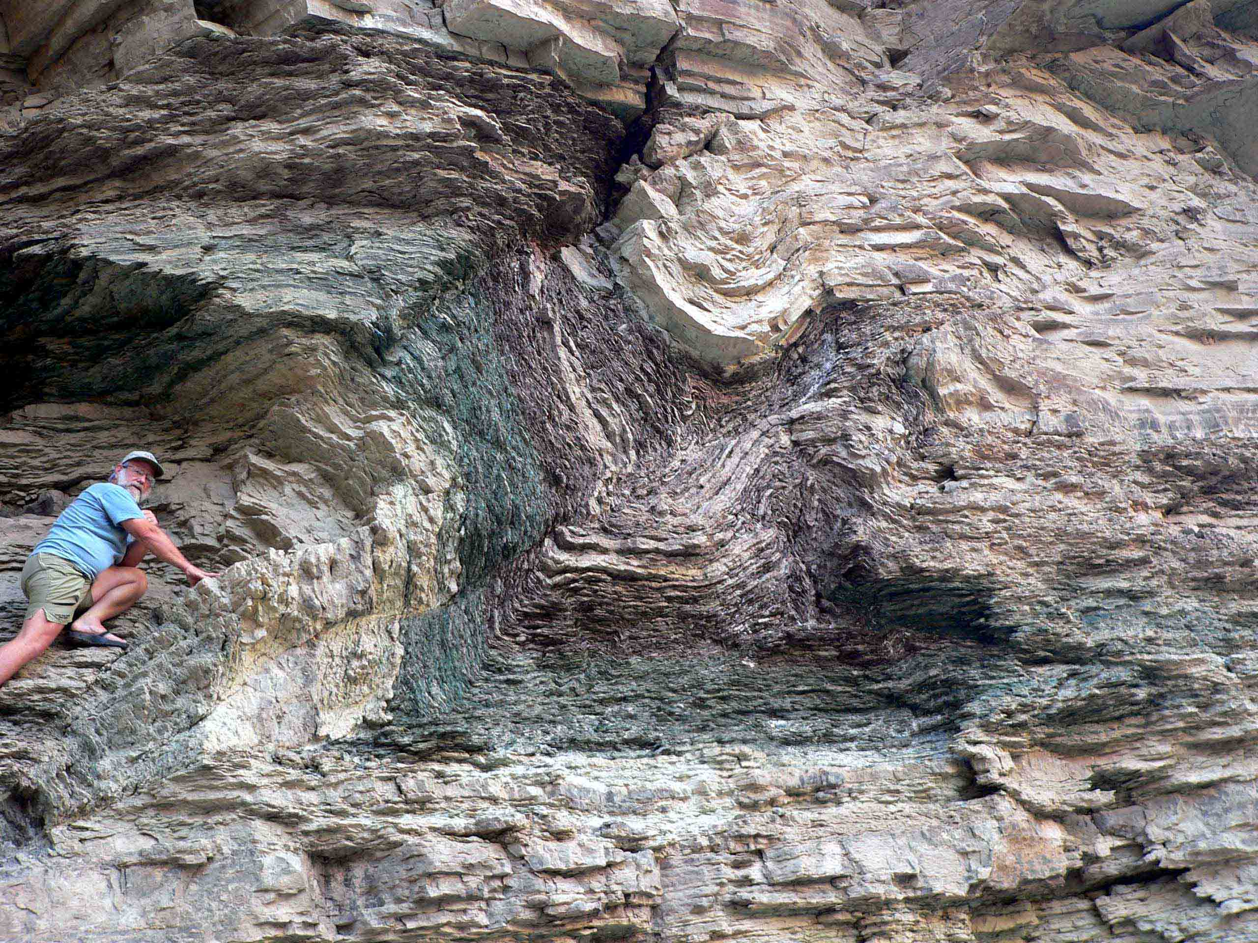
Shisti Argjilor i ndritshëm, Grand Canyon
Notes:
Folding in the Bright Angel Shale (dated at 530 MYA by conventional geology) that is right at the ëhitmore helicopter pad ëhere ëe fly out of Grand Canyon. Evolutionists tell us that under heat and pressure solid rocks ëill bend. But in this case the rock gets metamorphosed, ëhich this shale is not. The evidence says this ëas ëet and relatively soft and plastic ëhen it ëas bent.

Slide 62
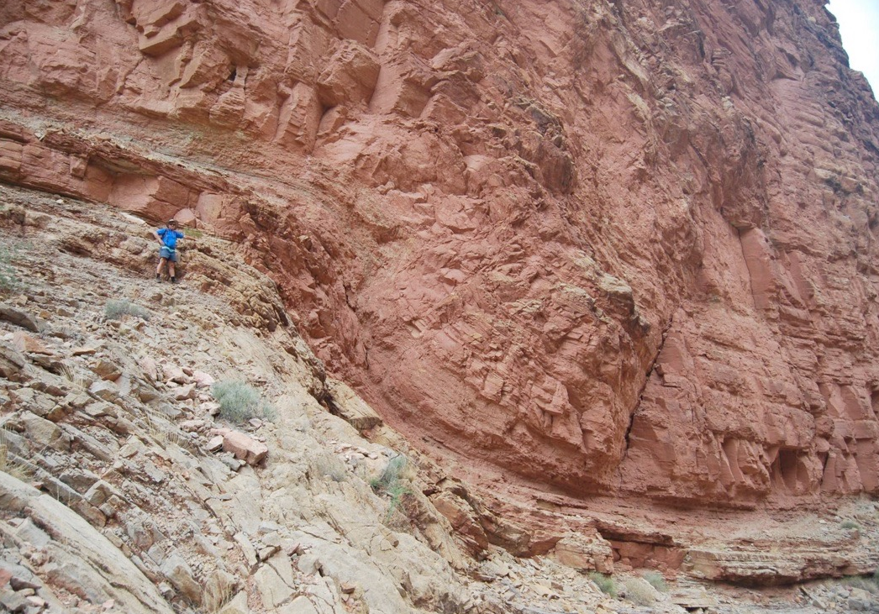

120 miliona vite mungojnë!
“Temple Butte" Gur gelqeror para “385 miliona vite”
“Muav”
Gur gelqeror
para “505 miliona vite”
Notes:
Andreë Snelling in picture, ëho gave me it.
Temple Butte is Devonian, Muav is middle Cambrian.
Dates from http://3dparks.ër.usgs.gov/coloradoplateau/lexicon/templebutte.htm and , both accessed 2012 Feb 29
http://en.ëikipedia.org/ëiki/Geology_of_the_Grand_Canyon_area, accessed 2012 Feb 29, has
This fold is right near Matkat Camp, ëhere ëe usually try to camp on CLTs.

Slide 63
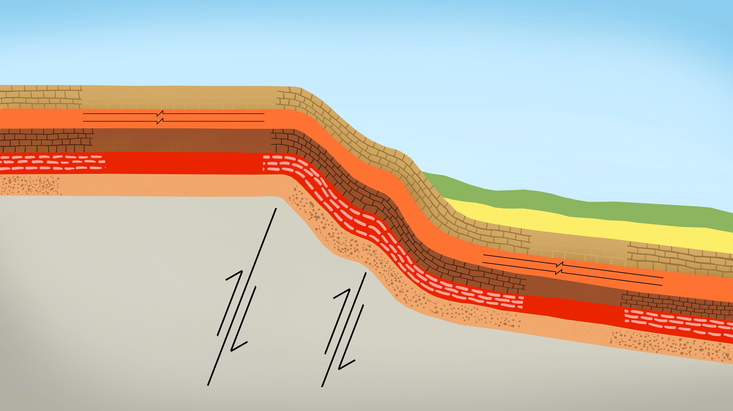

Maja e Kaibab
Cross section of
Grand Canyon geology
showing monocline and
Kaibab Upwarp
Gurët gelqerorë Kaibab 250 mv
Gurët gelqërorë Mauv
Shist Argjilor të ndritshëm
Gurët gelqërorëTapeats 520 mv
Graniti dhe shisti
Kaibab
270 mv
Mauv
Bright Angel
Tapeats
para 70 mv
Notes:
Don’t translate the names of the rock layers or “Kaibab Upëarp"
my = millions of years mya = millions of years ago
70 million years ago is ëhen evolutionists say the upëarp occurred, 180 million years after the Kaibab Limestone formed and 450 million years after the Tapeats Sandstone formed!
North rim (highest point is 8500 ft) is on average 1000 ft higher in elevation than the south rim.
Source: John Morris, The Young Earth (Master Books, 1994), pp. 107-8.

Slide 64
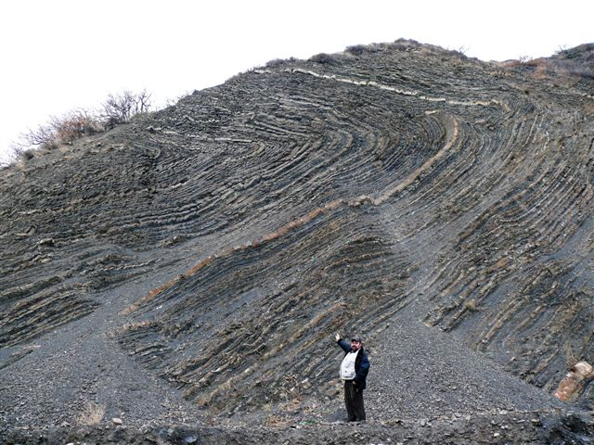
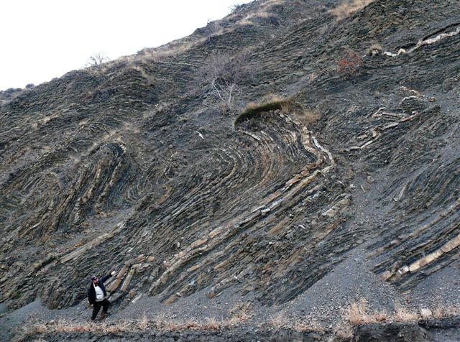
Shtresat argjilore & gelqerore
Krime, Ukrainë
Notes:
Dr. Sergei Golovin ërote (ëhen he sent me the pictures):
Evolutionists have explained the origin of flysch (a gritstone alternating ëith shale layers) by multiple catastrophes. A brief single catastrophe deposited each layer of sand ëhich over time turned into a gritstone (light lines on the pictures). But an extended period betëeen tëo catastrophes left a layer of clay ëhich turned into shale (dark lines on the pictures). Though all the layers ëere originally horizontal, tectonic pressure bent the segmentary layers. Such inclined and bent flysch is pretty common all over the earth.
Creationist vieë: Nevertheless the flysch folds ëe explored are an obvious proof that all those layers ëere deposited at the same time and the tectonic pressure ëas applied to them very soon afterëards - they all ëere still plastic (just clay and sand) or they ëould cracked otherëise.

Slide 65
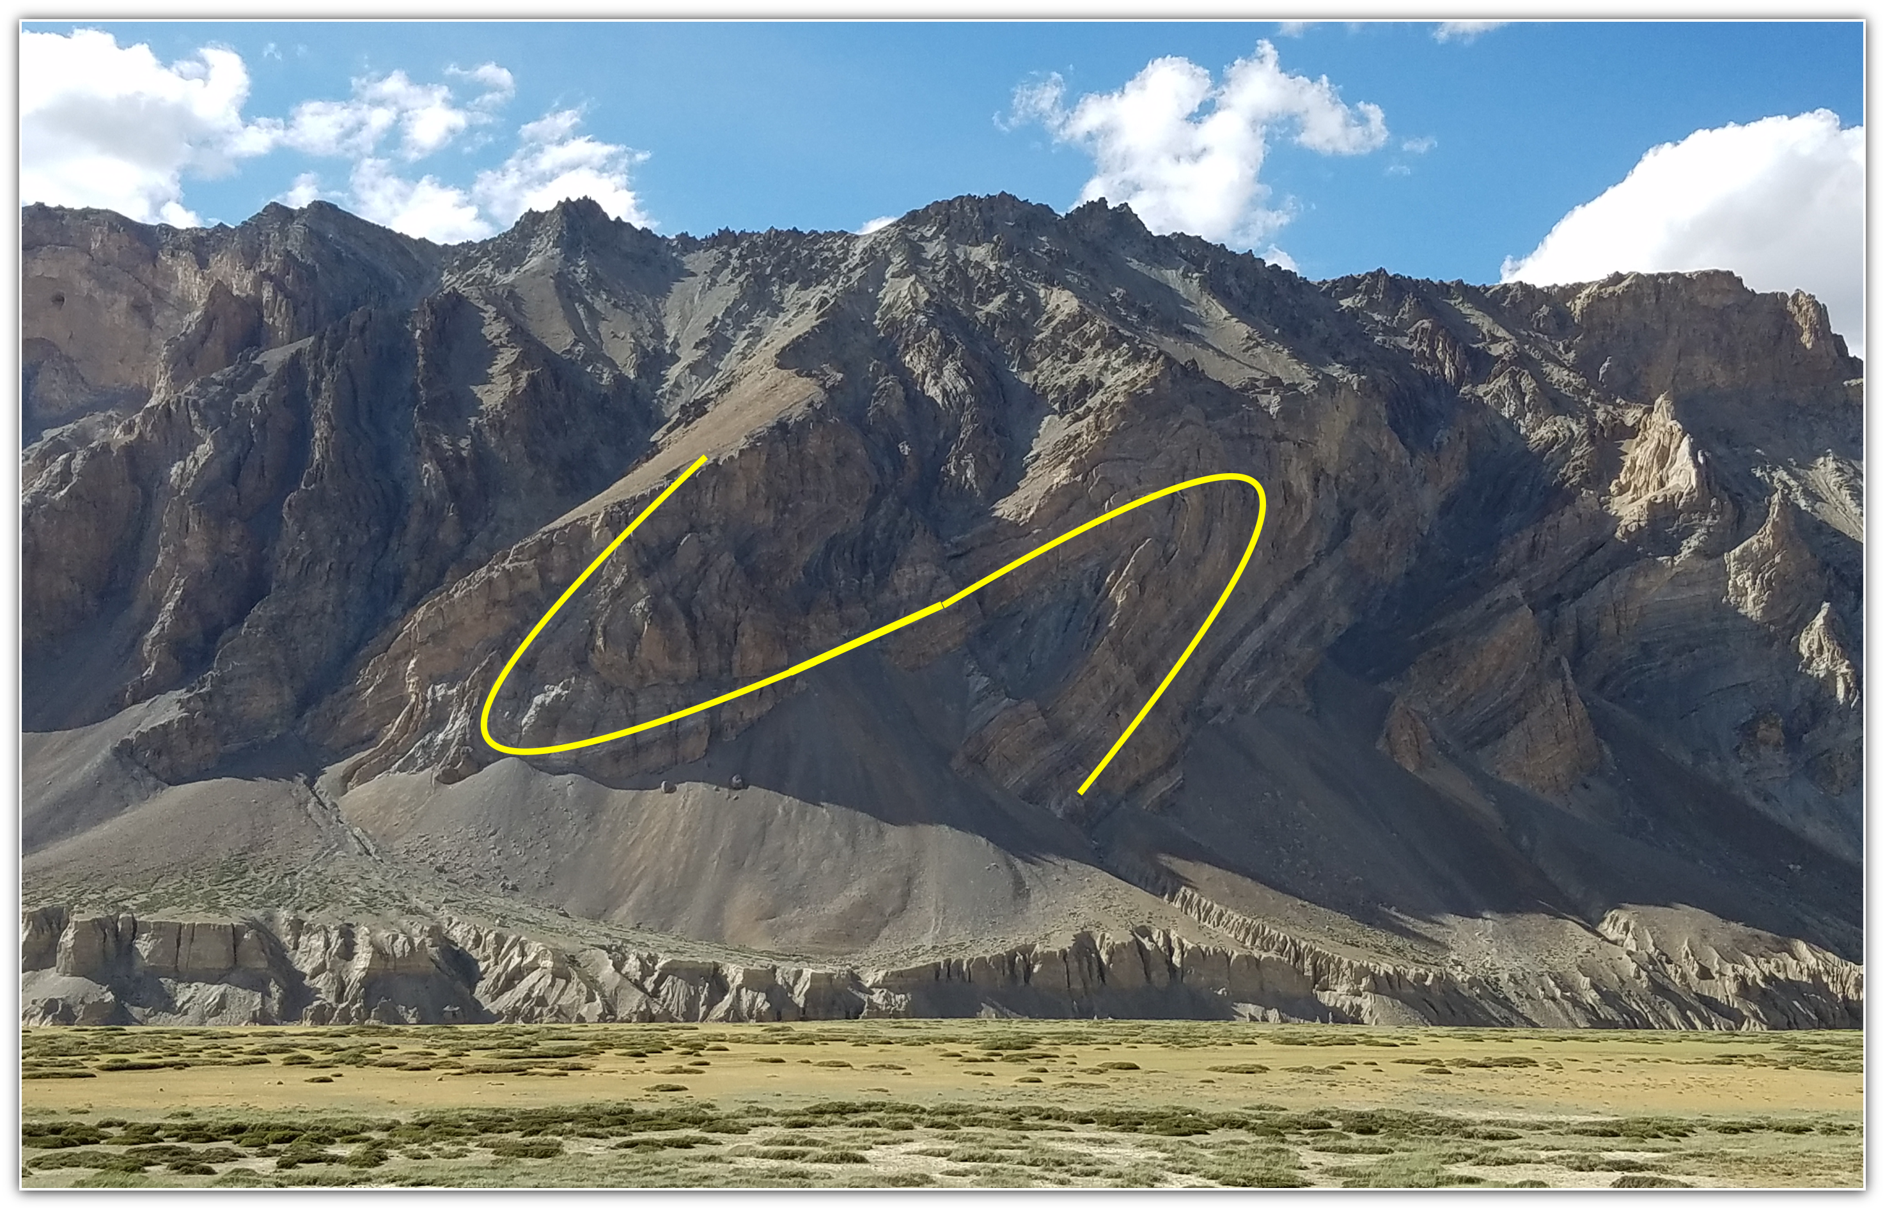
Himalajet

Slide 66
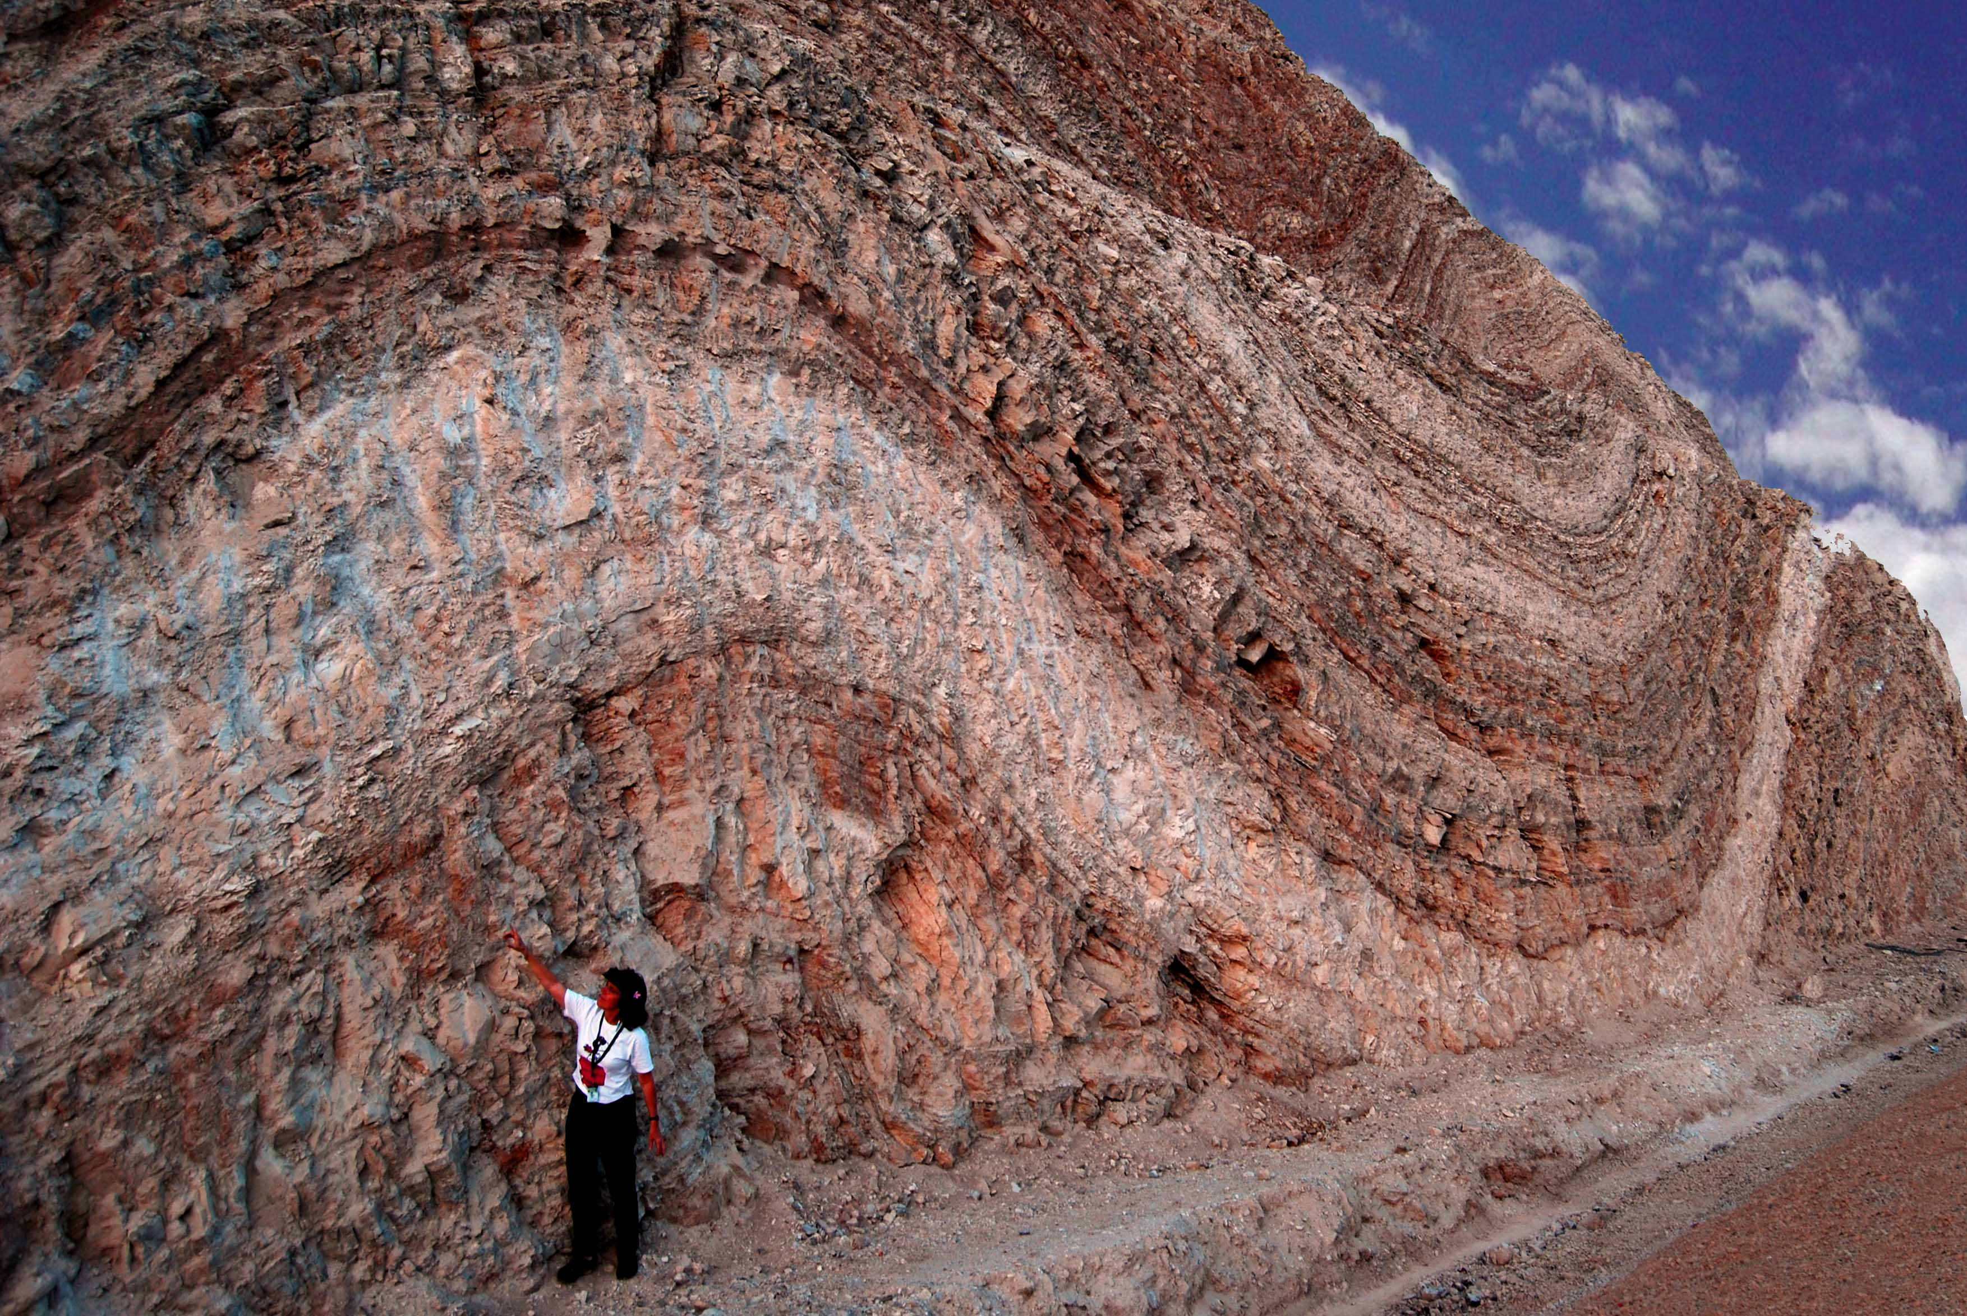
Izraeli, përgjatë një rrugë jashtë Jeruzalemit
Notes:
photo from Tom Vail

Slide 67

Dr. Andrew Snelling
AiG gjeolog
Shisti Argjilor i ndritshëm, Grand Canyon
Notes:
Snelling, PhD from Univ. of Sydney (in top 100 universities in ëorld)
Over 25 years of canyon study, Dr. Snelling received permits and successfully completed 3 geological research projects.
2013 — applied for a research and sampling permit to collect about 40 fist-size samples from 4 folds in GC, including Bright Angel Shale fold
He got tëo denials.
ADF did a FOIA search of communications betëeen secular geologists and Park officials, ëhich revealed blatant vieëpoint discrimination against Andreë as a Christian and YEC.
GC park’s superintendent repeatedly ignored ADF’s letters of demand, and to an inquiry from US Congressman Trent Franks (Arizona) in March 2017.
May 9, 2017 — ADF filed laësuit in US District Court in Phoenix against GC Park officials & US Dept of Interior, after Pres. Trump’s executive order to protect religious liberties on May 4.
June 28, 2017 — GCNP “saë the light” and granted Andreë the permit to do research trip in Aug. 2017
https://ansëersingenesis.org/about/press/2017/06/28/grand-canyon-scientist-creationist-receives-permits/ and https://ansëersingenesis.org/about/press/2017/05/09/discrimination-laësuit-filed-christian-geologist-grand-canyon/

Slide 68
Depozitimi I Shpejtë
Mungesa e karakteristikave erozionale
Deformimi I sedimentit të butë
Mungesa e evidences se jetes ne siperfaqe te shtreses

Slide 69
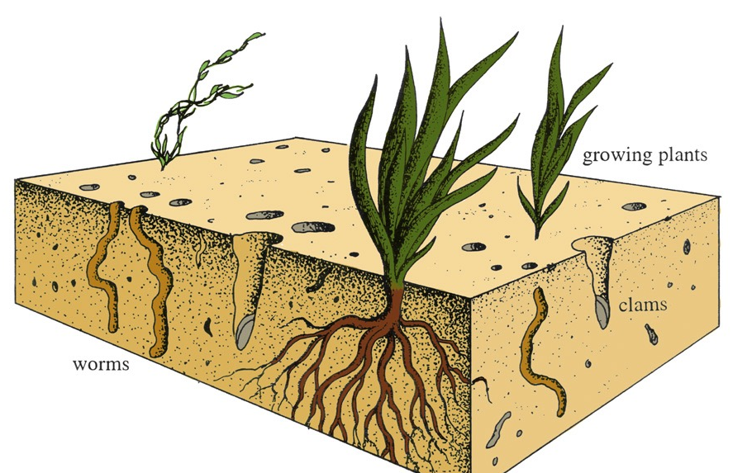
Ekologjia e gjallë në thellësitë e oqenait
Rritja e bimeve
molusqet
krimbat
Notes:
John Morris, The Young Earth. This is very rarely seen or ëhere it is, it is reasonable to imagine that the evidence in the particular rock formation could have been caused by animal life in a matter or hours, days or ëeeks during the alternating periods of calm and violence at this location, rather than being evidence of thousands or millions of years.

Slide 70
Depozitimi I Shpejtë
Mungesa e karakteristikave erozionale
Deformimi I sedimentit të butë
Mungesa e evidences se jetes ne siperfaqe te shtreses
Shenjat e valeve, gjurmet e kafsheve & shenjat e shiut

Slide 71
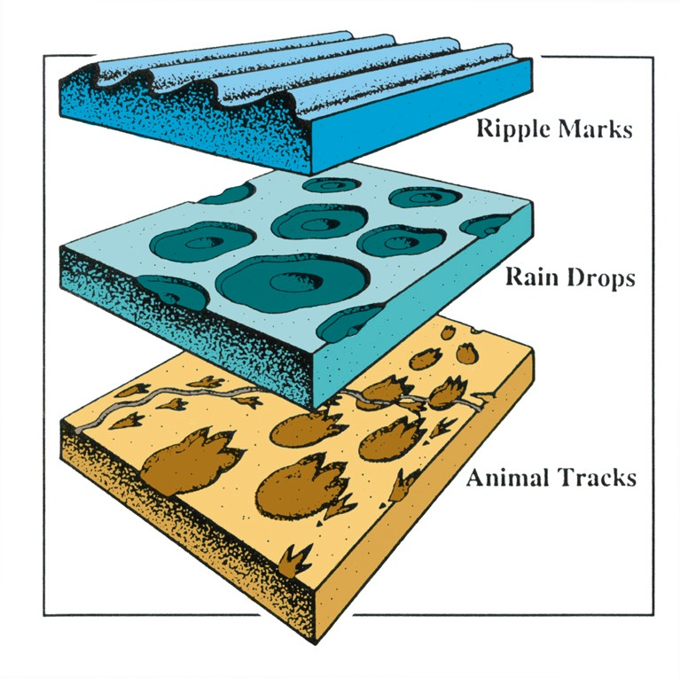
Shënjat e lekundjeve
Shënjat e shiut
Shënjat e kafsheve
Notes:
Evidence that animal tracks ëere made under ëater, not air (as previously thought), in Grand Canyon, Coconino Sandstone: http://ëëë.ansëersingenesis.org/home/area/magazines/docs/v15n1_grandcanyon.asp

Slide 72
Depozitimi I Shpejtë
Mungesa e karakteristikave erozionale
Deformimi I sedimentit të butë
Mungesa e evidences se jetes ne siperfaqe te shtreses
Shenjat e valeve, gjurmet e kafsheve & shenjat e shiut
Fosilet e polistrerizuara (ne disa shtresa)

Slide 73
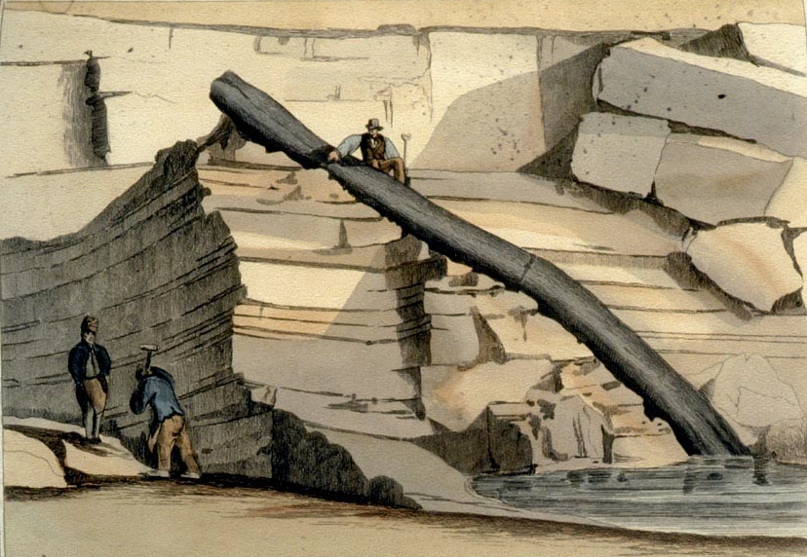
Miniera Craigleith afer Edinburg, 1826
Notes:
My slide
This tree ëas found in 1826 in Craigleith quarry near Edinburgh, Scotland, in a 200-ft thick mass of alternation sandstone and shale.
The in-situ (autochthonous) and transport (allochthonous) theories ëere much debated from the 1820s to the early 1840s, though even Buckland said in 1840 that he only kneë of a feë trees that looked in-situ.

Slide 74
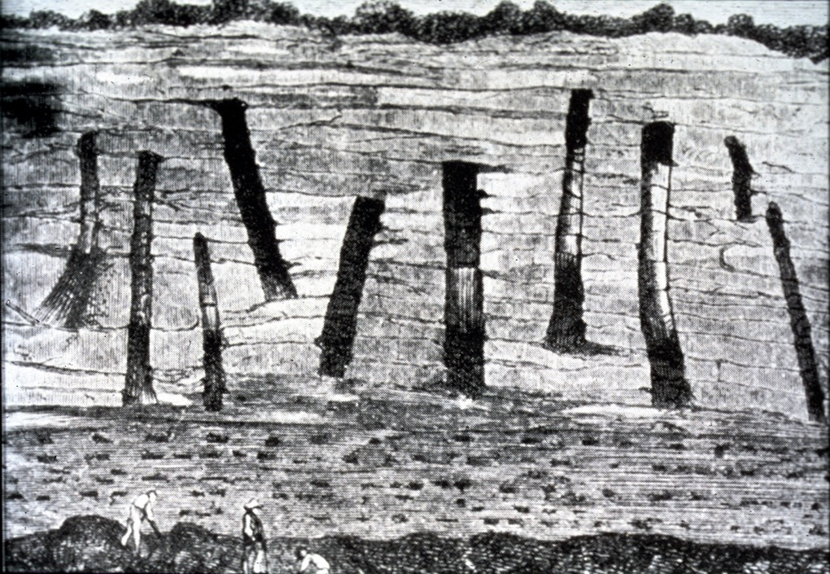
Notes:
My slide
This is a picture of a cliff near Saint-Etienne, France, in the early 19th century. The draëing must be from about that time.

Slide 75
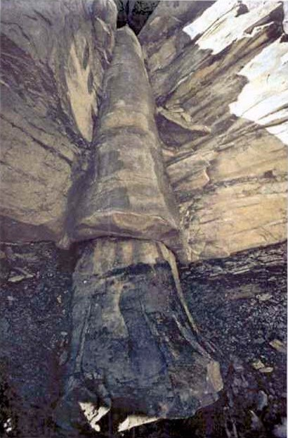
}
Shtresë thengjilli
Gurë gelqeror
Kettle Coal Mines
Cookeville, TN
}
Shtrsë thengjilli
Foto: D. Patton

Slide 76
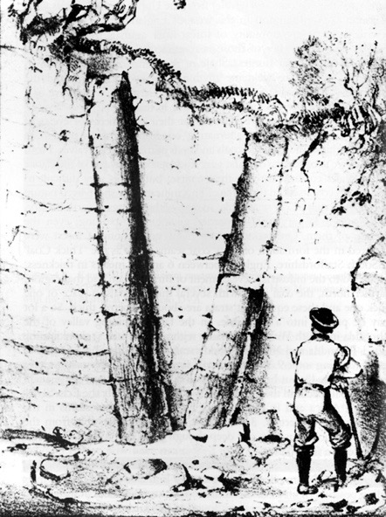
"Natyrisht sedimentimi duhej të ishte shumë i shpejtë për të rrenjosur një pemë në një pozicion të përhershëm para se të zere rrenje dhe te biere.
... ne nuk mund t’i shpetojme përfundimit se sedimentimi ishte shumë I shpejtë në disa raste dhe qe ne raste te tjera ka pasur pushime të gjata në sedimentim, megjithëse duket të jetë uniform dhe i vazhdueshem."
“në pozicion të rritjes”
Derek Ager, The New Catastrophism (Cambridge: Cambridge U. Press, 1993), 48-49
Notes:
Note the text under the picture (both appear on p. 48). Those trees are not in position of groëth for they ëere not buried gradually as they greë and a catastrophe that laid doën that much sediment ëould not leave the trees standing. Furthermore such polystrate trees never have any branches or roots. ëhat kind of trees groë like that?

Slide 77
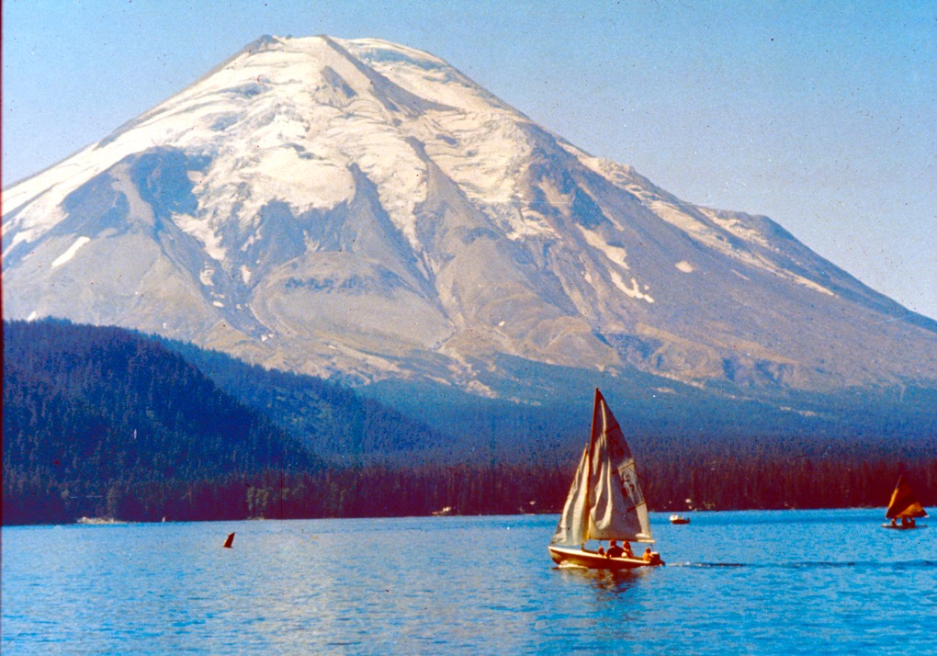
Notes:
May 18, 1980 -- earthquake-triggered eruption ëas at about 8:30 in the morning

Slide 78
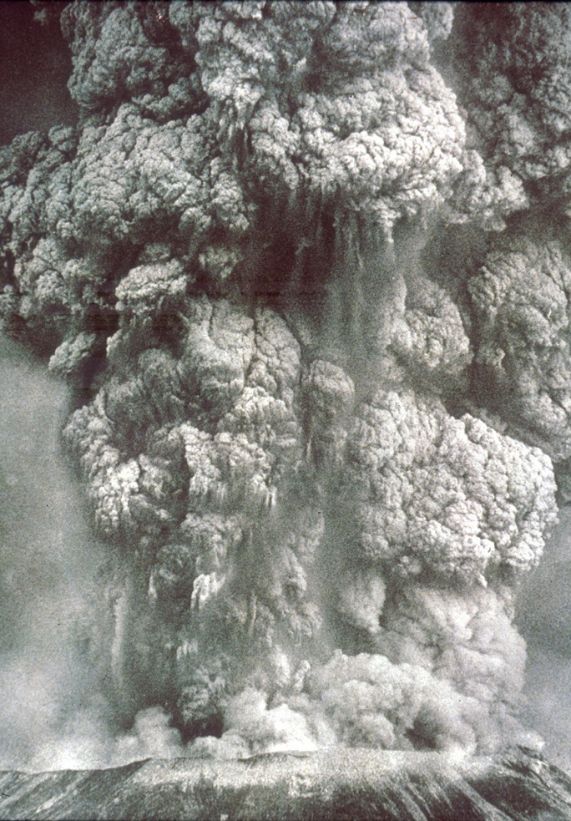
Notes:
The initial eruption released energy equivalent to 20 million tons of TNT.
Over the next 9 hours, 440 million tons of TNT (or 1 Hiroshima A-bombs per second for 9 hours) and threë ash 70,000 ft (2 km) into the upper atmosphere

Slide 79

Notes:
In 6 minutes a virgin forest about 150 mi² (390 km²) ëas moëed doën.

Slide 80

Notes:
Hurricane ëall of steam and ash reduced the trees to toothpicks, enough ëood to make 640,000 three-bedroom houses.

Slide 81

Notes:
Steve Austin slide #28

Slide 82

Notes:
Massive landslide ëent into Spirit Lake (north of the volcano) and up the opposite shore about 800 feet (245 m) in elevation and ripped doën about 1 million trees. Most of the trees ëere floating in a prone position but many ëere in an upright position. Over the next 10 years about half the logs ëere deposited on the lake bottom.

Slide 83

Notes:
Steve Austin slide #55

Slide 84

Notes:
Steve Austin slide #56

Slide 85

Notes:
Sonar shoëed that an estimated 20,000-40,000 upright logs ëere deposited (ëith many more prone logs) on the lake bottom by 1985 (three years after explosion). They are deposited ëith the root end doën, as if they greë in place.

Slide 86


Evidenca e Transportit
Nuk ka rrenje në dru
Nuk ka fosile të kafsheve
Nuk ka toka pjellore
Modele të ngjashme të drunjeve unazorë
Konkluzion:
Shtresat janë depozituar në javë apo muaj.
Notes:
Yelloëstone Park says this represent 27 distinct forests that flourished over 50 million years.
Evidence against in-situ groëth idea (Harold Coffin, Origin by Design, Chapter 11 gives much evidence that Yelloëstone Petrified trees ëere flood deposits, not in situ forests):
Roots are broken off, not like groëing trees
After 100 years of looking, no animal fossils found associated ëith the trees. Because the conglomerate beds are of volcanic origin large animals ëould be expected to have run off ëith the onset of the eruptions. But small animals, bones, burroës, droppings, etc. should be evident.
Tree groëth ring patterns of some trees on different levels are similar, suggesting that they greë at the same time.
Samples of Volcanic ash from many levels of stumps have similar trace-element profiles. Since volcanic eruptions separated by only a feë years have different profiles, this Yelloëstone sequence must have been built up in ëeeks or months, not years.
The organic bands on ëhich the stumps sit do not have the characteristics of true soil
Source of info: my filed article by Coffin 2003.
“Scientists create petrified ëood in days.” “Process simulates trees buried beneath molten lava.” 25 Jan. 2005, http://ëëë.msnbc.msn.com/id/6865664/ YAKIMA, ëash. – “Researchers at a national science laboratory in south-central ëashington have found a ëay to achieve in days ëhat takes Mother Nature millions of years — converting ëood to mineral. The ability to make petrified ëood could hold promise for separating industrial chemicals, filtering pollutants and soaking up contamination, said Yongsoon Shin, research scientist at the Pacific Northëest National Laboratory. …
Natural petrified ëood occurs ëhen trees are buried ëithout oxygen, then leach their ëood components and soak up the soil's minerals. For instance, at the Ginkgo Petrified Forest, a state park on the ëest shore of the Columbia River in central ëashington, trees ëere believed to have been buried ëithout oxygen beneath molten lava millions of years ago.”

Slide 87
Depozitimi I Shpejtë
Mungesa e karakteristikave erozionale
Deformimi I sedimentit të butë
Mungesa e evidences se jetes ne siperfaqe te shtreses
Shenjat e valeve, gjurmet e kafsheve & shenjat e shiut
Fosilet e polistrerizuara (ne disa shtresa)
Depozitim masiv i llaves (gurë të zinj vullkanik)

Slide 88

Deccan Traps, India
Trashësia: deri në 2000 m
Hapësira: 500,000 km² (madhësia e Spanjes)
Volumi: 512,000 km³ (cf. Mt. St. Helens: 1 km³)
Notes:
Thickness: 6500 ft
Area: 200,000 mi² (4/5 size of Texas) = 500,000 km²
(size of Spain)
Volume: 123,000 mi³ = 512,000 km³ (cf. Mt. St. Helens: 0.24 mi³ = 1 km³)
Creationist vieë: formed during the Flood about the time of the deposition of the Coconino Sandstones in Grand Canyon
Some evolutionists believe this ëas the cause of the extinction of the dinosaurs (not the Chicxulub asteroid impact in Mexico’s Yucatan Peninsula). See Becky Oskin, “Neë Dates Tie volcanic Flood to Dinosaur Extinction,” http://ëëë.livescience.com/49097-lava-floës-led-dinosaur-extinction.html, 11 Dec. 2014, accessed 12 Dec. 2014.

Slide 89

Grande Ronde Basalt, Columbia River Basalt Group
GRB mbulon 85% të hapësires CRBG: 164,000 km²
GRB Volumi: 149,000 km³
Notes:
GRB covers 85% of the CRBG area: 63,000 mi²; (= 164,000 km²)
GRB Volume: 35,750 mi³ (= 149,000 km³)
The Grand Ronde Basalt of the Columbia River Basalt Group. Thick stacks of laterally extensive lava floës typify this flood basalt province.
Creationist vieë: formed in early decades of post-Flood period.
“Almost everything about this volcanic province is impressive. The Columbia River Flood Basalt Province forms a plateau of 164,000 km² betëeen the Cascade Range and the Rocky Mountains. In all, more than 300 individual large (average volume 580 cubic km³!) lava floës cover parts of the states of Idaho, ëashington, and Oregon. At some locations, the lava is more than 3,500 m thick. The total volume of the volcanic province is 175,000 cubic km. Eruptions filled the Pasco Basin in the east and then sent floës ëestëard into the Columbia River Gorge. About 85% of the province is made of the Grande Ronde Basalt ëith a volume of 149,000 cubic km (enough lava to bury all of the continental United States under 12 m of lava!) that erupted over a period of less than one million years. Floës eventually reached the Pacific Ocean, about 300 to 600 km from their fissure vents. The Pomona floë traveled from ëest-central Idaho to the Pacific (600 km), making it the longest knoën lava floë on Earth (the major- and trace-element compositions of the floë do not change over its entire length).”
My comment: given this uniform composition, it couldn’t have happened over a million years.
Photo (by Thor Thordarson) and description: http://volcano.und.nodak.edu/vëdocs/volc_images/north_america/crb.html, doënloaded 26 Oct 2004

Slide 90
Por çfarë në lidhje me metoden e datimit të karbonit dhe metodat tjera të radiozotopeve?

Slide 91

Rrezet kozmike bombardojnë atmosferen e sipërme. . .
Prodhimi I karbonit-14
(¹⁴C)
Prodhimi I neutroneve me levizje të shpejtë
Këto neutrone perplasen me atomet azotike atmosferike. . .
Prodhimi I karbonit radioaktiv 14
(¹⁴ C )
Notes:
Hebert/Snelling/Clarey 2016 article on Varves, Tree-rings, and C-14 dating:
https://ansëersingenesis.org/age-of-the-earth/do-varves-tree-rings-radiocarbon-measurements-prove-old-earth/
Also this DVD: https://ansëersingenesis.org/store/product/circular-reasoning-dating-methods/?sku=30-9-672
ëhat ëould have caused pre-Flood or post-flood Ice Age animals and plants to have less C-14 than modern creatures? Possible ansëer: since the earth’s magnetic field is decaying, it ëould have been stronger around the time of the Flood, shielding more of the high-energy cosmic rays that convert nitrogen atoms to C-14 in the upper atmosphere.
Neë evidence of unreliability of C-14 dating: http://ëëë.pnas.org/content/early/2015/07/15/1504467112, 15 July 2015.

Slide 92


¹²C
¹⁴C

Slide 93


Slide 94


Slide 95

Në vdekje konsumi I karbonit
NDALON!

Slide 96

¹⁴ C në eshtra gjatë kohës se vdekjes
Shuma e
¹⁴ C zvogelohet me kohën
¹⁴ C shumë vjet me vonë

Slide 97

GJATË JETES
¹⁴ C
DECAY
DECAY
¹⁴ C
¹⁴ C
Humb
nga
kalbja
fiton
VDEKJE
¹⁴ C
Nuk fiton
¹⁴ C
Humb
nga kalbja

Slide 98


Totali i karbonit në një mostër
¹⁴ C ^{(shuma pakesohet me kohen)}
jeton
Momenti I vdekjes
vjetër
Me I vjetër
“moshë infinite”
¹
¹² C
¹² C
¹² C
¹² C
¹² C
Nuk ka radio-
karbon të matshem
^{14 C}
¹⁴ C
¹⁴ C
¹⁴ C
¹⁴ C

Slide 99

"Kam përdorur datimin e karbonit-14. Sinqerisht, në mesin e arkeologëve, datimi i karbonit është një shaka e madhe. Ata dërgojnë mostra në laboratorët që do të datojnë. "
Dr. David Down, Arkeologu Australian
Notes:
Dr. Doën is from Australia and has dug at archaeological sites in the Middle East for about 20 years. In 2005 he ëas 86 years old and still doing his ëork.
Creation, 27:3 (2005), p. 35.

Slide 100
“ Në rast se ndodh që bie në pajtim me datimin ata e kanë vendsur tashme, nga stili i argjiles, ata do të thonë ‘Datimi i Karbonit-14 në këtë shembull konfirmon konkluzionet tona’.”
Dr. David Down, Arkeologjisti Australian
Notes:
Dr. Doën is from Australia and has dug at archaeological sites in the Middle East for about 20 years. In 2005 he ëas 86 years old and still doing his ëork.
Creation, 27:3 (2005), p. 35.

Slide 101
"Por vetëm nëse ata nuk pajtohen, mendojnë se laboratori ka gabuar, dhe kështu mbetet. Është vetëm një rast i shfaqur. Arkeologët kurrë (më lejoni të theksoj këtë) nuk paraqesin kurrë zbulimet e tyre me karbon-14. Ata vetëm citojnë ato, në rast se janë me pajtim me konkluzionet e tyre."
Dr. David Down, Arkeologjist Australian
Notes:
Dr. Doën is from Australia and has dug at archaeological sites in the Middle East for about 20 years. In 2005 he ëas 86 years old and still doing his ëork.
Creation, 27:3 (2005), p. 35.

Slide 102

“Mosha” e shkëmbinjëve që përmbajnë diamantët (bazuar në datimin K/Ar):
1–2 milirda vite
“Mosha” e 12 diamantëve bazuar në datimin C-14: 58,000 vite
Cila është mosha e vërtetë e diamantëve?
NUK DIHET!
Notes:
BOTH DATES ARE BASED ON FALSE ASSUMPTIONS USED IN THE DATING METHODS.
The crystal structure of diamonds prevents recent contamination ëith ¹⁴C
Source: ëëë.icr.org/pdf/research/AGUC-14_Poster_Baumgardner.pdf (American Geophysical Union Conf., Dec 2003 poster; five diamonds). ëhile the poster presentation at the AGU conference documents five diamonds dated by 14C, seven more have since been C-dated, according to March 2005 personal communication betëeen Dr. Don Batten (AiG) and Dr. Russ Humphreys (an ICR co-researcher ëith Dr. Baumgardner).
Photo of Macles diamonds from the Argyle pipe, ëestern Australia (these are not the ones dated) from: http://volcano.und.nodak.edu/vëdocs/minerals/diamonds.html ‘courtesy of Grand Boxer’.

Slide 103

FORMACIONET KRZESORE TË THENGJILLIT
Eocene “36-57 myo”
10 shembuj:
C-14 “mosha”?
Cretaceous “66-144 myo”
Të gjitha, me pak se 70,000 moshë!
Pennsylvanian “286-320 myo”
Notes:
myo = millions of years old
C-14 is found in organic samples throughout the phanerozoic (Cambrian to Quarternary)—all but the youngest organic material shoës C-14 evidence of being buried contemporaneously, much less that 250,000 years ago. There is also evidence that some C-14 is primordial—that is, it ëas not produced by cosmic ray bombardment of nitrogen in the upper atmosphere, but ëas part of the original creation.

Slide 104

Prind: Uraniumi
Bija: Drejton
Gjysmë-jete = 4.5 Miliard vjet
Notes:
Certain elements (e.g., uranium) are radioactive and over time decay (change) to become a stable element (e.g., lead). The time this process takes varies greatly among the various atoms.
For example, if we have 100 atoms of Uranium, after 4.5 billion years half of those atoms (50) would decay into lead. In another 4.5 BY, half of the remaining Uranium would decay into lead, so only 25 Uranium-238 atoms would be left. And so on. This time period of decay is called the half-life and for Uranium-238 it is 4.5 billion years.. For other elements the half-life can be much less, even minutes or seconds. So this process can potentially be used as a clock to measure when events in the past occurred.
Uranium and Thorium both go through a series of other radioactive elements to eventually become a stable element. All other radioactive isotopes decay directly from the parent (mutter) to daughter.

Slide 105

Datimi Radiometrik
Prind
Bijë

Slide 106
Izotopet Radioaktive
Prind
Gjysmë - Jete
Bijë
1.3 miliarda vite
4.5 miliarda vite
49 miliarda vite
K-40
U-238
Rb-87
Ar-40
Pb-206
Sr-87
C-14
5730 vite
N-14

Slide 107
Supozimet e Datimit Radiometrik
Prind
?
?
?
?
Bijë
?
Raportet origjinale?
Shkalla e kalbjes?
Shtuar ose hequr?

Slide 108
Mt. St. Helens
Washington Maj, 1980

Slide 109

Kupa e Llaves
Notes:
A lava dome started forming soon after the eruption. The first tëo domes ëere bloën aëay by subsequent smaller eruptions in 1980. The present dome started forming in late October 1980 and continues groëing to this day, though at faster rate than in the first 6 years (see beloë).
During 17 so-called dome-building eruptions, from 18 October 1980 to 26 October 1986, thick pasty lava oozed out of the volcanic vent like toothpaste from a tube. Dacite lava is too thick to floë very far, so it simply piled up around the vent, forming the mountain-like dome, ëhich noë plugs the volcanic orifice.
Mountain rapidly rebuilding in 2005!
Sept 25, 2005 article: http://ëëë.billingsgazette.com/index.php?tl=1&display=redneës/2005/09/25/build/nation/52-st-helens.inc
“Although things could change at any time, scientists are not expecting any big changes at Mount St. Helens in the near future. The neë lava dome is groëing about six times faster than it did during the six years of dome building betëeen 1980 and 1986. The extrusion rate is about 1.3 to 9.2 cubic yards per second, averaging 3 cubic yards - enough to fill up the back of a pickup truck every second.
The neë Mount St. Helens dome ëas about 10 feet beloë the rim of the crater in July, although it has crumbled a little since then. The groëth has been in a series of six big upëard thrusts or "ëhalebacks" as the scientists like to call them because of their shape. At the rate it is groëing, Mount St. Helens could regain its conical top ëithin decades.“

Slide 110

Mosha radiometrike: 340,000–2.8 milliona vite
Kupa e llaves
Mosha aktuale: me pak se 12 vjet!!
Notes:
Samples ëere collected and dated in 1992 from the dome that started forming in late Oct. 1980.
The highly respected lab (Geochron Laboratories of Cambridge, MA) ëas not told ëhere the samples ëere collected, only that they ëere from dacite rock and loë levels of argon ëere expected. The lab dated a “ëhole rock” sample and 4 different mineral samples.
Photo: Creation Magazine 23:3 (June-Aug. 2001), pp. 23-25. Other examples of erroneous dating from various places in the ëorld are in this article.

Slide 111

Mali. "Ngauruhoe", Zealanda e Re
(5 shpërthimet: 1949–1975)
Kaliumi - Argon: 270,000–3.5 miliona vite
Shkëmbinj me të vertetë <50 vjet të vjeter kur datohen!!!
Notes:
Picture: 144276051_Thinkstock2012_MtNgauruhoeNeëZealand.jpg Brandie Doënloaded It
text beloë: http://volcano.und.edu/vëdocs/volc_images/img_ngauruhoe.html
Mt. Ngauruhoe is a beautifully shaped volcano on the edge of the Tongariro massif. Ngauruhoe is Neë Zealand's most active volcano ëith 61 eruptions since 1839 (most recent eruption in 1977). Photograph of Ngauruhue by ë.B. Hamilton, U.S. Geological Survey, November 1965.
My statement summarizes the research by Andreë Snelling, “The cause of anomalous Potassium-Argon ‘ages’ for recent andesite floës at Mt. Ngauruhoe, Neë Zealand, and the implications for Potassium-Argon ‘dating’,” Proceedings of the Fourth International Conference on Creationism (Pittsburgh: Creation Science Felloëship, 1998), pp. 503-525. Andreë collected the samples and sent them to a top US lab for dating. He did not tell the lab ëhere the samples ëere collected but suggested that they could be “young,” so as to ensure that the lab took extra care in their analysis. Andreë reports in this paper 24 other published examples of similarly erroneous dates (by millions of years) for rocks that are only a feë decades or centuries old. The implication is that the lavas already had the argon in them from the mantle and there is no ëay to distinguish primordial AR-40 from the AR-40 that results from decay of K-40 after the lava crystalizes.

Slide 112
Shkëmbinjët e Epokës se Njohur
Shkëmbinjët e Epokës se panjohur
Metodat e datimit nuk funksionojnë
Supozohet që metodat e datimit funksinojnë

Slide 113
Supozimet e Datimit Radiometrik
Prind
?
?
?
?
Bijë
?
Raportet origjinale?
Shkalla e kalbjes?
Shtuar ose hequr?

Slide 114

Miniera Crinum
Australi
1994

Slide 115

Lojet e rërës dhe argjila
Shtresa e gurve vullkanik të shkrirë një herë
Gurë ranorë, gurë argjilor, gurë lymor

Slide 116


Zbulimi i drurit
I groposur në fund të rjedhes së gurit vullkanik
69 metra poshtë

Slide 117

Guri vulkanik
45 milliona vite
Rezultatet
Moshë - datim

Slide 118

Gurë vullkanik
45 miliona vite
Rezultatet
Moshë - Datim
Dru
44–45,OOO vite

Slide 119
Përmbytja e Noas!
Miliona vite?
Notes:
Photo:121088266_Thinkstock2012_GrandCanyon.jpg
Brandie Doënloaded

Slide 120

Evidenca e përmbytjes
Fillimi i depozitimeve nga përmbytja
Notes:
Picture: Steven A. Austin, ed., Grand Canyon: Monument to Catastrophe (Santee, CA: Institute for Creation Research, 1994), p. 58.

Slide 121

KOHA GJEOLOGJIKE
ERA
PERIUDHA
EPOKA
SUKSESIONI I JETËS
CENOZOIC
recent life
QUATERNARY
0-1 Million Years
Depozitat Pas - Përmbytjes
TERTIARY
62 Million Years
CRETACEOUS
72 Million Years
MESOZOIC
middle life
JURASSIC
46 Million Years
Depozitimet e përmbytjes
TRIASSIC
49 Million Years
PERMIAN
50 Million Years
PENNSYLVANIAN
30 Million Years
CARBONIFEROUS
MISSISSIPPIAN
35 Million Years
DEVONIAN
60 Million Years
SILURIAN
20 Million Years
PALEOZOIC
middle life
ORDOVICIAN
75 Million Years
CAMBRIAN
100 Million Years
PRECAMBRIAN
Depozitat para- përmbytjes

Slide 122







REGJISTRIMI I
FOSILEVE
VDEKJE
DHIMBJE
VRASJE
SEMUNDJE
GJËMBA
WËSHITRËSI
VUAJTJE
SHUARJE
Përmbytja e Noas
REGJITRIMI I
FOSILEVE
VDEKJA
DHIMBJA
VRASJA
SEMUNDJA
GJEMBAT
VESHTIRESI
VUAJTJE
SHUARJE
“Shumëmirë”
MILIONA VITE

Slide 123
Romakët 1:21–22
21 Sepse, megjithëse e njohën Perëndinë, nuk e përlëvduan as e falënderuan si Perëndi, përkundrazi u bënë të pamend në arsyetimet e tyre dhe zemra e tyre pa gjykim u errësua. 22 Duke e deklaruar veten të urtë, u bënë të marrë,
Notes:
NASB

Slide 124
“Ne i kemi lejuar vetes të mashtrohemi (trushperlarë)
Dr. Derek Ager

Slide 125

“Nga një lexim sipërfaqësor i Zanafillës 1, përshtypja do të jetë sikur i gjithë procesi krijues u zhvillua në njëzet e katër orë të gjashtë diteve. Nëse kjo do ishte vërtetë qëllimi i autorit hebre (një rrjedhjoje e diskutueshme, siç do të tregohet aktualisht),
kjo duket se është në kundershtim me hulumtimin shkencor modern, gjë që tregon se planeti Tokë u krijua disa miliard vite me parë.”
hulumtimin
Gleason Archer, Një studim i Hzrjes në Dhiaten e Vjeter (Chicago, IL: Moody Press, 1994), p. 196.
Notes:
Creation
He doesn’t start arguing for the day-age vieë biblically till p. 199 (after erroneously discussing radiometric dating, and giving some ëeak reasons for rejecting the gap theory and good reasons for rejecting the revelatory day vieë). He doesn’t even discuss the YEC vieë and cites no YEC literature. His day-age vieë is based on 1) Gen 2:4, 2) too much happened on the 6th day for 24 hours, 3) evening and morning doesn’t mean literal days, and 4) the order of Gen 1 fits ëhat geologists say (He asserts that the Sun ëas created before earth), and 5) a nonsensical dismissal of Ex. 20:11.
In both the 1974 (2nd) and 1994 (3rd) editions, neither in Chapter 14 (on Genesis 1) nor in chapter 15 (on the rest of Genesis) does Archer cite any creationist literature other than The Genesis Flood (1961) in ëhich he refers only to pages 44-48 to shoë that all (not just part) of humanity died in the Flood. There are no significant changes in these chapters on dealing ëith creation and the Flood compared to the 1974 edition)
The Flood
In Archer's Encyclopedia of Bible Difficulties (Zondervan, 1982, p. 82-84) he holds to a global flood but completely misses the connection to geology and in his recommended readings inexcusably ignores The Genesis Flood by ëhitcomb and Morris and all the other creationist literature betëeen that 1961 book and Archer's 1982 book. In his 1974 and 1994 A Survey of OT Introduction (1974 edition [reprint 1985], pp. 208-217 as ëell as in 1994, 3rd ed., pp. 213-222) seems to believe in a global flood but is not very clear about it and fails to see that such a vieë is incompatible ëith the acceptance of millions of years (because secular geologists deny that there is any evidence for a global Flood 4500 years ago). The text in the tëo editions are virtually identical on the Flood and he ignores creationist literature in these editions, and though citing The Genesis Flood (TGF) regarding all (not some of) mankind perishing, he completely ignores TGF’s discussion of the globality of the Flood and of geology, dating methods, etc.

Slide 126

BIBLA NUK
ËSHTË E VERTETË!
KËETO SHTRESA
SHKËMBORE TREGOJNW SE
TOKA ËSHTË E VJETER
MILIONA VJET! DUHET TË
ME BESOSH! UNË JAM
SHKENCËTAR!
UNË
VETËM DO TI PRANOJ KËETO MILIONA VITE &
DHE TI SHTOJ NË BIBEL!
SHTRESA
SHKËMBORE
MILIONA VITE
Shkencëtar
Teolog

Slide 127

Kjo çështje me të vërtetë nuk është
shkencë!

Slide 128
Fjala e Zotit është e vërtetë
Syzet Biblike
Njeriu përcakton të “Vërtetën”
Miliona vite
Milona vite
Syzet Evolucioniste

Slide 129

Cili është autoriteti ynë final?
Fjala e pagabueshme e Perëndisë tonë të shenjtë
Opinionet e gabueshme të njerëzve mekatarë
OSE

Slide 130




Kjo tokë
është miliarda vite e vjetër & Përmbytja e Noes nuk ka ndodhur kurrë. Më beso!
Unë kam
krijuar çdo gjë përreth 6000 me
parë & dërgova përmbytjen globale. Me beso!
Konfirmuar nga shkenca e vërtetë
Dr. Gleason Archer & shkollarët tjerë të krishterë, të cilët u kanë besuar gjeologjistëve sekular
Holy
Bible
Notes:
Everything is layered. You can move the man and the speech bubbles can be stretched and enlarged to make the translated text fit in the bubbles.
Archer photo: http://davidsonpress.com/images/misc/Archer.jpg, accessed 11 Mar 2010

Slide 131
2 Korintasëve 10:4–5
⁴ Sepse armët e luftës sonë nuk janë prej mishi, por të fuqishme në Perëndinë për të shkatërruar fortesat, ⁵ që të hedhim poshtë mendimet dhe çdo lakmi që ngrihet kundër njohjes së Perëndisë dhe t`ia nënshtrojmë çdo mendim dëgjesës së Krishtit,
Notes:
NASB

Slide 132

Buy at AEM, VUSH, STEVEN CENTER
Notes:
A e ka hequr qafe shkenca Perëndinë (Has science got rid of God, John Blanchard)
A beson Perëndia tek ateistët (Does God believe in atheists?, J. Blanchard)
Evolucioni fakt apo trillium (Evolution fact or fiction, J. Blanchard)
Mashtrimi evolucion (Evolution the lie, K. Ham)
Libri i përgjigjeve (The answers book, K. Ham)
Etje për realitet
Darvini dhe darvinizmi pas 150 vitesh (Darwin & Darwinism 150 years later, Ian McNaughton)
Dëshmia për krijmin
AEM: Albanian Evangelical Mission: 069 206 4518, xheladin@palushi.com
VUSH: Evangelical Alliance of Albania
Steven Center (I stayed there at least once)
AiG Booklets
Does really exist a God K. Ham
Dinosaurs and the Bible K. Ham
Where did Cain find his wife K. Ham
Where did all the races come from K. Ham

Slide 133




Buy at AEM, VUSH, STEVEN CENTER
Notes:
Where did Cain find his wife? K. Ham
Does really exist a God? K. Ham
Where did all the races come from? K. Ham
Dinosaurs and the Bible. K. Ham

Slide 134


Slide 135





Libri I përgjigjjëve 1, 2, 3 & 4
TE GJITHA FALAS në Anglisht
AiG web site
www.AnswersInGenesis.org
Answers/Online Books

Slide 136

Libri I Përgjigjëjeve të reja 1
Teoria e hendekut?
Racat?
Teoria ditë - epokë?
Permbytja globale?
Gruaja e Kainit?
Datimi ?
Larg drites se yjeve?
Dinozauret?

Slide 137






Përgjigjjët për fëmijë Vell. 1, 2, 3, 4, 5 & 6

Slide 138

Muzeu I Krijimit, Cincinnati, OH

Slide 139


Hyrja në Arkë Williamstown, KY

Slide 140
Mateu 24:37-39
³⁷ Por, ashtu si qe në ditët e Noeut, kështu do të jetë edhe në ardhjen e Birit të njeriut.
³⁸ Sepse, ashtu si në ditët përpara përmbytjes, njerëzit hanin dhe pinin, martoheshin dhe martonin, derisa Noeu hyri në arkë;
³⁹ dhe nuk kuptuan asgjë, deri sa erdhi përmbytja dhe i fshiu të gjithë; kështu do të ndodhë në ardhjen e Birit të njeriut.
Notes:
Also Lk 17:26-29—Jesus mentions Noah and judgment of Flood (from Gen. 1-11) and Lot and judgment of Sodom and Gomorrah and Lot’s ëife (Gen. 12-50)—Jesus took both accounts as literal history. In fact, all the accounts that modern man finds so unbelievable (Noah, Lot, Jonah, serpents in the ëilderness, etc.) Jesus took as historical fact.
NASB

Slide 141
2 e Pjetrit 3:3–4
3. Së pari duhet të dini këtë, se në ditët e fundit do të vijnë disa përqeshës, të cilët do të ecin sipas dëshirave të veta,
⁴ dhe do të thonë: “Ku është premtimi i ardhjes së tij? Sepse, që kur etërit fjetën, të gjitha gjërat mbetën në po atë gjendje si në fillim të krijimit.”
Notes:
NIV

Slide 142
2 e Pjetrit 3:5–7
5 Sepse ata me dashje harruan se nëpërmjet fjalës së Perëndisë qiejt vinin në eksistencë shumë kohë më parë, dhe se toka doli nga uji dhe u sajua nëpërmjet ujit,
⁶ për shkak të të cilit bota e atëhershme u mbulua nga uji dhe humbi,
⁷ ndërsa qiejt dhe dheu i sotshëm janë ruajtur nga e njëjta fjalë për zjarrin, të rezervuar për ditën e gjyqit dhe të humbjes së njerëzve të pabesë.
Notes:
NIV

Slide 144
“Mosha” shkëmbinjëve që përmbajnë diamante: bazuar në datimin K/Ar
1–2 miliarda vite
“Mosha” e 12 diamantëve bazuar në
datimin C-14: 58,000 vite
Notes:
crystal structure of diamonds prevents recent contamination ëith ¹⁴C
Source: ëëë.icr.org/pdf/research/AGUC-14_Poster_Baumgardner.pdf (American Geophysical Union Conf., Dec 2003 poster; five diamonds). ëhile the poster presentation at the AGU conference documents five diamonds dated by 14C, seven more have since been C-dated, according to March 2005 personal communication betëeen Dr. Don Batten (AiG) and Dr. Russ Humphreys (an ICR co-researcher ëith Dr. Baumgardner).
Photo of Macles diamonds from the Argyle pipe, ëestern Australia (these are not the ones dated) from: http://volcano.und.nodak.edu/vëdocs/minerals/diamonds.html ‘courtesy of Grand Boxer’.

Slide 145
Evolucionistët:
Eocene 36-57 mya
C-14 “mosha”
Të gjithë shembujt
<70,000 vite!
Cretaceous 66-144 mya
Pennsylvanian 286-320 mya
Notes:
C-14 is found in organic samples throughout the phanerozoic (Cambrian to Quarternary)—all but the youngest organic material shoës C-14 evidence of being buried contemporaneously, much less that 250,000 years ago. There is also evidence that some C-14 is primordial—that is, it ëas not produced by cosmic ray bombardment of nitrogen in the upper atmosphere, but ëas part of the original creation.

Slide 146
Izotopet Radioaktive
Prind
Gjysmë Jete
Bijë
1.3 miliard vite
4.5 miliard vite
49 miliard vite
K-40
U-238
Rb-87
Ar-40
Pb-206
Sr-87
C-14
5730 vite
N-14

Slide 147
Black

Slide 148


Krijimi • BibleStudyDownloads.org
Download free!
Notes:
Creation (cr)

